Slide 1

U.S. Consumer Product Safety Commission
Highlights of Apparel and Textile Requirements in the United States
December 2015
This presentation was prepared by CPSC staff, has not been reviewed or approved by, and may not reflect the views of the Commission.

Slide 2

Overview
Specific requirements that apply to clothing, textiles used for clothing, and sleepwear
  Regulations under the Flammable Fabrics Act (FFA)
  Drawstring requirements
  Consumer Product Safety Improvement Act of 2008 (CPSIA)
Specific requirements that apply to carpets and rugs, and mattresses and mattress pads
  Regulations under the Flammable Fabrics Act (FFA)
  Consumer Product Safety Improvement Act of 2008 (CPSIA)

Slide 3
Flammable Fabrics Act (FFA)
Regulated Products
  Clothing Textiles, 16 CFR Part 1610
  Vinyl Plastic Film, 16 CFR Part 1611
  Children’s Sleepwear, 16 CFR Parts 1615/1616
  Carpets and Rugs, 16 CFR Parts 1630/1631
  Mattresses and Mattress Pads, 16 CFR Part 1632
  Mattress Sets, 16 CFR Part 1633

Slide 4
16 CFR Part 1610
Standard for the Flammability of Clothing Textiles

Slide 5
1610: Background
Commonly referred to as the General Wearing Apparel Standard
Originally enacted in the 1950s
Keeps the most dangerously flammable textile products and garments out of the marketplace
Notes:
The purpose of the standard is to reduce the risk of injury and loss of life and property by providing standard test methods and rating the flammability of textiles and textile products for clothing use, keep dangerously flammable textiles and garments made from those textiles out of commerce. This is a minimal standard and applies to both adult and children’s wearing apparel. (next slide)

Slide 6
1610: Summary
Applies to all adult and children’s wearing apparel.
  Some exceptions and exemptions
Specifies testing procedures used to determine the relative flammability of textiles used in apparel as one of three classes of flammability.
Fabrics that meet a specific exemption do not require testing.

Slide 7
§1610.1(c): Exceptions
Interlining fabrics
Most hats, gloves, and footwear
Examples that are not exempt:
  Gloves longer than 14 inches and or attached to a garment
  Hats that cover the neck, face, or shoulders
  Footwear that consists in whole or in part of hosiery or is part of another garment

Slide 8
§1610.1(d): Specific Exemptions
Plain surface fabrics ≥88.2 g/m² (2.6 oz/yd²), regardless of fiber content
Plain and raised surface fabrics made of:
acrylic,
modacrylic,
nylon,
olefin,
polyester,
wool,
or any combination of these fibers, regardless of weight.

Slide 9
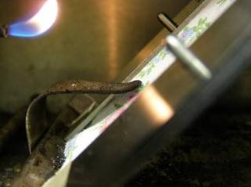
1610: Test Summary
16 mm (5/8 in) flame impinges on specimen mounted at 45 degree angle for 1 second
Allowed to burn full length or until stop thread breaks
Results of several tests are averaged and a Class designation is assigned

Slide 10
1610: Test Summary
First step: Determine fabric type and specifications
  Plain surface textile fabric or raised surface textile fabric
  Fabric weight
  Fiber content
Preliminary burns are conducted to determine the fastest burning area and direction of fabric.
Fabrics are tested in their original state, 5 specimens
  Tested in direction of fastest burn time
  Raised surface fabrics are brushed to raise fibers
Class 1 and 2 fabrics are refurbished and tested again, another 5 specimens
  All samples are dry cleaned
  All samples are washed and tumble dried, 1 cycle
The burn time of several specimens is averaged and a Class (Class 1, 2, or 3) designation is made based on the average burn time (speed of burning) and surface characteristics of the sample.

Slide 11
1610: Test Summary
Determine fabric type and specifications
  Plain surface or raised surface textile fabric
  Fabric weight
  Fiber content
Determining the direction of the pile

Slide 12
1610: Test Summary
Prepare specimens:
  Preliminary burns are performed to determine the fastest burning direction and area of the fabric
  Raised fiber fabrics are brushed
Mounting the specimen in the sample holder

Slide 13
1610: Test Summary
Condition specimens
  30 minutes at 105 degrees C
  Cool in desiccator
Mounting the specimen in the sample holder

Slide 14
1610: Test Summary
Test specimens:
  Apply flame for 1 second
  Allow to burn full length or until self-extinguishes
  Operator should observe behavior closely
Placing the specimen in the test chamber

Slide 15
1610: Test Summary
Refurbish and retest:
  Standard laundering and dry cleaning procedure
  Prepare and test samples after refurbishment
Measuring the washer water temperature

Slide 16
1610: Classifications
Class 1 – plain and raised surface fabrics that have no unusual burning characteristics and are acceptable for use in clothing
Class 2 – raised surface fabrics only, intermediate flammability- use with caution
Class 3 – fabrics are dangerously flammable and CANNOT be used in wearing apparel
Classification | Plain Surface | Raised Fiber Surface
Class 1 | Average burn time > 3.5 s | Average burn time > 7.0 s OR Average burn time is 0-7 s with no base burns (SFBB)
Class 2 | N/A | Average burn time is 4-7 s with base burn (SFBB)
Class 3 | Average burn time < 3.5 s | Average burn time < 4.0 s with base burn (SFBB)

Slide 17
1610: Common Noncomplying Fabrics
Sheer 100% rayon skirts and scarves
Sheer 100% silk scarves
100% rayon and rayon/nylon chenille sweaters
Long animal hair sweaters
Polyester/cotton and 100% cotton fleece garments
100% cotton terry cloth robes

Slide 18
16 CFR PartS 1615 and 1616
Standards for the Flammability of Children’s Sleepwear

Slide 19
1615 & 1616: Background
Originally developed in the early 1970s to address the ignition of children’s sleepwear, such as nightgowns, pajamas, and robes.
Intended to protect children from small open-flame sources, such as matches/lighters, candles, fireplace embers, stoves, and space heaters.
Not intended to protect children from large fires or fires started by flammable liquids, such as gasoline.
Notes:
The purpose of the standard is to protect children from the risk of injury from fire when children are unsupervised. The standards require that children’s sleepwear must be flame resistant and not continue to burn when removed from a small flame source.
Children’s sleepwear means any product of wearing apparel sizes larger than nine months, intended to be worn primarily for sleeping or activities related to sleep, except: diapers and underwear, infant garments and tight-fitting garments.

Slide 20
1615 & 1616: What is Covered?
Any product of wearing apparel intended to be worn primarily for sleeping or activities related to sleep in sizes larger than 9 months through size 14.
  Nightgowns, pajamas, robes, or similar or related items, such as loungewear, are included.
Several factors determine if a garment is sleepwear:
  Suitability for sleeping, likelihood of garment to be used for sleeping
  Garment and fabric features
  Marketing, merchandising/display, intended use

Slide 21
1615 & 1616: Exceptions
Diapers and Underwear (exempt)
Must comply with 16 CFR Part 1610
Infant garments (exempt)
Sizes 9 months or younger
One-piece garment does not exceed 64.8 cm (25.75”) in length
Two-piece garment has no piece exceeding 40 cm (15.75”) in length
Must comply with 16 CFR Part 1610

Slide 22
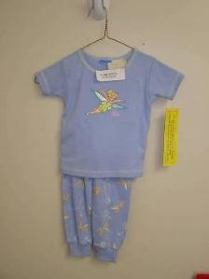

1615 & 1616: Exceptions
Tight-Fitting Sleepwear (exempt)
Tight-fitting garments (defined by the Standards) are exempt from testing to the sleepwear requirements.
Must meet specific maximum dimensions.
Must comply with 16 CFR Part 1610.
Must meet labeling requirements.

Slide 23
1615 & 1616: Requirements
Children’s sleepwear (that is not tight-fitting) must pass the flammability requirements.
  All fabrics and garments must be flame resistant and self-extinguish (not continue to burn) when removed from a small, open-flame ignition source.
Multiple stages of testing are required, following prescriptive sampling plans

Slide 24
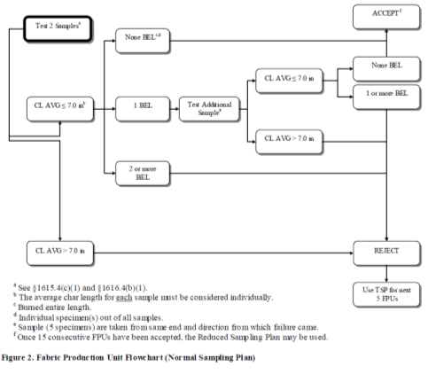
1615 & 1616: Requirements
Multiple stages of testing are required, following prescriptive sampling plans

Slide 25
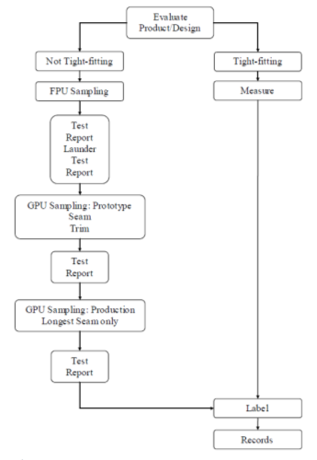
1615 & 1616: Summary
Requires tests of fabric, seams, and trim
Each test sample consists of five specimens
Each specimen is placed in a metal holder and suspended vertically in the test cabinet.
Tests conducted in original state and after 50 laundering cycles (if the sample passes the original state test)

Slide 26
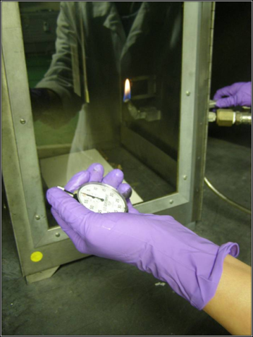
Children’s Sleepwear Standards
Five 8.9 cm x 25.4 cm (3.5 inches x10 inches) specimens of fabric, seams, and trim.
Specimens are conditioned before testing.
The gas flame of 3.8 cm (1.5 inches) is applied to the bottom edge of the specimen for 3 seconds.
Char (burn) length is measured after the flame/afterglow has ceased.
Preparing to apply ignition source to specimen

Slide 27
1615 & 1616: Requirements
The average char length of 5 specimens cannot exceed 17.8 cm (7.0 inches).
No individual specimen can have a char length of 25.4cm (10.0 inches) (full-specimen burn).
Production testing and recordkeeping requirements
  Tested samples must be retained

Slide 28
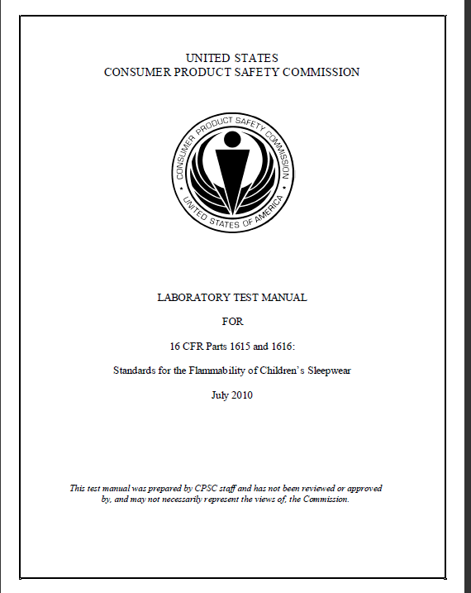
FFA Guidance
http://www.cpsc.gov/en/Regulations-Laws--Standards/Regulations-Mandatory-Standards--Bans/Regulated-Products/
  Search by product (use wearing apparel and sleepwear)
  http://www.cpsc.gov/businfo/loungewear.pdf

Slide 29
ASTM F1816-97
Drawstrings on Children’s Clothing

Slide 30

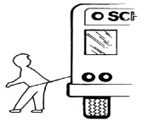
Drawstring Requirements
Children’s Clothing
CPSC issued guidelines (1996) later adopted by ASTM in 1997 (ASTM F1816-97)
  May 2006 letter to industry (http://www.cpsc.gov/PageFiles/135448/drawstring.pdf)
Substantial product hazard
Applies to drawstrings on upper outwear, jackets, and sweatshirts
  Sizes 2T-12 (or equivalent) with neck or hood drawstrings
  Sizes 2T-16 (or equivalent) with
  waist or bottom drawstrings
  that do not meet specified
  criteria
Dresses are not upper outerwear
Belts are not drawstrings
Notes:
Knots, toggles, and other decorative or functional attachments on the ends of long, loose
drawstrings can catch and snag on other objects. Two hazards associated with such drawstrings on primarily with hood and neck area drawstrings of upper outerwear; the potential vehicular dragging
hazard associated primarily with waist and bottom drawstrings of upper outerwear. This consumer
safety specification is intended to reduce the risk of drawstrings on children’s upper outwear accessing
and getting snagged in various entrapment areas.
children’s upper outerwear have been identified: the potential strangulation hazard associated
Fourteen Firms Agree to Pay More than $1 Million in Civil Penalties for Drawstring Violations

Slide 31
The Consumer product safety improvement act
Impact on Textiles and Related Products

Slide 32
CPSIA Requirements: Non-children’s Products
A General Certification of Conformity (GCC) is required for all products subject to a rule, ban, standard, or similar rule, ban, standard, or regulation under any act administered and enforced by the CPSC
  GCC shows conformance to applicable requirements (e.g., flammability)
  Example: for all products subject to 16 CFR Part 1610, including items that meet the Part 1610 specific exemptions and do not require testing
  Manufacturer or importer must issue a certificate to indicate that the product complies and why a test has not been conducted

Slide 33
CPSIA Requirements: Children’s Products
Many of the new requirements are specifically for children’s products
Children’s products are products designed and intended primarily for children 12 years or younger
Additional requirements for child care articles, items that are used for feeding/sleeping for children three years or younger

Slide 34
CPSIA Requirements: Children’s Products
Third-party testing: Certification based on testing performed by an accredited third party laboratory recognized by the CPSC
Children’s Product Certificate (CPC) required
  CPC shows conformance to applicable requirements (e.g., flammability, lead, phthalates), based on third party testing
Lead content and surface coating limits must be met for certain components of textile products
Tracking labels required
Child care articles (sleepwear for children 3 and under) subject to phthalate requirements

Slide 35
CPSIA Requirements-Lead
16 CFR Part 1303 protects consumers, especially children, from being poisoned from excessive lead in surface coatings on certain products. Includes surface coatings on toys or other articles intended for use by children, including clothing accessories.
The ban covers paint or any other similar surface coating that contains more than 0.009% lead (lead containing paint).
Section 101 limits the amount of lead content of children’s products to 100 ppm

Slide 36
CPSIA Requirements-Lead
Lead content and surface coating limits must be met for certain components of textile products
  For example, buttons, snaps, grommets, zippers, heat transfers, and screen prints
February 6, 2009, CPSC staff issued an enforcement policy on lead that is significant to the textile industry.
16 CFR § 1500.91 lists determinations made by CPSC where certain materials will not exceed lead limits; includes dyed or undyed textiles and nonmetallic thread and trim used in children’s apparel and fabric products

Slide 37
CPSIA Requirements: Tracking Labels
Require manufacturers of children’s products, to the extent practicable, to place distinguishing, permanent marks on a product and its packaging that would enable the purchaser to ascertain the source, date, and cohort (including the batch, run number, or other identifying characteristic) of production of the product by reference to those marks.

Slide 38
What’s Required: Clothing
Adult clothing:
  16 CFR Part 1610 (Flammability)
  GCC Required, including for products that are exempt from testing

Slide 39
What’s Required: Children’s Clothing
Children’s Clothing:
  16 CFR Part 1610 (Flammability)
  CPC Required, Third Party Testing
  Lead Content
  Lead Surface Coating
  Tracking Labels
  Drawstring Requirements

Slide 40
What’s Required: Children’s Sleepwear
Children’s Sleepwear:
  16 CFR Parts 1615 and 1616 (Flammability)
    16 CFR Part 1610 if tight-fitting
  CPC Required, Third Party Testing
  Lead Content
  Lead Surface Coating
  Tracking Labels
  Phthalate Requirements (sleepwear for children under three)

Slide 41
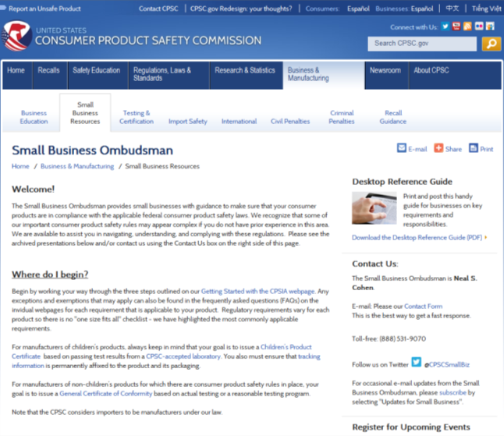
Resource: Small Business Ombudsman
http://www.cpsc.gov/en/Business--Manufacturing/Small-Business-Resources/

Slide 42
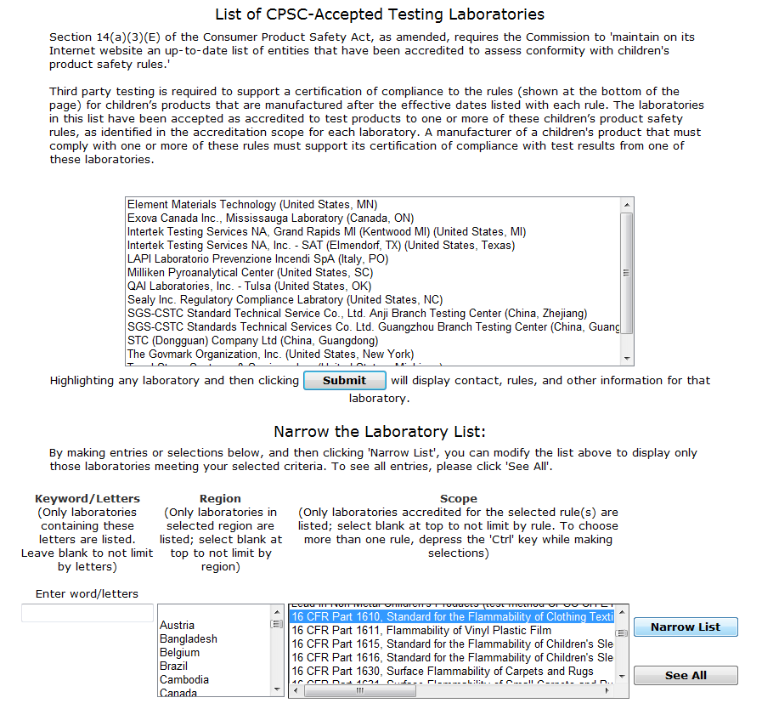
Resource: Searchable List of Laboratories
http://www.cpsc.gov/cgi-bin/labsearch/

Slide 43
For Further Information:
Ms. Patricia Adair
Division Director
Directorate for Engineering Sciences
301-504/7335
padair@cpsc.gov
www.cpsc.gov

