Slide 1
U.S. WTO TBT Enquiry Point
WTO TBT Member Notifications and Full Texts
www.nist.gov/notifyus
a free, web-based, e-mail registration service

Slide 2
What Is Notify US?
Database of all WTO TBT notifications* to the TBT Committee (*July 2005 – today)
Enables U.S. trade and business stakeholders to be immediately informed about changing or proposed regulations in global markets
Provides trade stakeholders information necessary to comment on and potentially influence those changing or proposed regulations as notified by the Members.
Notes:
We distribute all WTO member notifications to the committee on technical barriers to trade.
NUS offers U.S. entities (citizens, industries, organizations) an opportunity to review proposed foreign technical regulations that can affect their businesses and their access to international markets.
Active NUS Customers 3,115 (as of 10-26-15)
Active NUS Organizations 3,816 (as of 10-26-15)
So far in 2015, the USA TBT Enquiry Point has:
Distributed 3,574 notifications and associated full-texts to thousands of US stakeholders via Notify U.S.
Benefits:
Receive e-mail notifications of drafts or changes to technical regulations from as few or as many WTO members as desired for manufactured products in as few or as many product sectors as desired.
Read or request full texts
Learn deadlines for dates to comment
Submit comments regarding technical regulations
Request extensions on comment deadlines
Access WTO TBT-related information

Slide 3
Notify U.S. helps Stakeholders (U.S. Industry, Manufacturers, Exporters U.S. Government, Public International WTO Member TBT Inquiry Points)
Stay informed of global regulatory and conformity assessment activities
Request and full texts of the proposed regulation
Learn the deadlines for submitting comments
Request extensions on comment date deadlines
Learn how to submit effective comments
Submit comments to WTO Members
Access related WTO TBT information

Slide 4
Features of Notify U.S.
Built on a SQL database
Access via a web-based interface
It’s a user-friendly, self-service application
Users can customize their profiles to their interests
Free service to U.S. users and all WTO TBT Inquiry Points
A unique service in the U.S.
Developed, operated, and maintained by NIST

Slide 5
Register for Notify US

Slide 6
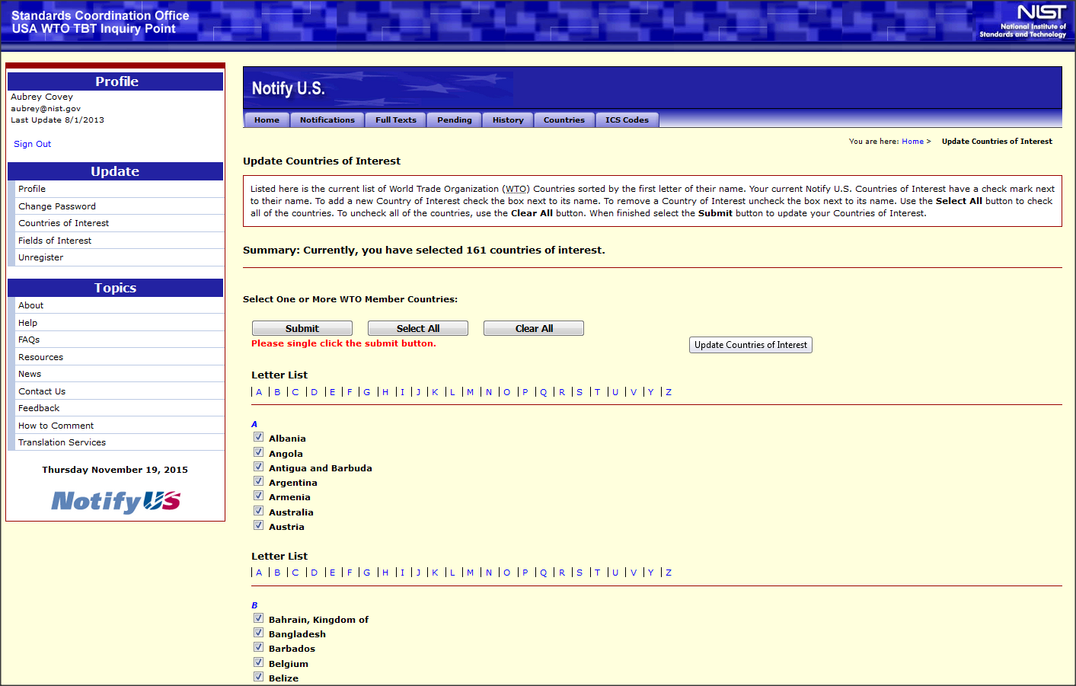
Select Countries of Interest

Slide 7
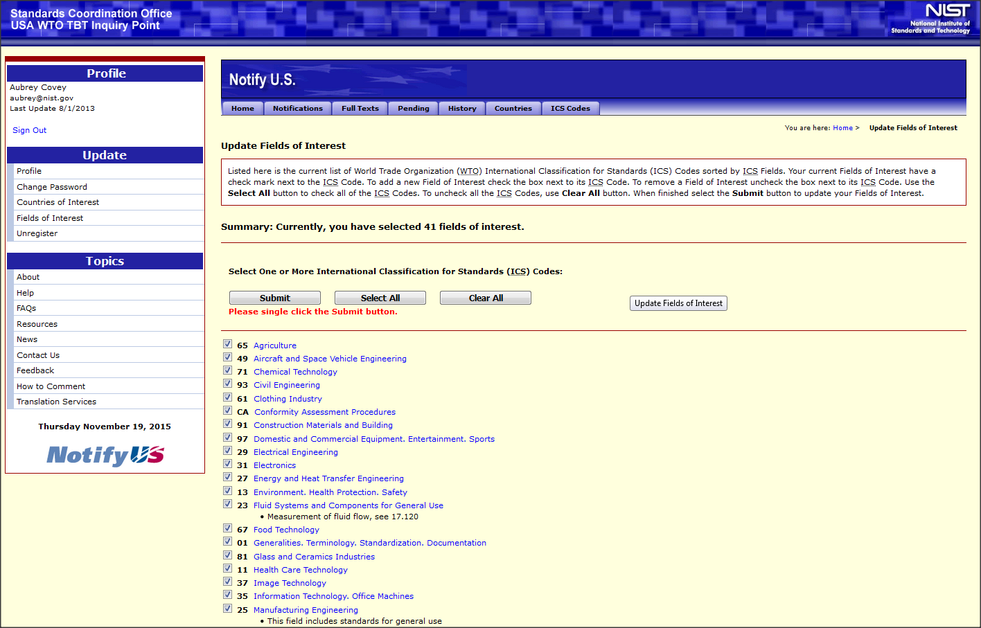
Select Industry Sectors

Slide 8
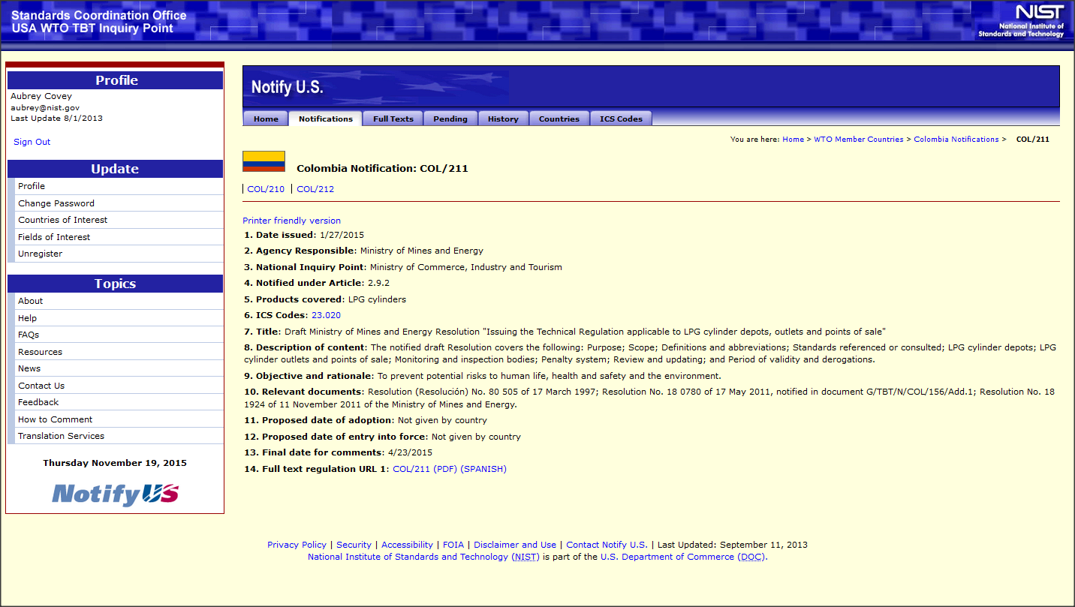
Example Notification

Slide 9
Example of Customized Alert
Notes:
Information is pushed to the subscriber via
Email notifications
Subscriber’s customized page alerts the user to new developments

Slide 10
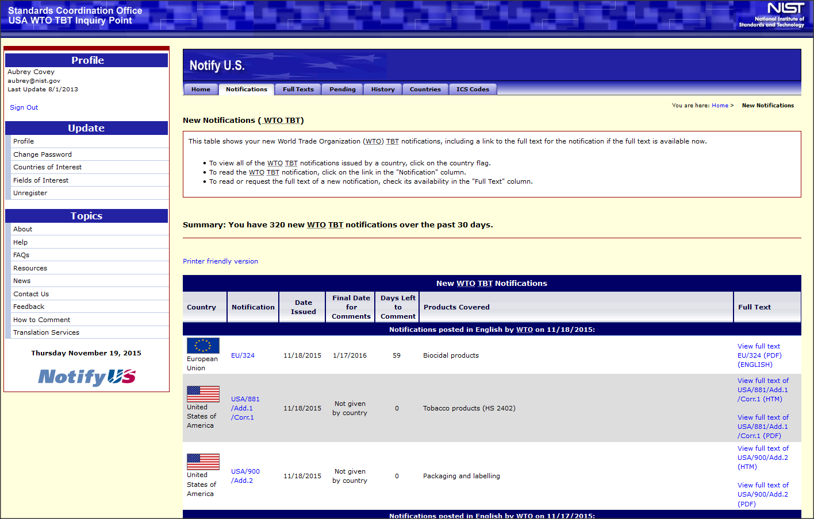
Log In to Notify US

Slide 11
Locate Relevant Notifications by Country

Slide 12
Locate Relevant Notifications by Product Sector (ICS Code)

Slide 13
Most Commonly Assigned ICS Codes*
Notes:
ICS is the International Classification for Standards. Data from our NUS administrator component reveals that the ICS codes that are most assigned to member notifications are as follows – we therefore expect and do see that the heaviest users of NUS and commenters are in theses sectors (both government and private industry): Not surprisingly, the majority of USA comments on other member notifications are for and from these sectors.
For example: Since 2005, The American Chemistry Council (ACC), which represents the business interests of hundreds of companies, has submitted over 20 sets of comments on various member notifications.
In 2015 Agriculture ICS 65 is the most searched on ICS code by our customers in NUS
Followed up by Telecommunications 33, Information Technology 35 and Environment Health Protection Safety 13.
In 2014 it was Electrical Engineering followed by Agriculture and Environment.

Slide 14
2015 Most Frequent Users by Industry Sector
Notes:
U.S. industry relies on the US government, trade and industry associations, as well as law firms and testing and calibration organizations whose business models are based on helping companies meet or exceed regulatory requirements, to monitor and make them aware of new or changing regulatory requirements. As a result of this, many Notify U.S. customers represent these types of organizations.
While the government is the most frequent NUS user, 85% of our customers are from the private sector and 11% are from the U.S. Federal Government.
Some of our most active customers in NUS represent:
-- USDA - FAS
-- HHS – FDA
-- DOC – NIST
--DOC
--ASTM International
--Bureau Veritas
--Underwriters Laboratories (UL)
--Distilled Spirits Council
--US Dairy Export Council
--National Food Processors Associations
--Personal Care Products Council
As well as many US companies such as IBM, John Deere, Caterpillar, and General Electric (to name a few).
These organizations all have multiple NUS subscribers who receive and review their TBT alerts daily. These subscribers actively request full-text documents.

Slide 15
USA WTO TBT Enquiry Point: Circulates USA and WTO Member Comments on TBTs
U.S. entities submit comments on proposed non-U.S. technical regulations (TBTs) to the USA Enquiry Point
USA Enquiry Point distributes comments to:
appropriate WTO member national enquiry point
U.S. government trade/export agencies
WTO members submit comments on USA measures to USA enquiry point
U.S. Enquiry Point distributes comments to:
U.S. government regulators and trade/export agencies
Notes:
Individuals registered for Notify U.S. receive their customized e-mail alerts (as noted previously). These alerts include notifications that meet their customized profile requirements. When they see a notification of interest and want to submit comments, the USA Enquiry Point offers guidance and assistance.
USA IP provides guidance on comments preparation to industry and also sends US comments to other members and accepts and circulates other member comments on USA TBT notifications.
Our role is to assist and guide US industry on submitting comments on behalf of their members and stakeholders on other member notifications. IPs are the official senders of US comments.
We do provide guidance on the Notify US website at https://tsapps.nist.gov/notifyus/data/guidance/guidance.cfm, and encourage you to visit for further details and information.

Slide 16
USA Comment Activity 2010 – 2015 to Current
 | 2010 | 2011 | 2012 | 2013 | 2014 | 2015 (to date)
USA Comments on WTO Member Notifications | 112 | 129 | 192 | 196 | 202 | 168
USA Requests for WTO Member Extension of Comment | 54 | 94 | 106 | 55 | 55 | 54
USA Information Requests to WTO Members | 53 | 74 | 48 | 106 | 33 | 34
Notes:
The mostly steady increase in U.S. TBT comment activity is a strong indicator that the U.S. private sector is more actively involved in monitoring and engaging with TBTs.
Due to industry engagement with the USG trade agencies with which our IP works, the US has successful in engaging Ecuador to accept ASTM standards for footwear safety,
The USA submits information requests and comments to other members when we become aware, mostly through the private sector, that another member is changing or implementing regulations that are not notified to the committee on Technical Barriers to Trade, or if the measures notified are unnecessarily trade restrictive.
Other IP Observations regarding comments:
Sometimes several industries / associations join together to submit comments:
American Farm Bureau Federation
Biotechnology Industry Organization
National Cattlemen’s Beef Association
National Milk Producers Federation
National Pork Producers Council
U.S. Dairy Export Council
NEMA
Distilled Spirits Council
Personal Care Products Council (PCPC),
Wine Institute
Advanced Medical Technology Association (AdvaMed) is a trade association that advances medical technology

Slide 17
 | 2010 | 2011 | 2012 | 2013 | 2014 | 2015 (to date)
WTO Member Comments on USA Notifications |  |  |  | 34 | 25 | 21
WTO Member Requests for USA Extension of Comment |  |  |  | 5 | 2 | 1
WTO Member Information Requests to USA |  |  |  | 66 | 66 | 98

Slide 18
Other Enquiry Point Services
Limited Translation of Notification Full-Texts for High Impact Sectors
Contact us when: you / your industry customer are not sure if a member has notified a technical regulation under the TBT agreement (we can check) or you want to submit comments on a member notification

Slide 19
Questions? www.nist.gov/notifyus
notifyus@nist.gov
Notes:
Feel free to contact us any time, we’ll help you reach the right place if we are unable to assist.

