Slide 1
The US Vehicle Safety Regulatory Process
Martin Koubek
Office of International Policy and Harmonization
National Highway Traffic Safety Administration
U.S. Department of Transportation

Slide 2
Overview
The National Highway Traffic Safety Administration (NHTSA)
Motor vehicle safety regulatory process
Certification and Enforcement

Slide 3
U.S. Road Traffic Safety
U.S. top transportation priority
Public health priority
>60,000 deaths per year and rising in the ‘60s
32,675 deaths in 2014
NHTSA (in DOT)- the lead U.S. agency on crash-related injury prevention

Slide 4
Vehicle Safety Act
Mandates establishing Federal Motor Vehicle Safety Standards* (FMVSS) for motor vehicles and motor vehicle equipment
No person may manufacture or import a vehicle or equipment unless it complies with applicable FMVSS
Manufacturers must certify (self-certification) that vehicles or equipment comply with FMVSS
* force of law

Slide 5
NHTSA Mission
Save lives, prevent injuries and reduce
traffic-related healthcare and other
economic costs

Slide 6
Strategy
Comprehensive policy approach
environment, vehicle, human
Science-based, data driven approach
pre-crash, crash, post-crash

Slide 7
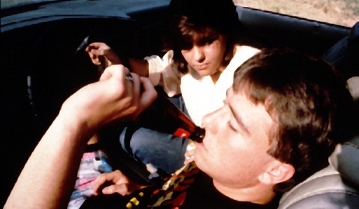
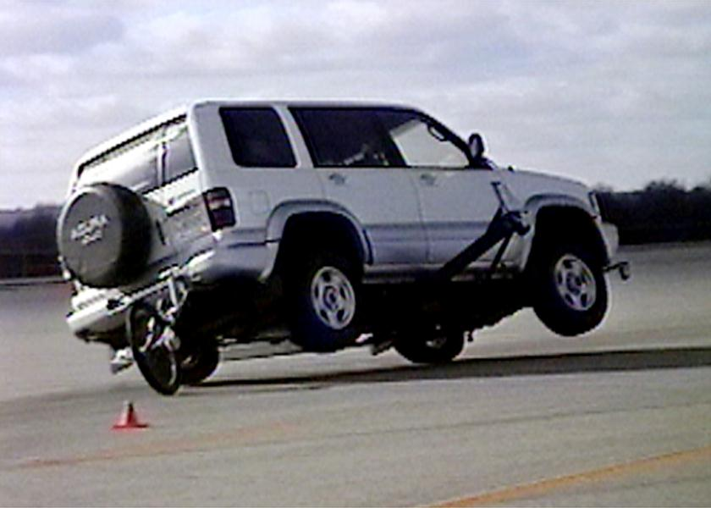
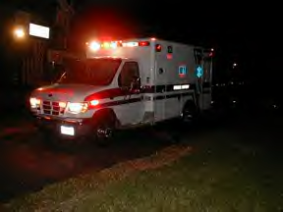
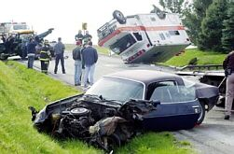
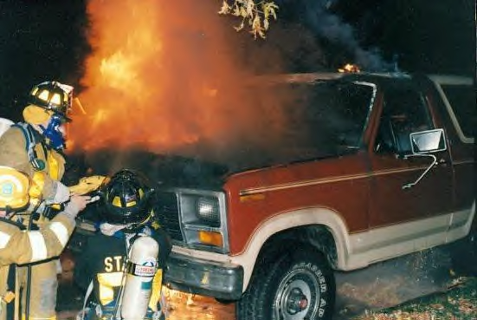
Haddon Matrix
Human
Vehicle
Environment
Pre-Crash
Crash
Post-Crash

Slide 8
Requirements for US Regulations
Must meet a specific safety need
Be practicable (technologically and economically)
Objectively measurable compliance
Performance-oriented (not design restrictive)
Appropriate for each vehicle type

Slide 9
Sources of Rulemaking Action
Voluntary Standards
Real World Crash Data Analysis, Research and Development
Legislation
Public Petition
Compliance Issue
International Standards
Technology Changes
Initiate Rulemaking

Slide 10
Traffic Crash Data
Fatality Analysis Reporting System (FARS)
Data on all fatal traffic crashes in the U.S.
National Automotive Sampling System (NASS)
More detailed, nationally representative data from police reports on fatal and nonfatal traffic crashes

Slide 11
Rulemaking Process Requirements
Administrative Procedure Act
Provide a rational connection between the facts and the choices made by the agency
Timely availability of information and opportunity for public comment
Consider alternatives
Written reasoned response to public comments

Slide 12
Benefits of Requirements
Better understanding of the problem being addressed and of the available solutions;
Better regulations, i.e., more effective, less intrusive and more cost-effective regulations;
Greater public understanding of the purposes and effects of regulations;
Greater public confidence that the regulations development process is fair to all; and
Greater public acceptance of the regulations being adopted.

Slide 13
Preliminary Notice (Optional)
Opportunity to comment very early in rulemaking process
Requests information on nature and extent of safety problem being considered problem
Requests suggestions for regulatory solutions

Slide 14
Notice of Proposed Rulemaking
Published in the Federal Register
Describes safety problem
Explains regulatory solution (proposed requirements and test procedures)
Identifies basis for proposal, including key research reports and crash data
Estimates benefits and costs of proposal
Typically 60-day comment period

Slide 15
Public Comments
Provide NHTSA with additional information, e.g., compliance difficulties
Challenge the Agency’s:
Factual assumptions
Policy choices
Analyses
Conclusions
Suggest changes to proposal

Slide 16
Final Rule
Explains the agency’s acceptance or rejection of each significant comment
Describes changes made to rule in response to comments
Explains choices among
Alternative regulatory approaches
Alternative levels of stringency

Slide 17
Post-Final Rule
Petitions for Reconsideration
Judicial Review
Congressional Review
Evaluation and Review

Slide 18
FMVSS - Regulations
Approximately 65 vehicle and equipment regulations
Crashworthiness
Crash avoidance
Miscellaneous (Labeling, CNG Containment, etc.)
The full text for all Federal Motor Vehicle Safety Standards (FMVSS) can be found at:
http://www.nhtsa.dot.gov

Slide 19
Certification Requirements
Manufacturers must permanently affix to each vehicle a label “self-certifying” that the vehicle complies with all applicable FMVSS in effect on the date of manufacture

Slide 20
Certification Requirements
Manufacturers’ self-certification, based on their testing and/or analysis
All certifications must be based on the manufacturer’s good faith belief that the certification is not false or misleading in any material respect.

Slide 21
Compliance Enforcement
Compliance test program
~100 vehicles and many more pieces of equipment tested each year
Inspection program
NCAP program
Consumer complaints
Recalls
May be ordered for non-compliance

Slide 22
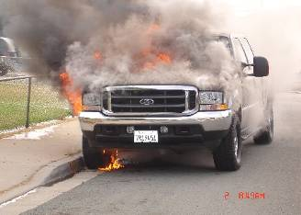
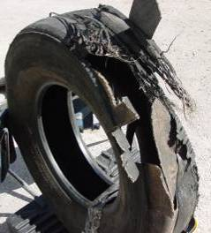
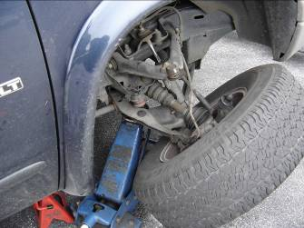
Safety Defects
“Defect related to motor vehicle safety” is an unreasonable risk to safety that is caused by any part of the motor vehicle
Notes:
Where OVSC deals with specific standards in the FMVSS, ODI enforces that one portion of the statute that says that vehicles and vehicle equipment must be free of defects that pose an unreasonable risk to safety.
ODI looks at the likelihood of the defect occurring and at the severity of the defect’s consequences.

Slide 23
Sources for Evidence of a Safety Defect
Manufacturer notices bulletins advisories
Consumer complaints (50,000/year)
Foreign recall reports
Early warning reports
Petitions from the public
Notes:
How does ODI know about these defects?
Manufacturers are often the best source, through their bulletins, advisories issued to vehicle owners.
About 50,000 consumer complaints reach us each year through the Auto Safety Hotline, letters, e-mails. We get more than 30,000 responses to Vehicle Owner Questionnaires. We also watch trade periodicals, websites and blogs to see what people are talking about.
We get recall reports from other countries.
We get early warning reports of deaths or injuries, damage claims, warranty claims.
And then sometimes, we get petitioned by the consumers themselves.

Slide 24
Recalls (Non-compliance and Defects)
600 recalls/year of vehicles and equipment
75% of recalls for defects
25% for regulatory non-compliance
25-30% recalls begin with NHTSA’s investigation

Slide 25
Agency Civil Penalties
Civil penalties for failure to comply or failure to attach a certification label to a vehicle that requires such a label; or for failure to report a defect
May be assessed for up to $7,200 per violation, with a maximum penalty for a related series of violations of $35 million

