Slide 1
Overview of the NIST Standards Coordination Office For Delegation from Colombia
December 3, 2015

Slide 2
Did you know…
80% of global merchandise trade
Faraways/shutterstock
Notes:
Estimated that 80% of global merchandise trade is influenced by testing and other measurement-related requirements of regulations and standards

Slide 3
The U.S. Standards System Today
The U.S. standards system is voluntary, decentralized, sector driven and is, sometimes, competitive.
The system relies on cooperation and communication among:
Private sector standards organizations
Industry
Government

Slide 4
Standards Coordination Office (SCO)
SCO provides standards and conformity assessment expertise and services in support of government and industry
Coordination
Information Services
Guidance
Notes:
SCO staff works closely with U.S. industry, standards developers, other government agencies, and leaders in the global standards community to build a standards infrastructure that supports innovation and creates opportunities for business to thrive. Customers include USG agencies carrying out regulatory, procurement and Federal assistance missions
Under the National Technology Transfer and Advancement Act, SCO manages the assigned responsibility of coordinating federal, state, and local technical standards and conformity assessment activities, as well as coordinating with those activities in the private sector.
NTTAA/A-119 direction that NIST coordinate standards and CA activities
“…coordinate Federal, State, and local technical standards activities and conformity assessment activities, with private sector technical standards activities and conformity assessment activities, with the goal of eliminating unnecessary duplication and complexity in the development and promulgation of conformity assessment requirements and measures”
SCO actively monitors and participates in standards development and conformity assessment activities globally.
Our goal is to equip US industry with the standards-related tools and information necessary to effectively compete in the global marketplace OR Equip US industry with standards-related mechanisms, access and information needed to effectively compete in the global marketplace
Standards solutions for national priorities
Smart Grid, electronic health records, cloud computing, forensics, etc.

Slide 5
SCO Tools and Services
WTO Technical Barriers to Trade Inquiry Point
Standards Information Center
Coordination role (ICSP)
Mutual Recognition Agreement (MRAs) designation
Standards and conformity assessment program development for federal agencies
Laboratory accreditation (NVLAP)
Standards curriculum development grants
Standards training program
Notes:
Assist USG agencies in designing standards and conformity assessment policies and programs that meet their needs
Support/facilitate a favorable environment for U.S. industry competing in foreign markets
In support of NIST’s mission to promote innovation and industrial competitiveness via documentary standards
Mechanisms:
National Center for Standards and Certification Information
Standards in Trade Workshops
Engagement in bilateral and regional standards dialogues and arrangements
The National Voluntary Laboratory Accreditation Program (NVLAP) provides third-party accreditation to 800+ testing and calibration laboratories. NVLAP's accreditation programs are established in response to Congressional mandates, administrative actions by the Federal Government, and requests from private-sector organizations and government agencies.
The NIST Quality System for Measurement Services is based on the ISO/IEC 17025 (General requirements for the competence of testing and calibration laboratories)
The scope includes the delivery of Calibration Services and the development and certification of Standard Reference Materials.
Training – talk about the fact that we offer the simulation in June at a downtown location and you will get information on this. Other opportunities for training.

Slide 6
USA Inquiry Point for World Trade Organization (WTO) Agreement on Technical Barriers to Trade (TBT)
ACTIVITIES
Identify, notify, and circulate USA proposed and final regulations
Circulate customized alerts and offer access to all WTO notifications
Facilitate the notification comment process
Provide U.S. trade stakeholders assistance & information in global trade issues
Answer inquiries from WTO member countries on U.S. technical regulations
IMPACTS
Serve as a world leader in Inquiry Point operations and
best practices
Save US industry time, energy and money
Enhance effectiveness of US trade officials

Slide 7
Standards Information Center
A no-charge clearinghouse for standards and conformity assessment information (email: standardsinfo@nist.gov)
Customers include the general public, academia, industry, and government agencies
Provides research and analysis on standards to support NIST and other federal agency projects, e.g.,
Disaster resilience
Hyperspectral imaging
Forensics
Security
Research and author US Compliance Guides
2

Slide 8
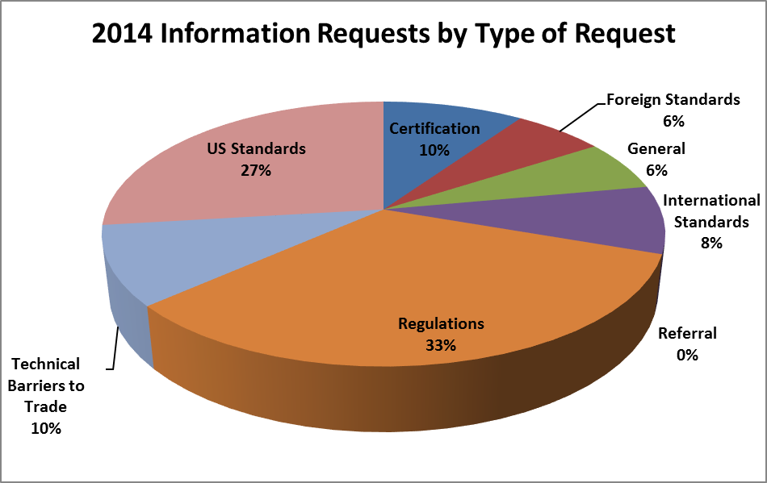
Standards Information Center Request Analysis - 2014
Notes:
Research and analysis on standards to support NIST projects, e.g.,
Disaster resilience
Hyperspectral imaging
Forensics
Centralized purchasing of standards & codes for NIST staff (only)
A no-charge clearinghouse for standards and conformity assessment information
Customers include the general public, academia, industry and government agencies

Slide 9
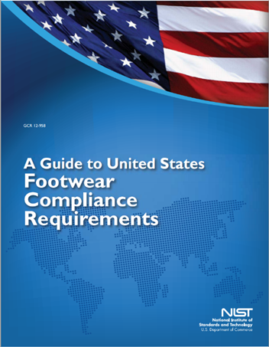
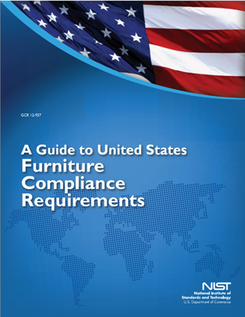
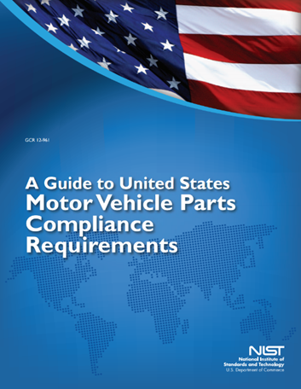
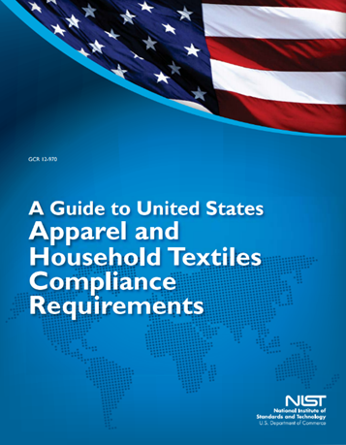
US Compliance Guides
http://gsi.nist.gov/global/index.cfm/L1-7/A-630/
3

Slide 10
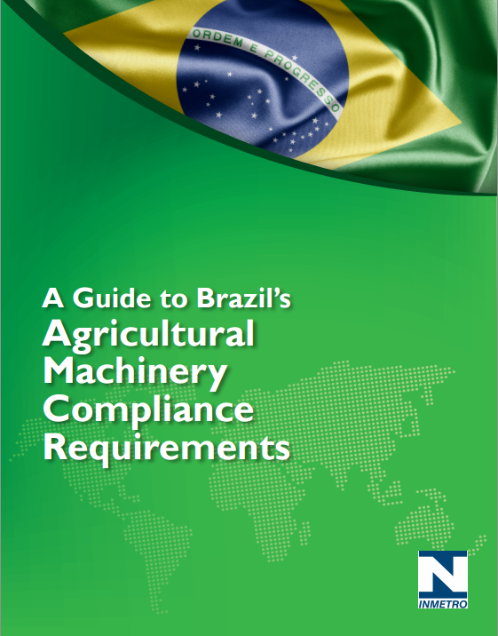
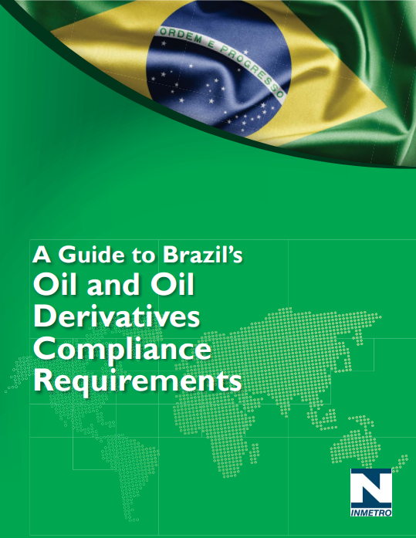
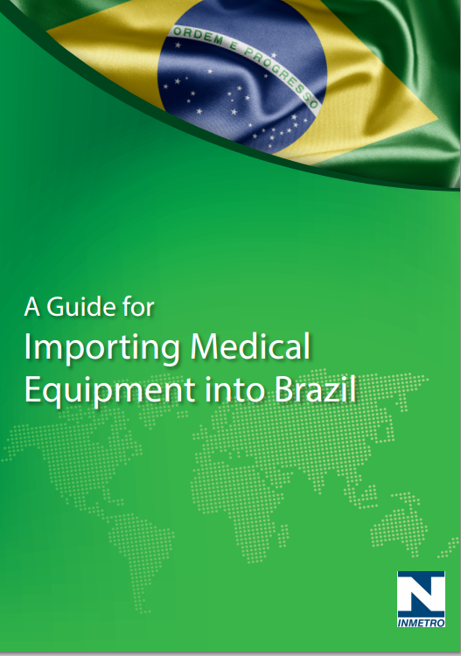
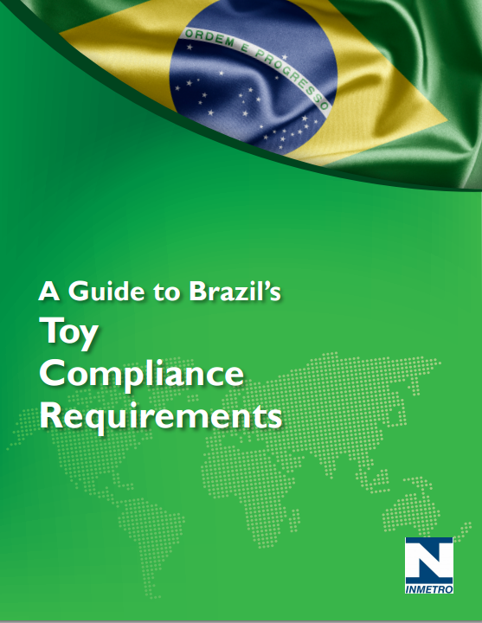
Brazil Compliance Guides
http://gsi.nist.gov/global/index.cfm/L1-7/A-630/
3

Slide 11
Interagency Committee on Standards Policy (ICSP)
Established in 1968
Fulfills mandate of OMB Circular A-119 which was
strengthened by the passage of the National Technology Transfer and Advancement Act of 1995 (Public Law 104-113)
Chaired by National Institute of Standards and Technology
Consists of Federal Standards Executives and their designated representatives
Meets 3-4 times per year
Forms working groups as needed

Slide 12
Facilitating the Trade of Telecommunications Equipment
$40 Billion
ITA’s estimated value of U.S. export of telecommunication equipment in 2013
Barriers to Trade
Redundant testing/certification
Lack of transparency in foreign regulatory requirements
Solution
Telecommunications Mutual Recognition Agreements (MRAs)
MRAs allow U.S. Industry to test/certify locally to foreign requirements prior to export
NIST Role
NIST, as Designating Authority, helps U.S. labs and certification bodies obtain recognition
from MRA partner countries
Reduce time and cost to market
Improve business opportunities for U.S. industry
Provide consumers with faster access to latest technologies

Slide 13
Types of Conformity Assessment
1st Party
2nd Party
3rd Party
Supplier’s Declaration of Conformity (SDoC)
Inspection
Testing
Certification
Registration
Accreditation
ISO/IEC 17050 parts 1 and 2
ISO/IEC 17020
ISO/IEC 17025
ISO/IEC 17065
ISO/IEC 17021
ISO/IEC 17011

Slide 14
Confidence Building
- Acceptance of conformity assessment results is based on confidence in the process.
- Confidence can be developed through various mechanisms
Sector-specific information exchanges
Witnessing of conformity assessment activities
Sector-specific technical training sessions

Slide 15
Who watches the watchers?
Accreditor
Certifier
Inspection Body, or
Laboratory
Object of Assessment

Slide 16
Cloud Service Provider
Federal Agencies
Contract
Leverage the provisional authorization
Authorize agency’s system for use
Services
3rd Party Assessment Organization (3PAO)
JAB
Conducts Independent Assessment
Reviews Significant Change
FedRAMP
Maintains Security Baseline
Maintains Assessment Criteria
Listing of Inspection Bodies
Listing of Provisional Authorized Systems
Security Operation Center*
Conducts Continuous Monitoring on Live Data Feeds and/or Measure of Measures
Incident notification Consuming Agencies
Perform Forensic activities

Slide 17
FedRAMP 3PAO Hierarchy
ISO/IEC 17011
+ technical requirements
FedRAMP PMO
Oversight &
Communication
Accreditor(s)
ISO/IEC 17020
+ FedRAMP competency requirements
Third Party Assessment Organization (3PAO)
(Inspection Body/ies)
FedRAMP
requirements for Provisional Authorization
Cloud Service Providers
ISO/IEC 17011; Conformity assessment -- General requirements for accreditation bodies accrediting conformity assessment bodies
ISO/IEC 17020; General criteria for the operation of various types of bodies performing inspection

Slide 18
NIST SCO Standards Development Support for Responders:
Fire Service, Law Enforcement, Public Safety, EMS
NIST SCO:
Creating a community of stakeholders: first responders, manufacturers, NIJ, US Army, NIST, testing laboratories, conformity assessment bodies
Sharing leadership of task groups developing standards
National Institute of Justice and US Army
ASTM International: Body armor standards – multiple test methods, guides, and practices.
InterAgency Board
ASTM International: Ballistic-resistant helmets and shields; standardized equipment training program format; robot operator standards; protective gloves for law enforcement and corrections.
UL, NFPA: Tactical operations video cameras, including body worn cameras; personal protective equipment for EMS
Notes:
NIST SCO supports the development of responder standards for two organizations:
National Institute of Justice (NIJ) and US Army:
NIJ publishes performance standards for law enforcement and corrections, including ballistic- and stab-resistant body armor standards, bomb suit standards, license plate reader standards. NIST supports development of all NIJ standards but is instrumental in helping NIJ to move standards into private-sector SDOs. The first effort is to separate the NIJ ballistic-resistant body armor standard into stand-alone test method, guides, and practices and publish those through ASTM; the next version of the NIJ standard will reference the ASTM methods
US Army also publishes standards for ballistic-resistant body armor, so we are collaborating with NIJ and the Army to harmonize test methods and practices, where practical. Currently, 7 standards are being developed through this collaboration, and more are planned.
InterAgency Board: The InterAgency Board (IAB) is a collaborative panel of first responders, federal employees, and subject matter experts representing a wide array of technical expertise. Its purpose is to provide a structured forum for the exchange of ideas to improve the nation’s ability to prepare for and respond safely to emergencies, disasters, and other critical incidents. A significant component of its mission is to facilitate development of standards for the responder community. NIST SCO is supporting the development of many new training and equipment standards for the IAB.

Slide 19
NVLAP IT Accreditation
NVLAP
Accredits
Testing Laboratory
product added to qualified product list
Performs testing against criteria
Software Products
Notes:
800 + laboratories accredited by the National Voluntary Laboratory Accreditation Program (NVLAP)

Slide 20
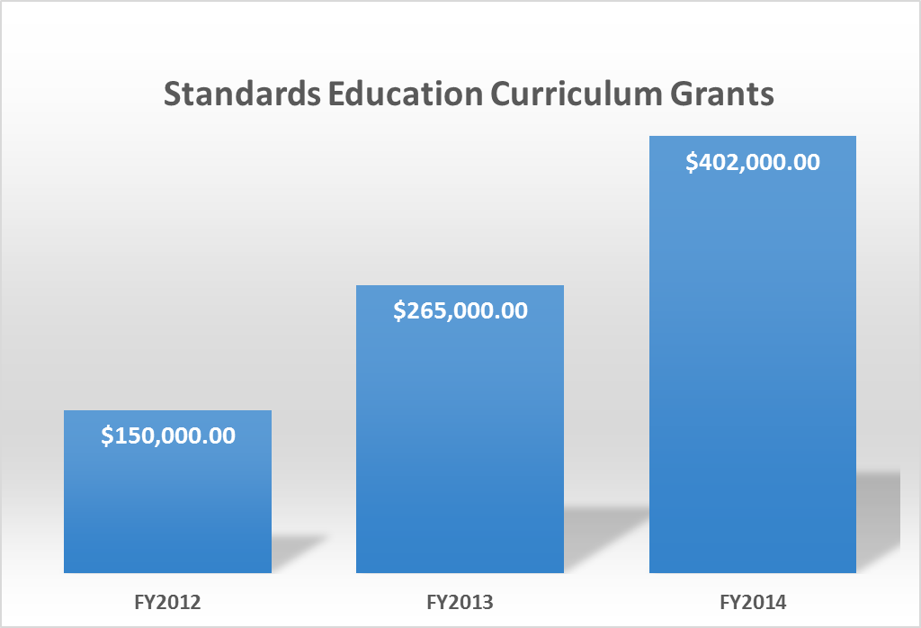

Slide 21
Example: Stevens Institute, NJ
Stevens Institute of Technology, College of Arts and Letters
Design for Standardization: Standards Education from the Classroom to Everyday Practice
To create an upper-level undergrad course, “Standards and Society”, offered through Stevens’ Program in Science and Technology Studies.
To develop content modules for the Institute’s “Design Spine” in the Schafer School of Engineering and Science. The Design Spine is a sequence of eight courses for engineering majors, through which students develop a set of competencies in creative thinking, problem solving, teamwork, economics of engineering, project management, communication skills, ethics, environmental awareness, and system thinking.
Notes:
Stevens’ describes the Design Spine as a unique and innovative way to motivate students to think more seriously about standards in their technical work at Stevens and throughout their careers.

Slide 22
Standards Training for Government Agencies
What
Fundamentals of standards, conformity assessment, and related topics
Why
NTTAA
Forum to address agency-specific concerns
Benefits
Valuable resource
Encourages participation in standards development
Partner to other agencies
Interactive training environment
Broad or tailored to meet individual agency needs
Standards negotiation and leadership skills
Notes:
to coordinate the use by Federal agencies of private sector standards, emphasizing where possible the use of standards developed by private, consensus organizations;'.
to coordinate Federal, State, and local technical standards activities and conformity assessment activities, with private sector technical standards activities and conformity assessment activities, with the goal of eliminating unnecessary duplication and complexity in the development and promulgation of conformity assessment requirements and measures.
Federal agencies and departments shall consult with voluntary, private sector, consensus standards bodies and shall, when such participation is in the public interest and is compatible with agency and departmental missions, authorities, priorities, and budget resources, participate with such bodies in the development of technical standards.
SEC. 12. STANDARDS CONFORMITY. (a) USE OF STANDARDS- Section 2(b) of the National Institute of Standards and Technology Act (15 U.S.C. 272(b)) is amended-- (1) in paragraph (2), by striking `, including comparing standards' and all that follows through `Federal Government'; (2) by redesignating paragraphs (3) through (11) as paragraphs (4) through (12), respectively; and (3) by inserting after paragraph (2) the following new paragraph: `(3) to compare standards used in scientific investigations, engineering, manufacturing, commerce, industry, and educational institutions with the standards adopted or recognized by the Federal Government and to coordinate the use by Federal agencies of private sector standards, emphasizing where possible the use of standards developed by private, consensus organizations;'. (b) CONFORMITY ASSESSMENT ACTIVITIES- Section 2(b) of the National Institute of Standards and Technology Act (15 U.S.C. 272(b)) is amended-- (1) by striking `and' at the end of paragraph (11), as so redesignated by subsection (a)(2) of this section; (2) by striking the period at the end of paragraph (12), as so redesignated by subsection (a)(2) of this section, and inserting in lieu thereof `; and'; and (3) by adding at the end the following new paragraph: `(13) to coordinate Federal, State, and local technical standards activities and conformity assessment activities, with private sector technical standards activities and conformity assessment activities, with the goal of eliminating unnecessary duplication and complexity in the development and promulgation of conformity assessment requirements and measures.'. (c) TRANSMITTAL OF PLAN TO CONGRESS- The National Institute of Standards and Technology shall, within 90 days after the date of enactment of this Act, transmit to the Congress a plan for implementing the amendments made by this section. (d) UTILIZATION OF CONSENSUS TECHNICAL STANDARDS BY FEDERAL AGENCIES; REPORTS- (1) IN GENERAL- Except as provided in paragraph (3) of this subsection, all Federal agencies and departments shall use technical standards that are developed or adopted by voluntary consensus standards bodies, using such technical standards as a means to carry out policy objectives or activities determined by the agencies and departments. (2) CONSULTATION; PARTICIPATION- In carrying out paragraph (1) of this subsection, Federal agencies and departments shall consult with voluntary, private sector, consensus standards bodies and shall, when such participation is in the public interest and is compatible with agency and departmental missions, authorities, priorities, and budget resources, participate with such bodies in the development of technical standards. (3) EXCEPTION- If compliance with paragraph (1) of this subsection is inconsistent with applicable law or otherwise impractical, a Federal agency or department may elect to use technical standards that are not developed or adopted by voluntary consensus standards bodies if the head of each such agency or department transmits to the Office of Management and Budget an explanation of the reasons for using such standards. Each year, beginning with fiscal year 1997, the Office of Management and Budget shall transmit to Congress and its committees a report summarizing all explanations received in the preceding year under this paragraph. (4) DEFINITION OF TECHNICAL STANDARDS- As used in this subsection, the term `technical standards' means performance-based or design-specific technical specifications and related management systems practices.

Slide 23
Standards Training for Government Agencies
Standards
Simulation
Exercise
Notes:
Each participant assumes a role in a fictional scenario.
Participants represent private sector, government, and NGOs and try to negotiate the best standards “deal” based on their special interests.
Provides an interactive, realistic, and exciting learning environment for standards education.

Slide 24
Overview of NIST and the
Standards Coordination Office
Erik Puskar David Alderman
puskar@nist.gov david.alderman@nist.gov
1-301-975-8619 1-301-975-4019

