Slide 1
The Clinical and Laboratory Standards Institute
Standards Alliance Medical Device Workshop - INVIMA

Slide 2

Vision and Mission
Vision
Quality practices for better health
Mission
Develop clinical and laboratory practices and promote their use worldwide.

Slide 3


Volunteer
Membership Organization
Not-for-profit

Slide 4
Global Organization
CLSI members come from 60+ countries. Members include:
  1,400+ Organizations
  1,100+ Hospitals and Independent Laboratories
  400+ Individuals
  100+ Industry Organizations
  50+ Health Systems
  45 Government Agencies
CLSI standards are written by 2500+ volunteers from 60+ countries.
CLSI standards have been purchased from over 100 different countries, including 17 countries in Latin America.

Slide 5
What Do We Do?
CLSI helps laboratories deliver standardized high-quality test results.
Our consensus process brings together experts from industry, government, and health care professions to develop timely and useful standards.
Our standards are recognized by laboratories, industry, accreditors, and regulators as the way to improve testing.

Slide 6
Benefits of Using CLSI Standards
Developed using an open, inclusive, and transparent consensus process
The authors include:
  Accrediting organizations.
  Government agencies charged with laboratory oversight.
  Practicing laboratory professionals providing expertise and real world experience.
  In vitro diagnostic industries.
  Professional societies.

Slide 7
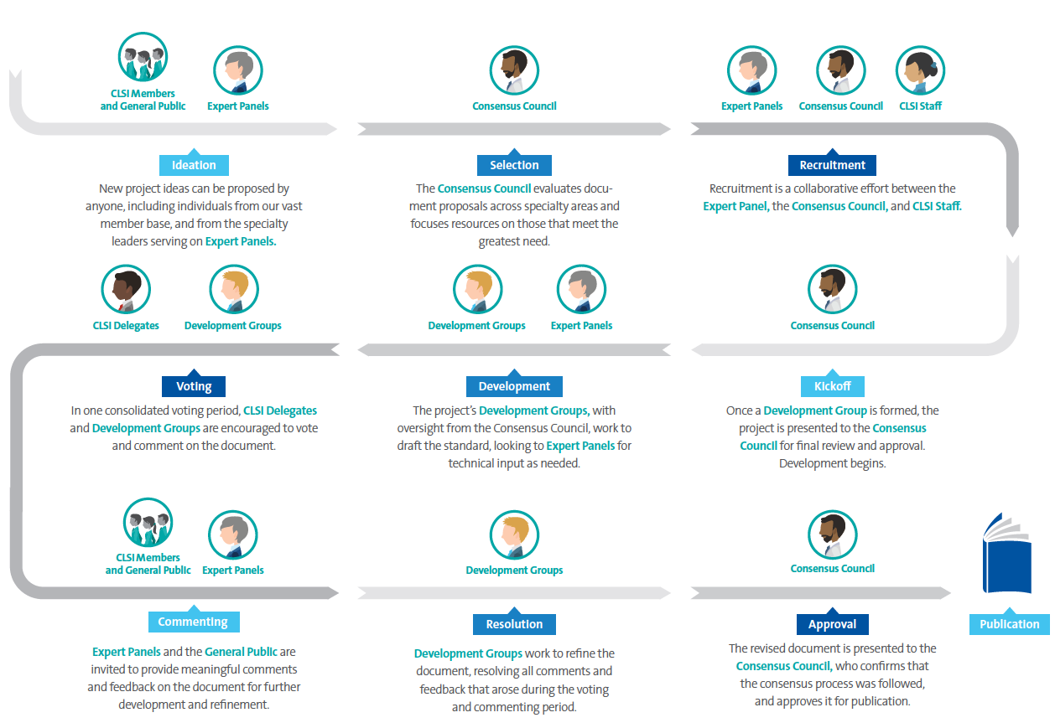
Our Process

Slide 8
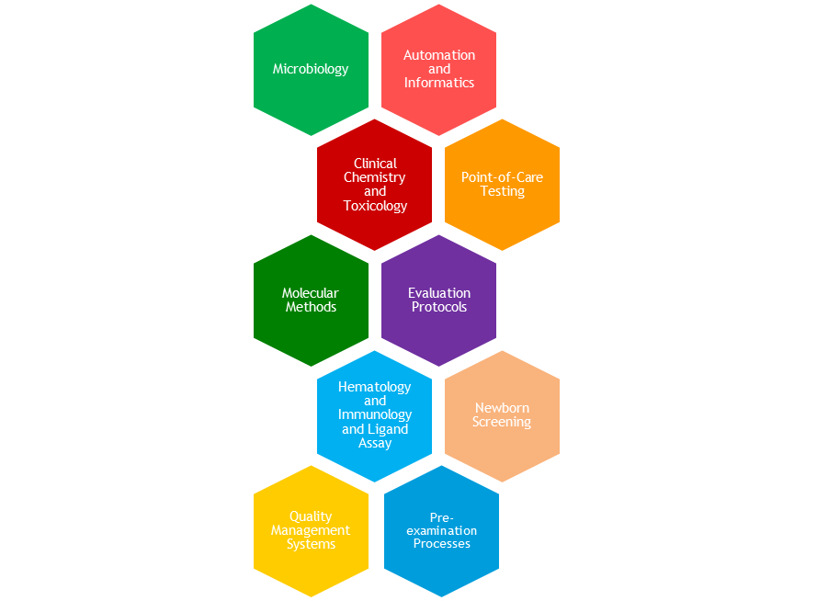
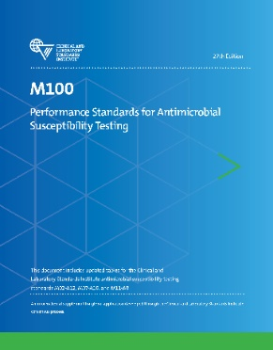
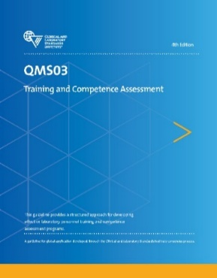
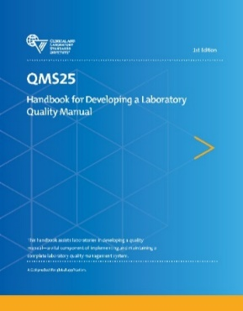
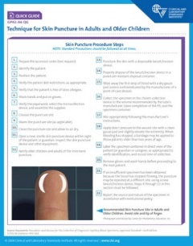
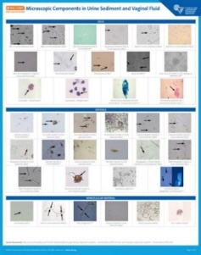
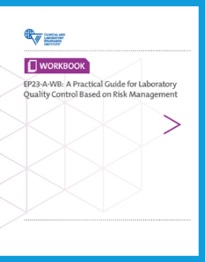
150+ Publications
Standards Library
Specialty Areas
Notes:
CLSI has a library of over 150 standards in following subject areas: evaluation methods, automation and informatics, point-of-care testing, clinical chemistry and toxicology, microbiology, molecular methods, immunology and ligand assay, quality management systems, newborn screening, and hematology.

Slide 9
CLSI Standards Committees for the Medical Technology Industry
CLSI members from the medical technology industry serve on document development committees that help us develop standards related to:
Automation and Informatics
Clinical Chemistry and Toxicology
Evaluation Protocols
Point-of-Care Testing

Slide 10
CLSI Evaluation Protocols Standards
Precision
Linearity
Interference testing
Method comparison
Matrix effects
Total analytical error
Evaluating qualitative tests
Verification of claims
Limits of detection
Risk management
QC based on risk management
Stability

Slide 11
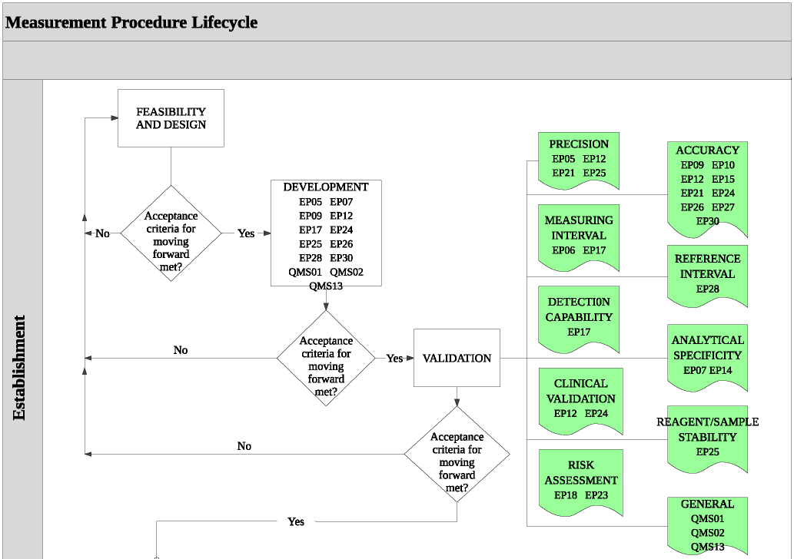
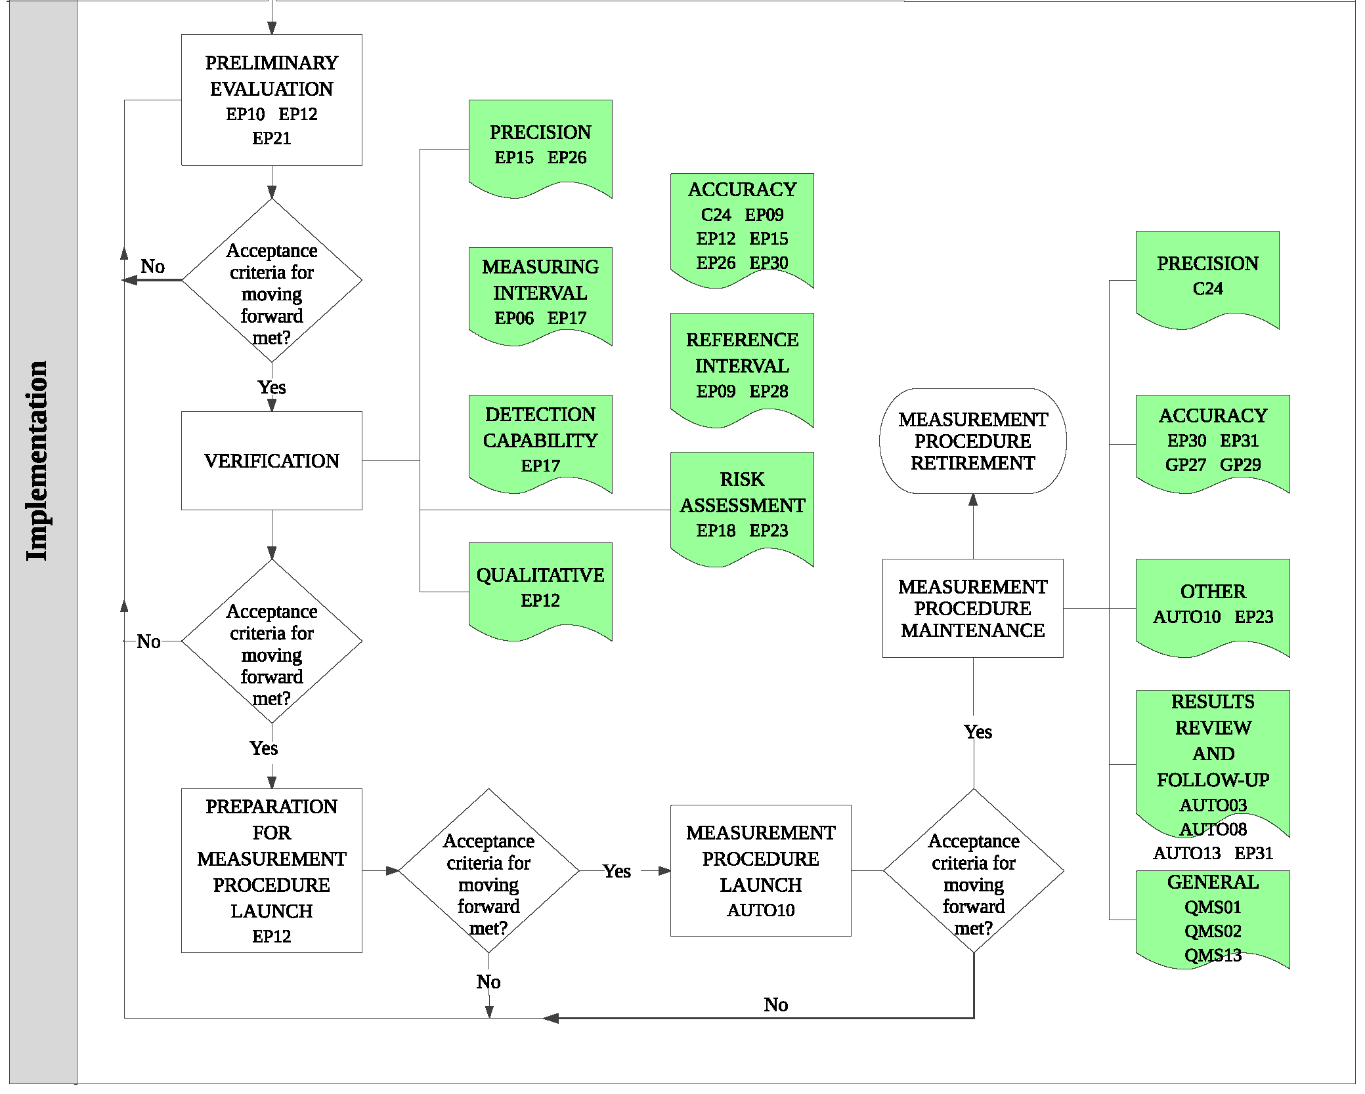
A Framework for Using CLSI Documents to Evaluate Clinical Laboratory Measurement Procedures (EP19)

Slide 12

ISO Standards
CLSI is the Secretariat for
ISO Technical Committee (TC) 212
CLSI is the Administrator of ANSI-accredited US Technical Advisory Group to ISO/TC 212
Abbreviation: ANSI, American National Standards Institute
Notes:
CLSI serves as the American National Standards Institute (ANSI)-appointed Secretariat for ISO Technical Committee 212, Clinical laboratory testing and in vitro diagnostic test systems. ISO/TC 212 is responsible for international standardization and guidance in the field of laboratory medicine and in vitro diagnostic test systems.

Slide 13
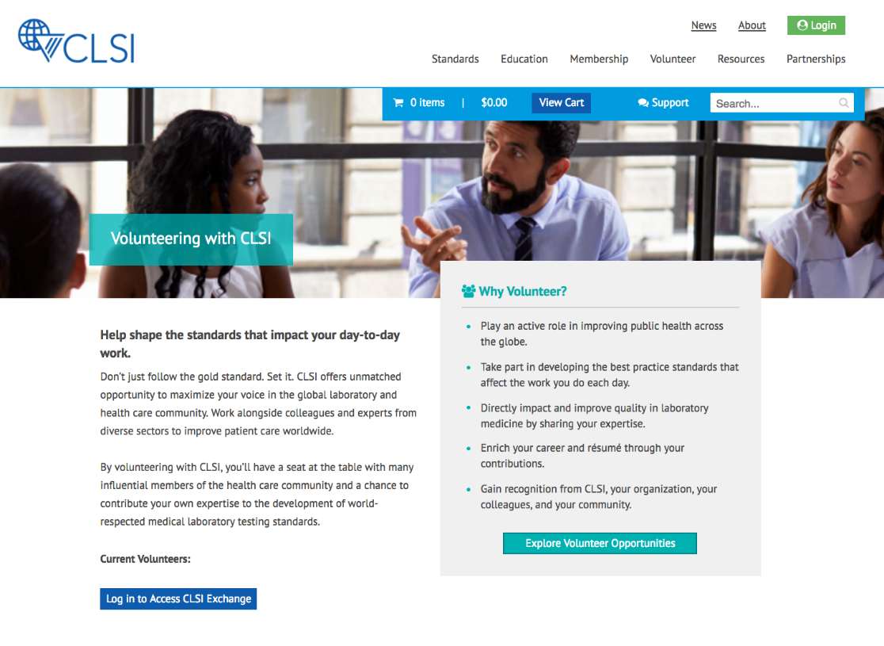
How Do I Get Involved?
clsi.org/volunteer

Slide 14
Membership
CLSI membership can help your organization develop innovative products by using globally recognized standards.
Through CLSI membership, industry organizations and commercial laboratories have access to standards for their organization and employees are able to volunteer to participate on document development committees.
To find out more about membership, contact membership@clsi.org.

Slide 15
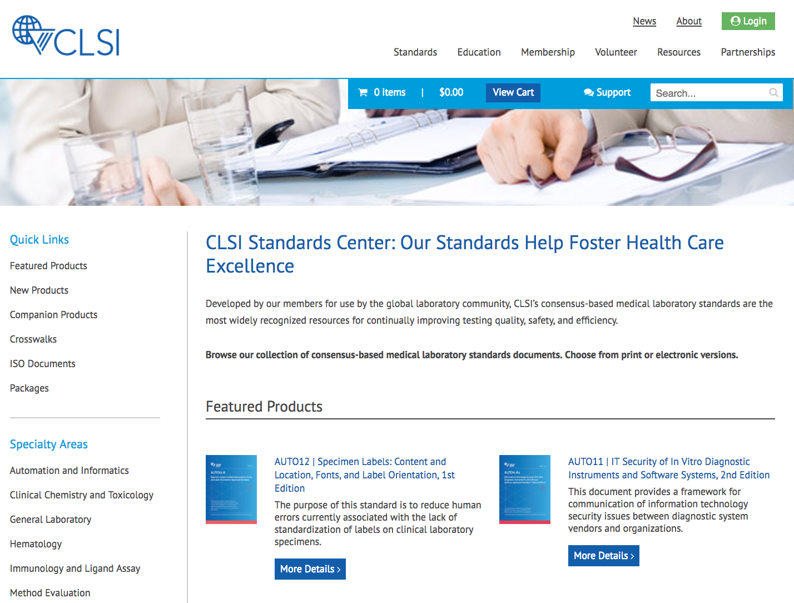
How Do I Find Standards?
clsi.org/standards

Slide 16
Summary
CLSI is a global, consensus-based, standards development organization with 150+ standards and related products.
CLSI standards are invaluable tools used by government agencies, health care professions, and industry organizations.
Ways to access CLSI standards, volunteering opportunities, and membership information were provided.

Slide 17





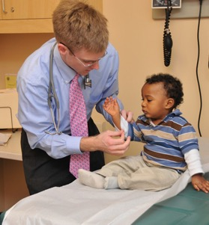
Global Laboratory Standards for a Healthier World

Slide 18

Contact Us
www.clsi.org
customerservice@clsi.org
Follow us on:
  Facebook
  Twitter
  LinkedIn
  Instagram
Jennifer K. Adams, MT(ASCP), MSHA
Vice President, Standards and Quality
jadams@clsi.org
Patrick McGinn
Vice President, Marketing and Membership
pmcginn@clsi.org

