Slide 1



ASTM International, Medical Device Standards, and Latin America
www.astm.org
Notes:
Introduction and my background.

Slide 2

Over a Century of Openness
How We Work
Worldwide acceptance and trust comes from the principle of openness
Experts, individuals, organizations, academia, governments, trade associations, consultants and consumers come together
Over 33,000 members from 150 countries
Exchanging expertise and knowledge
Participating in a transparent process – open to anyone, anywhere
Timely and relevant. Fully representative
of sectors. An aid to innovation, not a hurdle to overcome
Complying with WTO/TBT Principles for International Standards
147
main committees
with over 12,700
technical standards
Notes:
– The principle that makes ASTM standards accepted and trusted worldwide is openness.
– We bring together experts, individuals, organizations, academia, governments, trade associations, consultants and consumers from all over the world.
– Over 30,000 members from 149 countries.
– Exchanging expertise and knowledge, they participate in a transparent process that’s open to anyone, anywhere, with an interest in a standard’s development and use.
– This means that as well as being timely and relevant, an ASTM standard is fully representative of the sectors to which it applies.
– And an aid to innovation, not a hurdle to overcome.

Slide 3

Universal Equality of Opportunity
Operating Globally
ASTM is one of the world’s largest Standards Developing Organizations, with global reach and influence
Working across political, cultural and geographic borders
Trusted for market relevance
and technical quality
Our MoU program provides resources and tools to facilitate standards development that can be applied in regulation
110 Memoranda of Understanding
110
Memoranda of Understanding
Notes:
– ASTM is one of the world’s largest SDOs, but it’s the scale of our involvement and influence that counts for more.
– Complies with the six WTO principles for international standards development: transparency, openness, consensus, relevance, coherence, development dimension
– We work across political, cultural and geographic borders – recognizing expertise, not country of origin. This promotes a massive range of activity and a phenomenal exchange of knowledge.
– Trusted and known for market relevance and technical quality, our standards are the choice for many global industries – 50% outside the USA.
– We also believe in the power of standards to inspire and enable people and economies.
– Our global outreach activities increase understanding about standards and their application.
– And our Memorandum of Understanding Program provides tangible encouragement to developing economies.

Slide 4

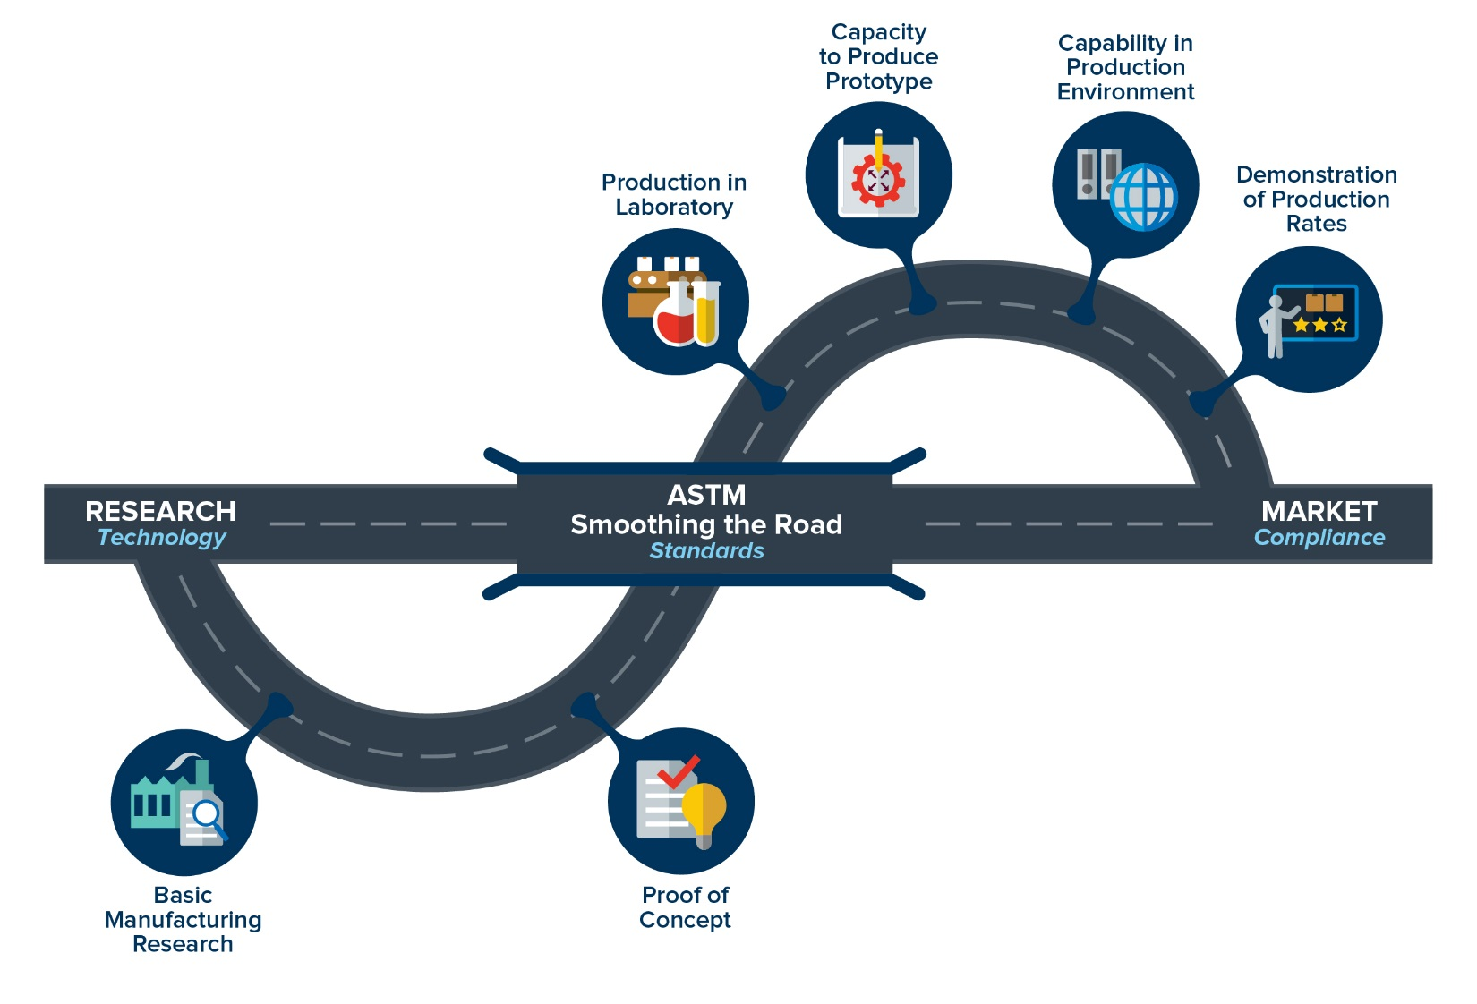

Slide 5
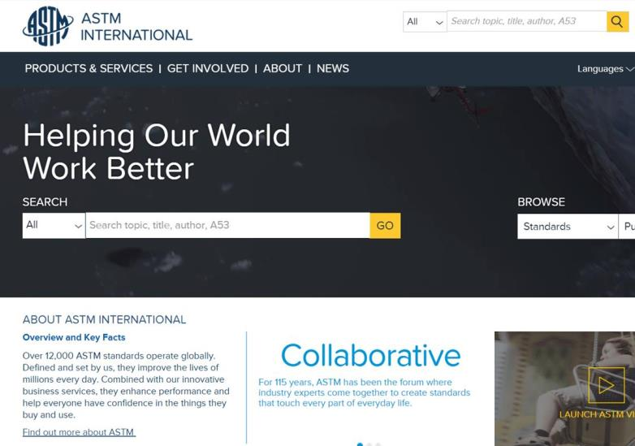
Access ASTM Anywhere in the World
Electronic Tools
Participation
      WebEx virtual meetings
      Personal “My ASTM” web page
                Committee update
                Balloting
                Draft document development/collaboration
    Communications/Engagement
      Standardization News
          E-News
      Social media
      Standards Tracker Tool
        Services
  Proficiency Testing Programs
  Certification and Declaration Programs
      E-Learning
Notes:
Membership- open to anyone who wants to use their expertise to influence standards
MOU membership is free- anyone interested in joining from Lao will be able to join for free
Over 30,000 global membership
WebEx virtual meeting and online access to standards development allows more economical and efficient participation for participants from around the world.

Slide 6
Technical Committee Structure:
Organization of Volunteer Members
Main Committee
Technical Committees Address specific industry subjects
Subcommittees
Address subsets of specialized subject matter
Subcommittee
.01
Subcommittee
.02
Subcommittee
.03
Task Groups
Organized by subcommittees: standards get drafted, revised, and developed at this level
Task Group
1
Task Group
2
Notes:
All technical committees are balanced: the number of Manufacturer and producer cannot exceed the number of users and general interest.
This allows for balance in the influence.

Slide 7
Applying ASTM International Medical Device Standards in Latin America
30 Standards
From 7 subcommittees:
Metallurgical Materials
Materials Testing
Osteosynthesis
Arthroplasty
Spinal Devices
Cardiovascular Standards
Medical/Surgical Devices
5 Nations
In Latin America cite ASTM F04 standards:
Chile
Colombia
Ecuador
Nicaragua
Peru
32 Citations
of Committee F04 standards including adoptions, consultations, and use as the basis of a national standard

Slide 8
ASTM Committee F04 on Medical and Surgical Devices
Organized in 1962
Includes over 950 members from 31 countries
  Argentina, Canada, Brazil, Germany, India, Italy, Japan, Mexico, Peru, Spain, United Kingdom, United States etc.
Meets twice a year with about 180 members in attendance
24 technical subcommittees
320 active standards and 57 draft proposed new standards
Organized into 4 Divisions:
  Division I – Resources
  Division II – Orthopaedic Devices
  Division III – Medical/Surgical Devices
  Division IV – Tissue Engineered Medical Products

Slide 9
F04 Technical Subcommittees
F04.11 Polymeric Materials
F04.12 Metallurgical Materials
F04.13 Ceramic Materials
F04.15 Material Test Methods
F04.16 Biocompatibility Test Methods
F04.21 Osteosynthesis
F04.22 Arthroplasty
F04.25 Spinal Devices
F04.30 Cardiovascular Standards
F04.31 Neurosurgical Standards
F04.32 Plastic and Reconstructive Surgery
F04.32.01 Mammary Implants
F04.33 Medical/Surgical Instruments
F04.34 Urological Materials and Devices
F04.35 GI Applications
F04.37 Implantable Hearing Devices (IHDs)
F04.38 Computer Assisted Orthopaedic Surgical Systems
F04.39 Human Clinical Trials
F04.41 Classification and Terminology for TEMPs
F04.42 Biomaterials and Biomolecules for TEMPs
F04.43 Cells and Tissue Engineered Constructs for TEMPs
F04.44 Assessment for TEMPs
F04.45 Adventitious Agents Safety
F04.46 Cell Signaling

Slide 10
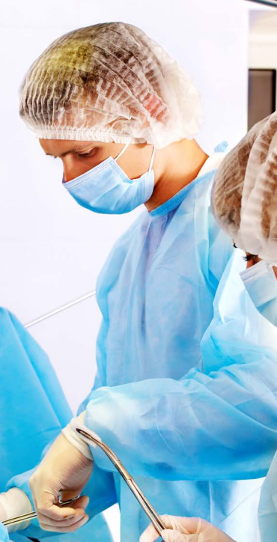
Division IV – Tissue Engineered Medical Products (TEMPs)
Division Scope
The development of standards and promotion of related materials for tissue engineered medical products focusing on components of combination medical products intended to repair, replace or regenerate human tissue. They comprise the biological components such as the cells, tissue, cellular products, and/or the bimolecular and the biomaterials components used in combination, including biologic, biomimetic, and/or synthetic materials.

Slide 11
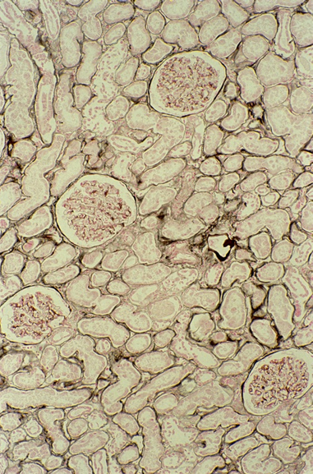
F2027 Standard Guide for Characterization and Testing of Raw or Starting Materials for Tissue-Engineered Medical Products
Developed by Subcommittee F04.42 on Biomaterials and Biomolecules for TEMPs
Originally approved in 2000
The physico-chemical characteristics of the raw or starting material used in regenerative medicine scaffolds carries significant potential to affect product performance by influencing cell behavior and/or the release of bioactive molecules or drugs.
This standard provides guidance on writing a materials specifications or characterizations of raw or starting materials to ensure reproducibility prior to their fabrication into implantable tissue engineering scaffolds for growth, support, or delivery of cells and/or biomolecules.

Slide 12

F2212 Standard Guide for Characterization of Type I Collagen as Starting Material for Surgical Implants and Substrates for Tissue Engineered Medical Products (TEMPs)
Developed by Subcommittee F04.42 on Biomaterials and Biomolecules for TEMPs
Originally approved in 2002
Guidance in the characterization of Type I collagen, which is the most abundant collagen in mammals, especially in skin and bone.
The collagen covered by this guide may be used in a broad range of applications, forms, or medical products, for example medical devices, tissue engineered medical products (TEMPs) or cell, drug, or DNA delivery devices for implantation.
This guide for characterizing collagen-containing biomaterials is intended to provide characteristics, properties, and test methods to more clearly identify the specific collagen materials used.

Slide 13

F2761 Medical Devices and Medical Systems - Essential safety requirements for equipment comprising the patient-centric integrated clinical environment (ICE) - Part 1: General requirements and conceptual model
Includes general requirements, a model and framework for integrating equipment to create an Integrated Clinical Environment (ICE)
Specifies the characteristics necessary for the safe integration of medical devices via an electronic interface, from different manufacturers into a single medical system for the care of a single high acuity patient
Establishes requirements for a medical system that is intended to have greater error resistance and improved patient safety, treatment efficacy and workflow efficiency than can be achieved with independently used medical devices

Slide 14
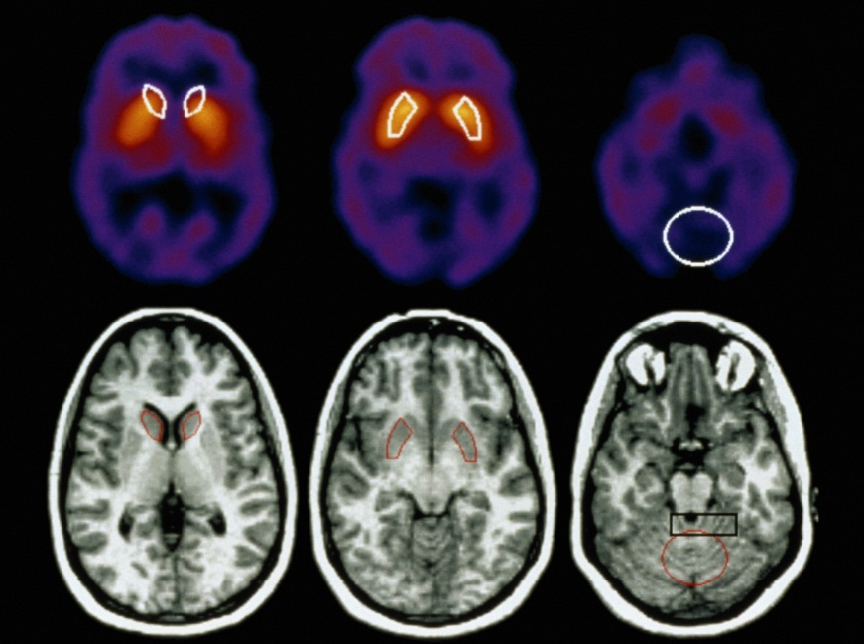
F04 Advanced Standards Initiatives – MRI
US FDA asks industry for information demonstrating MR safety for finished devices.
Needed test methods did not
exist.
US FDA requested ASTM
consider developing MR
safety/compatibility standards.
Recognized by FDA-CDRH

Slide 15
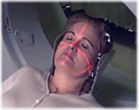
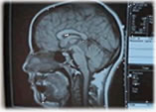
F04 Advanced Standards Initiatives – MRI
F2052 – Test method for measurement of magnetically induced displacement force on medical devices in the magnetic resonance environment
F2119 – Test method for evaluation of MR Image artifacts
from passive implants
F2182 – Test method for measurement of radio frequency induced heating near passive implants during magnetic resonance imaging
F2213 – Test method for measurement of magnetically induced torque on medical devices in the magnetic resonance environment
F2503 – Standard practice for marking medical devices and other items for safety in the magnetic resonance environment

Slide 16
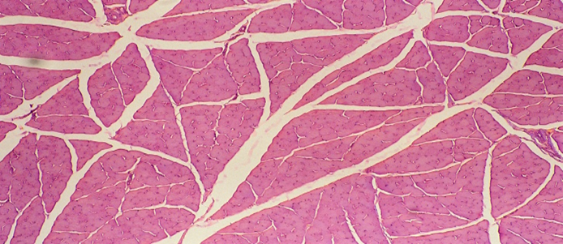
Current Activity in Subcommittee F04.42
Proposed New Standards
5 Year Review of Standards
WK51697 Testing and Characterization of Alginate Foam Scaffolds Used in Tissue Engineered Medical Products (TEMPs)
WK57514 Evaluating Biomaterial Decellularization Processes
F2212-11 Standard Guide for Characterization of Type I Collagen as Starting Material for Surgical Implants and Substrates for Tissue Engineered Medical Products (TEMPs)
Approved New Standards
F3259-18 New Guide for Micro Computed Tomography of Tissue Engineered Scaffolds

Slide 17
ASTM Committee F42 on Additive Manufacturing - Standards directly relevant to Medical Devices
Organized in 2009
  PSDO with ISO signed 2011 (ISO/ASTM Standards)
  Meets twice a year (US/Non-US locales) with ~120 attending
Includes over 600 members from 28 countries (177 members Int’l)
  Andorra, Australia, Belgium, Brazil, Canada, China, Czech Republic, France, Germany, India, Ireland, Israel, Italy, Japan, Korea, Mexico, Nigeria, Norway, Russian Federation, Saudi Arabia, Singapore, South Africa, Spain, Sweden, Switzerland, Taiwan, United Kingdom, United States
6 technical subcommittees
  F42.01 Test Methods F42.04 Design
  F42.05 Materials and Processes (F42.05.01 – Metals, F42.05.02 – Polymers, F42,05.03 – Medical Applications,
  F42.05.04 Aerospace Applications, F42.06 Environment, Health, and Safety)
  F42.90.05 Research and Innovation
  F42.91 Terminology
  F42.95 US TAG to ISO TC 261
23 active standards and 15 draft proposed new standards
The next few slides summarize some of the approved/draft standards that indirectly support the medical device community for additive manufacturing.

Slide 18
F42.01 Test Methods
Approved (3)
F2971 Practice for Reporting Data for Test Specimens Prepared by AM
F3122 Guide for Evaluating Mechanical Properties of Metal Materials Made via AM Processes
ISO/ASTM52921 Terminology for AM-Coordinate Systems and Test Methodologies
Under Development (4)
WK56649 / JG 60 - Practice for Intentionally Seeding Flaws in (AM) Parts
WK49229 / JG 61 - Orientation and Location Dependence Mechanical Testing for Metal AM
WK55297 / JG 52 - General Principles -- Standard Test Artefacts for AM
WK55610 / JG 63 - Characterization of Powder Flow Properties
Joint Groups (7)
JG59: NDT for AM
JG62: Guide for Conducting Round Robin Studies
JG66: Technical specification on metal powders
336
Stakeholders

Slide 19
F42.04 Design
Approved (2)
ISO/ASTM52915-16 Standard Specification for Additive Manufacturing File Format (AMF) Version 1.2
ISO/ASTM52910-17 Standard Guidelines for Design for Additive Manufacturing
F3280-17 Standard for Additive manufacturing, Technical Design Guideline for Powder Bed Fusion, Part 2: Laser-based Powder Bed Fusion of Polymers
F3281-17 Standard for Additive manufacturing, Technical Design Guideline for Powder Bed Fusion, Part 1: Laser-based Powder Bed Fusion of Metals
Under Development (3)
WK48549 New Specification for AMF Support for Solid Modeling: Voxel Information, Constructive Solid Geometry Representations and Solid Texturing
224
Stakeholders

Slide 20
F42.05 Materials and Processes
Approved (12)
F2924-14 Standard Specification for Additive Manufacturing Titanium-6 Aluminum-4 Vanadium with Powder Bed Fusion
F3049-14 Standard Guide for Characterizing Properties of Metal Powders Used for Additive Manufacturing Processes
F3055-14a Standard Specification for Additive Manufacturing Nickel Alloy (UNS N07718) with Powder Bed Fusion
F3056-14e1 Standard Specification for Additive Manufacturing Nickel Alloy (UNS N06625) with Powder Bed Fusion
F3091/F3091M-14 Standard Specification for Powder Bed Fusion of Plastic Materials
F3184-16 Standard Specification for Additive Manufacturing Stainless Steel Alloy (UNS S31603) with Powder Bed Fusion
F3187-16 Standard Guide for Directed Energy Deposition of Metals
ISO/ASTM52901-16 Standard Guide for Additive Manufacturing – General Principles – Requirements for Purchased AM Parts
Under Development (8)
WK60906 Additive Manufacturing - Process Characteristics and Performance - Metal Powder Bed Fusion Process to Meet Critical Applications
WK53878 Additive Manufacturing - Material Extrusion Based Additive Manufacturing of Plastic Materials - Part 1: Feedstock materials
WK58219 Additive Manufacturing - Feedstock Materials-Creating Feedstock Specifications for Metal Powder Bed Fusion
WK53423 Additive Manufacturing - Finished Part Properties-Standard Specification for AlSi10Mg via Powder Bed Fusion
WK58233 Additive Manufacturing - Post Thermal Processing of Metal Powder Bed Fusion Parts
WK60552 Additive Manufacturing-Finished Part Properties-Standard Specification for Additive Manufacturing Titanium Alloys via Powder Bed Fusion
331
Stakeholders

Slide 21


Slide 22
Core Program – ASTM MoU Program
Memorandum of Understanding
110 MoU partners worldwide
ASTM
Full collection of ASTM Standards (reference, adoption, use as basis of national standards)
Membership at no cost to participant
Information, training and partnership
National Standards Body Partner
Access to ASTM standards in its Information Center
Annual Report on use of ASTM standards
Utilization of ASTM standards where relevant and appropriate
7900+ citations of ASTM
standards
in 75 nations

Slide 23
ASTM Memorandums of Understanding
ASIA | EUROPE | CENTRAL & SOUTH AMERICA | CARIBBEAN | MIDDLE EAST & NORTH AFRICA | EASTERN, WESTERN & CENTRAL AFRICA | SOUTHERN AFRICA
BANGLADESH | ALBANIA | BOLIVIA | ANTIGUA AND BARBUDA | AFGHANISTAN | ARSO | ANGOLA
BHUTAN | ARMENIA | CHILE | BAHAMAS | BAHRAIN | BURUNDI | BOTSWANA
BRUNEI DARUSSALAM | AZERBAIJAN | COLOMBIA | BARBADOS | EGYPT | CAMEROON | MALAWI
CAMBODIA | BOSNIA | COSTA RICA | BELIZE | GSO | COTE d'IVOIRE | MAURITIUS
CHINA | BULGARIA | ECUADOR | CROSQ | IRAQ | DEM.REP. CONGO | NAMIBIA
INDONESIA | CROATIA | EL SALVADOR | DOMINICA | ISRAEL | ETHIOPIA | SEYCHELLES
KOREA | EASC | GUATEMALA | DOMINICAN REPUBLIC | JORDAN | GAMBIA | SADC
LAO | GEORGIA | HONDURAS | GRENADA | KUWAIT | GHANA | SOUTH AFRICA
MALAYSIA | KAZAKHSTAN | NICARAGUA | GUYANA | MOROCCO | KENYA | SWAZILAND
MONGOLIA | KOSOVO | PANAMA | HAITI | OMAN | MOZAMBIQUE | ZAMBIA
MYANMAR | MOLDOVA | PARAGUAY | JAMAICA | PALESTINE | NIGERIA | ZIMBABWE
NEPAL | MONTENEGRO | PERU | MONTSERRAT | QATAR | RWANDA
PAKISTAN | ROMANIA* | URUGUAY | ST. KITTS-NEVIS | SAUDI ARABIA | SIERRA LEONE
PAPUA NEW GUINEA | RUSSIA |  | ST. LUCIA | TUNISIA | SENEGAL
PHILIPPINES | SERBIA |  | ST. VINCENT - GRENADINES | TURKEY | TANZANIA
SINGAPORE | UKRAINE |  | SURINAME | U.A.E. | UGANDA
SRI LANKA |  |  | TRINIDAD & TOBAGO | YEMEN
TAIWAN
THAILAND
VIETNAM

Slide 24
Six Ways to Adopt and Reference ASTM
Available to all Public and Private Standards’ Users
Referenced in Regulations
Normative Reference
Code Reference
Available Only to MoU Partners
Identical Adoption
Equivalent Adoption
Used as the Basis of a National Standard or Consulted
Used as the Basis of National Standard or Consulted
Referenced in Regulation
Equivalent Adoption
Simple Ways to Adopt or Reference ASTM International Standards
Normative Reference
Identical Adoption
Code Reference

Slide 25
Key Training Programs for MoU Partners
Standards Expert Program
      2-4 weeks
  On-site at ASTM International Headquarters
  Training on various aspects of ASTM operations: technical committees, virtual tools, Committee Week, etc.
  Fully sponsored by ASTM
Technical Visitor Grant Program
  4-6 weeks
  Educational program on ASTM standards within a industry sector
  Candidates compete for two positions available annually
  ASTM funds up to 50% of the program cost to a limit of $5,000
Intensive Training Programs
  Delegations of 6-12 individuals
  Focused on a specific topic, industry, or set of standards
  Generally requested by an industry, institute, government ministry or university
  Tailored program includes site visits, technical discussions, and meetings with other related organizations
  ASTM facilitates all planning; staff accompanies delegation at no charge; delegation fees fully sponsored by requesting entity
Virtual training
  Interactive web-based training on technical and procedural topics
  Accommodate for time differences and languages

Slide 26
Contacts
Kate Chalfin (F04)
  Manager, Technical Committee Operations
  kchalfin@astm.org
Pat Picariello, J.D., CStd, FSES (F42)
  Director, Developmental Operations
  ppicariello@astm.org
María Isabel Barrios (Latin America)
  Representative, Latin America
  ASTMLatinAmerica@astm.org

