Slide 1
BIOETHANOL IN MOZAMBIQUE: Past and Present
September
2023

Slide 2
AGENDA
Biofuels country Context and Key Learnings
Institutional and Legal framework
Potential business partners
Final considerationsl – product & Market identification,

Slide 3
BIOFUEL COUNTRY CONTEXT & KEY LEARNINGS

Slide 4
INTRODUCTION
The uptake of biofuel related policies was initially driven by country strategies to reduce greenhouse gas emissions in the transport sector while securing a renewable and sustainable source of energy;
For developing countries, the potential benefits of biofuels extend beyond this as biofuel production and consumption to aid in economic and rural development by stimulating the agriculture sector while at the same time reducing country exposure to foreign shocks through energy imports;
Mozambique is one of the most promising African countries for producing biofuels and the national biofuel policy of 2009 identifies measures to incentivize biofuel production;
Demand for biofuels in the Southern African Development Community is expected to increase over the next few years as 7 of its 15 member states have implemented or proposed the implementation of blending mandates by 2020.

Slide 5
I. BIOFUEL COUNTRY STORYLINE
2004
Mozambique’s President declares that the country should be a biofuels exporting country & that wide scale plantations of Jatropha should take place in all unused land..
2004-2006
Jatropha seeds were distributed on a wide scale. The farmers were encouraged to cultivate jatropha on marginal and unused lands.
2005
An inter-ministerial working group to accompanying developments of the biofuels sector was set up.
Multiple activities in the sector. E.g.: Biofuels assessment by EconEnergy; Agro-ecological zooning 1 to 1.000.000 scale; Kick-off of development of the Mozambican sustainability criteria; Formal approval of the first Biofuels projects Procana & Principle Energy
2008
2009
Mozambican Biofuels Strategy was approved - Resolution 22/2009 of 21 May.
2010
48 biofuel projects registered in Mozambique. Granted areas between 8,000 – 20,000 ha. Average investment of US$23M
2011
Regulations on Biofuels and Blends was approved - Decree 58/2011 of 11 November
2014- 2022
Investments and interest in the Mozambican biofuels sector has slowed down. Projects closed. Concession licenses revoked,

Slide 6
II. KEY PROJECTS - SUMMARY OF BIOFUEL PROJECTS
 | Bioethanol | Biodiesel | Total
Number of projects authorised | 6 | 12 | 18
Number of projects implemented | 3 | 10 | 13
Total area authorised (ha) | 97,530 ha | 111,797 ha | 209,327 ha
Current area under cultivation (ha) | 2,080 ha | 4030 ha | 6110 ha
Planned area for cultivation (ha) | 98.000 ha | 127,732 ha | 225.732 ha
Current output of biofuel (specify tonnes/litres) | 3,500 tonnes/year | 152 tonnes/year | 3,652 tonnes/year
The table above summarizes key finding from the main biofuel’s projects:
The bioethanol projects had a different range of feedstock, namely sugar-cane, cassava, and sorghum;
Of the 6 bioethanol projects, only 3 were implemented;
In terms of Feedstock processing into biofuels, only 1 project had been fully operational - Cleanstar Mozambique;
Majority of the projects were developed to sell to the European market.

Slide 7
KEY PROJECTS - BIOETHANOL PROJECTS SUMMARY
Project | Project 1 | Project 2 | Project 3 | Project 4 | Project 5 | Project 6
Company | Massingir AgroIndustrial SA | Gulp Buzi | Grown Energy Zambeze | Cleanstar Mozambique | Mozambique Principle Energy | ENVALOR
Location | Gaza (Massingir) | Sofala (Buzi) | Zambezia (Chemba) | Sofala | Manica (Sussundenga) | Sofala (Caia)
Area of concession (HA) | 37,500 | 6,500 | 15,000 | 2,000 | 20,000 | 17,000
Planted area (HA) | 0 | 400 | 550 | 1000 | 130 | 0
Feeedstock | Sugarcane | Sugarcane | Sugarcane & Sorghum | Cassava | Sugarcane | Sugarcane & Sorghum
Production of feedstock (Tonnes) | 500,000 | No info | No info | 12,000 | No Info | No Info
Production of biofuel (litres/year) | 38 Million | No info | No info | 2,5 Million | 20 Million | 20 Million
Business model | Stand-Alone plantation | Company mixed with Outgrower | Company mixed with Outgrower | Company mixed with Outgrower | Stand-Alone Plantation | Stand-Alone plantation

Slide 8
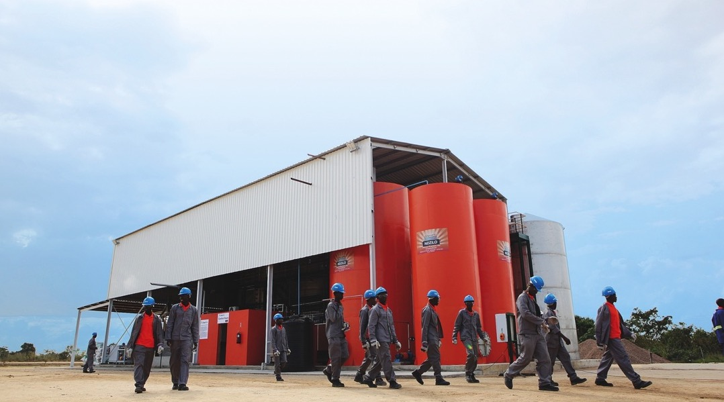
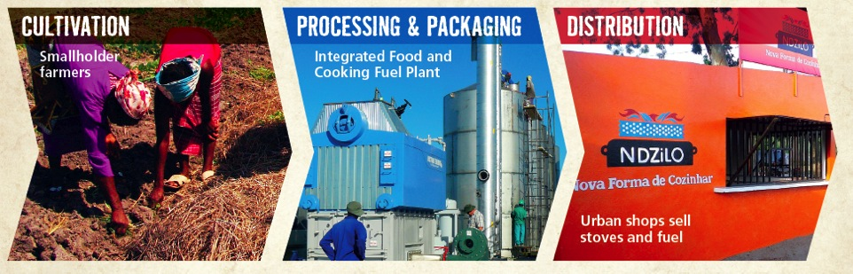


Slide 9
KEY PROJECTS - LESSONS LEARNED FROM A SUSTAINABILITY PERSPECTIVE
OPPORTUNITIES
THREATS
Improvement of sustainability criteria for biofuel with the support of private sector
Partnerships with INFP to develop people capabilities
Experimental trials for processing eficiency- IIAM
Licensing regulation & creation of blending stations to enable control & oversight of the production & commercialization
Lack of private sector ability to influence regulation
Complexity of DUAT acquisition process
Monopoly of IMOPETRO that can determine the price
Social and political instability
Lack of clear regulation related to mixtures of B5
Lack of readiness of institutions to deal with resettlements and compensations
Lack of commercial guarantees in out grower's model
INSTITUTIONAL
Knowledge transfer and improved productivity for food and energy crops
Introduction of technology that takes advantage of derivatives of biofuel crops
Research with other crops such as Cassava and Biomass to reduce risk associated with only having 1 crop
Development of productive value chain centered in local smallholders involving them in different parts of value chain
Lack of research with regard to Cassava viability, associated with small farmer on the ground experience
Lack of more advanced agriculture practices, limiting productivity
Lack of introduction of complementing activities and usages for the residues;
SOCIO-ECONOMIC

Slide 10
KEY PROJECTS - LESSONS LEARNED FROM A SUSTAINABILITY PERSPECTIVE
OPPORTUNITIES
THREATS
Inclusion of labor on the entire production value chain
Income generation through out-grow model;
CSR that involves education initiatives by the investors
Minimum feedstock purchase on local communities
Implement Social technologies associated with the projects, to produce fertilizers, brickets, etc.
Smallholder owned farms land vs large concessions Involving communities in the project decisions
Lack of legislation to guarantee fulfillment of socio & environmental compensation
Lack of human capital in all value chain including in country biofuel experts
Lack of trust between smallholders and investor that limits applicability of out grower model
SOCIO-ECONOMIC
(CONT.)
Creation of additional income through sale of bioethanol
Reservation of % of project concession for food production to ensure food security
Consortium model that secures food production in the communities
Lack of legislation to guarantee fulfillment of social responsibilities
Food vs Energy conflict
FOOD SECURITY

Slide 11
KEY PROJECTS - LESSONS LEARNED FROM A SUSTAINABILITY PERSPECTIVE
OPPORTUNITIES
THREATS
Biofuel being a cleaner fuel source, contributes to emissions reduction
Cultivation in areas affected by deforestation
Dissemination of sustainable production technologies
Biofertilizers produced through residues of ethanol processing, that reduces soil damage
Lack of fulfillment of environment compensation due to lack of legal framework
Pressure on Water resources
Possible food displacement to produce bioethanol feedstock
ENVIRONMENT
Diversification of energy matrix
Reduction of dependency of diesel imports
Generation of electricity for local consumption
Reduction on cooking coal;
Not identified
ENERGY SECURITY

Slide 12
INSTITUTIONAL & LEGISLATION FRAMEWORK

Slide 13
INSTITUTIONAL FRAMEWORK
Ministry of Mineral Resources and Energy (MIREME)
PETROMOC
Mozambican Energy Regulator Authority (ARENE)
Type of institution:
Ministry
Key Department:
National Directorate of Hydrocarbon Fuel
Main responsibilities:
Planning the national energy strategy and policy. Supervising the operation and development of the energy sector
Role in Biofuel:
Energy Policy making
Type of institution:
State-owned company
Key Department:
Project and Development Office
Main responsibilities:
Distributor of Petroleum products
Role in Biofuel:
Formerly designated as implementor of multiple projects in the past by the government
Type of institution:
Energy Regulator
Key Department:
Technical Regulation Directorate
Main responsibilities:
Energy regulatory authority, responsible within the scope of regulation and development of the energy sector, to instruct and process the public tender processes for the award of concessions for the production, transportation, distribution, and sale of electricity
Role in Biofuel:
Entity will play a key role in process to obtain the installation license, pricing etc. ( Same as for the liquid fuels sector)

Slide 14
INSTITUTIONAL FRAMEWORK
Ministry of Agriculture and Rural Development (MADER)
APIEX
Ministry of Land & Environment (MTA)
Type of institution:
Ministry
Key Department:
National Directorate of Commercial Agriculture Promotion; IIAM; Institute of Cotton & Oilseeds
Main responsibilities:
Planning the national agriculture strategy and policy, and for supervising the operation and development of the agriculture sector
Role in Biofuel:
Manage and coordinate biofuels activities such as land allocation, feedstock identification, investment analysis etc
Type of institution:
Public agency
Key Department:
Main responsibilities:
Promote and facilitate private and public investment and exports, special economic zones (SEZs), industrial free zones and rapid development zone
Role in Biofuel:
Responsible to the Project investment authorization and to provide incentives for investors, including provisions for capital movements
Type of institution:
Ministry
Key Department:
National Directorate of Environment
Main responsibilities:
Responsible for governing, planning, coordinating, controlling and ensuring the implementation of policies in the fields of management of Land, Forest Wildlife, Environment, and Conservation Areas
Role in Biofuel:
Responsible for issues related to Environmental Licensing for the projects

Slide 15
BIOFUEL LEGISLATION FRAMEWORK EVOLUTION & DESCRIPTION
1998
2009
2011
2015
Biofuel Framework
Biofuels Policy & Strategy
Regulation on Biofuels & Blends
National Development
Strategy 2015-2035
General Energy Framework
Renewable Energy Development Policy
New and Renewable Energy Development Strategy for the 2011-2025 period
Energy Policy
Energy Strategy
THE ECONOMIC ACCELERATION STIMULUS PACKAGE ( August 2022)
• VAT Exemption for imports in the productive sectors of agriculture and electrification
• Lower the Corporate Income tax rate from 32% to 10%, in the agriculture, aquaculture and urban transport sectors
• Tax incentives for new investments in key sectors carried out in the next 3 years
• Mandatory blending of imported fuels with biofuels
Complementary Legal Framework
Constitution of Mozambique (2004);
Investment Law (1993)
Law n. 3/93, of 24 June
Environmental Law
Law n. 20/97, of 1 October
Land Law
Law n. 19/97, of
1 October

Slide 16
BIOFUEL LEGISLATION FRAMEWORK EVOLUTION & DESCRIPTION
Biofuels Policy
& Strategy
Objective:
Promotion of biofuels through the creation of an appropriate platform, based on two key principles:
i) “Promotion and use of agro energy resources to obtain energy security and a sustainable social and economic development, while contributing to the reduction of Greenhouse Gases that aggravate global warming, by selecting & adopting more adequate production methods and technologies in agriculture and industry”;
ii) “the need to face the instability, unpredictability and volatility of fuel prices on the international market, and reduce the country’s dependence on imported fossil fuel and the burden of imports on the national economy”
Resolution 22/2009 of 21 May
Key
mandate:
Mandatory blend of up to 10% ethanol and 3% biodiesel by 2015 with a target of 20% bioethanol and 10% biodiesel after 2021.
Regulation on biofuels & blends
Objective:
This regulation establishes the regime governing the production, processing, marketing and distribution of biofuels and respective blends.
Decree 58/2011 of 11 November
Mandate:
licensing must be accompanied by an investment plan showing the technical, economic, financial, & environmental viability of the project.
Production, processing, storage, & distribution activities to introduce biofuels blends in the national market will be subject to licenses to be issued by the relevant Ministry (currently MIREME), if production is lower than 12,000,000 liters per year or by the Council of Ministers, if it exceeds this figure.
These requirements will not be applied to production below 5,000 liters per year or for personal use

Slide 17

BIOFUEL LEGISLATION – REGULATIONS TO BE DEVELOPED OR APPROVED
Biofuel Blending Program;
Biofuels Purchase regulation;
Biofuels licensing for production, storage, export, transport and commercialization;
Biofuels price structure regulation;
Biofuels Tax Incentives and Tax Collection;
Approval of Biofuel sustainability criteria;

Slide 18
POTENTIAL BUSINESS PARTNERSHIPS

Slide 19
POTENTIAL BUSINESS PARTNERSHIPS IN PROJECT LIFECYLE
Research & Testing
Planning & Resourcing
Cultivation & Processing
Lack of projects track record to validate bioetanol yields in the area
Lack of understanding of social context with regards to feedstock production
Unclarity regarding Gov. policy
Lack of visibility of trained smallholders in the region
Immature overall agriculture supply chain
Land acquisition process challenging
Out grower model definition
Water availability may be challenging in certain regions
Lack qualified & trained labor
Unclarity regarding Gov. Blending policy
Ethanol methodology production (Sugar, Starch or Biomass)
Storage
Sector Challenge
Validate transformation efficiency for different crops
Socio-Economic Impact Studies
Identification of local smallholders
Technology identification
Capacity building / Smallholder training
Land identification and acquisition
Social inclusion
Adjustment of processing technology according to feedstock
Training of local labor for processing plant
Establish blending procedures
Support Required
Potential Partners
Mozambique Bioetanol workshop

Slide 20
FINAL CONSIDERATIONS
Mozambique is uniquely placed to become a major supplier to such a market given its biophysical characteristics, significantly underutilized agriculture potential, well-developed sugar production sector and own blending mandates (Resolution No. 22/2009);
When studying the potential for biofuel production in Mozambique, social, economic and legal factors have to be taken into consideration to understand in which extent the reality matches the suggested potential;
The introduction of this new industry creates a demand for bioethanol crops, which can be supplied by the local market;
Feedstock crops are the largest input into the ethanol production process (~58% of costs).

Slide 21
FINAL CONSIDERATIONS
The blending mandates announced in South Africa (2 and 10% bioethanol until 2025) provide a key anchor market for biofuels in the SADC and Southern African region (1400 million litres per annum);
Coupling bioethanol production with biomass cogeneration provides additional economic opportunities can assist in energy security and reduce deforestation (cooking ethanol).
For the success of this initiative, the access to land for production must be efficient;
The purchase of bioethanol feedstock crops should be guaranteed;
Provide a more in-depth analysis of the environmental, legal and social considerations of biofuels expansion in Mozambique, speccialy in microeconomic level;
The vulnerability of the sector due to climatic changes should be evaluated.

Slide 22
www.greenlight-africa.com
mail@greenlight-africa.com
Tel.: +258 843048334
Localização:
Rua de Jose Macamo 285
Bairro da Polana, Maputo, Moçambique

