Slide 1
Fundamentals of Safe Electrical Installations in Users’ Facilities

Slide 2

To be introduced……
An overview of the electrical safety system infrastructure in the United States;
What are the key elements;
How the key elements work together;
Practices of verifying the conformity of electrical equipment and devices in the market;
Systems of inspecting the existing building and the procedures of auditing engineering plans of new buildings.

Slide 3
Electrical Safety in the U.S.
An overview of the electrical safety system infrastructure in the United States;
What are the key elements;
How the key elements work together;
Practices of verifying the conformity of electrical equipment and devices in the market;
Systems of inspecting the existing building and the procedures of auditing engineering plans of new buildings.

Slide 4
Introducing NEMA
Medical Imaging and Technology Alliance
Medical Imaging Informatics
Magnetic Resonance
Molecular Imaging
Radiation Therapy
Ultrasound Imaging
X-Ray Imaging Products
Industrial Automation Division
Carbon/Manufactured Graphite
Arc Welding
Industrial Automation Control
Motor and Generator
Power Electronics
Lighting Systems Division
Ballast and Driver
Emergency Lighting
Lighting Controls
Luminaire
Light Source
Electronics Division
Dry Battery
Residential & Commercial Controls
Electric Resistance Heating
Signaling Protection & Communication
Health Care Communications
Transportation Mgt. Systems
Industrial Imaging Division
Industrial Imaging and Communications
Building Systems Division
Cable Tray
Enclosures
Electric Vehicle Supply Equipment
Conduit Fittings
Cable Ties
Fuse
Health Care Facility Equipment
Low Voltage Distribution Equipment
Outlet and Switch Box

Slide 5
NEMA, continued
Building Systems Division (continued)
Ground Fault Personnel Protection
Pin & Sleeve Plug
Steel Conduit
Polymer Raceway Products
Low Voltage Surge Protective Devices
Wiring Device
Insulating Materials Division
Insulating Materials
Magnet Wire
Wire and Cable Division
High Performance Wire and Cable
Building Wire
Power & Control Cable
Flexible Cords
Power Equipment Division
Electrical Connector
Capacitor
Distribution Automation
Electricity Metering Group
Meter Mounting/Test Equipment
High Voltage Insulator
High Voltage Surge Arrester
Switchgear
Dry Type/Specialty Transformers
Transformers
Councils
Energy Storage Council
High Performance Buildings Council
Smart Grid Council
Cyber Security Council

Slide 6

The U.S. Electrical Safety System
Installation Codes
Product Standards and Certification
Inspection and Enforcement (verification)
Safe Products and Safe Installations

Slide 7
Electrical Installation Code
Importance
  Directs the safe installation of products and systems;
  Helps to ensure use of “safe products.”
Ties to other parts of the safety system
  Influences requirements in product standards;
  Used by the enforcement official to inspect an installation.

Slide 8
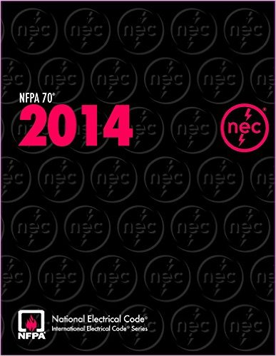
Installation Code in Users Facilities
Primary document is the National Electrical Code®
Developed and published by the National Fire Protection Association (NFPA)
Revised and published every three years
1st edition was in 1897
Wide public review and input
Adoption occurs at the local (state, city, county, etc.) level

Slide 9
Product Standards and Certification
Importance:
  Product standards set design, performance, construction, and certification requirements for products
  Provide basic requirements for “safe products”
  Developed by ANSI-accredited Standards Development Organizations (such as NEMA) or testing bodies (such as Underwriters Laboratories)

Slide 10
Product Standards/Certification, cont.
Tie to Other Parts of the Safety System
  certified compliance with standards indicates suitability for installation and use in accordance with the installation Code.
  inspectors rely on compliance to product standards to approve a particular product for installation
The standards are not “government regulations” nor are they government developed

Slide 11


Product Standards
Voluntary Standards
  Underwriters Laboratories (UL) (consumer and low voltage products)
    Compliance with UL Standards through UL (or another recognized body) results in LISTING
  Institute of Electrical and Electronic Engineers (IEEE) (medium and high voltage products)
    IEEE only develops the standards and does not do product evaluation
  National Electrical Manufacturers Association (NEMA) (low, medium and high voltage products)
    NEMA develops the standards; we do not do product evaluation

Slide 12
Product Certification
Conformity Assessment Requirements
  No government mandated conformity assessment at the time of design/manufacture
  Under the voluntary standards system, the product standards can have both design tests as well as production tests for the product

Slide 13
3rd Party Certification
Selection of the certifier is at the discretion of the manufacturer, but...
The certifier must be one acceptable at the local level due to conformity assessment requirements at the time of installation.

Slide 14
Inspection/Enforcement
Inspection and Enforcement (verification)
Importance
  The inspector verifies that installation complies with Code
  Inspection provides for systematic checks and balances in the system
  Uniform interpretation of the installation code
  Products that do not comply with required standards will most likely not be used

Slide 15
Inspection/Enforcement, cont.
Tie to Other Parts of the Safety System
  certified compliance with standards is evidence for the inspector that a product can be safely installed and used in accordance with the installation code
  3rd party product certifiers must be acceptable to the local authority having jurisdiction (AHJ)
  The AHJ is the enforcer of the installation code

Slide 16
Authority Having Jurisdiction
The organization, office or individual responsible for approving equipment, an installation, or a procedure.
At the local level this is typically the electrical inspector

Slide 17
Inspection/Verification
Electrical installations are governed by local laws and typically required to be inspected by a recognized inspection body
Inspectors can be publicly employed or privately employed and recognized by the local jurisdiction
Most inspectors will require products to be LISTED before granting approval of the installation
  liability of the inspector
  legal system structure
  ensures compliance with the product standards

Slide 18

Process of Inspection
Process
  Plan review (larger installations)
  Installation permit
  Rough-in inspection
  Final inspection
  Issuance of Certificate of Occupancy
For electrical products, the inspector will look for the acceptable third-party certification mark and ensure that the manufacturer’s instructions for installation are followed

Slide 19
To be introduced……
The system covers established risks for fire and electric shock;
The system handles over 3.8 trillion kWh of electricity annually;
Common practice and principles are used across the entire country;
Key standardizing bodies have existed for over 100 years

Slide 20
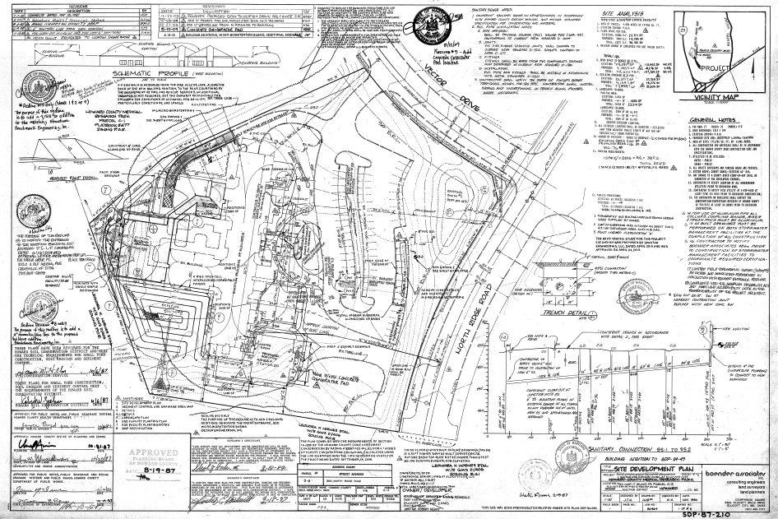
Example……Plan Review

Slide 21
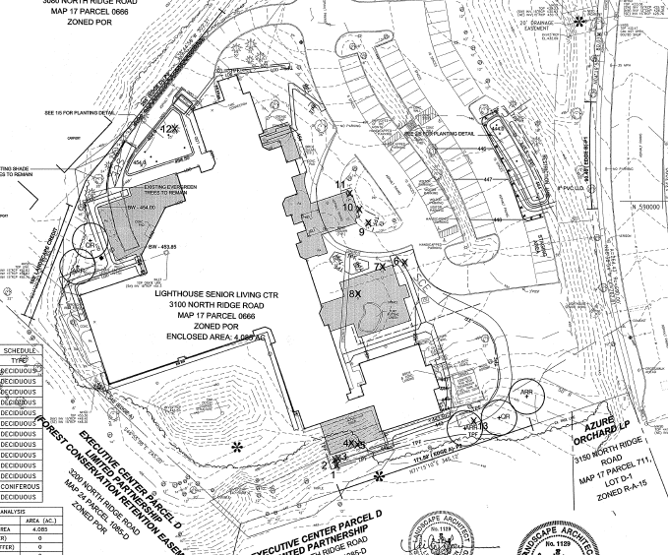
Example……

Slide 22
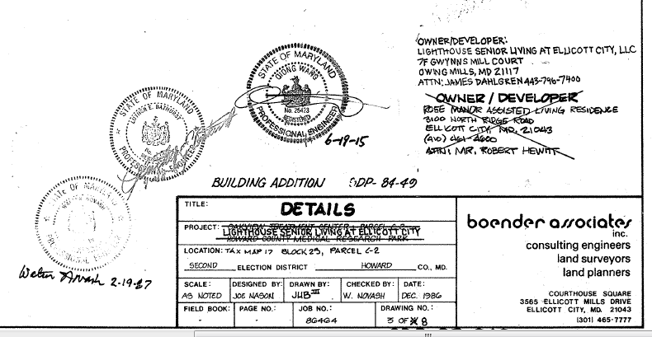
Example……Plan Approval

Slide 23
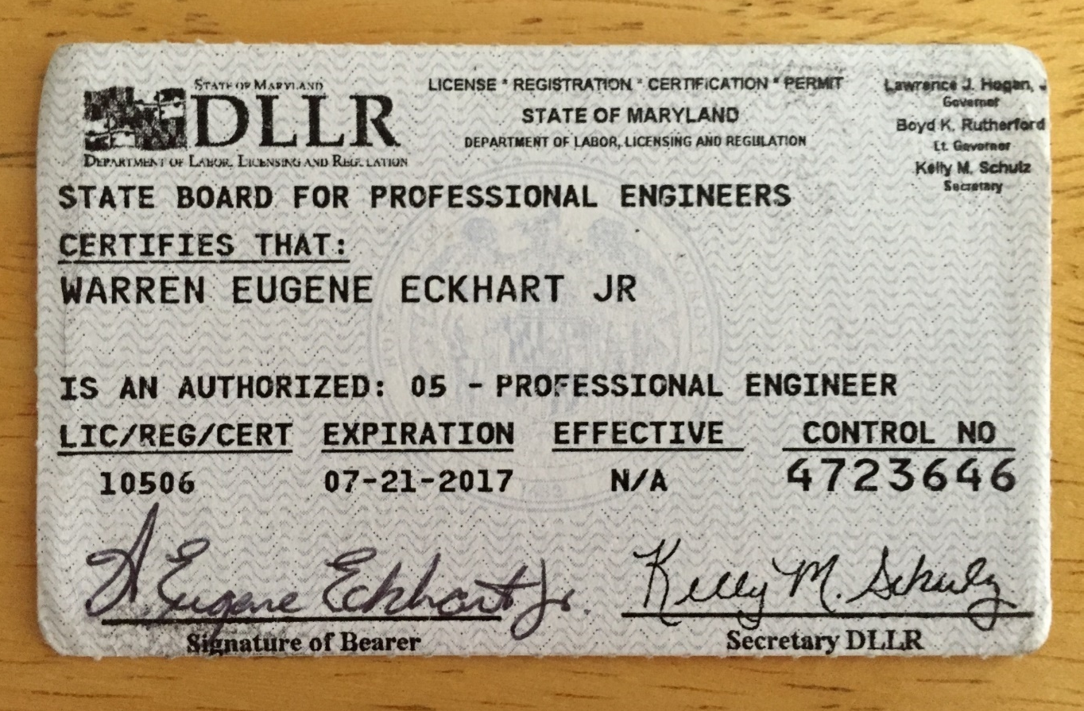
Example……Licensing Requirements

Slide 24
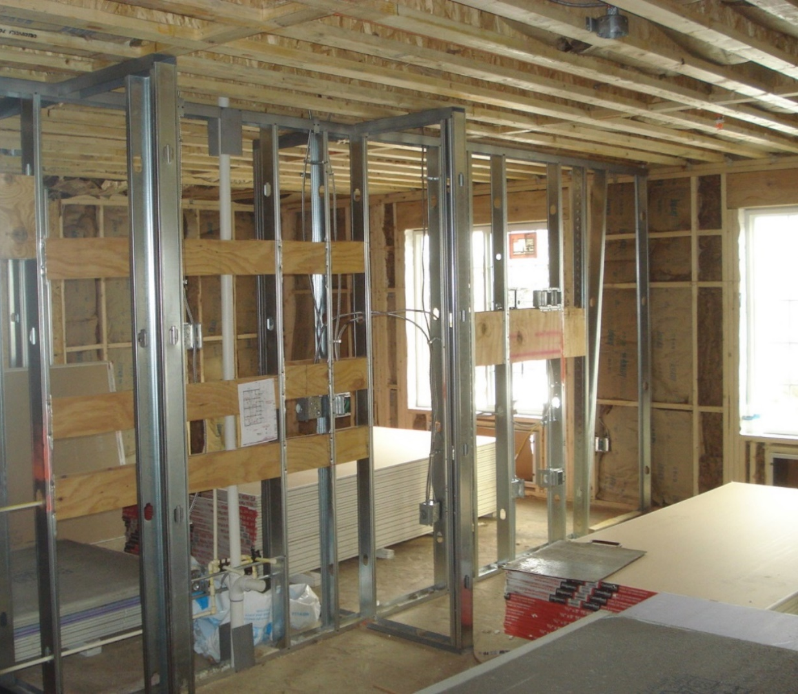
Example……Rough-in Inspection

Slide 25
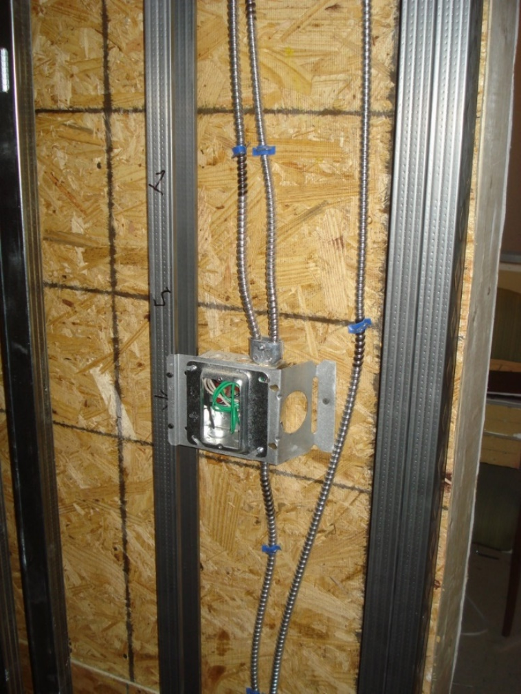
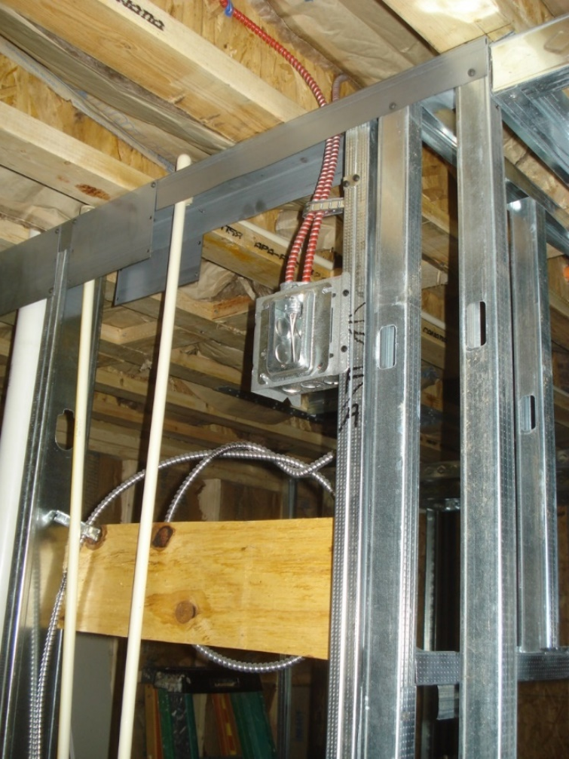
Example……Rough-in Inspection

Slide 26
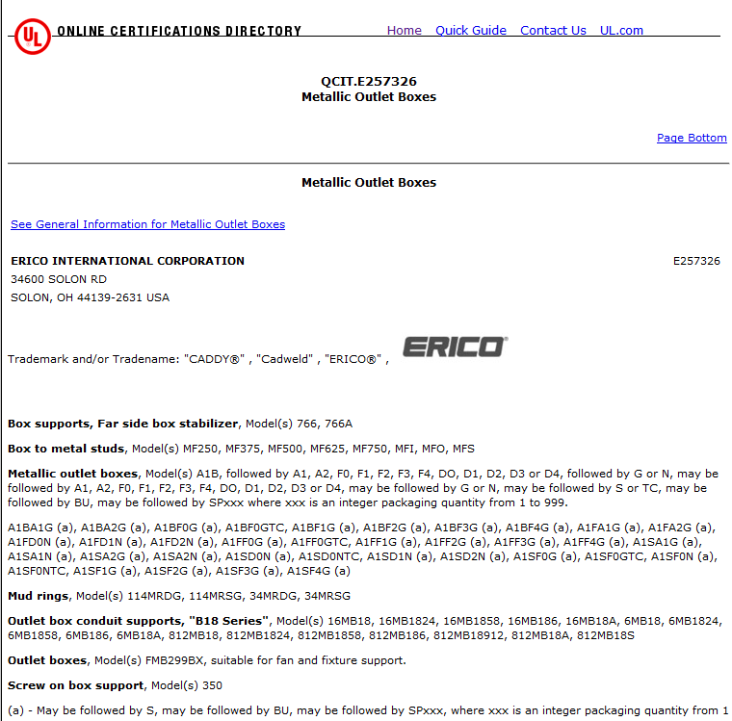
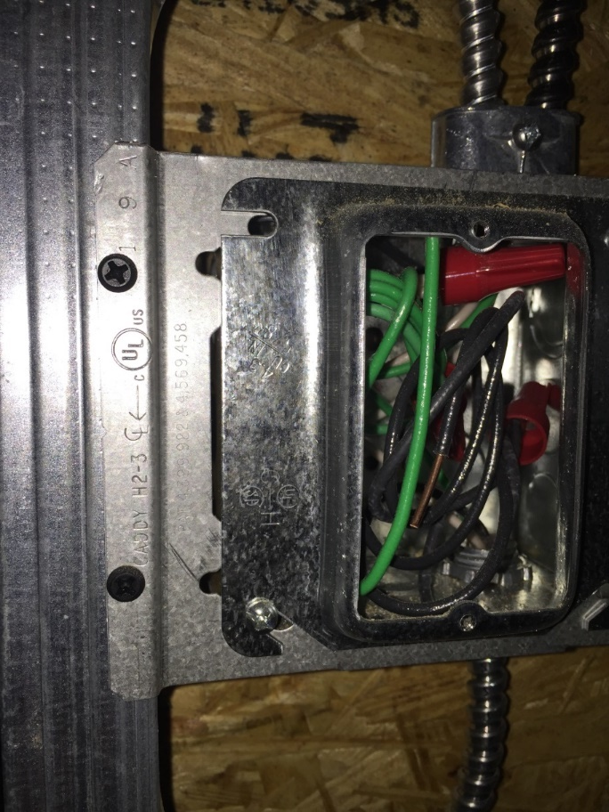
Example……Product LISTING

Slide 27
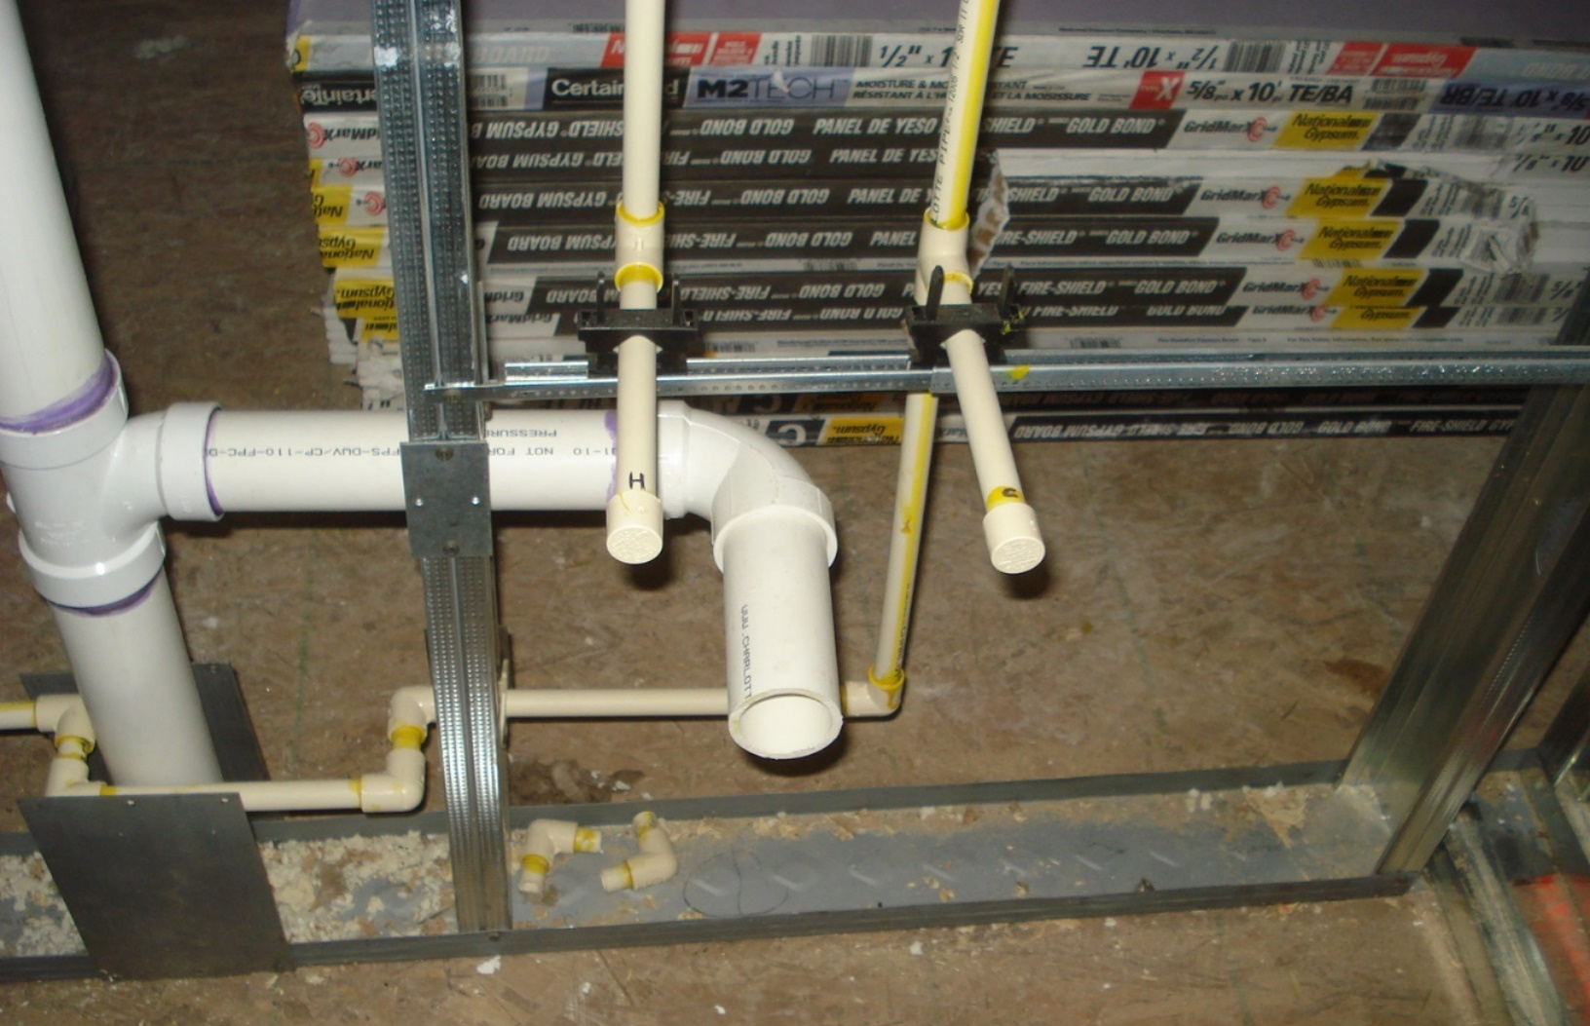
Example……Plumbing Inspection

Slide 28
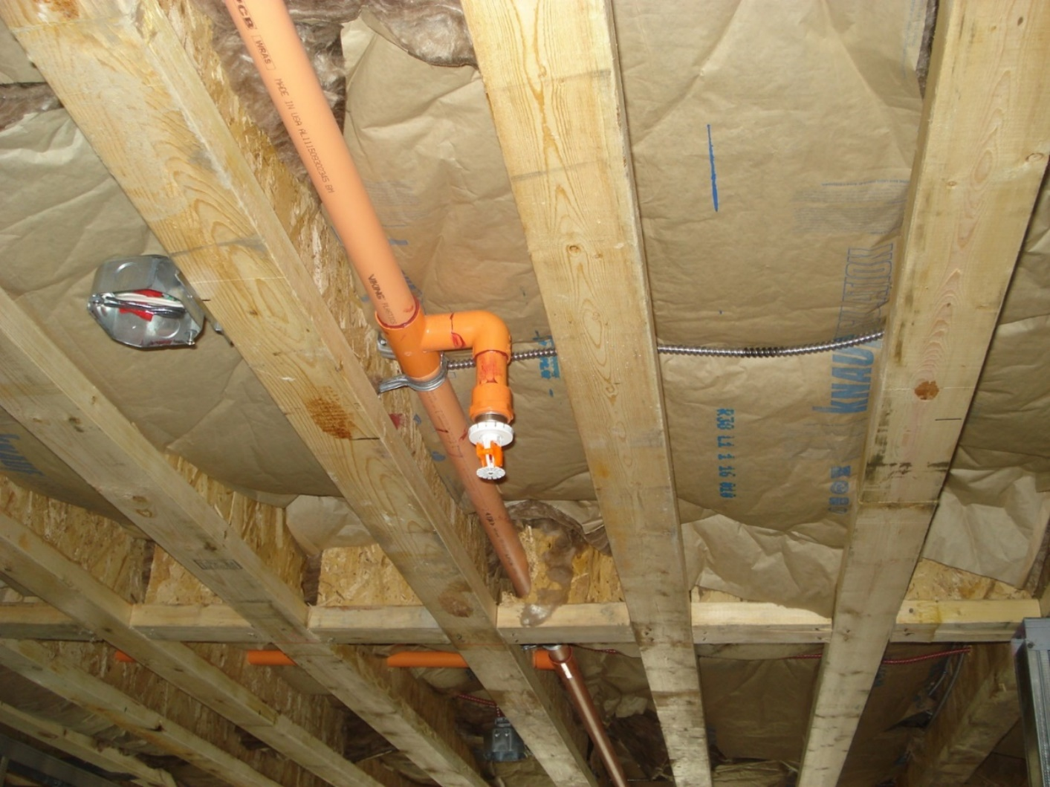
Example……Fire Suppression Inspection

Slide 29
Enforcement Results
If violations of the Code or improperly installed products are found the inspector will write a violation notice or can require that the product be removed
Certificate of Occupancy will not be issued until violations are corrected
Electrical utilities will not connect power until a valid Certificate of Occupancy is in place

Slide 30
Approval
Acceptable to the authority having jurisdiction
Clears the path for issuance of the Certificate of Occupancy.

Slide 31
The U.S. Electrical Safety System in Summary
Installation Codes
Product Standards and Certification
Inspection and Enforcement (verification)
Safe Products and Safe Installations

Slide 32
Thank you.
Any questions?
Gene.Eckhart@nema-consultant.org

