Slide 1
Treatment of patents in national standards in China
Yiyi Wang
CNIS

Slide 2
Contents
Combination of patents with standards
Important policy and Legal Framework
GB/T 20003.1<Special procedures for the development of standards part 1: Standards related to patents>（For approval）
Next plan

Slide 3
Combination of patents with standards
Reasons for the combination
The rise of knowledge-based industries promotes the patent intensity and increases complexity
Patented technology constitutes technical solution that can not be replaced
The relationship between standard and patent
Represent different interests
Improve technical level of standard
Expand implementation of patent

Slide 4
Combination of patents with standards
Impacts
Make the procedure for development and revision of standard more complex
Enhance the competitiveness of industries, and also may lead to monopoly
Promote innovative fruits to be widely implemented, and also may have the possibility of restraining innovation

Slide 5
Combination of patents with standards
Main issues need to be solved
Patent disclosure
Publication of patent disclosed and notification
Licensing claims
Transfer of patent rights

Slide 6
Contents
Combination of patents with standards
Important policy and Legal Framework
GB/T 20003.1<Special procedures for the development of standards part 1: Standards related to patents>（For approval）
Next plan

Slide 7
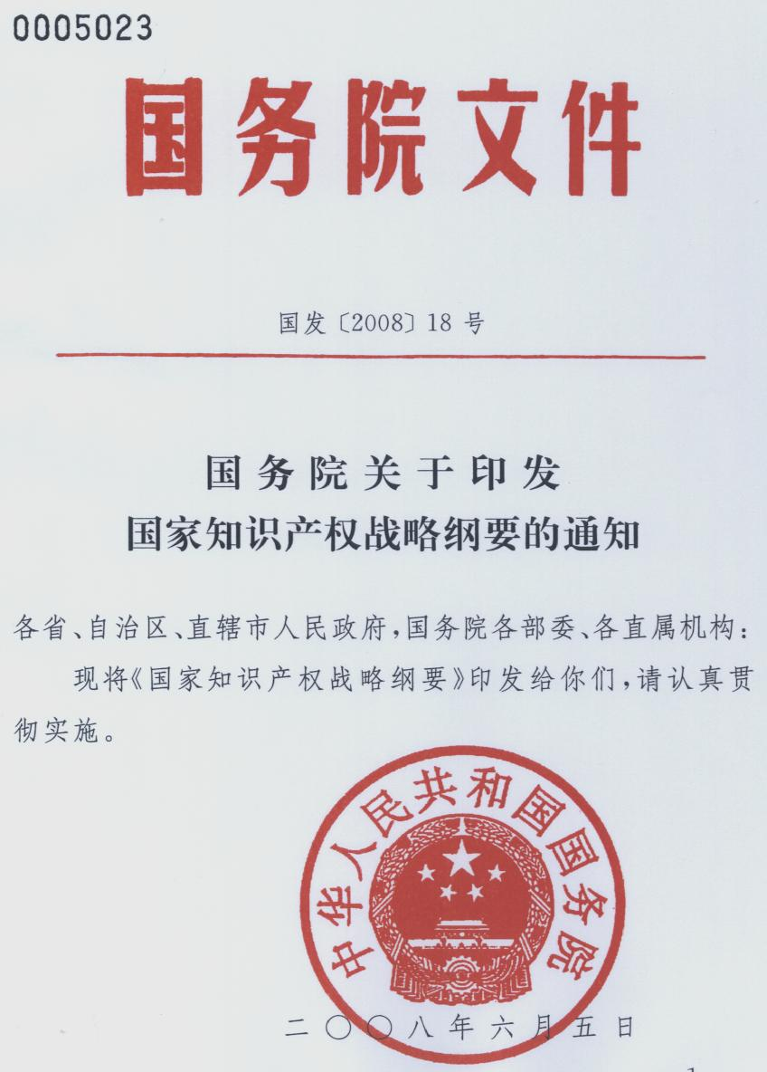
Outline of National Intellectual Property Strategy
Made to public in June 5, 2008
Article 11:
Acquisition of IPRs as goal
Being accepted by the technical standards
as endeavor direction
Article 12:
Choose some important technological areas
Create a number of core self-independent intellectual
properties and technical standards
Article 17:
Formulate and perfect policies related to standards
To regulate the inclusion of patents into standards

Slide 8
<Implementation plan for the national intellectual property strategy in 2009>
It requested:
Promote independent innovation fruits into technical standards
Accelerate the pace to issue <Provisions on the inclusion patents in national standards>
Publicizing <Provisions on the inclusion patents in national standards>
Strengthen cooperation between international standardization organizations
Notes:
加强与国际标准化组织合作：ITU-T知识产权特别工作组由三大国际标准组织ISO、IEC和ITU联合成立，制定共同专利政策实施指南与文件的专门机构，制定适用于ISO、IEC和ITU的共同知识产权政策，中国标准化研究院王益谊博士已成为其专家成员，并将于今年5月将其在瑞士的知识产权工作会议。

Slide 9
Legal Framework
Law
Standardization law
Departmental rules and regulations
Interim provisions on the development and revision of national standards related to patents
Policies made by SDOs
CCSA
CESI
Anti-monopoly law
AVS
……
National Standards(Guideline)
GB/T 20003.1<Special procedures for the development of standards part 1: Standards related to patents>
Patent law

Slide 10
Standardization policy
SAC
Interim provisions on the development and revision of national standards related to patents(public enquiry)
CNIS and other organizations
GB/T 20003.1<Special procedures for the development of standards part 1: Standards related to patents>（For approval）

Slide 11
Contents
Combination of patents with standards
Important policy and Legal Framework
GB/T 20003.1<Special procedures for the development of standards part 1: Standards related to patents>（For approval）
Next plan

Slide 12
GB/T 20003.1<Special procedures for the development of standards part 1: Standards related to patents>（For approval）

Slide 13
GB/T 20003.1<Special procedures for the development of standards part 1: Standards related to patents>（For approval）
In consistent with ISO/IEC/ITU common patent policy in principle
Public enquiry and feedbacks
Made for public enquiry in 2010.2
Received 299 feedbacks from 27 bodies

Slide 14
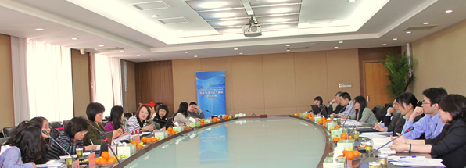
GB/T 20003.1<Special procedures for the development of standards part 1: Standards related to patents>（For approval）
Seminar on feedbacks of the Disposal Rules for the Inclusion of Patents in National Standards---April 2010
Main topics: the effectiveness of licensing declaration, the contents related to IPR in censor and review stage in standard development process, treatment of patents when adopting international standards and so on.

Slide 15
GB/T 20003.1<Special procedures for the development of standards part 1: Standards related to patents>（For approval）
Modification and perfection
Study and analyze feedbacks
——change the title of the standard:
GB/T 20003.1<Special procedures for the development of standards part 1: Standards related to patents>
——give a more clear distinction of the disclosure obligation of different stakeholders

Slide 16
Requirements for treatment of patents
Disclosure of essential patents
Publication of related information
Licensing claims of essential patent claims
Requirements for conducting of meetings
Requirements for documents
Develop national standard based on international standard or foreign standard

Slide 17
Treatment of patents in development and revision procedures of national standards
Preparing
Work Item
Draft
Public enquiry
Censor
Approval
Review
Withdraw

Slide 18
Contents
Combination of patents with standards
Important policy and Legal Framework
GB/T 20003.1<Special procedures for the development of standards part 1: Standards related to patents>（For approval）
Next plan

Slide 19
Next plan
Data collection and analysis with respect to standards related to patents
challenges:
How to get these data as China hasn’t paid much attention to this issue before? How to analyze? ……
Develop training programme to TC/SC, enterprises and so on.

Slide 20
Thank you
Yiyi Wang
Sub-institute Of Standardization Theory And Education, CNIS Address: No.4, Zhichun Road, Haidian, Beijing, China,100088
Tel(fax):010-58811659
E-mail: wangyy@cnis.gov.cn

