Slide 1
The internet of things
ESOs work on Technology Standards for the IoT
ANSI – ESOs meeting
Washington 21-22 February 2017

Slide 2


2 layers for the iot in etsi
Radio Access
  Basically relying on 3GPP’s work
  Though also worked in LTN (Low Throughput Networks, was an ETSI Group Specification and is now TC ERM TG28 LTN TR and TSs)
  Also in ULE (Ultra-Low Energy, an evolution of DECT for the IoT)
  And in other LPWAN technologies (through ERM TG28)
Services layer
  Under the umbrella of oneM2M
  But also contributing from ETSI through SmartM2M – e.g. SAREF is a direct ETSI contribution…
  … and others may be coming

Slide 3




(3G Partnership Project)
Organizational Partners
  Standards organizations:
Market Representative Partners
  14 Market partners representing the broader industry:
ARIB (Japan), ATIS (USA), CCSA (China), | ETSI (Europe), TTA (Korea), TTC (Japan), TSDSI (India)
4G Americas, COAI (India), GSA, GSMA, IMS Forum, InfoCommunication Union (Russia), IPV6 Forum, | MDG (formerly CDG), NGMN Alliance, Small Cell Forum, TCCA, TD Industry Alliance, TD-Forum, UMTS Forum
Source: 3GPP

Slide 4
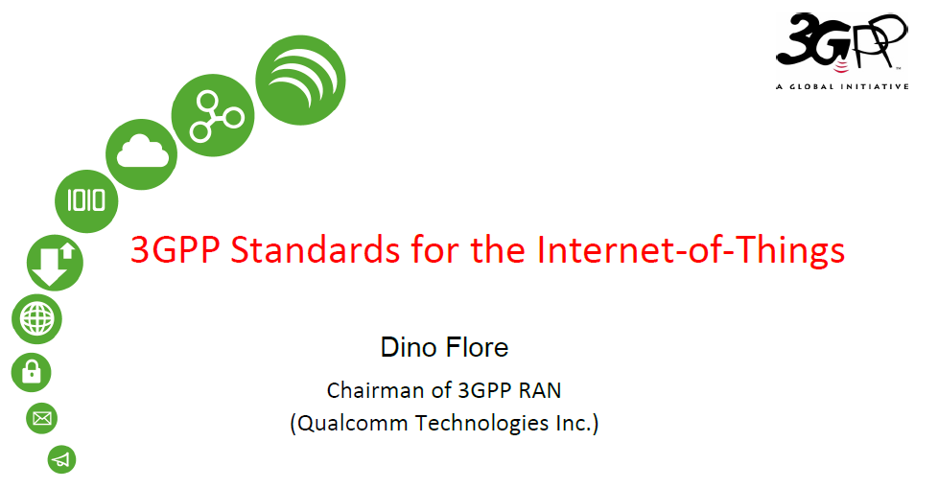
3GPP Standards for the Internet-of-Things
In Release-13 3GPP has made a major effort to address the IoT market
The portfolio of technologies that 3GPP operators can now use to address their different market requirements includes:
  eMTC - Further LTE enhancements for Machine Type Communications, building on the work started in Release-12 (UE Cat 0, new power saving mode: PSM)
  NB-IOT - New radio added to the LTE platform optimized for the low end of the market
  EC-GSM-IoT - EGPRS enhancements which in combination with PSM makes GSM/EDGE markets prepared for IoT
Freeze of the protocol specifications achieved in Q2-16
Source: 3GPP

Slide 5

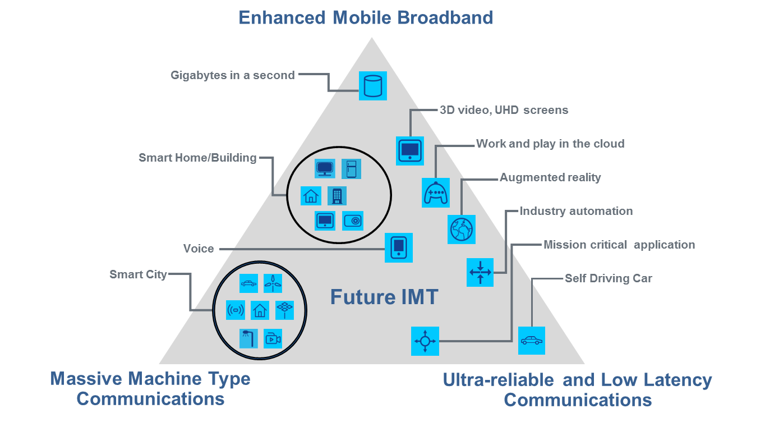
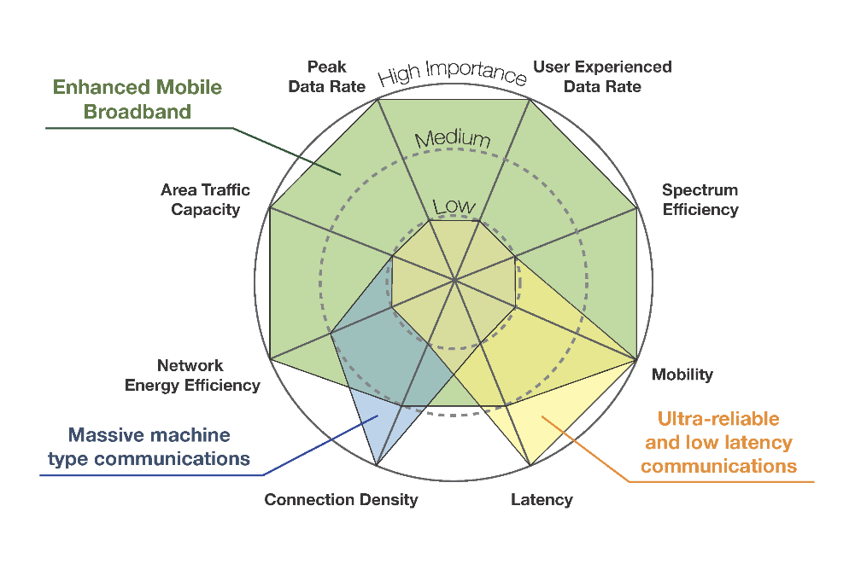
And…
is coming!
IMT-2020 (“5G”) usage scenario
IMT-2020 (“5G”) Key capabilities
Usage scenarios extend from MBB to Internet of Things
Different usage scenarios have quite different capability requirements.
Source: ITU-R
Recommendation ITU-R M.[IMT.VISION]

Slide 6

TC SmartM2M
ETSI SmartM2M:
  Developed two releases of M2M specifications.
  Used as one of the initial baseline proposal for the oneM2M initiative
ETSI SmartM2M is currently working on:
  Supporting the European industry and institutions on the identification and adoption of standards, in particular regarding the oneM2M framework
  Bridging the European needs in the area of M2M/IoT towards oneM2M
  Smart Appliance REFerence ontology SAREF / oneM2M IoT Semantic Interoperability

Slide 7
TC SmartM2M: CGs, AIOTI and H2020
ETSI is active and/or cooperating with:
  CEN-CENELEC-ETSI Coordination Groups : on Smart Cities SSCC-CG (also with ISO, IEC, UN, ITU-T..); Smart Meters SM-CG and Smart Grid SEG-CG
  AIOTI www.aioti.org: WG03 (IoT Standardisation/ETSI) and AIOTI WG08 (Smart Cities/Nokia) with many SDOs (ITU-T, W3C, IEEE, CEN, ISO, CENELEC, IEC, JTC1, ETSI, oneM2M, 3GPP..), OSS, Industry/Verticals and IoT Alliances, IERC, IoT-EPI, IoT LSPs…
  FIWARE / OASC.. Now members of the new ISG CIM (Context Information Management)
ETSI is a partner in the H2020 Smart City project ESPRESSO (OGC, CITYKEYS/Eurocities, Sharing Cities, EIP-SCC, Urban Platforms), IoT-EPI/UNIFY-IoT and IoT LSP CSA CREATE-IoT

Slide 8















oneM2M
Partnership Project
Over 200 member organizations in oneM2M
www.oneM2M.org
All documents are publicly available
Source: oneM2M

Slide 9
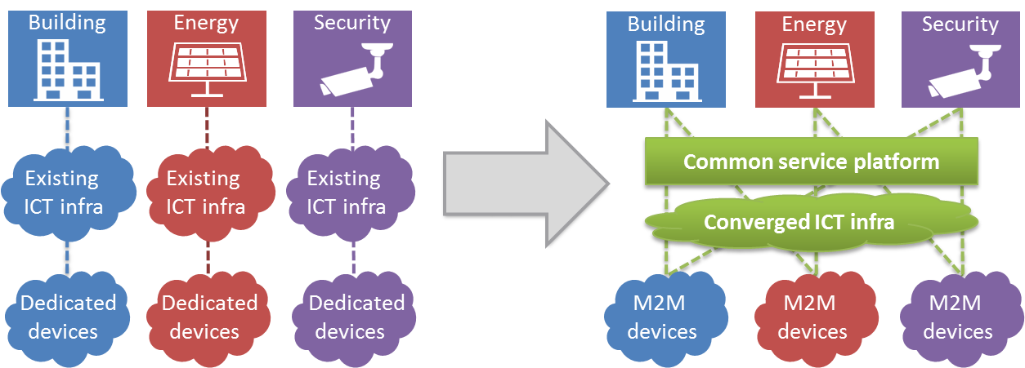
IoT cross-domain interoperability
Invert the pipe
Highly fragmented market with small vendor-specific applications.
Reinventing the wheel: Same services developed again and again.
Each silo contains its own technologies without interop.
End-to-end platform: common service capabilities layer.
Interoperability at the level of communications and data.
  Seamless interaction between heterogeneous applications and devices.
Source: oneM2M

Slide 10
Vision
App provider 1
City 1
Utility 1
Utility 2
City 2
Utility 1
Specialist application provider, under contract to cities. Connecting using Mca interface. Standardized interface, economy of scale
Cities with their own oneM2M platforms. Connecting to Mcc’ interfaces on Utilities platforms. Only see data, not connectivity
Utilities operating across multiple cities. Each with own applications, own data, own oneM2M platform
Source: oneM2M

Slide 11
Reality: SK Telecom, Korea
SK Telecom leading Smart City project in Busan
oneM2M-based open source IoT platform
Services:
  smart streetlights, lost-child prevention system, emergency evacuation system, smart parking, building energy management and small business marketing system
http://www.koreatimes.co.kr/www/news/tech/2015/12/133_192923.html
https://www.us-ignite.org/globalcityteams/actioncluster/5wSYxJhQoKef4WEvHmPLaZ/

Slide 12




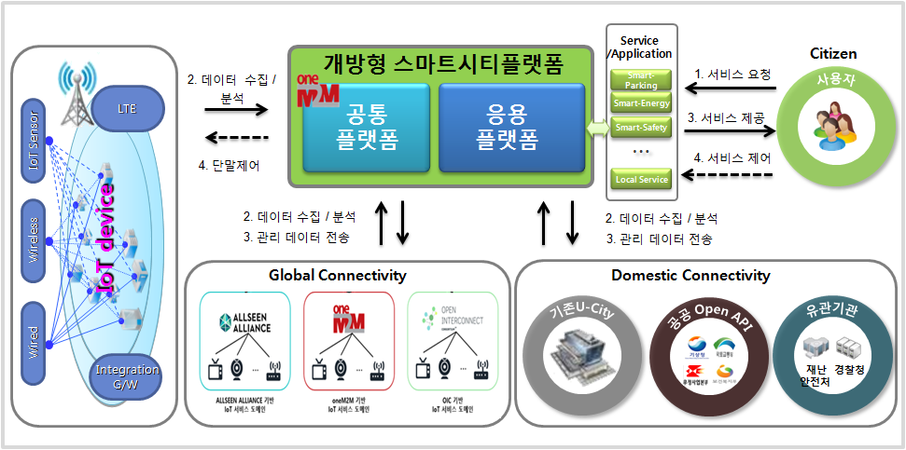








Smart city deployment example - Busan
Open Smart City Platform
Service/
Application
Citizen
1
Request services
2
Common
Platform
Application Platform
Smart-Parking
LTE
Smart-Energy
Data collection
/analysis
3
Provide services
Smart-Safety
IoT Sensor
Device control
Service control
4
…
4
Users
Local Service
2
Data collection/analysis
2
Data collection/analysis
Wireless
3
Data transmission
3
Data transmission
Global Connectivity
Domestic Connectivity
U-City
Public Open API
Government
Wired
Integration G/W
AllSeen Alliance-based
IoT service domain
oneM2M-based
IoT service domain
OIC-based
IoT service domain
Source: SKT
© 2015 oneM2M
Source: oneM2M

Slide 13




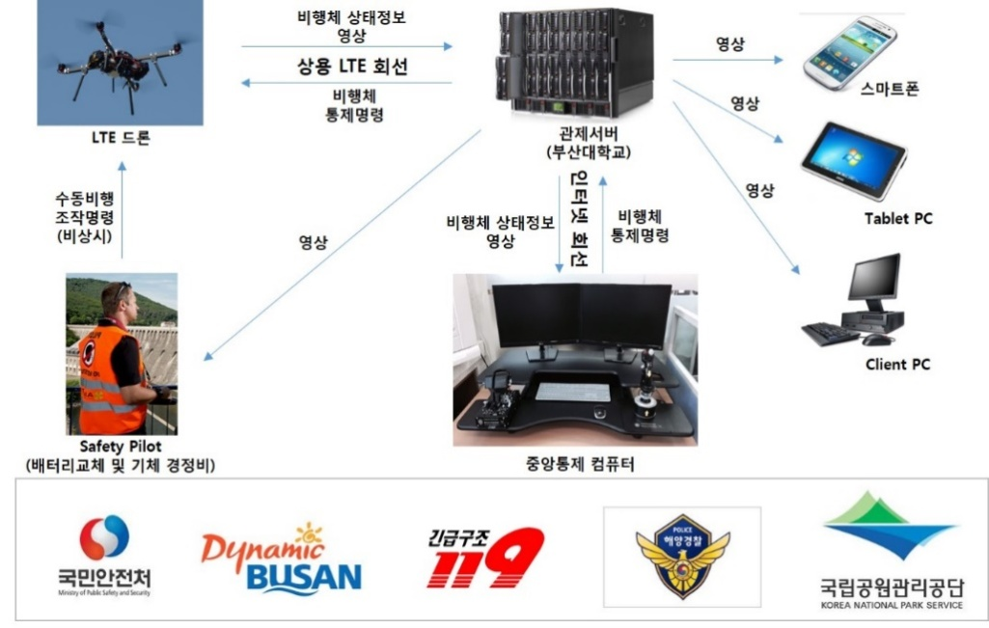

















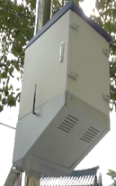







Smart city Busan use case examples
  Safety service for Children and the old
  Smart marine safety based on drone
    A Smart location management and a service of smart education supporting which are based on the free communications for the disadvantaged people such as the demented elderly, disabled people, children, infants
    In order to prevent coast and marine accidents, a drone with device of video transmission and automated pilot devices based on LTE controls the site in real-time.
Information and image on aircraft
Image
  GPS
Smart phone
Commercial LTE network
3G/ LTE
Command aircraft control
Control server
(Busan Univ.)
Image
Smart phone
  Centum/Jaesong/Banyeo
LTE drone
Image
Relieved Tag
  CCTV line
Command the manual flight
(in emergency)
image
Information on aircraft status
Command
the aircraft
control
LoRa
Internet network
Tablet PC
Gateway
CCTV
(Ethernet)
High speed communication network
Open IoT platform
Smart city
monitoring
Client PC
CCTV closure
Safety Pilot
(Battery exchange
and servicing the aircraft)
Operating PC
Central control computer
Gateway
Gateway
IP Camera
  G/W example of existing installment
  Cost saving due to the first utilization
  of service based on LPWA(LoRa)
  Provision of Integrated service
  CCTV image, health check
  with location service
  Application of auto pilot
  control with only
  domestic technology
  The national first unmanned
  marine surveillance
  /Implementation of control system
Source: SKT
© 2015 oneM2M

Slide 14
CEN & CENELEC IoT initiatives
Response to EC Digital Single Market Package
  EC Communication ICT Standardisation Priorities for the Digital Single Market’ (COM(2016) 176 final) - Five ICT essential technology building blocks (5G, Cloud, IoT, Big Data, Cybersecurity)
  CEN-CENELEC and ETSI jointly responding
  CEN-CENELEC priority sectors: eHealth, connected transport, Energy, manufacturing, home automation
  ESOs have proposed dialogue between EC-ESOs-industry on implementation needs
  Review JTC 1/WG 10 IoT outputs: ISO/IEC 30141 IoT Reference Architecture, ISO/IEC 20924 Information technology - IoT - Definition and Vocabulary, ISO/IEC TR IoT ‘use cases’, IoT Interoperability.

Slide 15
CEN & CENELEC IoT initiatives
Joint Initiative on Standardization Action 14 ‘Standardization to support Digitization of European Industry’
  EC initiative with industry, standardizers, regulators, societal
  CEN, CENELEC and ETSI jointly leaders
  Focus: Advanced Manufacturing & Smart Cities
  Objectives:
    Identify digital standardization needs for smart technologies applications and services (robotics, additive manufacturing, printed electronics, BIM, e-Learning, e-Skills) including connectivity, organization, semantics
    Engage with 17 national industry digitization platforms (Industry 4.0, Industrie du Futur…)
    Build on existing methodologies for digitization (e.g. reference architecture).

Slide 16
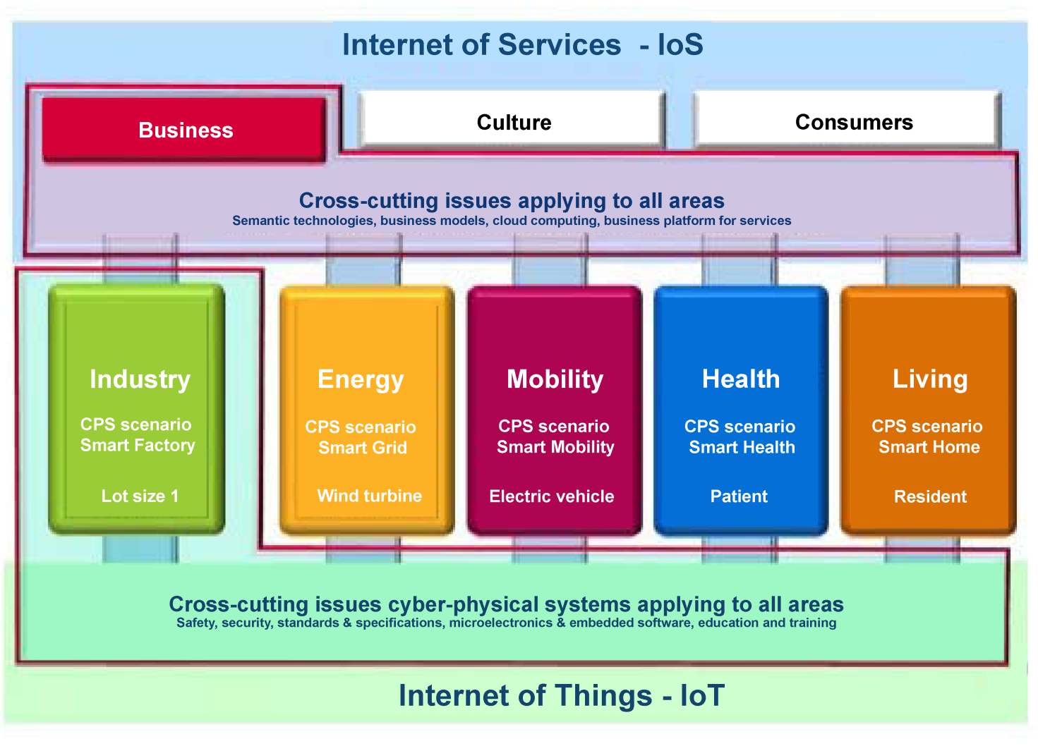
Digitalisation affects all areas of society

Slide 17



















The Internet of Things and Services (IoT)
Smart Home
Smart Building
Industrie 4.0
Health-care
Smart
Factory
Smart Meter
Smartphone
Smart Devices
Smart Mobility
Smart Grid
Graphics © Bosch Rexroth AG
© 2016 DKE Deutsche Kommission Elektrotechnik Elektronik Informationstechnik in DIN und VDE
18

Slide 18


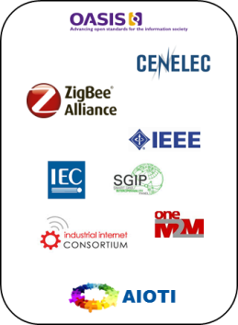
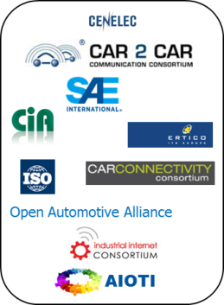

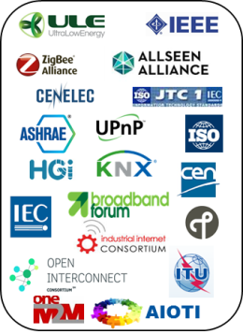
Digitalization of the Economy: The Standardization-Zoo
The Internet of Services
IoS: Internet of Services
Business
Culture
Consumer
Cross-sections that apply to all requirements
Semantic Topologies, Operational Models, Cloud Computing, Operator Platform for Services
Industrie 4.0
Energy
Mobility
Health
Living
Industrie
CPS-Szenario
Smart Factory
Energie
CPS-Szenario
Smart Grid
Mobilität
CPS-Szenario
Smart Mobility
Gesundheit
CPS-Szenario
Smart Health
Wohnen
CPS-Szenario
Smart Home
Wohnen
CPS Szenario
Smart Home
Losgröße 1
Das Windrad
Das E-Auto
Der Patient
Der Bewohner
Cross-sections Cyber Physical Systems that apply for all requirements
Security, Standards, Engineering, Microelectronics & Embedded Software, Training and Education
IoT: Internet of Things
The Internet OF Things
© 2016 DKE Deutsche Kommission Elektrotechnik Elektronik Informationstechnik in DIN und VDE
19

Slide 19


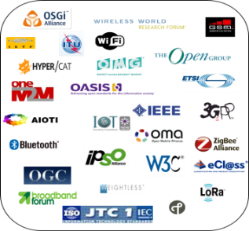

Standardization
Strategy
AG1
Standardization
Process-Support
Coordination
Recommendations
Support
Use Cases
Office DKE
Test
Advisory Board
Validation
Steering Committee
Expert Panel
Roadmap
DIN, DKE
Standardization
Implementation
Proposals
for
international Standards
CEN/CENELEC, ETSI
IEC, ISO
Int. standardization organizations
(with mandate)
de facto standard , open source
(consortial-consensus)
International standard
(full consensus)
© 2016 DKE Deutsche Kommission Elektrotechnik Elektronik Informationstechnik in DIN und VDE
20

Slide 20
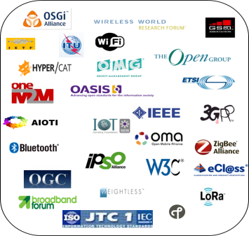


  Enhance the collaboration with international forums and consortia in order to realize interoperability in Industry 4.0
  Cooperation at international level is absolutely essential for opening up the way towards truly global standards and ensuring common understanding among all stakeholders
DKE,
DIN/NAM
Standardization
Implementation
Proposal for
int. Standards
ETSI
CEN/CENELEC
IEC, ISO
int. Standardization Organizations
(with mandate)
Consortial-Consens – de facto
Open source
int. standard (full consensus)
© 2016 DKE Deutsche Kommission Elektrotechnik Elektronik Informationstechnik in DIN und VDE
21

Slide 21
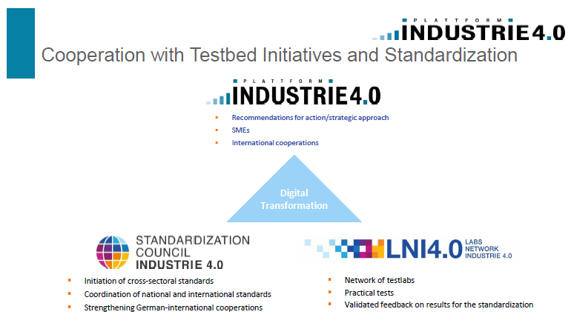
© 2016 DKE Deutsche Kommission Elektrotechnik Elektronik Informationstechnik in DIN und VDE
22

Slide 22
CEN & CENELEC IoT initiatives
Industry IoT Initiative
  Technology companies approached CEN and CENELEC to explore vertical sector needs for IoT that could be supported by standardization
  Technology companies are motivated to work in a standardization environment where the IP policy allows them to obtain a fair return on their investment in innovation
  CEN & CENELEC hosted a meeting in January of technology and manufacturing companies to discuss needs for smart manufacturing, smart energy and smart home
  Outcome: a first set of potential IoT topics identified to be further developed.
  This is a strategic opportunity for CEN and CENELEC to support industry sector stakeholders’ IoT application needs

Slide 23
CEN & CENELEC IoT initiatives
Alliance for Internet of Things Innovation (AIOTI)
  Alliance for the Internet of Things Innovation (AIOTI) created to support dynamic European IoT ecosystem
  AIOTI not a standardization body
  13 Working Groups (vertical and horizontal)
  CEN and CENELEC assessing need to partner with AIOTI, notably for vertical topics where CEN and CENELEC technical bodies are already established and are linking with international standardization (ISO and IEC).

Slide 24
CEN & CENELEC IoT initiatives
Machine-to-Machine technologies (M2M)
CEN and CENELEC joined oneM2M in 2016 as Partners Type 2
CEN & CENELEC:
    Contribute “ICT user” perspectives and needs of manufacturing, construction, transport, energy, healthcare sectors.
    improve visibility of ICT-specific developments at international level, including IoT Reference Architecture (IoT RA).
Adopting JTC1 standards:
CEN and CENELEC are adopting JTC1 standards related to IoT, big data, IT security and cloud.

Slide 25
THANK YOU!

