Slide 1
CEN activities related to services
ESOs – ANSI meeting
21&22 February 2017

Slide 2
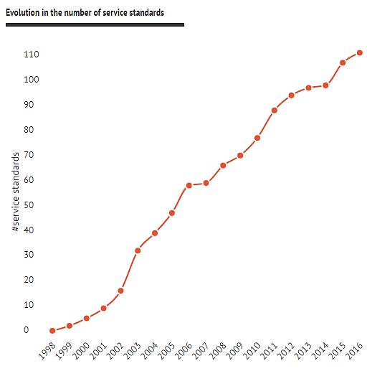
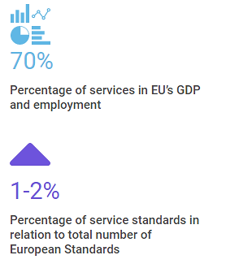
Context
Evolution in the number of service standards
Notes:
Services account for 70% of the economic activity and a similar proportion of total employment in Europe.
The number of European standards in the area of services has increased in recent years; nevertheless, their number is still small (between 1% and 2% of total number of standards) in comparison to the total number of European standards and the economic importance of the service sector in Europe.
There is a significant untapped potential from the development and use of European service standards. Within CEN, service standardization is a high priority topic and the importance of European service standardization is increasingly being recognised in the EU policy agenda.

Slide 3
Activities related to services
Strategic activities
Standards covering horizontal aspects
Sector specific standards
Service Standardization
Notes:
Regarding the CEN activities related to services, we can distinguish three types of activities:
1. At strategic level CEN is currently developing a strategy for standardization in the area of services. The group working on this strategy is the CEN/CA Strategic Advisory Group on Services. The strategy is also one of the actions included in the Joint Initiative (Action 12 – Encouraging the greater development and use of European service standards to help integrate Europe’s service markets).
2 &3. Regarding the standardization activities on the one hand we have a series of different technical committees that are developing sector specific service standards. These technical committees cover different sectors (Business to business and business to consumer services) that go from management consultancy or maintenance to tattooing services.
On the other hand in the last years CEN has also started to develop some horizontal standards, which cover subjects common to different service sectors. Currently CEN/TC 447 ‘Horizontal standards for the provision of services’ is working on the development of standards on terminology, procurement of services (covering both private and public procurement), service contracts (check list of issues that need to be included and possibly model clauses) and performance measurement under Mandate M/517 of the European Commission.
In the next slides I will give a bit more insights about these different activities.

Slide 4
CEN services strategy (JIS Action 12)
Main objectives:
Increase awareness
Define criteria to identify priority sectors
Better respond to the needs of the service stakeholders taking into account also the international dimension
Contents:
Trends affecting the service sector
Types of standards for services
Challenges in European service standardization
Criteria to identify priority sectors
Action Plan 2017-2018
Expected approval: March 2017
Notes:
At the end of 2015, the CEN Administrative Board acknowledged the strategic importance of services and decided to ask the CEN Strategic Advisory Group on Services (SAGS) to develop a strategy to address European standardization in the area of services. The strategy is being finalised and will be presented to the CEN CA for approval at the end of March 2017.
The aims of the strategy are:
• Increase awareness about service standardization and further engage with the different service sectors and other relevant stakeholders in order to better understand their needs and show them how they can benefit from European standardization in this area.
•Define the approach on how to identify priority sectors with potential to benefit from standardization (the approach is based on some criteria see below and should respond to the sector challenges)
•Reflect on how the European Standardization system can better respond to the needs of the different service sectors taking into account the global nature of some service sectors and the privileged relation with ISO to deliver international solutions when required.
The strategy covers the main trends that are affecting the service sector ( e.g. digitalisation, change in buyer behaviour, new business models, globalisation), explains and gives examples of different types of standards that can be developed in support of the service sectors and presents the main challenges for European service standardization. In addition the strategy specifies a series of criteria that will be used to define priority sectors that will afterwards be approached by CEN to discuss the possibilities for standardization. These criteria are around market relevance, market organization, standardization in the sector or public policy. The strategy also includes an Action plan for 2017 and 2018.
The strategy includes among others an action plan for 2017/2018.
The draft strategy was open for public comments until mid-November, we are now analysing those comments and the final strategy is expected to be published in March 2017.

Slide 5
Services strategy: Action plan
Strategic Objective | Timeframe
Engagement and dialogue with service stakeholders
Action 1 - Development of an awareness raising package | 2017
Action 2 - Provision of assistance to CEN members | 2018 and beyond
Action 3 - Aggregating market intelligence on emerging trends related to services | 2018 and beyond
Identify priority sectors to start dialogue on standardization
Action 4 – First pre-selection of service sectors | 2017
Action 5 – Application of the criteria to the list of pre-selected sectors | 2017
Action 6 – Contacting the priority sectors identified to have a discussion about the potential for standardization | 2018
Engagement with International Standards Bodies (ISO)
Action 7 - Coordinating actions with the ISO strategy for service standardization | continuous
Modernising the European Standardization system to meet the services sector needs
Action 8 – Assess the need to revise CEN Guide 15 ‘Guidance document for the development of service standards’ | 2018
Action 9 – Assess the need to revise the CEN-CENELEC Internal Regulations Part 2 ‘Common Rules for Standardization Work’ | 2018
Action 10 - Ensuring the service angle is taken on board on all relevant Joint Initiative on Standardisation (JIS) Actions | 2017-2018 and beyond
Notes:
Highlighted in red are the actions CEN will focus on in 2017. These two main actions for this year are:
- The development of an Awareness raising package. The aim is to develop materials containing targeted information for different types of service stakeholders. Some elements that could be included in this package are:
- Information on the potential benefits and limits of service standardization
- Information for newcomers on how standardization works and clarification on its financial model
- Information on the existing standards and the types of standards that can be developed in the area of services
- A centralised point gathering information on service standardization and information on European and national contacts
Case studies and examples of successful standardization using language tailored to the different types of stakeholders (societal stakeholders, businesses,…).
We are further refining the idea of what exactly should be the content of this package.
The identification of priority sectors to start a dialogue on standardization. In order to do this we will first of all do a pre-selection of service sectors to which the criteria identified in the strategy will be applied on the basis of:
a mapping of existing national service standards
work carried out by National Standards Bodies, e.g. the German Standardization Roadmap for Services , where some sectors having potential for standardization have already been identified
new trends affecting the service sector
mapping of service areas with higher detriment based on (cross border) consumer complaints data and the Consumer Markets Scoreboard (which is carried out by the European Commission)
Moreover we will further develop a methodology to apply the criteria included in the strategy with the aim to identify 5 or 6 priority sectors that should be contacted to see whether they are interested in European standardization. The idea is to have this list by the end of 2017 and start contacting those sectors in 2018.

Slide 6
Focus Group on healthcare services
Traditionally: medical devices, eHealth…
Recently: increasing initiatives related to healthcare services
… But concerns expressed by some stakeholders about standardization on healthcare services
Focus Group created in June 2016
Objective: discuss with stakeholders & make proposals for overall approach for standardization on healthcare services
First set of recommendation by mid-2017
Notes:
CEN has also created recently a Focus group on healthcare services. A focus group is a short-term group created to ensure the interaction between all relevant European stakeholders interested in potential standardization in a new field or subject.
In recent years, there has been an increasing level of demand from stakeholders in relation to the standardization of healthcare services. The increasing mobility of patients and health professionals and the ageing of our societies means that there is an increasing need for efficiency of healthcare services, ensuring quality of care, transparency about the services offered and for ensuring patient safety and the mutual recognition of qualifications.
At the same time, some stakeholders have raised concerns regarding the development of standards in the area of healthcare services and the subject is controversial. The concerns expressed had to do with the relation between clinical guidelines and standards (even though the intention is not to cover clinical aspects in standards) or the fact that standards are consensus based vs. evidence based medicine.
This is the reason why in 2014 CEN started a reflection on a common strategy on how to approach European standardization on healthcare services. As a follow-up of this Ad-hoc group CEN has created a Focus Group on Healthcare Services in June 2016. The Focus group will further elaborate on a strategy and provide a first set of recommendations by mid-2017. The first meeting of the group took place in November 2016. In the meeting it was decided to start work by agreeing on definitions and trying to identify criteria for new proposals in the area of healthcare services.

Slide 7
Horizontal service standards
Mandate M/517 on horizontal service standards:
Phase I: identification and prioritization of 6-7 proposals (Final report to EC submitted in March 2014)
Phase II: Development of horizontal service standards
CEN/TC 447 ‘Horizontal standards for the provision of services’ created in 2016
CEN/TC 447 work programme/priorities:
Terminology
Performance measurement
Service contracts (possibly including model clauses)
Service procurement (focus on first steps of procurement process)
Notes:
Horizontal or generic service standards are standards covering issues common to many service sectors.
In February 2016, the CEN Technical Board agreed to the creation of CEN/TC 447 ‘Horizontal standards for the provision of services’ to develop horizontal service standards under Mandate M/517.
The Mandate was structured in two phases. The main objective of Phase 1 was to identify a preliminary work programme including six or seven proposals for horizontal service standards in support of the Single Market for services, and their prioritization. Phase 2 of the Mandate consists in the development of the proposed standards.
The new technical committee will as a priority develop standards on services terminology, performance management, service contracts (check list of issues to be taken into account and possibly also model clauses) and service procurement (focus for the moment on how the procurer needs to define its needs and the characteristics of the provider that could deliver the service required. The focus is private procurement although the standards could apply to both public and private procurement).

Slide 8
Sector specific standards - Active Technical Committees
CEN/TC 319 - Maintenance
CEN/TC 320 - Transport – Logistics and services
CEN/TC 329 - Tourism services
CEN/TC 331 - Postal services
CEN/TC 348 - Facility management
CEN/TC 381 - Management Consultancy Services
CEN/TC 403 - Aesthetic Surgery and aesthetic non-surgical medical Services
CEN/TC 409 - Beauty salon services
CEN/TC 419 - Forensic science services
CEN/TC 427 - Services of Medical Doctors with additional qualification in Homeopathy
CEN/TC 431 - Service chain for Social Care Alarms
CEN/TC 432 - Competency for Customs representatives
CEN/TC 435 - Tattooing services
CEN/TC 439 - Private security services
CEN/TC 445 - Data information interchange in the Insurance Industry
CEN/TC 447- Horizontal standards for the provision of services
CEN/TC 448- Funeral services
CEN/TC 449- Quality of care for older people
CEN/TC 450- Patient involvement in person-centred care
CEN/TC 452 - Assistance Dog & Guide Dog Instructors Competences
CEN/CENELEC TC 4 - Services for fire safety and security systems
Notes:
Regarding sector specific standards, CEN is developing or has developed standards in relation to Business2Business and Business2Consumer services. Service standards cover a variety of issues such as terminology, key performance indicators, qualification of personnel, minimum requirements or recommendations regarding the delivery of the service (information to consumers, handling complaints), etc.
In this slide you can find a list with all the active committees in relation to services.
In addition to the active technical committees there are also other existing standards developed in the past and where no technical committee is active at the moment, e.g. customer contact centres, translation services, services of chiropractors, services of osteopaths, tanning services….

Slide 9
Many thanks for your attention!
www.cencenelec.eu www.cen.eu - www.cenelec.eu

