Slide 1
ANSI-ESO Q&A Documents: Status and Values John Kulick

Slide 2
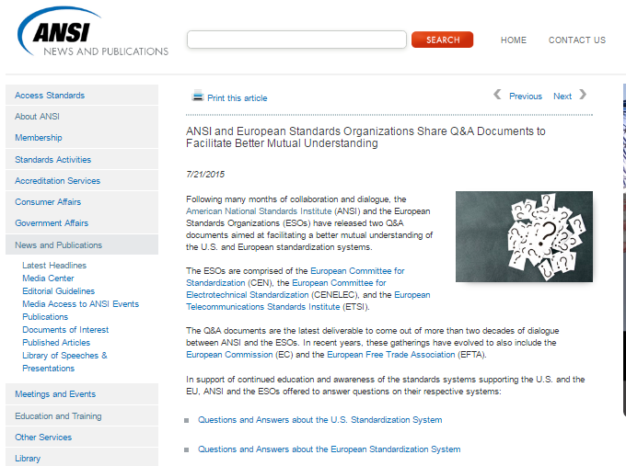
Location on ANSI Web Page
Since July 2015:
669 page views
and
526 unique views
Notes:
These figures do not include users accessing the site through an ANSI domain, essentially the metrics weed out all ANSI access of this page.

Slide 3
Potential Next Steps
An article to highlight the value of the Q&A documents, servicing to remind users that the documents are available
Are new questions needed to address new concerns?
Consider new questions once per quarter
Creation of a central link for users with additional questions

Slide 4
intl@ansi.org
www.standardsportal.org

