Slide 1
Standards & Regulations
Measuring the Link to Goods Trade
Jeff Okun-Kozlowicki
International Trade Administration (ITA)
Office of Standards and Investment Policy (OSIP)
http://www.trade.gov/td/osip/

Slide 2
Standards and Technical Regulations
Why are they important?
Set the rules on entering the market
Can lead to increased costs for exporters
Tough to measure impact
Trade agreement disciplines can be limited

Slide 3
Outline
WTO TBT Agreement
Assumptions
  Data Source: WTO Member notifications
Findings
  Size of the link
  Leading economies
  Leading industries
Robustness test: UNCTAD NTMs
Why does it matter?
What is ITA doing about it?

Slide 4
WTO TBT Agreement
Seeks to ensure regulations, testing procedures, and certification procedures do not create unnecessary obstacles to trade
Obligates members to notify pending technical regulations that
  “may have significant effect on trade”
  not “in accordance with relevant international standards”

Slide 5
WTO TBT Agreement - Notifications
Notifications are NOT necessarily TBTs
Only cover new measures
Measures may or may not be in force
Many contain information on products affected

Slide 6
Assumptions
WTO notifications
  underrepresent the stock of regulations with trade impact
  are a good proxy for the overall global regulatory environment
KEY ASSUMPTION: A notification by one economy for a particular product can be linked to all global exports and U.S. exports.

Slide 7
Data Source: WTO Member Notifications
WTO notifications from
January 1, 2006 to August 18, 2015
Commodity classification information at Harmonized System 4-digit or 6-digit level

Slide 8
Findings: Goods Exports Covered by WTO Notifications
92.9%
91.7%
of world exports
(2014)
of U.S. exports
(2015)
Calculations based on WTO notifications from January 1, 2006 to August 18, 2015 by all WTO members
(Source: WTO notifications from WTO I-TIP database; 2015 U.S. export data from U.S. Department of Commerce; and 2014 global exports data from UN Comtrade.)

Slide 9
Findings: Leading Economies
Economy | Number of Notifications
European Union* | 1,198
China# | 949
Saudi Arabia | 857
United States | 856
Israel | 694
Uganda | 502
South Korea | 498
Brazil | 445
Kenya | 423
Qatar | 390
All others | 6,028
Total | 12,840
…with Product Information
24%
77%
57%
93%
94%
90%
12%
57%
91%
68%
53%
59%
…with “In Force” Information
20%
9%
2%
36%
7%
0%
12%
14%
8%
1%
18%
13%
Calculations based on WTO notifications from January 1, 2006 to August 18, 2015 by all WTO members.
* includes notifications made by the EU and its member states.
# excludes Hong Kong and Macao, which made a combined 25 notifications.
(Source: WTO notifications from WTO I-TIP database)

Slide 10
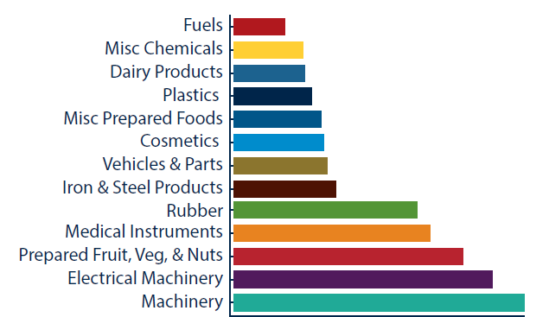
Top Commodities by Number of Notifications
Note: Based on entries created from notifications by all WTO members except the United States from January 1, 2006 to August 18, 2015. Only entries with an HS-4 or an HS-6 code were used. One measure may have multiple entries under the same HS classification.
(Source: WTO notifications from WTO I-TIP database.)

Slide 11
Finding: Notifications in Each 4-digit Category
Textiles and Shoes
  Furniture/bedding
  Apparel, fabrics, fibers, filaments
  Footwear
Foods and agricultural products
  Meat, prepared meat/fish
  Coffee/tea, sugar, vegetables, fruits
  Milling products and cereals
Other chemical products
  Explosives
  Fertilizers

Slide 12
Robustness Test: UNCTAD TBT NTMs
Classified by UNCTAD experts
Based on official government documents
Only available for selected economies
  Focus: European Union (2014)

Slide 13
Robustness Test: Goods Exports Covered by UNCAT TBT NTMs
94.4%
91.8%
of EU imports
(6-digit level)
of EU imports
(8-digit level)
Assumptions about WTO Notifications seem reasonable
(Source: EU TBT NTM Data from World Bank WITS; 2015 U.S. export data from U.S. Department of Commerce; 2014 HS-6 EU import data from UN Comtrade; and 2014 CN-8 EU import data from Eurostat.)

Slide 14
Recap
Assumptions
    WTO notifications are a good proxy for the overall global regulatory environment
    One economy’s notification can be linked to all exports
Findings
  Size of the link: 92 to 93 percent
  Leading countries: EU, China, Saudi, U.S.
  Leading industries: Machinery, food, vehicles, cosmetics, fuel, textiles, etc.
Robustness test: UNCTAD NTMs
  Size of the link: 92 to 94 percent
  Our assumptions seem reasonable

Slide 15
Why does it matter?
Standards and Technical Regulations are Important!
Technical regulations are pervasive
Differing regulations can create challenges for exporters
Need further studies on impact of divergent approaches

Slide 16
ITA Messaging and Data Analysis
Goal: make the case for devoting more resources and attention to standards
Partnership with Stakeholders
Messaging Documents
Data Analysis and Visualization

Slide 17
Standards & Regulations
Measuring the Link to Goods Trade
Jeff Okun-Kozlowicki
Jeff.Okun-Kozlowicki@trade.gov
International Trade Administration (ITA)
Office of Standards and Investment Policy (OSIP)
http://www.trade.gov/td/osip/

