Slide 1
NWIPs from Korea
Including NWIP for OLED semi-integrated
module safety standard (IEC TC34)
KATS

Slide 2
1. Standardization bodies related to lighting
International Standard
IEC : International
Electrotechnical
Commission TC 34
ISO : International
Organization for
Standardization TC 274
CIE : Commission
Internationale
de l´Eclairage
National Standard
EU
De Facto Standard
(Company Association)
KR
USA
JP
CN
E U
The Connected Lighting Alliance
Agency
KATS
ANSI (NEMA)
METI
SAC
CEN / CENELEC
Engine
Wireless con.
- Indoor 用
Wireless con.
- Outdoor 用

Slide 3
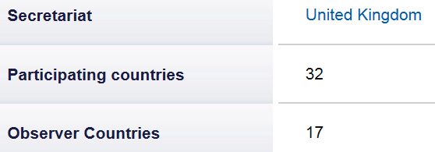
2. IEC TC34 & SC 34A Structure
IEC TC 34 : Lamps and Related Equipment
- Chair: Mr Andreas Scholtz (DE)
SC 34A : Lamp(Light Sources)
- Chair: Mr Alan Prest (NL)
Automotive light sources
OLED light sources
LED light sources
PRESCO : Conventional
WG2
SC 34B : Caps and Holders
- Chair: Mr. Kenji Sugiyama (JP)
WG3
SC 34C : Auxiliaries for Lamp
- Chair: Mr Norbert Wittig (DE)
SC 34D : Luminaires
- Chair: Mr. Andy Hughes (GB)
WG4
AG4 : Lighting Systems
- Chair: Mr. M. Duffy (US)
WG

Slide 4
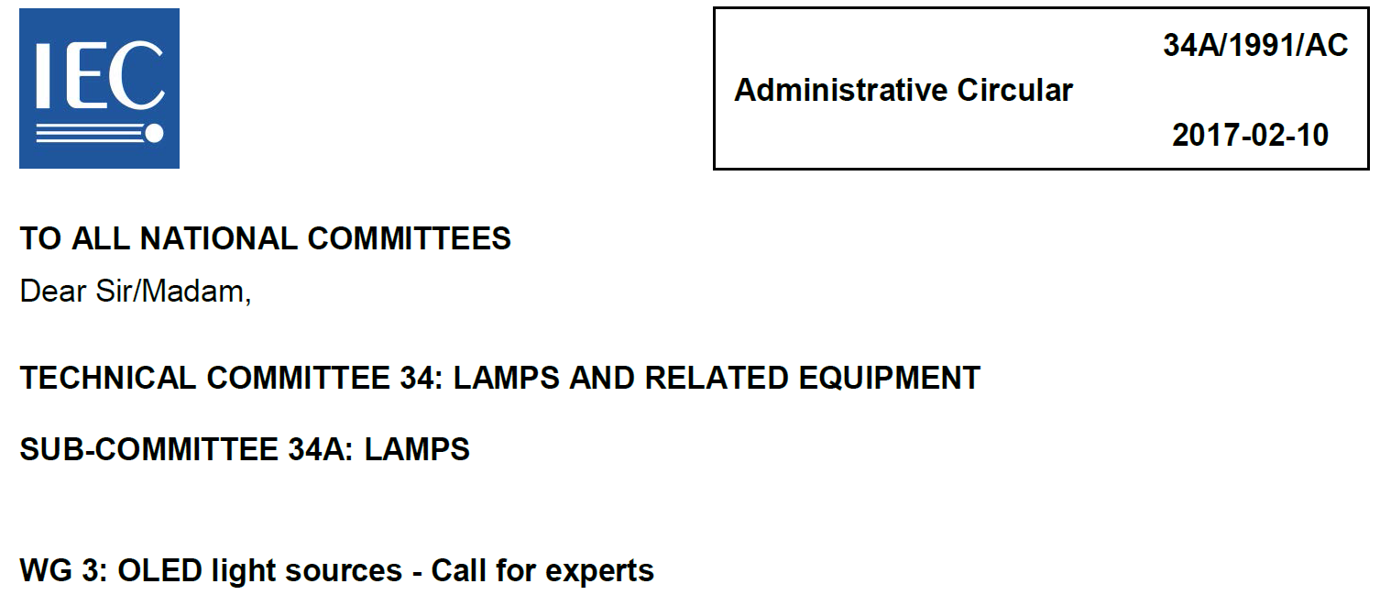
3. IEC TC34 SC34A WG 3 (OLED light sources)
□ WG 3 OLED light sources
- To prepare proposals for maintenance of standards relating to OLED light sources
and preparing new standards for OLED light sources. (34A/1965/Q, 34A/1985/RQ)
- See documents 34A/1965/Q and 34A/1985/RQ.
□ WG 3 OLED convenor & members (now on calling for experts)

Slide 5
4. IEC TC34 SC34A WG 3 standards
□ WG 3 OLED standards
Number | Title | Status
IEC 62868 | OLED panels for general lighting – safety requirements | Edition 1.0 (2014-09-25)
IEC62922 | OLED panels for general lighting – performance requirements | Edition 1.0 (2016-11-18)
IEC/TS 62972 | OLED products and related equipment – Terms and definitions | Edition 1.0 (2016-07-21)
IEC 62868-2-1 | OLED light source safety – Part 2-1: Particular requirements for semi-integrated OLED modules | NP Circulation (proposed by KR NC)
IEC 62868 2-2 | OLED light source safety – Part 2-2: Particular requirements for integrated OLED modules | NP Circulation (proposed by JP NC)

Slide 6
5. 34A/1999/NP : IEC 62868-2-1
□ 34A/1999/NP

Slide 7
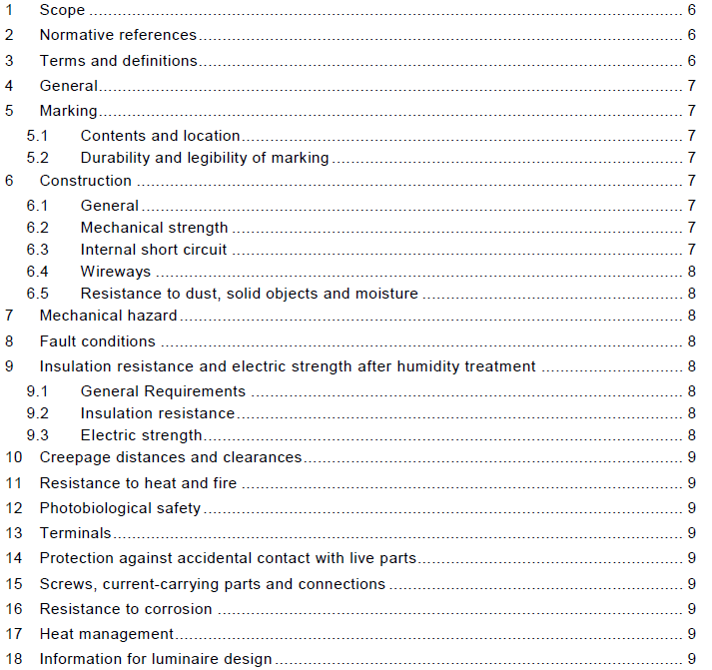
6. 34A/1999/NP : IEC 62868-2-1
□ Contents of 34A/1999/NP

Slide 8
7. 34A/1999/NP : IEC 62868-2-1
□ History of 34A/1999/NP
- During the OLED project team meeting held in Numazu (June 6-7, 2016),
OLED PT discussed about “34A/1907/DC Semi-integrated organic light
emitting diode (OLED) modules for general lighting – Safety requirements”.
- And during the OLED project team meeting held in Delft (January 26-27,
2017), it was agreed to circulate NP about safety requirements of semi-
integrated OLED modules as a particular requirements of IEC 62868.
- This NP document was circulated in OLED WG before submitting to IEC CO.
- Most part and contents of this document are based on 34A/1907/DC and
some parts are revised according to the 34A/1917A/INF.
- The 34A/1962/Q was circulated in 34A including to progress this NP and
got positive results as 34A/1984/RQ.
□ PURPOSE AND JUSTIFICATION : See 34/378/Q for IEC TC 34 SBP
- There is a strong market request (need) for solid-state lighting solution for
LED and OLED lighting.
- One main activity of TC 34 is to keep pace with the market demand for new LED
and OLED standards and publications supporting this transitional marketplace.

Slide 9
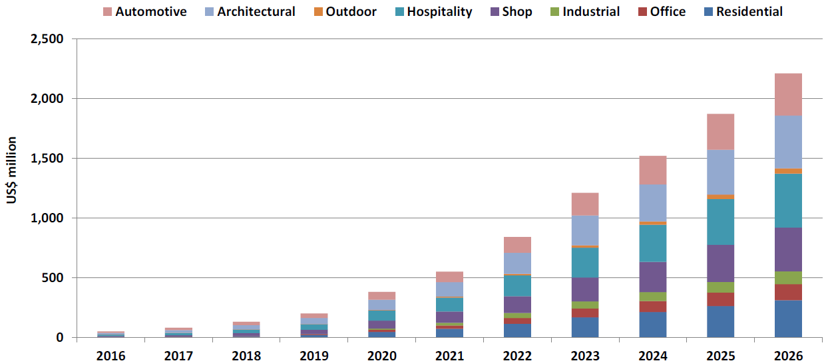
8. Why OLED lighting ?
□ OLED lighting
- Surface Emission, Cold emission, Colour comfort and Flexibility (vs. LED)
$2.2 billion in 2026
CAGR of 52%
[source: IDTechExOLED Lighting Opportunities 2016-2026:, 2016]

Slide 10
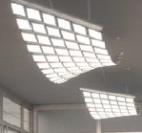
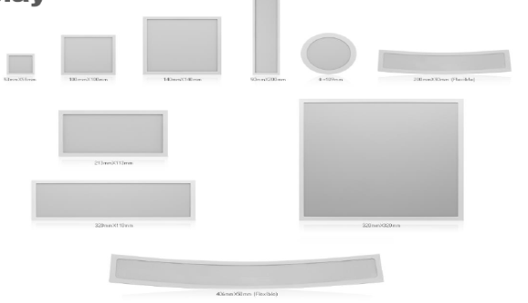
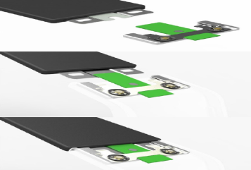
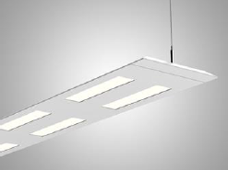
9. Why OLED lighting ?
□ OLED lighting Chain : You can buy OLED lighting at markets now.
□ OLED lighting : Show enough efficacy [lm/W] within years.
[Panels] [Modules] [Luminaires]
[source: OLED companies]

Slide 11
More NWIPs from KOREA (1)
NWIP(IEC/TC 47E(Discrete semiconductor devices))
* Title: Test method of optoelectronic efficiencies of light emitting diodes
NWIP(IEC/TC 47E(Discrete semiconductor devices))
Title: Test method of the internal quantum efficiency based on the temperature-dependent electroluminescence
NWIP(IEC/TC 47E(Discrete semiconductor devices))
Title: Test method of the internal quantum efficiency based on the room-temperature reference point
NWIP(IEC/TC 47(Semiconductor devices))
Title: Semiconductor devices - Semiconductor devices for energy harvesting and generation - Part 6-Vertical contact mode triboelectric energy harvesting
NWIP(IEC/TC 119(Printed electronics))
Title: Printed electronics – Part 202-5 : Materials - Conductive film – Environment reliability test of a printed metal based conductive layer on flexible substrate
NWIP(IEC/TC 119(Printed electronics))
Title: Printed Electronics - Part 50X : Quality Assessment - Flexible gas sensor: Mechanical and Thermal testing

Slide 12
More NWIPs from KOREA (2)
NWIP (ISO/TC85 SC2 (Radiological protection))
Title : Measurements for the clearance of waste contaminated with radioisotopes for medical application —Part 2: Measurement of dose rate
NWIP (ISO/TC85 SC2 (Radiological protection))
Title : Measurement and prediction of the ambient dose equivalent rate from patients receiving iodine 131 administration after thyroid ablation —Part 2: After release from the hospital
NWIP(ISO/TC 122(Package))
Title: Transport Packaging - Cleaning and sanitation methods of reusable transport Items for distribution purpose
New Application (6 Graphical symbols)
*Title: ISO/TC 145(Graphical symbols-Public information symbol, Safety symbol)
NWIP (IEC/TC 82 WG 3 (PV system))
* Title : Monitoring parameter analysis on PV modules mechanical stability .

