Slide 1
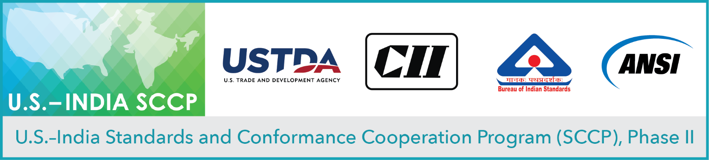
Virtual Workshop on Clean Energy: Advancing Growth of Photovoltaic Development in India
Session 3
Investments in Utility and Distributed Generation PV Projects in India: Challenges and Opportunities
October 6, 2020

Slide 2
Opening Remarks
United States Trade and Development Agency (USTDA)
Tanvi Madhusudanan, Country Manager, Indo-Pacific
U.S. Department of Commerce (DoC)
Aileen Nandi, Senior Commercial Officer, India
Bureau of Indian Standards (BIS)
Jayanta Roy Chowdhury, Deputy Director General— Standardization (Products and Methods)

Slide 3

 | Challenges & Opportunities in Indian Solar Projects
Dinesh Kumar, PhD (Physics)
SB Energy Pvt Ltd (Soft Bank Group)
New Delhi, India

Slide 4
Agenda
Indian PV Market – Size & Growth
Tariff Trend
Challenges
Opportunities

Slide 5
SB Energy Pvt Ltd
Renewable Projects in India and USA
1.4GWp Operational Projects in India
USA – Texas & California (1.7GWp Cumulative)
India: 3GWp under construction
Leading innovation promoter @ utility scale projects with 3MWp innovation Centre
Indian Projects: robot based automated module cleaning
Focus – Hybrid Projects, Renewable Energy Projects with Energy Storage

Slide 6
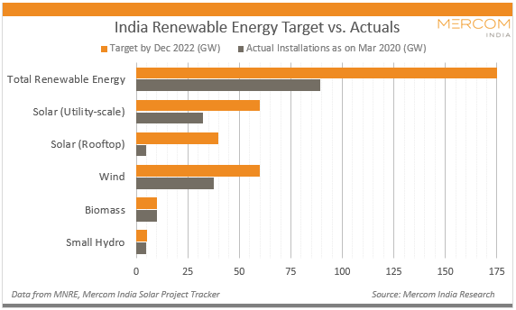
Indian PV Market- Size & Growth
India: Renewable Energy Target – 175GWp by 2022
Solar Projects trailing behind targets
Source: MNRE / MERCOM India/ Public Web Resources

Slide 7
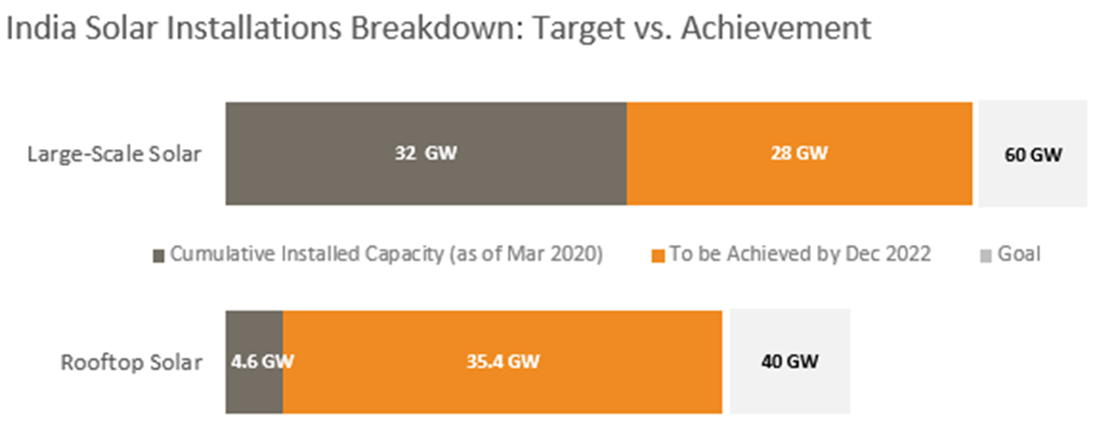
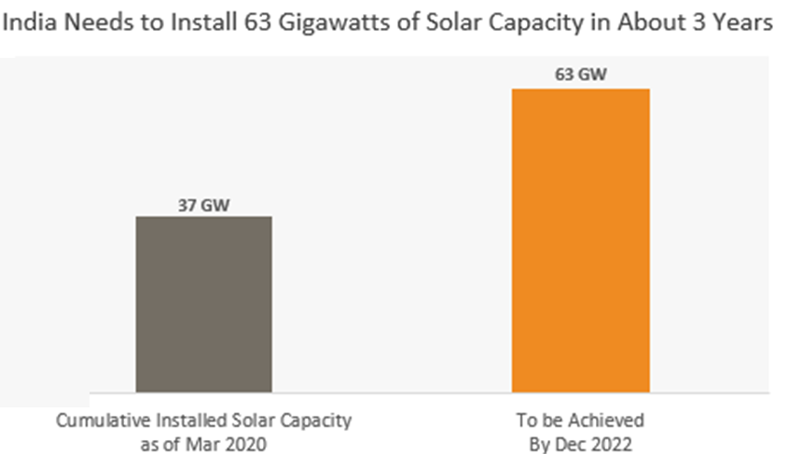
Indian PV Market- Size & Growth
Solar Projects are trailing behind targets
Roof Top Projects are primarily driven by C&I Segment followed by Govt. Captive Consumption Requirements
2022 target for utility scale projects seems to be difficult to achieve.
Still 63 GWp need to be installed
Source: MNRE / MERCOM India/ Public Web Resources

Slide 8
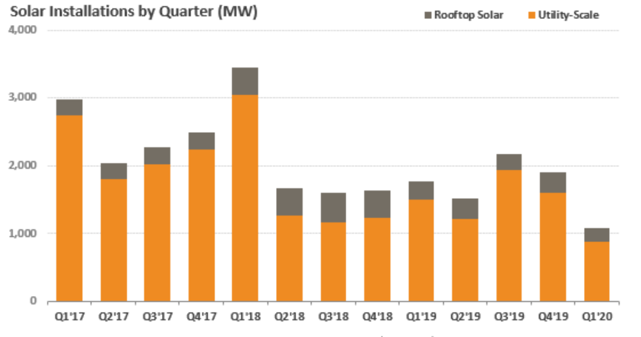
Indian PV Market- Size & Growth
Quarterly installations does not indicate or provide trend to achieve the targets
Source: MNRE / MERCOM India/ Public Web Resources

Slide 9
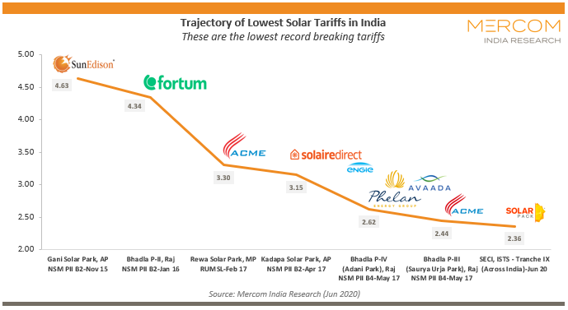
Indian PV Market- Tariff Trend
India known for aggressive tariffs and driver of cost reduction
3.14 $cent/kWh

Slide 10
Indian PV Market- Conclusion
Trailing behind targets
Will result in many – may GWp for bidding
Low Cost – Grid Parity / Fossil Fuel based energy generation
Indicates – opportunities for Solar PV sector in near future

Slide 11
If we are going to see many-many GWp for bidding & Prices are attractive –
Then what are the challenges ?

Slide 12
Challenges for Indian Solar Developers
Bid Price & Project Viability –
Land (Location)
Power Evacuation Infra
Project Timelines
Project Cost including Module Cost & Technology
Land Aggregation
Operational Challenges & Cost
Project Life (Reliability, Durability)
Annual Energy Yield, Module Performance, Reliability & Degradation

Slide 13
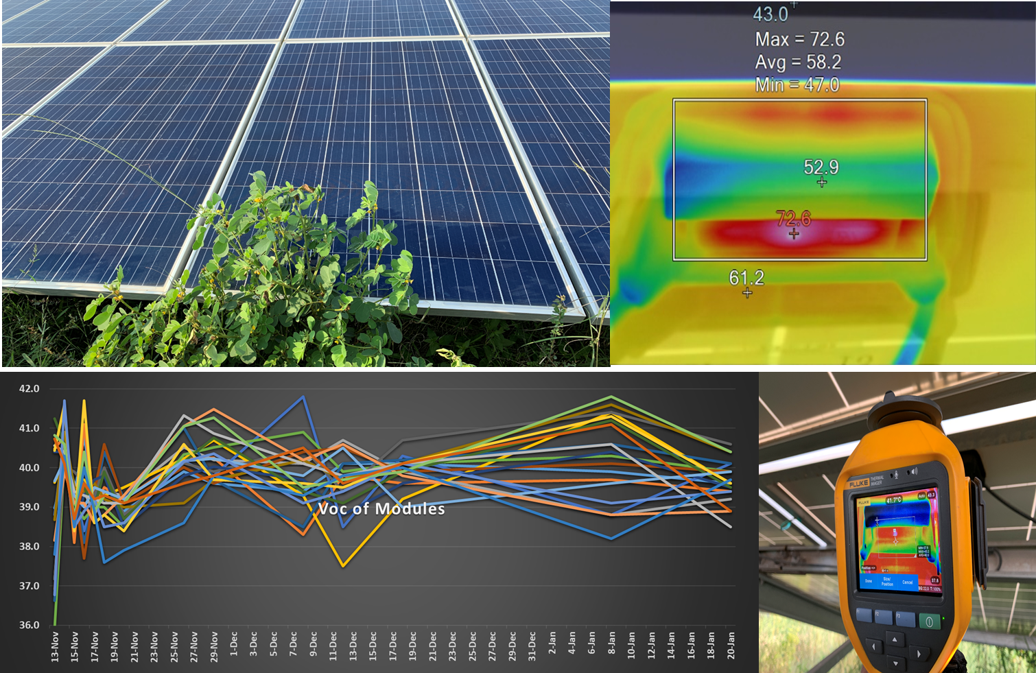
Indian PV Market- Challenges (Operational Issues)
Poor Asset Management Practices – affecting Reliability of System Components

Slide 14
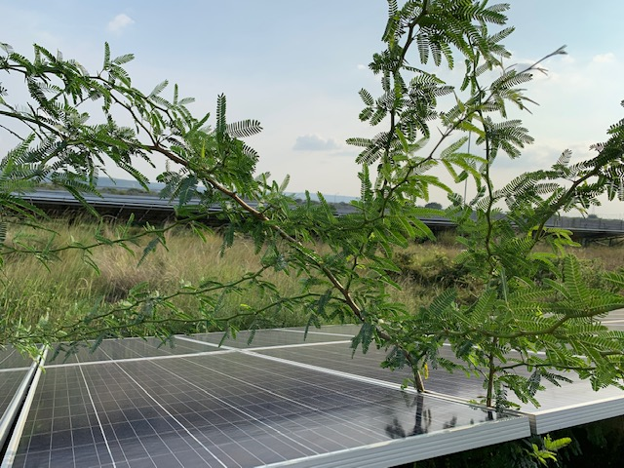
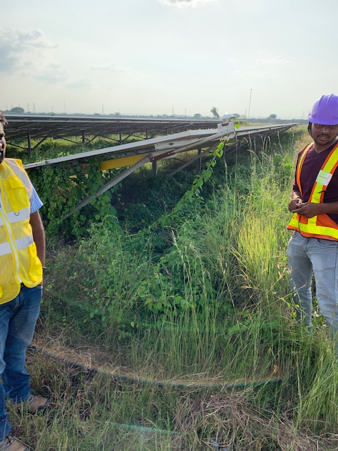
Indian PV Market- Challenges
Proper asset management leads to rise in operation cost of project

Slide 15
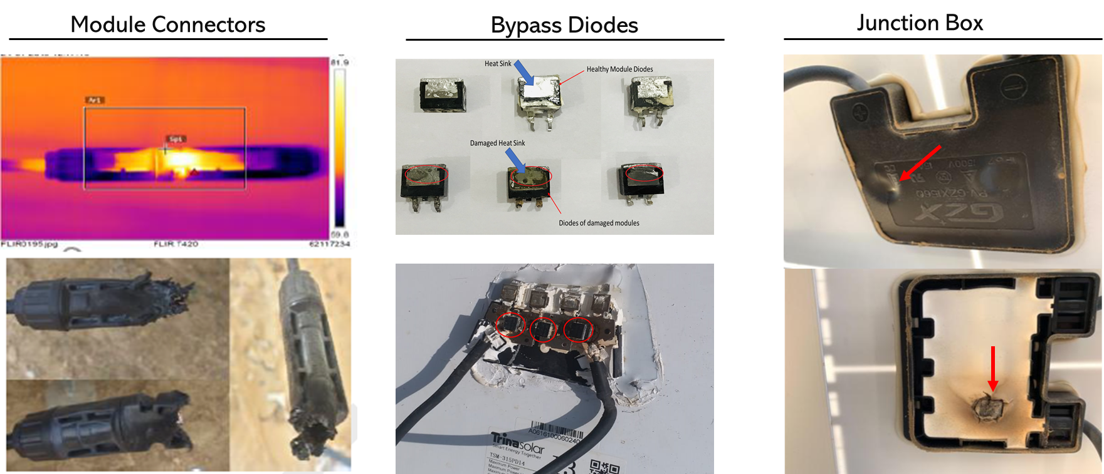
Indian PV Market- Challenges (Reliability)
Frequent Module Issues & Failures leading to Energy Loss
Cost Pressure – Quality Compromise in Indian Projects

Slide 16
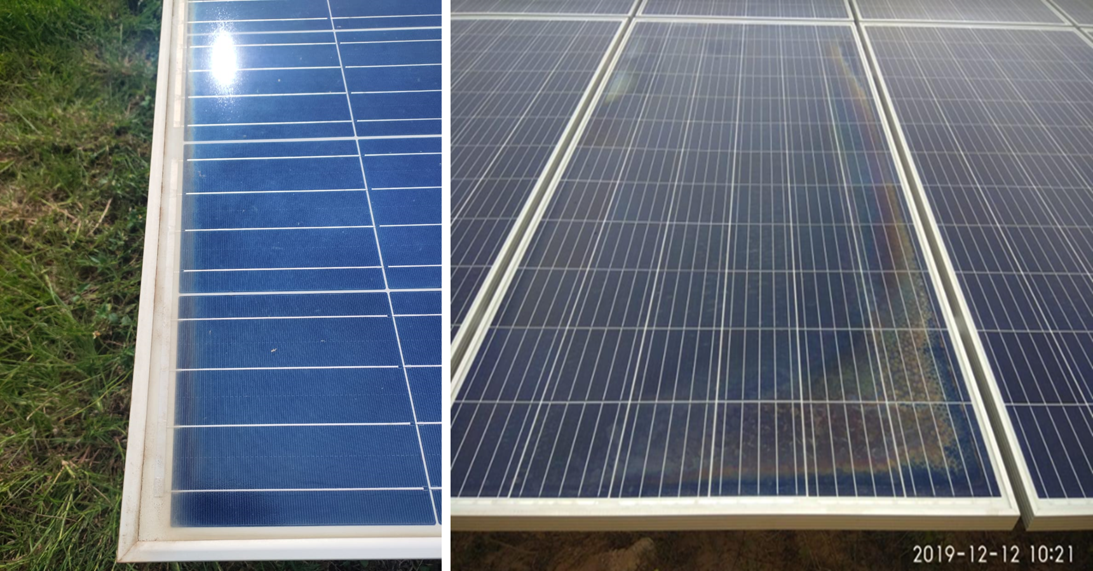
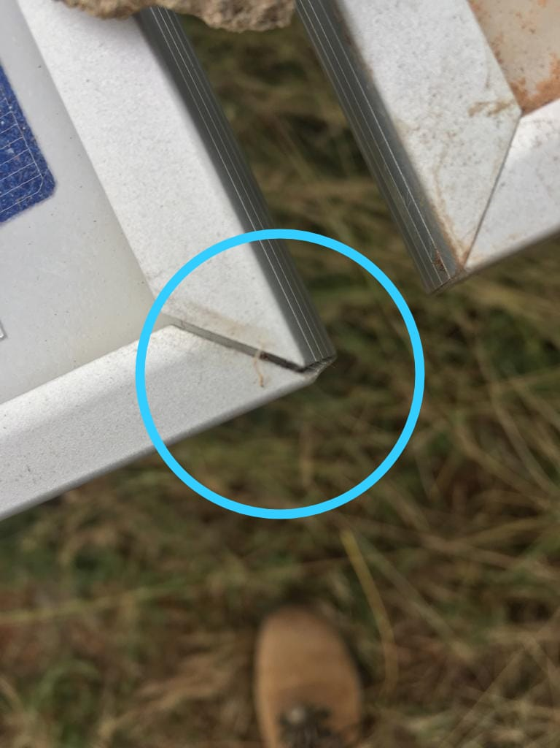
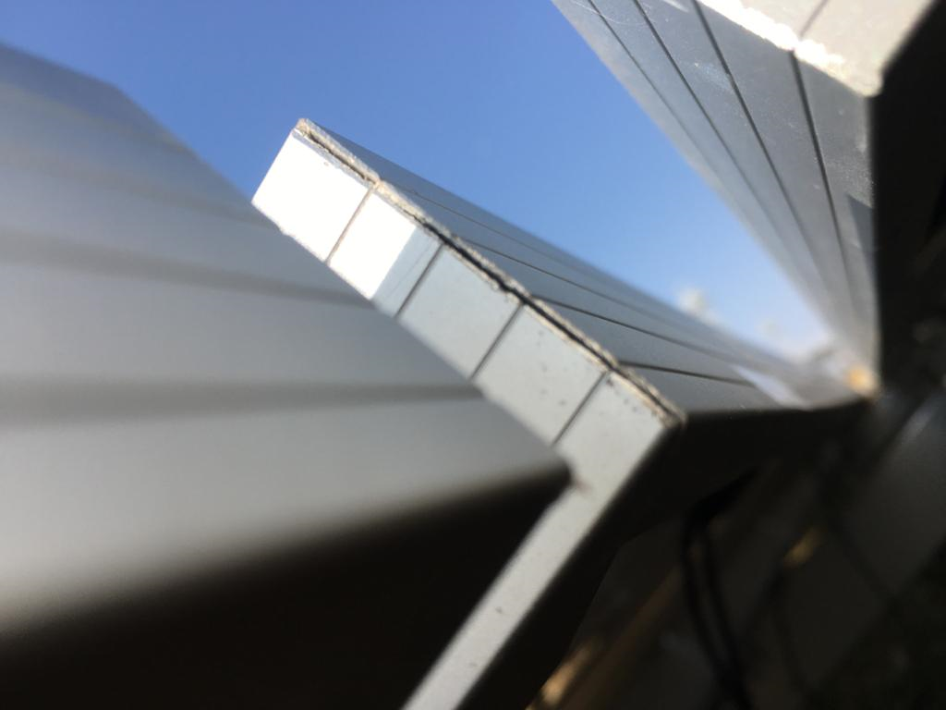
Indian PV Market- Challenges (Reliability)
Low Project Cost – Challenges in Module Quality / BOM Quality

Slide 17
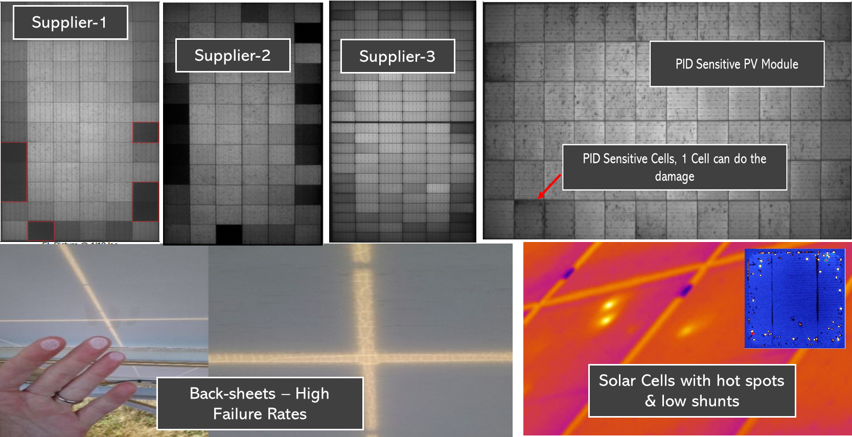
Indian PV Market- Challenges (Reliability)
Low Project Cost – Challenges in Module Quality / BOM Quality

Slide 18

Indian PV Market- Challenges
Construction Quality

Slide 19
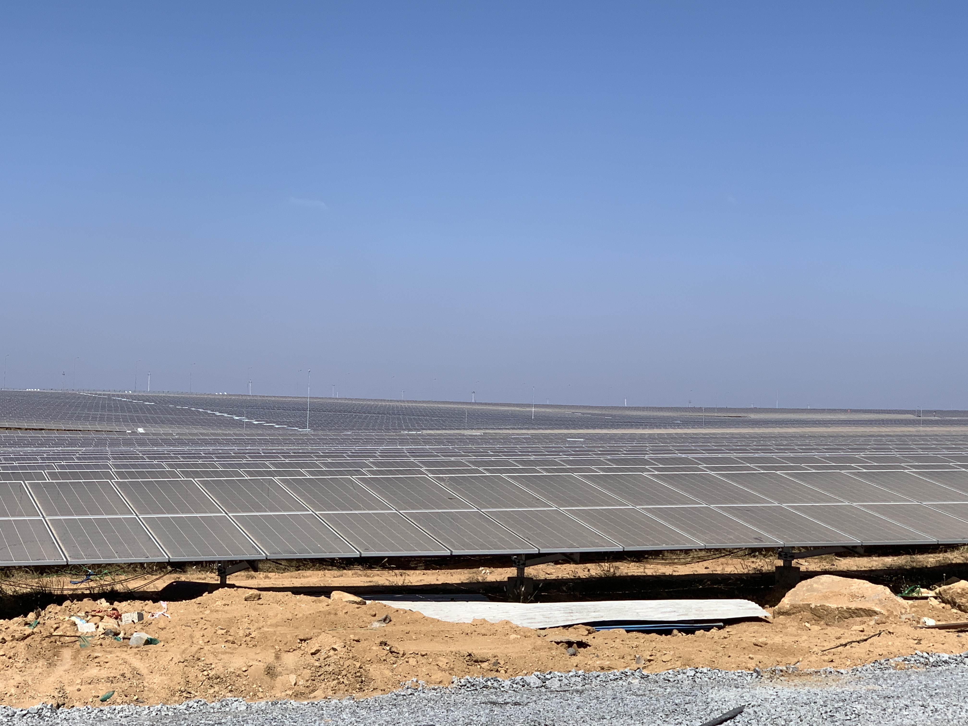
Indian PV Market- Challenges (Operational)
Module Cleaning
Water Quality & Availability
Quality of Cleaning / method etc

Slide 20
Indian PV Market- Opportunities for Developers
Matured, Stable & Consistent Market – Long Term
Geography most suitable for Solar Projects, Availability of Land
Regulatory Norms & Guidelines – lessons learnt
Low Cost Structure – is perfect for Energy Storage Projects and early viability of the same
Automation: Module Cleaning , Asset management , Drone Survey/thermography
Asset management – onsite testing and data analysis (Mobile Test Labs)
Advance data analytics / Machine Learning
Short Term: Hybrid Projects
Mid Terms: Energy Storage

Slide 21
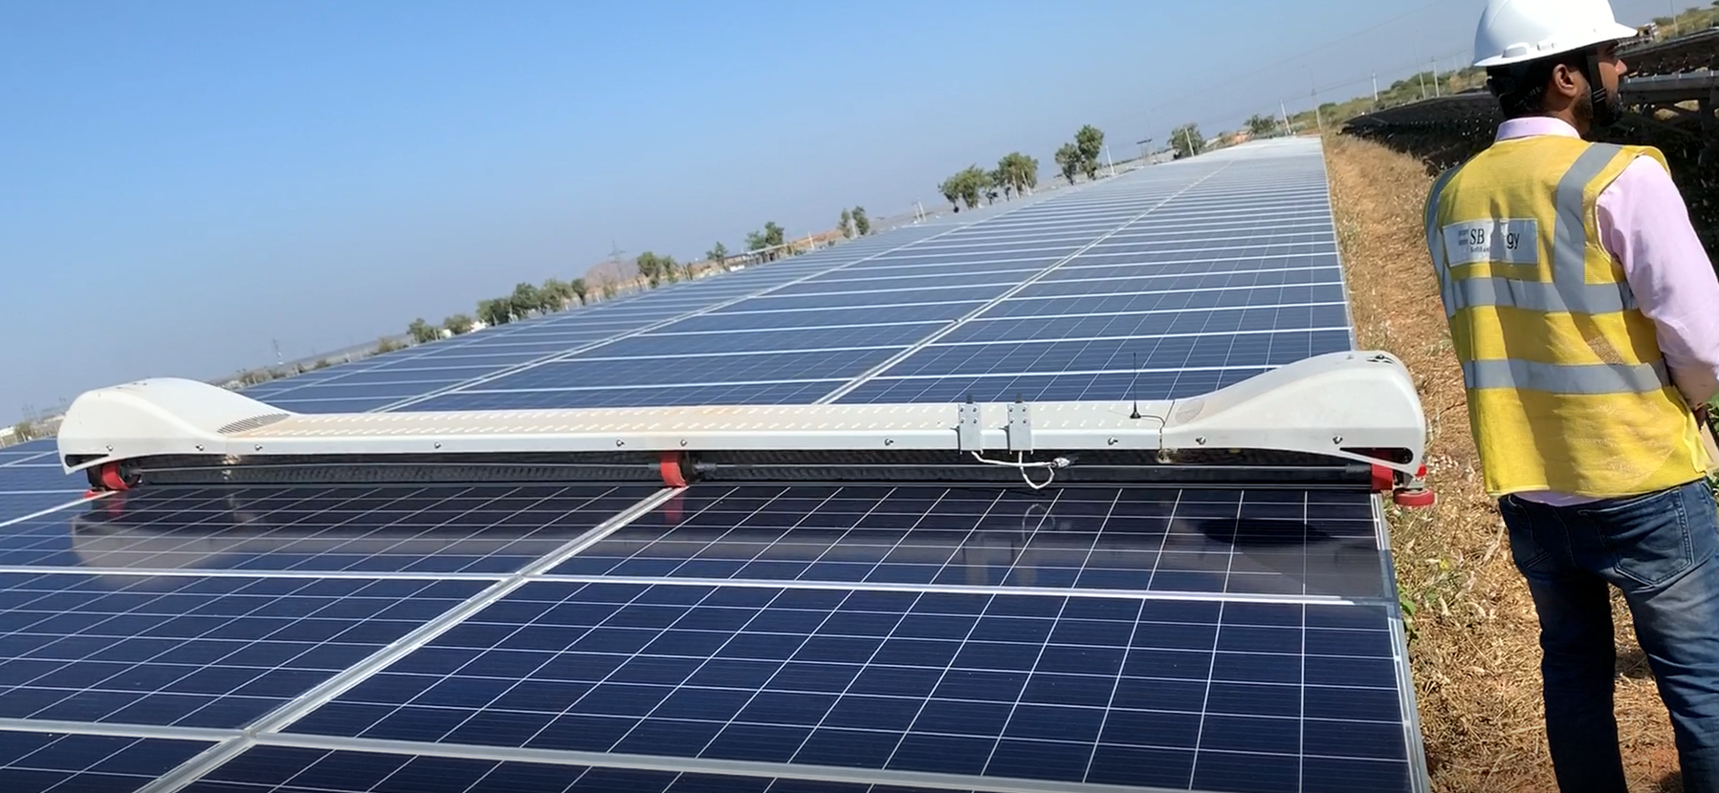
SB Energy- Leading in use of innovative means for O&M

Slide 22
Conclusions
India Trailing in committed renewable targets especially Solar PV
Coming years will see many projects available for bidding
Challenges for developers – cost, timelines, quality ( construction & components) & asset managements
Opportunities for adopting energy storage, long terms projects pipelines, innovative means for O&M
Dedication & Commitment turns challenges in opportunity – true for Indian Solar Projects

Slide 23
Innovation and Optimization in Design Engineering and Installation
Create Sustainable and Efficient Green Energy
To be the leading provider of intelligent energy solutions
Prasanta Kumar Patra
Notes:
23

Slide 24





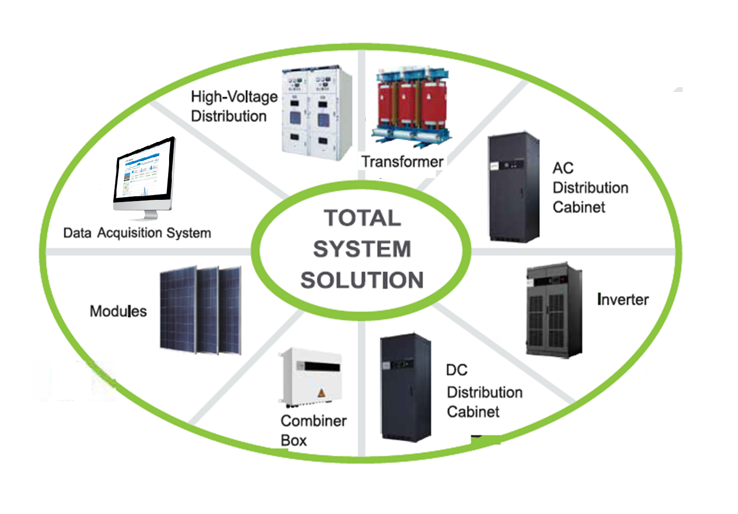
Overview
Founded in :2006
Capacity :5GW
Employees :4000+

Slide 25

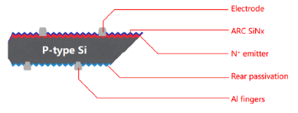

Current Mass Production
PERC +

Slide 26

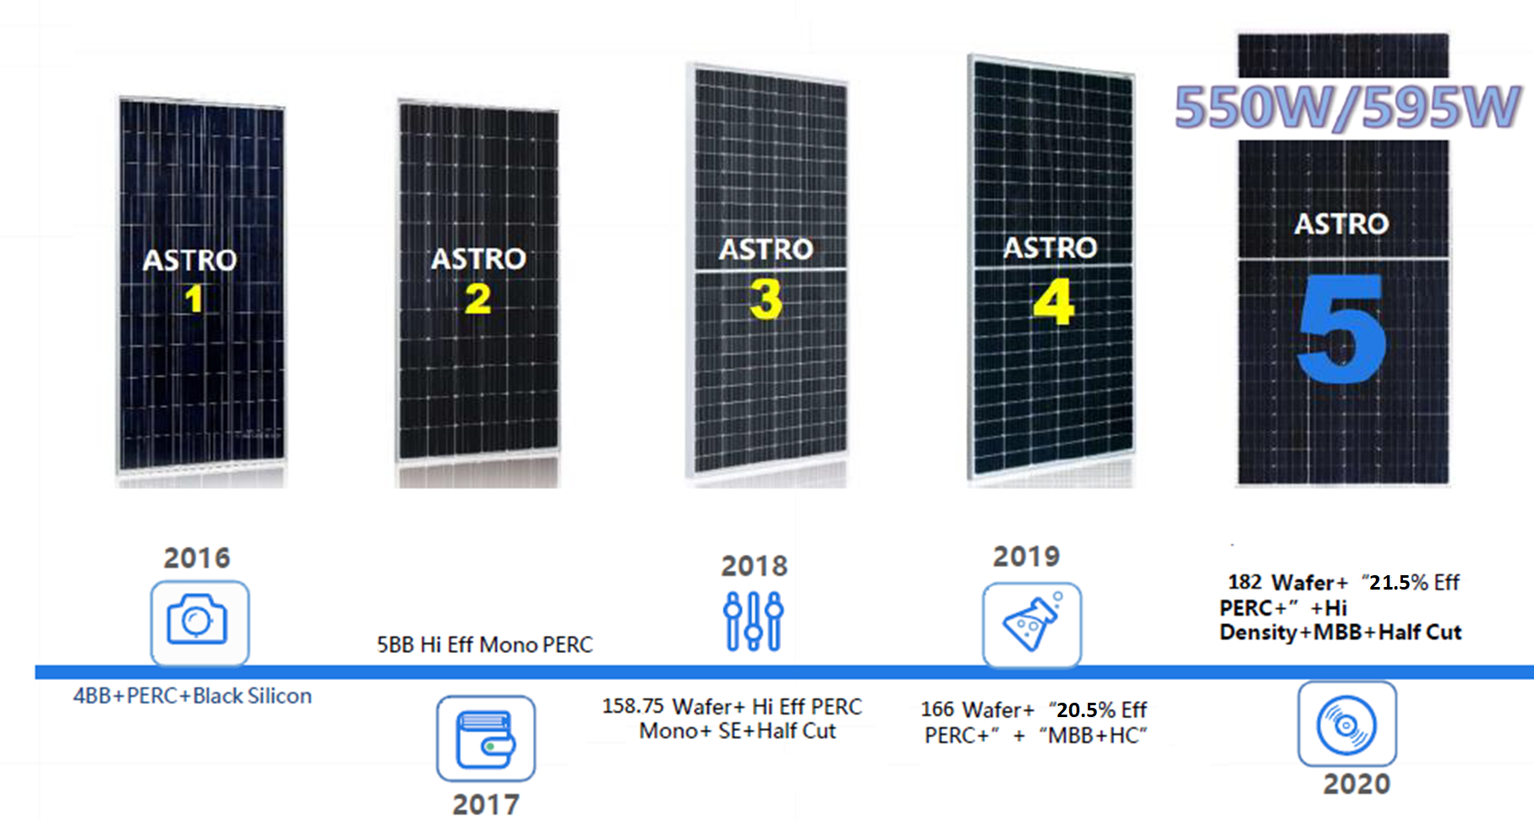



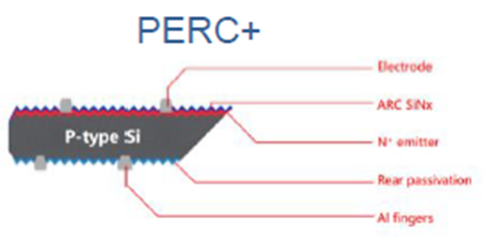

New Product Series

Slide 27
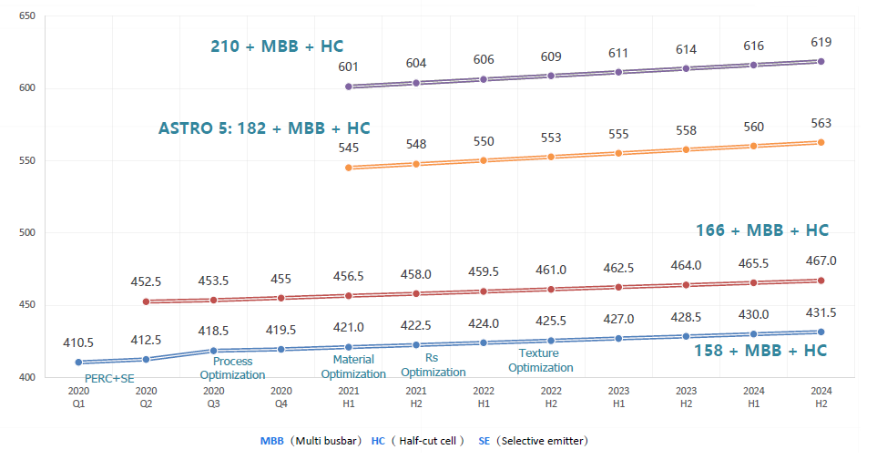
P- Mono Product Roadmap

Slide 28
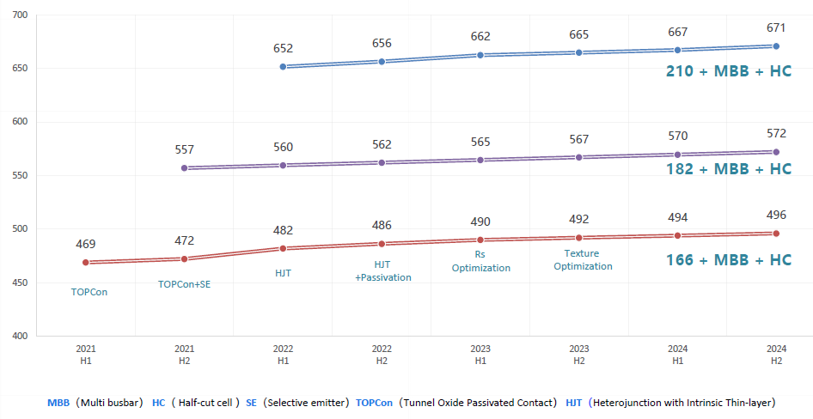
N - Mono Product Roadmap

Slide 29









Emerging Trends in Solar Energy Technologies
SOLAR SYSTEM
Cheaper
Capex & Opex
PV MODULE
DC & AC SYSTEM
Faster
Erection & Commissioning
MECHANICAL & CIVIL
MONITORING &
COMMUNICATION
Better
Safe & Reliable

Slide 30
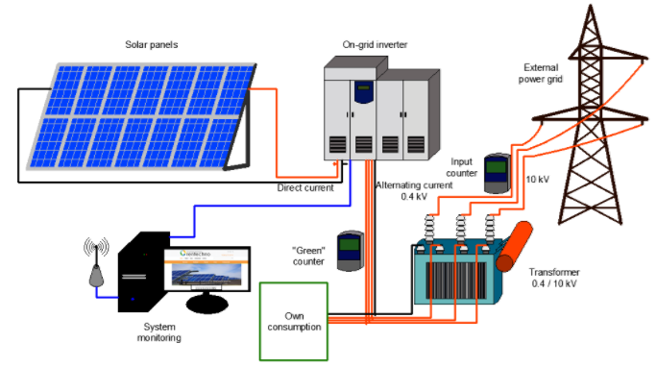
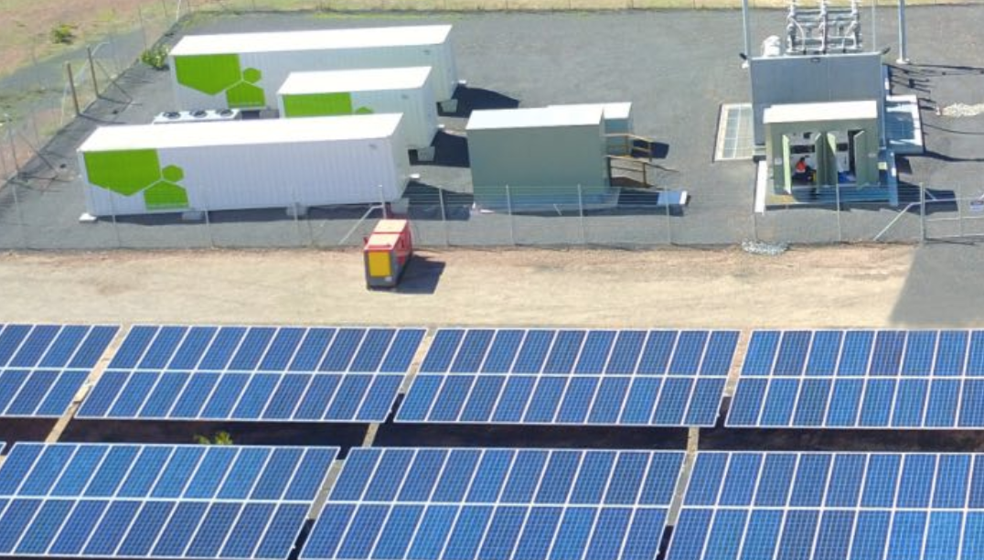
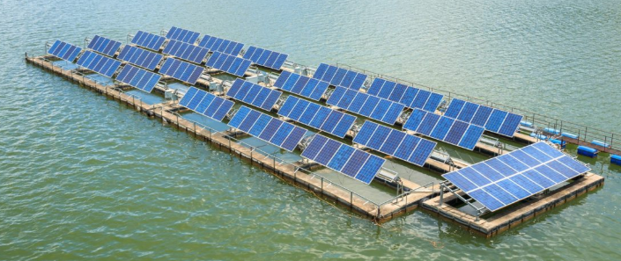
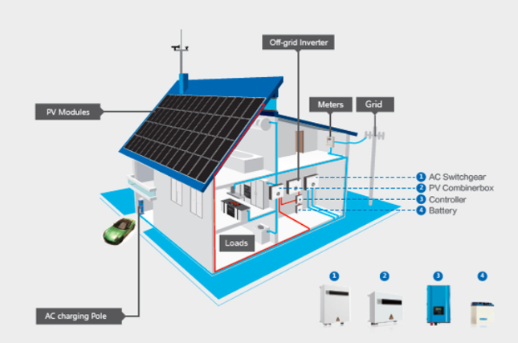
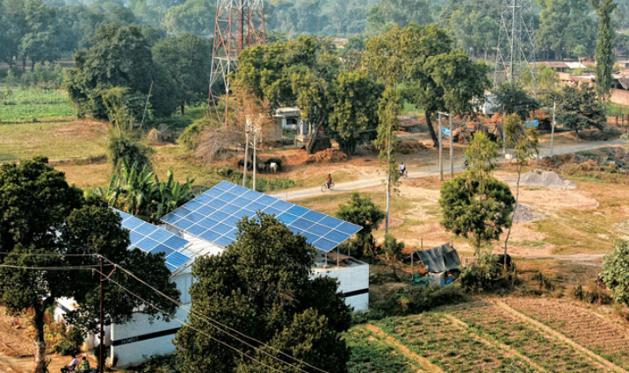
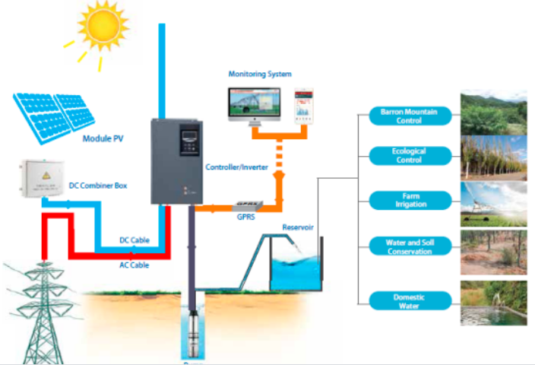
Solar Photovoltaic
Utility Grid Connected PV
Utility Grid Connected PV with Battery
Utility Grid Connected PV floating solar
ON / Off Grid PV for
Residential, Commercial & Industry
Micro GRID
Solar Pump

Slide 31
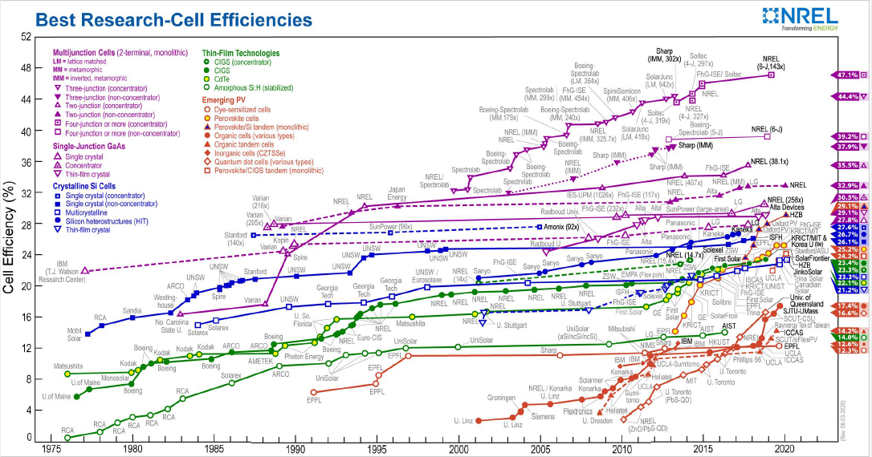
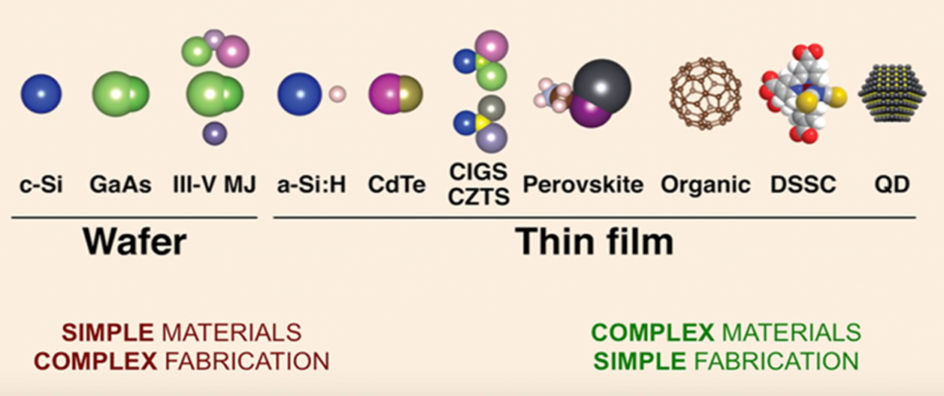
PV Cell Developments
Cell Efficiency
47.1%
Commercial Cell
PERC
HJT
Commercial PV Panel
Mono-crystalline
Poly-crystalline
Light Capturing
Mono-facial
Bi-facial

Slide 32
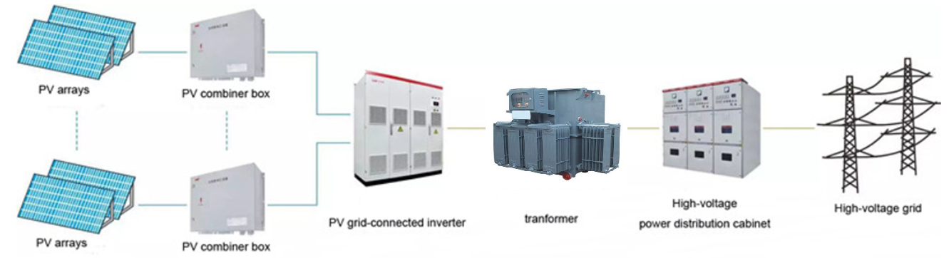
Technology Developments in DC & AC System
PV DC System
Shifting from 1000V to 1500V
Intelligent Combiner Box
String level MPPT
Advance Automated Design Tools
Reflectors to improve the generation of module
PV AC System
Multi- winding Transformer
IoT Transformer
Smart GRID
Integrating Energy Storage System
PV Inverter
Central Inverter with high capacity
Outdoor Inverter with IP65
Central Distributed Inverter
Energy Storage Inverter
String Inverter with Multi MPPT
Micro Inverter

Slide 33
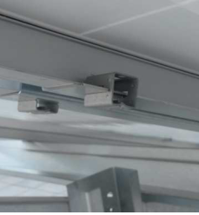

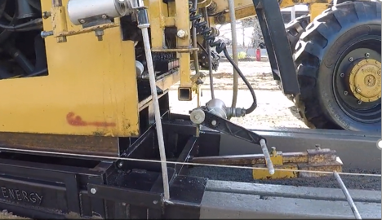
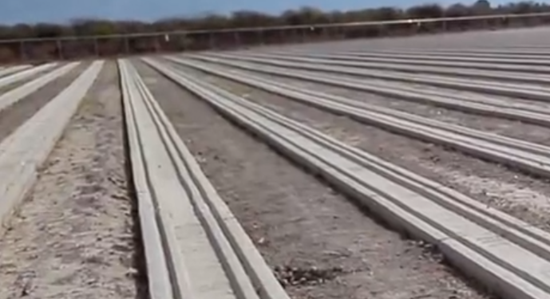
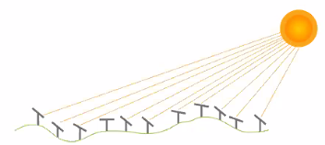
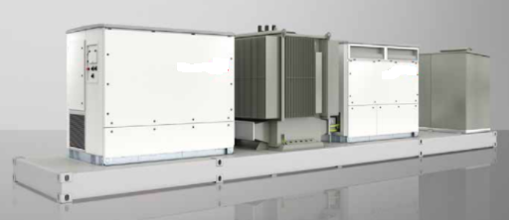
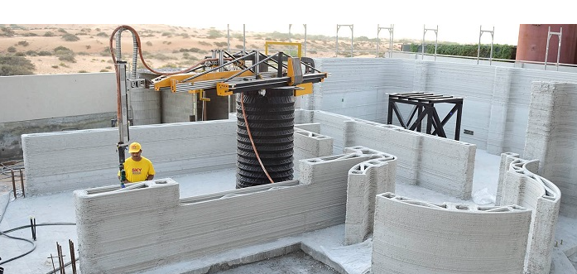
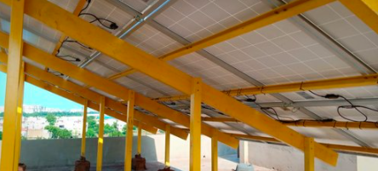
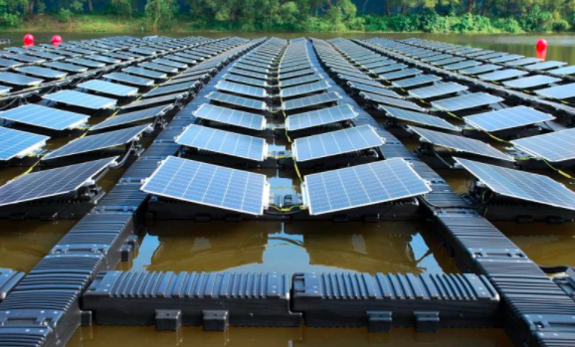
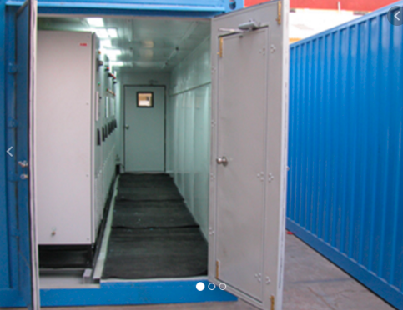
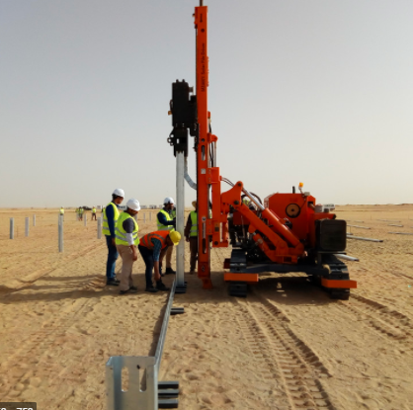
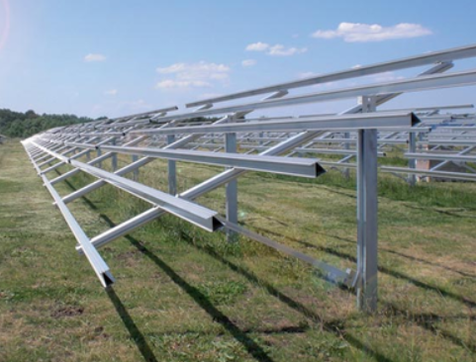
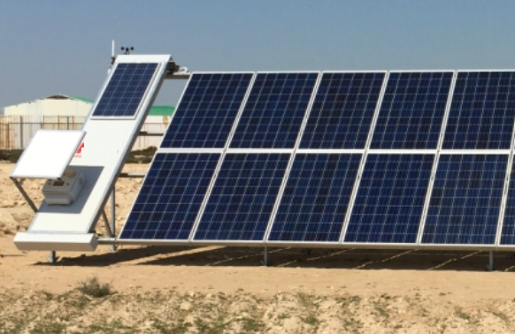
Technology Developments in Mechanical & Civil
Fast Module Mounting
Advance tracking to reduce shading
Faster Civil foundation – Extrusion method
Snap fit Clips
Hook mounting
SKID/ KIT Inverter Solution
3D Construction Control Room
FRP Structure
Floater
Low tonnage Structure
Robotic Cleaning Docking System
Prefab Rooms
Ramming Pile foundation

Slide 34
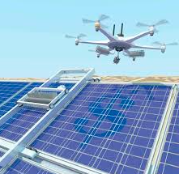
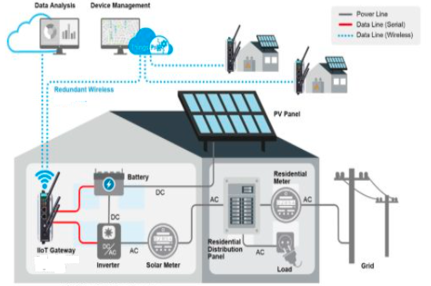

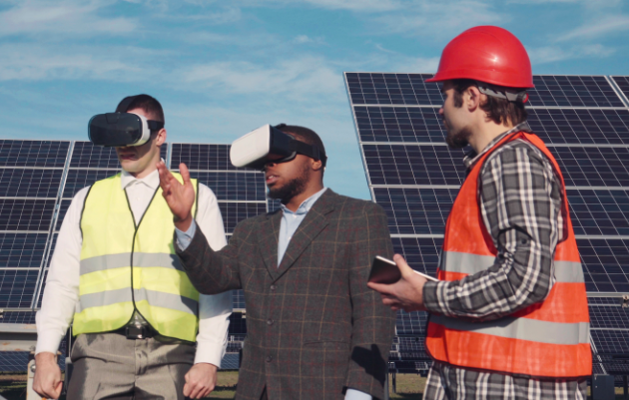
Technology Developments in Monitoring & Communication
Thermal Imaging
IoT based SCADA
Contour Mapping
LoRa, ZigBee Wireless Communication
Project Progress Monitoring
Live Plant monitoring
Security & Surveillance
Remote Operation Centre
Asset Management Monitoring
AR & VR Construction & Maintenance
Module Cleaning
Performance Analysis using ML & AI

Slide 35

Thank You for your Kind Attention
Contact : prasanta@astronergy.com

Slide 36
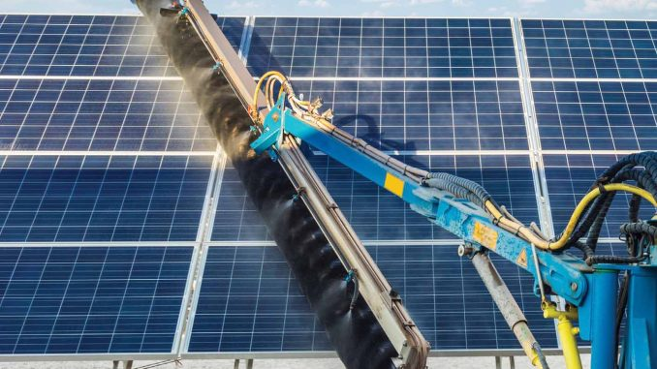
Effective
Operation & Maintenance – Technology and Data
By: Saravanan Manoharan
GM – Design & Engineering
Ayana Renewable Power Private Ltd.
Date: 06.10.2020

Slide 37
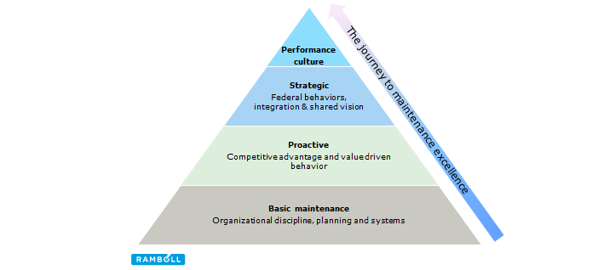
Effective O&M- Why we need? ( Technology adoption)
Effective O&M is measured by
Lowest LCOE is the requirement
Extended useful life of assets
Reduce the cost of O&M
Improve performance
Productivity(Solar farm)= Fn. (Irradiation, Module Performance, operations)
Operations : Controllable (Use of Data , Technology , Predictive Maintenance)
Module Performance : Long term (Manufacturing, Quality Control, Working conditions)
Irradiation : Uncontrolled (By Nature Sun availability and intensity is uncertain)
Need of effective O&M
Climate Change (Irradiation Variability)
Reduced margins ( Increased lending rates, stiff tariff regime, Volatility of currency)
Suitability of technologies to site specific operating conditions
Grid integration challenges

Slide 38
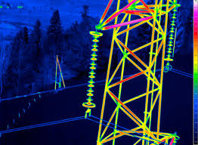
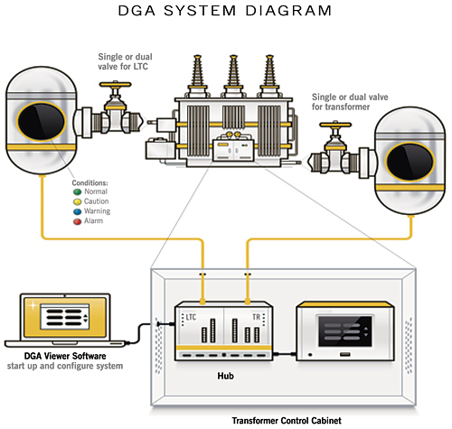
Effective O&M - Approach
Degree of Control:
“If you cannot forecast it, you have NO control of it….”
The degree of variation between the forecast and the actual performance is the degree of control that exists at the time of the forecast….
Being in control:
Forecast outages
Minimize the deviations forecast v/s actual (no Surprises)
Bundling of activities (Scheduled , unscheduled, Inputs of predicts, inputs of trending's)
Focus areas:
Moving from time based to data based - Maintenance
Common drivers - O&M service provider, Owner
BOP to adopt technological advancement - Thermography, Online DGA, Farm control
Construction & manufacturing quality to cater serviceability - life cycle

Slide 39



Effective O&M- Modern Concept
Owners are under increasing pressure to achieve lowest LCOE
Adoption of technology
Robotic cleaning
Drone Inspections
Mechanised seasonal tilt
Continuous monitoring and control-
IoT- reduced cost of capex
Development of AI to replace hardware
Optimised level of monitoring
Action driven outlier detection
Data driven O&M
Predictive maintenance
Prescriptive diagnostics
Forecasting based maintenance
Equipment life cycle management
Long term service agreements with OEM
Increased useful life – certified life extension

Slide 40

Effective O&M- Identify controllable opportunities
Binning of losses - Lost production opportunity
Bifurcation of controllable and uncontrollable losses
Do pareto analysis
Control big contributors
Repeat above steps
Feedback to Engineering
Feedback to improve design
Adoption of new technologies
Capex provision during O&M
Test platform for decision making
Repowering
Use high capacity modules
Replacement of outdated products
Forecasting and Scheduling
Use of technology to improve accuracy - Cloud monitoring
Use of Storage – Battery , Gravity based
Round the clock supply
Improved reliability to meet scheduled power

Slide 41


Slide 42
IEEE 1547 – The DER Interconnection Standard
Jason ALlnutt
U.S.-India SCCP, Virtual Workshop on Clean Energy: Advancing Growth of Photovoltaic Development in India
6 October 2020

Slide 43



The Institute of Electrical and Electronics Engineers
MAC Address Registration Authority
80:7B:85:FE:10:95
Members - >374,00
Countries - > 160
Conferences – 1200 + a year
30% of the world’s electro-technical publications
1,300 Active Standards – 500 additional projects

Slide 44
Ieee 1547 – 2003
Published – 28 July 2003
Scope – This standard establishes criteria and requirements for interconnection of distributed resources (DR) with electric power systems.
The original expectation was DER penetration would remain low as compared to today’s numbers.
Commitment to the standard being universally adoptable and technology neutral
No communication specifications
10 MVA limits on DER size
27 Pages (only 16 of which are actual technical content)

Slide 45
Energy Policy Act – 2005
Public Law 109-58-Aug. 8, 2005
Sec. 1254. Interconnection
Adoption of Standards. – Section 111(d) of the Public Utility Regulatory Policies Act of 1978 (16 U.S.C. 2621(d)) is amended by adding at the end the following”
“(15) Interconnection. – Each electric utility shall make available, upon request, interconnection service to any electric consumer that the electric utility serves. For purposes of this paragraph, the term ‘interconnection service’ means service to an electric consumer under which an on-site generating facility on the consumer’s premises shall be connected to the local distribution facilities. Interconnection services shall be offered based upon the standards developed by the Institute of Electrical and Electronics Engineers: IEEE Standard 1547 for Interconnection Distributed Resources with Electric Power Systems, as they may be amended from time to time. In addition, agreements and procedures shall be established whereby the services are offered shall promote current best practices of interconnection for distributed generation, including but not limited to practices stipulated in model codes adopted by associations of state regulator agencies. All such agreements and procedures shall be just and reasonable, and not unduly discriminatory or preferential.”.

Slide 46


Evolution of the Grid
Large generation systems
Central control
Highly regulated
Current Power System
Future Power Systems
New Challenges
New energy technologies and services
Penetration of variable renewables in grid
New communications and controls (e.g., Smart Grids)
Electrification of transportation
Integration of distributed energy storage
Regulatory advances
DRIVERS
Increased variable generation
More bi-directional flow at distribution level
Increased number of smart/active devices

Slide 47
IEEE 1547-2018 Scope and Purpose
Published – 6 April 2018
Title: Standard for Interconnection and Interoperability of Distributed Energy Resources with Associated Electric Power Systems Interfaces
Scope: This standard establishes criteria and requirements for interconnection of distributed energy resources (DER) with electric power systems (EPS), and associated interfaces.
Purpose: This document provides a uniform standard for the interconnection and interoperability of distributed energy resources (DER) with electric power systems (EPS). It provides requirements relevant to the interconnection and interoperability performance, operation, and testing, and, safety, maintenance and security considerations.
Changes from IEEE 1547-2003 shown in red

Slide 48
Important Changes in focus and Coverage
IEEE Std 1547-2003
Focused only on distribution system
Specifications for the “interconnection system” sufficiently achieve the standard’s objective.
Meant as DER interconnection standard but mainly used for equipment listing.
Limited to electrical requirements.
DER unit
Area EPS
Interconnection System
Scope of IEEE 1547-2003
IEEE 1547-2018
Focused on distribution and bulk system
Specifications encompass the whole DER
Equipment listing as well as plant-level verification.
Includes both electrical as well as interoperability/communications requirements.
Communication Interface
DER
Area EPS
Power Interface
Scope of IEEE 1547-2018

Slide 49
Definition of Distributed Energy Resource
In the context of IEEE 1547:
“A source of electric power that is not directly connected to a bulk power system.”
Includes distributed generators.
Includes distributed energy storage technologies.
Does not include controllable loads used for demand response.

Slide 50
IEEE 1547 Evolution of Grid Support Functions
IEEE 1547-2003
Shall NOT actively regulate voltage
Shall trip on abnormal voltage/frequency
IEEE 1547a-2014
(Amendment 1)
May actively regulate voltage
May ride through abnormal voltage/frequency
May provide frequency response¹ (frequency-droop)
IEEE 1547-2018
Shall be capable of actively regulating voltage
Shall ride through abnormal voltage/frequency
Shall be capable of frequency response²
May provide inertial response³
¹Frequency response is capability to modulate power output as a function of frequency
²Mandatory capability for Categories II and III under high frequency conditions, Mandatory for Categories II and III under low frequency conditions, optional for Category I
³Inertial response is capability for DER to modulate active power in proportion to the rate of change of frequency

Slide 51

Assignment of Performance Categories
Normal and abnormal operating performance categories
Category I
Category A
Ride-Through
DER Vendors
Authorities Governing Interconnection Requirements (AGIRs)¹
Voltage Regulation
Category II
Category B
Stakeholder Engagement
Distribution utilities.
Bulk system operators & planners.
DER developers.
Others.
Category III
Control / trip settings
Ranges of allowable settings
Default parameters
Market Analysis
Costs
Market segment
Etc.
Impact Assessment
Technical conditions: type & capacity & future penetration of DER, type of grid configuration, etc.
Non-technical issues: DER use case, impacts on environment, emissions, and sustainability, etc.
¹ Regulatory agencies, public utility commissions, municipalities, cooperative governing boards, etc.
Courtesy of Dr. J. Boemer/EPRI

Slide 52

Interoperability
Categories of Information to be Exchanged
Nameplate Data – As-built characteristics of the DER, e.g.:
Manufacturer/model
Active and reactive power rating, etc.
Configuration Information – alternative nameplate ratings
Monitoring Information – Measured values of:
Active and reactive power
Voltage, etc.
Management information – update functional and mode settings for the DER.
List of Eligible Protocols

Slide 53
IEEE 1547.1-2020 – 1547 Test Procedures – Test & Verification Process
Maintenance
Periodic
In-service confirmation on recurring schedule
Commissioning Tests
Confirm DER functionality and interoperability on site
Post-installation review
As-Built Installation Evaluation
Confirm DER is installed as designed
Interconnection review
Design Evaluation
Desk study prior to installation
Production Tests
Equipment conformance
testing
Test of every unit, usually in factory
Type Tests
Test in laboratory or factory of a representative DER unit

Slide 54
ICAP - IEEE 1547 Education and Credentialing Program
Create a credentialing program that will evaluate and train and certify individuals who can verify any installed DER Interconnection (e.g., Residential, Utility-Scale, Micro-grid, etc.) for its compliance with the IEEE 1547-2018 standard and local jurisdictional requirements.
Comprehensive 1547 educational content and platform
Focus on IEEE 1547-2018 commissioning details
Inclusion of common jurisdictional requirements to assist with understanding different interconnection agreement
Certification mechanism for individuals as Certified IEEE 1547 Commissioning Agents
Expectation for certified agents to be third-party resource for the complete commissioning of DER Interconnections to IEEE 1547 and local interconnection agreement requirements
Standardized IEEE 1547 Commissioning Process
Standardized documentation for pre-visit, on-site, and final report generation
Guidance and documentation of periodic assessment (i.e., future reviews of DER Interconnection after the initial)
To be taught during educational content so that all certified agents have the same foundation of commissioning

Slide 55



Ghana Pilot - 20 MW Solar Installation
Utility scale 20 MW Solar PV Installation with approx. 400 string inverters
Commissioning of the interconnection for its compliance with IEEE 1547 in accordance with the approved Ghana Interconnection Agreement
On-site evaluation showed that IEEE 1547 test requirements met at inverters as well as facility wide at the PCC.
On-site inspections identified some grounding issues.

Slide 56
Thank you
Jason Allnutt
Conformity Assessment Speicalist
IEEE Standards Association
J.Allnutt@ieee.org
https://standards.ieee.org/icap
https://www.linkedin.com/in/jason-allnutt-ee/

Slide 57
LVDC: Powering the Last Mile – Challenges and Opportunities
Venkat Rajaraman
CEO, Cygni Energy
E: venkat@cygni.com

Slide 58

Energy is the is the golden thread that connects economic growth, increased social equity, and an environment that allows the world to thrive’ Ban Ki-moon, Former United Nations Secretary-General
Energy is opportunity. It transforms lives. Economies. And our planet.
© The Energy Resource Institute

Slide 59


Ensure access to affordable, reliable and modern energy for all by 2030
Notes:
Company Overview – Mr. Venkat Rajaraman

Slide 60

Notes:
Company Overview – Mr. Venkat Rajaraman

Slide 61

Devices: LED lighting, IT and multimedia, consumer appliances
Cost down
Energy efficiency up
UN SDGs and regulations creating a market
Why Now?
Cost down
Electricity Access
Sources:PV Panels, Energy storage
Why LVDC?
and Why now?
Notes:
Company Overview – Mr. Venkat Rajaraman

Slide 62














All the things we and run on LVDC
We already live in a DC World!
Notes:
Company Overview – Mr. Venkat Rajaraman

Slide 63


Two main market drivers
Energy Efficiency in Developed Economies
Electricity Access in Developing Economies
Notes:
Company Overview – Mr. Venkat Rajaraman

Slide 64
New Standard for LVDC
Standard – IS16711:2017
A standard for India, developed by BIS
Several thousand installations have been already done based on this standard
Proven rules for creating solutions at optimal cost
Standard ensures maintainability, repair and availability of spares
Uptake of distributed renewables. Much bigger opportunity in the developing world
Choice of Voltage
48V, Primary Voltage as defined in IEC 60038
Is safe – Falls under SELV System Classification and SELV circuit classification as per IEC 60950
Optimal voltage considering safety and distribution
Leverage EV battery eco-system and automotive battery eco-system for storage
DC-DC chips available with synchronous capabilities that operate beyond 48V

Slide 65
Electricity Access – Priority and Considerations
Priority
Define a basic architecture for fast and immediate access to electricity
Safety, considering first time users of electricity
Scalability – Energy Sharing, DC/AC Microgrids, AC Grid
Standardise rules when AC Grid eventually gets connected
Uptake of distributed renewables. Much bigger opportunity in the developing world
Considerations
First Time users with no prior exposure to electricity and its potential for hazard to human life
Minimum requirement to power few lights, fans and mobile chargers, sources and storage
Leverage existing AC components, interconnects, electrical interfaces that are locally available as much as possible to reduce costs
Distribution to be standardised for low losses.
Provide a platform for funding renewable energy projects

Slide 66
Some Specifics of the Standard
Specifics
48V Bus Voltage Nominal
5A max. per circuit
No limit to number of circuits
Distribution topology similar to AC distribution
AC wiring conductors of 1.5sq.mm, 2.5sq.mm or 4 sq.mm can be used depending on the length. AC over-current devices can be used
Co-existence with AC, through an isolating interface
Safety
Safe from single fault
Safety from Electric Shock – SELV, floating outputs
Safety from fire – due to arcing - only 5A in each circuit limits energy and does not allow arc to propagate
Safety from fire – due to over current – limited by the finite power capability of the converter at the front end
Safety from 230V shock during interoperability – RCD trips at the AC side
Safety from fire and heat due to high instantaneous power from battery – Battery outputs to have over current protection

Slide 67




LVDC Installations in India Over 45,000 installations in the States of Assam, Rajasthan, Manipur, J&K and Meghalaya
Notes:
Company Overview – Mr. Venkat Rajaraman

Slide 68

Village School with LVDC System
Notes:
Company Overview – Mr. Venkat Rajaraman

Slide 69


Last Mile Challenges
Material transport by ferry to reach villages on other side of river
Multiple trips needed for heavier items such as battery packs & solar panels
Exercise due care & caution so that the material is not wet during transport

Slide 70


Last Mile Challenges – Precarious Roads and water logging

Slide 71


Last Mile Challenges – No motorable roads
Notes:
No motor-able roads
Material transport must be done by smaller cargo vehicles & require multiple trips
Vehicles get stuck on bad roads and during rains

Slide 72



Last Mile Challenges – Transport by boat

Slide 73


Last Mile Challenges – Assam - Unpaved Roads

Slide 74



Last Mile Challenges - Manipur – Foot Journey

Slide 75


Last Mile – Manipur – Foot Journey

Slide 76
Recognition
Innovative Direct-Current Microgrids to Solve India’s Power Woes -Solar DC micro-grids could do for electrification what mobile phones did for telephony
https://spectrum.ieee.org/energy/renewables/innovative-direct-current-microgrids-to-solve-indias-power-woes
Solar DC Microgrid for Indian Homes –A transforming power scenario [IEEE]. Solar DC has won the IEEE Spectrum Award for technology in 2017

Slide 77
CONTACT US
Head Office ( Hyderabad, India )
Second Floor, Lansum House, 283, Rd Number 78, Jubilee Hills, Telangana 500033
THANK YOU
++91 40 2354 5001
venkat@cygni.com
info@cygni.com
www.cygni.com

Slide 78
Panel Discussion
How can standards and conformity assessment help to address some of the challenges that have been identified?
National Renewable Energy Laboratory (NREL)
Ingrid Repins, Principal Scientist (Ingrid.repins@nrel.gov)
Underwriters Laboratories (UL)
Scott Jezwinski, Business Development Manager, Renewable Energy-Solar (scott.Jezwinski@ul.com)
Indian Institute of Technology (IIT) Bombay
Narendra Shiradkar, PhD, Assistant Professor and Lead, PV Reliability Group (naren@ee.iitb.ac.in)

Slide 79
The IECRE (RE = Renewable Energy) Certification System
Project Timeline
✓
✓
✓
✓
Design Qualification
Commissioning
Annual Performance
Asset Transfer
Provides confidence in PV system quality at each stage of PV system life
Over 30 standards and operational documents were created or revised by international teams of experts, starting in 2014, to enable IECRE certifications for PV.

Slide 80
Thank you!
Please complete the Post-Workshop Questionnaire that will be distributed shortly after this session

