Slide 1
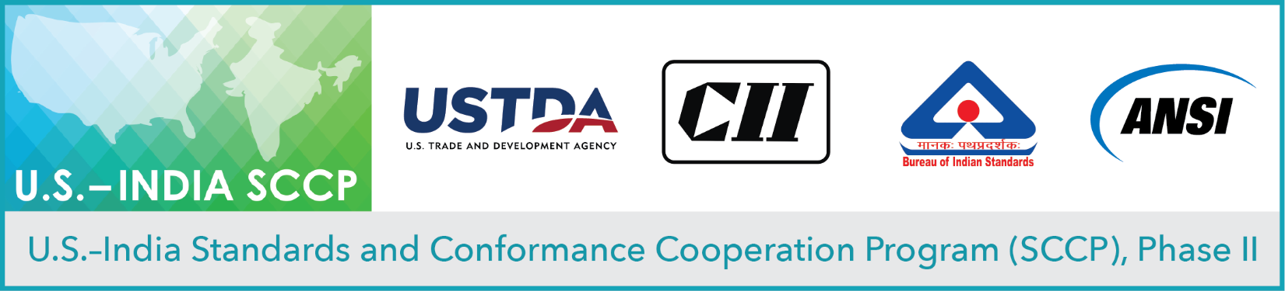
Virtual Workshop on Clean Energy: Advancing Growth of Photovoltaic Development in India
Session 2
PV Module & Balance of System Durability and Reliability
September 29, 2020

Slide 2
Opening Remarks
United States Trade and Development Agency (USTDA)
Tanvi Madhusudanan, Country Manager, Indo-Pacific
U.S. Department of Commerce (DoC)
Aileen Nandi, Senior Commercial Officer, India
Confederation of Indian Industry (CII)
Anupam Kaul, Principal & Head (Quality, Metrology & Standards)

Slide 3

STANDARDIZATION ON PV MODULES
Bureau of Indian Standards

Slide 4
Introduction -
BIS Act 1986
BIS Act 2016
Indian Standards Institution 1947
The Indian Standards Institution (ISI) founded in 1947
BIS Act 1986 gave statutory status to BIS
BIS Act 2016 makes BIS NSB of India
15 Division Councils, 842 Committees/Panels
More than 10000 Experts.
Founder Member of ISO and holds several Leadership positions.
Notes:
Fun fact – November 3rd 2017 was the 48th world standards day and BIS organized a seminar with the theme – Standards make cities smarter. Mr Chaudhary and Mr. Paswan both made comments which can be found here - http://taxongo.com/columnDesc.php?qwer43fcxzt=MjA3OA==

Slide 5
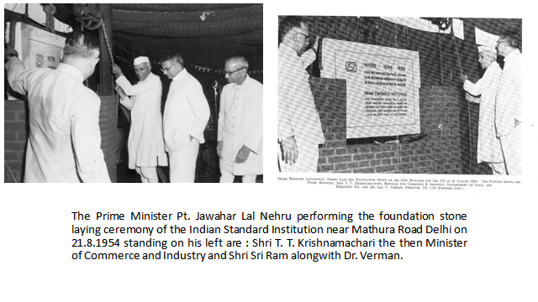

Slide 6
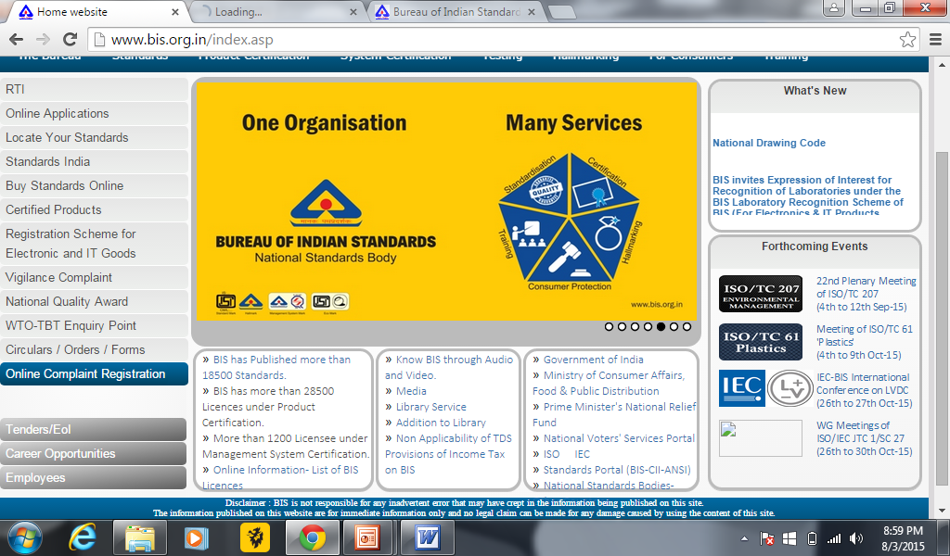

Slide 7
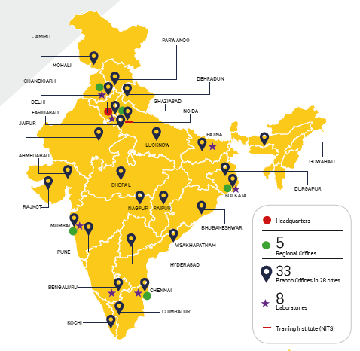
OUR PRESENCE

Slide 8
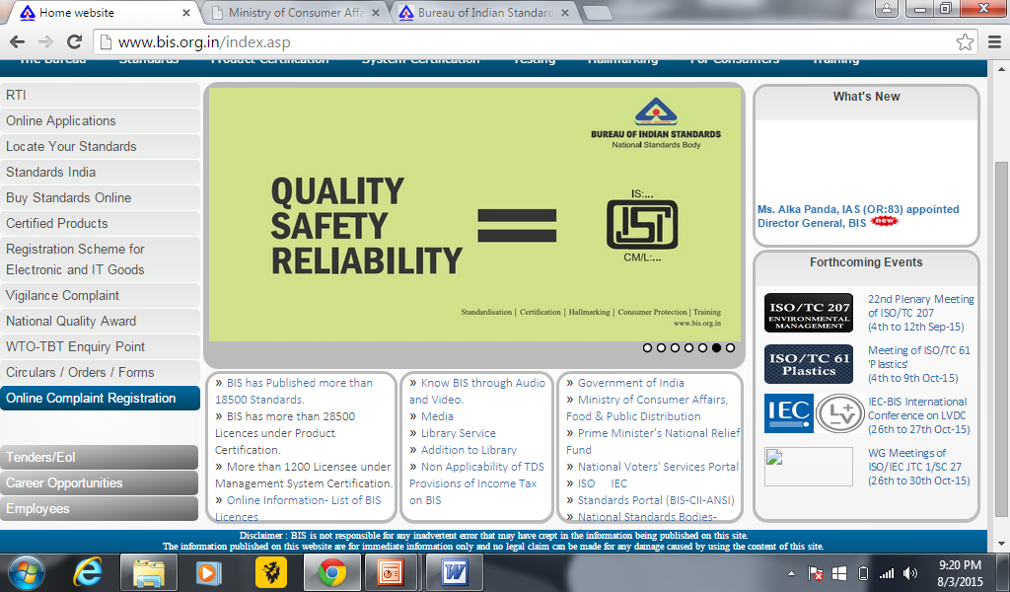

Slide 9
Need for Standardization
Orderly approach to a specific activity
Provisions for common and repeated use
Interoperability
Address actual or potential problems
Safety and functional requirement
Promote consistent quality and economic production.

Slide 10
Standards are developed with following in mind
Safety
Ease of use and adaptability
Simple Technology
Value for money products
Energy Efficiency & Environment

Slide 11
Structure for development of Standards
Standards Advisory Committee
Divisional Council
Sectional Committee
Sub-Committees
Panel

Slide 12
COMPOSITION
of
STANDARD FORMING COMMITTEE
Chairman (Independent Body)
Member Secretary (BIS)
Manufacturer
Laboratories/ R&D Institutions
Government & Regulatory Bodies
Consumer/ User Organization
Industry Association
Public Sector Units
Consulting Firms
Professional & Academic Bodies

Slide 13
Stage 2 : Building consensus among committee members
Stage 3: Building national consensus
Stage 4 – Collaboration of Science, Technology and Expertise
STAGES OF STANDARD FORMULATION
Indian
Standard
(IS)
STAGE 4
Finalized
Draft
(F)
STAGE 3
Wide
Circulation
(WC)
STAGE 2
Preliminary
Draft
(P)
STAGE 1
New Work
Item Proposal
(NWIP)
International Training Programme, 10 May 2012
Notes:
BIS, being a signatory to the WTO-TBT 'Code of Good Practice for the preparation, adoption and application of standards” has also accordingly aligned its standards formulation procedure. Apart from establishing new standards, the timely revision of existing standards is also crucial for keeping pace with the changes in technology, standards and regulations that impact safety, health and the environment. This has become imperative in view of globalization and consequent opening up of economies of the world. All the Indian Standards are reviewed for their continued relevance at least once in five years.

Slide 14
COMMENTS
NEW WORK ITEM
CIRCULATION
TO
COMMITTEE
MEMBERS
FIRST
DRAFT
P-DRAFT
COMMENTS
PUBLIC
CIRCULATION
+Web
(30 to 90 Days)
CIRCULATION
TO
COMMITTEE
MEMBERS
WC
DRAFT
MEETING
COMMENTS
F-DRAFT
STANDARD
MEETING
ADOPTION BY DIVISION
COUNCIL
NATIONAL STANDARD
STANDARDS DEVELOPMENT PROCESS
14

Slide 15
DEVELOPMENT OF A PROJECT
PROJECT STAGE | PROPOSAL STAGE | PREPARATORY STAGE | COMMITTEE STAGE | APPROVAL STAGE | Publication stage
NORMAL PROCEDURE | Acceptance of proposal | Preparation of P/Working Draft | Development and Acceptance of P- Draft | Approval of Wide Circulation Draft | Publication of NATIONAL STANDARD
ADOPTION OF EXISTING STANDARD | Acceptance of Proposal |  |  | Approval of Wide Circulation Draft | Publication of NATIONAL STANDARD

Slide 16
STANDARDIZATION SPACE
ENGINEERING
INDUSTRY
COMMERCE
SCIENCE
EDUCATION
TRANSPORT
HOUSING/BUILDING
FOOD
AGRICULTURE
FORESTRY
TEXTILES
CHEMICALS
INTERNATIONAL --
REGIONAL --
NATIONAL --
ASSOCIATION --
COMPANY --
INDIVIDUAL --
LEVEL
SUBJECT
-- NOMENCLATURE
-- SPECIFICATION
-- SAMPLING & INSPECTION
-- TEST & ANALYSIS
-- SYMBOLS
-- CODE OF PRACTICE
ASPECT
Notes:
16

Slide 17
Areas of Standardization
Chemical
Civil Engineering
Electronics and Information Technology
Electro technical
Food and Agriculture
Management and Systems
Mechanical Engineering
Medical Equipment and Hospital Planning
Metallurgical Engineering
PetrochemicalCoal & Related Products
Production and General Engineering
Textiles
Transport Engineering
Water Resources
Service Sector Department

Slide 18
ELECTROTECHNICAL DIVISION COUNCIL (ETDC)
ETDC is responsible standardization in the field of electrical power generation, transmission, distribution and utilization equipment, and insulating materials, winding wires, measuring and process control instruments and primary and secondary batteries
At present, 44 sectional committees are working under ETDC engaging more than 1600 experts

Slide 19
LIST OF SECTIONAL COMMITTEES UNDER ETDC
Sl. No | SC NO | SECTIONAL COMMITTEE NAME
1 | ETD 01 | BASIC ELECTROTECHNICAL STANDARDS AND POWER QUALITY
2 | ETD 02 | SOLID ELECTRICAL INSULATING MATERIALS AND INSULATING SYSTEMS
3 | ETD 03 | FLUIDS FOR ELECTROTECHNICAL APPLICATIONS
4 | ETD 06 | ELECTRICAL INSULATORS AND ACCESSORIES
5 | ETD 07 | LOW VOLTAGE SWITCHGEAR & CONTROLGEAR
6 | ETD 08 | HIGH VOLTAGE SWITCHGEAR AND CONTROLGEAR
7 | ETD 09 | POWER CABLES
8 | ETD 10 | PRIMARY CELLS AND BATTERIES
9 | ETD 11 | SECONDARY CELLS AND BATTERIES
10 | ETD 12 | MEASURING EQUIPMENT FOR BASIC ELECTRICAL QUANTITIES
11 | ETD 13 | EQUIPMENT FOR ELECTRICAL ENERGY MEASUREMENT AND LOAD CONTROL

Slide 20
Sl. No | SC NO | SECTIONAL COMMITTEE NAME
12 | ETD 14 | ELECTRICAL WIRING ACCESSORIES
13 | ETD 15 | ROTATING MACHINERY
14 | ETD 16 | TRANSFORMERS
15 | ETD 18 | INDUSTRIAL PROCESS MEASUREMENT AND CONTROL
16 | ETD 19 | HIGH VOLTAGE ENGINEERING
17 | ETD 20 | ELECTRICAL INSTALLATIONS
18 | ETD 21 | ELECTRIC WELDING EQUIPMENT
19 | ETD 22 | ELECTRICAL APPARATUS FOR EXPLOSIVE ATMOSPHERES
20 | ETD 23 | LAMPS AND RELATED EQUIPMENTS
21 | ETD 25 | LIFTS AND ESCALLATORS
22 | ETD 28 | SOLAR PHOTOVOLTAIC ENERGY SYSTEMS
23 | ETD 29 | POWER CAPACITORS
24 | ETD 30 | SURGE ARRESTERS
25 | ETD 31 | POWER ELECTRONICS

Slide 21
Sl. No | SC NO | SECTIONAL COMMITTEE NAME
26 | ETD 32 | ELECTRICAL APPLIANCES
27 | ETD 33 | WINDING WIRES
28 | ETD 34 | INSTRUMENT TRANSFORMERS
29 | ETD 35 | POWER SYSTEMS RELAYS
30 | ETD 36 | TOOLS AND EQUIPMENT FOR LIVE WORKING
31 | ETD 37 | CONDUCTORS AND ACCESSORIES FOR OVERHEAD LINES
32 | ETD 39 | FUSES
33 | ETD 40 | HVDC POWER SYSTEMS
34 | ETD 42 | WIND TURBINES
35 | ETD 43 | STANDARDIZATION OF ENVIRONMENTAL ASPECTS FOR ELECTRICAL AND ELECTRONIC PRODUCTS
36 | ETD 44 | SAFETY OF MACHINERY
37 | ETD 46 | GRID INTEGRATION
38 | ETD 47 | RAILWAY ELECTRIC TRACTION EQUIPMENT

Slide 22
Sl. No | SC NO | SECTIONAL COMMITTEE NAME
39 | ETD 48 | STANDARDIZATION IN THE FIELD OF UHV AC TRANSMISSION SYSTEMS
40 | ETD 49 | ILLUMINATION ENGINEERING AND LUMINAIRES (NEW COMMITTEE)
41 | ETD 50 | LVDC POWER DISTRIBUTION SYSTEMS
42 | ETD 51 | ELECTROTECHNOLOGY IN MOBILITY
43 | ETD 52 | ELECTRICAL ENERGY STORAGE SYSTEMS
44 | ETD 53 | STANDARDIZATION OF THE MANAGEMENT OF ASSETS IN POWER NETWORKS

Slide 23
ETD 28 (Solar Photovoltaic Energy Systems)
Scope - To prepare standards for systems of photovoltaic conversion of solar energy into electrical energy and for all the elements in the entire photovoltaic energy systems.
It includes the entire field from light input to solar cell and interface with the electrical system(s) to which energy is supplied.
Total Standards published – 81
Total Standards under development -15

Slide 24
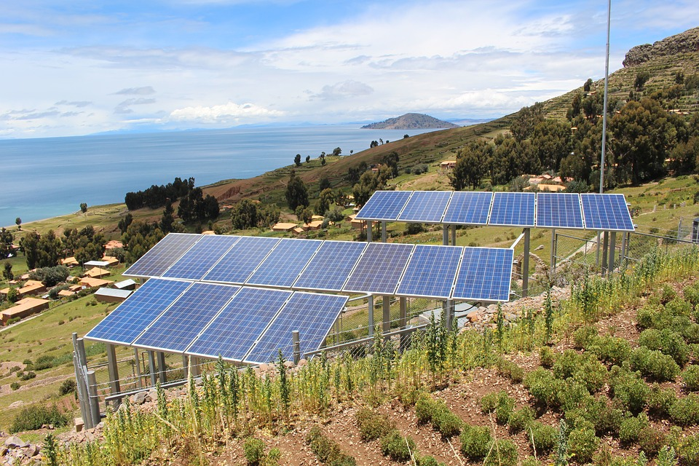
Important Published Standards
PV Panel | IS 14286 ( Part 1 / Sec 1) : 2019 IEC 61215-1-1 : 2016 | Testing requirements of crystalline silicon photovoltaic PV modules
 | IS 14286 ( Part 1 / Sec 2) : 2019 IEC 61215-1-2 : 2016 | Testing requirements of thin - Film cadmium telluride CdTe based photovoltaic PV modules
 | IS 14286 ( Part 1 / Sec 3) : 2019 IEC 61215-1-3: 2016 | Testing requirements of thin - Film amorphous silicon based photovoltaic PV modules
 | IS 14286 ( Part 1 / Sec 4) : 2019 IEC 61215-1-4 : 2016 | Testing requirements of thin - Film Cu In ga S se ₂ based photovoltaic PV modules

Slide 25
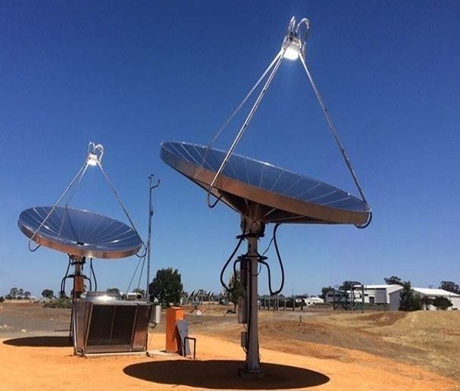
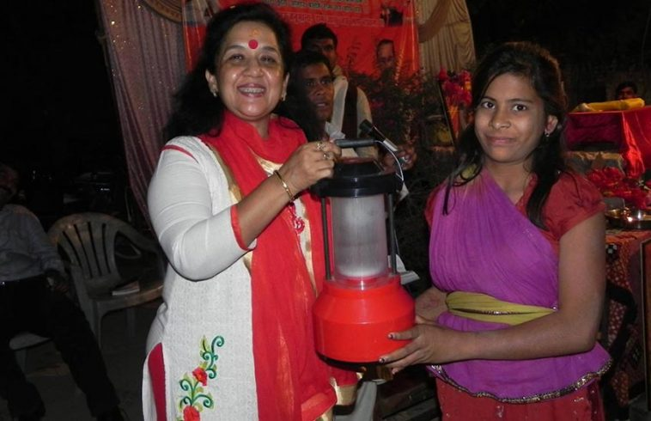
Concentrator CPV Modules | IS 16662 ( Part 2) : 2018 IEC 62670-2 : 2015 | Performance testing: Part 1 Standard conditions
 | IS 16662 ( Part 2) : 2018 IEC 62670-2 : 2015 | Performance testing : Part 2 Energy measurement
 | IS 16662 ( Part 3) : 2018 IEC 62670-3 | Performance testing : Part 3 Performance measurements and power rating
LED based Solar Lantern | IS 16476 ( Part 1) : 2017 | Specification
 | IS 16476 ( Part 2) : 2018 | Method of test

Slide 26
Testing Standards
IS/IEC 61701 : 2011 IEC 61701:2011 | Salt mist corrosion testing of photovoltaic PV module
IS 16664 : 2018 IEC 62716 : 2013 | Photovoltaic PV Modules- Ammonia Corrosion Testing
Reference Standards
IS 12762 : Part 1 : 2010 IEC 60904-1 : 2006 | Measurement of photovoltaic Current - Voltage characteristics
IS 12762 : Part 2 : 2018 IEC 60904-2 : 2007 | Requirements for reference solar devices
IS 12762 : Part 4 : 2014 IEC 60904-4 : 2009 | Reference solar devices - Procedures for establishing calibration traceability
IS 12762 : Part 8 : 2018 IEC 60904-8 : 2014 | Measurement of spectral responsivity of a photovoltaic (PV) device
IS 12762 : Part 9 : 2010 IEC 60904-9:2007 | Solar simulator performance requirements

Slide 27
STANDARDS UNDER DEVELOPMENT
1. Transportation and shipping of module package units
2. Marking and documentation requirements for Photovoltaic Modules
3. Low concentration Photovoltaic Concentrators
4. LBIC(Light Beam Induced Current) based analysis of PV Modules

Slide 28
Participation at International Standardization work
International Electrotechnical Commission(IEC) is leading platform for Standards and Conformity Assessment Systems.
Membership Status at IEC-
P- membership – 90 TC/SC
O- membership – 72 TC/SC
Active member
Nominate technical experts in working groups.
Comments on documents.
NWIP (New Work Item Proposal)

Slide 29
IEC TC 82 (Solar photovoltaic energy systems)
Scope - To prepare international standards for systems of photovoltaic conversion of solar energy into electrical energy and for all the elements in the entire photovoltaic energy system. In this context, the concept "photovoltaic energy system" includes the entire field from light input to a photovoltaic cell to and including the interface with the electrical system(s) to which energy is supplied.
“P” membership
Total publication - 126

Slide 30
IMPLEMENTATION OF STANDARDS
Normally standards are voluntary
Selected Indian Standards have been made mandatory compliance of BIS Standard mark to protect consumer s’ health and safety.
133 standards are covered under Mandatory certification
50 standards are covered under Compulsory Registration Scheme (of which 05 are Solar Photovoltaics, Systems, Devices and Components)

Slide 31
05 ISSs notified under Solar Photovoltaics Systems, Devices and Component Goods (Requirement for Compulsory Registration Order), 2017 by MNRE
T
Indian Standard | Name of Product
IS 14286 IS/IEC 61730 -1 IS/IEC 61730 -2 | Crystalline Silicon Terrestrial Photovoltaic (PV) modules – Design Qualification And Type Approval
IS 16077 IS/IEC 61730 -1 IS/IEC 61730 -2 | Thin-Film Terrestrial Photovoltaic (PV) Modules – Design Qualification and Type Approval
IS 16221 (Part 2) | Safety of Power Converters for Use in Photovoltaic Power Systems Part 2-Particular Requirements for Inverters
IS 16169 | Test Procedure of Islanding Prevention Measures for Utility-Interconnected Photovoltaic Inverters
IS 16270 | Secondary Cells and Batteries for Solar Photovoltaic Application General-Requirements and Methods of Test

Slide 32

COMPULSORY REGISTRATION ORDER
Mandates Registration with BIS for the notified goods:
No person shall manufacture or store for sale, import, sell or distribute Goods which do not conform to the specified Standard and do not bear the standard mark/word “ Self declaration – conforming to IS ” on such Goods after obtaining Registration from BIS

Slide 33
PENALTY FOR CONTRAVENTION
Imprisonment for a term which may extend up to two years, or
Fine - two lakh rupees for the first contravention and five lakh rupees for subsequent contraventions, extending up to ten times the value of goods or articles produced or sold or offered to be sold or affixed or applied with a standard mark

Slide 34
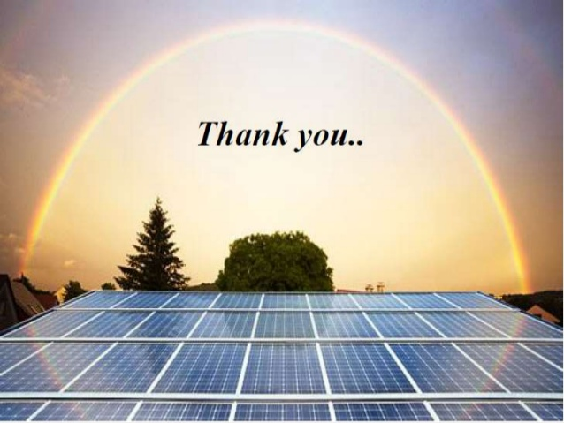

Slide 35
Application of Combined - Accelerated Stress Testing for Evaluating Durability of PV Modules
Peter Hacke, Michael Owen-Bellini, David Miller, Michael Kempe, Dana Sulas-Kern, Derek Holsapple, Michel Woodhouse: National Renewable Energy Laboratory
Sergiu Spataru : DTU Fotonik
Stefan Mitterhofer, Marko Jankovec, Marko Topič : University of Ljubljana
Wei Luo : SERIS - National University of Singapore
Tadanori Tanahashi: National Institute of Advanced Industrial Science and Technology (AIST)
Workshop on Clean Energy: Advancing Growth of PV Development in India
Notes:
`

Slide 36
Overview
Motivation
Experiment
Results
Degradation modes
Analysis
Costing
Acceleration factors
Wrap-up

Slide 37
Overview
Motivation
Experiment
Results
Degradation modes
Analysis
Costing
Acceleration factors
Wrap-up

Slide 38
Purpose for being
Numerous field failures seen in modules that pass qualification testing (IEC 61215)
We create mechanism-specific tests only after the failure mode has been found in the field
Numerous parallel tests getting time consuming and expensive
Stakeholders considering buying into new technologies, materials, and designs incur residual risk, increasing LCOE
Risk of new designs/materials (like PERC, n-PERT)
Risk from incremental changes (like going to thinner cells)
Risks from failure of critical parts (like an edge seal for moisture-sensitive PV cells)
PV module reliability standards – more objectivity is sought
Subject and limited to interest of those seeking to initiate the standards
Only move forward when all of industry understands and can solve the degradation mode
$US Billion industry. Risks as well as benefits of progress are substantial
Addressing this, differing PV testing paradigm required

Slide 39
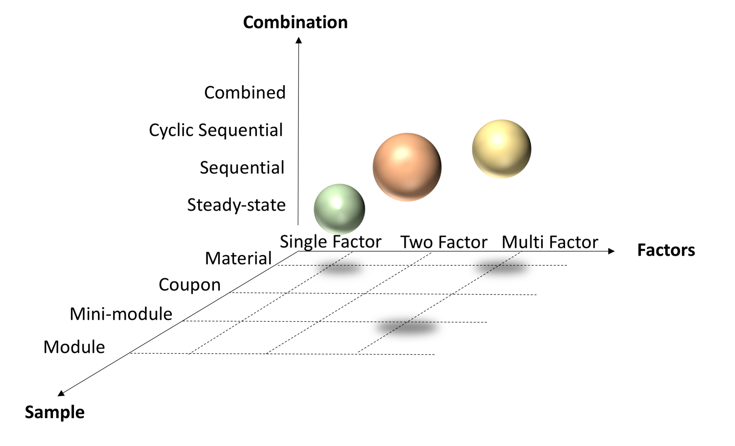
Comprehensiveness of representation in testing
“Sample”: representation of the materials interfaces, boundary conditions of the shipping module
“Factors”: extent of inclusion of the stress factors of the natural environment
“Combination”: representation of the actual combination of stress factors as in the natural environment and their balance (exceeding vs not exceeding real-world stress levels)

Slide 40
Overview
Motivation
Experiment
Results
Degradation modes
Analysis
Costing
Acceleration factors
Wrap-up

Slide 41
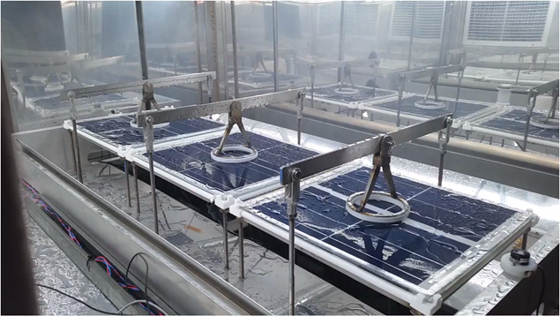
Combined-accelerated stress testing
Heat
Light
Humidity
Condensing
Non-condensing
Mechanical pressure
System voltage
Reverse bias (in progress)
In-situ Metrology
I-V, EL
Modified Atlas XR-260 Weatherometer
Discover potential weaknesses in module designs, both known and not a-priori recognized, reduce risk, accelerate time to market, bankability and reduce costly overdesign, to lower the levelized cost of electricity.

Slide 42
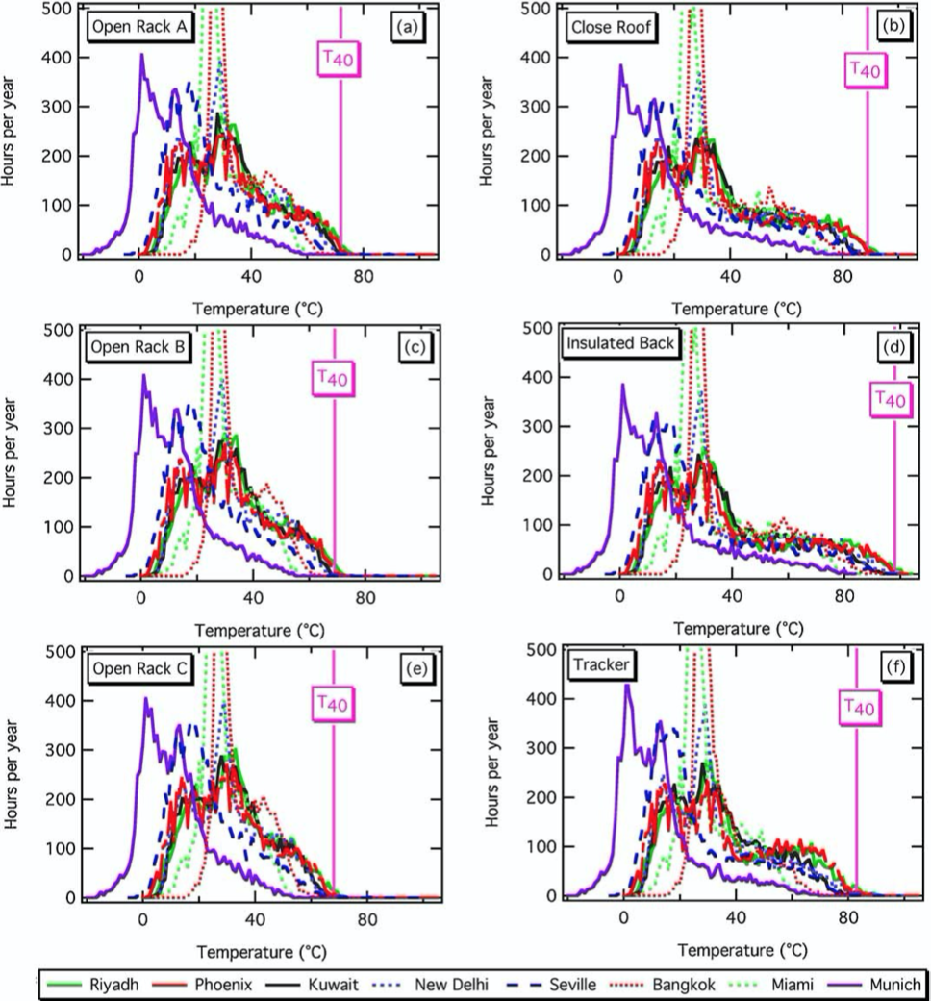
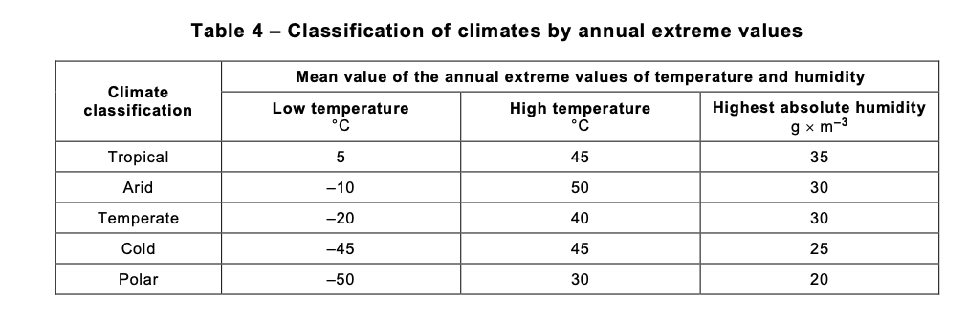
Choice of maximum level: statistical extremes of environment
Choice of maximum temperature
Choice of maximum humidity
Modeled temperatures of modules in various configurations
Under darkness: same as ASTM D7869 cycle. Wet at 40°C
90°C
IEC 60721-2-1
Under light: based on
ASTM D7869: maintain dew point of 36.7 °C
IEC 60721-2-1 ed 2, 35 g/m³ water:
@ 90° C module temperature, 8% module surface RH
(~ 27% in 60°C air)
Keeping levels in the range of what is seen in the natural environment should reduce artifact failures
Modules get much hotter than this during inverter clipping, curtailing; cell mismatch, hotspots
Adapted from Kurtz et al, https://doi.org/10.1002/pip.1103

Slide 43
C-AST Cycle
Dead of winter
(1 d)
-40 °C
DML 10k (1 s)
C-AST includes the effects of the cyclic and sequential nature of the stresses such as diurnal and seasonal cycling, and multiple climates
-40 °C
SL ⨉ 2 (3 m)
x 12
15 °C (35 °C) 20 % RH 0,8 Suns System Voltage
Spring
(2 d)
Rain
0.5 h
1 h
1 h
~ 24 h/ cycle x 35
Damp Heat
Light Soak
Freeze
x4
Tropical
(35 d)
ASTM D7869-based
40 °C, 95 % RH Rain Spray
60 °C (90 °C) 28 % RH 1,9 Suns System Voltage
DML x 16 (3 s)
-20 °C 28 % RH, 95 % RH DML x 20 (3 s)
60 °C (90 °C) 28 % RH 1,9 Suns System Voltage
40 °C 95 % RH Rain Spray
4 hours
1 hour
2 hours
0.5 hours
4 hours
x 60
High desert
(7 d)
-20 °C SL x 2 (15 min)
60 °C (90 °C) 5 % RH 1,9 Suns
SL x 2 (15 min)
0.5 h
0.75 h
0.5 h
Multiple environment combined-accelerated stress testing (C-AST) cycle. Module temperature, when different from chamber air temperature, is shown in parenthesis. Ramp periods are not necessarily included and shown time is sometimes rounded to the next higher integer unit.

Slide 44
Overview
Motivation
Experiment
Results
Degradation modes
Analysis
Costing
Acceleration factors
Wrap-up

Slide 45
Modes, stress factors, and results
Mode | Stress factors
Solder bond failure leading to open circuit (→ hot spots) | Mechanical and thermomechanical stress on conductors. Current leading to joule heating in the conductors
Corrosion, cell-front delamination | Heat, sunlight, voltage and moisture
Potential-induced degradation | Heat, sunlight, voltage, mechanical stress, and humidity
Cell and glass cracks | Heat, humidity, light, system voltage bias, mechanical stress
Yellowing & module packaging optical losses | Heat, sunlight, voltage and moisture
Cracking of backsheet and delamination | Heat, sunlight, voltage, mechanical stress, and humidity
Light-induced degradation | Sunlight and temperature

Slide 46
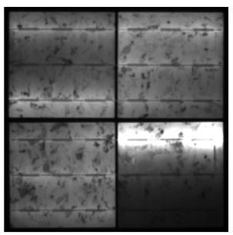
Modes, stress factors, and results
Mode | Stress factors
Solder bond failure leading to open circuit (→ hot spots) | Mechanical and thermomechanical stress on conductors. Current leading to joule heating in the conductors
Corrosion, cell-front delamination | Heat, sunlight, voltage and moisture
Potential-induced degradation | Heat, sunlight, voltage, mechanical stress, and humidity
Cell and glass cracks | Heat, humidity, light, system voltage bias, mechanical stress
Yellowing & module packaging optical losses | Heat, sunlight, voltage and moisture
Cracking of backsheet and delamination | Heat, sunlight, voltage, mechanical stress, and humidity
Light-induced degradation | Sunlight and temperature
Ribbon/bus connection failure

Slide 47
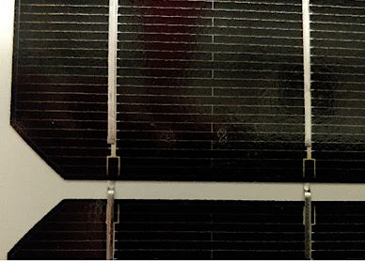
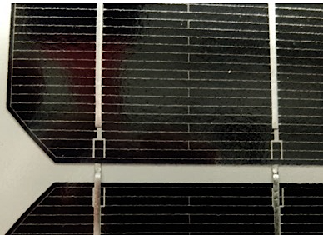
Modes, stress factors, and results
Mode | Stress factors
Solder bond failure leading to open circuit (→ hot spots) | Mechanical and thermomechanical stress on conductors. Current leading to joule heating in the conductors
Corrosion, cell-front delamination | Heat, sunlight, voltage and moisture
Potential-induced degradation | Heat, sunlight, voltage, mechanical stress, and humidity
Cell and glass cracks | Heat, humidity, light, system voltage bias, mechanical stress
Yellowing & module packaging optical losses | Heat, sunlight, voltage and moisture
Cracking of backsheet and delamination | Heat, sunlight, voltage, mechanical stress, and humidity
Light-induced degradation | Sunlight and temperature
Polyamide
PVDF
PVDF = Polyvinylidene difluoride

Slide 48
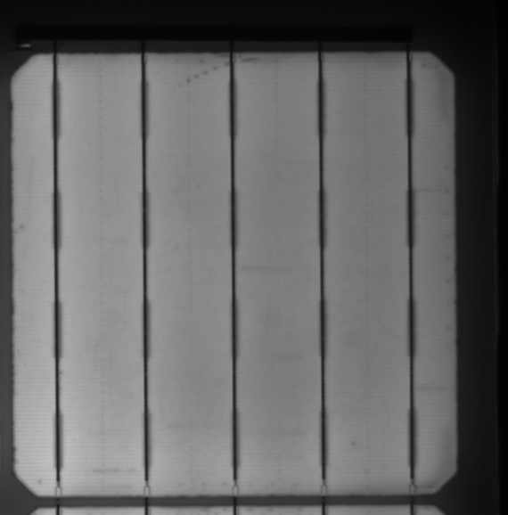
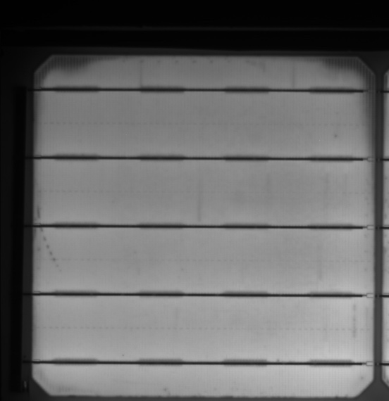
Modes, stress factors, and results
Mode | Stress factors
Solder bond failure leading to open circuit (→ hot spots) | Mechanical and thermomechanical stress on conductors. Current leading to joule heating in the conductors
Corrosion, cell-front delamination | Heat, sunlight, voltage and moisture
Potential-induced degradation | Heat, sunlight, voltage, mechanical stress, and humidity
Cell and glass cracks | Heat, humidity, light, system voltage bias, mechanical stress
Yellowing & module packaging optical losses | Heat, sunlight, voltage and moisture
Cracking of backsheet and delamination | Heat, sunlight, voltage, mechanical stress, and humidity
Light-induced degradation | Sunlight and temperature

Slide 49
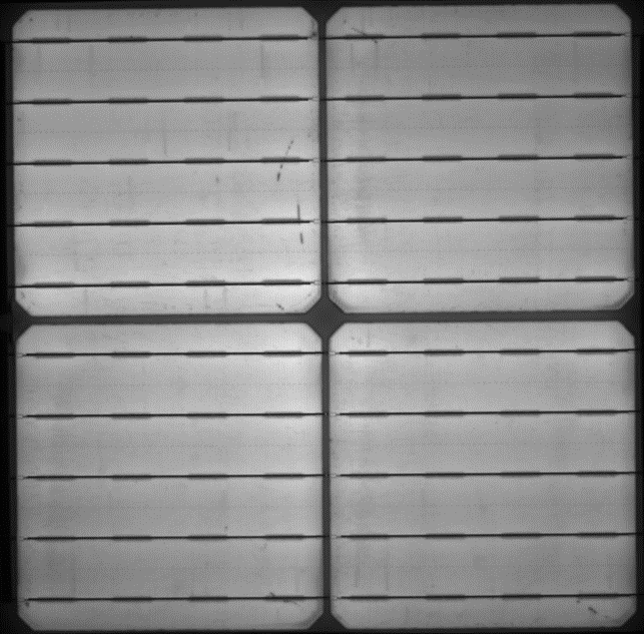
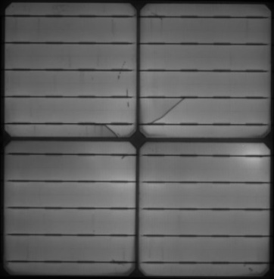
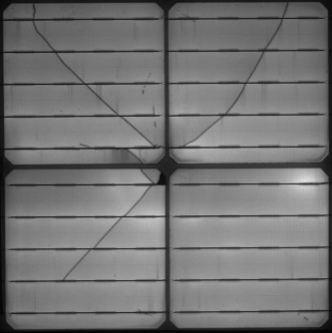
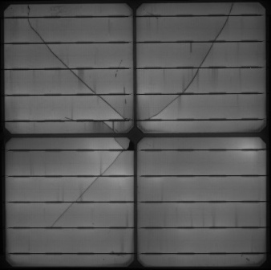
Modes, stress factors, and results
Mode | Stress factors
Solder bond failure leading to open circuit (→ hot spots) | Mechanical and thermomechanical stress on conductors. Current leading to joule heating in the conductors
Corrosion, cell-front delamination | Heat, sunlight, voltage and moisture
Potential-induced degradation | Heat, sunlight, voltage, mechanical stress, and humidity
Cell and glass cracks | Heat, humidity, light, system voltage bias, mechanical stress
Yellowing & module packaging optical losses | Heat, sunlight, voltage and moisture
Cracking of backsheet and delamination | Heat, sunlight, voltage, mechanical stress, and humidity
Light-induced degradation | Sunlight and temperature

Slide 50
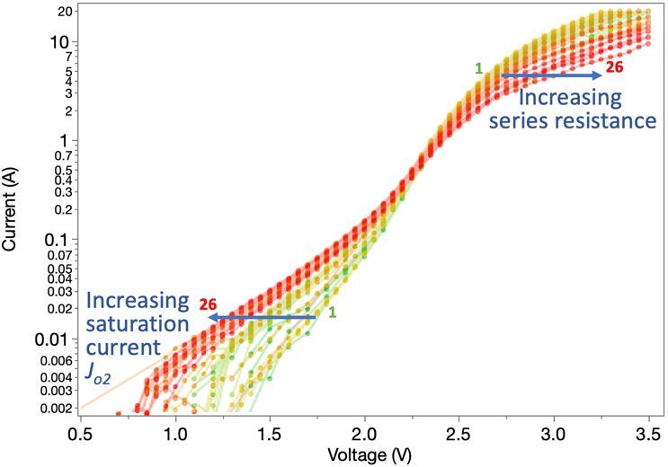
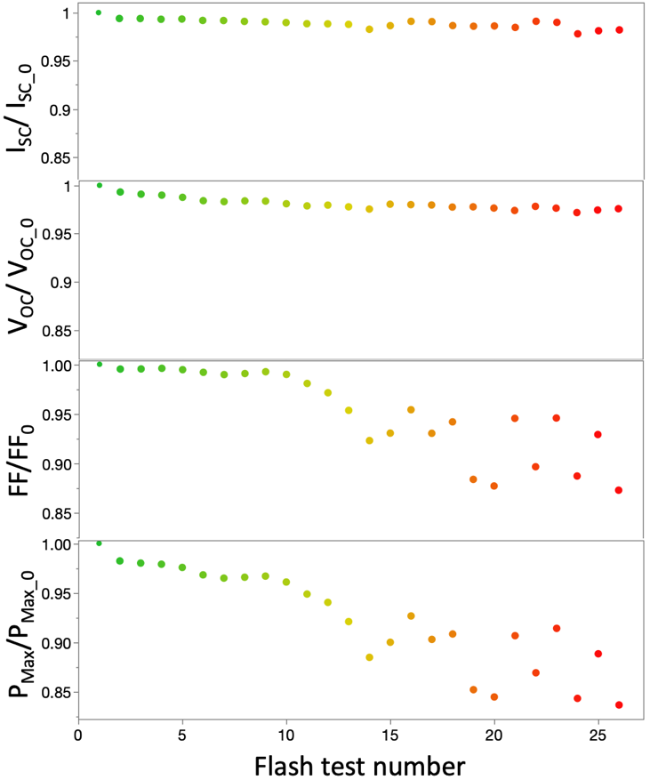
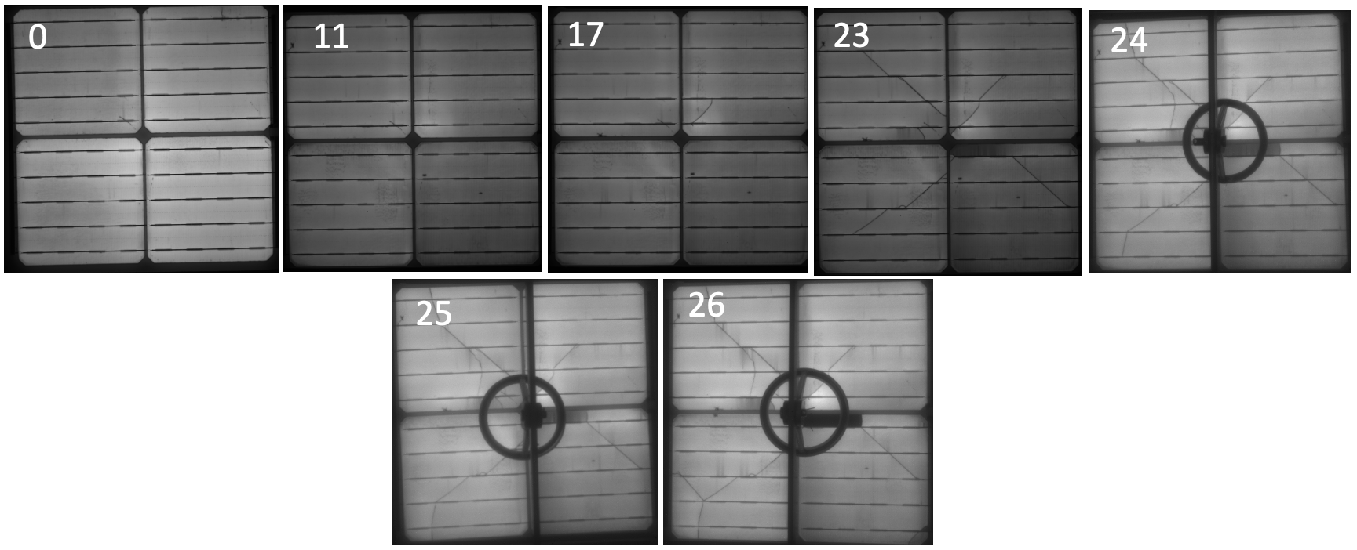
Analysis: c-Si PERC Cell Breakage in Glass/Backsheet Modules
Approximately 8 months of testing
Light I-V (ex-situ) analysis
Dark I-V (in-situ) fit with 2 diode model
Dark I-V (in-situ)
 | Initial | Final
R_{shunt} (Ohm-cm²) | 1 x 10⁹ | 1 x 10⁹
J₀₁ (Ohm/cm²) | 3.3 x 10⁻¹³ | 3.1 x 10⁻¹³
n₁ | 1.0 | 1.0
J₀₂ (Ohm/cm²) | 1.5 x 10⁻⁷ | 6.7 x 10⁻⁷
n₂ | 2.6 | 3.0
R_{series}(Ohm/cm²) | 2.5 | 4.8
FF (Light I-V) | 0.796 | 0.661 – 0.707
Calculated FF_{Final} due to series resistance = 0.796 – .042*(4.8–2.5) = 0.700
Electroluminescence

Slide 51
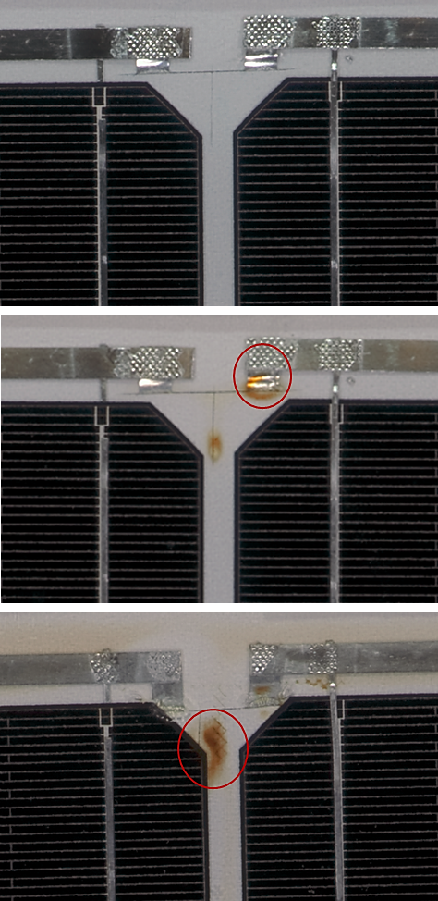
Modes, stress factors, and results
Mode | Stress factors
Solder bond failure leading to open circuit (→ hot spots) | Mechanical and thermomechanical stress on conductors. Current leading to joule heating in the conductors
Corrosion, cell-front delamination | Heat, sunlight, voltage and moisture
Potential-induced degradation | Heat, sunlight, voltage, mechanical stress, and humidity
Cell and glass cracks | Heat, humidity, light, system voltage bias, mechanical stress
Yellowing & module packaging optical losses | Heat, sunlight, voltage and moisture
Cracking of backsheet and delamination | Heat, sunlight, voltage, mechanical stress, and humidity
Light-induced degradation | Sunlight and temperature
Bad
soldering
(TPT Backsheet)

Slide 52
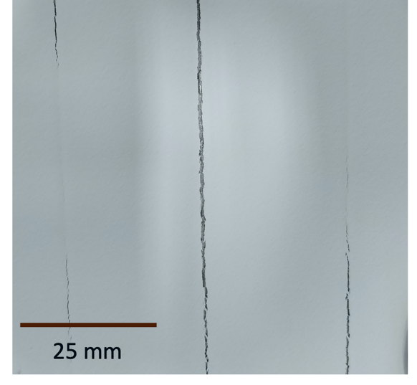
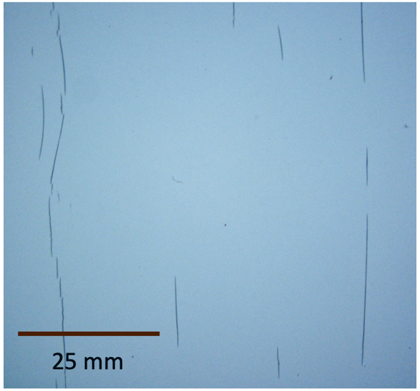
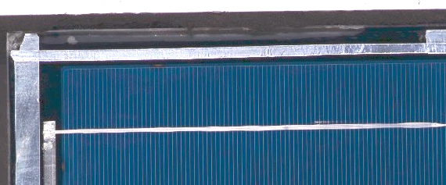
Modes, stress factors, and results
Mode | Stress factors
Solder bond failure leading to open circuit (→ hot spots) | Mechanical and thermomechanical stress on conductors. Current leading to joule heating in the conductors
Corrosion, cell-front delamination | Heat, sunlight, voltage and moisture
Potential-induced degradation | Heat, sunlight, voltage, mechanical stress, and humidity
Cell and glass cracks | Heat, humidity, light, system voltage bias, mechanical stress
Yellowing & module packaging optical losses | Heat, sunlight, voltage and moisture
Cracking of backsheet and delamination | Heat, sunlight, voltage, mechanical stress, and humidity
Light-induced degradation | Sunlight and temperature
PA Backsheet cracking
PA = polyamide
PVDF Backsheet cracking
PVDF = Polyvinylidene difluoride
Silicone encapsulant delamination

Slide 53
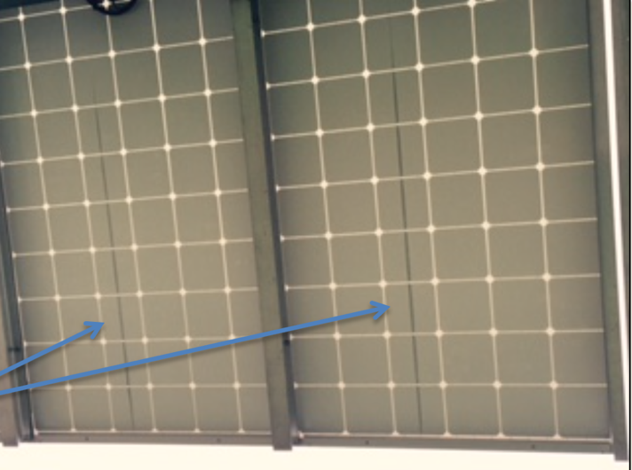
Analysis: PVDF cracking - fundamentals
Issue does not seem to be found in
IEC 61215
IEC 61730
PVEL’s PQP (in modification to catch it)
CSA Group’s C450
IEC 63209 draft (in modification to catch it)
Was found in
DuPont MAST 1
PVDF
Saskatchewan Canada, 5 y
(photo credit: DuPont)

Slide 54
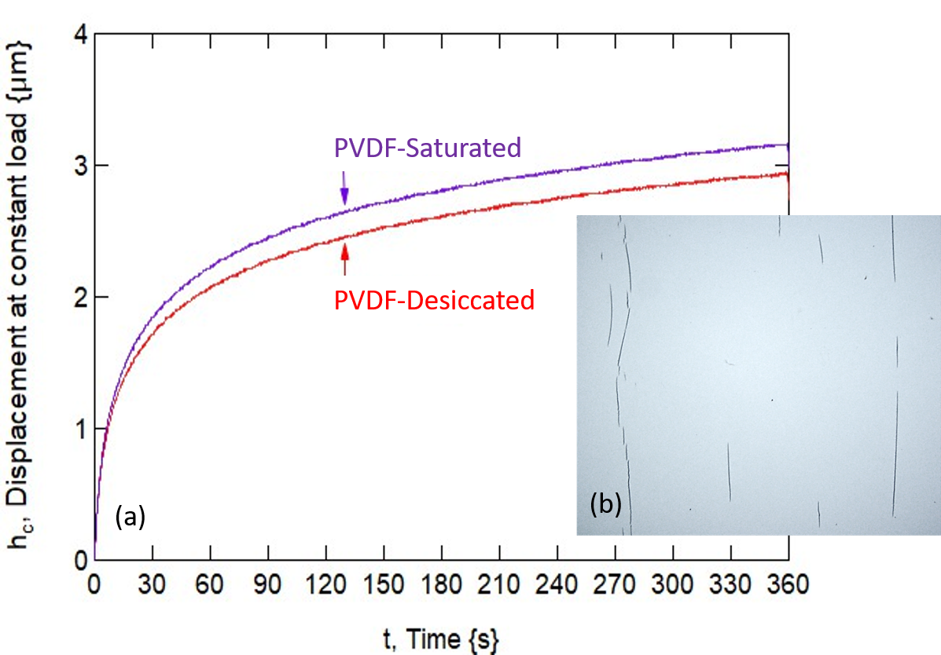
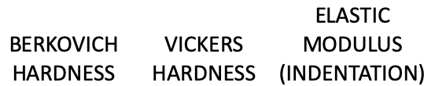
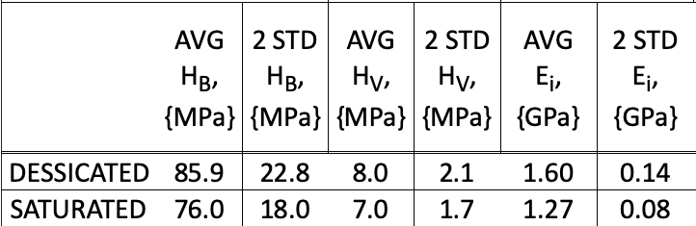
Analysis: cause of the PVDF cracking
Indentation testing
Displacement/time data for creep–hold indentation tests for a PVDF backsheet type following 24-weeks in C-AST Tropical followed by the following courses for 14 days:
desiccation (20 °C, <5% RH)
moisture saturation (40 °C / 96% RH)
Moisture leads to plasticization of the backsheet – whereas the desiccated PVDF is harder, more rigid, less prone to creep.
Dry conditions on the weathered material finally produce the cracking.
Degradation believe associated with poly(methyl methacrylate) PMMA additive used for adhesion, processing, and cost
Owen‐Bellini, M., Hacke, P., Miller, D.C., Kempe, M.D., Spataru, S., Tanahashi, T., Mitterhofer, S., Jankovec, M. and Topič, M., Advancing reliability assessments of photovoltaic modules and materials using combined‐accelerated stress testing. Progress in Photovoltaics: Research and Applications https://doi.org/10.1002/pip.3342

Slide 55
Modes, stress factors, and results
Mode | Stress factors
Solder bond failure leading to open circuit (→ hot spots) | Mechanical and thermomechanical stress on conductors. Current leading to joule heating in the conductors
Corrosion, cell-front delamination | Heat, sunlight, voltage and moisture
Potential-induced degradation | Heat, sunlight, voltage, mechanical stress, and humidity
Cell and glass cracks | Heat, humidity, light, system voltage bias, mechanical stress
Yellowing & module packaging optical losses | Heat, sunlight, voltage and moisture
Cracking of backsheet and delamination | Heat, sunlight, voltage, mechanical stress, and humidity
Light-induced degradation | Sunlight and temperature
B-O LID
Light & elevated temperature degradation (LeTID)
UV LID (H, charges)

Slide 56
Analysis: Light-induced degradation modes
B-O LID
Light & elevated temperature degradation (LeTID)
UV LID (H, charges)
Remains to be studied in C-AST
• Anticipated to manifest in spring cycle
- because lights are run with sample at low temperature
- (light + high temperature → stabilized “C” state)
Spring
(2 days)
-40 °C
SL ⨉ 2 (3 m)
x 12
15 °C (35 °C) 20 % RH 0,8 Suns System Voltage
Rain
0.5 h
1 h
1 h

Slide 57
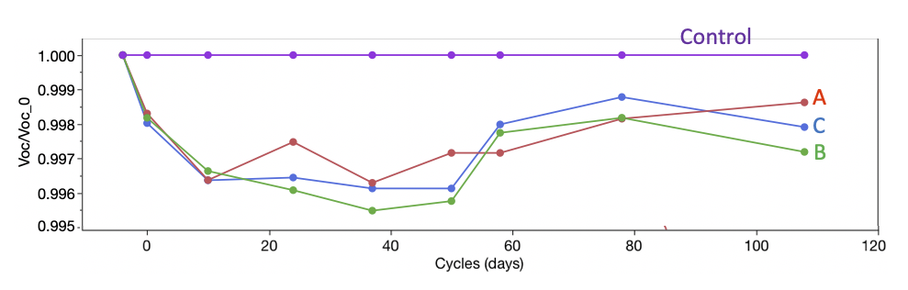
Analysis: Light-induced degradation modes
B-O LID
Light & elevated temperature degradation (LeTID)
UV LID (H, charges)
Seen in C-AST in the Tropical cycle
Modules degrade and then recover in V_{oc} characteristic of LeTID
~ 24 h/ cycle x 35
Damp Heat
Light Soak
Freeze
x4
Tropical
(5 weeks)
ASTM D7869-based
40 °C, 95 % RH Rain Spray
60 °C (90 °C) 28 % RH 1,9 Suns System Voltage
DML x 16 (3 s)
-20 °C 28 % RH, 95 % RH DML x 20 (3 s)
60 °C (90 °C) 28 % RH 1,9 Suns System Voltage
40 °C 95 % RH Rain Spray
4 hours
1 hour
2 hours
0.5 hours
4 hours
Hartman, K., Hacke, P., Owen-Bellini, M., et.al., 2019, June. Validation of Advanced Photovoltaic Module Materials and Processes by Combined-Accelerated Stress Testing (C-AST). In 2019 IEEE 46th Photovoltaic Specialists Conference (PVSC) (pp. 2243-2248). IEEE.

Slide 58
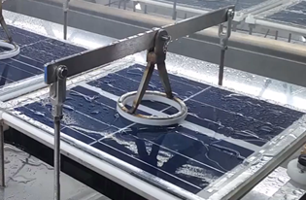
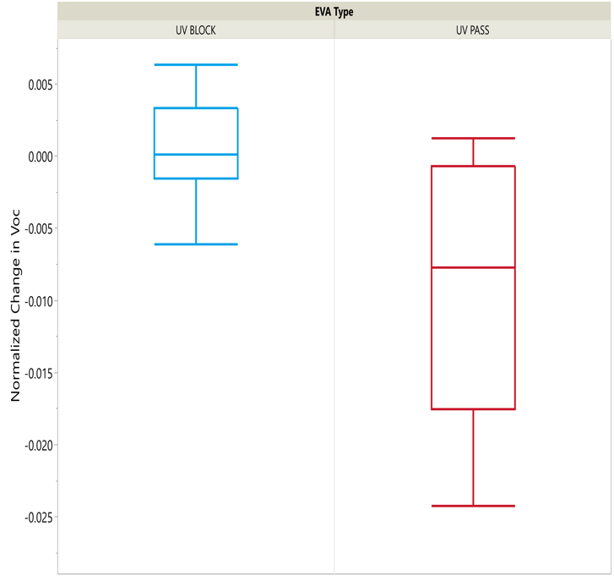
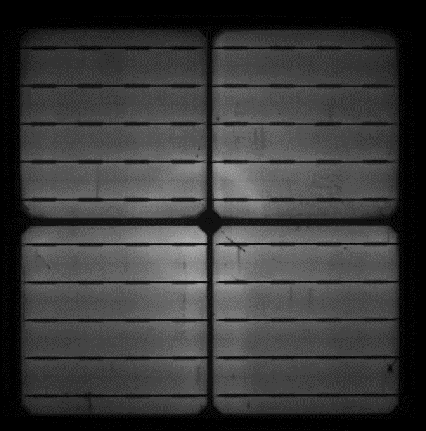
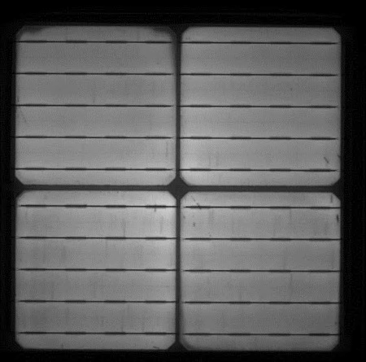
Analysis: Light-induced degradation modes
B-O LID
Light & elevated temperature degradation (LeTID)
UV LID (H, charges)
Seen in C-AST in the Tropical cycle
UV Pass EVA
UV Block EVA
UV Block EVA
UV Pass EVA
-7.5 mV
-0 mV
-0 mV
-7.5 mV
Shadowed region showing higher lifetime: attributed to UV degradation in tropical test

Slide 59
Modes, stress factors, and results
Mode | Stress factors
Solder bond failure leading to open circuit (→ hot spots) | Mechanical and thermomechanical stress on conductors. Current leading to joule heating in the conductors
Corrosion, cell-front delamination | Heat, sunlight, voltage and moisture
Potential-induced degradation | Heat, sunlight, voltage, mechanical stress, and humidity
Cell and glass cracks | Heat, humidity, light, system voltage bias, mechanical stress
Yellowing & module packaging optical losses | Heat, sunlight, voltage and moisture
Cracking of backsheet and delamination | Heat, sunlight, voltage, mechanical stress, and humidity
Light-induced degradation | Sunlight and temperature

Slide 60
Overview
Motivation
Experiment
Results
Degradation modes
Analysis
Costing
Acceleration factors
Wrap-up

Slide 61
PRELIMINARY Results for Bottom-Up Cost Modeling of C-AST
6 full-sized modules per year tested in each C-AST chamber
2018 industry medians: 2% of revenues budgeted for R&D plus 11% of revenues budgeted for S, G, & A
$180/m² per year facility leasing costs
7-year straight line depreciation of investment in C-AST chambers
$0.08/kWh electricity price
5 C-AST chambers per direct operator, 4 shifts
20 C-AST chambers per supervisor, 4 shifts
20 C-AST chambers per engineer, day shifts only
200 hours of maintenance time per chamber per year
A little lower than PVEL PQP
$79,424
See: https://www.duramat.org/assets/pdfs/duramat_webinar_march2020.pdf

Slide 62
PRELIMINARY Results for Bottom-Up Cost Modeling of C-AST
6 full-sized modules per year tested in each C-AST chamber
2018 PV industry medians: 2% of revenues budgeted for R&D plus 11% of revenues budgeted for S, G, & A
$180/m² per year facility leasing costs
7-year straight line depreciation of investment in C-AST chambers
$0.08/kWh electricity price
5 C-AST chambers per direct operator, 4 shifts
20 C-AST chambers per supervisor, 4 shifts
20 C-AST chambers per engineer, day shifts only
200 hours of total maintenance time per chamber per year (2.2% downtime)
Better / lower-cost C-AST designs anticipated
12 modules
per 50 MW
See: https://www.duramat.org/assets/pdfs/duramat_webinar_march2020.pdf

Slide 63
Overview
Motivation
Experiment
Results
Degradation modes
Analysis
Costing
Acceleration factors
Wrap-up

Slide 64
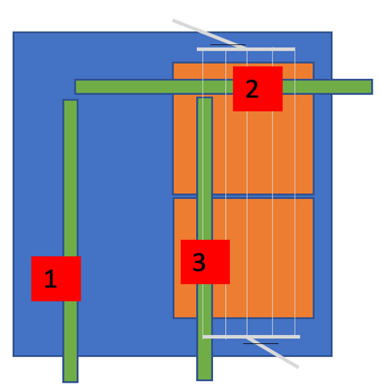
C-AST Tropical cycle: acceleration
Evaluation of acceleration factors with respect to:
Degradation of outer layer of backsheet as a function of temperature and light
Degradation of inner layer PET in backsheet as a function of temperature and humidity
Electrochemical degradation using leakage current as in indicator
Method of internal humidity measurements based on the method of Jankovec et. al.
Module Internal
Relative Humidity (%)
Irradiance (W/m²)
Module Temperature (°C)
Jankovec and coworkers, IEEE J. Photovoltaics 6(5) 2016

Slide 65
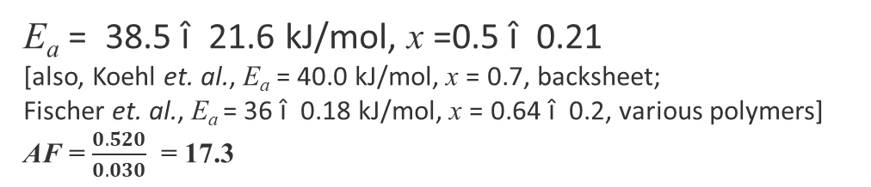
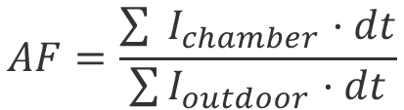
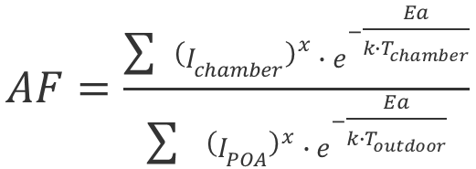

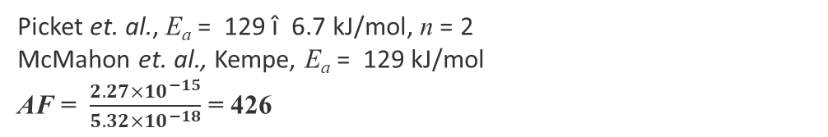
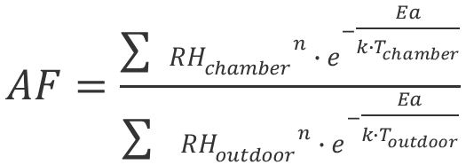
Acceleration in combined-accelerated stress testing: Tropical cycle
Hacke, P., et. al. Establishing Module Durability with Combined-Accelerated Stress Testing, in 10th International Conference on Crystalline Silicon Photovoltaics 2020, June 1-5 Hangzhou, China https://cms2020.siliconpv.com/video/list
Acceleration in degradation rate f (T, I) of C-AST Tropical vs. Miami FL USA TMY Outer layer polymer
$$AF=\frac{\sum{ }{\left(I_{chamber}\right)}^{x}∙e^{−\frac{Ea}{k∙T_{chamber}}}}{\sum{ {\left(I_{POA}\right)}^{x}{∙e}^{−\frac{Ea}{k∙T_{outdoor}}}}}$$
E_{a} = 38.5 ± 21.6 kJ/mol, x =0.5 ± 0.21
[also, Koehl et. al., E_{a} = 40.0 kJ/mol, x = 0.7, backsheet;
Fischer et. al., E_{a} = 36 ± 0.18 kJ/mol, x = 0.64 ± 0.2, various polymers]
AF = $\frac{0.520}{0.030}$ = 17.3
Acceleration in degradation rate f (T, RH) of C-AST Tropical vs. Miami FL USA TMY Inner layer PET
$$AF=\frac{\sum{ }{{RH}_{chamber}}^{n}∙e^{−\frac{Ea}{k∙T_{chamber}}}}{\sum{ {{RH}_{outdoor}}^{n}{∙e}^{−\frac{Ea}{k∙T_{outdoor}}}}}$$
Picket et. al., E_{a} = 129 ± 6.7 kJ/mol, n = 2
McMahon et. al., Kempe, E_{a} = 129 kJ/mol
AF = $\frac{{2.27×10}^{−15}}{{5.32×10}^{−18}}$ = 426
Acceleration in electrochemical corrosion of C-AST Tropical vs. Cocoa FL USA
$$AF=\frac{\sum{ }I_{chamber}·dt}{\sum{I_{outdoor}·dt}}$$
AF = $\frac{{8.37 × 10}^{−4} C/(V·cm·y)}{{5.937 × 10}^{−5} C/(V·cm·y)}$ = 14.1
Coulombs transferred in chamber vs. measured in modules in Florida, Hacke et. al.
30

Slide 66
Wrap-up
Combined-accelerated stress testing is designed to test for almost all failure modes in PV modules, including those we haven’t developed tests for in new designs/materials
A C-AST system was constructed by modifying a weathering chamber
Failure modes seen include: solder bond failure leading to open circuit (→ hot spots) corrosion, cell-front delamination, potential-induced degradation, cell cracks, yellowing & module packaging optical losses, cracking of backsheet and delamination, various light-induced degradation modes.
Degradation characterized by in-situ EL and I-V curves, e.g., fill factor loss due to series resistance and recombination currents
Multi-season stress sequences lead to failures not seen in steady-state tests
Analyses show failure mechanism representative of those seen in the field
Cost of C-AST slightly better than suite of mechanism-specific extended sequential parallel tests implemented in industry and much room for improvement in C-AST tooling for cost effectiveness exists.
Acceleration factors for three degradation modes for the C-AST tropical sequence for the Florida USA environment computed:
- Degradation due to temperature irradiance of outer layer polymerics, 17.3 x
- Degradation of inner layer PET: 426 x
Humidity-related degradation occurs most rapidly when the sun comes out after hot/humid wet periods
- Electrochemical degradation associated with current transfer through the module packaging: 14.1 x

Slide 67
Thank you
AIST Team: Tadanori Tanahashi, Keiichiro Sakurai Dupont Team: Bill Gambogi, John Trout Mitsui Chemical: Tsuyoshi Shioda
Tessolar Inc: Katy Hartman Itek Energy/Silfab PVQAT TG3 members, DuraMAT team
This work was authored by the National Renewable Energy Laboratory, operated by Alliance for Sustainable Energy, LLC, for the U.S. Department of Energy (DOE) under Contract No. DE-AC36-08GO28308. Funding provided by EERE The views expressed in the article do not necessarily represent the views of the DOE or the U.S. Government. The U.S. Government retains and the publisher, by accepting the article for publication, acknowledges that the U.S. Government retains a nonexclusive, paid-up, irrevocable, worldwide license to publish or reproduce the published form of this work, or allow others to do so, for U.S. Government purposes.

Slide 68
Component Qualification and Beyond: How Standards Help Us Improve PV System Reliability
Ingrid Repins, Steve Johnston
Workshop on Clean Energy: Advancing Growth of PV Development in India
September 29, 2020

Slide 69
How Standards Help Us Improve PV System Reliabilty
Module Standards
How they have been developed
How they benefit us
Updates to IEC 61215 for 2021
Moving beyond just component standards
IECRE

Slide 70
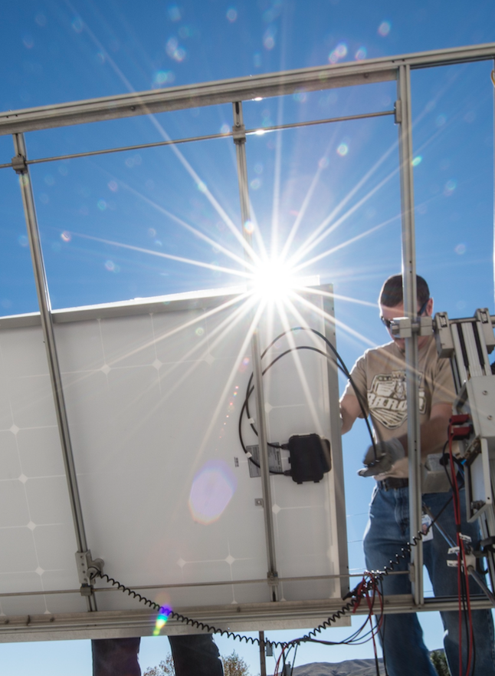
Module Standards
Modules have been the focus of standardization in PV over the years because
complex construction,
workhorse of system,
historically the most expensive
People want to know
Is it safe?
Is it durable?

Slide 71
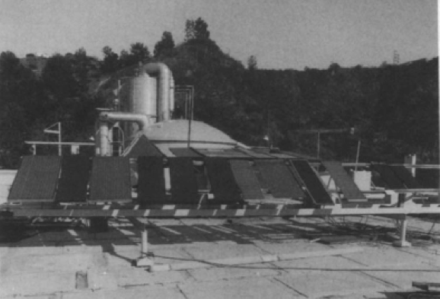
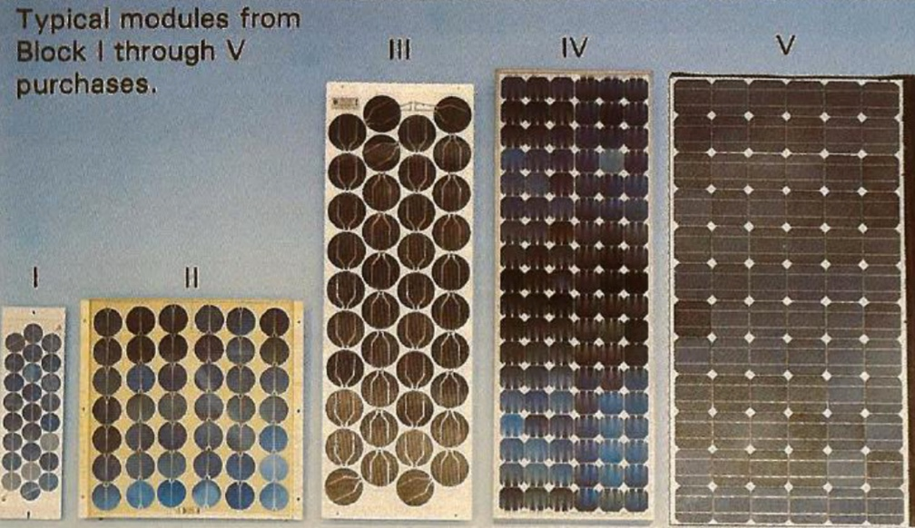
Origins of Standard PV Module Accelerated Tests
PVB
PVB Modules corroded
Define associated accelerated tests
Bulk conductivity
EVA
Identify failures
Design modules to pass tests
Deploy modules
Solar Cells, 28 (1990)
Wohlgemuth, IEEE 43
Jet Propulsion Laboratory executed a series of “block buys” in 1975-1986

Slide 72
Origins of Standard PV Module Accelerated Tests
Test | Block I | Block II | Block III | Block IV | Block V
Thermal Cycles | 100 -40 to +90C | 50 -40 to +90C | 50 -40 to +90C | 50 -40 to +90C | 200 -40 to + 90C
Humidity Freeze | 70C,90% 68 hrs | 5 cycles 40 C, 90%RH to -23 C | 5 cycles 40 C, 90%RH to -23 C | 5 cycles 54C, 90%RH to -23 C | 10 cycles: 20 h at 85 C / 85% RH, 4 h excursion to -40°C
Hot Spot |  |  |  |  | 3 cells 100 hrs
Mechanical Load |  | 100 cycles ± 2400 Pa | 100 cycles ± 2400 Pa | 10000 ± 2400 Pa | 10000 ± 2400 Pa
Hail |  |  |  | 9 impacts ¾” –45 mph | 10 impacts 1” – 52 mph
High Pot |  | <15 µA 1500 V | < 50 µA 1500 V | < 50 µA 1500 V | < 50 µA 2*Vs+1000
Aspects of these test conditions look familiar from today’s standards.
The process of observing failures and applying stresses continues for newer failures (e.g. PID).

Slide 73
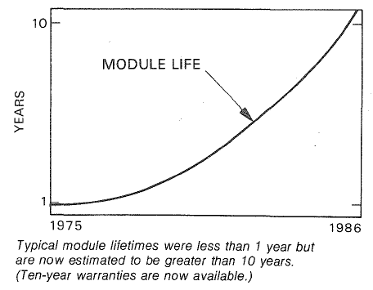
Origins and Success of Standard PV Module Accelerated Tests
The tests developed in the block buy program increased deployed module lifetime dramatically.
JPL final report
Wohlgemuth, IEEE 43

Slide 74
Origins and Success of Standard PV Module Accelerated Tests
Incorporation of these accelerated tests and related work into IEC 61215 (design qualification) and IEC 61730 (safety) standards has resulted in typical performance warranties around 25 years (and climbing).
The tests developed in the block buy program increased deployed module lifetime dramatically.
JPL final report
Wohlgemuth, IEEE 43

Slide 75
IEC 61215 and IEC 61730 Have a Lot in Common (Heritage and Tests)
IEC 61730
Safety
Maximum power determination
MQT 2, MST 3
Robustness of terminations MST 42, MQT 14
Accessibility
MST 11
Insulation t
MST 4
IEC 61215
Durability
NMOT
MQT 5
Performance at STC
MST 2, MQT 6
Continuity
MST 13
Peel
MST 35
Breakage
MST 32
Performance at low irradiance
MQT 7
Bypass diode
MST 7, MST 25, MQT 18
Damp heat test MST 53,MQT 13
Impulse V
MST 14
Stabilization MQT 19
Construction Requirements
Creep
MST 37
Insulation test
MST 13, MQT 3
Humidity-freeze test MST 52, MQT 12
UV
MQT 10, MST 54
Sharp Edge
MST 6
Hail test MQT 17
Outdoor exposure MQT 8
Markings
MST 5
Hot-spot test
MST 22, MQT 9
Fire and Ignitability
MST 23, 24
Wet leakage current
MST 14, MQT 15
Static mechanical load test
MST 34, MQT 16
T coefficents
MQT 4
Cut
MST 12
Screw
MST 33
Temperature
MST 21
Reverse Current
MST 26
Visual inspection
MQT 1, MST 1
Thermal cycling
MQT 11,MST 51
Performance requirements
Lap Shear
MST 36
Cold
MST 36

Slide 76
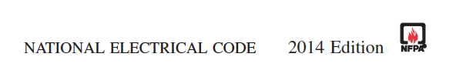
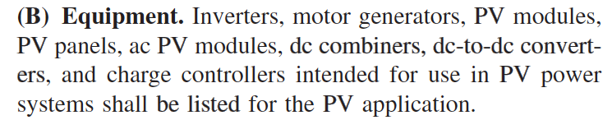

How adoption of IEC 61730 and IEC 61215 in U.S. Helps System Quality
The U.S. National Electric Code requires components to be listed (UL 61730 for modules).
Minimizes occurrence of unsafe conditions (e.g. shaded module overheats)
Incentive programs may require passing UL 61215 to ensure known early failures are not experienced.
Example – module installed before IEC 61215 adoption. Solder bond fatigue is well understood and screened by IEC 61215, but these modules were not design-qualified.

Slide 77






How adoption of IEC 61730 and IEC 61215 in U.S. Helps System Quality
The U.S. National Electric Code requires components to be listed (UL 61730 for modules).
Minimizes occurrence of unsafe conditions (e.g. shaded module overheats)
Incentive programs may require passing UL 61215 to ensure known early failures are not experienced.
Example – module installed before IEC 61215 adoption. Solder bond fatigue is well understood and screened by IEC 61215, but these modules were not design-qualified.

Slide 78
Updates for IEC 61215 New Edition (expected 2021)
Standards are continually modified to account for new technologies, and newly- observed degradation modes:
(* = also applied to IEC 61730)

Slide 79

Updates for IEC 61215 New Edition (expected 2021)
Standards are continually modified to account for new technologies, and newly- observed degradation modes:
Procedures for bifacial modules*
Addition of dynamic mechanical load test
Addition of potential induced degradation test
Use of representative samples
New Stabilization for Boron-Oxygen Light Induced Degradation (B-O LID)
Removal of NMOT test
(* = also applied to IEC 61730)
Rear W/m²: 135 for performance, 300 worst-case for stress
Measure as per IEC TS 60904-1-2
Stress | Test # (MQT) | Level for Monofacial Module | Level for Bifacial Module
Nameplate verification | Gate No. 1 | 1000 W/m² | Also 1000 W/m² front, 135 W/m² rear
UV Exposure | 10 | Front only | Front then rear side
Thermal Cycling | 11 | Imp@STC | Imp@(STC+ 300 rear)
Bypass Thermal Diode Test | 18.1 | 1.25 x Isc@STC | Test Current = 1.25 x Isc@(STC + 300 rear)
Bypass Diode Functionality Test | 18.2 | 1.25 x Isc@STC | Test Current = 1.25 x Isc@(STC + 300 rear)
Hot Spot Endurance | 09 | 1000 W/m² | 1000 W/m² on front and 300 W/m² on rear

Slide 80

Updates for IEC 61215 New Edition (expected 2021)
Standards are continually modified to account for new technologies, and newly- observed degradation modes:
Procedures for bifacial modules*
Addition of dynamic mechanical load test
Addition of potential induced degradation test
Use of representative samples
New Stabilization for Boron-Oxygen Light Induced Degradation (B-O LID)
Removal of NMOT test
Tests for extreme susceptibility to mechanical stress. (E.g. cells that are already cracked by stringer, at left.)
Test is taken from IEC TS 62782.
1000 Pa for 1000 cycles, based largely on BP data.
Enough force and repetition to detect pre-existing problems.
It is not a module abuse test.

Slide 81

Updates for IEC 61215 New Edition (expected 2021)
Standards are continually modified to account for new technologies, and newly- observed degradation modes:
Procedures for bifacial modules*
Addition of dynamic mechanical load test
Addition of potential induced degradation test
Simulator requirements
Use of representative samples
New Stabilization for Boron-Oxygen Light Induced Degradation (B-O LID)
Removal of NMOT test
Looking for degradation via Na migration from glass into cell and associated shunting (PID-s).
Stress level is harshest of 3 levels defined in IEC TS 62804-1.
Estimated for Si to produce effects similar to ~20 years exposure in warm humid climate.
The most susceptible designs from each device technology fail.

Slide 82

Updates for IEC 61215 New Edition (expected 2021)
Standards are continually modified to account for new technologies, and newly- observed degradation modes:
Procedures for bifacial modules*
Addition of dynamic mechanical load test
Addition of potential induced degradation test
Use of representative samples*
New Stabilization for Boron-Oxygen Light Induced Degradation (B-O LID)
Removal of NMOT test
A small fraction of new products are larger than typical test equipment.
For modules larger than 2.2 m x 1.5 m, representative samples may be used for applying stress and evaluating gate 2 on very large modules.
Reduced dimension(s) shall be no less than one half those that define an eligible module.

Slide 83
Updates for IEC 61215 New Edition (expected 2021)
Standards are continually modified to account for new technologies, and newly- observed degradation modes:
Procedures for bifacial modules*
Addition of dynamic mechanical load test
Addition of potential induced degradation test
Use of representative samples*
New Stabilization for Boron-Oxygen Light Induced Degradation (B-O LID)*
Removal of NMOT test
PERC modules can fail damp heat due to boron-oxygen destabilization (not field-representative)
Private sector data illustrating the problem available at:
https://data.mendeley.com/datasets/b2k4jcd656/1
“Stabilization of Light-Induced Effects in Si Modules for IEC 61215 Design Qualification,” with free access until October 15: https://authors.elsevier.com/a/1be3X_,5YmkEiF

Slide 84

Updates for IEC 61215 New Edition (expected 2021)
Standards are continually modified to account for new technologies, and newly- observed degradation modes:
Procedures for bifacial modules*
Addition of dynamic mechanical load test
Addition of potential induced degradation test
Use of representative samples*
New Stabilization for Boron-Oxygen Light Induced Degradation (B-O LID)*
Removal of NMOT test
Lower-cost, faster product qualification
Higher confidence in design durability
Many locations could not satisfy weather conditions in reasonable time period.
Customers were not using NMOT data much.

Slide 85

Why Do We Need To Move Beyond Just Module Standards?
Example: System at Denver International Airport
Completed in 2008
Welcomes visitors to our area.
Illustrates that we really enjoy the outdoors and want to take care of it.
It’s a really great system, except…..
….they used hydraulics on the trackers that are not qualified for solar.
The trackers get stuck a lot.
One component, or poor workmanship in integrating components (e.g. connectors not tight), can devastate your energy yield.

Slide 86

Why Do We Need To Move Beyond Just Component Standards?
Example: System at Denver International Airport
Completed in 2008
Welcomes visitors to our area.
Illustrates that we really enjoy the outdoors and want to take care of it.
It’s a really great system, except…..
….they used hydraulics on the trackers that are not qualified for solar.
The trackers get stuck a lot.
One component, or poor workmanship in integration, can devastate your energy yield.
To achieve high return on investment, a metric for system quality, not just initial cost per watt, is needed.

Slide 87
The IECRE (RE = Renewable Energy) Certification System
Project Timeline
✓
✓
✓
✓
Design Qualification
Commissioning
Annual Performance
Asset Transfer
Provides confidence in PV system quality at each stage of PV system life
Over 30 standards and operational documents were created or revised by international teams of experts, starting in 2014, to enable IECRE certifications for PV.

Slide 88


The IECRE (RE = Renewable Energy) Certification System
Excerpt from OD-401 on plant commissioning
For each stage of system life, the required standards are collected into an “operational document” (OD). You can browse OD’s for free at https://www.iecre.org/documents/refdocs/
Solar OD’s have names of the format “OD-4xx”.

Slide 89

The IECRE (RE = Renewable Energy) Certification System
The IECRE system is fairly new, but we are starting to see certificates issued!
How you can take advantage:
Specify IECRE certification or use of methods in IECRE OD’s as a procurement requirement.
Differentiate your company by quality certification, or use of IECRE methods.

Slide 90
Thank you
Component Qualification and Beyond
This work was authored by the National Renewable Energy Laboratory, operated by Alliance for Sustainable Energy, LLC, for the U.S. Department of Energy (DOE) under Contract No. DE-AC36-08GO28308. The views expressed in the article do not necessarily represent the views of the DOE or the U.S. Government. The U.S. Government retains and the publisher, by accepting the article for publication, acknowledges that the U.S. Government retains a nonexclusive, paid-up, irrevocable, worldwide license to publish or reproduce the published form of this work, or allow others to do so, for U.S. Government purposes.

Slide 91


Assessing wind loads to ensure reliability of solar assets Dr. David Banks President CPP Wind Engineering

Slide 92


Who is David Banks?
President of CPP Wind Engineering
12 years directing solar wind load studies
Half of leading trackers use CPP
Notes:
Publications represent maybe… 5% of what we’ve done and learned?

Slide 93



Who is David Banks?
President of CPP Wind Engineering
12 years directing solar wind load studies
Publications
Notes:
Publications represent maybe… 5% of what we’ve done and learned?

Slide 94

Who is David Banks?
President of CPP Wind Engineering
12 years directing solar wind load studies
Publications
Codes and Standards
Good design should win.
SEAOC PV2

Slide 95

Who are you?
Owner/operator
Engineering, Procurement, Construction (EPC)
Developer
Racking supplier
Insurance
Independent Engineer (IE)
Authority Having Jurisdiction (AHJ)
Notes:
Everyone gets called in when there’s a failure. Including me.
Every person in the chain ends up with their own expert review… yet still this happens. Because it’s

Slide 96

Root Cause of PV claims
Who are you?
Owner/operator
Engineering, Procurement, Construction (EPC)
Developer
Racking supplier
Insurance
Independent Engineer (IE)
Authority Having Jurisdiction (AHJ)
“Weather” includes floods, hail, snow, and wind
Notes:
https://www.solarpowerworldonline.com/2018/01/solar-industry-responding-increasing-intensity-natural-disasters/
(North America)
So hopefully I’ve impressed on you why I care about wind loads, and why you should too.

Slide 97


Design Wind speed
Do you trust this map?
Notes:
Huge changes at boundary = bad sign
Speeds in north unrealistic
This is not a good safety net for poor design. Quite the opposite, only cheaters will be competitive.

Slide 98



Ground Mount
Carport loads in the building code are not adequate
Notes:
Tilt = 7.49°…
Higher loads on leeward to get loads in corner posts
Divided in half, should be into thirds or quarters.
Gust factor should be 1.0
Asymmetric loads along span
Aspect ratio ignored
Multi-row has an effect
Gaps have an effect

Slide 99

Ground Mount
Inertial loading must be considered
Dynamics
Because of multiple rows
Need to pluck to get damping
Notes:
1.03 Hz is not rigid; huge vortex shedding peak is at 2 Hz.
DAF can be 3 or 4, if damping is low.
No one is considering this, because you can’t sell a system if you do.

Slide 100

Single Axis Trackers require Aeroelastic wind tunnel test
Notes:
Happens at 40 mph/ 15 m/s; which occurs annually in many places.
Numerical simulation? Were is the validation?

Slide 101

Commercial Roof Mount

Slide 102

Bubble Separation

Slide 103


Conical vortices form at roof corners
Wind from 45°
Notes:
The worst suction forces on the roof itself are created by the corner vortices that form during cornering winds.
They also form over the wings of some kinds of aircraft, so they are sometimes called “delta-wing vortices”.

Slide 104



Commercial Roof Mount Wind Tunnel Testing
Don’t just test on small roof
Notes:
Small roof is often all that’s tests
Or increase the height, same deal.
Small
Thought experiment: what if all dimensions 2X bigger? Load would be about the same.

Slide 105

Limitations
Is Geometry change OK?
Change in tilt
Change in row spacing
Change in height off roof
Distortion due to loading
Alignment to roof edges
How flat is “flat”?

Slide 106

How to know if analysis is valid?
Code unlikely to be adequate, so
don’t put code-compliance in the contract.
Emphasize performance, warranty, etc.
Best-before date on reports?
Track record
Ask for evidence of survival.
Notes:
““Given the current pace of changes in this field, it is recommended that wind tunnel testing reports be reviewed by the originator every 3 or 4 years from the date of the report to assess the appropriateness and accuracy of the report for continued use.”
Harder than you might think… Developer wants to flip, racking company need quarterly sales, EPC has insurance, insurance company just ups the rates, owner trusts the IE, IE only has nuclear option

Slide 107


What if we had a “black box”?
Notes:
A clearinghouse to share information about root cause of failures?
Can the insurance companies play this role?

Slide 108
Reliability
Wind Climate
Static & Dynamic Loads
Instability
Understand Risk
Notes:
This is where I’d like to end up.

Slide 109
Extra slides

Slide 110

What have we learned?
Residential roof mounts
Equalizing
Roof zones…
Notes:
But what if roof zones are not accurate?
Tell the story of the increase in ASCE low rise coefficients, and opposition from all over.
DON’T HIDE SAFETY FACTORS IN THE ROOF COEFFICIENTS
Also: 3 ft silliness; want wider spacing, instead, jammed together to avoid 3 ft perimeter.

Slide 111

Other systems

Slide 112

Torsional Galloping

Slide 113

Vortex lock-in

Slide 114
Peer Review
wind tunnel details;
profiles, ABL details;
array model details;
building model details;
configurations;
blockage, Reynolds number;
instrumentation details;
Sampling/signal processing details;
peak coefficients method;

Slide 115
How can we help good design to win?
Good testing
Thorough peer reviews
System is slanted to reward under-design
Your wind load determine the winners and losers
Beware of Hubris
It’s not as simple as it appears:
support structure, 2nd row peak, small gaps, taps/row
State your uncertainties
Best-before data on reports
Help those interested in good design
Developer flips, owner trusts IE, IE in tough spot, EPC has insurance, Insurance just raise the rates
Notes:
Good testing – good procedures, but also, useful testing. No one is building dual axis trackers on a rooftop. Come on now.
These peer reviews matter. If you say OK to loads that are too low, then someone will build hundreds of sites using your numbers: schools, shopping malls, island nations. Can you explain why the loads are different from the code?
You may also put several good systems off the market; and your client will assume their success is because of their hard work and great system.
Hubris: yours, and theirs. Aerospace labs, CFD shops, but also best labs in the world RWDI, IFI, etc go with business as usual.
Harder than you might think… Developer wants to flip, racking company need quarterly sales, EPC has insurance, insurance company just ups the rates, owner trusts the IE, IE only has nuclear option

Slide 116
The Outputs
Edge factors
Parapet factor
Zones scale with building
Limitations
Notes:
Limitations: I’ve seen tests on 4m tall building listed as valid for up to 20m
- Skewed from the edges? Rooftop appurtenances?

Slide 117



How can we help good design to win?
Better wind maps
Avoid speed tax
India’s 50-yr wind speed map
2016 West USA 700-yr wind speed map
Notes:
How does a better wind map help good design?
Because poor design is hiding behind good reliability in locations with unreasonably high wind speeds
Don’t let AHJ push up wind speeds to make up for poor construction or other uncertainties

Slide 118

Failures
Notes:
Solar should not be worse off than the other structures… maybe it should even perform better, as it provides critical power?
Is this the limit state for ultimate strength?
What if it was as reliable as the diesel generators it is supposed to replace?

Slide 119

Failures
Notes:
https://www.youtube.com/watch?v=TQEj_E0SseM
Typically, when there’s a failure, there’s more than one cause.
Poor or improper installation + bad wind load method + error in calculations

Slide 120


Oil train wreck in Quebec.
Notes:
The somewhat cavalier attitude to failures in solar is shocking, at least in comparison to attitudes of the design team for, say an air traffic control tower or a bridge.
Until you realize that it’s energy.
Lac-Mégantic rail disaster occurred in the town of Lac-Mégantic, in the Eastern Townships region of Quebec, Canada, at approximately 01:15 EDT, on July 6, 2013, when an unattended 74-car freight train carrying Bakken Formation crude oil rolled down a 1.2% grade from Nantes and derailed downtown
Destroyed 30 buildings. 47 dead.
Expectations, apparently, are different for energy.

Slide 121
Why does Solar need wind engineers?
So the best designs win
Notes:
Wind loads determine the winners and losers.
Tell story of Atrib < area of the array…
2 clients, one with higher loads keeps winning jobs from the other guy
Not just best rack, but best roof, best location.
Good wind design isn’t enough, of course: easy to ship, easy to assemble, easy to service, warranty, etc etc

Slide 122

PV Module Quality Improvements Through Reliability And Durability Testing: Indian Perspective
-Dr. Parth Bhatt
parthbhatt@waaree.com

Slide 123



WAAREE
VERTICALLY INTEGRATED COMPANY WITH GLOBAL OPERATIONS
AT GLANCE
1
TIER
30 Years of
Industry Experience
2 GW Module
Manufacturing Facility
3 GW Modules
Supplied Globally
TIER 1 Solar
Module Manufacturer
#1 Indian Module
Manufacturer*
Products Exported in
68+ Countries
600+MW Projects
Commissioned
10000+ Projects in
Pumps, Telecom & Rooftop
Energy Storage
Solutions
26.5% CAGR
YOY Growth
2500+ Employees
Globally
350+ Sales &
Service Centers
*(JMK Report)

Slide 124
OUR
TECHNOLOGICALLY ADVANCED END-TO-END SOLAR SOLUTIONS
PORTFOLIO
Technologically Advanced End To End Solar Solutions
Solar Modules
Module Mounting
Structures
EPC Services
Rooftop Solutions
Floating Solar
On Grid Inverters
Off Grid Inverters
Energy Storage
Solutions
Lithium ion
Batteries
Solar Products
Water Pump, Street Lights
Solar Thermal
Solutions
Solar Partners

Slide 125


OUR
FACILITY
2 GW STATE OF THE ART MANUFACTURING INTEGRATING WORLD-CLASS MACHINERY, PEOPLE & MATERIALS
Fully automatic Production Line
Line capable to produce Bifacial & half cut cell modules
State of the Art Laboratory for Raw Material Testing
State of the Art Laboratory for Reliability Testing
Specialty Products Like AC Modules and Merlin Modules

Slide 126

3 GW⁺ SOLAR MODULES
INSTALLED GLOBALLY
Germany
Italy
Netherlands Srilanka
USA
Turkey
UK
Vietnam Yemen Spain
UAE
Saudi Arabia Czech Republic
Uganda
Iraq
South Africa
Nepal
Qatar
Canada
Belgium
Kenya
Thailand
Morocco
Australia
Austria
Malta
Panama
Bangladesh
Nigeria
Our Products are exported in over 68 countries depicting the quality, performance and reliability

Slide 127



Solar Modules
Reliability
Only electronic product to witness a transition in generation
Warranted to go through 25 seasonal cycles
One for All

Slide 128

Solar Modules
Reliability – Indian Scenario
India has been divided into 6 primary climatic zones based on its weather through out the year
The difference in average daily temperature, RH, irradiances, etc. varies through out the year in each climatic zones
The performance of solar module varies with all the above parameters and hence in each climatic zone
That means a single design PV module should last for the warranted period of 25 years in all this different climatic zones
Source: NCPRE, IIT BOMBAY

Slide 129






Solar Modules
Reliability – Indian Scenario
Hot & Dry
Warm & Humid
Composite
Moderate
Max. Temp :– 46-47 ºC
Min. Temp :– 6-8 ºC
Avg. Annual R.H. :- 54.9%
Avg. Max UV Index :- 11
Max. Temp :– 40-41 ºC
Min. Temp :– 19-20 ºC
Avg. Annual R.H. :- 70%
Avg. Max UV Index :- 12
Max. Temp :– 47-48 ºC
Min. Temp :– 7-8 ºC
Avg. Annual R.H. :- 56%
Avg. Max UV Index :- 9
Max. Temp :– 32-33 ºC
Min. Temp :– 7-8 ºC
Avg. Annual R.H. :- 65%
Avg. Max UV Index :- 11
Cold & Sunny
Cold & Cloudy
Max. Temp :– 24-25 ºC
Min. Temp :– (-6) – (-7) ºC
Avg. Annual R.H. :- 41%
Avg. Max UV Index :- 12
Max. Temp :– 32-33 ºC
Min. Temp :– (-9) – (-10) ºC
Avg. Annual R.H. :- 34%
Avg. Max UV Index :- 12

Slide 130





Solar Modules
Field Failures
Corrosion
PID
Snail Trail
Delamination

Slide 131




Solar Modules
Field Failures
Hot Spots
Hail and wind storm
J Box Failure

Slide 132
SOLAR MODULES
COMPONENTS
Cells
Backsheet
Encapsulant
Primary function of holding the module together
Glass
Gives mechanical strength to the module
Junction Box
Collection point for the power generated in the module
It insulated the module operating at higher voltage
Light unable to excite the electron is reflected back inside the module from backsheet
They are actually responsible for generating power
Aluminum Frame
They are however only 0.2 mm thick.
It hence needs protection from external environmental factors
First point of contact of light.
Transmits around 91~93% of light inside
Protects entire module from wind, snow, soil, rain, etc.
Blocks harmful UV rays from reaching the solar cell
Prevents entrance of moisture, soil, etc. from backside
Also has reverse diode for protection against hotspot
Allows the module to be installed easily on the understructure.

Slide 133








WORLD CLASS
RAW MATERIAL TESTING
Cell Dimension Tests
Hot Water Test for Bubbles
Soldering Peel Test
Electrical Parameter Tests
Volume Resistivity Test for EVA
JB Ingress Protection Test
Encapsulant Gel Content Test
Frame Anodizing Thickness Test

Slide 134















Solar Modules
Manufacturing Process
1
2
3
4
5
Stringer
Auto Layup
Bussing
EVA & Back sheet placement
Pre LAM EL Inspection
10
9
8
7
6
Curing
Framing
Post LAM Visual Inspection
Trimming
Lamination
11
12
13
14
15
IR/GCW/GND Test
Sun Simulation
Final EL Inspection
Sorting
Packing

Slide 135









WORLD CLASS
TESTING FACILITY
The combined expertise of our people and the stringent internal & external tests on solar modules leads to reliability, Worldwide acceptance and bankability
Dynamic mechanical load test
Robustness Of Termination Test
Hail Impact Test
Humidity Freeze test & Thermal cycling test
UV test
Damp heat test
PID Test
Salt Mist Corrosion Test

Slide 136
WORLD CLASS
TESTING FACILITY
Visual Inspection
Maximum power determination
Insulation test
Measurement of temperature coefficients
Measurement of NMOT
Performance at STC and NMOT
Performance at low irradiance
Outdoor exposure test
Hot-spot endurance test
UV preconditioning
Thermal cycling test
Humidity freeze test
Damp heat test
Robustness of termination
Wet leakage current test
Static mechanical load test
Hail test
Bypass diode thermal test
Stabilization
Dynamic Mechanical Load test
Salt Mist Corrosion test
PID Test
Dielectric withstand test
Electroluminescence
Ground Continuity Test /Continuity test for equipotential bonding
LID test
LeTID Test
Bypass diode – Thermal runaway test
Extended thermal cycling

Slide 137




Product Range
Offerings
ARKA SERIES (60 Cells)
Mono - 295 Wp to 330 Wp
AHNAY SERIES (72 / 144 Cells)
ARKA SERIES (72 Cells)
ARKA SERIES (144 Cells)
Mono PERC 350 Wp to 395 Wp
Mono Half Cut - 365 Wp to 400 Wp
Bifacial - 350 Wp to 400 Wp

Slide 138
THANK
YOU
WAAREE Energies Ltd.
602, Western Edge-I, Off. Western Express Highway, Borivali (E), Mumbai 400066, Maharashtra, India
+91-22-6644 4444 • 1800 2121 321
waaree@waaree.com
www.waaree.com

Slide 139
Thank you!
Remember to register for our final Clean Energy PV Virtual Workshop sessions on October 6th

