Slide 1

Virtual Workshop on Clean Energy: Advancing Growth of Photovoltaic Development in India
Session 1
Operational PV Performance Data: Maximizing PV Investments
September 22, 2020

Slide 2
Opening Remarks
United States Trade and Development Agency
Mehnaz Ansari, USTDA Representative, India, South and Southeast Asia
U.S. Department of Commerce
Aileen Nandi, Senior Commercial Officer, India
Bureau of Indian Standards
Jayanta Roy Chowdhury, Deputy Director General— Standardization (Products and Methods)

Slide 3
Ensuring data quality through SCADA design, installation and maintenance Nick de Vries SVP Technology & Asset Management 9/22/20

Slide 4
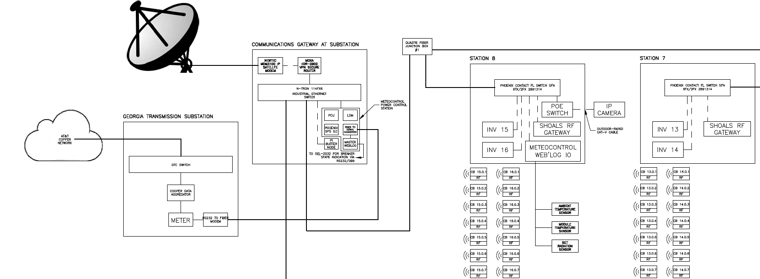
Reach and Purpose of a SCADA
Substation
Inverter
Grid
PV Array
SCADA backbone runs through the entire PV plant
Allow monitoring of performance
Control of substation, inverters & trackers

Slide 5
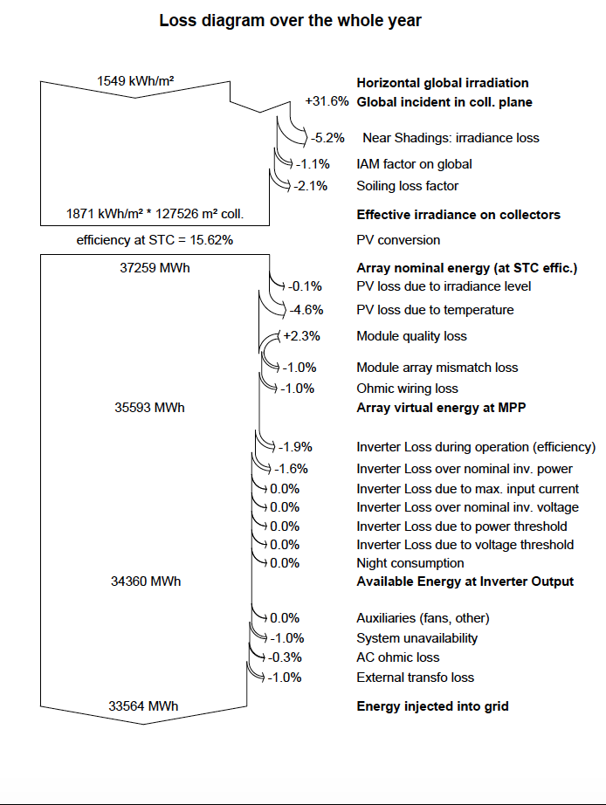
What does a SCADA measure and why
GHI
We measure energy output in the form of Active Energy (kWh) from the Meter
We measure fuel input in the form of Global Incident Irradiance (W/m²) with a POA Pyranometer
We adjust the irradiance values based on the temperature of the modules which are impacted by ambient temp and wind. Measured with Back of Module Sensors
POA
Module temperature impact
Performance Ratio
SCADA design starts with fundamentals from performance engineering
Meter

Slide 6

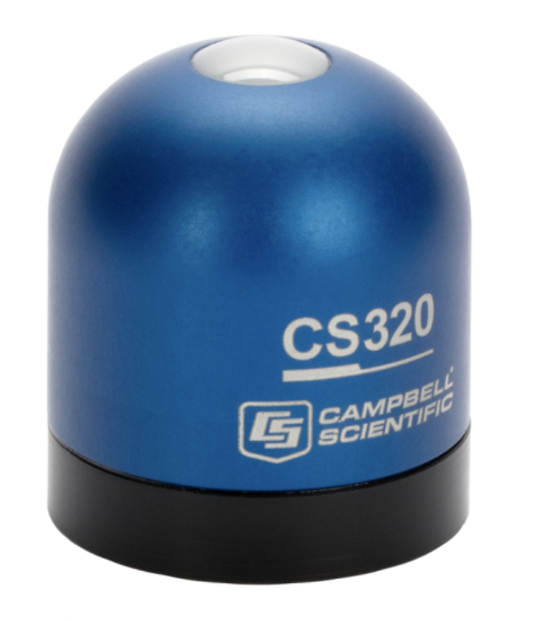
Pyranometer
Purpose: Measure the irradiance (sunlight) collected in a specific orientation
There are 3-4 different manufactures. Digital and analog, different accuracy classes.
Standards & Contracts typically call for 2 class A pyranometers to preform PR tests and calculations

Slide 7
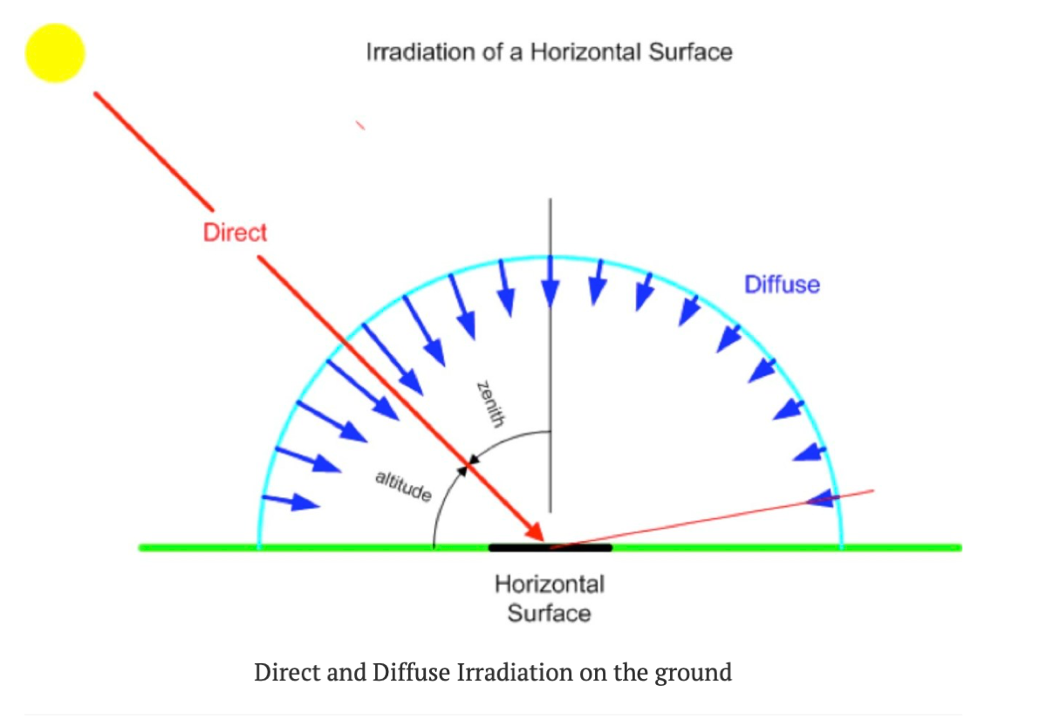
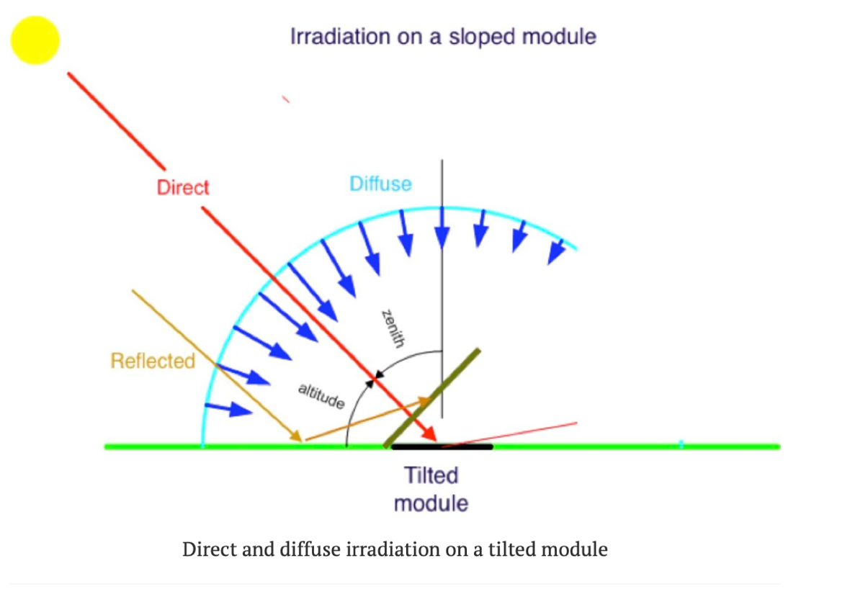
Pyranometer Orientations
Global Horizontal Irradiance (GHI)
Plane of Array (POA)
Used the measure the light received in the horizontal plane,
Can be used to run correlation studies with weather data from TMY & satellite sources
Good to use a cross check of the data coming from the POA sensors
Used the measure the light received in the horizontal plane,
Needed for Performance Ratio & Capacity Tests
Project specific angle and mounting requirements

Slide 8
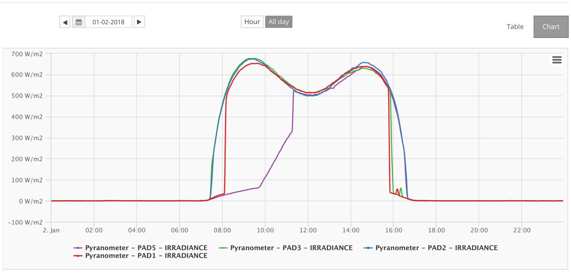
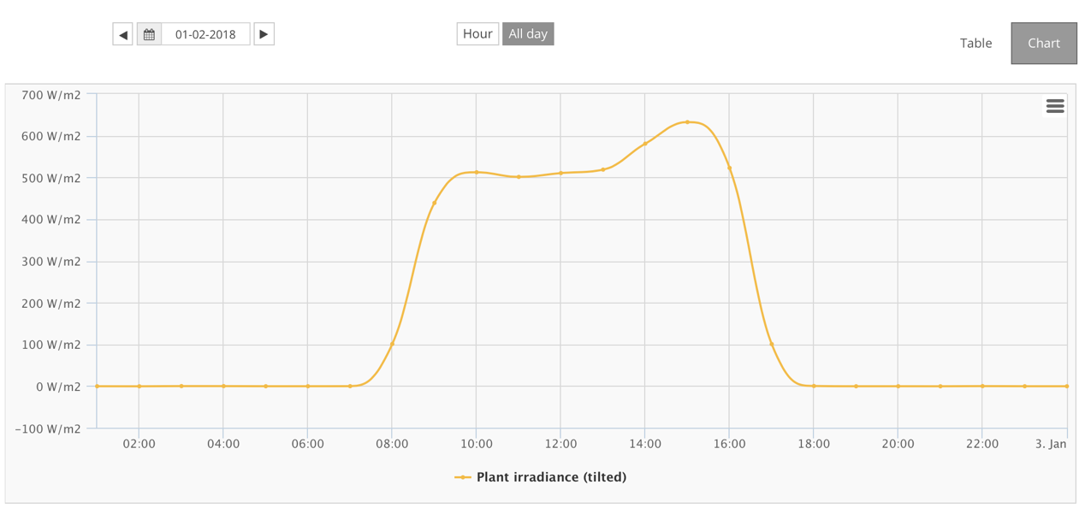
Pyranometer Mounting Impact of PR Tests
All 4 Separate Pyranometer Readings
Combined Plant Irradiance Value
2 Pyranometers are improperly impacted by row to row shading
1 Pyranometer is on tracker in maintenance, and pointed incorrectly
Only 1 of 4 pyranometers read correct irradiance levels totaling: 5.06 kWhr/m²
Since all 4 pyranometer readings are averaged together the Plant Irradiance values are spoiled, and only totals: 4.41 kWhr/m²
Results in performance calcs with a built in error of 13%
Solution: Identify correctly installed pyranometers, and only use data from those trusted pyranometers in PR calcs

Slide 9
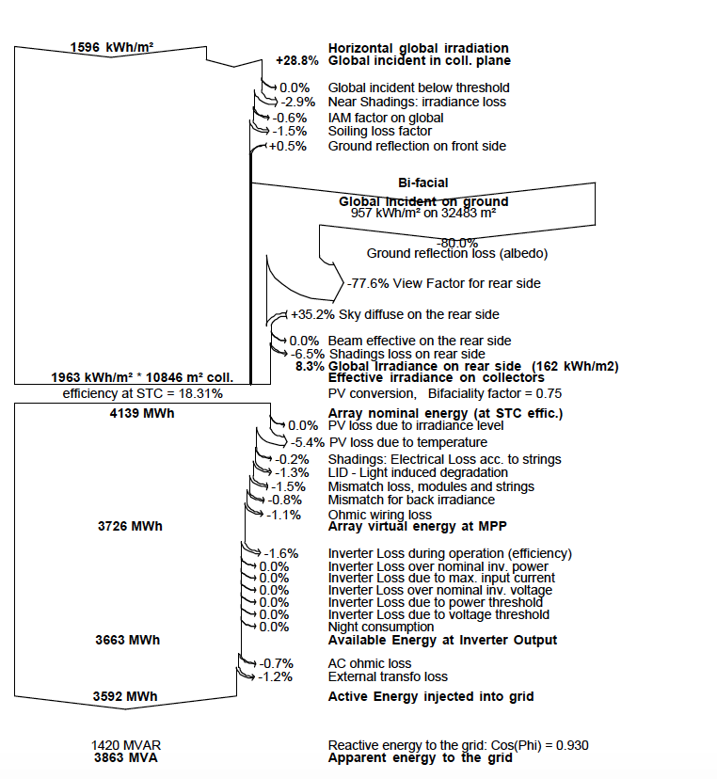
How this changes with Bifacial
GHI
We measure energy output in the form of Active Energy (kWh) from the Meter
We measure fuel input in the form of Global Incident Irradiance (W/m²) with a POA Pyranometer
We adjust the irradiance values based on the temperature of the modules which are impacted by ambient temp and wind. Measured with Back of Module Sensors
We have to measure albedo to compare to assumptions. Measured with an Albedometer
POA
Albedo
Performance Ratio
Module temperature impact
Meter

Slide 10
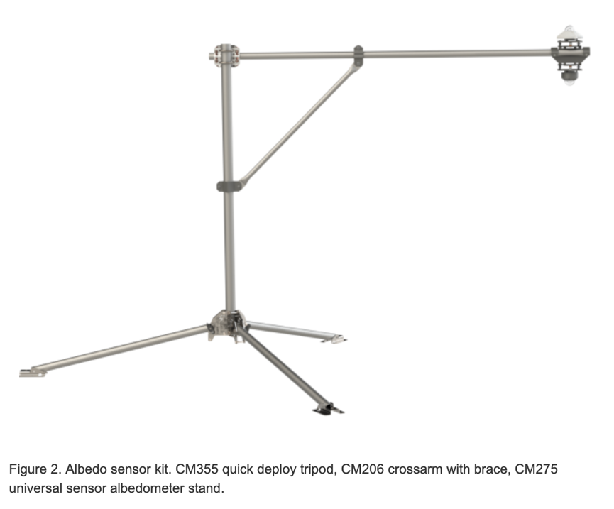
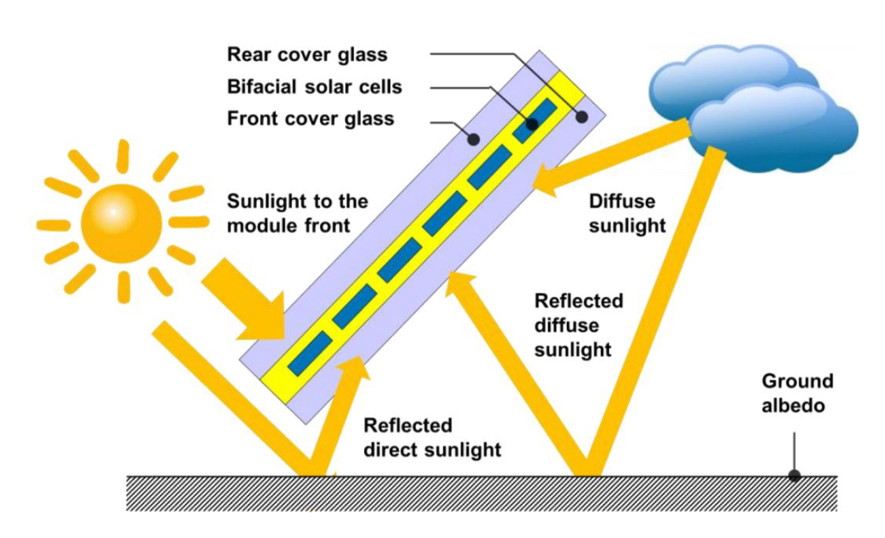
Bifacial introduces the albedometer
Purpose: Measure the albedo (reflectivity) of the ground
Literally two pyranometers mounted 180 deg from each other. One in GHI, one facing the ground
It does not directly measure the light received on the backside of the module – That is a backside pyranometer

Slide 11
Thank You

Slide 12
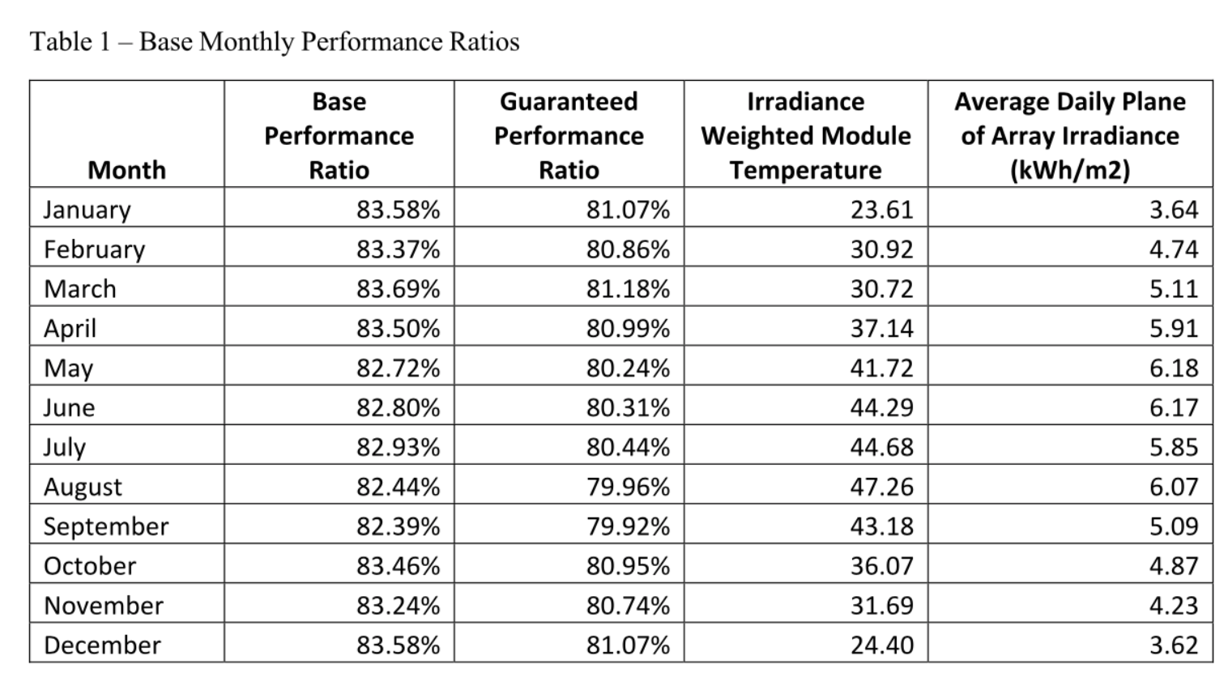
Contractual Performance Table
POA
Meter, POA, Module Temp
Module temperature impact

Slide 13

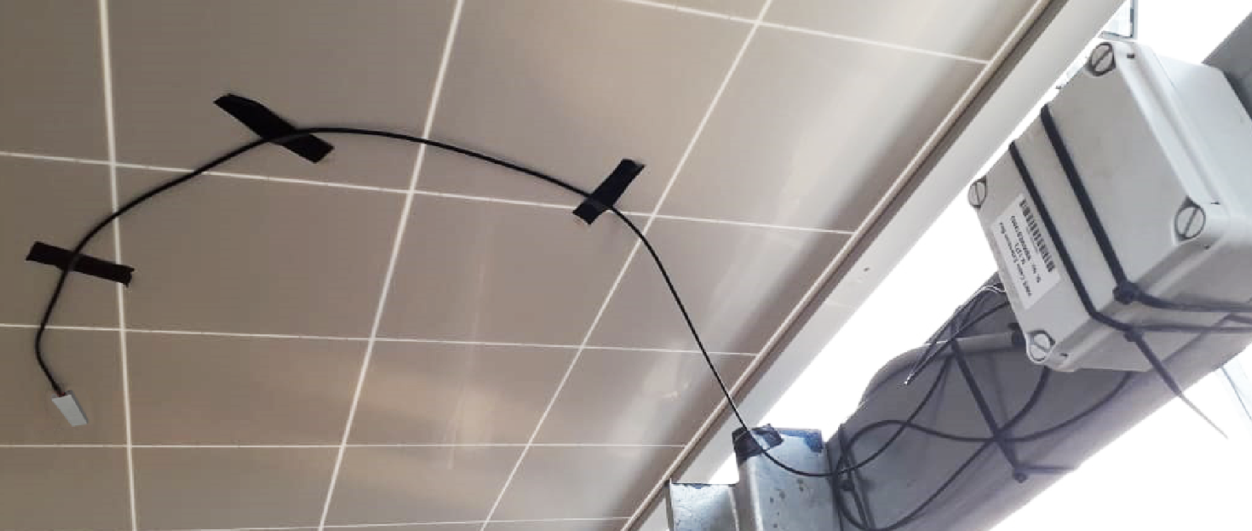
Back of Module Temperature Sensor
Actually behind a cell!
Module temperature impacts voltage and power. Each module is unique and is characterized by its temperature coefficient
Temp Co for power range from (-0.25 to -0.40) %/Deg C
3-4 degrees changes impact power by 1%

Slide 14
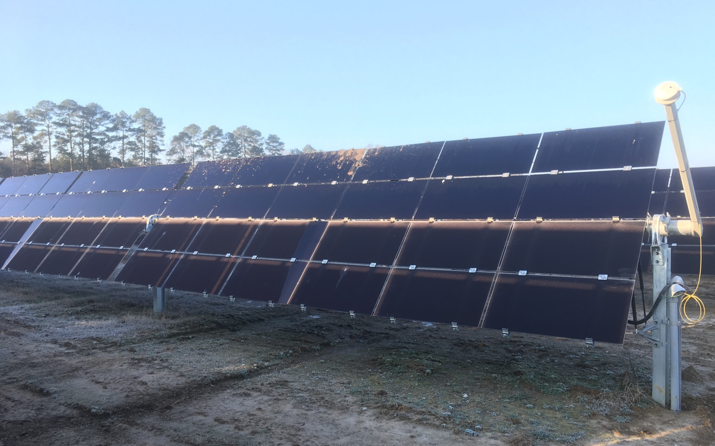
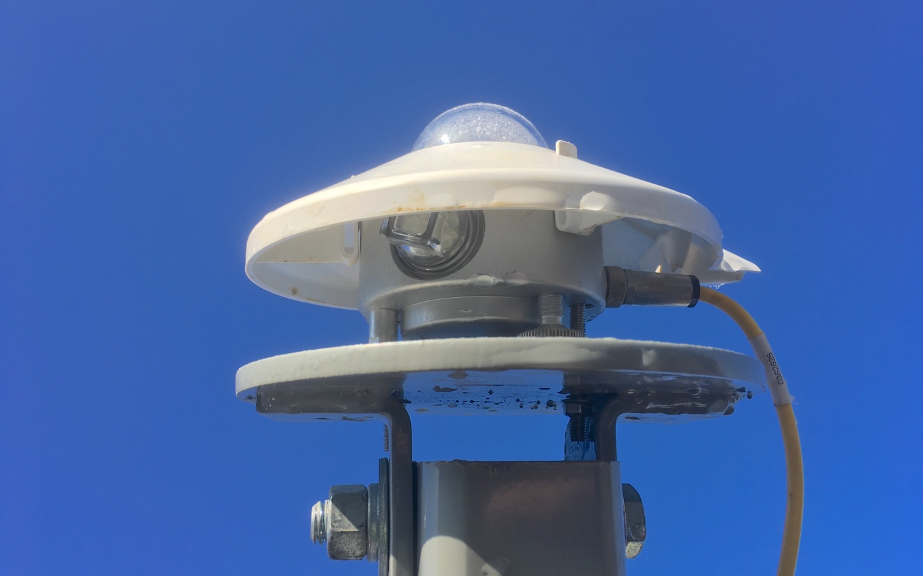
Why the mast?
POA Pyranometers must not be subjected to systemic shade. Systemic shade is part of the PR expectation of the plant.
Trackers which back track inherently avoid systemic shade.
Tracker with FLSR do not back track and therefore pose a problem in measuring irradiance without shade

Slide 15

Clear Sky Analytics
PV Analytics and Advisory Services

Slide 16
Performance Analytics for Assessment, Optimization and Monitoring of PV Plants
Synthesis
Analysis
Application
Resource and Production Data +
Project Design and Location
Metrics
Performance Indices
Resource Indices
Loss Attribution
Systematic Issues
Addressable Issues
Non-addressable issues
Assess for Investment
Base Case Valuation
Scenario Based Valuation
Optimize
Identify Opportunities
Verify Improvement
Performance Analysis
Observed resource vs assumption
Actual energy vs energy expected based on observed resource
Accounting of losses by specific loss type
Monitor and Manage
Reporting
Data driven decision and planning tools
Forecast
Updated Forecast using loss assumptions based on actual realized performance

Slide 17
Performance Analytics in Plant Operation
Originate
Execute
Validate
Sustain
Produce Accurate Reports
Identify & Quantify Losses
Evaluate Opportunities
Prioritize Actions
Create Value
Increase Production
Reduce Waste
Optimize Operations
Analytics
Asset Management, O&M
Asset Management, O&M
Analytics
Optimize portfolio level operations
Manage and incentivize O&M
Inform improvement in future plant design and supply chain management
Recognize Value
Verify & Quantify Gains
Attribute Improvements

Slide 18
Performance Analytics in Full Lifecycle of PV Plants
Build
Operate
Sell
Develop
Operations
Leverage Quantified Experience with Supply Chain and Vendors
Timely Commissioning
Optimize Production and Budget
O&M Accountability
Supplier Accountability
Automated and Accurate Reporting
EPC
Asset Management, O&M
Project Development
Transactions
Business
Exhaustive Optimization of Design
Leverage Quantified Experience of Risks and Opportunities from Past Plants
Demonstrable Record of Performance
Optimize Asset for Sale with Value Accretive Repairs and Maintenance

Slide 19
Company Information
Clear Sky Analytics
Founded March 2017
Created software for analyzing performance data from PV plants
Delivered over 3 GW of projects
~150 projects
Utility scale and commercial plants
Diverse geographies and designs
Customers include investors and operators
Founders
Ajay Saproo and John Corson
Over 10 years each of experience in PV including MiaSole and SunEdison
Flexible and Scalable Model
Consulting (incl. sub-contracting)
Analytics as a Service
Software as a Service (Future)
We distill and interpret operating performance data for Assessment, Optimization and Monitoring of PV Plants

Slide 20
Software
The Clear Sky Analytics Platform
Data Curation
Algorithms use physical models and statistical techniques to detect and repair data quality issues
Random data issues such as time-shifts and data gaps are handled
Energy Model
Comprehensive physical model of modules, inverters and circuitry
Loss Attribution
The variance between the actual and expected output is quantified for each 15 minute period
Variance is algorithmically attributed and allocated to multiple loss categories.
Systematic issues such as sensor drift, mis-pointed irradiance sensors are handled
Going beyond simple filtering and backfilling enables accurate and comprehensive analyses
Model for plane-of-array irradiance for fixed tilt and tracker systems
Generates expectation of energy and electrical parameters based on data from sensors for every 15 minute period
Captures the complexity of applying continuously varying irradiance and weather input to inherently non-linear responses of PV plants
The waterfall of losses accounts for the variance between expected and actual output.
Comprehensive quantitative accounting of energy produced and attribution of losses to specific causes
Python code deployed on local desktops and expandable cloud site (AWS)
Proprietary software integrates open source models and proprietary algorithms for data curation, energy modeling, loss attribution and forecasting.
Receive data in csv files from customer or directly from data acquisition system (DAS)
Data output in csv files for use in visualization and reporting tools
Onboarding data in csv files
Project and system design information
Data nomenclature, formats and mapping
Reference model if available

Slide 21







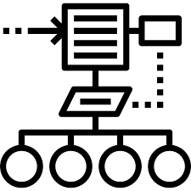

Clear Sky Analytics Workflow: A Schematic Overview
Resource Data
Project Info
Data
Curation
Energy Production Model
Updated Forecast ( For Investor)
Production Data
Data
Curation
Expected energy
and parameters
for every device for each 15-minute period
Ongoing Monitoring , Variance, Metrics and Advisory
Updated Energy Production Model
Key
Actual Historical Energy
And Parameters
Project Information (Lat/Long, Size)
System Design: Modules, Inverters, Mounting, Trackers, Ground Slope.
Actionable Insight : Maximize ROI
(For O&M, Asset Management)
Resource Data.
(Irradiance and Temperature)
Resource Availability and Snow
Degradation and Trend Losses
Systematic Modeling Variances
Tracker Related Losses
AC Availability
DC Outages, Curtailment, Other
DC Quality and Inverter Efficiency
Energy and Parametric Data
(For Each Inverter, Meter)
Data Curation and Repair
Variance
Attribution
Compare Actual Resources and Energy to Expected Resources and Energy Compute Variance
Deep Dive Report , Variance, Metrics and Advisory
Attribution Algorithms
Variance Waterfall : Expected to Actual

Slide 22
Example: Life of Project Performance Summary
93,900* MWh
92,958 MWh
Expected Nominal
+ Actual Weather
Observed Optimal
+ Observed Quality
91,803 MWh
89,278 MWh
Degraded Optimal
+ Observed Degradation
Output Trend
+ Reverting Trends
(Soiling/ DC defects)
87,971 MWh
Assumptions, Model
Resource Variance
Quality Level Variance
Project Forecast
@ Reference
Lost to Cyclical Factors
79,279 MWh
*Assuming zero degradation,
soiling or availability loss
Lost to Breakdowns, Availability and Systematic Issues
Actual Output
+ Breakdowns/Availability
Performance Summary
Period: Sep’13 to Jan’19
Output = 79,279 MWh
Degradation Rate = 0.9% per year
Average IPR = 0.90
Average WPR = 0.98
Average OPR = 0.92
Average PI-Q* = 0.84
Attribution of Losses - Cumulative
Initial Quality (Gain) = 941 MWh 1.00 %
Degradation = 1,155 MWh 1.23 %
Soiling/Trend Losses = 2,524 MWh 2.69 %
DC Outages = 678 MWh 0.72 %
Shading** = 426 MWh 0.45 %
Non-Optimal MPPT = 334 MWh 0.36 %
Snow = 3,125 MWh 3.33 %
Inverter Outages = 1,247 MWh 1.33 %
Project Outages# = 4,768 MWh 5.08 %
Meter Loss (Gain)** = (1,915 MWh) (2.04 %)
Not Attributed/Other = 1,385 MWh 1.47 %
xx
12,569 kW DC
10,000 kW AC
Fixed Tilt
xx Modules
xx Inverters
5+ years of operation
** Above Modeled Loss
# Includes Q1’18 recloser incident contribution of ~2.9%

Slide 23
Example: Forecasts Updated to Reflect Actual Quality, Degradation, Historical Losses and Scenarios Based on Remediation
(Excludes impacts of project outages at start up and recloser failure in Q1’2018)
(Includes expectation of 1.5% reduction in availability related losses)
Updated forecast
(monthly and annual – Year 1 starts September 2013 – we are in year 6)

Slide 24
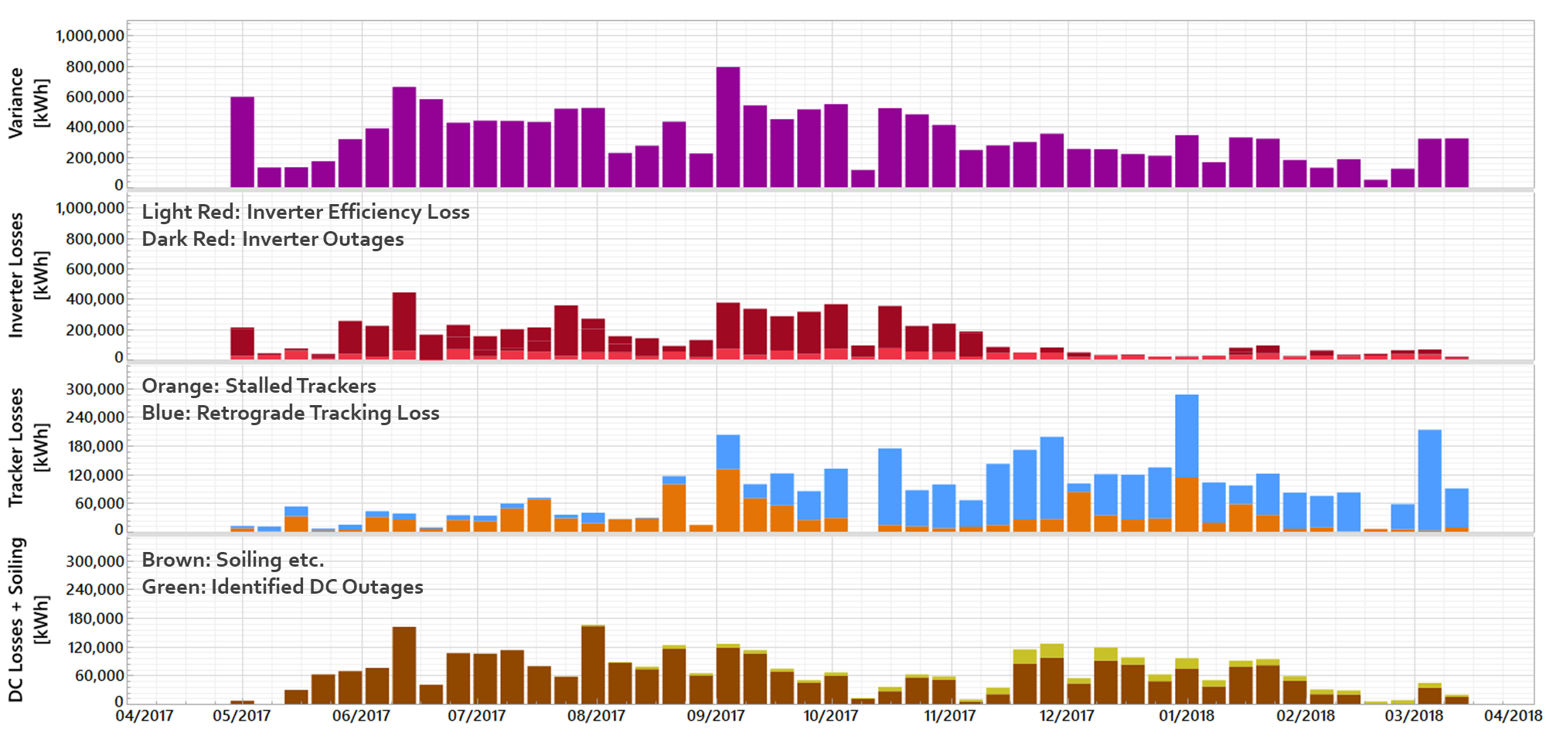
Analytics Enable!
Example: Project has under-performed and the O&M has identified a root cause. Is that the only or dominant issue with the best ROI?
Targeted Repair: Uncovered remediable sources of energy loss not identified by legacy systems. Executed repairs, maintenance and warranty claims.
Validation: Objective, quantitative means of evaluating effectiveness of O&M and engineering
Portfolio Level Optimization: Aligning service protocols, personnel, inventory and infrastructure spending based on ROI

Slide 25
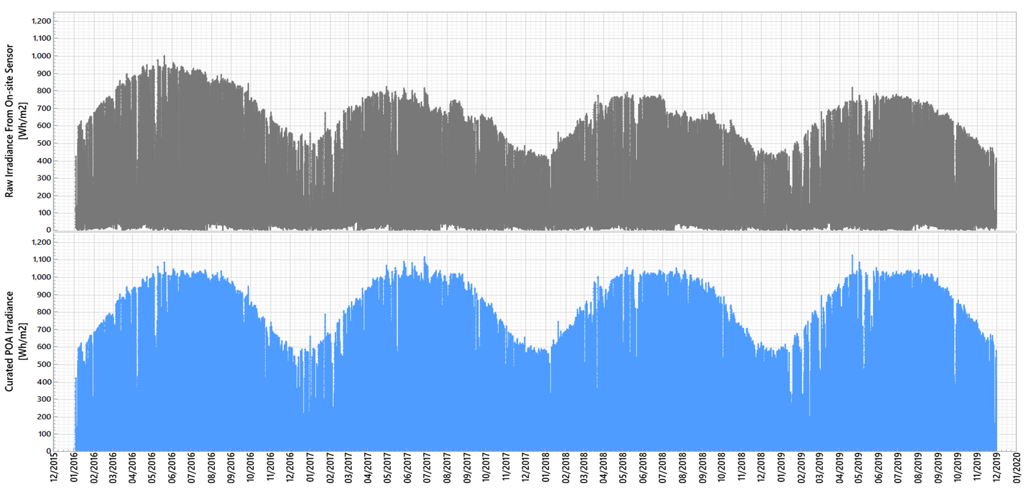
The Utility of Data Curation
x
Illustration of Irradiance Data Curation
(Project lifetime view showing impact of drift and instability)
The raw irradiance data here suffers from long term drift, seasonal variation and intraday sensor obstruction from a nearby structure
Left uncorrected, this erroneous measurement of irradiance would have led to erroneous energy expectation
Without the indicated data curation, this case would have resulted in inaccurate determination of quality, degradation and soiling losses

Slide 26
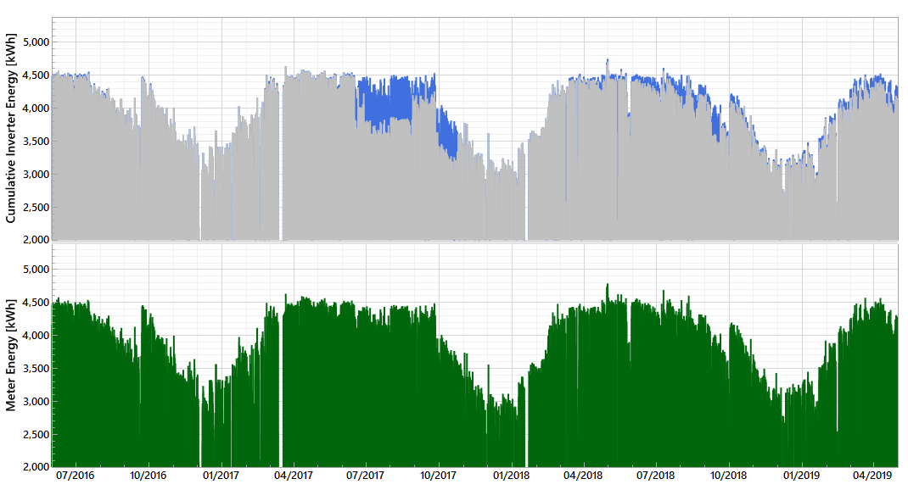


The Utility of Data Curation
Illustration of Inverter Power Data Curation
(Backfilling periods of data loss and accounting for calibration shifts)
Accurate performance metrics
Accurate quantification of losses
Avoids false positives alarms

Slide 27
Assess Operations
Specific Application: Operations Assessment
Measure operational performance against contractual requirements and performance guarantees.
Objective means of evaluating the effectiveness O&M by quantifying the impact of Controllable Factors such as AC availability, DC health, soiling/vegetation abatement, and timely repairs.
Isolate and control for factors related resource availability, snow, forced curtailment, grid outages and system degradation.
Detect opportunities for performance improvement through O&M actions and use analysis of energy lost or available to guide and justify operational decisions.
Report objective, quantitative metrics on a periodic basis using comprehensive automated data curation and performance analysis [Clear Sky PaaS]
Include industry standard and contractually defined metrics for performance and resource availability
Quantify performance impact of factors controllable by O&M
Addressable Availability
Inverter outages
Tracker outages
Non-Addressable
Resource Variance
Soiling abatement
Tracker set up
Addressable Maintenance
Snow
Forced Curtailment
Grid Outage
Module Degradation
Vegetation abatement
Plant control
Inverter set up
Other AC outages
DC outages

Slide 28
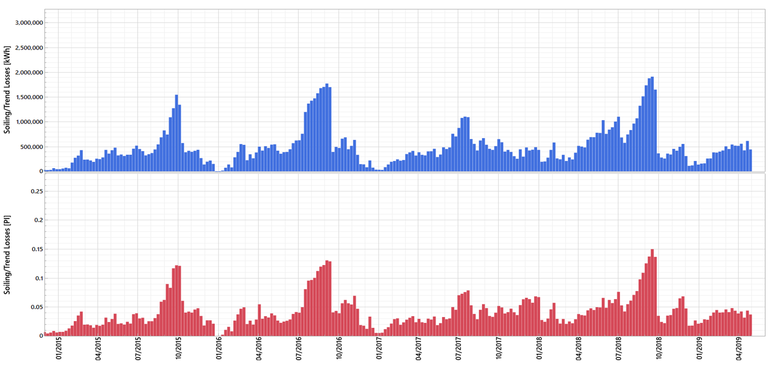
Cost Benefit Analysis of Managing Soiling Losses
Specific Application: Optimizing ROI on O&M Resources
Cumulative Impact of Soiling: 4.3% of expected energy at this plant was lost to soiling
Recoverable Energy Quantified: This is more useful than a visual assessment or only knowing the impact on effective irradiance. The energy recoverable by washing is a complex function of system design, state of the system, weather conditions and the degree of soiling.
Module Washing Optimization: Washing schedule (number and timing) can be optimized by either utilizing the historical seasonality or dynamically using our performance analysis in real time.

Slide 29
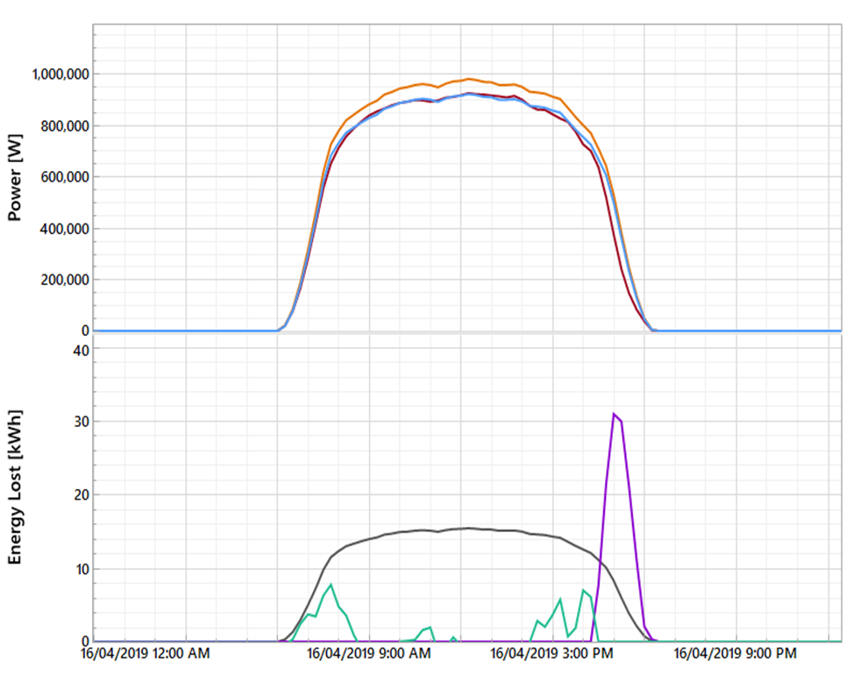
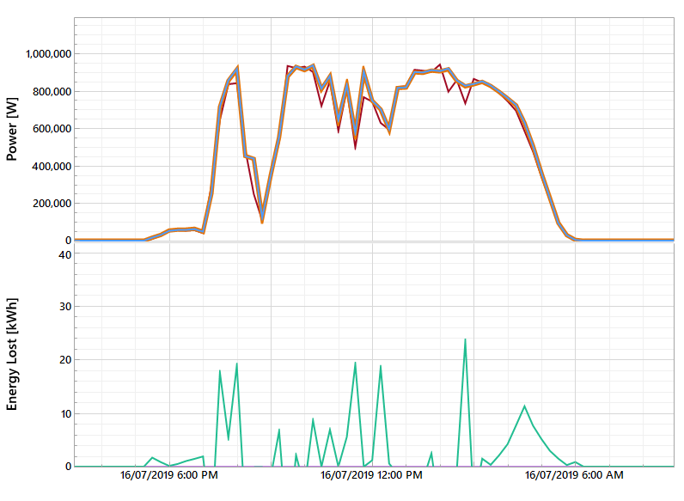


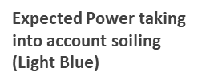

Illustration of Soiling Behavior
Heavy Soiling Period
Expected power accounting for determined level of soiling and actual power match up well. Illustrates determination of heavy soiling loss in this period.
Other losses are determined relative to this soiled state of the system.
Minimal Soiling Period (Rainy Season)
Expected power with and without determined level of soiling match up well indicating minimal soiling detected in this period.
Actual power matches this expectation which validates the fact that soiling loss is minimal in this period.

Slide 30
Analytics and Advisory Services Offered
Assess & Optimize
Evaluation and Remediation of Plants
Clear Sky PaaS
Performance Analytics as a Service
Advisory services to evaluate historical system performance and produce reports that
Describe generation capacity, degradation rate and a waterfall of losses to quantify and classify factors driving variance from expected performance
Update energy forecasts; assuming historical loss rates or assume mitigation of specific issues
Identify and prioritize addressable opportunities for remediation
Quantify expected energy impact from specific corrective actions – Determine ROI
An automated service that extracts raw data from existing data acquisition systems and delivers an ongoing stream of computed metrics
Each refresh is a comprehensive re-analysis with the up to date data
Report performance with speed and accuracy
Optimize performance and resource allocation
Enable integration with existing data and asset management platforms
Clear Sky Analytics Platform
Import and Prepare Data, Model System Performance, Quantify Variances, Attribute Losses and Interpret Findings

Slide 31
Clear Sky Analytics
Contact : ajay@clearskyanalytics.com

Slide 32
Increasing Bifacial PV System Revenue with Operational Data
Ben Bourne
September 21, 2020

Slide 33
BrightNight Mission
An experienced and differentiated energy company focused on customers’ needs.
International solar + energy storage company
Serving fast growing markets in U.S. and Asia
More than 3 GW under development
Founded by Martin Hermann
Founder and former CEO of 8minutenergy
Developed 3,000+ MW of contracted solar photovoltaic and solar plus battery energy storage projects
Focused on customers’ needs
Providing clean, customized, differentiated solutions
Delivering safe, reliable, high-value products at lowest cost
Energy, capacity, ancillary services
Dispatchable solar, firmed/shaped deliveries
Leveraging best-in-class development experience
US business launched in 2019, but team has extensive experience
Integrating industry-leading technologies and software
Leveraging deep supplier relationships built by team members with over combined 200+ years of industry experience
Positioned to capitalize on market inflection point
As Available (PV-only, Wind-only)
Dispatchable Renewable Energy
Market Penetration
Inflection Point
2007
2018
2030

Slide 34





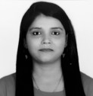

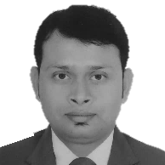

BrightNight Global Leadership & Engineering Team
Martin Hermann – Chief Executive Officer
Ramkumar Krishnan, PhD – Chief Technology Officer
Jerome Ortiz – Managing Director, Asia
Martin is a serial entrepreneur with 30 years in clean- + high-tech, and closed business transactions of $7+B. He founded 8minutenergy in 2009. When Martin sold his interests in 2018, 8minutenergy had developed a pipeline of 14+GWs with now 3+GWs contracted. In 2018, he launched BrightNight, a next generation dispatchable renewable energy company. Martin owned a semiconductor tools company in the 1990s, which he sold to Intel 10 years later.
Previous roles: 8minute (Founder & CEO), Advent, Intel, CAD-UL
Ram brings over two decades of education, leadership and expertise in the areas of renewable energy generation, energy storage, and conversion technologies. Prior to BrightNight, Ram led and advised several energy companies and helped launch commercial products. At NantEnergy (formerly Fluidic), Ram lead for 11+ years the product + R&D teams in the development of the game-changing rechargeable and long duration metal air energy storage technology.
Previous roles: NantEnergy, CESA, Motorola, University of Washington
Jerome brings more than 16 years of development and financing experience in the power and renewables sector across a number of emerging markets. Prior to BrightNight, Jerome was Vice President at 8minute, where he spearheaded the firm’s efforts into fast growth markets in Asia. Before that, he previously acted as Asia head of power and renewables at MUFG, the world’s largest project finance bank.
Previous roles: 8minute, MUFG, Standard Chartered
Based in: Singapore
Ben Bourne – Vice President, Solar Engineering
Kiran Pandey – Director, DC Design
Ben brings over 18 years of engineering experience in solar and computational analytics. Before joining BrightNight, he spent 13 years with SunPower where he managed the System and Products Performance Teams across the residential, commercial and utility market sectors, including developing and maintaining SunPower’s proprietary PV system simulation tool, PVSim.
Previous roles: Earthbound Analytics, SunPower, SRI International
Kiran brings more than 10 years of experience in solar PV design and engineering gained at Azure Power, one of the most successful renewables platform in India. Kiran led the design of over 3 GW of solar PV projects in India and she was a key contributor to bring down solar LCOE in the region.
Previous roles: Azure Power
Based in: India
Akshay Ladwa – Vice President, ESS Engineering
Faisal Al Mamun – Sr. Manager, Transmission
Yogesh Sharma – Sr. Engineer, Project Design
Akshay brings more than a decade of expertise in battery energy storage across a wide spectrum of areas encompassing product development to multi-MW projects, leading engineering, procurement and deployment. Prior to BrightNight, Akshay was VP of Engineering at Wartsila overseeing deployment of storage and storage paired hybrid power plants across four continents.
Previous roles: Wärtsilä, Greensmith, Insolare Energy
Faisal brings more than 13 years of experience in the power sector. He has worked extensively in different publicly and privately owned power plant & substation projects, including Bangladesh’s first 400 kV HVDC back-to-back substation. To date he has completed more than 850 MW of power plant projects.
Previous roles: Bangladesh Erectors
Based in: Bangladesh
Yogesh brings more than 9 years of experience in solar PV design and engineering gained at Azure Power, one of the most successful renewables platforms in India. At Azure he played significant role in system design, verification & optimization. He lead the drafting works from engineering side for over 1.5GW of projects in India right from the concept to the commissioning.
Previous roles: Azure Power
Based in: India

Slide 35

BrightNight Bifacial Technology Experience
Ben Bourne – Vice President, Solar Engineering
Ben brings over 18 years of engineering experience in solar and computational analytics. Before joining BrightNight, he spent 13 years with SunPower where he managed the System and Products Performance Teams across the residential, commercial and utility market sectors, including developing and maintaining SunPower’s proprietary PV system simulation tool, PVSim.
Consulting
PVEL – Technology & modeling training
NEXTracker – Outdoor test & technology evaluation
Publications
B. Bourne, “Ground Albedo Field Measurements”, Bifacial PV Workshop, 2018.
M. A. Anoma, D. Jacob, B. C. Bourne, J. A. Scholl, D. M. Riley, and C. W. Hansen, "View Factor Model and Validation for Bifacial PV and Diffuse Shade on Single-Axis Trackers,“ presented at the 44th IEEE PVSC, Washington, DC, 2017.
A. Asgharzadeh Shishavan, M. Anoma, A. Hoffman, C. Chaudhari, S. Sushrut, R. Perkins, D. Cohen, G. Kimball, D. Riley, R. Toor, B. Bourne. “A Benchmark and Validation of Bifacial PV Irradiance Models,” presented at the 46th IEEE PVSC, Chicago, IL, 2019.
B. Bourne, “PV Modeling Accuracy & Bankability,” DOE Workshop: Differentiating Quality PV Standards & Methodology for Underwriting Certainty, 2012.
Technology Characterization
SunPower R&D – printed backsheet for bifacial application (patent 2014)
Maxeon Performance 5 Bifacial (625W, M12)
Bifacial Model Development
pvfactors – SunPower 2D view factor bifacial model, available in pvlib-python
Validation & benchmarking of industry bifacial models (pvfactors, bifacial_vf, PVSyst)
Technology Testing - SunPower Outdoor R&D Ranch
SunPower Oasis 3 Single-Axis Tracker
China Tier 1 & SunPower/Maxeon Bifacial technologies
Albedo Measurements & ground cover manipulation

Slide 36
Optimizing Operational Bifacial PV Power Plants

Slide 37
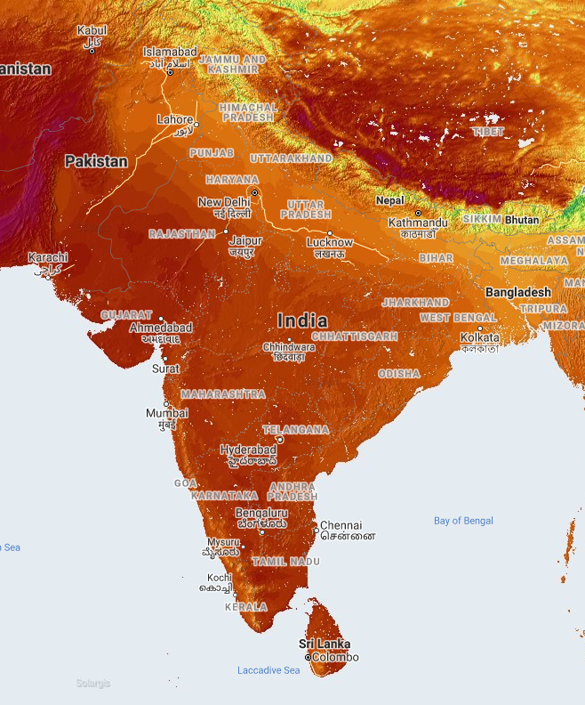
Optimizing Operational Bifacial PV Power Plants
How can I get the most out of my bifacial PV utility plant?
Energy generated from a well-designed bifacial PV plant is 10-20x more sensitive to front-side light capture than to rear-side light capture
There are no algorithmic opportunities to improve yield through increased back-side gain
Truetracking vs. Backtracking: 0 days in a full year when truetracked production is greater than backtracked production
Flat stow: 0 days in a full year when flat stow production is greater than sun-tracked production
All operational optimization managed by O&M
Tuning trackers to minimize front-side row shading
Administering washing schedules to mitigate excessive soiling
Ensuring as-modeled ground albedo
Maintaining plant uptime
Operational gains must be evaluated against operational costs
Sample Site: Rajasthan, India
Image source: Solargis

Slide 38
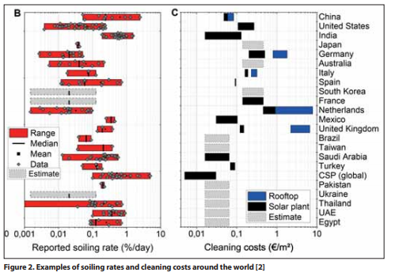
Operational Optimization Case Study: Soiling
High soiling buildup rates in India
Front-side: 0.2-1%/day = 6-30%/month
Front side soils 6x faster than back side in dry/heavy soiling climates¹
Estimated back-side soiling: 1-5%/month
Back-side not washed during natural rainfall events
Washing costs relatively low in India
Significant return on manual front-side washing
Back-side washing costs higher than front-side costs, but long-term soiling buildup may justify back-side washing costs
Recommendation
Evaluate cost of backside soiling sensors + manual washing schedule
Sources: 2 & 3
Luque, Enric & Antonanzas, Fernando & Escobar, Rodrigo. (2018). “Effect of soiling in bifacial PV modules and cleaning schedule optimization,” Energy Conversion and Management. 174. 615-625. 10.1016/j.enconman.2018.08.065.
“PV soiling in dry climates: causes, impacts and solutions,” PV Tech Power, vol.21, p.14, November 2019
J. B. K. Ilse, B.W. Figgis, F. Wolfertstetter, L. Micheli, K. Lange, D. Daßler, H. Hanifi, V. Naumann, C. Hagendorf, R. Gottschalg, “Assessment of soiling losses in global solar energy production and mitigation strategies,” Joule, no. in print, 2019.

Slide 39
Operational Optimization
So, what *should* I do to optimize performance of my bifacial PV plant?
Soiling – wash whenever economically beneficial
Monthly front-side wash: 5-10% yield recovery
Monthly back-side wash: 1-2% yield recovery
Monitor front-side & back-side soiling level
Shading – minimize early in project operational life
Reduce back-side shading obstructions in plant design: 0.2-0.5% yield gain
Reduce front-side row-to-row shading with smart tracking methods: 0.25-1% yield recovery
Monitor visually & string/block-level current to assess localized row shading
Ground Albedo management – increase ground reflectance if sufficient cost benefit
Albedo increase from 0.20 to 0.30: 3.75% bifacial yield gain
Monitor ground albedo to characterize seasonal reflectance and unanticipated albedo reductions
Plant Uptime – manage operations to minimize duration of equipment outages
Fuse Failure detection
Tracker operation
Spare parts
Monitor strings and/or blocks to detect blown fuses and tracker operation errors, store sufficient spare parts

Slide 40
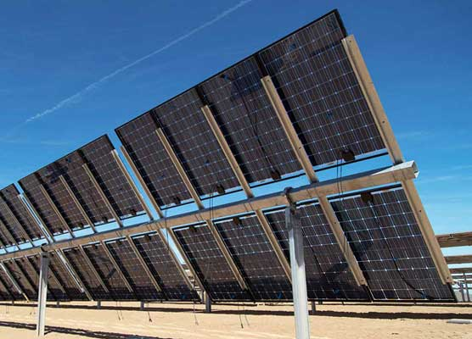
Conclusions & Recommendations
Optimize front-side gain in both project design and operational maintenance to maximize yield
Invest in reliable technologies and O&M to maximize plant uptime
Evaluate cost of increasing back-side gain and only apply cost-effective, safe back-side loss mitigation
Monitoring sensors: Ground albedo, back-side soiling sensors
Ground cover management/enhancements
Back-side panel washing
Source: Saur News Bureau/ Nov. 2017

Slide 41
Ben Bourne (US)
Kiran Pandey (Asia)
VP, Solar Engineering
Director, Design Engineering
+1 650.208.6957
+91 8800-190292
ben@brightnightenergy.com
kiran@brightnightenergy.com

Slide 42
Thank you!
Remember to register for our next Clean Energy PV webinar sessions on September 29th and October 6th

