Slide 1
ANSI-SAC Workshop
6 December 2017
Hangzhou
Teresa J. Cendrowska, ASTM
Vice president, Global Cooperation
www.astm.org

Slide 2
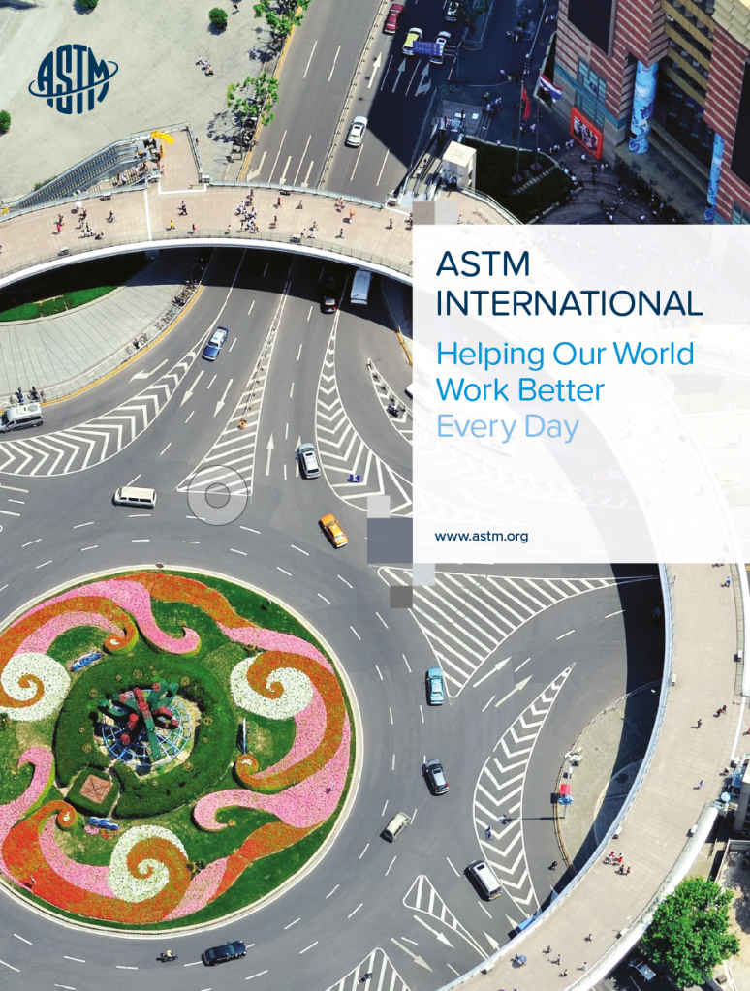
Key Points
1
Overview of ASTM International
2
Ensuring Balance 3 Ensuring Transparency
4
Ensuring Consensus 5 Ensuring Relevance 6 Success stories

Slide 3
Overview of ASTM
ASTM’s Context
Since 1898, ASTM has offered a robust development process delivering globally accepted and respected standards known for
Market relevance and technical quality
Knowledge, tools and reputation developed over more than a century of learned experiences.
Success based on responsiveness to the market – listening to the needs of both the member and the customers

Slide 4
Overview of ASTM International
30,000+ volunteer members
150 nations Varied interests
147 main committees
Over 2,000 subcommittees
Over 12,700 standards
In 2016
- 180 New
- 1924 Revised
- 818 Reapproved
- 75 Withdrawn
Collaborative
Wide ranging
Dynamic
Open to anyone, anywhere
Broad range of interests – industry, government, academia, business, consumers, laboratories
Consistent consensus process
Direct access and participation through e-tools and on-line information
Serving over 90 industry sectors
Standards are voluntary and global
7,400+ citations by more than 75 nations worldwide
The choice of many global industries; 48% sales outside the US
Relevant and responsive
Stakeholder driven
Efficient
Regular review

Slide 5
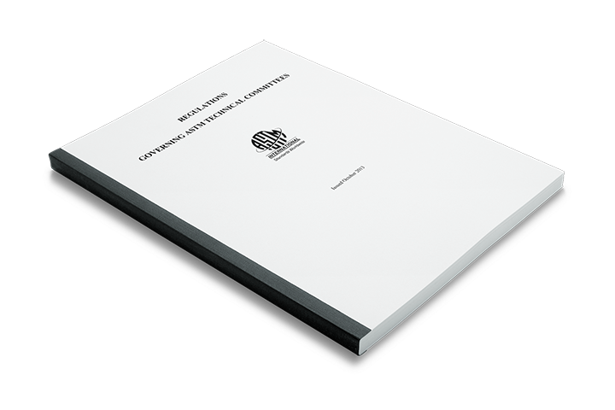
ASTM’s Guidance Document
Regulations Governing ASTM Technical Committee Operations
Information on
Committee formation
Committee and member classification
Vote assignments
Procedures for standards
Balloting
Handling negatives
Committee operation
Conduct of business
Notes:
ASTM has our guidance document; the Regulations. The Society uses these regulations to govern the consensus process. My job and that of my peers is to ensure that these are always upheld. They cover everything from new activity development, to member classification, to the handling of negatives votes.

Slide 6
Ensuring Balance
Any committee developing standards for products offered for sale is classified.
Members classified as producer, user, general interest or consumer
Based on the interest the individual represents and the scope of the TC or SC
If classified as a producer on the SC, assigned producer classification on the TC
One “official” vote is assigned per interest in a TC or SC
Producer interests can not dominate decisions (waiting list for votes)
Failure to return three ballots revokes official vote
No limit on number of members in a TC or SC
In executive committee, no two officers can represent the same interest
Producer
User and General Interest
ASTM
- Every member, regardless of official vote assignment, has the ability to vote and is encouraged to return ballots
Notes:
Technical committees are “classified” and “balanced”
Committee Members are “classified” as one of the following:
Producer, User, General Interest, or Consumer

Slide 7
Ensuring Transparency
Made possible by…
Providing visibility for all steps, all the way through the process
Whether in the formation of a new activity or the proposal for a new standard or revision
Informing and informing again
Push information out to stakeholders
Engage all that are interested
Use multiple tools in electronic and print format
Examples: Standards Tracker, press releases, social media, web site, articles, face-to-face and virtual presentations
Facilitate remote participation and information sharing through on-line tools

Slide 8
Ensuring Consensus
ASTM Regulations Ensure Due Process
Balance and openness are critical factors to successful consensus
Same process applied in all committees/ sectors
Everyone has the opportunity to provide input to the process
All responses must be considered and negatives must be resolved by the technical subcommittee before moving forward
Technical and procedural appeals allowed
Staff are experts on the process; they offer guidance to committees
We educate members on the process regularly
Regulations Governing ASTM Technical Committees
More than 15 pages of guidance outlining the ASTM consensus process
Notes:
ASTM has our guidance document; the Regulations. The Society uses these regulations to govern the consensus process. My job and that of my peers is to ensure that these are always upheld. They cover everything from new activity development, to member classification, to the handling of negatives votes.

Slide 9
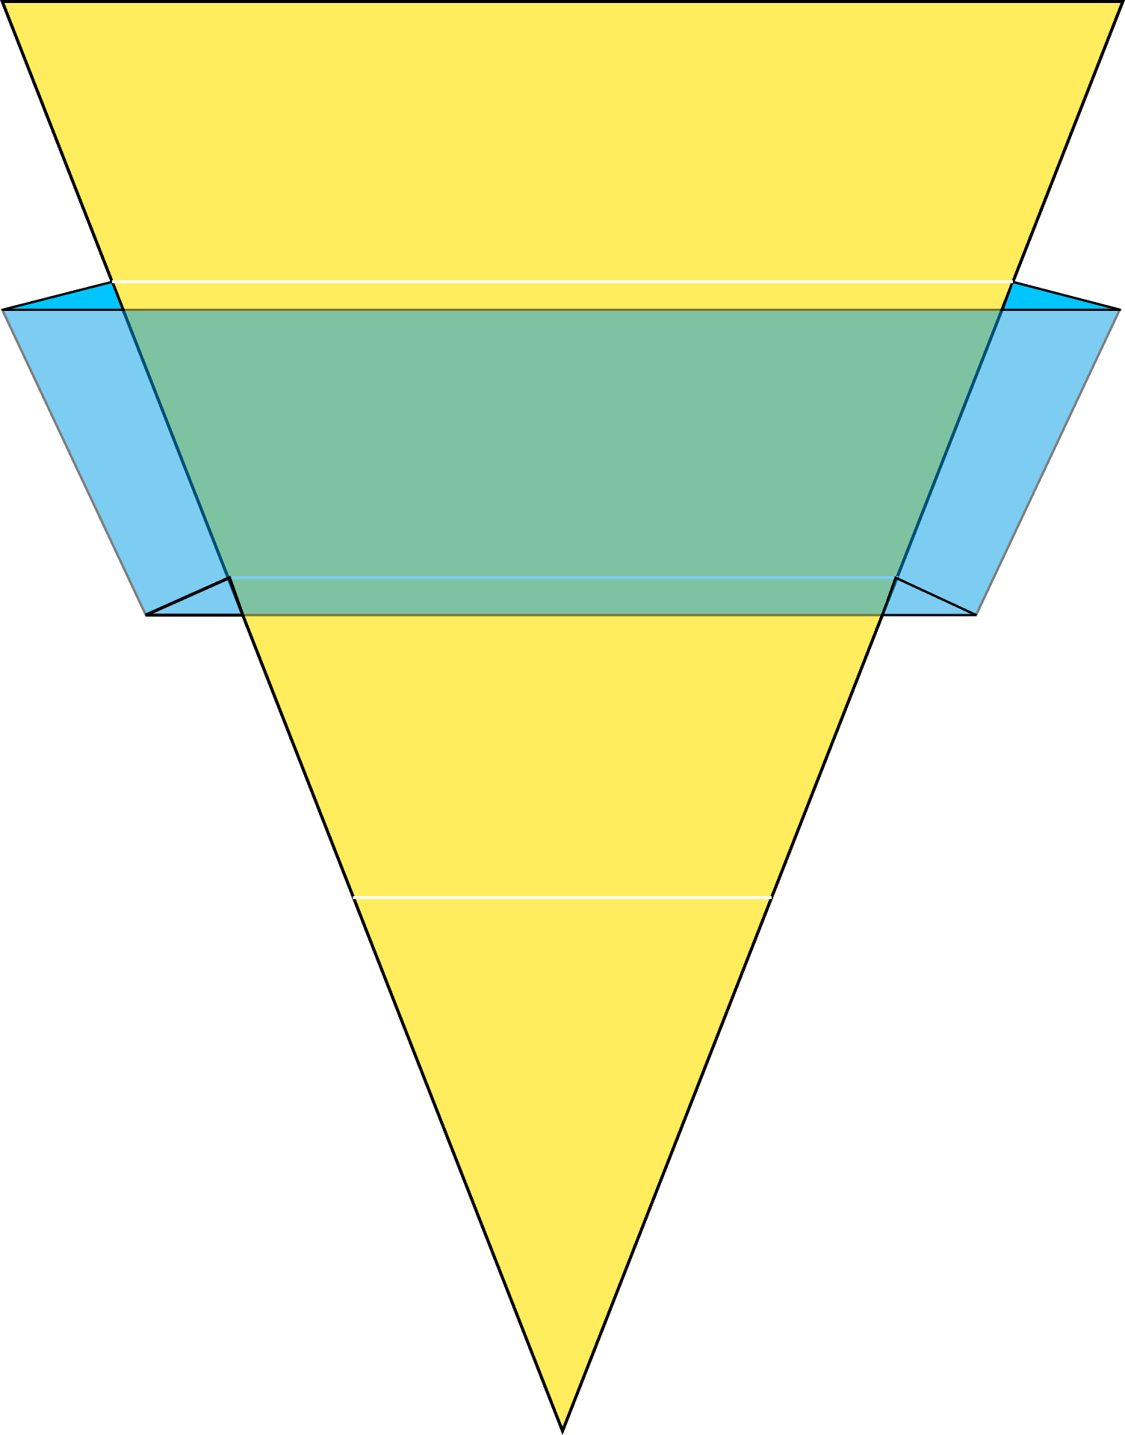
The Development of ASTM International Standards
Committee on Standards
Society Review
Main Committee
Subcommittee
Task Group
Final Review and Approval
of Procedures
No % Return Required
No % Affirmative Required
60% Return Required
90% Affirmative Required
60% Return Required
2/3 Affirmative Required
Membership Not Required
Notes:
Member participation from around the world is what makes ASTM a truly international standards development organization. ASTM opens its doors to all interested individuals and organizations from around the globe that want to participate in the Society's consensus process for standards development. This process ensures that all interested parties have an equal vote in determining a standard's content. ASTM's enduring philosophy of consensus without borders helps make ASTM responsive and relevant to the needs of the global marketplace. As a result, more than 40 percent of ASTM's standards are sold outside the United States.

Slide 10
Consensus
Creates a bridge
ASTM implements consensus in standards development and the formation of new activities by:
Engaging all affected parties
Gathering diverse market interests to address common issues
Providing a neutral forum where all have equal influence
Instilling confidence by applying a reliable, routine, reputable process
Accommodating change
Transferring technology to the marketplace through standards and value added services
Avoiding duplication which wastes time and resources

Slide 11
Ensuring Relevance…meeting market demand
ASTM standards are developed based on market need
Members determine need and content
Development of standards is not based on a financial criteria or staff input
Technical quality and market relevance contribute to the global use and application of ASTM standards
ASTM standards applied for many reasons:
Innovation - Economy
Efficiency - Quality/reliability
Reputation - Liability reduction
Safety - Market access
Standards are reviewed regularly and updated as needed at anytime
Approximately 1/3 of the 12,700 standards are in the ballot process at any given time

Slide 12
ASTM’s Process at Work: Success in China
Chinese Companies Making Light Sport Aircraft (LSA)
In 2009, the Civil Aviation Administration of China (CAAC) issued the Guide on Air-worthiness Administration for Light Sports Aircrafts
CAAC updated the Guide in 2015 to cite 22 ASTM Standards
The standards address aspects such as:
Design/performance
Operation and safety monitoring
Pilot operation
Production acceptance
The LSA standards don’t exist anywhere else except in ASTM
The guide, along with the ASTM standards, enabled CAAC to issue airworthiness certificates for eight Chinese LSA models.
The use of ASTM standards enabled CAAC to be more efficient in its review and allowed the companies to move product to market more quickly
Market estimates indicate that the Chinese market for LSA will grow rapidly in the next 5 to 10 years as LSA are used for training, tourism and flying clubs.
Meeting the ASTM standards supports safety, builds reputation of a product, creates market opportunity for Chinese companies.

Slide 13
Success Story
“ASTM LSA standards greatly support the research, preparation and manufacturing of our electrical light sports aircraft and successfully help [support the application] for the air worthiness certificate.”
MA Hongtu Director for Airworthiness Liaoning General Aviation Academy

Slide 14
ASTM’s Process at Work: Success in China
SINOPEC and ASTM Committee D16 on Aromatic, Industrial, Specialty, and Related Chemicals
Designated SINOPEC representative joined one ASTM committee in 2005, then joined two additional committees in 2006
Learned ASTM process and standards’ content
Became familiar with a network of peers and experts
Secured support for additional SINOPEC colleagues to attend the meetings
Proposed changes to documents to advance SINOPEC’s interests
Accepted subcommittee chairmanship assignment in 2009
Began identifying new work items (revisions and new standards)
Individual is leading or has championed 17 work items
Incorporating SINOPEC technology into documents
Participating in two ILS programs
Evaluating test methods and SINOPEC lab performance

Slide 15
Success Story
“…Participation in ASTM standardization activities, enables us to communicate with the peers and experts from different countries, to learn about the development and updates of the international standards, to upgrade the technical level of specification and test methods of Chinese products, and then to expand China’s influence in international standards arena.”
ZHANG Yuhong, Chairman D16.04 Technical Specialist SINOPEC Shanghai Research Institute of Petrochemical Technology

Slide 16
Contacts
ASTM China Office - Beijing
LIU Fei – Chief Representative
fliu@astm.org
+86-10-5109-6033
HU Yanan – Operations Manager
nhu@astm.org
+86-10-5109-6029
ASTM International Headquarters
Teresa Cendrowska – Vice President, Global Cooperation
tcendrowska@astm.org
00-1-610-832-9718
Weiwei Swei – Manager - International Engagement, Global Cooperation
wswei@astm.org
00-1-610-832-9711
www.astm.org

