Slide 1
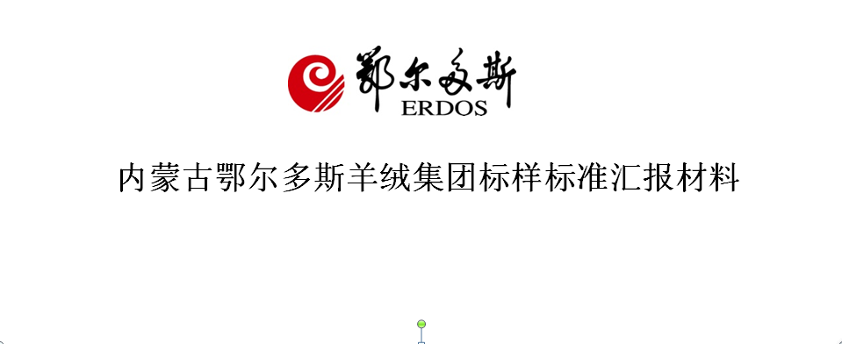
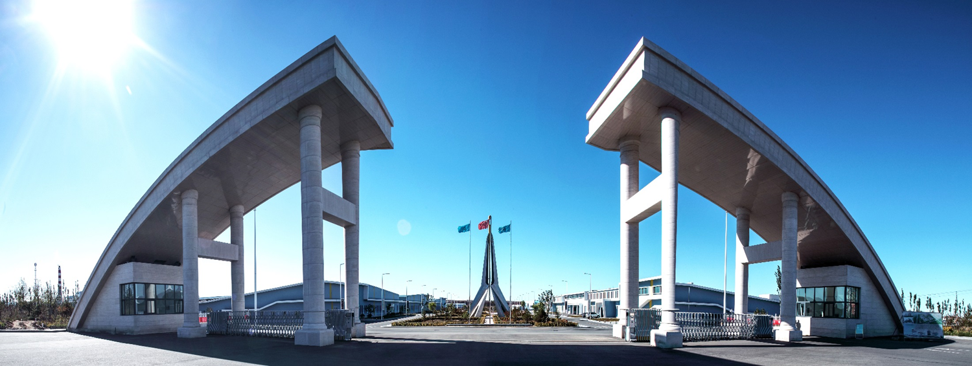
内蒙古鄂尔多斯羊绒集团标样标准汇报材料
Quality Improvement & Trade Facilitation through Corporate Standardization
Speaker：Zhi Zhang-Chief Engineer of Inner Mongolia Erdos Cashmere Group. Co. Ltd.

Slide 2
Contents
Company profile of Inner Mongolia Erdos Cashmere Group
Corporate standardization development
Function of standards
Future prospect

Slide 3
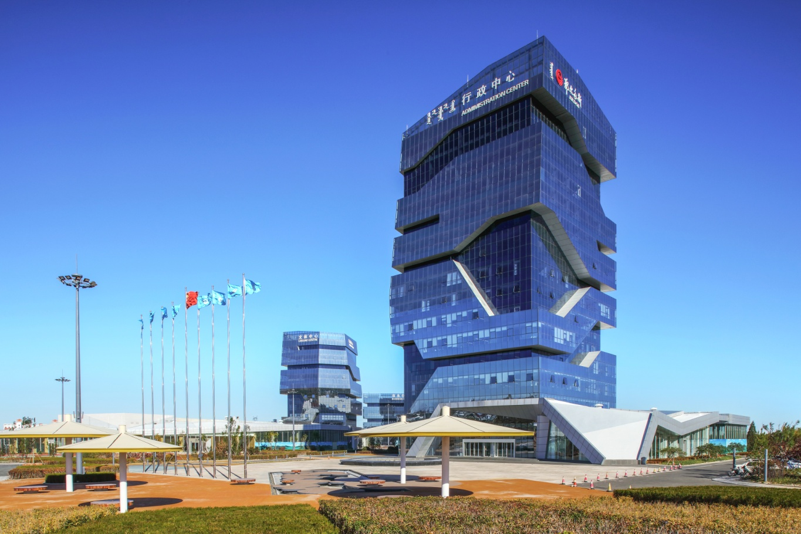
1. Company Profile
Established in 1981, the annual production and marketing capacity of Inner Mongolia Erdos Cashmere Group reaches 10 million pieces which accounts for 40% of China and 30% of world production. Product category includes cashmere raw material (dehaired cashmere), cashmere yarns, various types of cashmere products represented by cashmere sweater.

Slide 4
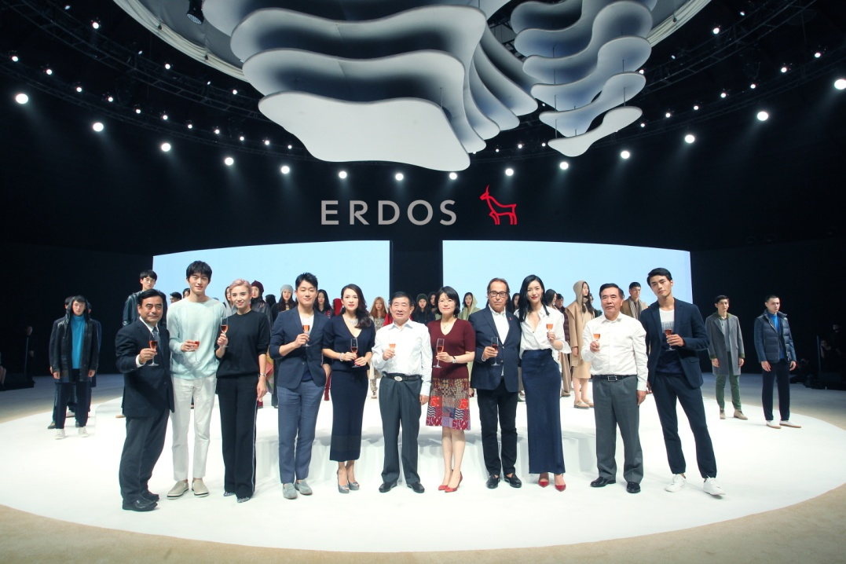
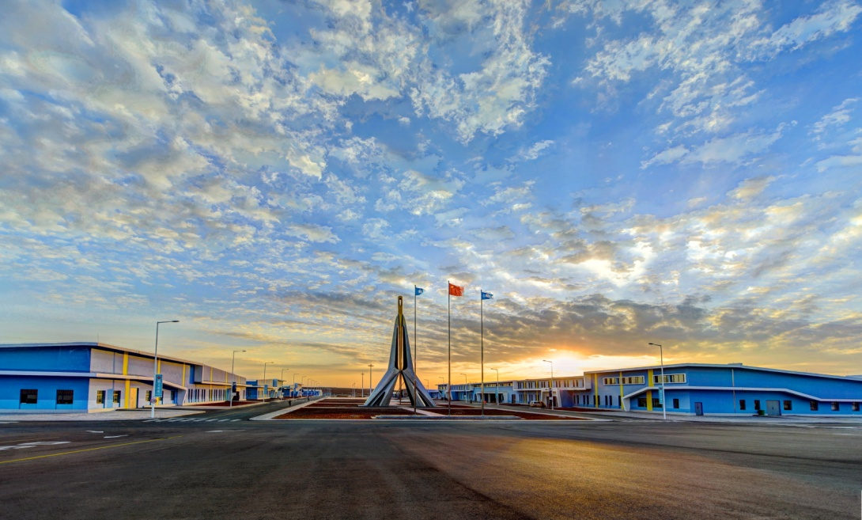
1. Company Profile
Erdos brand ranks 1st of national cashmere industry in 19 consecutive years and 5th of textile industry through the establishment of standard system, quality improvement, technical R&D, green and environmentally-friendly production-supply chain and brand development strategy.
Valued 93.158 billion, Erdos brand lists 46 in the Top 500 of China’s most valuable brand list, which is also the 1st in textile and apparel industry.

Slide 5
2. Corporate Standardization
1). Framework of Standardization
Company Chief Engineer
Engineering Center, Technical Center,(Science Association)
Standardization
Service
Standardization
Research Dept.
Management &
Operation
Dyeing & Finishing Technical Group
Yarn Spinning Technical Group
Knitting Technical Group
Weaving Technical Group
Equipment Technical Group
Testing & Standard Development

Slide 6
2. Corporate Standardization
2). Standardization Scheme
National Cashmere Products
Engineering & Technical Center
Standard Development Dept.
of Technical Center
International Standard
National Standard
Association Standard
Corporate Standard
Standard Development
Company Science Association
Domestic & International
Standardization Organizations
Domestic & International Technical
Cooperation & Communication on
Testing and Standardization

Slide 7
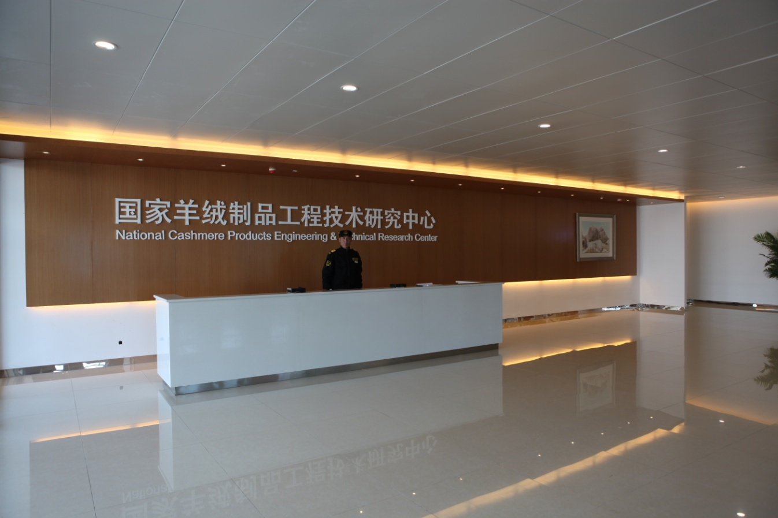
2. Corporate Standardization
3). National level “National Cashmere Products Engineering & Technical Center” and “Corporate Technical Center” engages in the development of new technology, new products and development of testing standards.

Slide 8
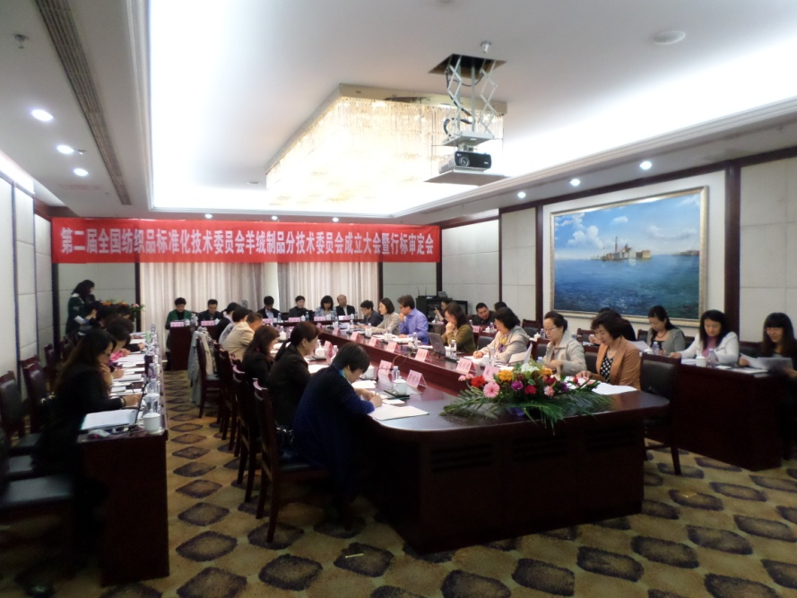
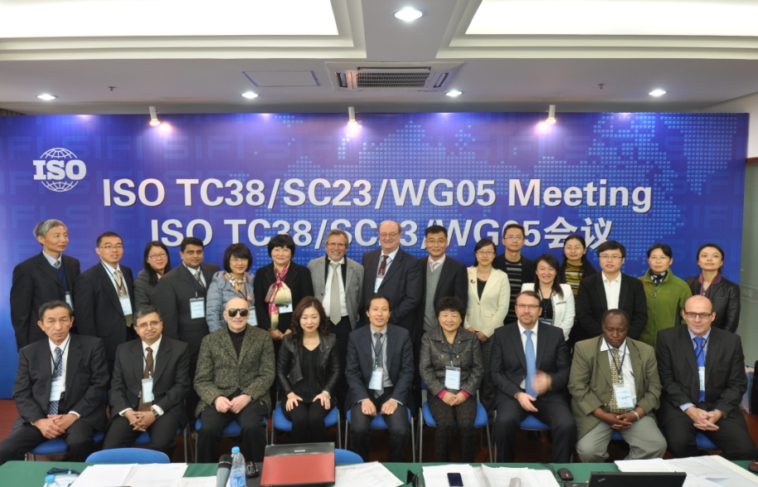
2. Corporate Standardization
4). Founding of Sub Technical Committee for Cashmere Products of National Technical Committee for Textiles Standardization （TC209/SC9）, Secretariat undertaken by Inner Mongolia Erdos Cashmere Group
5).Secretariat of Working Group ISO/TC38/SC23/WG05 ISO/Textiles/Fiber
& Yarns/Natural Proteins. Convener is Madam Zhi Zhang of Erdos Group.
Madam Zhi Zhang is also a registered expert of ISO/TC38/WG22 Composition & Chemical Test

Slide 9
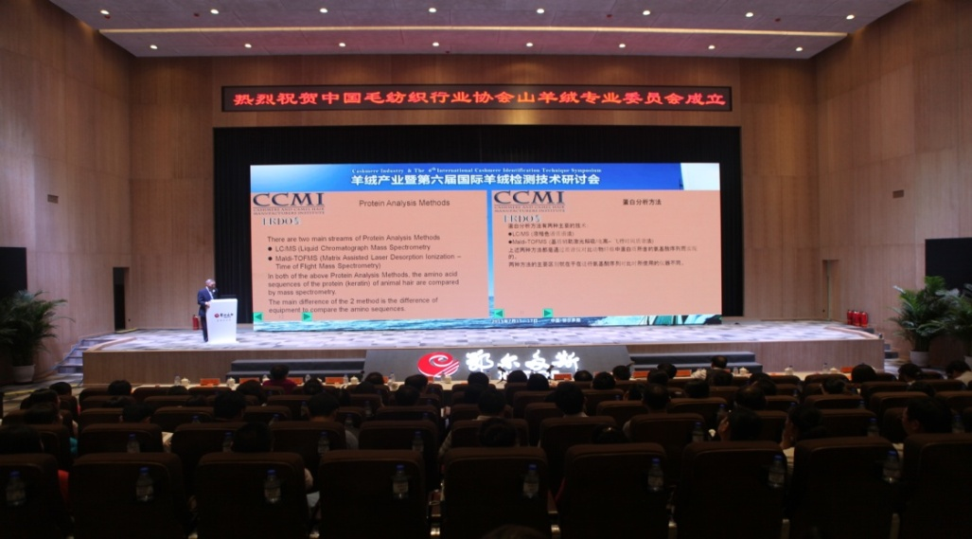
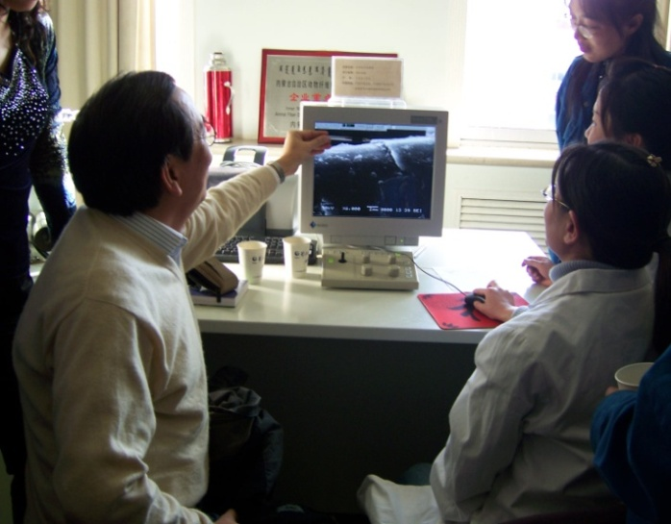
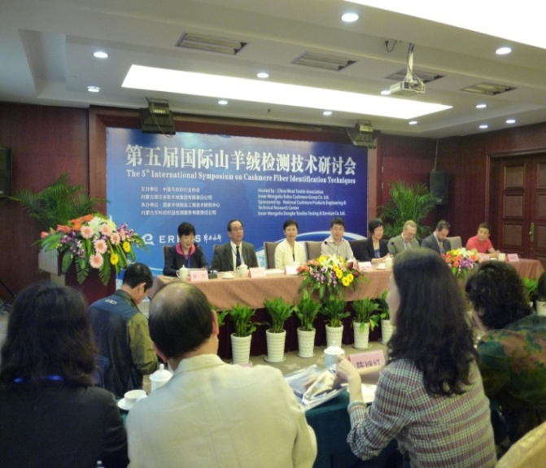
2. Corporate Standardization
6). Technical communication: 6 sessions of “International Symposium on Cashmere Fibre Identification Techniques” were held. Participants from authoritative organizations such as AATCC, CCMI attended to mutually discuss issues of cashmere fibre identification methods such as microscopy, DNA method, light spectrum method and LC-MS methods.

Slide 10
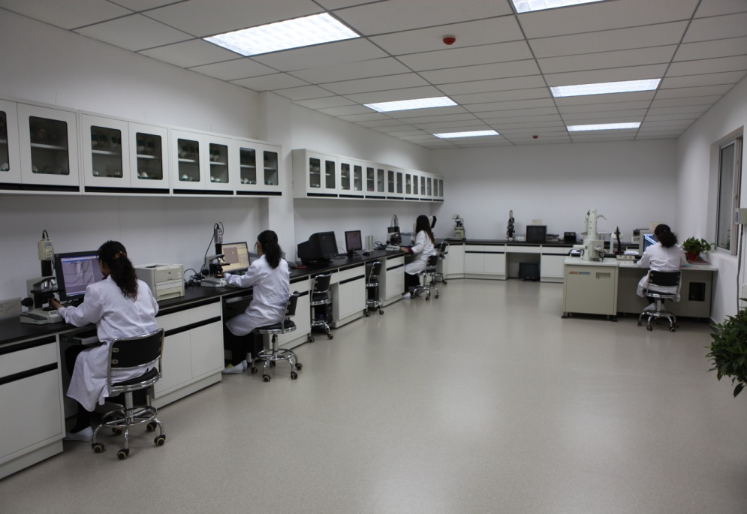
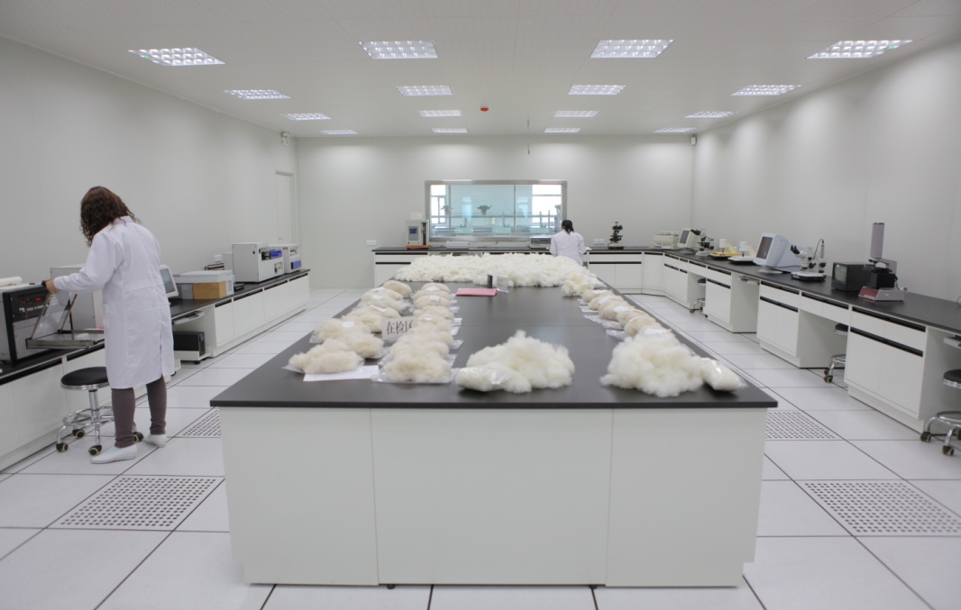
2. Corporate Standardization
Erdos joined CCMI(there are only 2 Chinese members) in 2009， CCMI (Cashmere & Camel Hair Manufacturers Institute) works to protect the interests of consumers, manufacturers and retailers, maintaining the integrity of cashmere and camel hair and fine wool products through information, quality assurance monitoring and industry cooperation.
Our testing laboratory is also the listed lab recommended by CCMI(only 3 Chinese labs) which participated the annual CCMI Round Trial on Cashmere to contribute to the technical improvement and progress on testing and standards of cashmere industry.

Slide 11
2. Corporate Standardization
7). There are 61 standards developed by Inner Mongolia Erdos Cashmere Group including 3 international standard, 8 national standard, 8 industrial standards, 1 association standard and 41 corporate standards. There are also 20 standards under development.
Standard System （Total 61 Items）
The advance and development of standardization works actually realizing “cultivating brand, increasing types and improving quality”.
3 international standard
6 test method standards
10 products and CRF standards
1 green design association standard
41 corporate Product standards

Slide 12
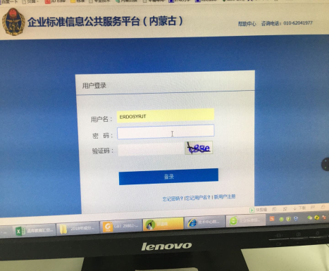
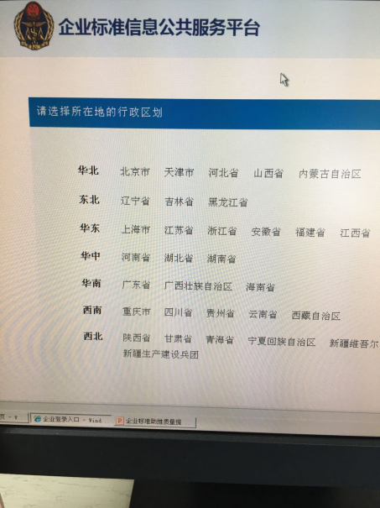
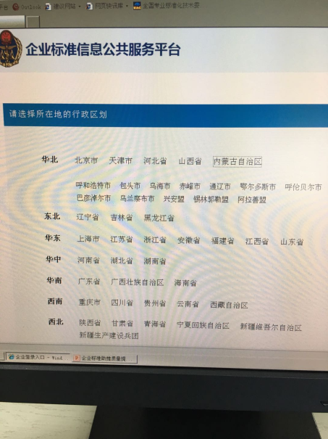
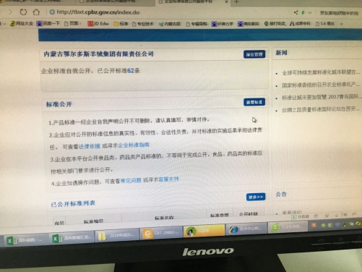
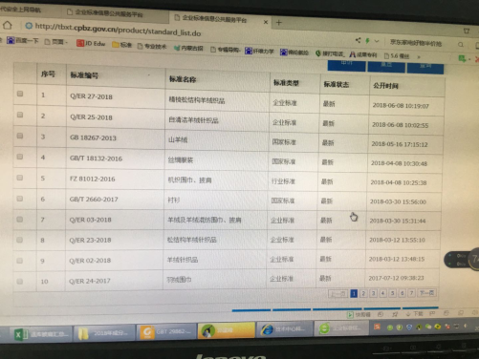
2. Corporate Standardization
Corporate standards published and implemented on National Public Service Platform for Standard Information by Erdos Cashmere Group are strictly carried out according to regulations of Standardization Law of the People’s Republic of China. The specific procedures are as follows: log on in to the website --- Choose region---choose city---company---standard declaration---upload standard.
3
1
2
4
5

Slide 13
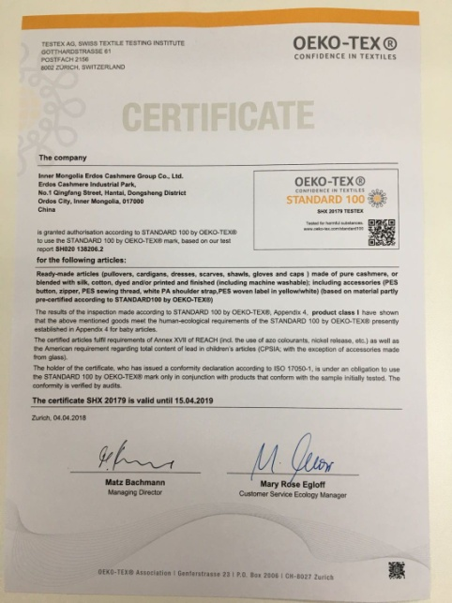
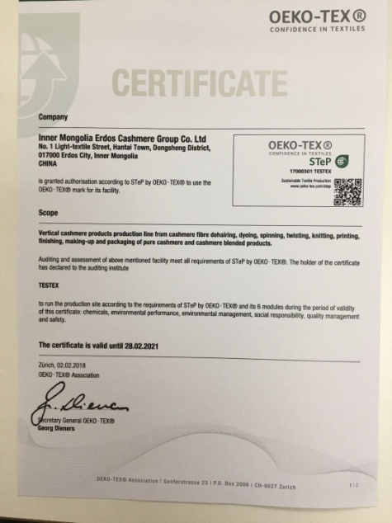
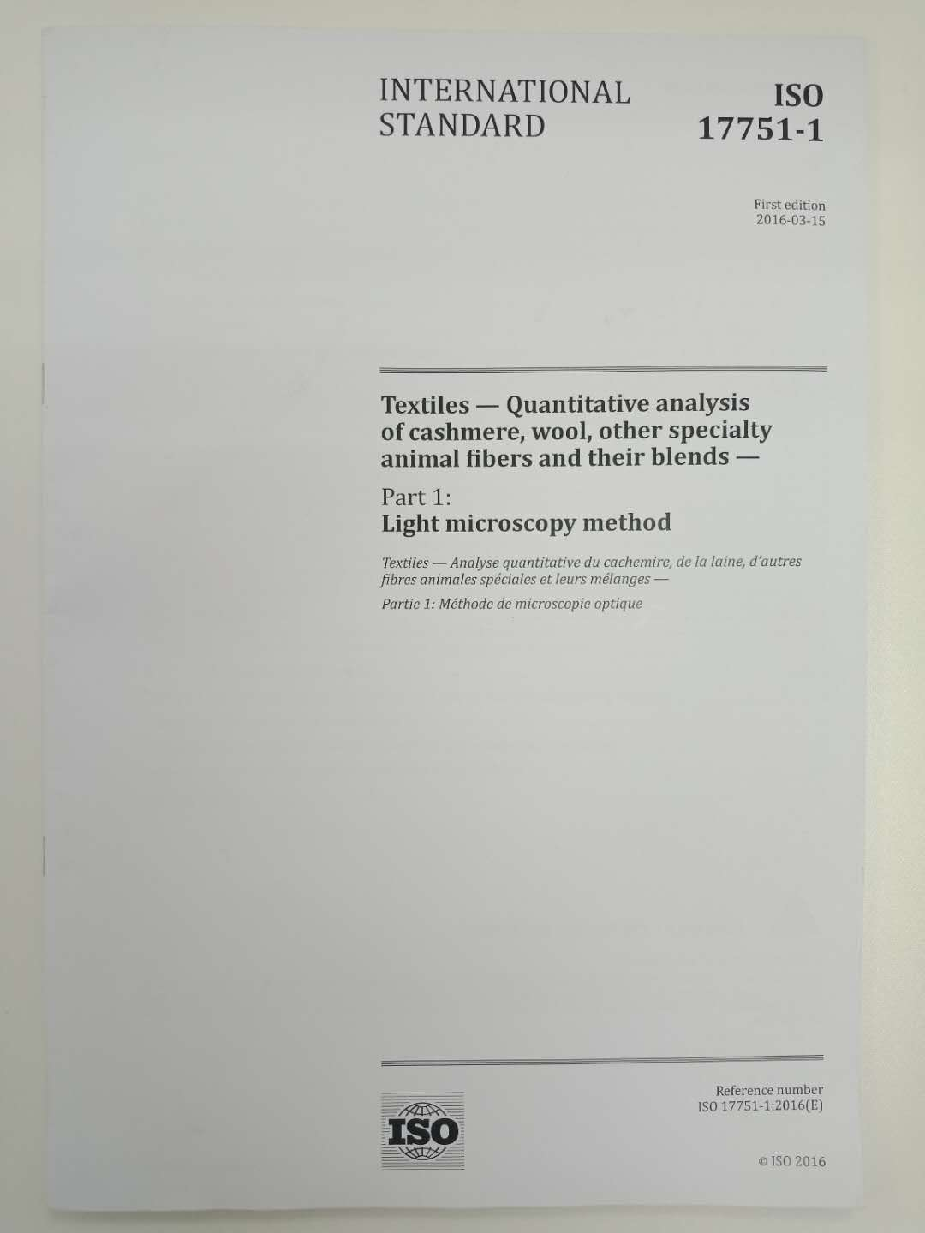
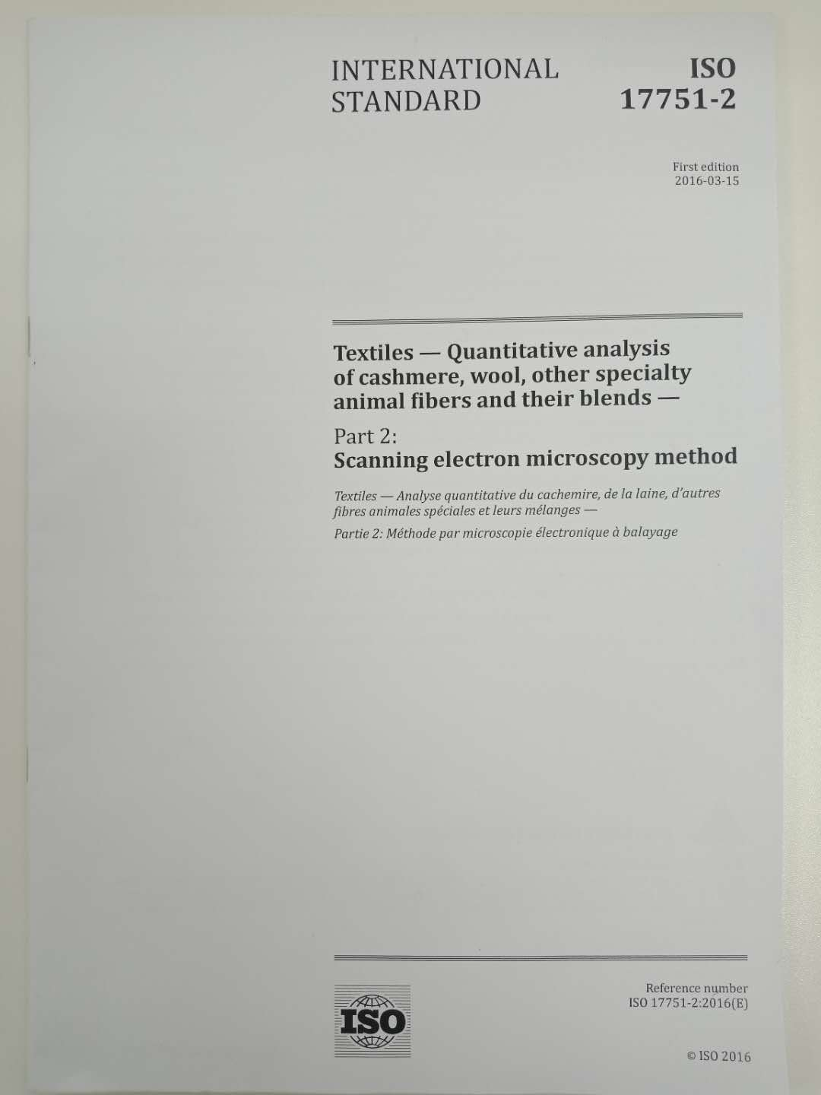
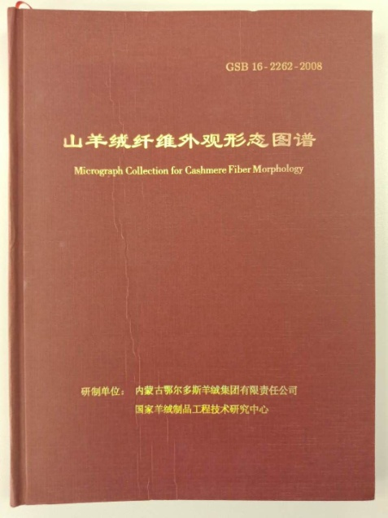
3. Function of Standard
Erdos has always been dedicated in the development of standard. Since originally cashmere industry is attached to wool industry in China and all standards are tested and controlled according to wool product standard. There is an urgent need for the standards specific for cashmere industry. So Erdos group actively organizes and undertake the development of product and test method standard related to cashmere products on labeling, animal husbandry, production, marketing, green certification (including both products and production process) which effectively ensures the healthy and sustainable development. Such standards plays great functions on technical R&D, product quality control as well as import and export trade etc.

Slide 16
4. Future Prospect
1. Improve products quality, increase brand influence and fulfill brand globalization of Chinese brands through advanced international standards.
2. Actively participate in international standardization works on the mutual benefits and win-win principle to contribute to the healthy and sustainable development of cashmere industry.
3. Advance the internationalization of cashmere standard to promote the technical progress and international trade of cashmere industry.
4. As world-renowned rare natural high quality textile raw material, cashmere fiber is widely favored by consumers from various countries( USA, EU countries, Japan, China etc.) and international luxury brands ( Loro Piana, Coach , 1436 etc.) benefiting from its unique quality characteristics.
We’d like to cooperate with elites in American textile industry for a better future of cashmere industry.

Slide 17
Thank you!

