Slide 1
ANSI-SAC Industry Roundtable on Enterprise Standards
Tim West
Manager, Enterprise Engineering Standards
Deere & Company

Slide 2
U.S. Standards System
U.S. Companies Participation
U.S. Companies and Enterprise Standards
What Standards Do Not Do For U.S. Companies
Notes:
What I will cover

Slide 3
U.S. Companies Participation
In Standards Development
Industry typically complies with International and National Standards
Subscribe to the Principles of ANSI and ISO
Transparency Open Participation
Harmonized Consensus
Performance Based Due Process
Effective & Relevant Technical Assistance
Notes:
Prefer international standards
Then national standards
Follow the principles of ANSI and ISO

Slide 4
U.S. Companies Participation
In Standards Development
Industry Led
Largely Industry Funded
Time
Talent
$
All Stakeholders can Participate
Science
Social
Standard
Development
Industry
Consumers
Government
Notes:
Industry is heavily invested in Standards making

Slide 5
U.S. Companies Participation
In Standards Development
Benefits
Strong industry voice
Less regulation
Better products
Product safety
Customer benefits
Notes:
Maybe keep this one hidden

Slide 6
Company Specific Standards
Preference for International and National Standards
But may not fill all business needs
A business may create an Internal Company Specific Standard
Proprietary
Protected
Notes:
Enterprise stands do not follow the ISO and ANSI principles
They are considered intellectual property and not shared or only selectively shared (with suppliers)

Slide 7
Company Specific Standards
Why Create a Company Specific Standard
Fill gaps in External Standards
Reduce the range in External Standards
Establish preferences
Allow the use of alternative External Standards
Notes:
other examples of why
Document the “state of the art”
Manage risk regarding product liability
Avoid unnecessary and more expensive regulation
Demonstrate social responsibility
Protect intellectual property or competitive position
Enable supply base & reduce cost
Simplify communications
Transfer knowledge

Slide 8
What Standards Do Not Do
Do not mandate product quality
Do not provide consumer protection
Quality, reliability, dependability
Characteristics of a successful company
Not mandated by standards making
Consumer protection is accomplished in other ways
Notes:
In the context of PRC standards reform
May reference ISO 9001 which is a management standard
That only says that a company has processes in place
It does not necessarily mean that the product quality is good
This only comes from a successful company that is intent on providing these for their customers

Slide 9
What Standards Do Not Do
Consumer Protection
Product Warranties
State and National Laws
Fraud Protection
Truth in Advertising
70+ National Laws
Government Agencies
Consumer protection Agency
Federal trade Commission
Notes:
Companies provide warranty and guarantees
This can be a competitive advantage
Plus there are legal requirements – laws
And government agencies are in place to assure that consumers rights are protected

Slide 10
What Standards Do Not Do
Consumer Protection
Published Product Specifications
References standards extensively
At times explicitly
This is not standards work
Notes:
Companies do publish their specifications
Based on standards and some explicit references
But this is not standards work

Slide 11
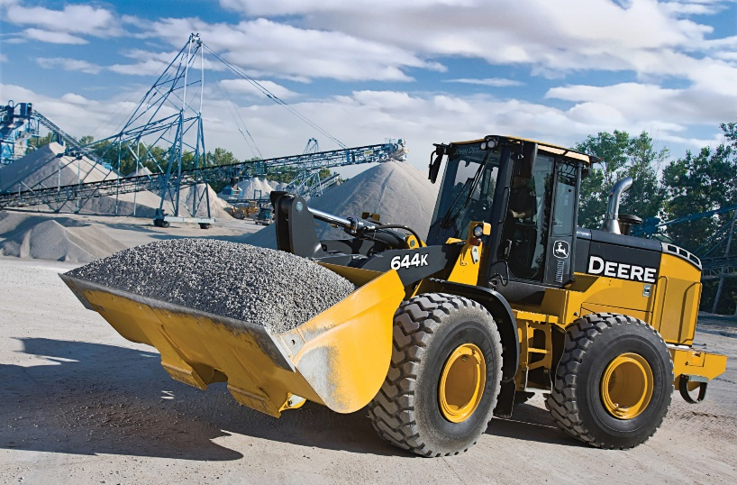
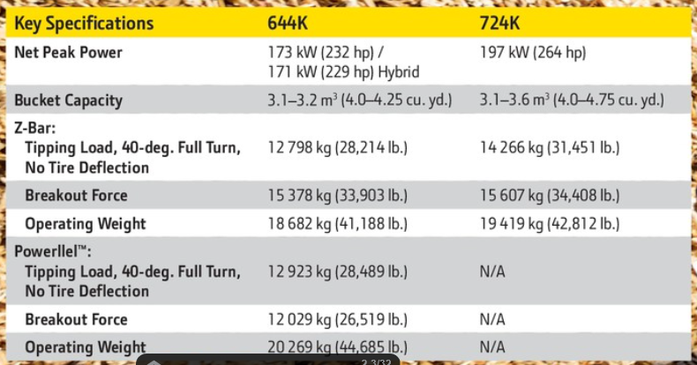
Product Specifications
Examples

Slide 12
Product Specifications
Examples

Slide 13
Product Specifications
Examples

