Slide 1
SAC – ANSI Roundtable On Enterprise Standards
James E Matthews III
Director, Technical Standards & Standards Policy
GTIS / MT&E
Corning Incorporated 17 July 2018
James E Matthews III
技术标准与标准政策总监
全球技术和工业标准组/制造工程技术部
康宁公司
17 July 2018

Slide 2
Founded: 1851
成立于1851年
Corning Incorporated is one of the world’s leading innovators in materials science. For more than 167 years, Corning has applied its unparalleled expertise in glass science, ceramics, and optical physics to develop products and processes that have transformed industries and enhanced people’s lives.
康宁公司是世界领先的材料科学创新者。 167多年来，康宁凭借其在特殊玻璃、陶瓷和光学物理领域无与伦比的专业技术，开发出的产品与制造工艺开创了新的行业，也改变了人类生活。
Headquarters:
Corning, New York
总部位于美国纽约州康宁市
Employees:
~46,000 worldwide
全球员工约： ~46,000 人
2017 Core Sales: $10.3 billion
2017核心业务销售收入： $103亿
Fortune 500 Ranking (2018): 293
2018年美国财富500强第293位

Slide 3
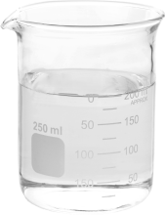
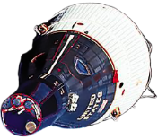
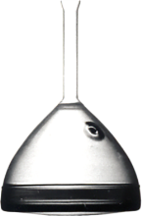
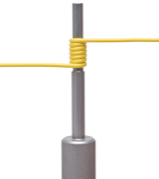
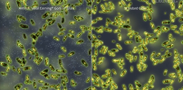
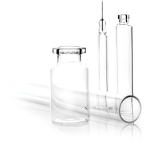
A Track Record of Innovation/创新的历史记录
1877
1879
1912
1915
1932
1934
1935
1947
1952
1961
1964
1970
1972
Signal Lenses
Glass Bulb
for Edison’s Electric Light
Railroad
Lanterns
Heat-Resistant
PYREX® Glass
High-Purity
Fused Silica
Silicones
Hale
Telescope
Mirror
Television
Picture Tube
Processes
Glass-Ceramics
Spacecraft
Window Glass
Fusion
Overflow
Process
Low-Loss
Optical Fiber
Ceramic
Substrates
for Catalytic Convertors
透镜
爱迪生电灯泡玻璃外壳
铁路用
信号灯
耐热PYREX®
玻璃
高纯
熔融硅
硅树脂
Hale望远镜的镜面
电视机显像管制造工艺
玻璃陶瓷
航天飞机玻窗玻璃
熔融溢流制程
低损耗光纤
用于汽车
催化转化器的陶瓷载体
1982
2000
2006
2007
2012
2013
2015
2016
2017
Liquid Crystal
Display Glass
Low-Density
LCD Glass
High
Throughput
Cell Culture Solutions
Tough, Thin
Cover Glass
for Mobile Devices
Ultra-Bendable
Optical Fiber
Ultra-Slim
Flexible Glass
All-Optical
Converged
Cellular &
Wi-Fi Solution
Antimicrobial
Glass
Light, Tough
Automotive
Glass
High-Transmission
Light-Guide Plate
for LCD Displays
Advanced
Glass for Wearables
Gasoline Particulate
Filters
Damage-Resistant Pharmaceutical Glass Packaging
液晶显示器用玻璃
低密度LCD用玻璃
用于药物开发的高通量无标记筛选平台
移动设备显示器用超薄、高强度玻璃
弯曲不敏感光纤
超薄柔性玻璃
全光汇聚蜂窝和Wi-Fi解决方案
抗菌保护玻璃
重量轻、强度高的汽车用玻璃
用于LCD显示器的高透射导光板
穿戴设备用高级玻璃
汽油微粒过滤器
耐损伤医药玻璃包装

Slide 4
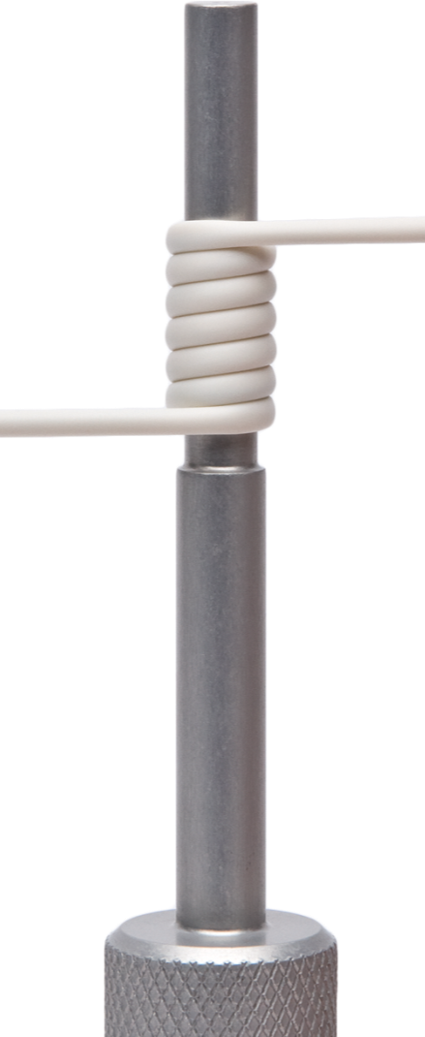
Business Segments That Lead Growth Industries 引领产业成长的业务部门
显示科技
光通信
环境科技
生命科学
特殊材料
Display Technologies
Optical
Communications
Environmental Technologies
Life Sciences
Specialty Materials
© 2018 Corning Incorporated .

Slide 5
Strong Investment in RD&E 大力投入研究与开发
We invest, on average, ~8% of annual sales in RD&E
我们年平均研究与开发的投入约占年销
售收入~8%
We innovate for today’s businesses while creating tomorrow’s growth drivers
我们为今天的业务而创新，同时也
创造明天业务的增长。
We sustain our investment in good times and bad
无论顺境还是逆境，我们始终坚持投入

Slide 6
Standards Are Not Regulations/标准不是规章制度
Standard: Agreement on technical description of characteristics
标准：
达成一致的技术要求
Regulation: Law or policy set by government agency or legislature
规章制度：
由政府部门或立法机构制定的法律或政策
versus
Widely adopted
广泛采用
Can include all or part of a standard
可以包括全部或部分标准
Open, consensus based process
开放、协商一致的过程
Compliance mandated
强制执行
Use of standards is voluntary
标准的使用是自愿的
Penalties for non-compliance may apply
不遵守可能受到处罚

Slide 7
Intellectual Property In Standards/标准中的知识产权
Industry’s Goal /行业目标:
One Standard, One Test, Accepted Everywhere
一样标准，一样测试，处处接受的标准
Most Companies Seek Global Standards (WTO TBT Principles)
大多数公司寻求全球标准 (WTO技术性贸易壁垒原则 )
Follow Best Practices For Intellectual Property/遵循知识产权的最佳做法
ANSI Patent Policy/美国国家标准学会专利政策: https://share.ansi.org/Shared%20Documents/Standards%20Activities/American%20National%20Standards/Procedures,%20Guides,%20and%20Forms/ANSI%20Patent%20Policy%20Guidelines%202012%20final.pdf
ANSI Process For >240 Standards Developers /美国国家标准学会授权 > 240个标准组织开发标准: https://share.ansi.org/Shared%20Documents/Standards%20Activities/American%20National%20Standards/Procedures%2C%20Guides%2C%20and%20Forms/ANSI-Essential-Requirements-2018.pdf
Joint IEC / ISO / ITU Patent Policy/IEC/ISO/ITU联合专利政策:
http://www.iec.ch/members_experts/tools/patents/documents/ITU-T_ITU-R_ISO_IEC_Common_Guidelines_2015-06-26.pdf

Slide 8
What Makes A Good IPR Policy? 什么是好的知识产权政策？
For Standards Essential Patent/对于标准中的必要专利:
(Early) Disclosure Is Encouraged/ 鼓励早披露
License Details Not Part Of The Standards Process/许可证细节不是标准过程的一部分
Reasonable And Non-Discriminatory Terms/合理和非歧视条款
Available To All Who Request/可供所有请求者使用
Owner Requested To File Declaration/专利拥有者需提出许可声明
License Free Of Charge/免费许可
License Under Reasonable and Non-Discriminatory Terms/合理和非歧视条件下的许可
Refuse To License/拒绝许可
Standards Organization Makes All Declarations Public/标准组织公开所有专利许可声明

Slide 9
Standards IPR/标准 知识产权
If Possible Write Standards So Patents Are Not Essential
如果可能，标准中避免包含必须的专利
Design Standard Approach: Specific Description
设计要求式标准: 具体描述
Becomes Outdated/变得过时
Limits Innovation/限制创新
Functional Standards Approach: Requirements And Interfaces
功能要求式标准： 需求与接口的要求
Lasts Long Time/持续很长时间
Encourages Innovation/鼓励创新
Fewest Essential Patents/包含尽量少的基本专利

Slide 10
Key Messages/要点回顾
Industry Wants Open and Transparent Standards Processes
行业需要公开透明的标准流程
Seek To/ 寻求
Use Global (WTO TBT ) Standards Where Possible
在可能的情况下使用全球（WTO TBT）标准
Write Standards With Minimum Standards Essential Patents
编写标准时尽量少的包含基本（必须）专利
Good Global Standards Avoids Need For Enterprise Standards
有好的全球标准可避免对企业标准的需求
Open And Consistent IPR Process In Standards Making
在标准制定中保持公开一致的知识产权流程
Standards Support Innovation/标准应支持创新

