Slide 1
The Lastest Developments of Chinese Enterprise Standards ——Self-declaration and Disclosure System of Enterprise Standards
Tang Wanjin, Vice President of China National Institute of Standardization
July 17,2018

Slide 2
Main Contents
一
Why disclose?
二
How to disclose?
三
Development of disclosure

Slide 3
Main contents
一
Why disclose
二
How to disclose
三
Development of disclosure

Slide 4
1.Significance
It is good for solving the problem of information asymmetry and protecting consumers’rights.
It is good for the enterprise to protect its dominant position and undertake its entity responsibilities.
It is good for the government to provide public service and supervision at present and after the event, thus promoting fair competition in the market.

Slide 5
2.Stakeholders
Government Sector
4
Enterprise
1
Supervising &
Stimulating
Self-declaration & Disclosure
2
3
Consumer
Third-party Organization
Using & Supervising
Services & Assessments

Slide 6
Main contents
一
Why disclose
二
How to disclose
三
Development of disclosure

Slide 7
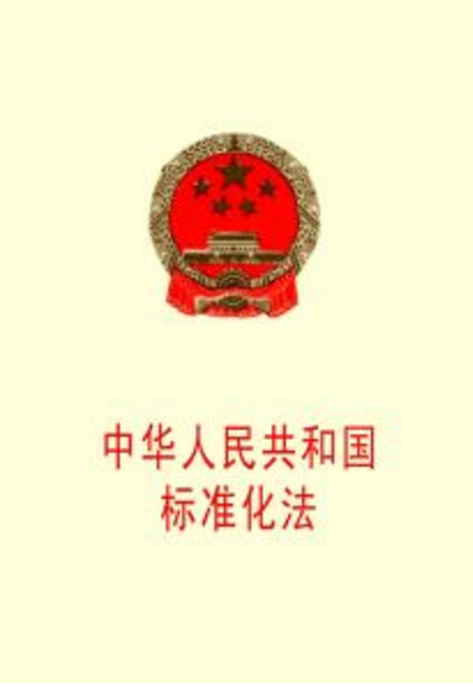
1.Legal ground
Article 27 of New Standardization Law of The People’s Republic of China explicitly stipulates that “the country applies the self-declaration, disclosure and supervision system of enterprise standards ”.

Slide 8
2.Contents of the disclosure
Firstly, if an enterprise directly executes the governmental standard, the standard’s designation, number and name shall be disclosed.
Content
Secondly, if an enterprise executes its self-developed enterprise standard, the functional and performance indicators shall be disclosed.

Slide 9
2.Contents of the disclosure
Function indicator
It refers to the description of the function/effect of a product/service.
e.g. The function of an air-conditioner is to adjust the air temperature.
Performance indicator
The extent of a product/service performs under certain conditions.
e.g. an air-conditioner’s power consumption.
Let’s take air-conditioner as an example:
“Type: cooling/heating” is the function indicator of the air-conditioner. It indicates that this air-conditioner has two functions, i.e. heating and cooling;
“Cooling power (W) 1110, heating power (W)1500” are the performance indicators of the air-conditioner. They indicate the power consumption of the air-conditioner.
Example

Slide 10
2.Contents of the disclosure
Few points needing attention
The contents of disclosure do not involve the intellectual property and trade secrets of the enterprises.
The type and contents of the disclosed standards shall be determined independently by the enterprise based on its own features.
The Disclosure of self-declaration of imported products shall not be taken into account for the time being.

Slide 11
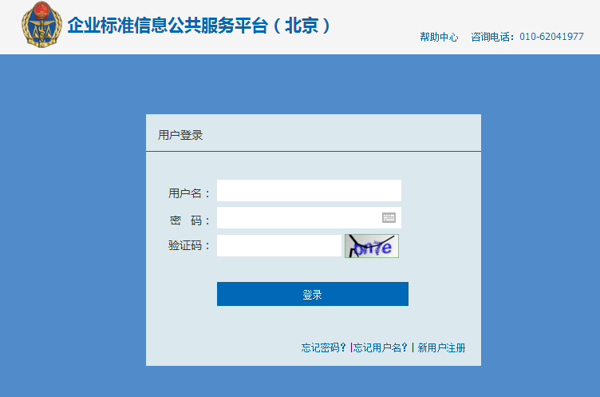
3.Way of disclosure
The enterprise is encouraged to disclose its self-declaration on the national unified platform.
www.cpbz.gov.cn
Public service platform on enterprise standard information.

Slide 12
3.Way of disclosure
Feature embodiments
Convenience
Access Anywhere
24/7 uninterrupted service
Timeliness
Self-renewal
Real-time check

Slide 13
Main contents
一
Why disclose
二
How to disclose
三
Development of disclosure

Slide 14
1.Progress
By July 13,2018
There are 736,762 self-declarations on enterprise standard have been disclosed.
Standard
There are 166,628 participating enterprises.
Enterprise
Cover 1,249,624 types of products.
Product

Slide 15
1.Progress
Standard figure
Enterprise figure
Product figure

Slide 16
2.Next step
Improve supporting laws and regulations, revise Rules on Management of Enterprise Standardization.
Strengthen training on enterprise standardization and provide consultancy service.
Match self-declaration system to voluntary sustainable standard platform.

Slide 17
Thank you!

