Slide 1
Sino-U.S. Cooperation and the Internationalization of Standardization: Priorities and Opportunities
Washington, D.C.
25 April 2016
Teresa J. Cendrowska, VP – Global Cooperation

Slide 2
ASTM International
Standardization Priorities
Demonstrating WTO/TBT Compliance
Collaborative and Inclusive
Globally
Flexible, Innovative
ASTM International’s Standardization Priorities
Relevant and Timely
Open and Transparent
Responsive and Trustworthy
ASTM Presentation to SAC Delegation at ANSI

Slide 3
ASTM Priorities
35,000+ global members from 148 countries participating in ASTM
146 Main Committees
and 2,013 Subcommittees
12,671 standards
177 new standards
1,958 revised standards in 2014
Collaborative and Inclusive
Responsive and Trustworthy
Relevant and Timely
Standards developed by consensus
Every member has equal say
Members come from government, manufacturers, end-users, academia, laboratories, professional societies and consumers
Engaging established and emerging economies
Member expertise drives the decision on which standards are written and the content
Environment dedicated to scientific and technical excellence
Reviewed every 5 years at a minimum
Ensure safety, quality and reliability, market access
Serving the needs of consumers, business, government, industry
Applied to manufacturing and materials, products and processes, systems and services
Able to negotiate and solve problems “expert-to-expert”
New standards developed in 16-18 months, revisions in 6-8 months
The choice of many global industries; 6,900+ citations by more than 75 nations, with 50% of standards sold outside the U.S.
ASTM Presentation to SAC Delegation at ANSI

Slide 4
ASTM Priorities
Online Tools/Access
38,838 website visits per day
1,333 virtual meetings
1,325 collaboration areas
Standards Tracker tool
Serving 90+ Industry Sectors
Six Principles
Open and Transparent
Flexible and Innovative
WTO/TBT Principles
Anyone, anywhere may participate via a defined and consistent process
Low or no-cost membership
Blind to political, cultural and geographic borders
Participation based on interest, not criteria
E-tools provide 24/7 global and cost-effective engagement
From traditional to cutting edge — additive manufacturing to steel
Responding to new challenges, technologies and markets
Bringing together good science, engineering and judgement; harnessing expertise
Aiding innovation rather than creating hurdles
Responsive delivery options; increasing customization and flexibility
Demonstrating compliance
Supporting the multiple path approach to international standards
Advocate choosing standards based on merit
ASTM Presentation to SAC Delegation at ANSI

Slide 5
Suggested Building Blocks
Please consider these factors
Based on ASTM’s response to the SAC call for comments
Formulate “globally”
Follow WTO/TBT principles
Consider/serve the market
Transparency
Share information
Invite and consider comments
Educate Everyone
Participants
Users
Regulators
Students
Consumers
ASTM International’s Standardization Priorities
Relevance
Specify and conduct regular review of approved standards
Thoughtfully consider proposals
Intellectual Property
Recognize it
Enforce it
Openness
Engage all stakeholders
Domestic and foreign
ASTM Presentation to SAC Delegation at ANSI

Slide 6
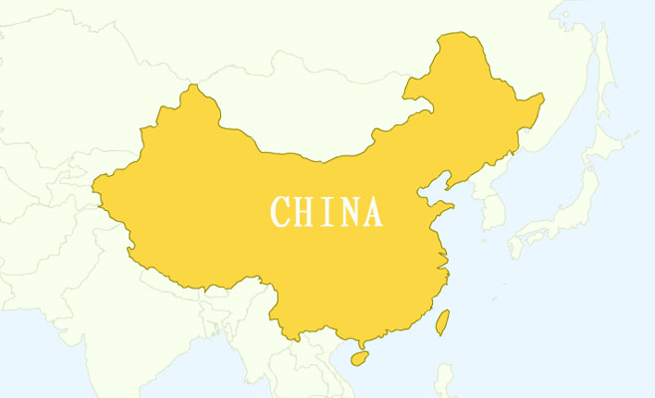
ASTM and China — Opportunities
MoU Signed in 2004
Allows for adoption of ASTM standards as GB standards
Offers no-cost membership
Report more than 1,060 citations of ASTM standards
Adoptions
Basis of GB standards
Consulted
Referenced
Over 650 Chinese technical experts in ASTM across 100+ ASTM TCs
Increased number of work item submissions from industry and government across various sectors
Shipbuilding
Petroleum
Electrical Insulating materials
Atmospheric analysis
Steel
Growing number of TC/SC/TG leaders and meeting delegates from China
Engaging in and with university students and professors
ASTM Presentation to SAC Delegation at ANSI

Slide 7
In closing…
We understand; it’s a difficult task
We are happy to help
You are taking a good approach and making progress
ASTM Presentation to SAC Delegation at ANSI

Slide 8
Questions?
Thank you!
tcendrowska@astm.org
fliu@astm.org

