Slide 1
Security and Privacy Standards and Technical Challenges of End to End Security in 5G Networks and Smart Cities
Suhas Shivanna
September 2019

Slide 2
Agenda
Digital transformation, 5G and smart cities : Opportunities and Challenges
Emerging Security Trends and Challenges
What does End to End Security mean to smart cities/5G solutions
Conclusion

Slide 3
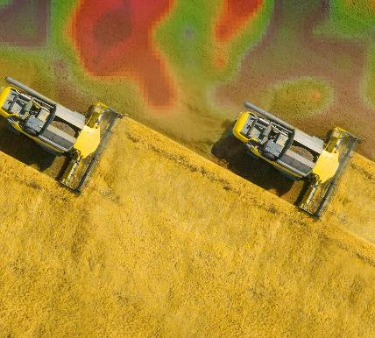
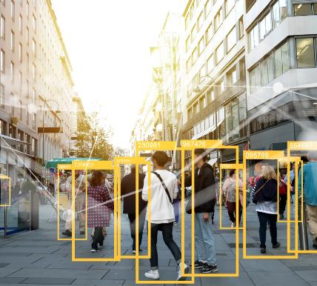
We live in a world where everything computes
Technology will be embedded everywhere
Everyone and everything will be connected
Everything will be understood
“Data is the new oil”. IOT, Smart Cities, 5G, AI/ML and many more technologies make this a reality

Slide 4
Today’s digital Enterprise: Key Pillars: Cloud, Big Data, BYOD, Security
PaaS
IaaS
Off Premise
SaaS
On Premise and Edge
Protect your most business-critical digital assets and their interactions, regardless of device
USERS
APPS
DATA
Pervasive connectivity
Smart device expansion
Explosion of
Information and tools
Off Premise
BIG DATA
BYOD
Large Scale Distributed IT, Highly Complex, Perimeter disappearing

Slide 5
5G, Smart cities will power the growth in the edge market
Security should start from Edge to Core to Cloud
The Edge
Operations technology
Edge IT, Data center and Cloud
Data is sensed,
Things controlled
Data acquired and aggregated
Early analytics and compute
Deep analytics
and compute
“Things”
generate data and need control
Stage 1
Stage 2
Stage 3
Stage 4
Data flow
Control flow
IoT intersection of IT (information technologies) with OT (operations technologies)
The “Things” evolving operations systems producing massive amounts of new data
The “Edge” is a place, its outside the traditional data center or cloud – near the “Things”
Less Physical Security, Increased Attack Surface

Slide 6
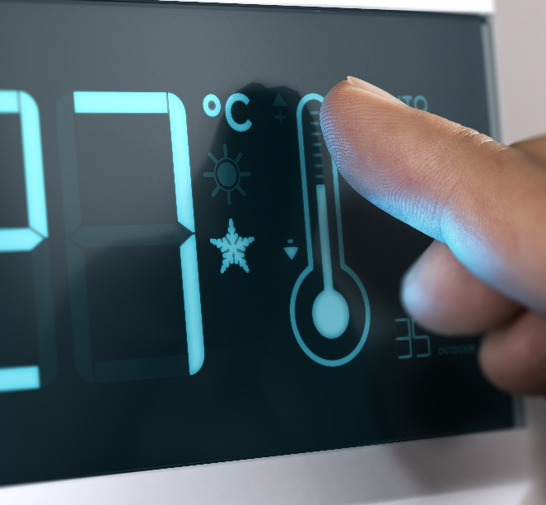
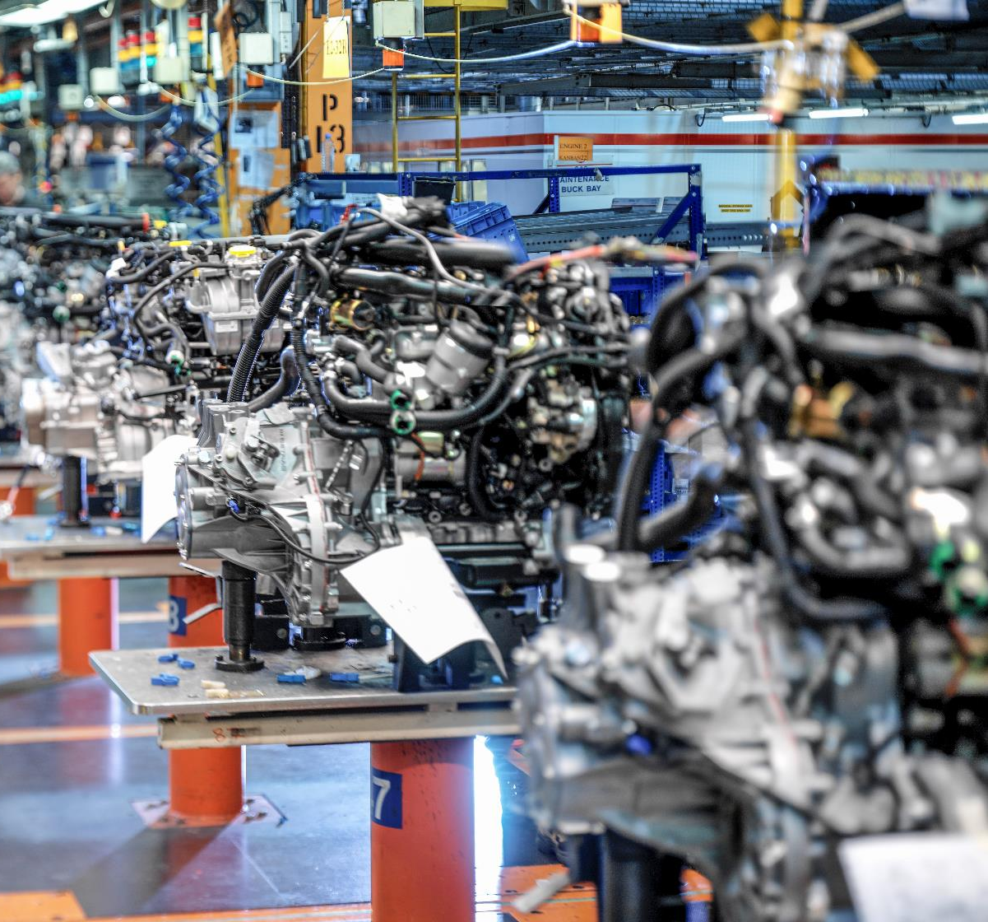
The Internet of things will be used everywhere
HOME
BUILDINGS
CITIES
MANUFACTURING
Lighting
Irrigation
Water Recycling
Security
Pet Feeding
Smoke/CO Monitoring
Infotainment
Cooking
Shopping
Energy Optimization
Sleep Optimization
Heating and air conditioning
Security
Lighting
Electrical
Parking Control
Emergency Alerts
Structural Integrity
Meeting Room Management
Hot Desks
Huddle Spaces
Digital Visitor Management
Digital Signage
Waste Management
Sewage and Water
Surveillance
Emergencies
Public Space Design
Parking
Air Pollution
Crime Mapping
Pothole find and fix
Inventory Tracking
Supply Chain Tracking
Precision Plant Leasing
Collaborative Design
Improved Safety
Resource Optimization
Pollution Management
Predictive Maintenance
3D-printed Space Parts
Enhanced Monitoring
Physical Security
TRANSPORT
HEALTH
RETAIL
FARMING
Traffic routing
Air pollution
“Green priority”
Safety
Self-driving cars
Self-driving buses
Precision Insurance
Precision Leasing
Parking
Condition-based Maintenance
Elderly Monitoring at home
Equipment Monitoring
Hospital Cleaning
Bio Wearables
Food Sensors
Geo-fencing of Equipment
Directions within Hospitals
Assisted Diagnostics
Uber for Doctors
Hospital Workflow Design
Smart Shopping Lists
Counterfeit Reduction
Inventory Theft
Add-on Suggestions
Targeted Promotions
Optimal Store Design
Autonomous Checkout
Digital Signage
Store Shelf Sensors
Precision Fertilizer
Precision Irrigation
Animal Tracking and Proof
Security – anti-poaching
Robotic Picking
Vertical City Farming
Self-driving Machinery
Predictive Maintenance
Drone Herding
Fish Farming
Artificial Insemination
Newer Applications, Unprecedented Connectivity/Scale, Newer Threats

Slide 7
Some Emerging Security Trends and Challenges
Increased attacks at lower layers
Attacks moving to FW/HW, Many hardware vulnerabilities Increased threats to IOT devices
“Scale, heterogeneous, newer technologies, more tools
NFV, SDN, Radio, Stack, VRAN, CRAN, IOT Platforms etc.
Region Specific security/privacy standards, processes and certification requirements
CCPA , UK IOT Bill, ITSAR, 3GPP, etc.
Increasing sophistication:
PDoS vs Data Theft
From annoying viruses to Cybercrime to Cyberwar
Data Privacy challenges
More data, more users, more apps, more privacy issues
Supply Chain Security
“…. how do I confirm that the code on the hardware that I received is same as the one that vendor intended to ship?”
Lack of Cyber Security skills and increased internal threats
Lack of skills, complexity, scale compounding the security problem
Holistic 5G and Smart City security solutions is key to meet emerging trends/threat landscape.

Slide 8
Smart cities and connected world need holistic security solutions for modern threat landscape
Holistic security is all about
Build security in to the product using secure development lifecycle
Build products with secure by default principle in mind
Don’t ignore supply chain security
Ensure agile, standardized and risk based security hardening and operations
Ensuring privacy by design
Secure the stack: Do all the above from Device to Gateway to Edge to Network to Core to Cloud
Drive towards Zero trust methodologies/architectures
Don’t trust, always verify, Audit ready, analytics driven, adaptive and context aware
Embrace newer security technologies and solutions
Identity management, Remote attestation, Security AIOps, UEBA etc.
Design Smart city and modern networks with Protect, Detect, Recover philosophy

Slide 9
Conclusion
Think about security from the beginning
Understand the threat landscape, design products with security in mind
Remember the protect, detect and recover philosophy
“Security is as strong as the weakest link”, Think about security holistically and look at end to end solutions
Automate, Orchestrate Security to deliver to simplify operations/asset management
Remove complexity, Simplify Processes, Simple everything
Standards are important, Be proactive, Keep it simple
Think about unifying/reducing standards, don’t think of standards after the damage is done

Slide 10
THANK YOU
Security is a continuous process, keep evolving and think holistically

Slide 11
Recent Large Scale Security Attacks
German Steel Mill attack
APT that destroyed large parts of a steel mill
Shamoon virus attack on Saudi Aramco
Coordinated attack to bring down ~30000 machines
Key files wiped out in the machine
Few weeks to recover from this large scale attack
Ukraine critical infrastructure attack (power grid)
Stuxnet virus
Attack on Iran nuclear facility
Destroyed huge part of Iran’s nuclear facility(centrifuges)
BrickerBot attack on 2 Million IOT devices
Sony Attack
Private communication, unreleased movies, future plans, salary details were leaked to public
Notes:
https://www.sentryo.net/cyberattack-on-a-german-steel-mill/

