Slide 1
Overview of the 5G India Test Bed
Rajat Rao
IIT Madras
Sep 2019

Slide 2
5G Test Bed in India, by India
Infrastructure for implementing the entire 5G network.
What
To be at the forefront of 5G developments and deployments
Aim
Digital Connectivity programmes
Make in India
Startup India
Building 5G ecosystem
Why
How
Scale and evolve nascent test beds
Leverage wireless expertise
Monetise Outcomes of 5G research project

Slide 3
Indigenous 5G Testbed Project
First proposed by Dr. Paulraj
Funded by Department of Telecommunications (DOT)
THANK YOU!
Rs 240 Crore project ($35 million)
Three year duration
Build and demonstrate an
end-to-end 5G test bed

Slide 4
Major Goals of 5G test bed
Indigenous Telecom Products and Services.
Encourage telecom product startups in India
New startups
Multiply R&D capability to develop 5G based solutions for Indian markets
Increase India’s participation in global forums (3GPP, ITU, IEEE) - present test results for Indian use cases
Demonstrate solutions for India
LMLC for Rural network deployments, smart cities, etc.
5G Research from Indian universities.

Slide 5
5G Test Bed Team

Slide 6
Collaborating Institutes
IITB
IITH
IITM
IITD
IISc
IITK

Slide 7
CEWiT | Baseband Algorithms, Core Network, Hardware Platforms
IIT Bombay | Core Network
IIT Delhi | Baseband Algorithms, LiFi, Security
IIT Hyderabad | NB-IoT Asic, Algorithms, UE (CPE form factor)
IIT Madras | Hardware Platforms, Core Network, Algorithms
IIT Kanpur | Relay, Hardware Platforms,
IISc Bangalore | Baseband Algorithms, IoT, LiFi
SAMEER | Antennas, RF platforms
40 Investigators (faculty members/Senior researchers) from 8 institutes
Currently 200 researchers working on the testbed
Engaging with Indian telecom startups for various sub-systems

Slide 8
Test Bed Locations
IITD, Delhi
IITB, Mumbai
IITH, Hyderabad
IISc, Bangalore
IITM/CEWiT, Chennai

Slide 9
Subsystems and Use cases being Developed

Slide 10
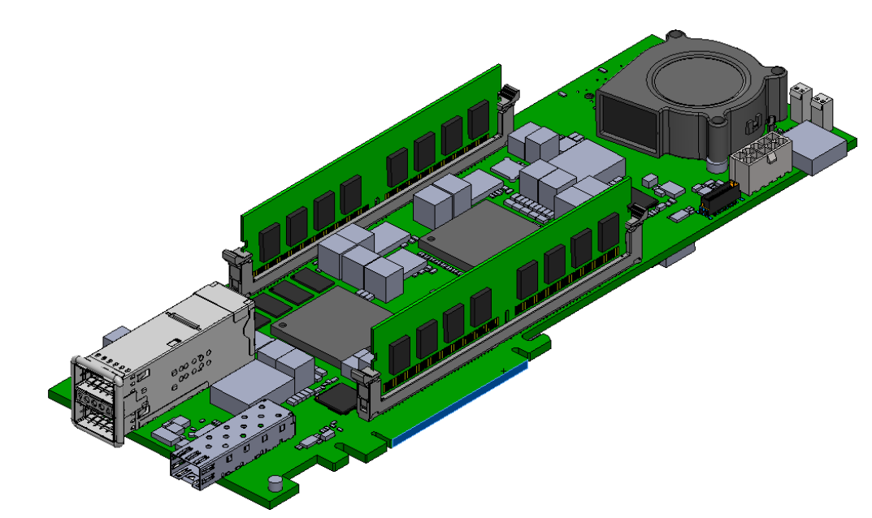
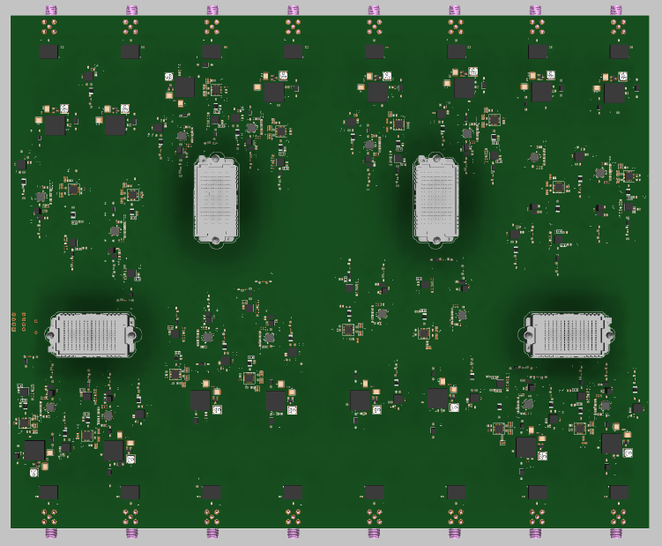
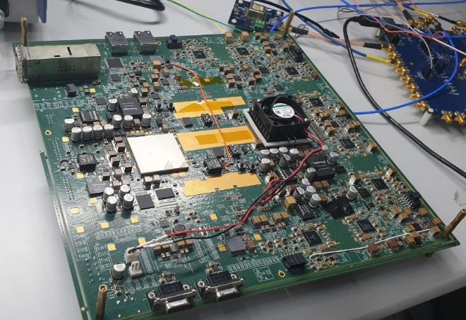
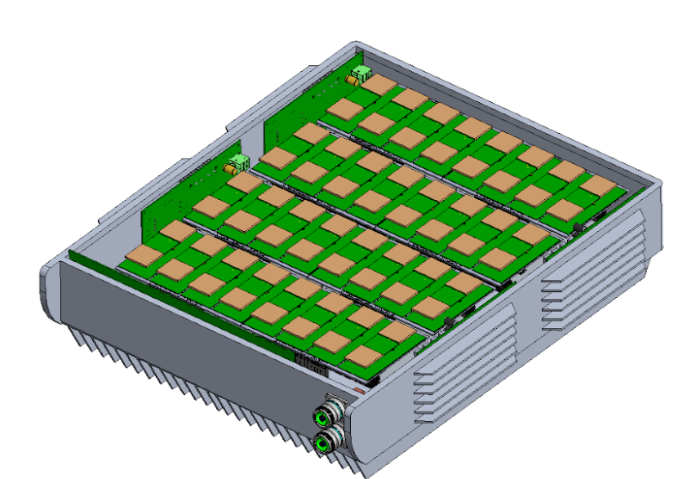
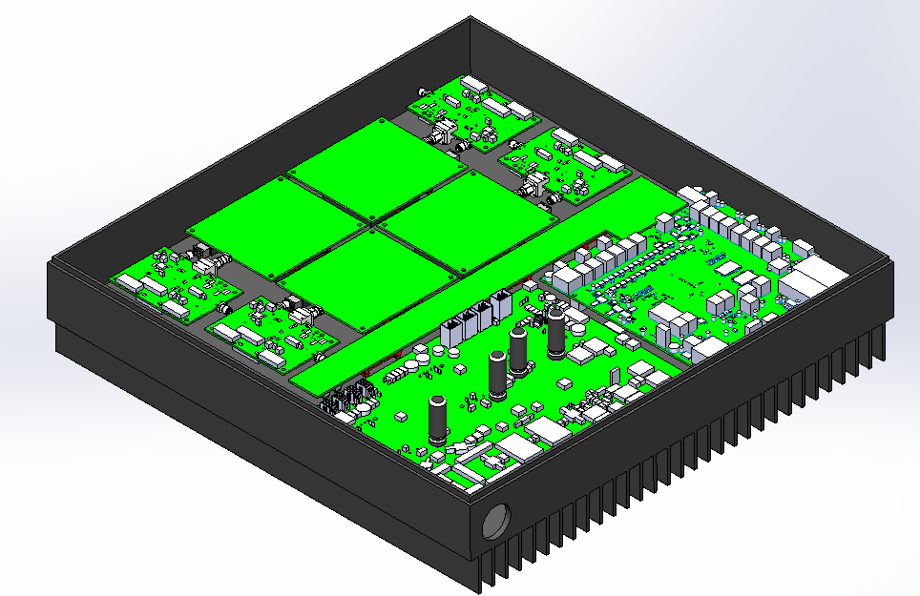
Major Subsystems 1/3 – Hardware
Being developed world over for the first time
Integrated mmWave Radio Front end
Development of hybrid analog/digital architectures
256 Antenna (with 4 streams)
Massive MIMO subsystem
64 Antenna systems (Sub 6 GHz)
Radio, Front end, Baseband
Baseband Unit
Analog Front-end
Digital Front-end
Massive MIMO RRH
mm-wave RRH

Slide 11
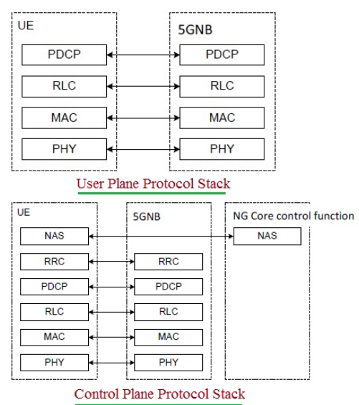
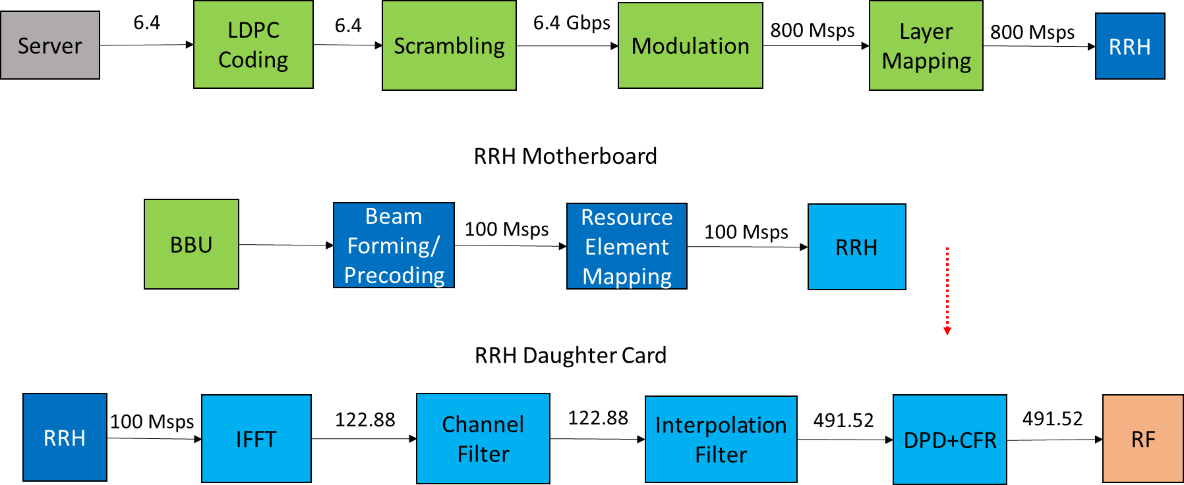
Major Subsystems 2/3 – Software
Being developed world over for the first time
5G Baseband
5G NR (3GPP 38 Series) compliant
Supporting lower bands (< 6 GHz) and higher bands (> 6 GHz).
5G Protocol Stack
5G NR (3GPP 38 Series) compliant
5G Core Network
SDN based with NFV
Multi-RAT using WiFi etc
5G Baseband Flow
5G Protocol Stack

Slide 12
Major Subsystems 3/3 – New Use Cases
Being developed world over for the first time
Full Duplex Radios
Edge Computing Subsystem
CloudRAN
Centralized baseband implementation with cooperative schemes
IoT (Internet of Things)
An end-to-end IoT network will be developed using a mix of commercial and prototype components
Security
Security for IoT will be a special focus
Security for SDN and NFV architectures will be a new challenge to address
Li-Fi
Giga bits range high-speed Li-Fi system

Slide 13
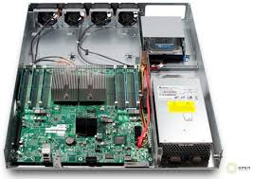
Test Bed Setup - Final
MIMO BW: 100 MHz
MIMO layers: 8
Mandatory PHY procedures
And enhanced algorithms
IMS, AF
FPGA
FPGA
Fronthaul
e-CPRI
External
Network
Base band cards
FPGA
FPGA
FPGA
FPGA
5G core
PCIe interface
UE (CPE)
FPGA
FPGA
FPGA
FPGA
L2/L3
MIMO: 100 MHz,8 Ant
MMwave: 400 MHz
Core
NSSF, UDM
UDSF, AMF
SMF, NRF
PCF, NEF
UPF
64 Antennas (MIMO@ 3.5)
100 MHz
256 Antennas (Mmwave@ 28)
400 MHz
TDD
LMLC: 700MHZ, BW 20 MHz
UE (CPE)
FPGA
FPGA
Final: End-to-End testbed

Slide 14
Using the Testbed

Slide 15
Classes of Test Bed Usage
Use of Hardware, Software and Patents
(Licensed/License-free)
Prototypes, Patents, Hardware platforms, ASICs, Stacks, Algo’s, Tools
5G
Test Bed
Use of Test for R&D and Learning – Module, Subsystem, End-to-end
Use of Test Bed for Services and Applications Demo
AF APIs, TB Management, End to end test bed
Hardware platforms, Lab tools, Algo’s, APIs

Slide 16
Test Bed Users
Equipment companies
R&D for product and stack developments
Telecom Startups
Experience end to end perspectives
Potential Starting point for product/solution development
Setup for validations and pre-interoperability
Appln/Solution Developers
End to end test bed to demo appln
Understand integration issues with 5G Network
E.g over the Top Applications/ Network Related Data / IOT Solutions
Prototypes, Patents, Hardware platforms, Algo’s, Tools
HW, ASICs, Module designs, IPs, Stacks, Patents, Lab tools
HW, APIs
5G Test Bed
Academic Institutes
Research and validation of algorithms
Implementation perspectives
Experiential learning tool for 5G
Operators
Understanding of 5G
In-depth understanding of technical aspects
Demos based on 5G (Ex.LMLC)
Research platforms, Lab tools, Algo’s, APIs

Slide 17
INTEGRATED TEST BED SUMMARY 1/2
Version | Summary Features Available
Version 0 May 1, 2019 | Individual RF, RRH, BB subsystems ready for demo to users. Platform/Tool providers get technical feedback.
Version 1 January 1, 2020 | Integrated end to end basic functionality ready for demo for users. Users can understand the 5G aspects by seeing demo related to massive MIMO, mmWave etc. Experiential learning tool for 5G technology. Users can plug in their own modules and check for those features which are within the scope of Ver1. Partners get an initial version of working hardware and software for internal use.

Slide 18
INTEGRATED TEST BED SUMMARY 2/2
Version | Summary Features Available
Version 2 September 1, 2020 | Integrated end to end functionality ready for demo for users. Users can run end to end applications. Users can plug in their own modules in RAN or Core and run them in the end to end functionality within the functionality of Ver2. Researcher can put in their algorithms and check performance. Software and Hardware ready for initial licensing.
Version 3 April 1, 2021 | Integrated end to end functionality ready for use case demos like LMLC, Dense Urban, IOT scenarios. Users can run end to end applications including IOT. Users can plug in their own modules in RAN or Core and run them in the end to end functionality. Users can use slicing techniques to understand its effectiveness. Users can bring in a network element and integrate with the test bed. Users can license parts of the test bed Software and Hardware.

Slide 19
An exciting opportunity for academia, industry collaboration
Thank You

