Slide 1
IoT/ M2M STANDARDISATION -
The Indian perspective
Pamela Kumar
Aug 26, 2019

Slide 2
AGENda
India’s unique challenges
The role of Standardisation

Slide 3
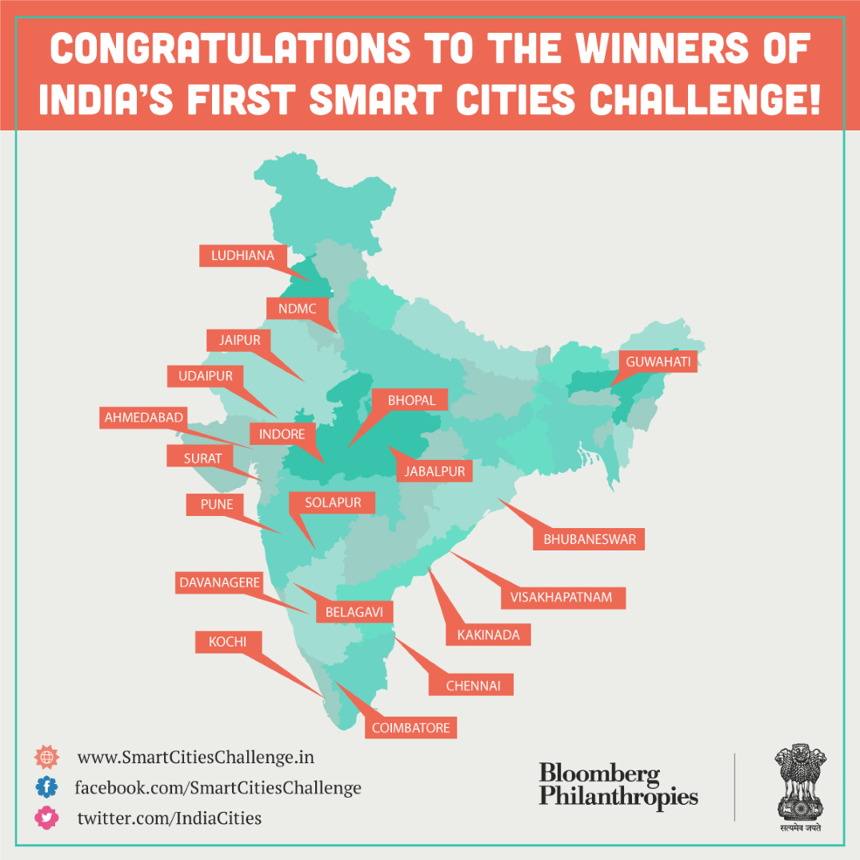
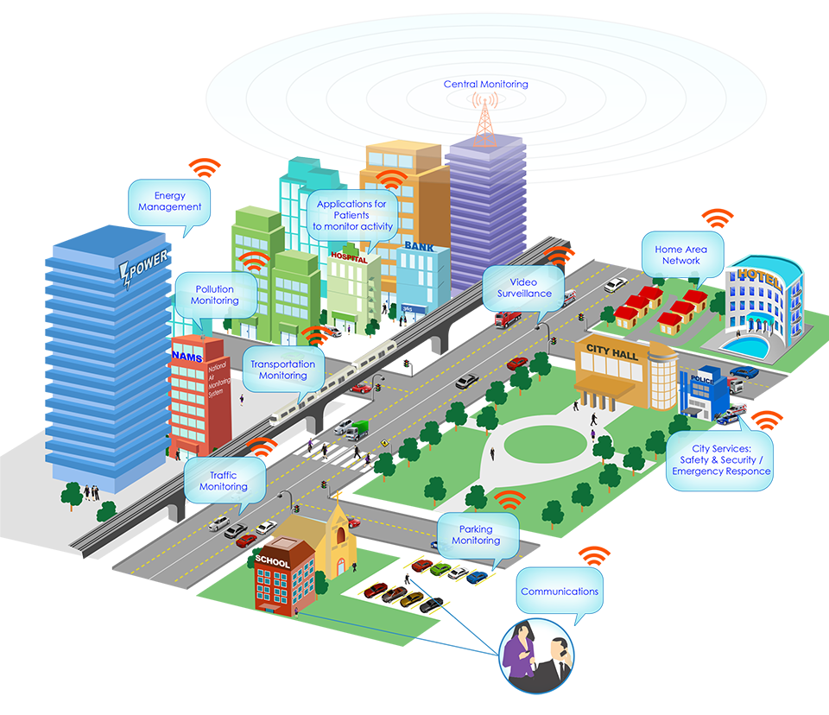
INDIA’s SMART CITY CHALLENGE
MoUD
SMART CITY Challenge
DoT/ MeitY
TSDSI
TEC- ICT Smart City Forum
BIS
Smart Infrastructure Panel
IoT Panel
Notes:
A perusal of Smart City Plans of 50 cities revealed that taking advantage of unique features
and strengths of respective cities:
▪ 11 cities aimed at emerging as clean, green and sustainable cities
▪ 9 cities seek to leverage rich cultural heritage legacy for stimulating development
▪ 8 cities state economic growth and development upfront as the core of their vision

Slide 4
Smart City Solutions in India
“99 smart cities have been selected and to be allocated
Rs 2.04 lakh crore ($30 B)
2020: $1.5 trillion market
MoHUA has released Solution Exchange for Transformation of Urban India
Integrated Command and Control Center: Maturity Assessment Framework
Smart cities Promoting Innovation Research and Incubation in Technology (SPIRIT)
DataSmart Cities: Empowering Cities through Data
QUEST for an Interoperable Common Services Platform – Is oneM2M the answer?
Notes:
4

Slide 5
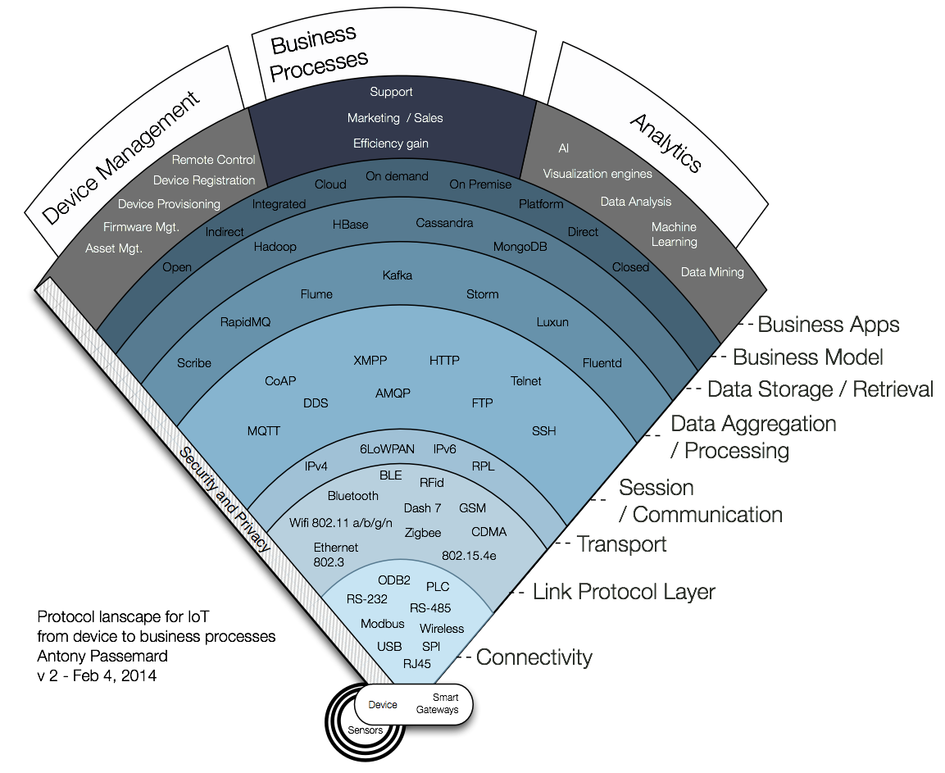
Dilemma for the SMART CITY SPV today
Service oriented approach that facilitates quick deployment/ interoperability of new applications / workflows / dashboards
Recommendations on IoT deployment and application protocols for scalability and performance
Options for Data storage and information Models
Recommendations on last mile communication protocols

Slide 6
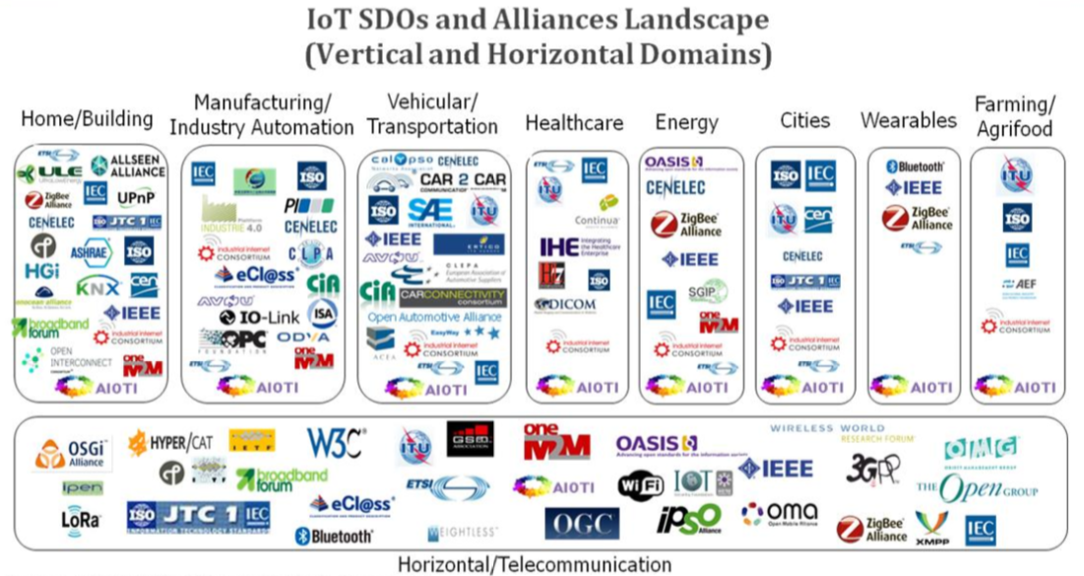
Source: AIOTI WG3

Slide 7
IoT & Smart Cities: challenges…
Force fitting solutions - without factoring in India specific needs
Advancements in technology - rapid and disruptive
Inappropriate last mile solutions - Deployment diversity
Limited Tech know-how by Administrators and City Officials
Unstandardised disharmony - No common framework and architecture
Restricted, closed solutions – vendor lock-in, proprietary interfaces
Examples of failure due to technology, business & functional misalignment - Nirbhaya tender cancellation, Bangalore Traffic+Metereology

Slide 8
RECIPE FOR SURE SHOT …
Force fitting solutions - without factoring in India specific needs
Advancements in technology - rapid and disruptive
Inappropriate last mile solutions - Deployment diversity
Limited Tech know-how by Administrators and City Officials
Unstandardised disharmony - No common framework and architecture
Restricted, closed solutions – vendor lock-in, proprietary interfaces
Examples of failure due to technology, business & functional misalignment - Nirbhaya tender cancellation, Bangalore Traffic+Metereology

Slide 9
AGENda
India’s unique challenges
The role of Standardisation

Slide 10
Global Standards
Impact
GLOBAL COMPETITIVENESS
Research &
Innovation Capability
Global Standards Collaboration (GSC), a high‐level gathering of world’s leading ICT) standards organizations,
9/6/2019
10
Notes:
w

Slide 11
5 year journey of TSDSI at a Glance
Feb 2018 Mar 2019
45 Members 65 Members
1811 Standards and Reports
CPRI – Fronthaul
ITU - RIT/SRIT submission
oneM2M as National STD
STANDARDISATION ROADMAP
3GPP Release 17
Feb 2017
41 Members
ITU- IMT 2020 TPR : LMLC mandatory
3GPP & One M2M –
Active participation & Contributions
Transpositions initiated
Indo-EU Collaboration
Oct 2015
39 Members
Jan 2014
11 Members
Indian Telecom SDO
RnR, IPR Policy
Working Procedures
Partner @ 3GPP & oneM2M
FORMING STORMING NORMING PERFORMING

Slide 12
TSDSI’s contributions & engagements at oneM2m
CONTRIBUTIONS | ENGAGEMENTS
TSDSI has 5 IMs for oneM2M – More in pipeline. C-DOT developed a Common Service Platform based on oneM2M . Made 100+ contributions & participated in Inter-op events. TSDSI transposed Release 2 (2017) – DoT approval as National Standard in process TSDSI to Transpose Release 3 shortly (Published by oneM2M in May 2019) | Indo EU collaboration- Hackathons and Tutorials TP # 31 in Bangalore during 19th to 23rd Sept 2017 with over 50 Global participants Industry Day with 90+ participants & 20+ global & Indian speakers TSDSI contributing man days to MARCOM & Work Program activities remotely TSDSI TEC CDOT studying over sixty Global installations based on oneM2M TSDSI to host TP # 42 in September 2019 in Hyderabad with Industry day and inter-op event
Working Groups (oneM2M) | Contributions
Architecture (ARC) | 21
Protocols (PRO) | 64
Security (SEC) | 2
Testing (TST) | 3
Total | 90

Slide 13
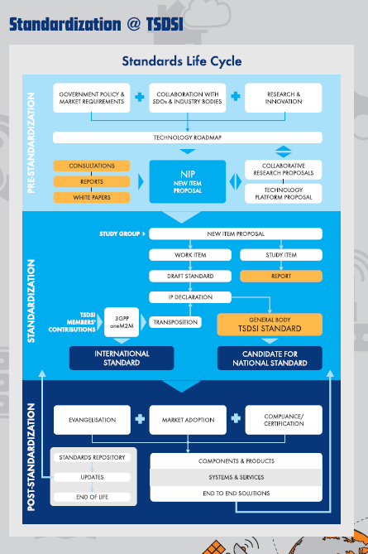
Study Group- Networks
CPRI FrontHaul
Channel Characteristics : 60GHz for 4G/5G backhaul
Enablers for Private Networks
NB-IoT Extension
Broadcast offload
Spectrum Studies
IMT2020 (5G) technologies ; 3GPP Release 17
Study Group- Services & Solutions
Cloud Interoperability and Portability
Public Protection and Disaster Recovery
Dual SIM Services
Support for Indian Languages
Information Centric Networking
UAV/Drone Communications and Services
M2M/IoT
Security and Privacy
oneM2M

Slide 14
Application Layer Stds.
Participation in International Stds.
Spectrum
Major Trials & Technology Development
Education & Awareness
Use Case Labs
Regulatory
5G India 2020 High Level Forum
5G technology has the potential of ushering a major societal transformation in India by enabling rapid expansion of the role of information technology across manufacturing, educational, healthcare, agricultural, financial &social sectors.
India must embrace this opportunity by deploying 5G networks early, efficiently, and pervasively, as well as emerge as a significant innovator and technology supplier at the global level.
Emphasis should be on 5G touching the lives of rural and weaker economic segments to make it a truly inclusive technology.

Slide 15
Study and Analysis of India specific Use Cases
Development of Requirements, SLAs and Test Cases
Market Enablement, Accelerated deployment, Research, Innovation, Standards, Applications, Services & Products
USE CASE LABS OBJECTIVES & OUTCOMES
-FRAMEWORK for the Labs :
USER GROUP | TECHNOLOGY GROUP | FACILITATORS | ACTIVITIES
End User Ministries | Technology Ministries | Govt. Agencies | DEMOs & Simulations : Hands-on experience for USER Group
TSPs/ ISPs | Vendors, OEMs; Start-ups | Global Partners | Study, analysis and modelling of India Specific Usage Scenarios, challenges & Use Cases
Domain/Mngt Institutes; Use Case Experts | Technology Institutes; Researchers & Innovators | Professional Bodies | Proof of concept testing, Interoperability and pilot testing
SCOPE - In line with national initiatives like Digital India, Smart Cities etc. and the focus areas in 5G :
SMART COMMERCE /BANKING : Department of financial services, LAB @ IDRBT | INTELLIGENT TRANSPORT : Ministry of Railways Ministry of Road Transport & Highways | SMART AGRICULTURE: Department of Agriculture & Farmers Welfare
SMART CITIES : Ministry of Housing & Urban Affairs | SMART GRID : Ministry of Power | SMART WATER : Ministry of Water Resources, River Development & Ganga Rejuvenation
INDUSTRY 4.0 Department of Industrial Policy and Promotion | SMART EDUCATION : Department of Higher Education Department of School Education | SMART HEALTH: Department of Health & Family Welfare

Slide 16
NETWORK of LABs
Centralised IFL
DTL* & NTL*
Banking & Finance
DCL
Water DCL
Power
DCL
Industry
DCL
Health
DCL
Transport Railways DCL
Agriculture DCL
Education DCL
Urban Development DCL
First Set of LABS
Second Set of LABS
Third Set of LABS
DCL - Demo and concept Lab
DTL - Device Testing Lab
NTL - Network Testing Lab
IFL - Interoperability and
Field Scenario Test Lab
Notes:
We propose a Network of Labs comprising of :
I - Demo and concept Lab
II - Device Testing Lab
III - Network Testing Lab
IV - Interoperability and Field Scenario Test Lab
It is recommended to set up Demo and Concept Labs will be needed for each Vertical Industry. Whereas the other 3 Labs should be centralised facilities which can de shared amongst verticals.

Slide 17
Application Layer Standards
USE CASE LABS
DOMAIN Working Groups
MAJOR TRIALS
Smart Cities
Finance
PPDR
Health
Agriculture
Education
Utilities
Transport
Industry
Immersive experience AR/VR
Health
Artificial Intelligence/ Machine Learning
Global SDOs
Automonous Systems
Technology Study Groups
Technology Study Groups
Web Technologies
Integrated Data Exchange
Security and Privacy
IoT /M2M Common Services Layer
Cloud Computing
OPEN ++

Slide 18
Strengthening the GLOBAL FOOTPRINT
2022
10+ Chair/Vice Chair
Roles
20% CONTRIBUTIONS in PLENARIES
2021
5+ Chair /Vice Chair roles
2020
3GPP PCG Chair
2019
3GPP SA6 CHAIR
10 experts 20 experts 50 experts 100 experts 200+ experts
( 50% of them contributing consistently in GLOBAL SDO meetings)

Slide 19
Opportunities for members @ TSDSI
Pre-standardisation :
Govt Consultations – NDCP, Strengthening the STDs Framework
5G India2020 Forum – Use Case Labs; Education, Awareness & Promotion
Spectrum for 5G – White paper
Numerous workshops - Smart City, Security, PPDR, Cloud Computing etc.
Global Collaborations – Indo EU, Indo Taiwan, IEEE 5G World Forum
Conferences, tradeshows – IMC, World Telecom Day, NCC, COMSNETS
Standardisation :
Participate in Standardisation Roadmap Committee
Participate in SG/WGs - Submit your use cases & innovations as NIPs, Contribute to ongoing Work Items
Collaborate & Participate in 3GPP , OneM2M , ITU- R/T.

Slide 20
Collaboration Framework w Professional Bodies
CONNECT :
Workshops, Conferences, Webinars
CO-OPERATE :
MoU, Bilateral Standardisation,
Open Source Projects,
Global SDO contributions;
Exchange programs, Industry connect
Co-CREATE :
White Papers, Use Case Labs, Open Source platforms
Centers of Excellence

Slide 21
STANDARDS are the Collaboration piece of
“Co-opetition”
The TOOL is Consensus Building,
&
It is a lot of fun and learning in an open, fearless forum
THANK YOU
Acknowledgements
TSDSI GC and Members
TSDSI Secretariat
5G INDIA2020 HLF Task Forces PRESENTED in MY PERSONAL CAPACITY

