Slide 1
India’s plan for IoT, 5G and Smart cities.
QoS
in
IoT based data driven Smart cities
Sushil Kumar
Dy. Director General (IoT)
Telecommunication Engineering Center
Department of Telecommunications
Government of India

Slide 2
Telecommunication Engineering Centre (TEC)
TEC is the technical wing of DoT (Department of Telecommunications)
DoT is the nodal agency for coordinating with ITU from India.
TEC coordinates with ITU-T and having National Working Groups (NWGs) in line with ITU-T Study Groups.
National Standards Body (NSB) for Telecom sector
Entrusted with the responsibility to implement Mandatory Testing & Certification of Telecom Equipment (MTCTE)
Designated National Enquiry point for WTO –TBT (Technical Barrier to Trade) for telecom sector
MRA (Mutual recognition agreement) with Singapore for product certification
Development/ Adoption of standards for telecom and related ICT sector

Slide 3
Some Challenges of major Indian cities
  Population : Approx. 1.28 billion,
      32% living in urban areas.
      68% in rural area (in 0.65M villages or 0.25M VPs)
  Migration from rural to urban areas ?
      Reasons : In search of jobs, better education, health care etc.
      Around 25-30 people migrate / minute to major India cities.
  Average speed in most of the congested roads / highways – 15-20 Km/ Hr
  Pollution
  Waste disposal
  Crime
  Power
  Drinking Water shortage : Non revenue water (NRW) in India: 40 - 65%
  Singapore < 5%, USA : 12- 15%
  Health Care
Notes:
It is also estimated that by the year 2050, the number of people living in Indian cities may touch around 843 million.

Slide 4
How to address these challenges efficiently:
needs to create Smart Infrastructure to manage complexities of public services, reduce expenses, increase efficiency and improve the quality of life.
Smart Infrastructure may be in the verticals
      Automotive sector - Intelligent Transport System : DSRC or C-V2X
      City Surveillance
      Waste management
      Water management
      Power
      Health
Integrated command & Control centre, DC & DR, Platform to manage data, devices, communication network, gateways etc.
Use M2M/ IoT and ICT to make all the verticals smart - will provide data in real time.
Goal : To improve the quality of life.
Notes:
E-Governance and Citizen services.

Slide 5
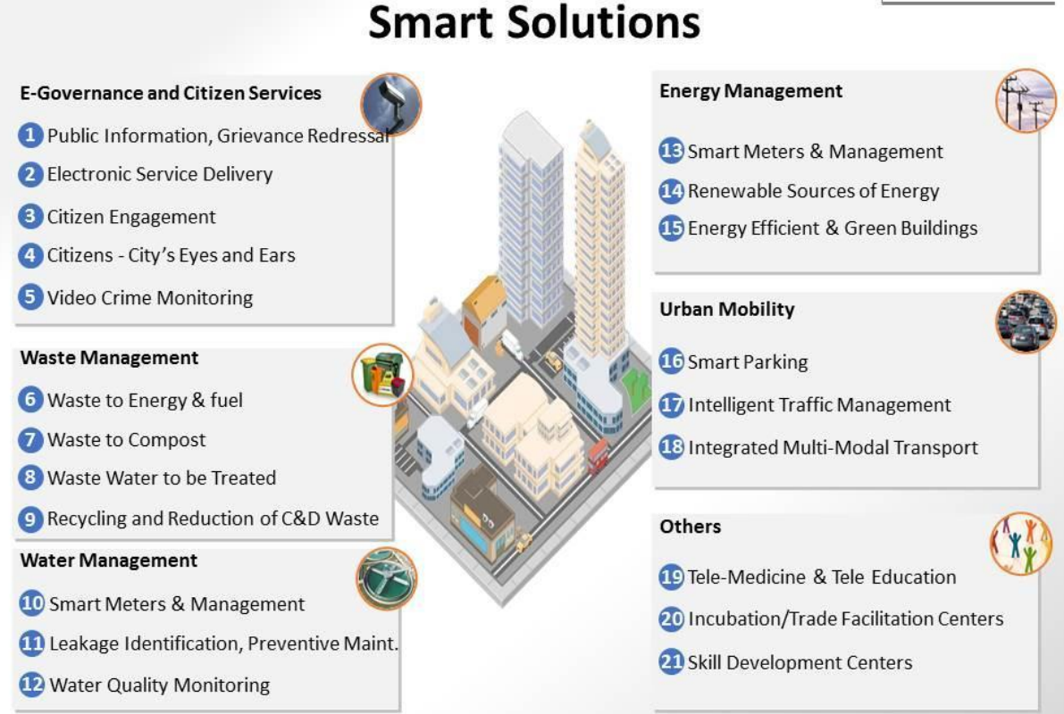
Smart Cities Mission List of Smart Solutions
Source: Smart City Mission

Slide 6
Proposed Solution – example of Agra

Slide 7
Smart Sustainable Cities (SSC)
As per ITU, a smart sustainable city (SSC) is an innovative city that uses information and communication technologies (ICTs) and other means to improve quality of life, efficiency of urban operation and services, and competitiveness, while ensuring that it meets the needs of present and future generations with respect to economic, social, environmental as well as cultural aspects.

Slide 8
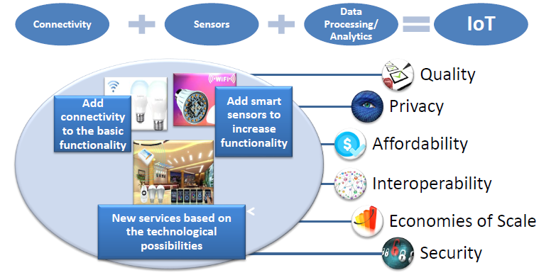
What is IoT ?
Notes:
User interface (web, Smart phones, HMI)
IoT Platform
In practice the IoT will consist of hybrid infrastructure of non IP and IP connected devices through IP connected gateways.

Slide 9
IoT and leading technologies
IoT will benefit from the integration of a no. of leading technologies, including those for:
  Machine to Machine Communication (M2M)
  Advanced sensing and actuation
  Cloud computing and (distributed computing / edge computing)
  Softwarization (including SDN, NFC)
  Artificial Intelligence, Machine learning, facial recognition
  Service delivery platforms
  Big data management
  Semantics support
  Privacy, Security and Trust

Slide 10
M2M / IoT market: Projections
Global projections varies from 26 billion to 50 billion connected devices by 2020
There may be around 2.6 billion connected devices by 2020 and 8 billion by 2026 and 24 billion by 2032 in India – TEC projection in 2015
Create an ecosystem for 5Billion connected devices in India by 2022 - National Digital Communication Policy 2018

Slide 11
Smart Cities as super application domain of IoT

Slide 12
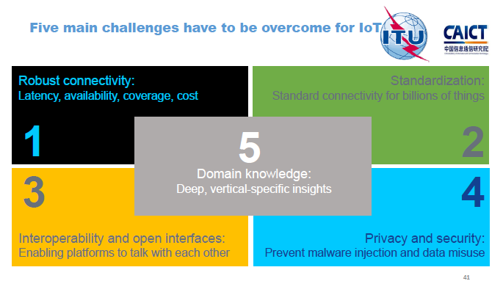
IoT standardization activities and progress, ITU, Oct 2017

Slide 13
Broad key Technologies for development of IoT
Platform based on standards enabling Interoperability, scalability, modularity.
Intelligence- Support of AI and Machine learning
Analytics at the edge of Gateway router or mobile network
Security: Support for embedded security solutions. Security by design features (Hardware & software).
Low power wide area networks Cellular / non cellular and e-SIM
extended battery life as most of the devices will be unmanned and charging not possible.
6. High speed and reliable internet at fixed and mobile devices
Technology roadmap for short term, mid term and long term ?

Slide 14
International organizations working on Standards

Slide 15
1/3
Participation in standardization work
International organizations: TEC participates in the programmes of following standardization bodies:
          ITU
          3GPP
          oneM2M
          ETSI
          GSMA
          IEEE
Indian organizations: collaborates with the following bodies
          BIS (Bureau of Indian Standards)
          TSDSI

Slide 16
ITU activities on IoT and Smart Cities
ITU-T Study Group -20: Development & implementation of International Standards
U4SSC: ITU, UNECE and other UN bodies created U4SSC. Released KPIs for for the Smart sustainable cities to establish the criteria to evaluate the ICT´s contributions in making cities smarter and more sustainable
ITU-T FGDPM: Research & pre standardization work on data processing & management
IoT4SDGs: Considers the importance of IoT to contribute for achieving the 2030 agenda for sustainable development.

Slide 17
Important activities in ITU-T SG-20
Study Period : 2017-2020
WP1/20
Q1/20:End to end connectivity, networks, and interoperability, infrastructures and Big Data aspects related to IoT and SC&C
Q2/20: Requirements, capabilities, and use cases across verticals
Q3/20: Architectures, management, protocols and Quality of Service
Q4/20: e/Smart services, applications and supporting platforms
WP2/20
Q5/20: Research and emerging technologies, terminologies and definitions
Q6/20: Security, privacy, trust and identification
Q7/20: Evaluation and assessment of Smart Sustainable Cities and Communities

Slide 18
ITU activities in AI / ML
AI for Good Global Summit: 2019, 2018, 2017
AI Repository
Global Symposium for Regulators 2018
ITU Focus Group on Artificial Intelligence for Health
  Meeting held in Geneva in May 2019
  Meeting proposed in New Delhi, Nov 2019
ITU Focus Group on Machine Learning for Future Networks including 5G
ITU News Magazine on Artificial Intelligence
ITU News blog on building trust for Artificial Intelligence
ITU News Magazine on AI for Social Good
ITU News blogs on Artificial Intelligence

Slide 19
OneM2M
OneM2M is a partnership project of ETSI and other SDOs.
OneM2M was created in 2012 to specify and promote a standards for M2M/ IoT common service layer.
Layers of OneM2M Architecture:
      Application Layer
      Service Layer – provides horizontal services that IoT applications across different industry segments commonly need.
      Network layer

Slide 20
Common Service Layer Architecture
Source: KETI

Slide 21

OneM2M Horizontal service layer
Registration
Service Layer
Registration
Discovery
Security
Group Management
Communication Management
Data Management & Repository
Subscription & Notification
Device Management
Application & Service Management
Network Service Exposure
Location
Service Charging & Accounting
Semantics
Transaction Management

Slide 22
Standardization activities in TEC, DoT, India
M2M / IoT domain
TEC started working in M2M/ IoT domain since 2014.
13 Multi stake holders working groups have been created in the last 5 years.
Thirteen Technical Reports (TRs) have been released in the last 4 years as detailed below:
    M2M Enablement in Power Sector
    M2M Enablement in Intelligent Transport System
    M2M Enablement in Remote Health Management
    M2M Enablement in Safety & Surveillance Systemss
    M2M Gateway & Architecture.
    M2M Number resource requirement and options
    V2V / V2I Radio Communication and Embedded SIM

Slide 23
M2M/ IoT Standardization activities in TEC, DoT...
Spectrum requirements for PLC and Low Power RF Communications.
ICT Deployments and strategies for India’s smart cities: A curtain raiser.
M2M/ IoT Enablement in Smart Homes.
Communication Technologies in M2M / IoT domain
Design and Planning Smart Cities with IoT/ ICT
Recommendations for IoT / M2M Security
Technical reports (TRs) are available on www.tec.gov.in/technical-reports

Slide 24
Actionable points emerged from the Technical Reports (TRs):
Some are listed as below:
13 digit M2M Numbering plan for SIM based devices/ Gateways which will co exist with existing 10 digit numbering scheme being used for mobile phones.
    DoT has approved this scheme and issued orders to all the TSPs for implementation.
    Five codes of 3 digit each (559, 575, 576, 579 and 597) have been allotted as a M2M identifier.
Country code, 2 digit (+91) | M2M Identifier (3digit) | Licensee identifier, 4 digit (10000 blocks) | Device Number, 6 digit (One million)

Slide 25
Actionable points emerged from the Technical Reports……
2. Embedded SIM & remote subscription management:
DoT has approved the use of Embedded SIM with over the air (OTA) provisioning in India in May 2018.
Ministry of Road Transport and Highways, India has already included Embedded SIM in AIS140 standard mandated for Vehicle location tracking services (VLTS).
BIS has also included embedded SIM in the standard for VLTS released recently.

Slide 26
Actionable points emerged from the Technical Reports….
3. Any device / Gateway having direct connectivity with PSTN / PLMN should have static IP (IPv6 or IPv4). As IPv4 addresses are going to exhaust, early adoption of IPv6 at device, network and application level will be necessary.
Bureau of Indian Standards (BIS) has mandated IPv6 for Smart meters to be connected on Cellular technologies, IS16444.
4. For devices behind the gateway, public numbering / private numbering may be used depending upon Government policy on security.

Slide 27
Actionable points emerged from the Technical Reports….
Additional Spectrum requirement for Low power RF communications in Sub GHz ISM band.
Multi protocol gateways.
M2M Network architecture and various Service delivery models for providing services in M2M domain.
Spectrum requirement for DSRC technology.
Licensing for LPWAN on non cellular technologies, providing public services.
Common service layer requirement at the platforms, important for data sharing, Security and interoperability.

Slide 28
Participation in ITU-T SG-20
Participating in all SG-20 meetings in person / remotely from Jan 2016. Contributions are being submitted and presented.
Based on Indian contribution , template for use cases was finalized and agreed in SG-20 meeting, Geneva, July 2016.
Y.IoT-Use case document having first five (1 to 5) use cases from India and one (sl no. 6) from Egypt was agreed in SG-20 meeting, Dec 2018.
  Vehicle emergency call system for automotive road safety
  Digitization and automation of Vehicle Tracking, Safety, Conformance, Registration and Transfer via the application of e-SIM and Digital Identity
  Remote monitoring the health of a patient
  Connected Smart homes.
  AMI (Advanced metering infrastructure)
  RFID Based Digital Identification for Vehicle Tracking, Registration, and Data Transfer
This document has been published by ITU-T as a standard Recommendation Y Suppl. 53 (12/2018) and is available on https://www.itu.int/ITU-T/recommendations/rec.aspx?rec=13867

Slide 29
Important contributions submitted in ITU-T SG-20….
The technical report on “M2M enablement in Remote health management” has been recognized as a valuable information by e-Health expert of ITU-D Study group 2 and has been submitted as a contribution in the ITU- D meeting 7-11 September 2015, Geneva.

Slide 30
Mandatory testing and Certification of Telecom equipment
Gazette notifications issued. Available on TEC website.
Regulatory and legal compliance requirements - Devices with communication facility needs testing and certification against
  EMC (Electro magnetic compatibility),
  Safety,
  Technical protocols including Interoperability & Conformance testing,
  Security
  Others (SAR, IPv6 or RoHS )
Testing will be done in the accredited labs in India
In case of MRA (Mutual Recognition Arrangement) with the other countries, devices may be tested there and no need of further testing in India.
Being implemented wef 1st August 2019.
Ers (essential requirements) framed for the smart devices.
Test Once : Use any where

Slide 31
Important work items in progress related to M2M/ IoT domain
      Finalising IoT/ ICT standards for Smart Cities
      Adoption of OneM2M standards transposed by TSDSI
      Establishing IoT Experience Centre in TEC
      Framework for Security by design principle and National Trust Centre for IoT

Slide 32
1/2
IoT / ICT - Policy related activities in DoT
National Telecom Policy – 2012 :- thrust on high quality broadband services, Cloud computing, Mobile Internet, IPv6, Machine to Machine communication and telecom equipment manufacturing.
M2M Road map released in May 2015.
M2M Service provider policy covering machine KYC, embedded SIM, SM-DP and SM-SR expected in near future
TRAI recommendations on Spectrum, Roaming and QoS related requirements in Machine-to-Machine (M2M) Communications accepted by DoT
National Digital Communication Policy (NDCP) 2018 released focusing on strengthening telecom infrastructure, IoT, 5G, AI etc.

Slide 33
Government of India Initiative on AI
Budget 2018: Government allocated $ 480 million for digital India programme with emphasis on the development of new technologies IoT, AI, ML, 3D printing, Blockchain
Niti Aayog will oversee a national programme on AI focusing on R & D
Four committees have been formed focusing on
    Research and working on development of AI
    Creating a data platform
    Skilling, reskilling for capacity building
    legal, ethical, regulatory and cybersecurity issues

Slide 34
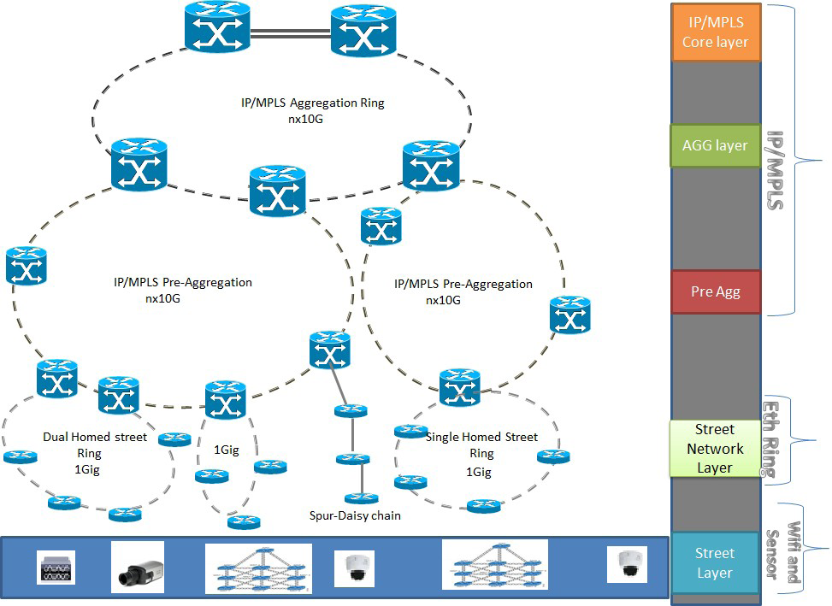
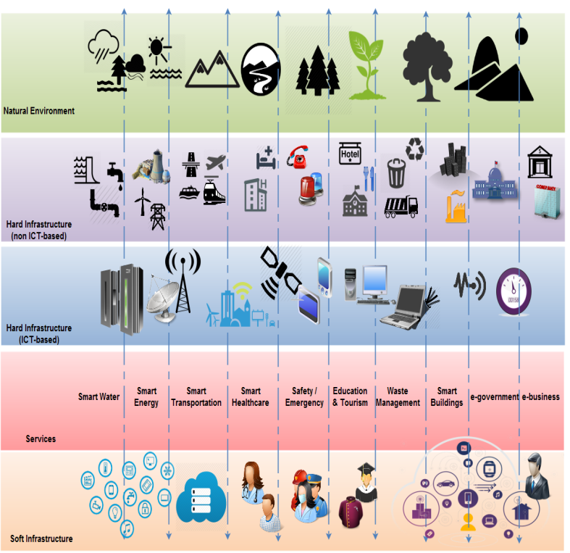
DC/ DR
(IP/MPLS)
IP/MPLS DC/ DR
Aggregation
(MPLS-TP/ DWDM/ Ethernet/GPON)
MPLS-TP/ Ethernet/ GPON/ DWDM/OTN
Transport
Architecture
For Smart Cities
MPLS-TP/ Ethernet/ GPON/ DWDM/OTN
Access
(Ethernet/ GPON)
Street
(Wi-Fi)
Multi-tier meta-architecture
Multi-tier Telecom Architecture

Slide 35
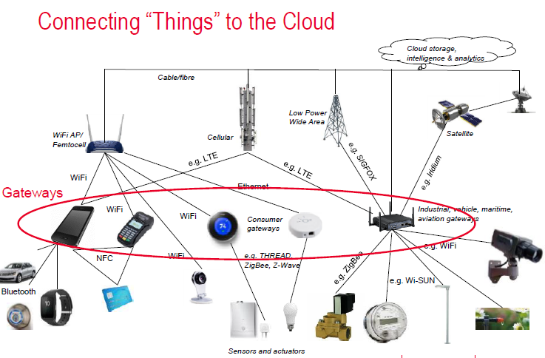
Source: Keysight technologies
Notes:
Hetrogeneous n/w of IP and non IP devices connected through a IP gateway

Slide 36
Enabling technologies …..
5G will bring ultra high reliability, ultra low latency, wide coverage and high security network, suitable for M2M / IoT.
Static IP (IPv6 or dual stack) but in future IPv6 only.
Digital Identity : e-KYC for individuals and digital certificates for companies.
High speed and reliable internet services on fixed line and mobile.
Smart Phone will work as a Smart device and Gateway to other devices
Wireless spectrum (Licensed / Un licensed)
ICT backbone
Cloud (Public, private clouds)
M2M SIM (Embedded SIM)
Notes:
As on date around 350 Million regular internet users. Sporadic users may be around 400- 450 Million. But in new policy to come, there may be higher projection such as 800- 900 million.
It will contribute in rise of GDP. Globally 10% increase in mobile and BB, there is a rise of 1.3%.
But in case of India, it may be 3.3% as per study of ICRIER.

Slide 37

: A unifying connectivity
Mobile connectivity beyond 2020 : Every thing on wireless
: Extended and enriched wireless services
1. Enhanced Mobile broadband –
    UHD video (4K, 8K) 3D video
    Virtual Reality (VR), Augmented Reality (AR),
    Tactile Internet, Cloud gaming, Broadband kiosks,
    Real time simulation & training
    Remote class room, Hologram
2. Mission critical services (Ultra reliable & low latency communication) –
    Industrial Automation,
    e-health, hazardous environments, rescue missions, etc.
    Self-driving vehicles
    Drones
    Vehicular communication (V2V, V2I, V2P)
3. Massive Machine type communication / Massive IoT :
    Smart home
    Smart city
Notes:
Three-carrier aggregation has already been successfully demonstrated using a 3GPP Release 10 (LTE-Advanced) system specification. LTE Releases 12 and 13 specifications will introduce a new LTE-compatible air interface for MTC, capable of low complexity and energy variants for delay-tolerant sensor systems.

Slide 38
5G target performance
5G radio access will provide a total solution for wider range of requirements by 2020
  Higher data rate : 100x faster, peak data rate – 10 Gbps
  Reduced latency : RAN latency < 1ms
  Higher system capacity : 1000x per sq Km
  Massive device connectivity : 100x more connected devices

Slide 39
5G Vision : Spectrum Bands under study
Spectrum can be roughly divided into the following three ranges:
      Low-range: < 1 GHz
      Mid-range: 1 GHz to 6 GHz
      High-range: above ~6 GHz or mm wave
Key bands under discussion for 5G:
      700 MHz in low range.
      3.3 - 3.4 and 3.4- 3.6 GHz in the mid range. is globally allocated. Some countries have gone for 3.3- 3.4 GHz. Europe is planning 3.4 – 3.8 GHz.
      24.2 -27.5 GHz, 27.5-29.5 GHz and 37- 43.5 GHz in high range.
      71 – 76 GHz and 81-86 GHz (E bands)
24-86 GHz range under study for WRC 19.
Notes:
Low spectrum provides large coverage but with limited capacity, suitable for massive IoT
Mid range provides wider bandwidth for enhanced mobile broadband and mission critical communication.
High range provides extreme bandwidth, shorter range for extreme mobile broadband
Mid spectrum range provides reasonable coverage and capacity.
The high-range of spectrum is more limited in coverage, but could provide very high capacity due to the amount of unused spectrum available at these frequencies.

Slide 40
Major families of 5G use cases
    Enhanced Mobile broadband
    Connected Vehicles
    Enhanced Multi media
    Massive IoT
    URLLC Applications
    FWA (Early 5G deployments)

Slide 41
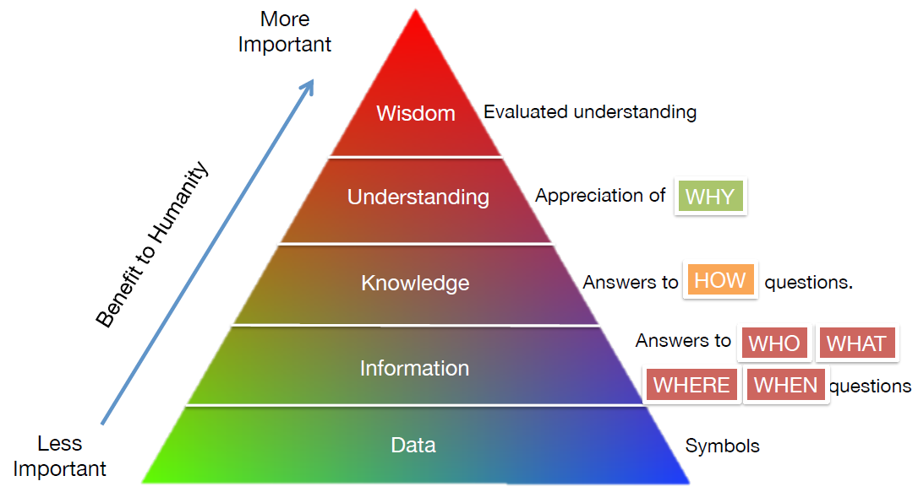
Opportunities and Challenges of data in IoT
Knowledge hierarchy applied in data processing
Target: Right data at right time, right location
Challenges: Variety of data, Data privacy, security and trust
Benefits: ?

Slide 42
Opportunities and challenges of Data in IoT
Structured and unstructured data
Data types: Volume, Variety, Velocity, Veracity, Variability
Availability and (open) access to Data
Trust, Security and Privacy of Data
Data ownership and Data Governance

Slide 43
Network QoS requirement
Communication for M2M/ IoT is different from the voice communication as size of data in M2M may vary from few bytes ( meter reading) to several MBs ( surveillance video in).
Services requirement
    Timely transmission is of utmost important.
    Communication network is required to be more reliable with low latency

Slide 44
Cross domain data utilization
Source: ITU

Slide 46
ITU standards related to Smart city Platform
S.No. | Title | ITU number
1 | Requirements for the interoperability of smart city platforms | Y. 4200
2 | High-level requirements and reference framework of smart city platforms | Y. 4201
3 | Requirements and reference architecture of the machine-to-machine service layer | Y. 4413

Slide 47
oneM2M Standards adopted by ITU
S. No. | Title | ITU No.
1 | oneM2M – Functional architecture | Y 4500.1
2 | oneM2M – Requirements | Y 4500.2
3 | oneM2M – Service layer core protocol specification | Y 4500.4
4 | oneM2M - management enablement (OMA) | Y 4500.5
5 | oneM2M - management enablement (BBF) | Y 4500.6
6 | oneM2M – CoAP protocol binding | Y 4500.8
7 | oneM2M – HTTP protocol binding | Y 4500.9
8 | oneM2M – MQTT protocol binding | Y 4500.10
9 | oneM2M – Common terminology | Y 4500.11
10 | oneM2M - base ontology | Y 4500.12
11 | oneM2M – Interoperability testing | Y 4500.13
12 | oneM2M – LwM2M interworking | Y 4500.14
13 | oneM2M – Testing framework | Y 4500.15
14 | oneM2M – Web Socket protocol binding | Y 4500.20
15 | oneM2M – Field device configuration | Y 4500.22
16 | oneM2M – Home appliances information model and mapping | Y 4500.23
17 | oneM2M – MAF and MEF Interface Specification | Y 4500.32

Slide 48
IoT/ ICT standards related to SSCs
Verticals ITU Standard Other standards
Power/ Energy Y. 4251 (Capabilities of ubiquitous sensor IS 16444
networks for supporting the requirements of smart metering services)
Automotive/ Transport Y. 4119 (AERS), AIS 140 (MoRTH),
Y. 4456 (Smart Parking), IS 16833 (BIS)
Y. 4457 (transportation safety services)
Water Management Y. 4107 (Requirements for water quality
assessment services using ubiquitous sensor networks
Safety & Surveillance onVIF
Health Y. 4110 Service and capability requirements for e-health
monitoring services
Y. 4408 Capability framework for e-health monitoring services
Y. 4117 Requirements and capabilities of the Internet of things for support of wearable devices and related services

Slide 49
IoT/ ICT standards related to SSCs
Verticals ITU Standard
Gateway Y. 4101 Common requirements and capabilities of a gateway for IoT applications.
Y. 4418 Common requirements for IoT applications
Setting the framework for an ICT architecture : Y Suppl. 27
IoT Use cases : Y Suppl. 53
Data Layer/ Platform : FG-DPM D3.3 (data interoperability)
Sensor/ Devices (Applicable for all verticals) : Y. 4553, FG-DPM D3.2

Slide 50
ITU standards related to SSCs
SSC KPIs : Y.4900 / L.1600 & Y.4901 / L.1601
SSC Impact Assessment : Y.4905
ITU has published a report in 2019 on “Building SDG-Smart Villages: A blueprint
Piloted in Niger”

Slide 51
Open standards and Interoperability are the key to Resilience, Sustainable and Scalable Smart City growth.

Slide 52
THANKS
(For detail, see the TR available on www.tec.gov.in/technical-reports/)
Sushil Kumar
+919868131551
sushil.k.123@gmail.com
in.linkedin.com/in/sushil-kumar-98895560

