Slide 1
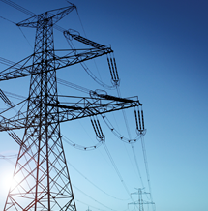
Preparing Bankable Projects
FEASIBILITY STUDIES & TECHNICAL ASSISTANCE
Early Stage Project Planning
USTDA funds feasibility studies, technical assistance, and other project preparation activities that provide the comprehensive analysis required for infrastructure investments to move from the concept stage to the financing and implementation stages.
PILOT PROJECTS
USTDA connects the U.S. private sector to priority infrastructure projects in India.
Demonstrating U.S. Capabilities
The Agency pilots U.S. equipment and technologies in an overseas setting to:
Highlight the effectiveness of U.S. solutions
Identify opportunities for scalability and replicability throughout a market
$2.5B
63
168
REVERSE TRADE MISSIONS
Indian
partners
U.S. exports generated
Showcasing U.S. Expertise
Projects funded in India
USTDA hosts reverse trade missions bringing overseas decision-makers to the United States to see the design, manufacture, and operation of U.S. equipment, technologies, and services.

Slide 2
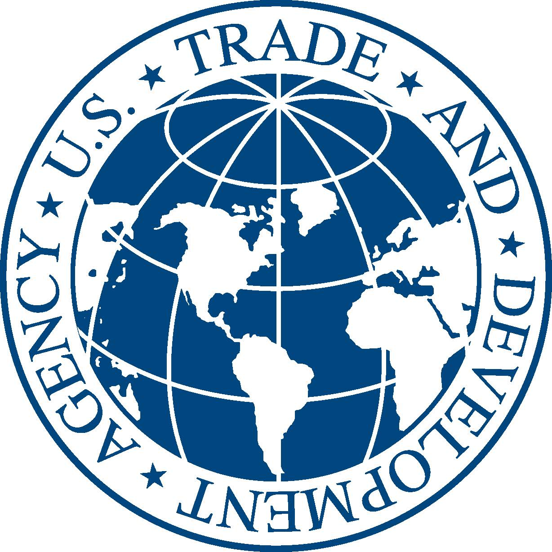
Supporting ICT Infrastructure Development in the Indo-Pacific Region
In the past decade, USTDA has funded 87 ICT projects in the Indo-Pacific related to:
Smart City Master Planning
Intelligent Transportation Systems
Integration of ICT-Applications in the Water Sector
Emergency Communication Systems
Cybersecurity
Disaster management
Connectivity and cable networks
Digital infrastructure
ICT strategy
The U.S. Trade and Development Agency (USTDA) is committed to supporting the development of telecommunications infrastructure across the Indo-Pacific.

Slide 3
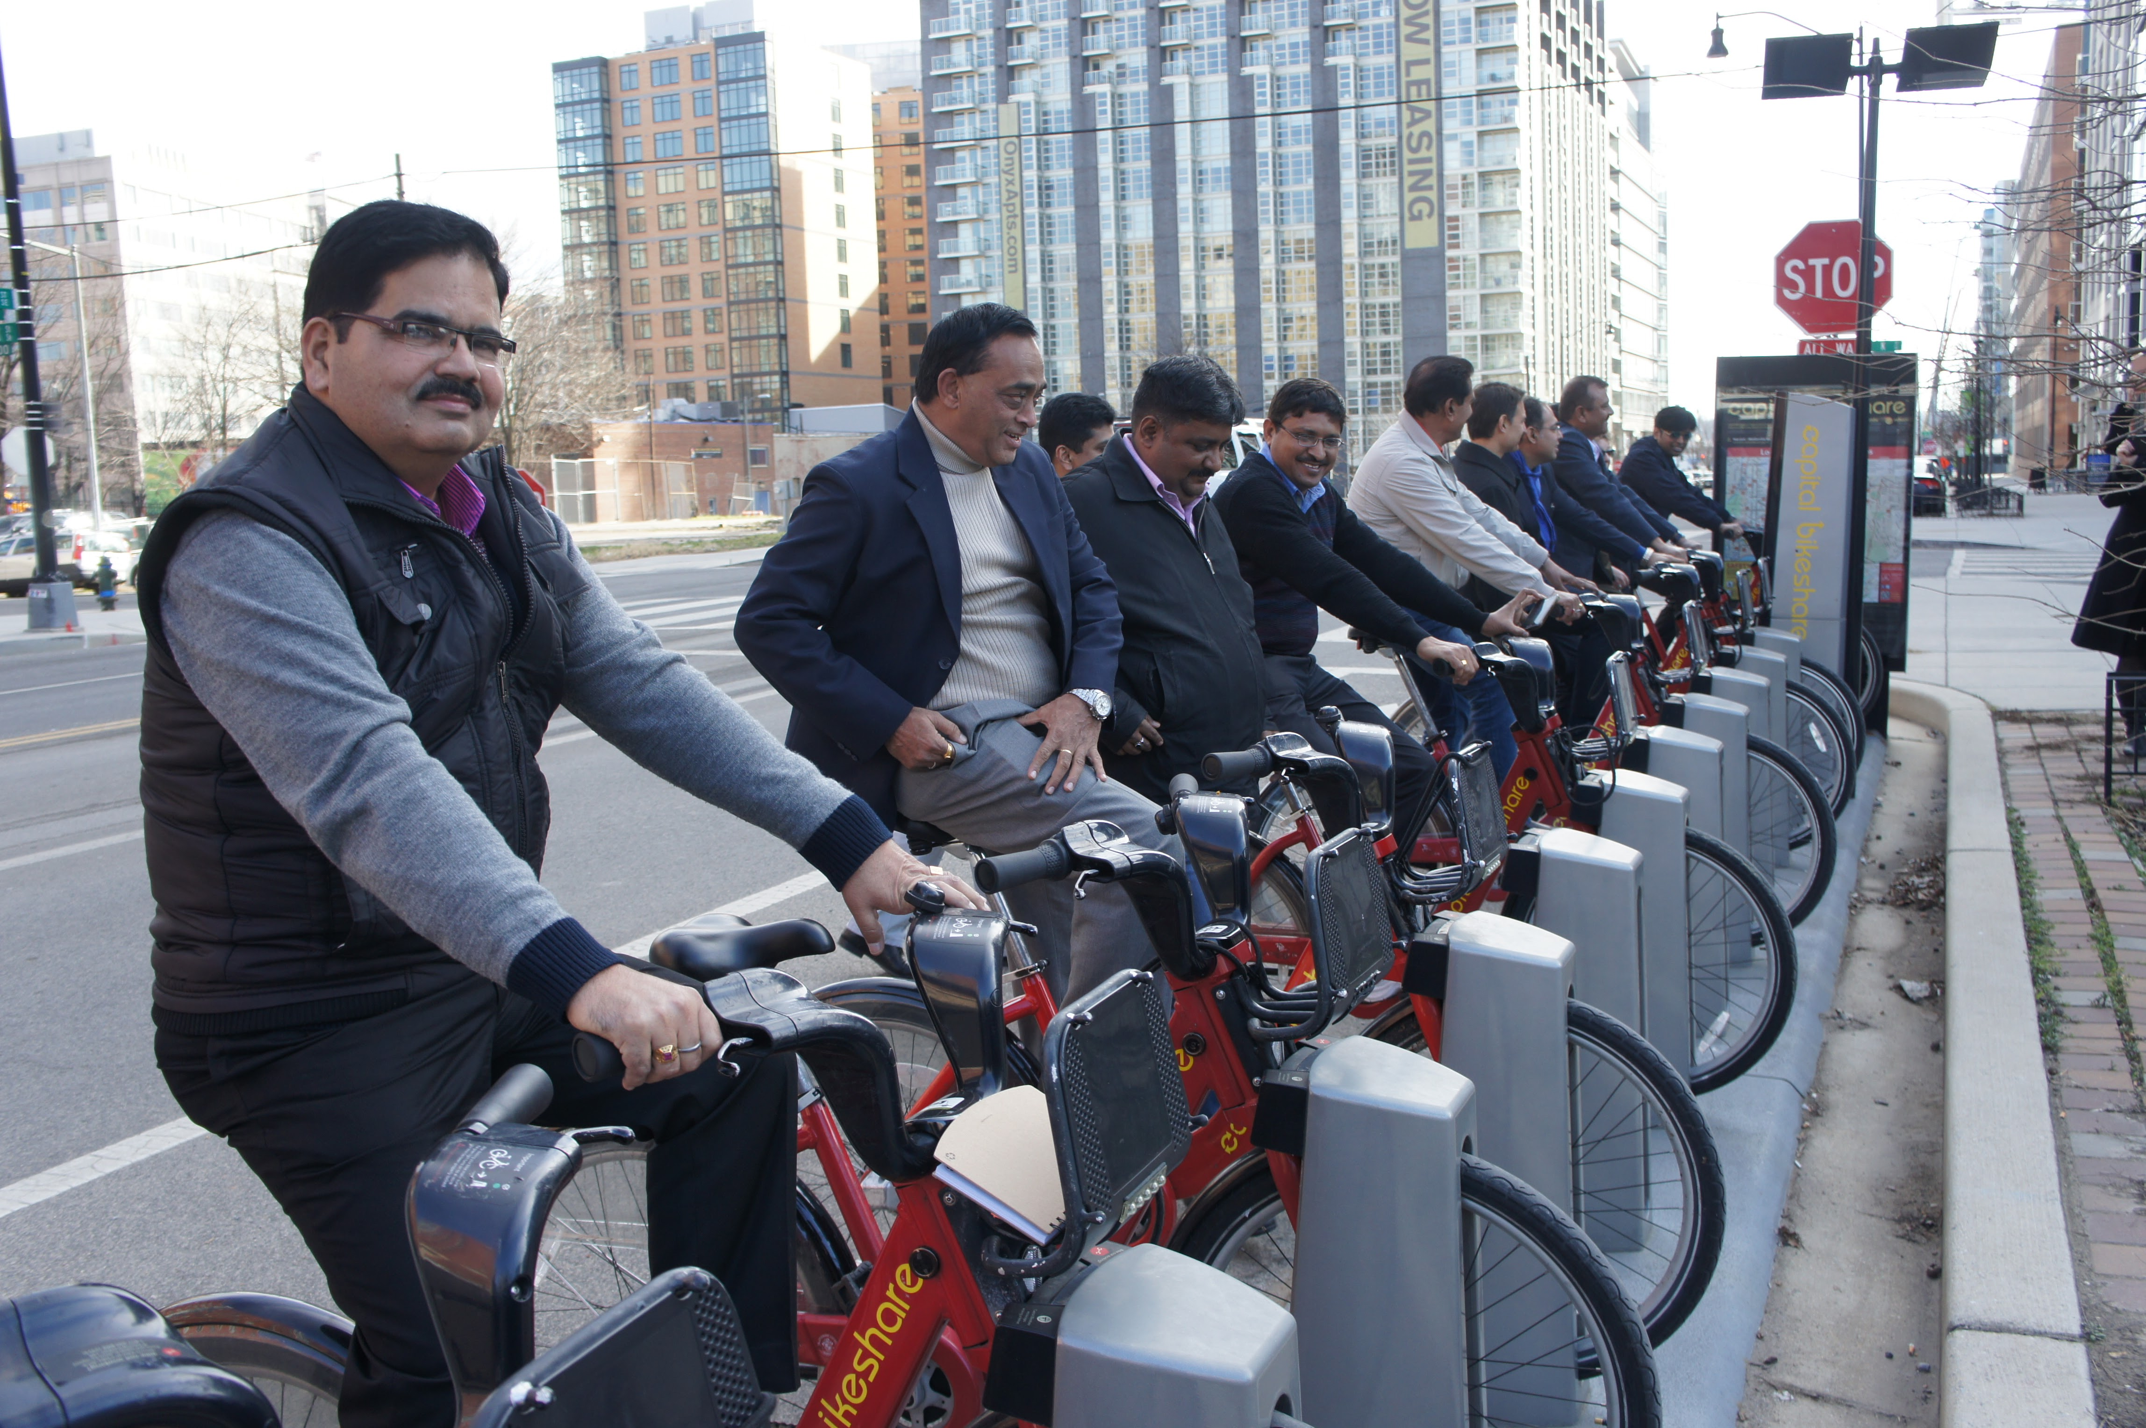
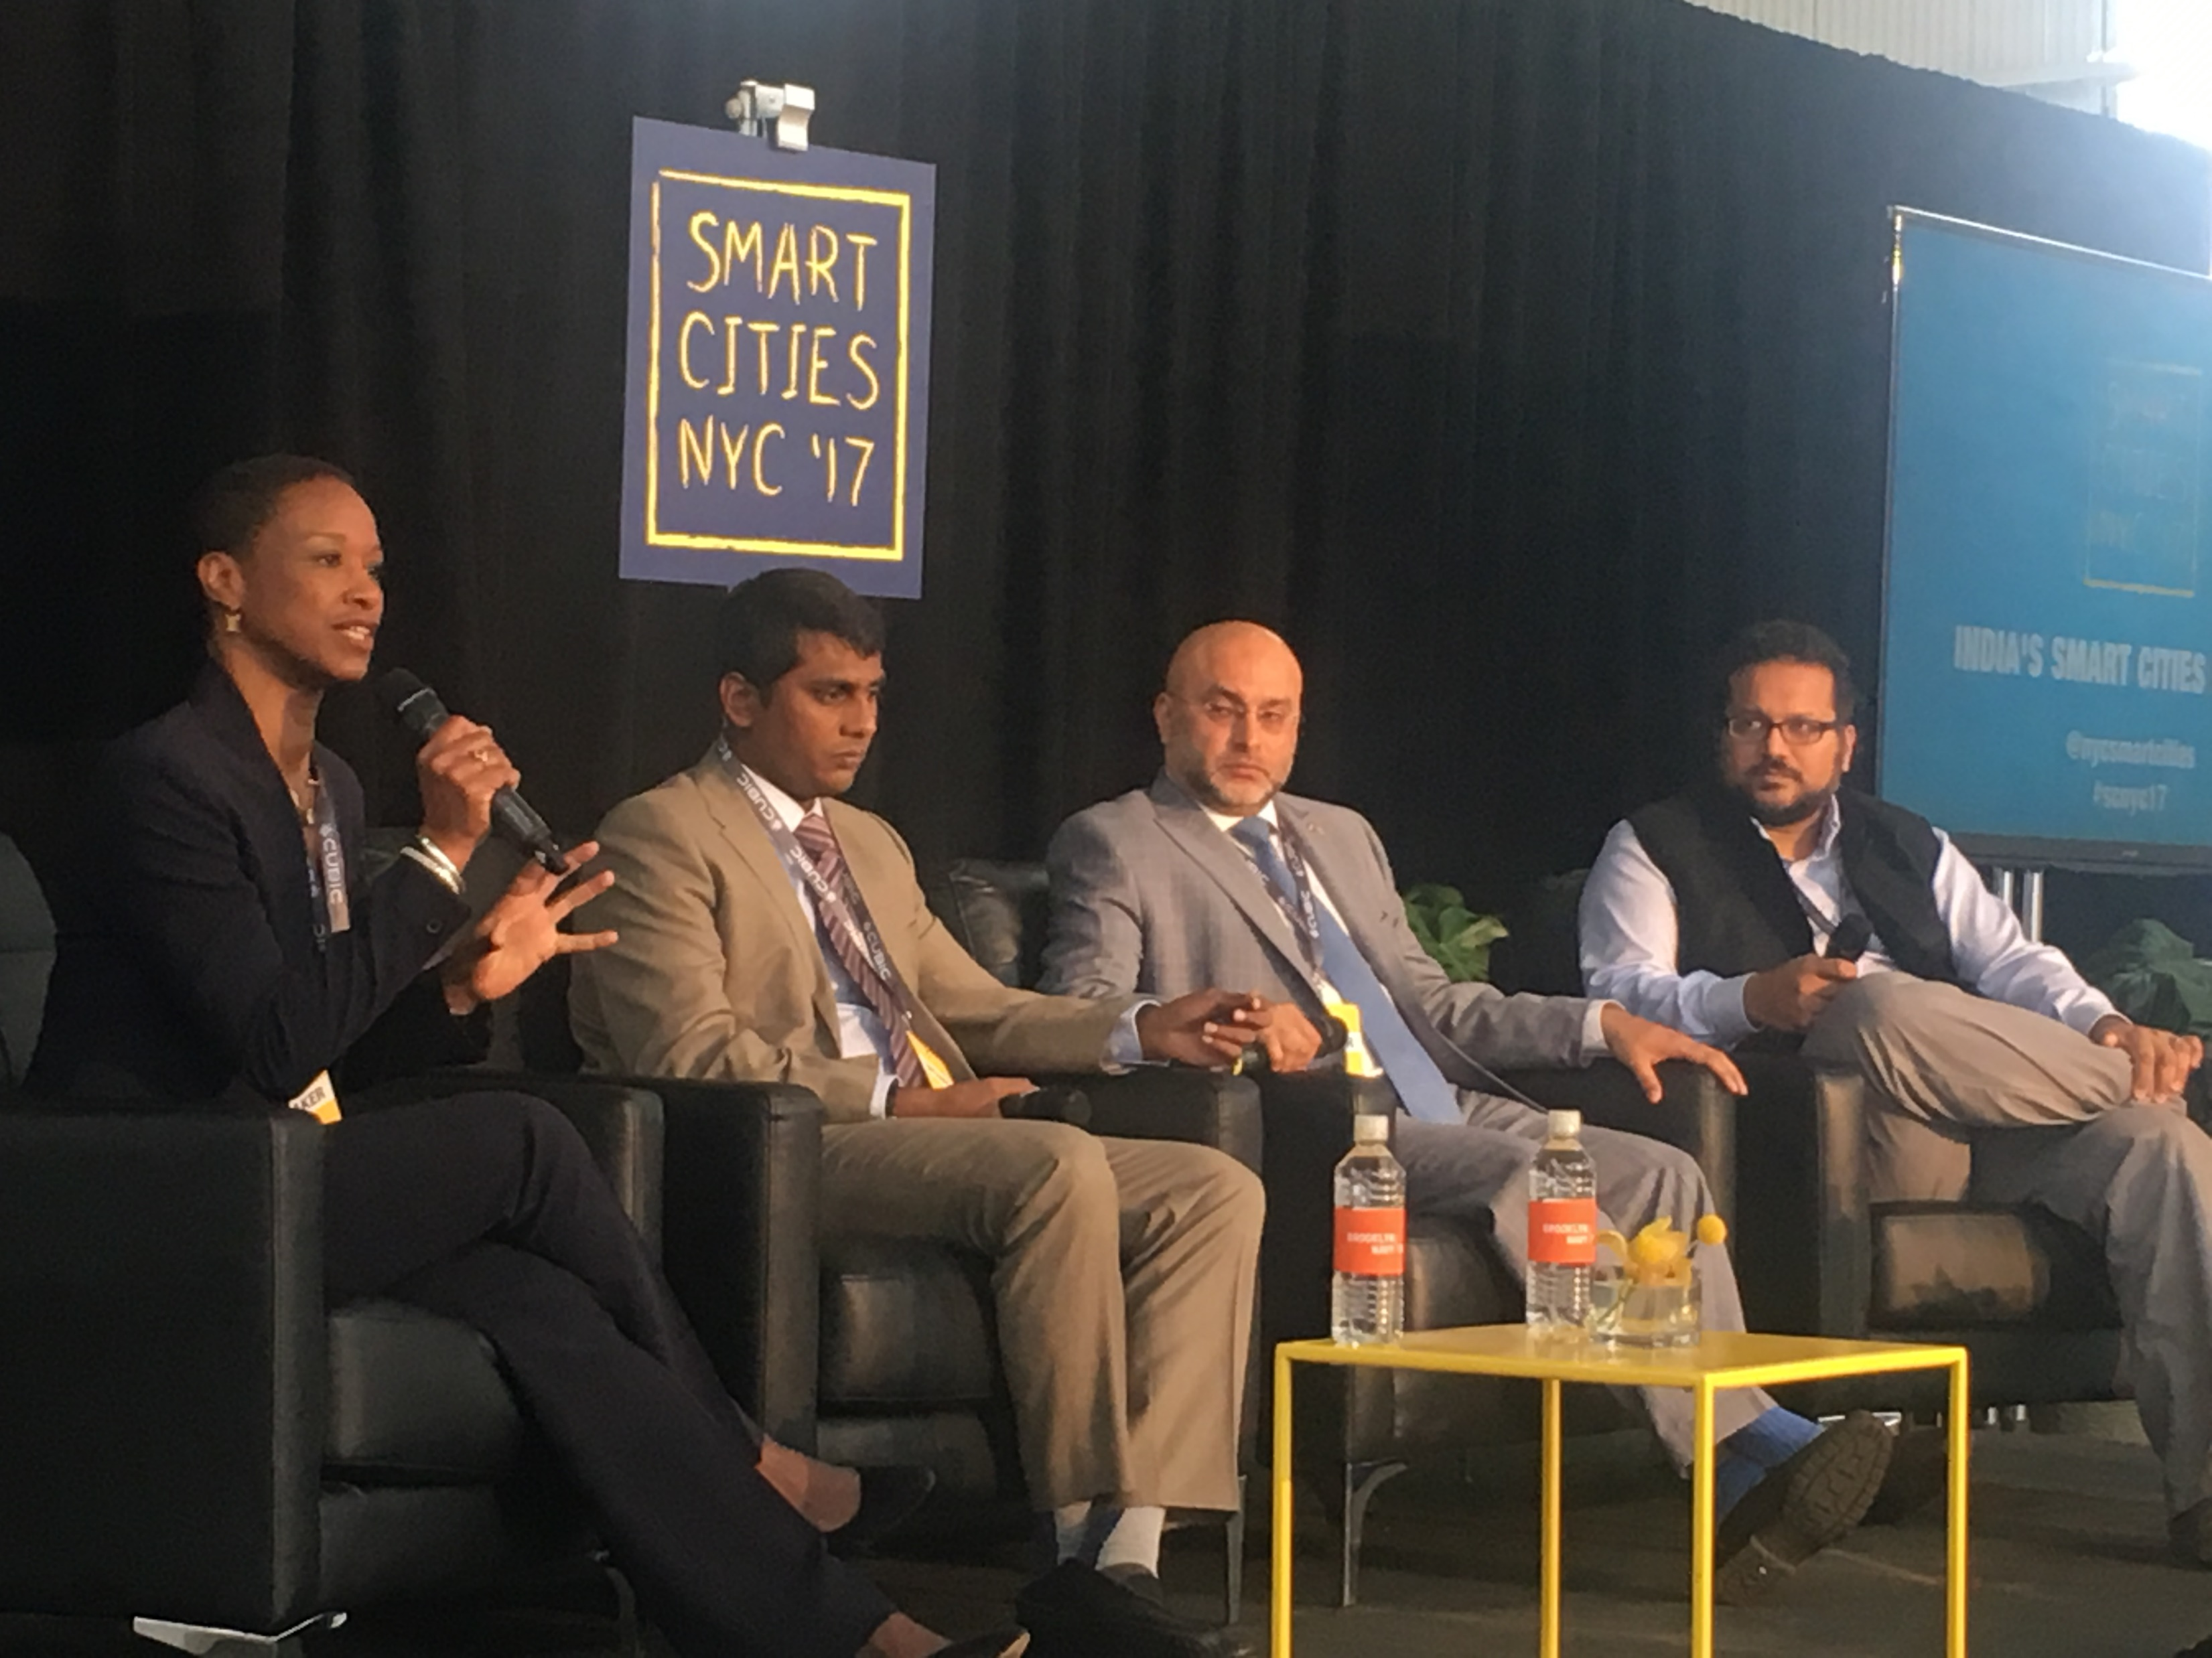
Partnership with Japan
USTDA and METI MOU on developing quality infrastructure in the Indo-Pacific region (2017)
LNG Supply and Natural Gas Cooperation Program (2018-2019)
USTDA’s Smart Solutions for Smart Cities Initiative
Utilizes U.S. industry expertise for advisory and project preparation services to support comprehensive, sustainable urban infrastructure development throughout India.
Smart city advisory services in Andhra Pradesh, Uttar Pradesh and Rajasthan
Series of Reverse Trade Missions to connect state officials with U.S. best practices and technologies for smart cities
Notes:
1st Picture – Rajasthan RTM (Smart Solutions for Smart Cities RTM Series)
2nd Picture – 2017 Smart Cities conference in NYC

Slide 4
Ongoing Support for ICT Development in the Indo-Pacific Region
USTDA is currently supporting numerous smart city activities in the Indo-Pacific region, including the following:
Visakhapatnam Smart City Infrastructure Project Plans Technical Assistance (ongoing)
Ho Chi Minh City Emergency Communications System Technical Assistance (ongoing)
India Digital Infrastructure Reverse Trade Mission (upcoming)
Ho Chi Minh City Intelligent Transportation Technical Assistance (proposed)
Recently completed activities:
U.S.-Vietnam Smart Cities Workshop (June 2017 in Hanoi, Vietnam)
Ho Chi Minh City Metro Integrated Telecommunications Control Center Feasibility Study (completed in 2016)
India Smart Solutions for Smart Cities Reverse Trade Mission Series (completed in 2018)

Slide 5
USTDA’s Feasibility Study Objectives
Feasibility Studies for Early Stage Project Planning
U.S. company-led feasibility studies link foreign project sponsors with U.S. businesses at the critical early stage when technology options and project requirements are being defined.
These studies provide the comprehensive analysis required for major infrastructure investments to achieve financing and implementation.
USTDA’s feasibility studies prepare bankable projects to link U.S. companies with global opportunities
Criteria for Funding Feasibility Studies
USTDA works with strong partners in developing and middle-income countries around the world to advance important development objectives. Our program responds to priorities that overseas project sponsors establish for themselves.
Grant recipients are required to select U.S. firms to perform USTDA-funded activities, however, there is no further obligation to procure U.S. goods or services once a USTDA activity is complete.
USTDA connects the U.S. private sector to priority infrastructure projects throughout the Indo-Pacific Region.
Priority Markets:
India
Vietnam
Philippines
Indonesia
Priority ICT Sectors:
Connectivity
Cybersecurity
Data Analytics
Smart Cities

Slide 6
Timeline for Funding Feasibility Studies
USTDA receives project proposal from Overseas Partner and/or U.S. Company (Contractor)
USTDA evaluates proposal and presents for internal approval
USTDA and Overseas Partner negotiate and sign grant agreement
Overseas partner and U.S. Contractor negotiate and sign secondary agreement
Work on feasibility study begins
Typical Sources of Implementation Financing
Almost two-thirds of USTDA projects are implemented using host country or Multilateral Development Bank financing.
The most frequent source of implementation financing for these projects comes from the Host Country Government (i.e. the government of USTDA’s Overseas Partner). Other common sources of implementation financing include:
Host
Country Financing
Other Financing Sources
Multilateral Development Banks
Private, Commercial Banks
3rd Country Governments
U.S. Government Financing
Multilateral Development Banks

Slide 7
Upcoming Reverse Trade Missions
EVNNPT RTMs Reverse Trade Mission
Anticipated for spring 2020, USTDA is supporting a delegation from Vietnam’s National Power Transmission Corporation (EVNNPT), and related subsidiary transmission companies to introduce them to advanced technologies that would help ensure the efficiency and reliability of Vietnam’s transmission system as electricity demand and generation grow rapidly.
ASEAN Cybersecurity & Digital Solutions
Reverse Trade Mission
Digital Infrastructure Reverse Trade Missions
Anticipated for spring 2020, USTDA is funding two Reverse Trade Missions to familiarize representatives from ASEAN with the latest U.S. technologies, services, and best practices in cybersecurity for financial institutions and utilities.
In 2019, USTDA will support two reverse trade missions to promote U.S. solutions and services to improve e-governance, financial services, internet connectivity, and cybersecurity practices throughout India.
U.S.-India Standards Cooperation Program
USTDA, in partnership with the American National Standards Institute, is funding workshops in India for U.S. and Indian industry and government representatives to discuss standards and conformity assessment practices in three core sectors of U.S.-India trade: clean energy, smart cities, and water and sanitation.
Connect with USTDA for more information: www.ustda.gov | +1 703-875-4357 | south_southeast_asia@ustda.gov

