Slide 1
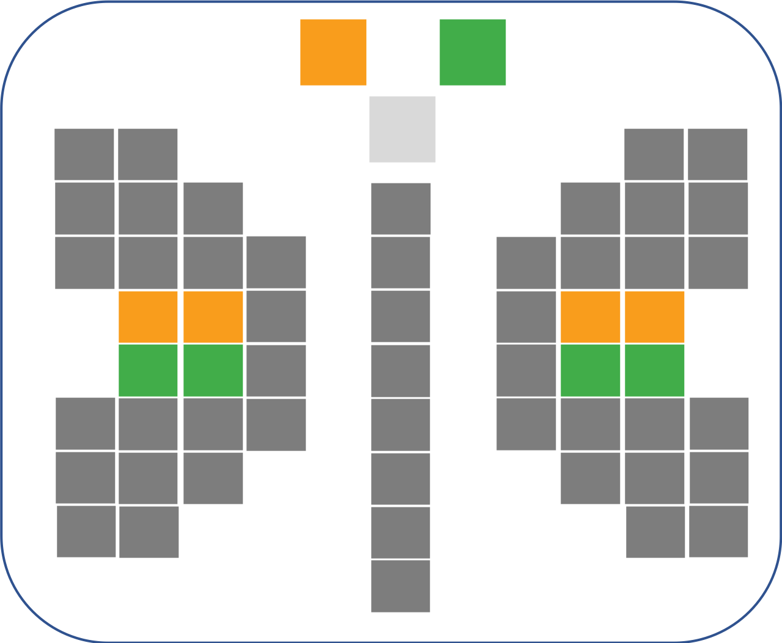

India’s Approach to
KPI Based QoS Framework for Smart Cities
narang n. kishor
mentor & principal design architect
narnix technolabs pvt. ltd.

Slide 2
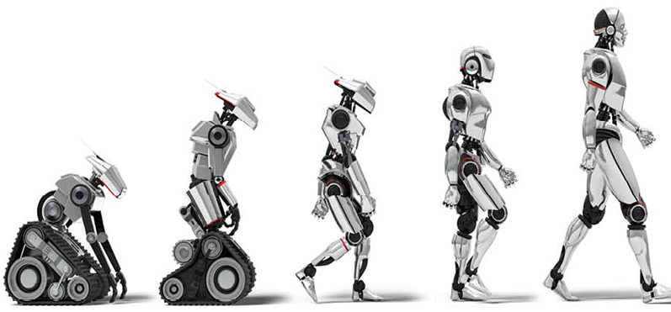
Cities >>> Smart Cities >>> Sustainable & Secure Cities

Slide 3
Smart Cities Mission
Mission Transform-Nation
Notes:
The total investment in Indian smart cities over a period of 5 years is estimated to be around US$30 billion.
The first wave of projects in selected 100 smart cities is well underway and implementation efforts are proceeding rapidly.

Slide 4
Smart Cities Mission
100 Cities
100 million people
Notes:
I would like to highlight that the Smart City projects were chosen through a comprehensive process of citizen engagement and public/private collaboration. The resulting outcomes are therefore quite different for each city, with each city investing in applications, infrastructure, and services that meet hopes and aspirations of their citizens and stakeholders.

Slide 5
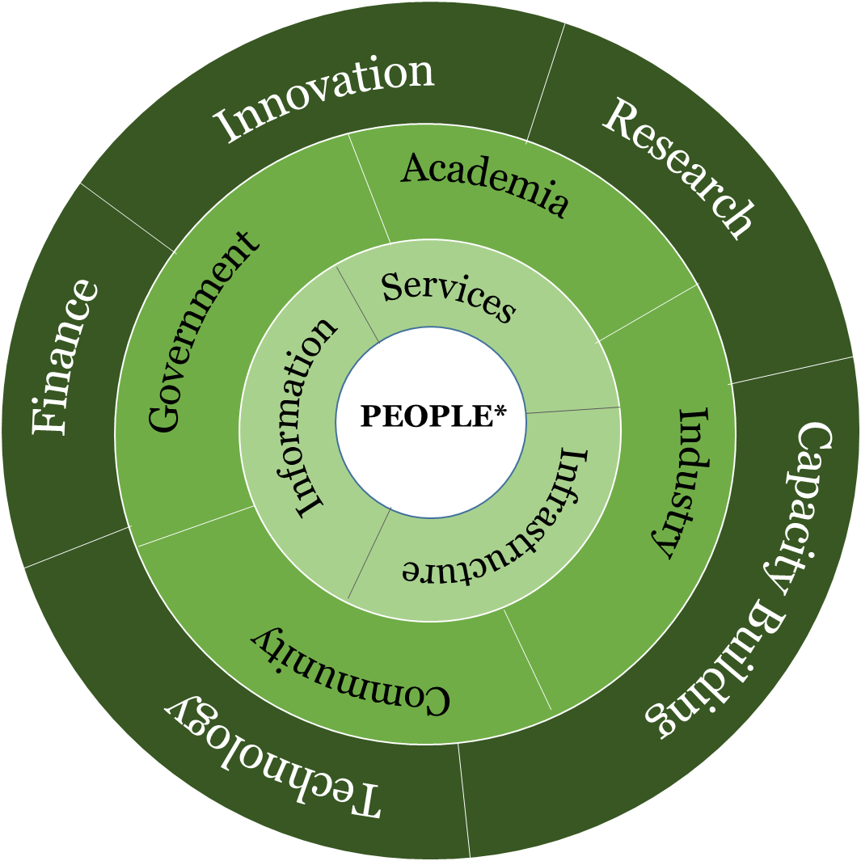
Understanding Smart Cities
*Collective Consciousness of Humanity
Ease of Living
Economic Growth
Connected
Inclusiveness
Safe
Resilient
Adaptive
Sustainable
Trust and Privacy
Energy Efficient
PLATFORMS
Notes:
1. Focus on people
2. Outcomes
3. Build Infra, services and info networks.
4. GIAC
5. Levers/Enablers

Slide 6
Smart Cities – Addressing 3 Core issues
Ease of Living
Economic-ability
Sustainability
Citizen at Core
Cooperative and Competitive Federalism
Technology is the means, not goal
More from less
Integration, Innovation, Sustainability
Inclusiveness
Notes:
The Indian Smart Cities are evolving as connected, livable, energy efficient, adaptive and resilient cities using cutting edge emerging technologies.

Slide 7
Mission Strategy
MISSION PROJECTS
QUALITY OF LIFE
ECONOMIC ABILITY
SMART CITIES
SERVICES
FINANACE
DATA
SUSTAINABILITY
PLANNING
TECHNOLOGY
GOVERNANCE
Notes:
A lot of the data generated in smart cities, remains in silos within their organizations. In order to solve the myriad complex issues faced by cities, it is vital that data locked in such silos be unlocked and shared amongst these entities. Not to forget, Right data, to the right people, at the right time.

Slide 8
Initiatives of the Mission
Standardisation and Security
Platform agnostic
Backward Compatibility and economies of scale.
Capacity Building
Integrated approach.
Standardization of common processes
Standardization of terminologies and semantics
Standardization of KPIs
Standardization of technology components (including identification/ development of Open standards for IoT/M2M, for interoperability)
Data re-use
Notes:
A Smart City, where the integration of multiple parties, devices and applications is a key requirement, presents its own security challenges. While there is no limit to security, enough standardisation is required in the manner we access and share the data securely.
Platform agnostic, as such developments are designed to increased market adoption and reduce complexity for adoption from one city to another.
Backward Compatibility and economy of scale.
Capacity Building up for standardised deployment and long term sustenance.
Move from Silo-ed Approach to Integrated approach.
One of the key objective of a Smart City is working towards “Ease of Living” and we need the systems to support this through standaridised way of data sharing and assessemnts as our Smart cities are now transitioning from “Input based approach” to “Output/Outcome based performance assessement”. Same would hold true for other KPIs of a Smart City like economic growth, sustainability , improved delivery of government services etc.

Slide 9
The Smart Transformation
The society, the business, the infrastructure, the services and all other aspects of the civilization on the planet Earth are going through a paradigm shift in the wake of technological advancements, especially in the field of ICT
All the ecosystems, be it Smart Cities, Smart Grid, Smart Buildings or Smart Factories now find themselves making three classes of transformations:
improvement of infrastructure – to make it resilient & sustainable…
addition of the digital layer- which is the essence of the smart paradigm; and
business process transformation - necessary to capitalize on the investments in smart technology.

Slide 10
The genesis of Smart City
In a Smart City-
  ‘Sustainability is the Destination’
  ‘Resilience is the Characteristic’
  ‘Smart is the Accelerator’
Standards are the Chromosomes of Smart Infrastructure

Slide 11
Features of a Smart City
Intelligent government services
Energy supply
Energy source
Water supply
Waste water management
Water quality
Air quality
Energy efficiency
Underground electric wiring
SanitatIon
Waste management
Safety
Citizen participation
Identity and culture
Economy and employment
Health
Education
Mixed use
Compactness
Open spaces
Housing and Inclusiveness
Transportation & Mobility
Walkable
IT connctivity
ICT and IoT Opportunities in all these areas!
24 Features identified by MoHUA
GoI

Slide 12
The Imperatives:
The technological trends in “Smart Homes”, “Smart Buildings”, “Smart Cities” & “Smart Grid” are being considered and pursued in isolation from each other by the respective stake holders. In fact, they form a very tightly interwoven & homogenous confluence of similar technologies being applied in different domains for a common cause of making our planet earth “smart, green n secure”.

Slide 13
Smart Cities & Smart Infrastructure
A sample Indian business case for next 5-10 years:
250 million Smart Electricity Meters are going to be procured & deployed under the NSGM (National Smart Grid Mission).
All these Smart Meters are going to use 250 million Communication Modules and minimum 0.5 million Gateways/DCUs (Data Concentrator Units).
Smart Streetlights are going to use more than 100 million Communication Modules and at least half a million of DCUs/Gateways…
Smart Buildings are going to deploy more than 50 million smart Sensors and at least 100K – 200K DCUs/gateways…
Automobiles shall be using at least 100-200 million communication nodes for Vehicle O & M, V to V, V to I & other telematics applications…
Similarly, various applications of the Smart Infrastructure paradigm like Smart Water, Smart Gas, Smart Traffic, Smart Environment, Smart sewage Disposal etc. are going to use a few billions of Smart Sensors with Communication Modules
To summarize, India ALONE, is going to need a minimum of 5 - 10 billion Communication modules to be integrated into the Smart Sensors and Controllers and 10– 50 million Gateways that shall be needed to operate and maintain the Nation Wide Critical Infrastructure that needs to be deployed to enable and empower the citizens to lead a sustainable, safe and secure life …

Slide 14
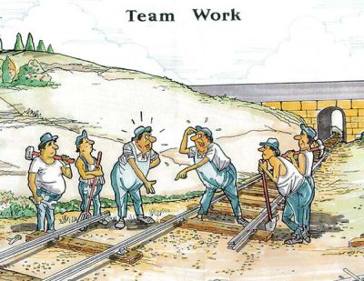
Common Understanding is a Big Deal
To map out the scope of smart city
To clarify the universal values of smart city
To reach consensus on the core capabilities of smart city
To indicate commonalities between different city systems
To provide the reference for integration & interoperability
To smooth the collaboration of SDOs and other city stakeholders
……

Slide 15
General Architecture of Smart City ICT Indicators –ISO30146

Slide 16
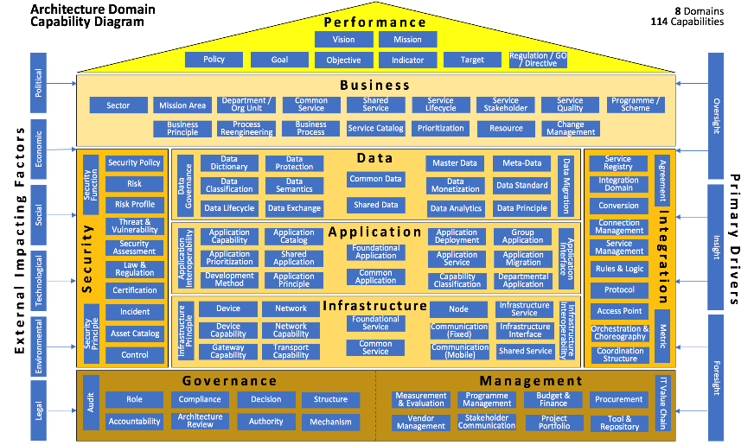
Smart City Capabilities Framework
……

Slide 17
Capabilities Evaluation Framework
Questionnaire
What is the Vision, Mission, Objectives of the City
What are the Key Short Term (1-3 years) and Long Term Goals
Has the City Identified them?
  Is Data to be captured identified (Sensors, Events, Social Networks)
  Is the Data Catalogued
  Has the Data been classified as private, public, temporary, permanent
  Has the Data life cycle (ingestion, storage and deletion) documented
  Is there a Data Monetization plan for key datasets of value
  Is there a Data sharing plan for operations data (Transparency Goals)
  Are there plans to engage citizens to annotate, augment sensor data

Slide 18
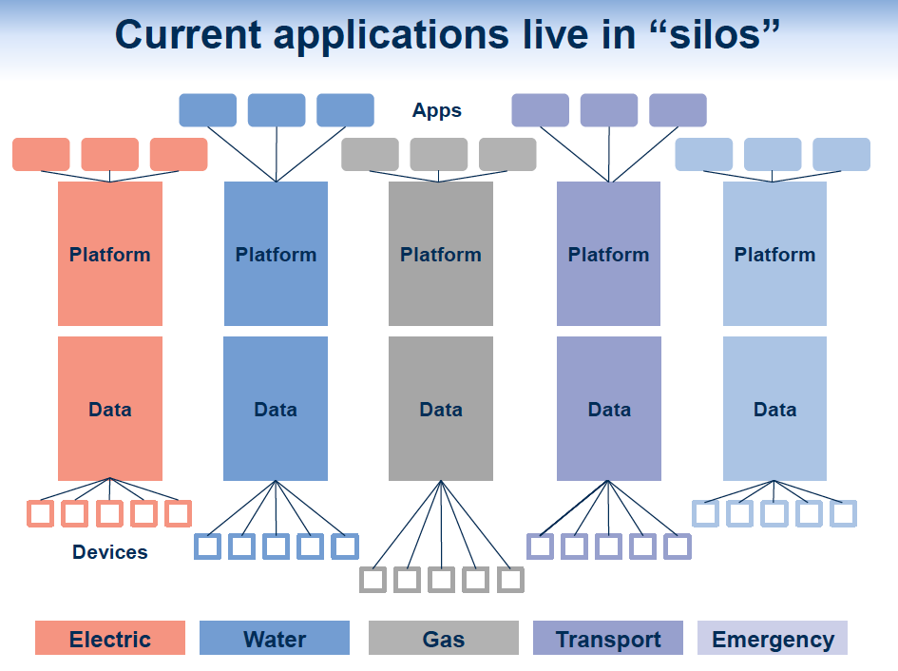
Current Applications live in silos
Notes:
The Interplay – Smart Utility – Smart Cities
The relationship between Smart Utilities and Smart Cities needs to be understood in this context:
“In a smart city, energy, water, transportation, public health and safety, and other key services are managed in concert to support smooth operation of critical infrastructure while providing for a clean, economic and safe environment in which to live, work and play”.
Hence, the perspective in Infrastructure Design for any city has undergone a paradigm shift with advent of convergence and networking technologies, solutions for information, communication, entertainment, security and surveillance; which are beginning to have a profound impact on the way we look at the Buildings’ Design (be it residential or commercial) and Town Planning.

Slide 19
“The beauty of standards is that there are so many to choose from!“
Andrew S. Tanenbaum, 1990
“Standards & even SDOs are not at the forefront of city planners’, utilities’ or users’ minds”
There are misconceptions on what standards are for, and, the case for use of standards has not been made.
Liberalization and Markets have a lot of great virtues, but they cannot create their own conditions of existences: they must be designed!

Slide 20

CACOPHONY or SYMPHONY ? ? ?
The Enraged Musician, William Hogarth, 1741

Slide 21
One of the most challenging Imperatives
for
“Standard Development Organizations”
Harmonization of Standards
in
Smart Homes, Smart Buildings, Smart Manufacturing, Smart Grid & Smart Cities
for
smart, sustainable & secure communities

Slide 22
If “Data is the Oil of the 21st Century”
Two Underlying philosophies
Standards are the chromosomes of Smart Infrastructure
&
Neelie Kroes, EU Commissioner responsible for the Digital Agenda
(without pollution side effects)
Then “Big Data” is the Crude Oil
Narang N. Kishor, NARNIX TECHNOLABS
As it needs lot of processing before it becomes usable

Slide 23
Smart City Digitization - Why Standards
Diverse Stakeholders: Citizens, City officials, Developers, Service providers, Organizations
Geographical Diversity: Parking Lots, Streets, Buildings, Electric Stations, etc.
Several Services and Business Processes: with diverse functionality and consumers need to be developed.
Diverse Sensors: Temperature, Pollution, Smart Meters, Surveillance Cameras etc.
Diverse Data & Formats: Geo Spatial Data, Sensor Data, Social Networking Data and Events Data and formats like Time-series, Images, Text, Streaming, etc.
Diverse Technologies: Programming Languages, Middleware, Networking, Carriers, etc.

Slide 24
Smart Cities ICT
Architecture Approaches
Smart Cities three key principles facilitating Emergence as a outcome :
  Interoperability
  Composability
  Harmonization
2 Approaches to Architecture Definition
  System of System Approach
  Enterprise Architecture Approach

Slide 25
System of Systems - Key Characteristics
Characteristics
Operational Independence of the elements
Managerial Independence of the elements
Evolutionary Development
Emergent Behavior
Geographic Distribution
Classes based on above characteristics
Directed
Collaborative
Virtual

Slide 26
BIS Standardization Strategy & Roadmap
“Unified, Secure & Sustainable ICT Infrastructure
for Smart Cities/Infrastructure”
LITD 28 – Smart Infrastructure Sectional Committee
Electronics & IT Division, Bureau of Indian Standards

Slide 27
Four levels of abstraction in the Systems Approach
Reference Model
abstract framework for understanding concepts and relationships between them in a particular problem space (or subject field)
Reference Architecture
template for solution architectures which realizes a predefined set of requirements
  Note: A reference architecture uses its subject field reference model (as the next higher level of abstraction) and provides a common (architectural) vision, a modularization and the logic behind the architectural decisions taken
Solution Architecture
architecture of the system-of-interest
  Note: A solution architecture (also known as a blueprint) can be a tailored version of a particular reference architecture (which is the next higher level of abstraction)
Implementation - realisation of a system-of-interest

Slide 28

Levels of architecting
design and experiment
build and test
Various needs
architect
2.Reference architecture
3. Reference Solution Architecture
Reference Implementation
align
refinement
feasibility feedback
architect
Scenario 1 reference architecture
build and test
1.Reference model
design and engineer
4. Implementation A1
extract
3.Solution architecture A
4. Implementation A2
constraints and opportunities
field feedback
Scenario 2 reference architecture
design and engineer
A few scenario reference architectures may be derived from the reference architecture
AAL: personal telehealth, home
Smart Cities: megalopolis, city, village, island
extract essentials
constraints and opportunities
3. Solution architecture B
Problem space
Solution space

Slide 29
Smart Cities ICT Architecture - Simplified View
City KPI (Vision, Mission, Liveability Index)
Citizens
Administrator
Service Provider
Smart City Applications
O
P
E
R
A
T
I
O
N
S
Go
V
E
R
N
A
N
C
E
S
E
C
U
R
I
T
Y
I
N
T
E
G
R
A
T
I
O
N
Domain Adaptation Layer
API & Service Orchestration Layer
Context Layer (GIS, Time Servers)
Data Exchange & Data Processing Layer
Network & Communication Layer
Sensors, Device & Gateway Layer

Slide 30
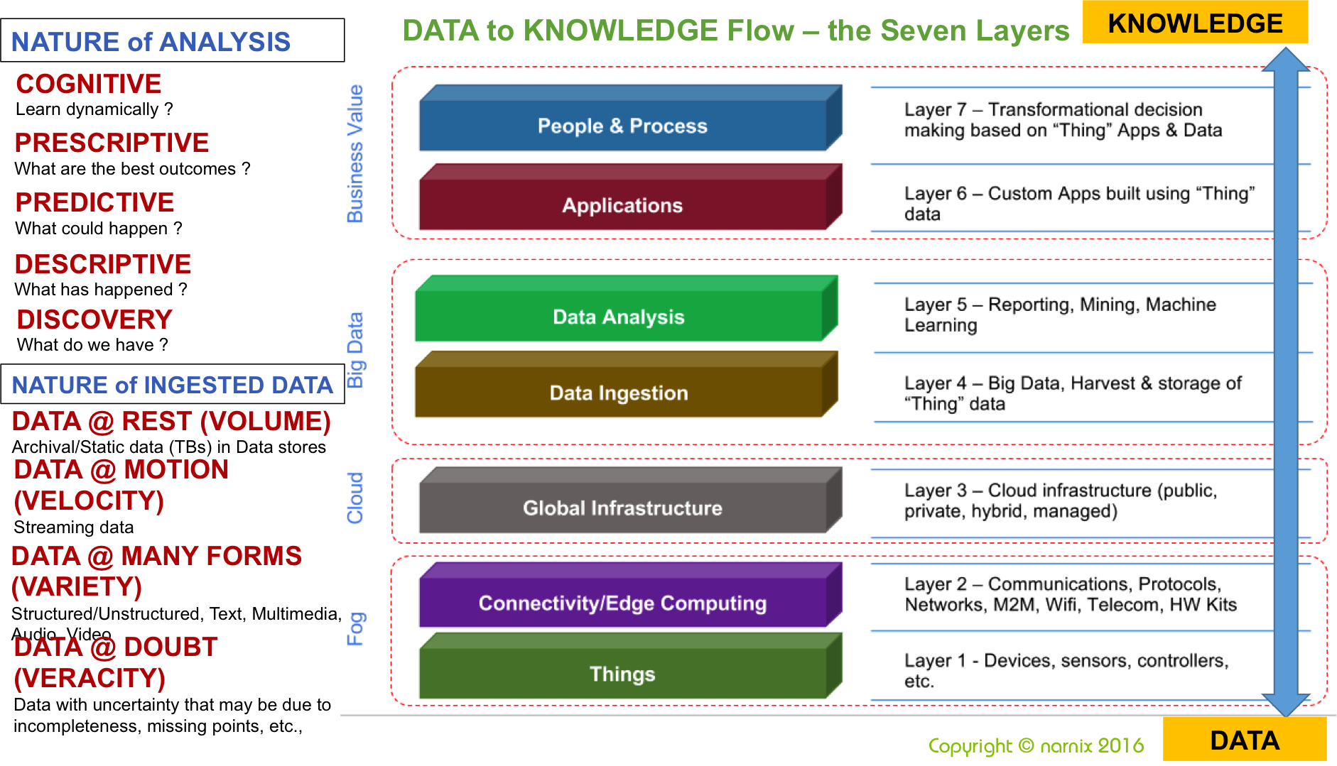
7 Layers of Information Flow

Slide 31
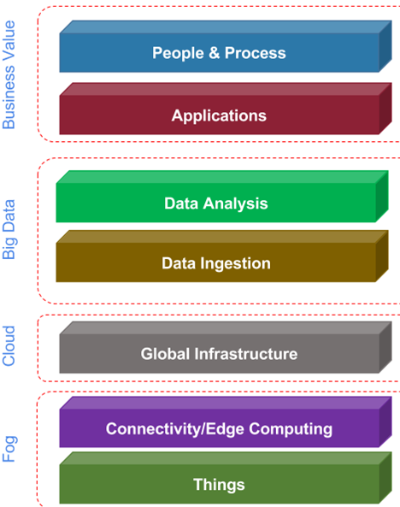
Mapping the Smart Infrastructure Philosophy to High-level Functionality
Physical Infrastructure
Social Infrastructure
Economic Infrastructure
Institutional Infrastructure

Slide 32
Mapping the Smart Infrastructure Philosophy to High-level Functionality
Physical Infrastructure
Social Infrastructure
Economic Infrastructure
Institutional Infrastructure
The application needs change (as part of the users’ requirement) to derive value from different infrastructure pillars, but the ICT and IoT backbone remains (or should remain) the SAME !!!

Slide 33
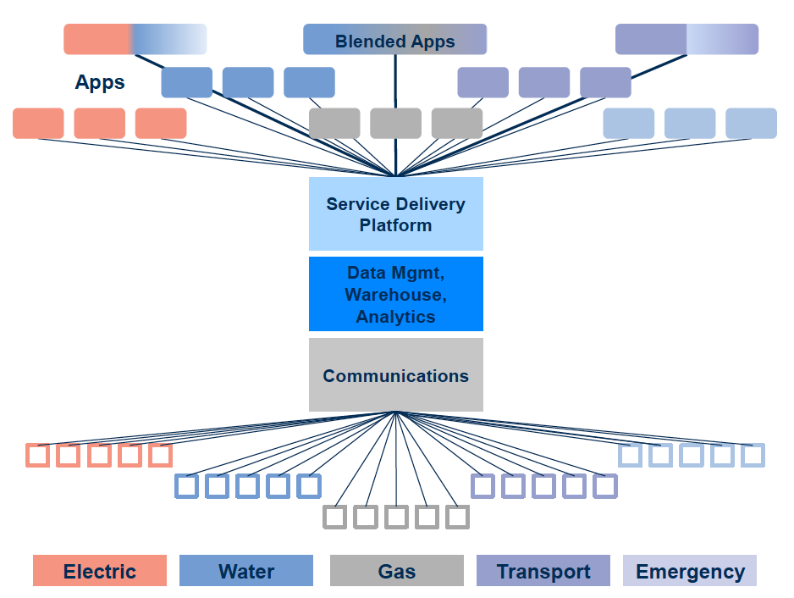
The way forward: Unified architecture
Notes:
Such a systems level approach in design and standardization is likely to not only enable newer and better services, but also allow far greater synergies and cost-effective deployments, reducing the lifecycle (total) cost of ownership of any Infrastructure, be it the smart grid, a home, a building or even a city, with attendant environmental benefits, including carbon reductions.
Fast, secure, interoperable, reliable and cost effective communications are critical for any ‘Smart Infrastructure’, an entire interconnected network of interactive smart devices.
With the evolution of the converged and networked society, further fueled by the ‘Internet of Things’ era, a multitude of new applications of the Information and communication technologies have changed the way we live, work, play, interact and even think.

Slide 34
A Typical Smart Utility ICT Architecture…
Cloud Infra
Solution_<Name>
Interactive Visualization Block
Security, Services, Management
Application Block
Coordination Block
Common
Unique
Patterns
Activities
Business Grounding
Orchestration
Choreography
Information Block
Reporting
Analytics
Domain ontologies
Data Block
Data Models
Repository
Data Validation
Data Ingestion
Backhaul Communication
Field Infra
Control
Security, services Management
Sensing
Identification
Actuation
Last-Mile Communication

Slide 35
Smart Utilities ICT Architecture
Domain 1
2..3..4…
Domain n
Cloud Infra
Solution_<Name>
Cloud Infra
Solution_<Name>
Interactive Visualization Block
Security, Services, Management
Interactive Visualization Block
Security, Services, Management
Application Block
Coordination Block
Application Block
Coordination Block
Common
Unique
Patterns
Activities
Common
Unique
Patterns
Activities
Business Grounding
Orchestration
Business Grounding
Orchestration
Choreography
………..
Choreography
Information Block
Information Block
Reporting
Analytics
Reporting
Analytics
Domain ontologies
Domain ontologies
Data Block
Data Block
Data Models
Repository
Data Models
Repository
Data Validation
Data Validation
Data Ingestion
Data Ingestion
Backhaul Communication
Backhaul Communication
Field Infra
Control
Security, services Management
Field Infra
Control
Security, services Management
Sensing
Identification
Actuation
Sensing
Identification
Actuation
Last-Mile Communication
Last-Mile Communication

Slide 36
Smart Utilities ICT Architecture
Domain 1
2..3..4…
Domain n
Cloud Infra
Solution_<Name>
Cloud Infra
Solution_<Name>
Interactive Visualization Block
Security, Services, Management
Interactive Visualization Block
Security, Services, Management
Application Block
Coordination Block
Application Block
Coordination Block
Common
Unique
Patterns
Activities
Common
Unique
Patterns
Activities
Business Grounding
Orchestration
Business Grounding
Orchestration
Choreography
………..
Choreography
Information Block
Information Block
Reporting
Analytics
Reporting
Analytics
Domain ontologies
Unified ICT Backbone
Domain ontologies
Data Block
Data Block
Data Models
Repository
Data Models
Repository
Data Validation
Data Validation
Data Ingestion
Data Ingestion
Backhaul Communication
Backhaul Communication
Field Infra
Control
Security, services Management
Field Infra
Control
Security, services Management
Sensing
Identification
Actuation
Sensing
Identification
Actuation
Last-Mile Communication
Last-Mile Communication

Slide 37
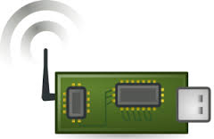
Smart Utilities ICT Architecture
Domain 1
2..3..4…
Domain n
Cloud Infra
Solution_<Name>
Cloud Infra
Solution_<Name>
Interactive Visualization Block
Security, Services, Management
Interactive Visualization Block
Security, Services, Management
Application Block
Coordination Block
Application Block
Coordination Block
Common
Unique
Patterns
Activities
Common
Unique
Patterns
Activities
Business Grounding
Orchestration
Business Grounding
Orchestration
Choreography
………..
Choreography
Information Block
Information Block
Reporting
Analytics
Reporting
Analytics
Domain ontologies
Unified ICT Backbone
Domain ontologies
Data Block
Data Block
Data Models
Repository
Data Models
Repository
Data Validation
Data Validation
Data Ingestion
Data Ingestion
Backhaul Communication
L6: APP
Backhaul Communication
Field Infra
Control
Security, services Management
L5: TRANSPORT
Field Infra
Control
Security, services Management
Sensing
Identification
L4: ROUTING
Sensing
Identification
Actuation
Actuation
L3: NETWORK
Last-Mile Communication
L2: MAC
Last-Mile Communication
L1: PHY

Slide 38
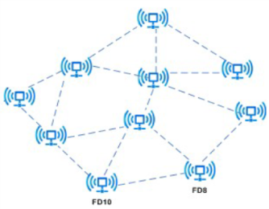
Smart Utilities ICT Architecture
Domain 1
2..3..4…
Domain n
Cloud Infra
Solution_<Name>
Cloud Infra
Solution_<Name>
Interactive Visualization Block
Security, Services, Management
Interactive Visualization Block
Security, Services, Management
Application Block
Coordination Block
Application Block
Coordination Block
Common
Unique
Patterns
Activities
Common
Unique
Patterns
Activities
Business Grounding
Orchestration
Business Grounding
Orchestration
Choreography
Choreography
Information Block
………..
Information Block
Reporting
Analytics
Reporting
Analytics
Domain ontologies
Domain ontologies
Unified ICT Backbone
Data Block
Data Block
Data Models
Repository
Data Models
Repository
Data Validation
Data Validation
Data Ingestion
Data Ingestion
Backhaul Communication
Backhaul Communication
Field Infra
Control
Security, services Management
Field Infra
Control
Security, services Management
Sensing
Identification
Actuation
Sensing
Identification
Actuation
Last-Mile Communication
Last-Mile Communication

Slide 39


Smart City Platform
Key Micro Services
Application Layer
Smart Parking
Smart Energy
ICCC
Developer Apps
API Management
SOM: Coordination of services
Service Mesh (Orchestration)
Adapters : Plug-n-Play
Identity Layer
Partner & Policy Layer.
Device Layer.
Context Layer
Data Layer
Data Workflow Layer
Data Analytics Layer
$$$
User Account Mgmt.
User Authentication (Two Factor)
Password Protection & Recovery
Authorization & RBACS
User Profile Management (Extensible)
Single Sign-On & Global Logout
Social Integration
Open standards support (OAuth, SAML, OpenID)
White Labeling - Login Box for web apps and mobile apps
Customization and Rules
AD Integration
Partner / Service Provider Onboarding
Developer Onboarding
Dashboards
API Key Management
App Management
Tools for Workflow Customization
Monetization Support
Integration with Billing & Reporting
Multi-Tenancy and Data Level Isolation
Secure Device Onboarding
Device Registration / un-registration
Device authentication & association
Device Attestation & Blacklisting
Asset Management
Field Gateway as Device Proxies
OTA updates and configuration
Open standards support (TR-69, OMA-DM, LWM2M)
Device – Application Permissions
Customization and Rules
Time & Location Services
Base Map Service
Organization - Department Space Boundaries
Map Visualization API’s
Spatial Planning Tools
Space ID’s
Virtual Private Address
Location coordinates specification
Time synchronization service (NTP, PTP)
Time format specification
Time-Order Guarantees
Sensor Data & Events Data
Flexible Data Model Support
Data Schema (Ontology) Support
Stream & Point Data
Persistent Storage & Ephemeral Data
Data Encryption at REST
IOT Hub (Pub-Sub)
Transport protocols (HTTP / MQTT / Any other ?)
Support for Video ?
Binary Data Support
Spatio – Temporal Querying
Configurable processing for data streams
Rule engine Integration
Multi-channel notification support (Email / SMS / GCM)
Real time processing
Push Notification
Function-as-a-Service
Web Hooks integration for notification to
Secure Enclave for running analytics containers near data
Offline and real-time big data analytics
Time series analysis (trend, trend variance), Graph analytics
Cohort / Funnel Analysis for recommendation
Deep Learning frameworks with support for Computer Vision, NLP workloads
Infra Services
E-Governance Services
OneM2M
Platform Services for Smart City as a Service
ICT Standardization to leverage from existing standards efforts

Slide 40
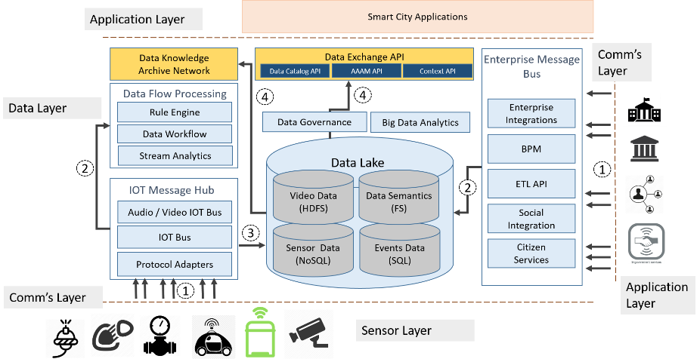
Data Layer Architecture

Slide 41
Device Management – One M2M
Registration
Discovery
Security
Group Management
Data Management & Repository
Subscription & Notification
Device Management
Application & Service Management
Communication Management and Delivery Handling
Network Service Exposure
Location
Service Charging & Accounting

Slide 42
Last Mile Communication
Application
CoAP, LWM2M,….., …
Unified Stack Interweaving Layer
…..
Transport Layer
UDP, TCP, DHCPv6, …
Security
EAP-TLS, 802.1x, 802.11i, …
Network Layer
IPv6, ICMPv6, …
Network Access Layer
…..

Slide 43
Last Mile Communication
Application
CoAP, LWM2M, DLMS, …
Network Access Interface layer
6LoWPAN, RPL, IEEE 802.15.9, …
Transport Layer
UDP, TCP, DHCPv6, …
Security
EAP-TLS, 802.1x, 802.11i, …
Network Layer
IPv6, ICMPv6, …
Network Access Layer
IEEE 802.15.4-2015, 15.4u, 15.4v [MAC, PHY]

Slide 44
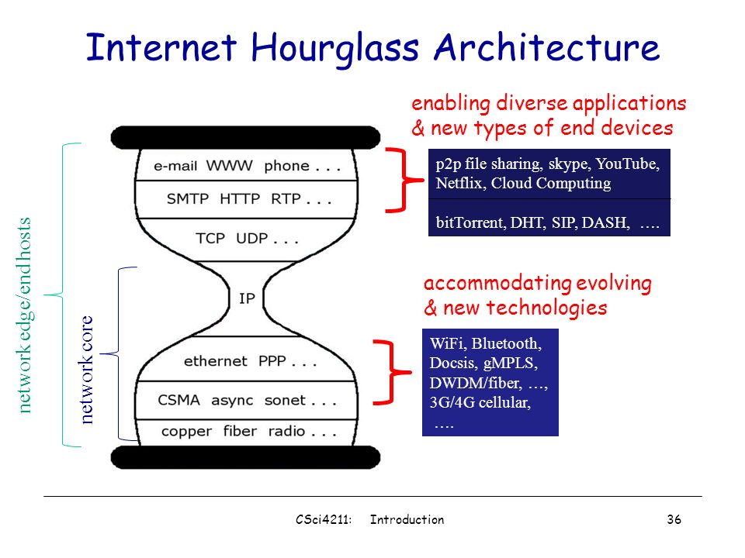
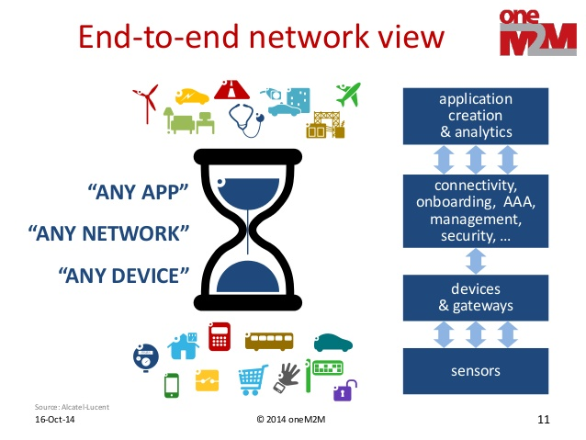
Unified ICT Architecture Abstraction:
Moving from Hour Glass Architecture to…

Slide 45
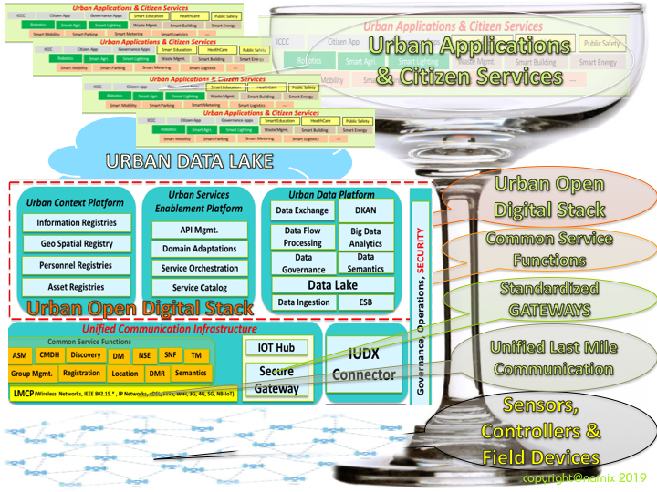
Classic Saucer Champagne Glass Architecture Model:

Slide 46
…Classic Saucer Champagne Glass Architecture:
The evolved Comprehensively Unified ICT Architecture can be modelled as a “Classic Saucer Champagne Glass” with a wide Flat Bottom Base depicting the multitude of Field Devices & sensors etc. The Saucer Shaped Bowl on the Top depicting being filled with an ever-increasing spectrum of City Applications and Citizens’ Services. The Long Stem depicts all the Common Layers viz.: the Unified Last Mile Communication, Common Standardized Gateways (application or Vertical Agnostic), Common Service layer representing the Common Service Functions in the Gateways, as well as, in the Cloud… and the Smart City Middleware & City Data Reservoir in the Cloud.
It is the “Long Stem” of the “Champagne Glass Model” instead of the Short & Narrow Neck in the “Hourglass Model” that brings the comprehensive harmonization, standardization & interoperability in the Architecture leading to optimization in operational efficiency & Life Cycle Cost of the ICT Infrastructure in any Smart City.

Slide 47
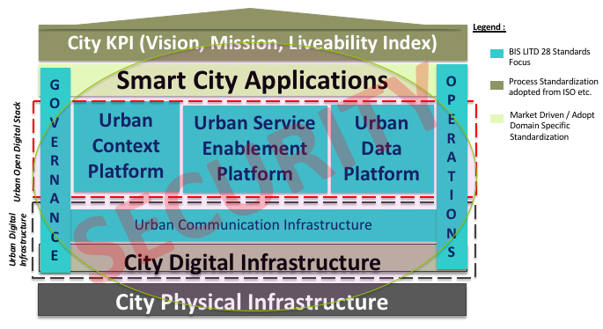

Slide 48
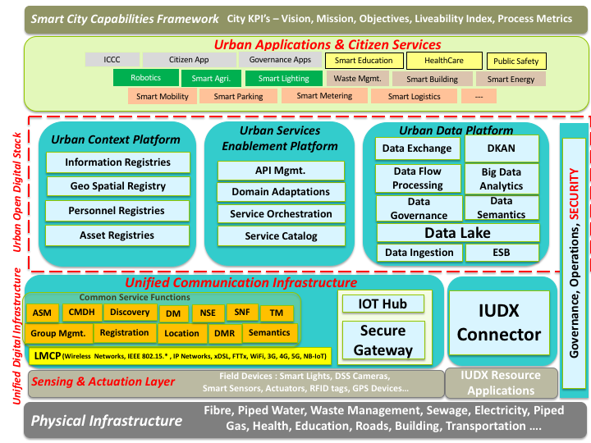

Slide 49
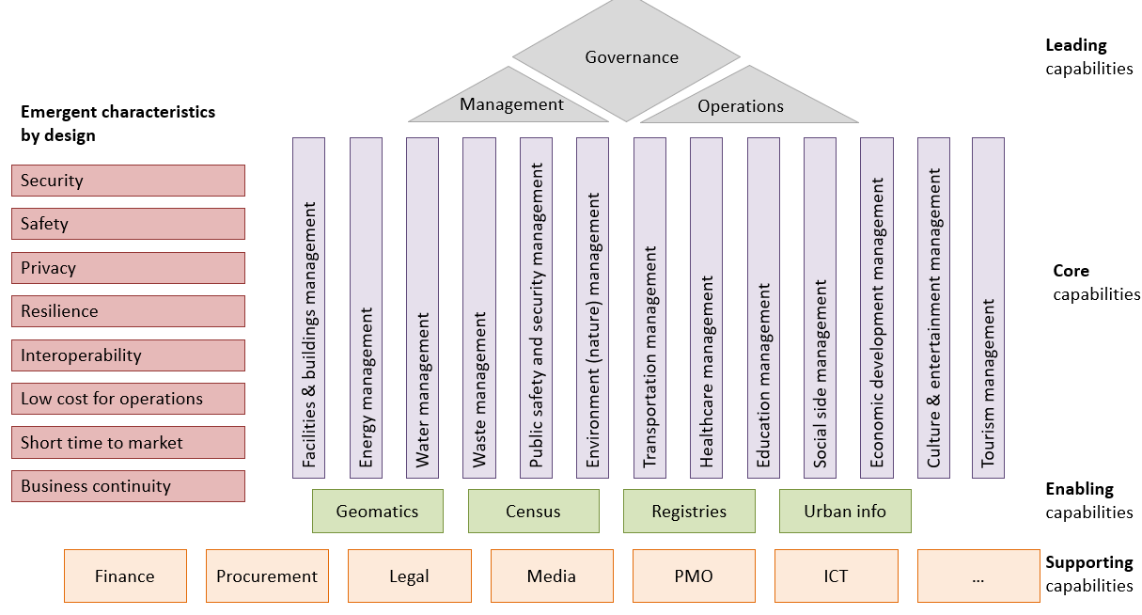
Common digital platform and digital solutions
Step-by-step absorbing by the digital platform Smart Cities capabilities
  Supporting
  Enabling
  Leading
  Core
Initial implementations can be a digital solution which is later transferred into the digital platform

Slide 50

Common digital platform and digital solutions
Solution β
Solution α
Zones
Water
Transport
Waste
Environment
Culture
Energy
Public safety
Tourism
Procurement
City
Governance
Finance
PMO
Geomatics
Management
Legal
ICT
Census
Operations
Security management
Universal
Software factory
API management
Event management
Data persistence
IoT management
Process management
Analytics & reporting

Slide 51
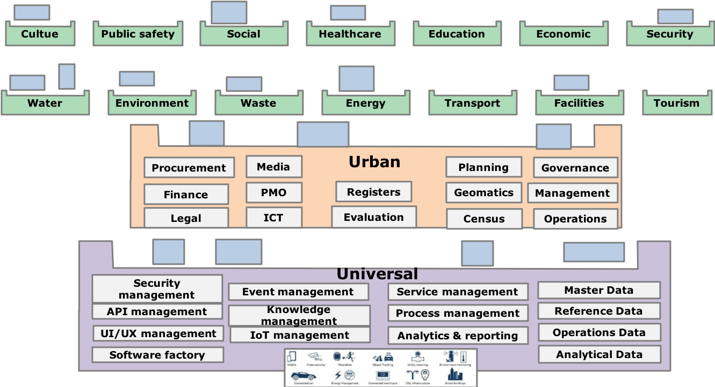
Platforms Approach…

Slide 52
Some more focus Areas…
BIS LITD 28 shall also undertake studies on the following subjects:
E-governance portals delivering services online (like single windows for building plans etc.)
Transportation systems that integrate multiple modes of transport and enable integration through common smart fare cards etc.
Various SCADA systems being integrated into command centers at city level
Various energy systems and their integration
Electric Vehicle Charging Infrastructure Integration
How to manage decentralized systems that require wireless as well as hard-wire access to data servers
How to manage standards in systems that employ GIS maps as well as other digital data sources
Interoperability and automation of alerts and commands between the GIS systems and command and control centers
Role of Blockchain, Artificial Intelligence and Machine Learning in the Smart Infrastructure ICT Framework
Stakeholder mapping of all the data expected to be generated from smart city
….

Slide 53
BIS LITD 28 Deliverables Imperatives:
Comprehensive Security Architecture
Comprehensive Big Data Architecture
5G Inclusive ICT Reference Architecture
for Unified & Secure Smart Infrastructure

Slide 54
Study Group 5 on 5G Imperatives for Smart Cities
LITD – 28 - Smart infrastructure Sectional Committee , Bureau of Indian Standards

Slide 55
A few steps being undertaken…
Identify 5G Friendly, 5G Intensive & 5G Extensive Applications & Use Cases within the Smart Infrastructure paradigm and even outside…
Identify the feasibility of developing Application Layer Standards around them…
Develop a phased implementation & deployment plan for them…
Develop the most optimized “5G inclusive ICT Reference Architecture for Smart Infrastructure”…
Develop a smooth migration & adoption strategy from Contemporary ICT Architectures to the 5G Inclusive Architectures…

Slide 56
A few Next steps…
Study SBA/ Open API’s at 3GPP versus common service layer platform for use cases – examine API’s
How to leverage network slicing/ SBA 5G to implement diverse critical use cases and e2e QoS mapping from transport layer to application layer
Role of virtualization/ SDN/ MEC for dynamic use cases implementation and deployment flexibility

Slide 57
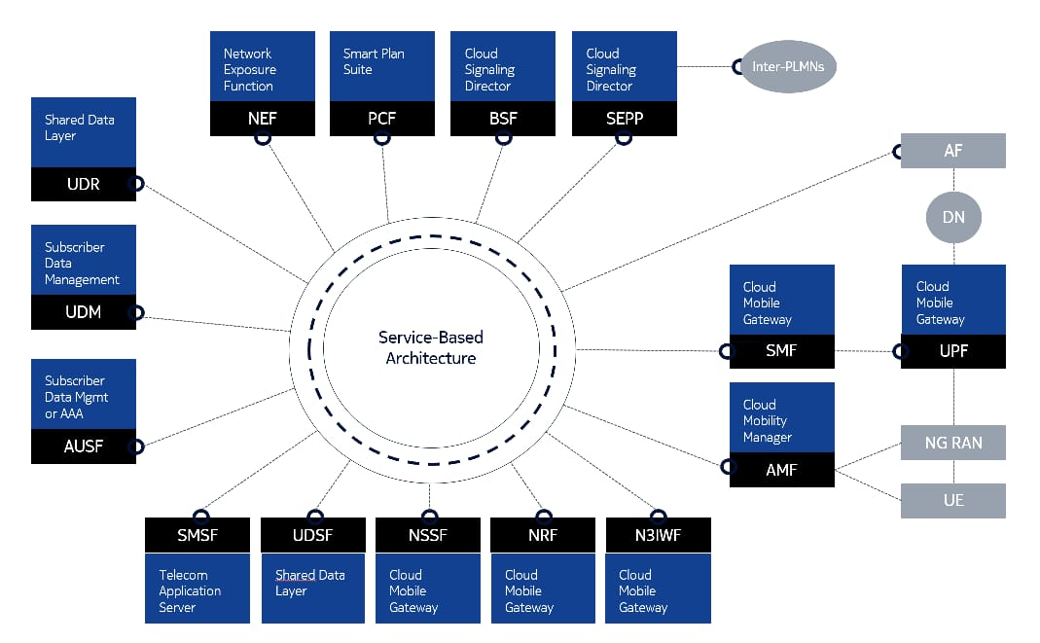
5G Service Based Architecture

Slide 58
Example of a micro service architecture

Slide 59
Cloud native application stacks

Slide 60
5G spectrum strategy

Slide 61
5G Networks Characteristics
The ability to handle multiple, tailored use cases is what makes 5G more disruptive than previous generations of cellular technology.
As 5G will need to coexist and interwork with 4G for many years to come, we’re likely to see the vast majority of these deployments as non stand-alone (NSA) initially, as a way of reducing time to market and ensuring good coverage and mobility.

Slide 62
Network Architecture
Current network architecture needs to evolve to meet the needs of the wide variety of use cases enabled by 5G technology.
As part of this, the transport network must evolve and scale efficiently to meet widely varying, but strict, requirements for performance, capacity, latency, and security.
It must also support the various needs of parallel network architectures and technologies, and seamlessly support the coordination between many more cell sites, including those that will coexist with 4G technology for many years to come.

Slide 63
Design Principles
Agnosticism
A Micro-service Architecture
Application Resiliency
State Optimized Design
Orchestration and Automation
  Internal automation and orchestration
  Network level orchestration and automation

Slide 64
5G Paradigm – Key Attributes…
Distributed Architecture
Network Slicing
CUPS
Cloud RAN
Virtual Network Functions (on Cloud native)
Cloud Native Digital Services
Microservices Architecture
Continuously Evolving Software
DevOps

Slide 65
Today, one of the main concerns about virtualizing the network functions is backward compatibility. It is critical to make sure the virtual network functions (VNFs) can interoperate with the physical network functions and the older infrastructure.
But even more important is how best to develop, test, deploy, and manage APPLICATIONS to take advantage of the new capabilities provided by 5G Paradigm with all its key attributes...

Slide 66
Some Questions…
Under ALS, what are we going to Standardize?
  The Application Platforms? For different use cases?
  Interfaces of the AL with other 5G Network Layers ?
  And/or….
  Whatever, we choose to Standardize, how granular we want to (or should) go?

Slide 67
A few inputs for the immediate NEXT STEPS…
Follow the Systems Approach
Study & Analyze the selected Use Cases to understand their respective Characteristics
Study & Analyze the 5G Network Architecture(s) and enumerate their characteristics, as well…
Develop a Matrix to map the Application(use cases) characteristics with the 5G Network Architecture Characteristics that shall enable & empower the Applications’ characteristics.

Slide 68
This Mapping shall help us understand & develop the customized “5G Architecture Views” that shall meet any single or set of Applications & /or use cases.
This shall also help us understand the kind of VNFs, Network Slices, Microservices, Containers, Data Repositories that shall be needed to serve the respective applications…

Slide 69
Only after this stage,
we could actually identify as to what aspects can or should be standardized in the Application Layer Domain…

Slide 70
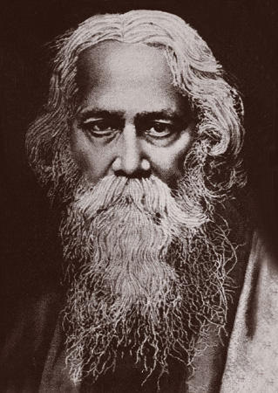
Resilience….
Let us not pray to be sheltered from dangers but to be fearless when facing them

Slide 71



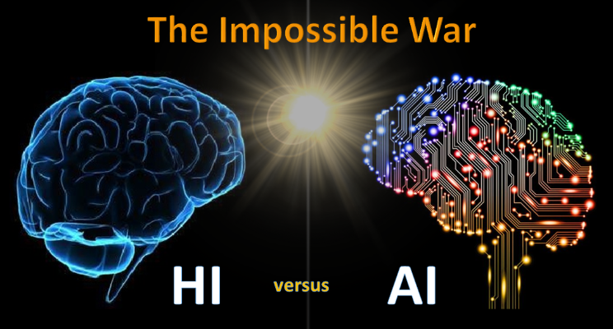









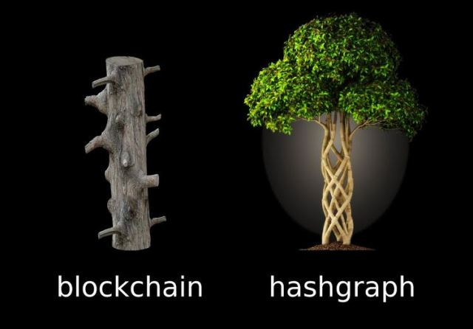
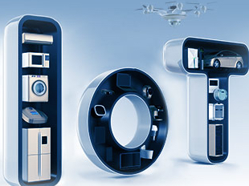





design is our religion
&
we are fanatically religious

Slide 72
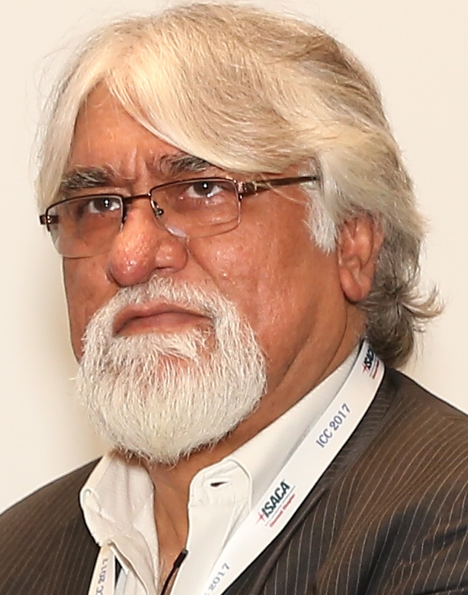
Brief Profile - narang n. kishor
Technology Philanthropist,
Innovation & Standardization Evangelist…
Technology Consultant, Mentor & Design Architect in Electrical, Electronics & ICT…
Over 40 years of professional experience in education, research, design and consulting .
Over 30 years of hardcore Research and Design Development Experience in Solutions, Systems, Products, Hardware, Software & Firmware (Embedded Software) in fields of Industrial, Power, IT, Telecom, Medical, Energy and Environment.
Over 10 years of Consultancy Experience to different segments of business & industry.
Over 200 Research & Design Mentees in the Electronics & ICT & STI Ecosystems.
Leading & contributing in multiple National & Global Standardization Initiatives at BIS, Niti Ayog, TSDSI, IEC, ISO, ITU, IEEE etc.…
narang n. kishor
Mentor &
Principal Design Architect
narnix technolabs pvt. ltd.

Slide 73
Brief Profile - narang n. kishor
Leading Standardization activities @BIS - the Indian National SDO in - Smart Cities, Smart Manufacturing, Smart Energy & Active Assisted Living as the Chairman of Smart Infrastructure Sectional Committee LITD 28 in BIS.
Contribution in Global SDOs:
Vice Chair – Strategy in IEC SyC Smart Cities.
Project Leader – IEC TS 63188 ED1 – Smart Cities Reference Architecture Methodology
Project Leader – IEC 63205 ED1 – Smart Cities Reference Architecture
Co-Editor – ISO 30145 on Smart City ICT Reference Framework
Co-Editor – ISO 30146 on Smart City ICT Indicators
Representing Indian National Body BIS & contributing with Indian perspective in
IEC – SyC Smart Energy, SyC Active Assisted Living & SyC Smart Cities. IEC - SEG4, SEG6, SEG7, SEG8 & SEG9
ISO - TC 268 on Sustainable Development in Communities.
ISO/IEC JTC1/SC 41 – Internet of Things & related Technologies, JTC1/SC 42 - Big Data & Artificial Intelligence; and JTC1/WG11 – Smart Cities.
ITU-T SG20 - Internet of Things (IoT) and its applications including smart cities and communities (SC&C).
IEEE Smart Cities & Internet of Things Steering Committees.
……….. ……….

