Slide 1
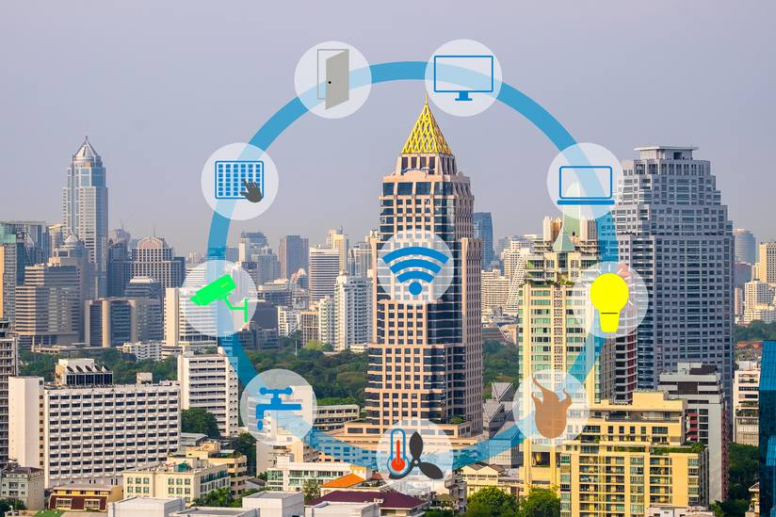
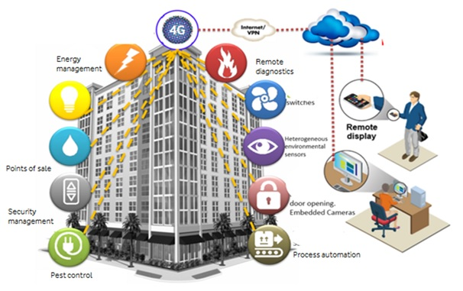
Smart Buildings Buildings as a Service
Ken Koffman
CTO & SVP Business Performance
Telecommunications Industry Association
kkoffman@tiaonline.org
+1 561 213-1654
Notes:
In order to support today’s promising technologies, consumers and businesses need reliable, fast and secure connectivity. Private networks are increasingly a solution that supports these needs, and, small cell and DAS are critical components of this coming shift in building networks.

Slide 2
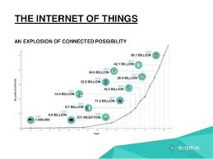
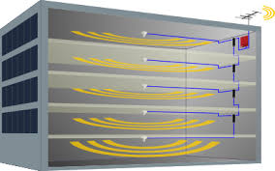
Smart Building Demand Drivers
Integrated Buildings
IoT Explosion
In-Building Coverage
Safety & Security
LTE Evolution & 5G
Enterprise Networks
Latency Reduction
Massive Data

Slide 3
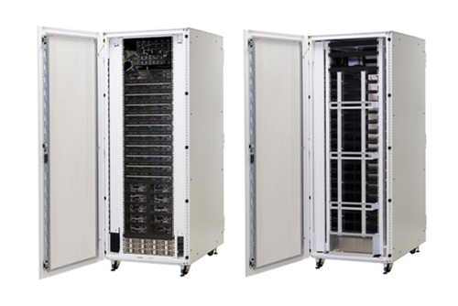
Facial Recognition
Cloud vs Private Smart Building Network
Dallas TX
Reston VA
30 to 90 seconds
On Site
< 2 -4 MS
Latency Reduction

Slide 4
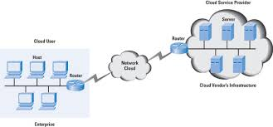
Private Networks (PN)
Speed
Low-Latency
Security
Privacy
Reliability
Massive Data
Flexibility
Complexity
Aggregation
First Gen Networks
direct user-to-user connections
Over time, the structure of the network shifted to the cloud
Now shifting back to private / edge networks.

Slide 5
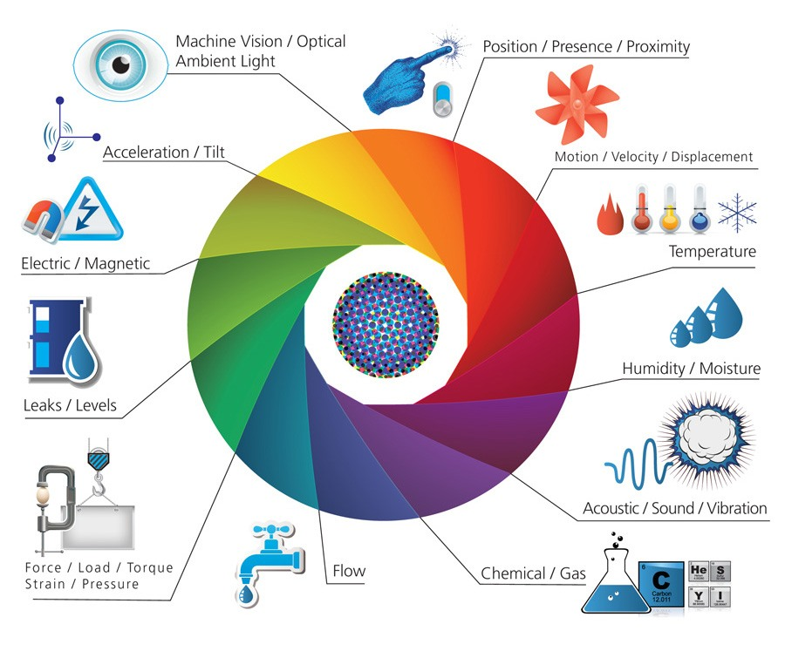
IoT Sensors and Actuators: Lots of Them
IoT Explosion
Source: Image from IoT Infographic

Slide 6
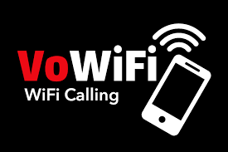
What’s In Your Building?
Fiber
Cable
Copper
Cellular WAN | WLAN/WPAN | WAN WAN Fixed | LPWAN, IoT Broadband Wireless
 |  | PAN BAN | Other Wireless
In-Building DAS
Signal Boosters
Satellite
© 2019 TIA w w w . T I A onl i ne. o r g

Slide 7
Why does TIA care about smart buildings?
Efficiency, Productivity, Wellness
You can’t optimize what you don’t measure
Edge (Deloitte, Amsterdam) uses 70% less energy than the average office building
Ethernet-powered LED lighting system is 80% more efficient than conventional illumination
HVAC, lighting, and some types of electrical loads, can expect savings 10%-25% savings with a proactive energy-management programs
Effect a desk to colleague ratio of 1:14 (Hot Desking)
Personalized control of room temperature can raise productivity by 3%
Optimized air quality can increase productivity by 11%
Happy employee increases productivity from 12%-36%

Slide 8
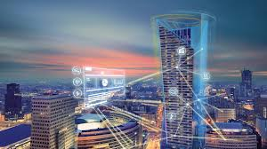
TIA Smart Building Definition:
A Smart Building uses an integrated set of technology, systems and infrastructure to optimize building performance and occupant experience.

Slide 9
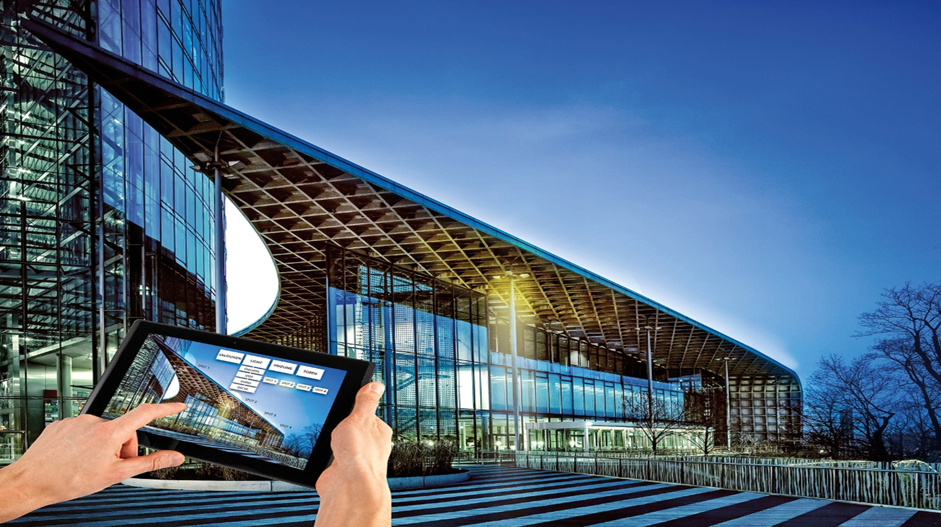
Vision = Fully Integrated
Fully Integrated Smart Building:
Connectivity
Networking
Interoperability
Bandwidth / Capacity
Applications / Services
Data Driven
Resilience & Secure
Building as a Platform
- Microcosm of Smart City - T.I.C. (Test, Inspect, Certify)
- Certification & Registration - New Business Opportunities

Slide 10
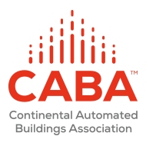
Community collaboration
Large California RE Developer

Slide 11
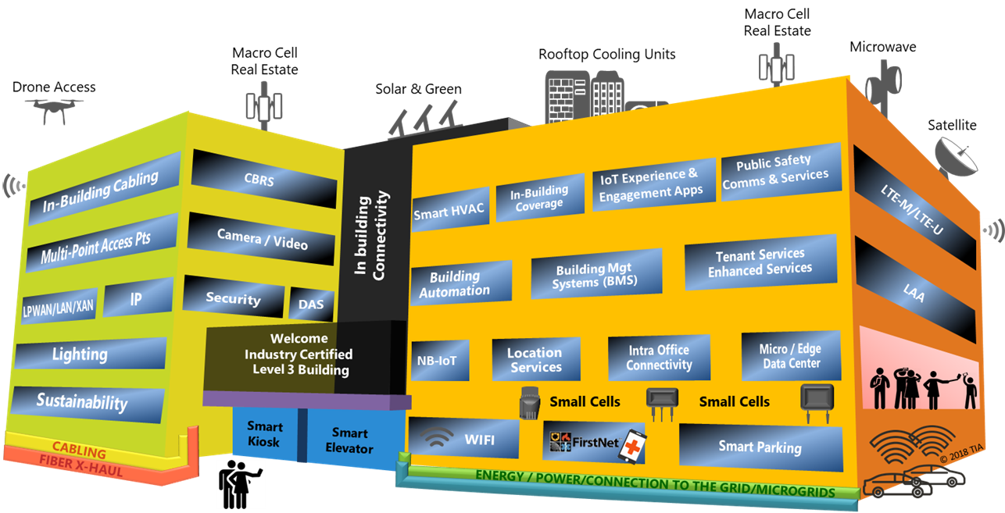
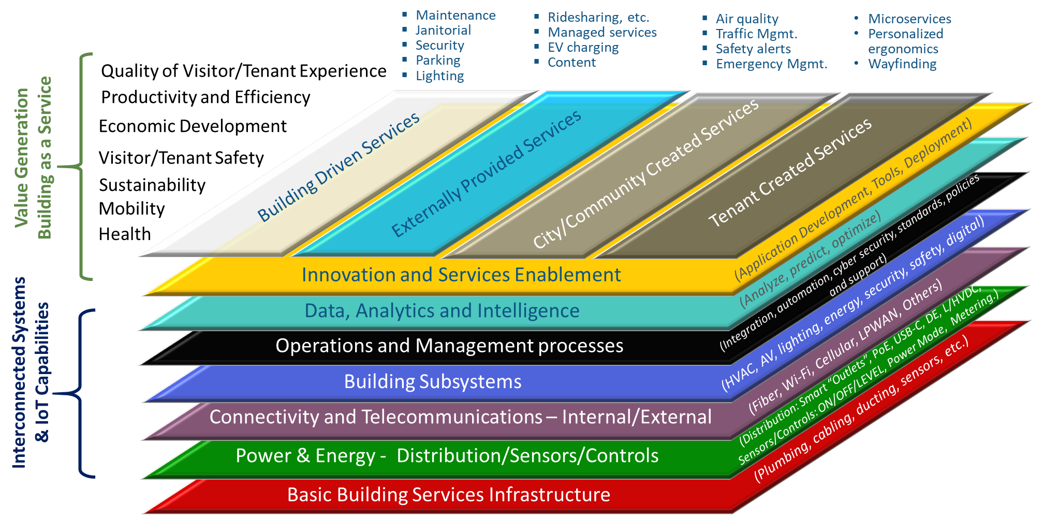
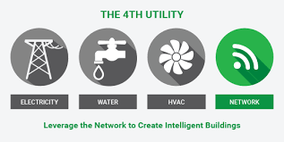
Vision – Smart Buildings
Assessment
Buildings As A Connected Asset
New Marketplace
Networking Connectivity
Certification
Registration
Buildings As A Service
SB market will grow to $33B in 2023
Source: https://www.marketresearchfuture.com/reports/smart-building-market-1860

Slide 12
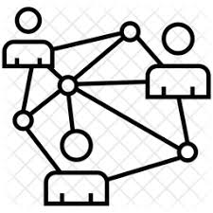
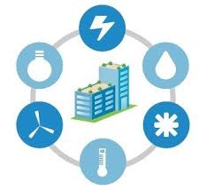
Some Use Examples
Energy Management
Utilities, Water, Gas, Electric, HVAC
Water/ fluid levels / Leaks
Communications Network
Connectivity Network
Environmental Control
Air Quality
IoT sensors
Smart Metering
Occupancy Detection
Interoperable Systems / Management
Building Automation Systems
Information Management (Data)
Building Management Systems
Asset Tracking/ Management
Access
Security / Safety
PropTech
Tenant Facing Services
Applications Platform
Patient Information
Equipment Monitoring
Logistics and Distribution
Robotics
Industrial
Retail
Daylight Harvesting
M2M, AI, VR Networks

Slide 13
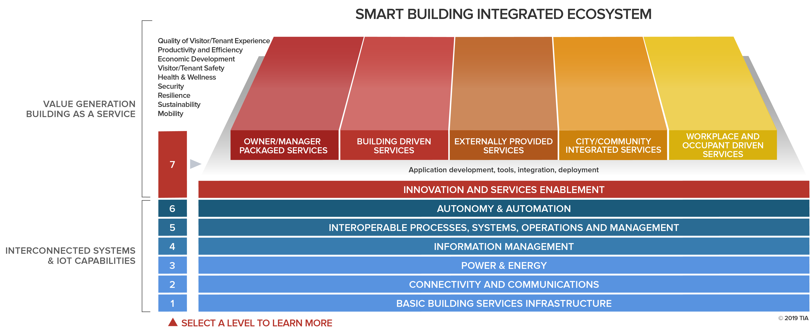
A System of Systems
Notes:
HI Tom, Tom Yes
Red Ball
What you’re looking forward to for the day/why you’re here – Yes!

Slide 14
Value Proposition
Financial Proposition:
Reduce Total Cost of Ownership
Efficiencies
Monetize Connectivity
Competitive Advantage
Net Operating Income (NOI)
Tenant Proposition:
Workforce Enhancements
Safety, Comfort, Satisfaction
Mobility & Flexibility
Quality of Experience (QoE)
Innovative Solutions
Owner Proposition:
Optimized Operations
Bus Intelligence, Data, Analytics
Environmental
Resilience / Sustainability
Social Responsibility

Slide 15
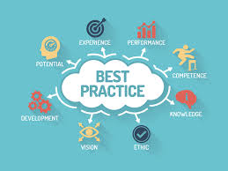
What is TIA Doing?
1
Thought Leadership
Marketplace Portal
Building Ecosystem
Best Practices/Stds.
Services & Products
B-A-T-I-C-R
Educate & Train
Branding & Revenues
B-A-T-I-C-R = Benchmarking, Assessments, Testing, Inspection, Certification, Registration

Slide 16
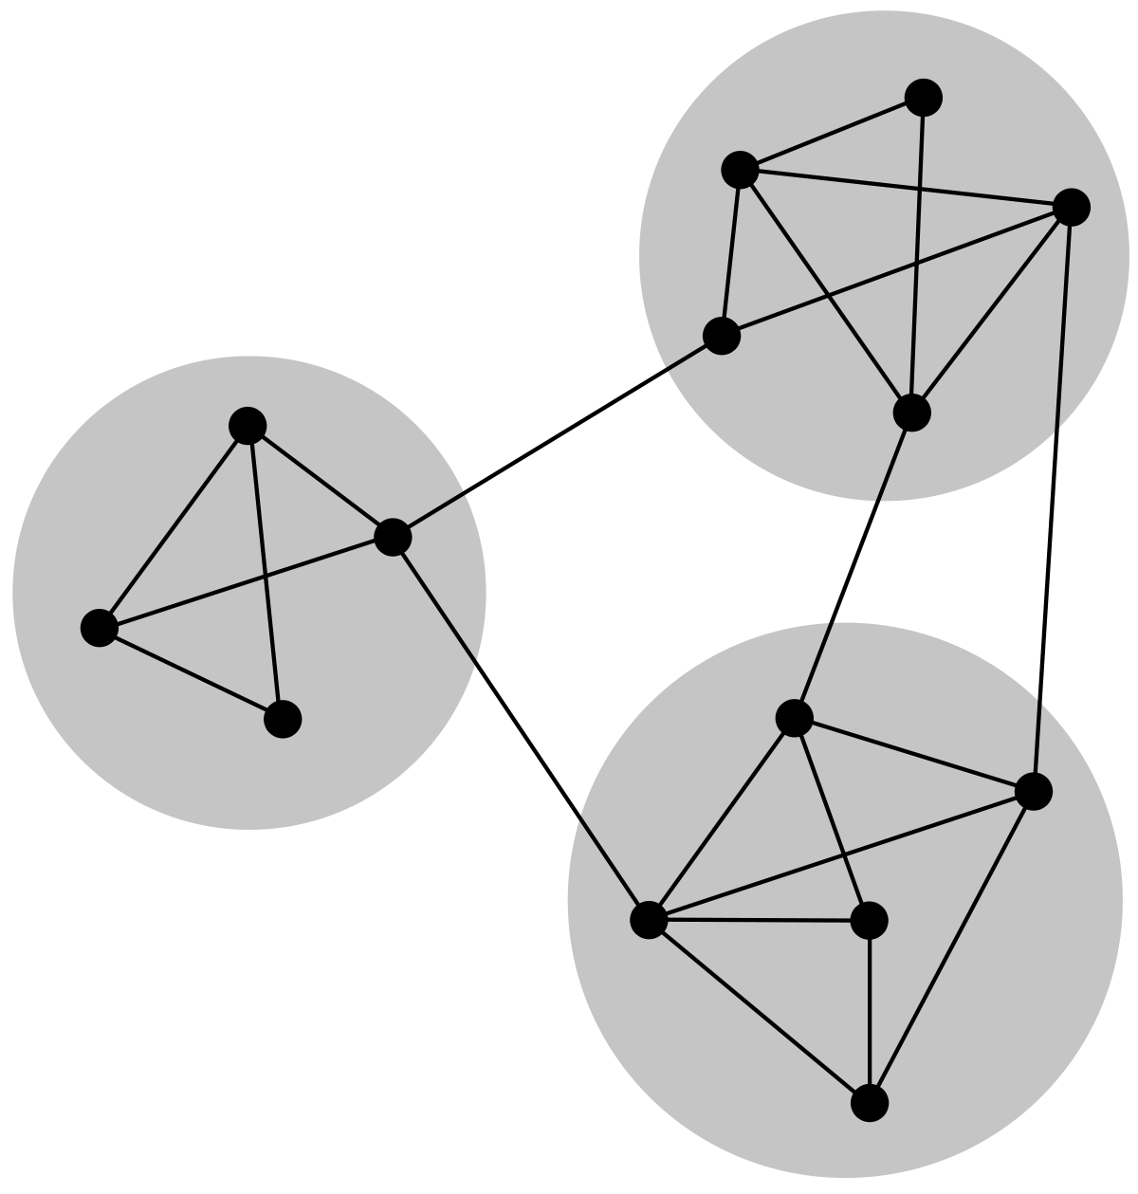
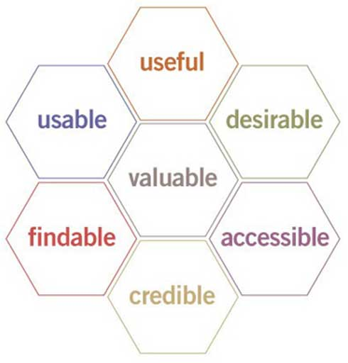
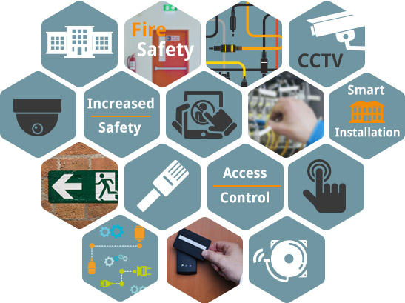
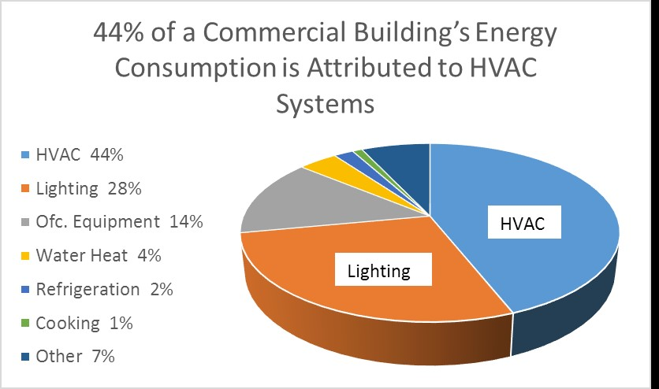
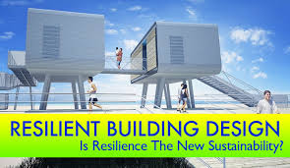
Smart Building Assessment
Connectivity
Interoperability
Functionality Experience
Intelligence And Data
Safety
Security Cyber & Physical
Power & Energy
Resilience

Slide 17
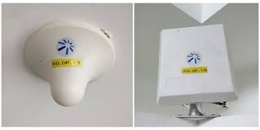
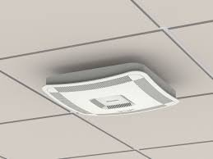
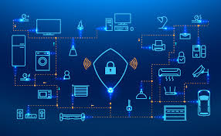
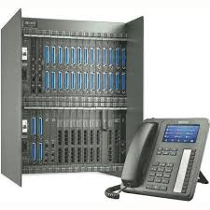
Connectivity Resiliency
Redundancy (Equipment, Access Network, Power)
Routing / cabling path diversity
Active performance monitoring
Predictive maintenance
Autonomous redundancy switchover
Redundant power sources
Back-up power (generator, battery, etc.)
IoT and BMS connectivity
Virtualization
Distributed Antenna Systems
Small Cells
IoT Network(s)
In-Building Wireless
PBX
active electronics in the system must be housed in a National Electrical Manufacturers Association (NEMA)-4 enclosure for protection from water
Cellular

Slide 18
TIA Smart Building Program
TIA’s Smart Buildings Program is all about connectivity, interoperability, communications and capacity.
A cross-industry working group is developing use cases, value propositions, information portals, best practices, assessments and an overall ecosystem for smart buildings.
Interested parties should contact either:
Harry Smeenk
Senior Vice President Technology Programs hsmeenk@tiaonline.org 1.972.832.2992
Limor Schafman
Sr. Director Smart Buildings Evolution LSchafman@tiaonline.org 1.703.907.7582

