Slide 1
Next Generation Network Assurance – Use cases and applications
Jacques Fluet
September 5, 2019

Slide 2
Technology Evolution
Low cost sensors
Off-the-shelf high computing power
Ubiquitous connectivity
Cloud-native applications
AI/ML
Big Data
Distributed computing
Smart everything

Slide 3
World Evolution - Digital Transformation
Access to services
Quality of life
Assets efficiency
People safety
Scarce resources protection
Personalization
Simplification
Notes:
Improved process efficiency
Smart factory
Cobot
Predictive/preventive maintenance
Smart logistics
Asset tracking
Cold chain monitoring
Smart City
Mobility management
E-government
Improved quality of life
Telemedicine
ADAS -> AV
Security
Public Safety
Home/office automation
AR/MR
Smart city
Air quality
Mobility mgmt
Efficient use of resources
Precision agriculture
Smart irrigation
Water distribution monitoring
Energy consumption management

Slide 4
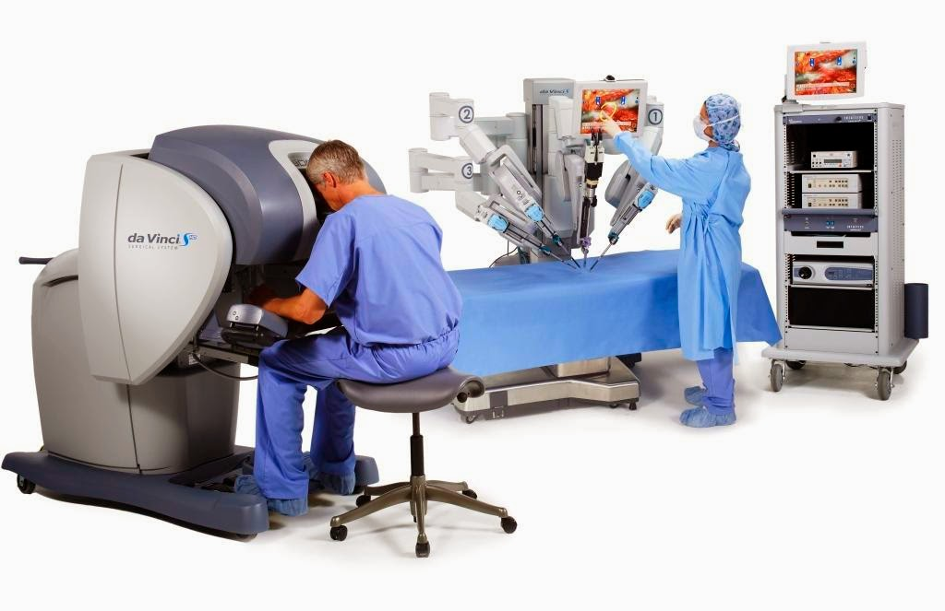
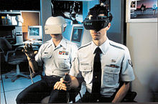
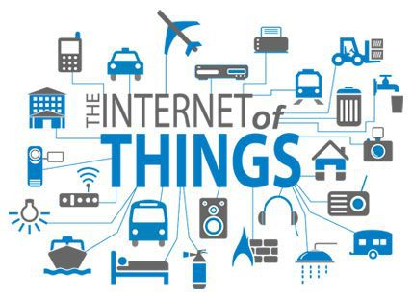
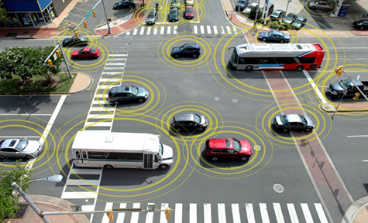
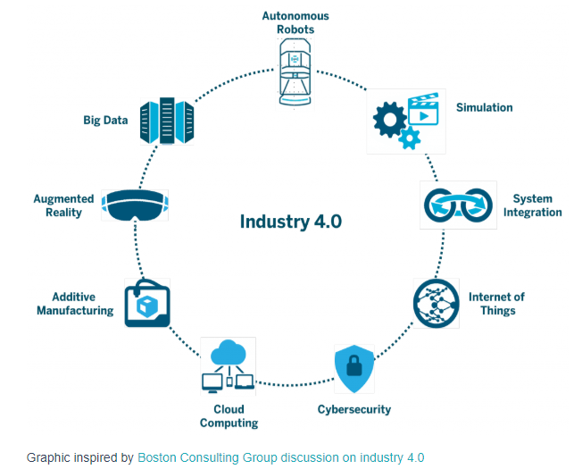
New Use Cases
United States Department of Transportation
This Photo by Unknown Author is licensed under CC BY-SA

Slide 5
Use Cases Performance Examples
Dense Urban Mobile Broadband (MBB)
Robotic Motion Control
Intelligent Transport Systems
User DL data rate: 300 Mbps
DL Traffic density: 750 Gbps/km²
User density: 25,000/km²
Mobility: 0-60 km/h
E2E latency: 1 ms
Jitter: 1 µs
Availability: 99.9999%
Traffic density: 1 Tbps/km²
Connection density: 100,000/km²
E2E latency: 10 ms
Jitter: 20 ms
Availability: 99.9999%
Traffic density: 10 Gbps/km²
Connection density: 1,000/km²
Electricity Distribution – High Voltage
Massive Machine-Type-Communication (MTC)
Augmented and Virtual Reality
E2E latency: 5 ms
Jitter: 1 ms
Availability: 99.9999%
Traffic density: 100 Gbps/km²
Connection density: 1,000/km²
E2E latency: Seconds to hours
Data rate: 1-100 kbps
User density: 200,000/km²
Mobility: 0-500 km/h
Immersive video: 6 DoF
User DL data rate: 1 Gbps
E2E latency: 7 -15 ms
Motion-to-Photon: 15 ms
Vestibulo-Ocular Reflex: 7 ms
Ref: 3GPP TS 22.261 V16.6.0 (2018-12)
Enabling Mobile Augmented and Virtual Reality with 5G Networks (Jan 2017)
Notes:
The vestibulo-ocular reflex (VOR) is a reflex, where activation of the vestibular system causes eye movement. This reflex functions to stabilize images on the retinas (in yoked vision[clarification needed]) during head movement by producing eye movements in the direction opposite to head movement, thus preserving the image on the center of the visual field(s).[citation needed] For example, when the head moves to the right, the eyes move to the left, and vice versa. Since slight head movement is present all the time, VOR is necessary for stabilizing vision

Slide 6
Network Evolution
Hardware-centric
Physical Network Functions
Vendor-specific Interfaces
Central Offices
Manual Configuration
Hierarchical Network
Vendor-specific Hardware
Physical Network
Telecom-driven Services
Software-centric
Virtual Network Functions
Open Standard APIs
Data Centers
Self-Organizing Networks
Distributed Cloud
White Boxes
Logical Network Slicing
Industry/User-driven Applications

Slide 7
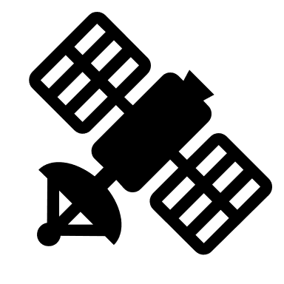
Next Generation Network
AI

Slide 8
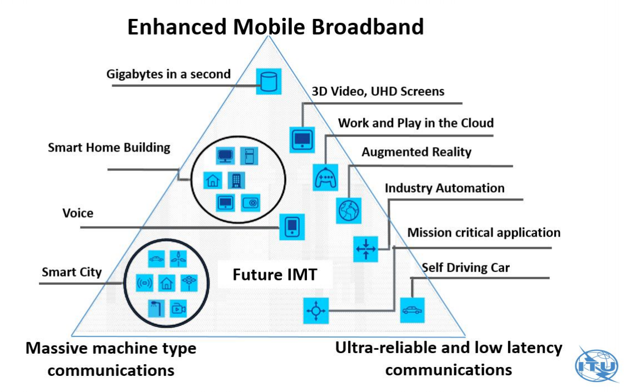
Next Generation Service Assurance
Application-centric network: Predictable and reliable application connectivity performance
Next generation service assurance is key to deliver the 5G and Connected Intelligence promises
➔ Trust building
Real-time monitoring
Configuration
Performance
Predictive and prescriptive analytics
Service Performance Reliability: Minimum guaranteed service performance level when and where an application is used

Slide 9
TIA Service Performance Reliability Program
Industry-driven program to define how to measure and report the Service Performance Reliability
Participants include Network Operators, Equipment Vendors, and Service Assurance Solutions Providers
To participate, please contact:
Jacques Fluet, jfluet@tiaonline.org

Slide 10
Thank you!

