Slide 1


Platforms for Advanced Wireless Research
One Year On: Progress, Lessons, New Investments
Jacques Fluet on behalf of Abhimanyu Gosain
Technical Program Director
https://www.advancedwireless.org/

Slide 2
Platforms for Advanced Wireless Research
1
1
2
Kick-Off April 2017
Industry Consortium
<$ + In-Kind>
$50M
NSF
<$>
$50M

Slide 3
Level-Setting: PAWR Approach
Attribute |  | Approach
Problem Definition |  | Enhanced efforts of ~400 university researchers who need mid-scale testing capabilities to ensure success
Early Industry Involvement |  | Multi-use research platforms with “pre-competitive” research topic areas selected bottom-up by university PIs, with industry input
Research Scope |  | Mid-sized areas within cities, experimental platforms, 10-20 antenna sites, backhaul, SDRs
Flexibility and Speed |  | 1 - 2 platforms per year in years 1 and 2
Streamlined governance, deployment, and operation |  | One governance consortium focused on upfront research and policy; city/university teams propose how to streamline deployment and ops

Slide 4




















Charter Members
PPO is Looking for more Industry Partners….

Slide 5

PAWR Awardees
Announced April 9 2018
http://powderwireless.net http://cosmos-lab.org

Slide 6




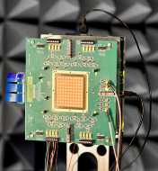
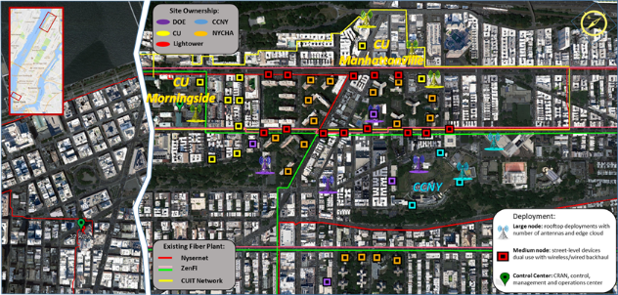
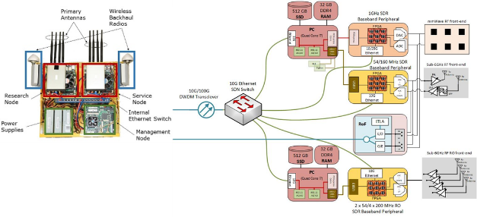
COSMOS: Cloud Enhanced Open Software Defined Mobile Wireless Testbed for City-Scale Deployment
A multi-layered computing system with an RF thin client; flexible signal processing; network function virtualization (NFV) between a local SDR (with FPGA assist) and a remote cloud radio access network (CRAN) with massive CPU/GPU and FPGA assist
Deployed in New York City, one of the country’s most populated urban centers
Wideband radio signal processing (with bandwidths of ~500 MHz or more)
Support for mmWave communication (28 and 60 GHz)
Optical switching technology (~1µs) provides passive WDM switch fabrics and
radio over fiber interfaces for ultra-low latency connections
28GHz phased-array ICs and phased-array antenna modules (PAAM)
Deployment Area: West Manhattan/Harlem
COSMOS Radio Site Design All-Optical Network Design

Slide 7
COSMOS mmWave Node Specifications
• 64-dual polarized antennas and 4 ICs
each with 32 TRX elements
• 128 TRX elements in total
• 8 independent 16-element beamformers,
each supporting 1 polarization of 16 ant.
• RF true time delay based architecture
• 28GHz RF, 5GHz ext. LO, 3GHz input/output IF
• 54dBm saturated EIRP on each polarization

Slide 8



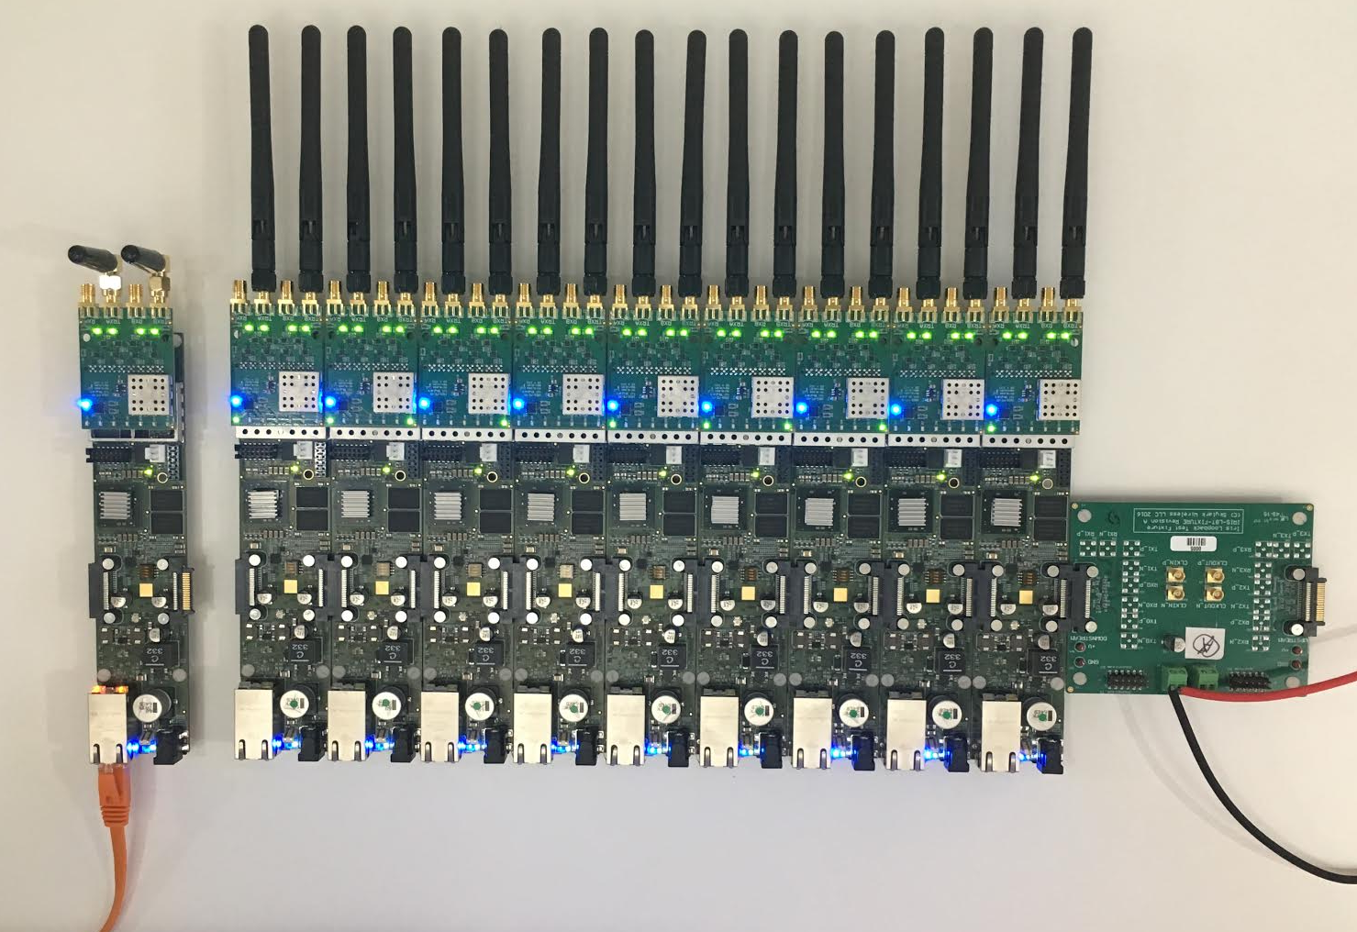
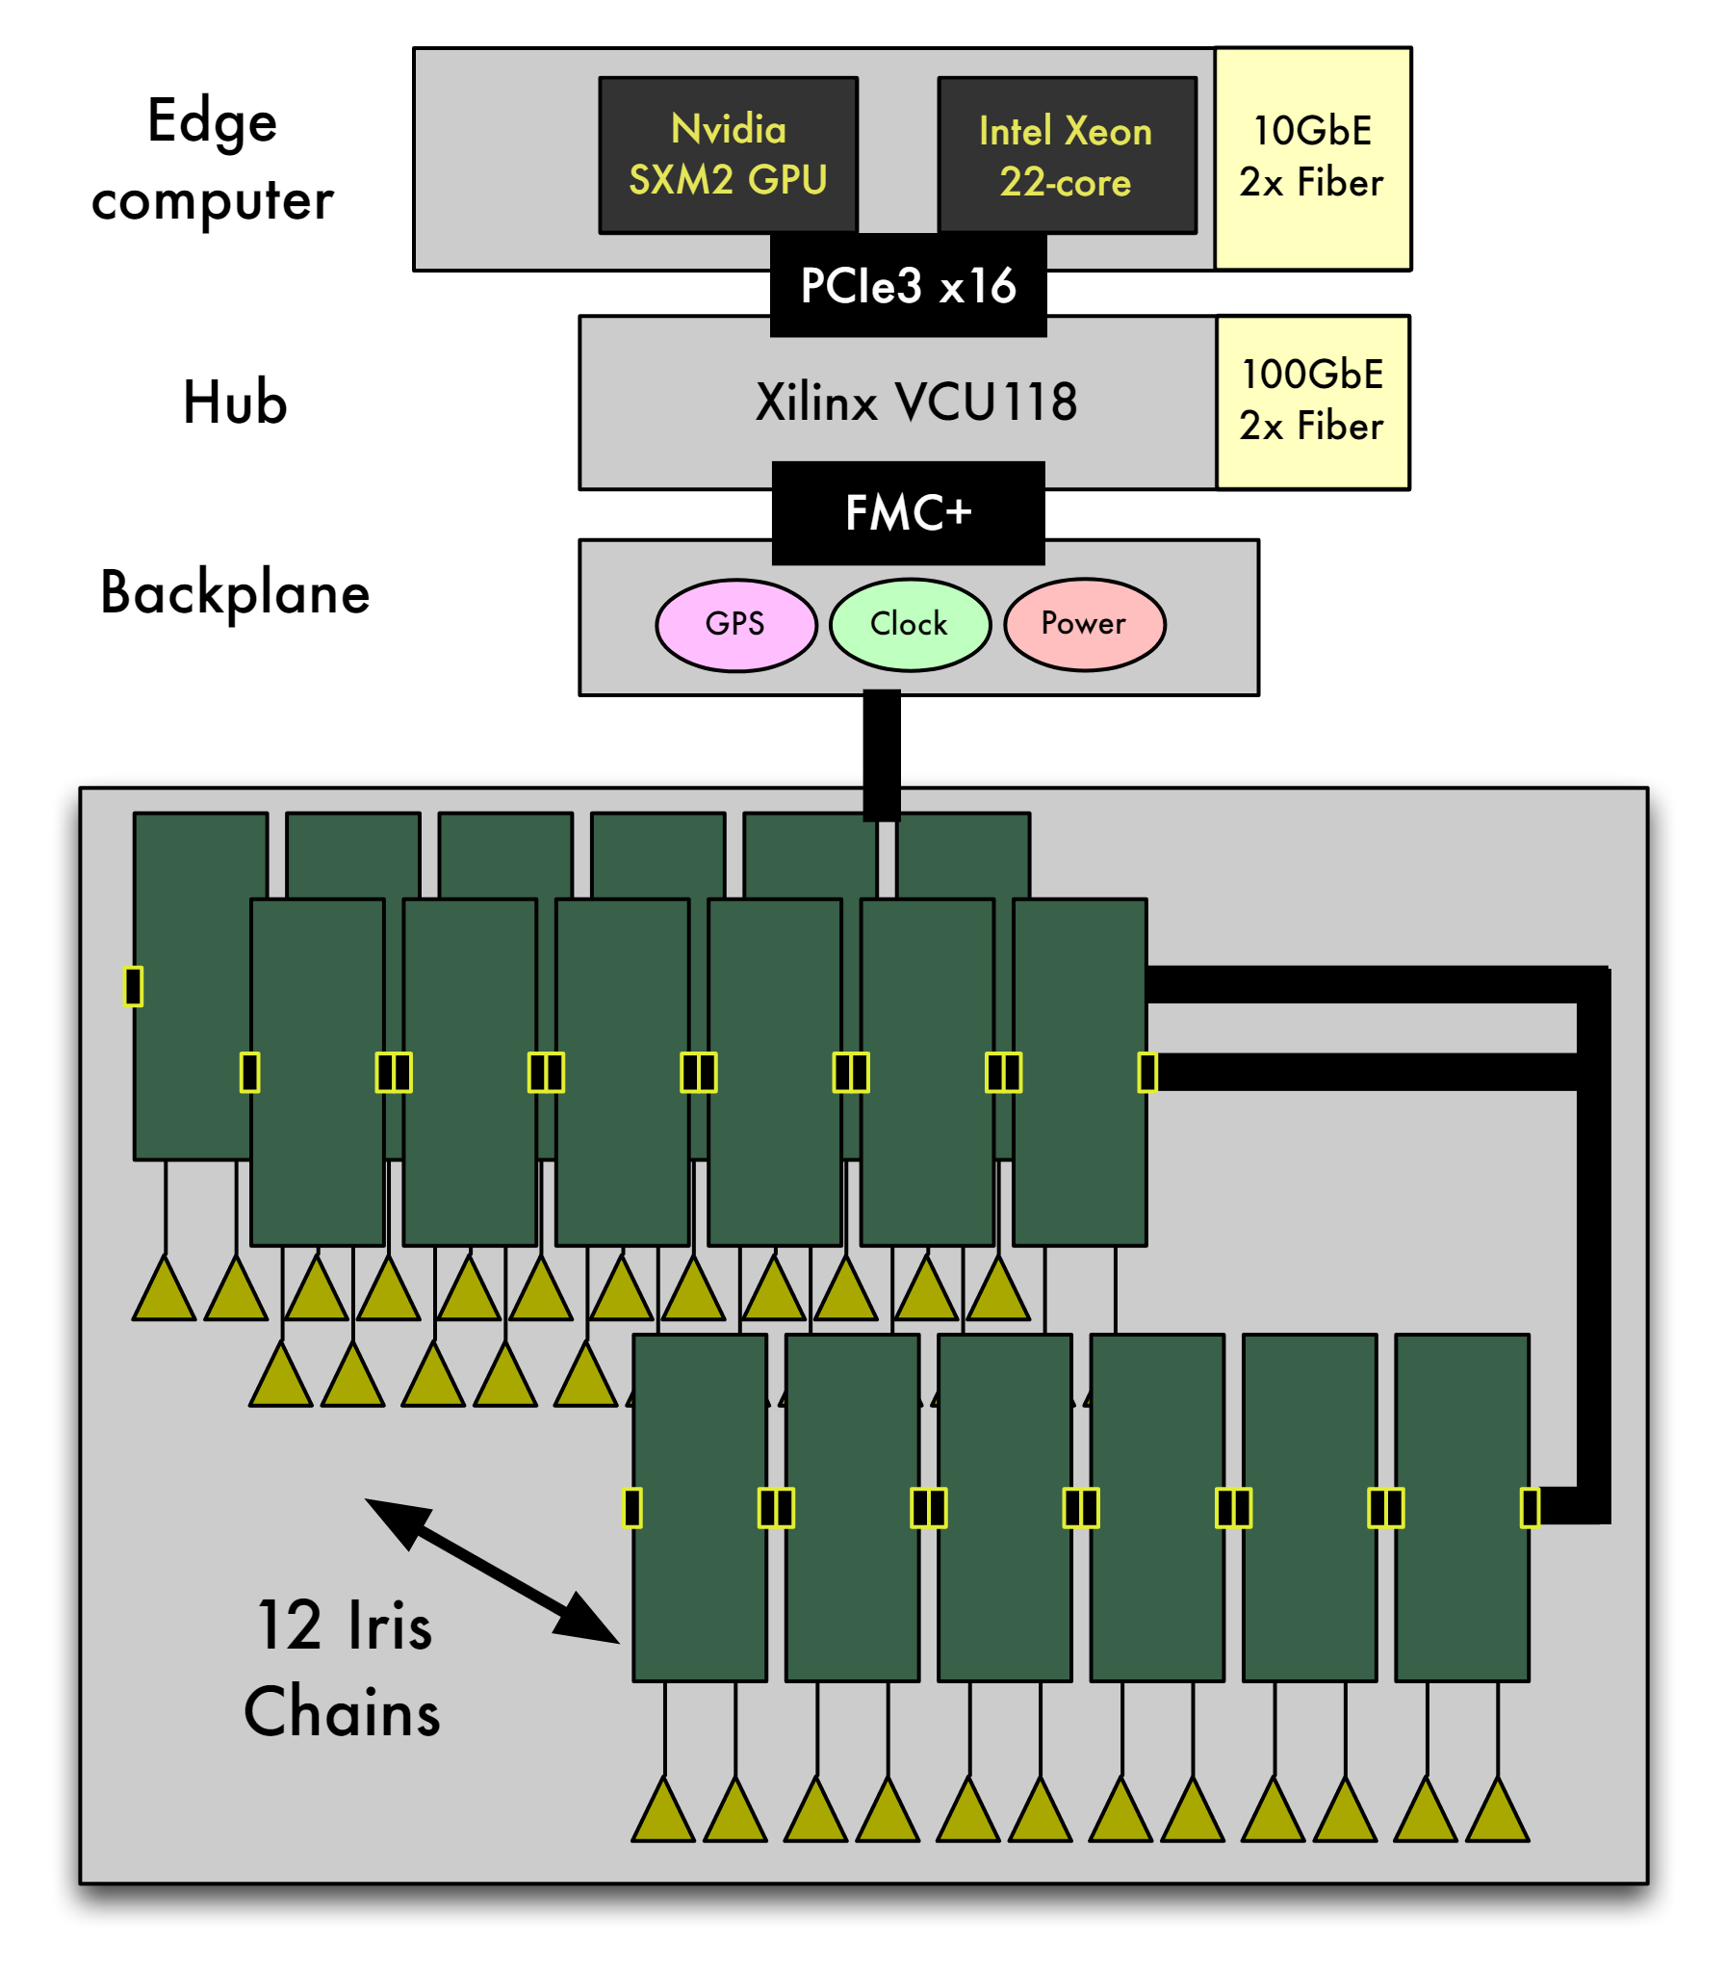
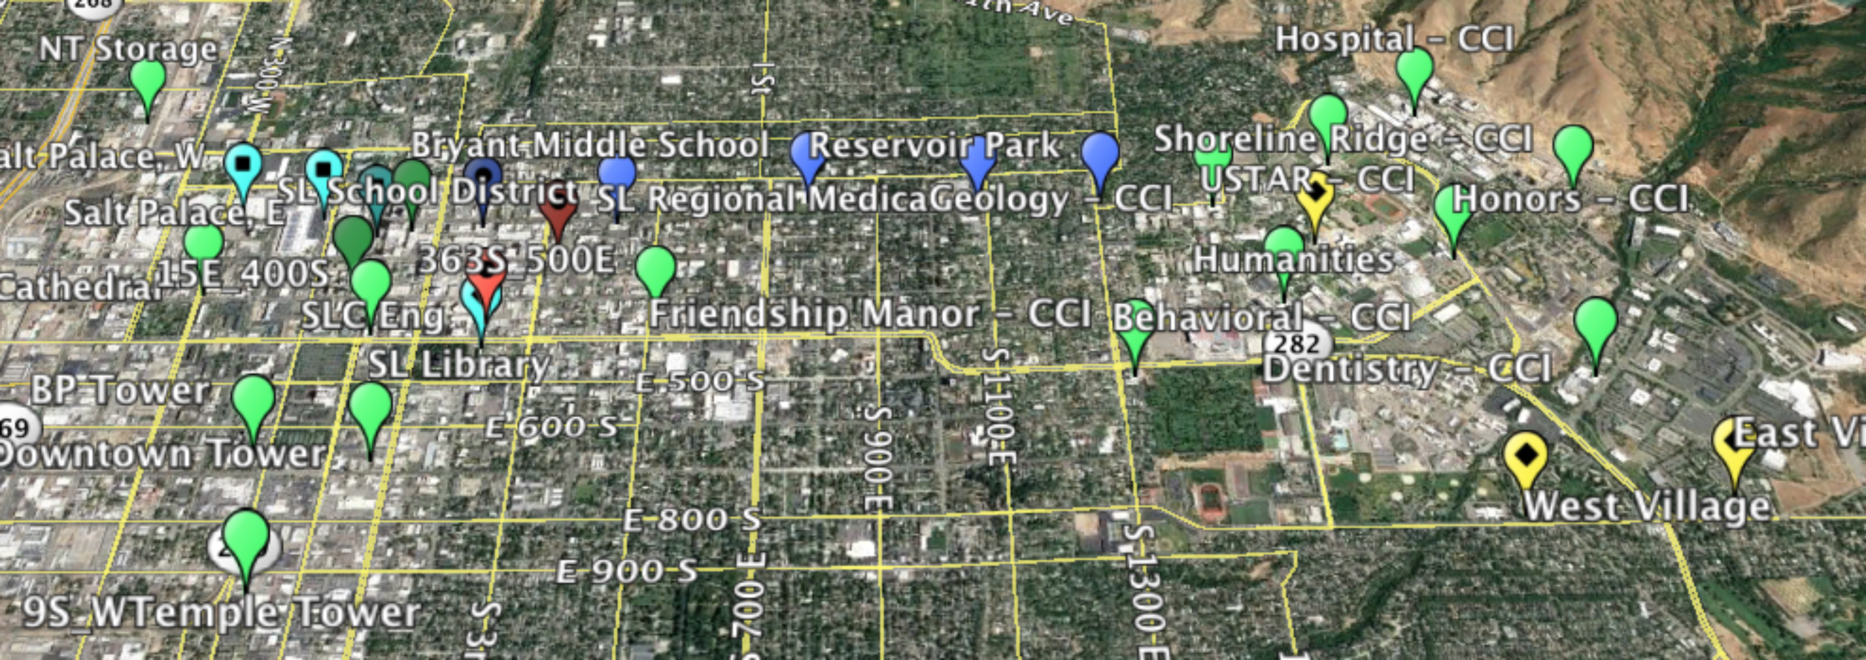
POWDER: Platform for Open Wireless Data-driven Experimental Research
RENEW: A Reconfigurable Eco-system for Next-generation End-to-end Wireless
Next Generation Wireless Architecture
Dynamic Spectrum Sharing
Distinct environments: a dense urban downtown and a hilly campus environment.
RENEW Massive MIMO base station
End-to-End Programmable
Diverse Spectrum Access 50 MHz-3.8GHz
Hybrid Edge computer composed of FPGA and GPU/CPU-based processing,
Hub Board aggregates/distributes streams of radio samples
Deployment Area: UofU Campus +Downtown SLC + Connected Corridor
IRIS software-defined radio modules
Control Framework with Hardware + Software Building Blocks
Architectural view of RENEW base station

Slide 9

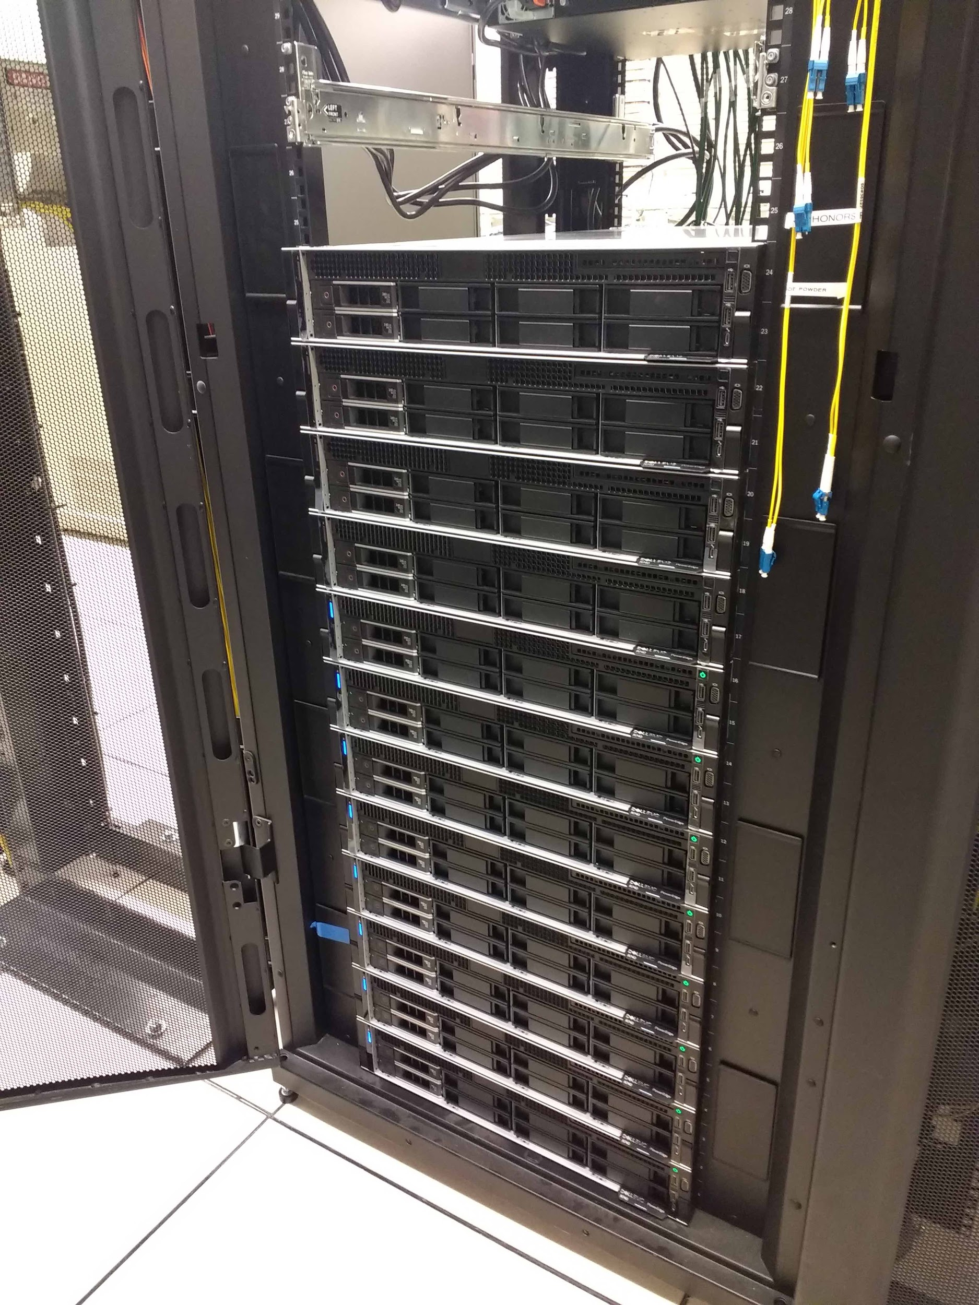






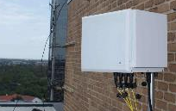



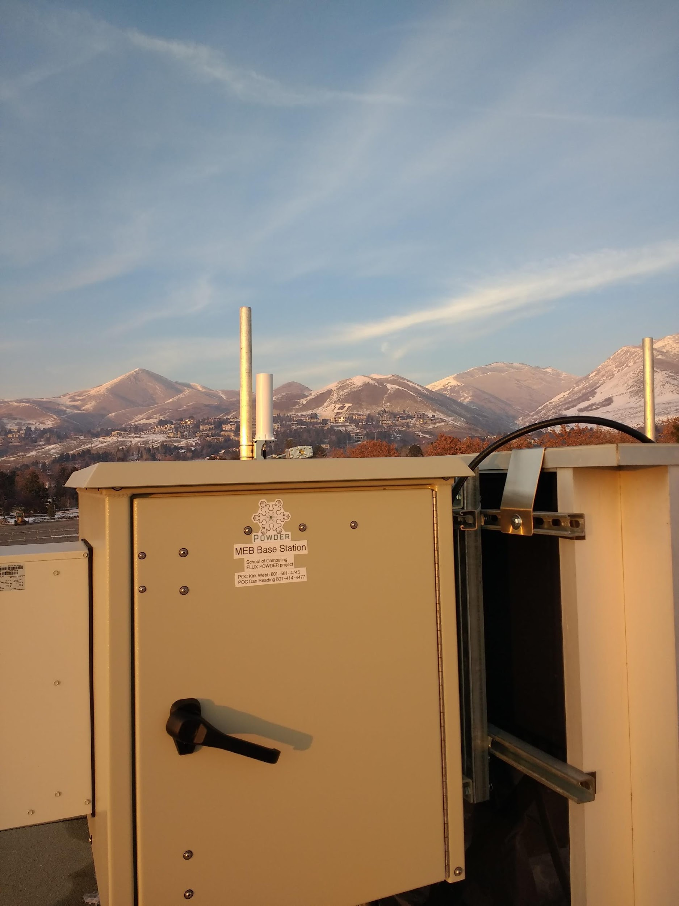





System Architecture
Core
Metro Cloud
Wide Area
Remote Cloud
Fiber Fronthaul/Backhaul
Edge Compute
Edge
Controlled RF
Stationary Radios
Radio
Access
Predictable Couriers
Unpredictable
Backpacks
Sensors

Slide 10
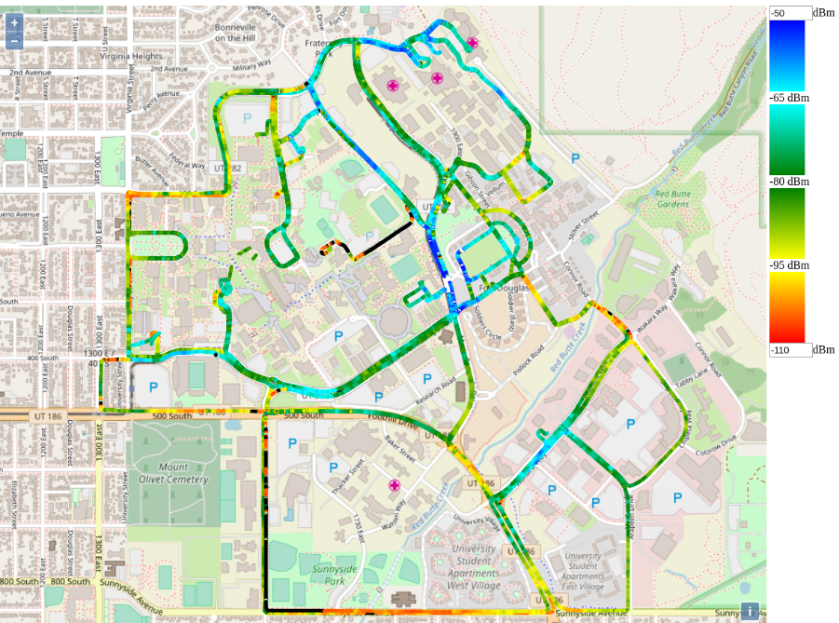
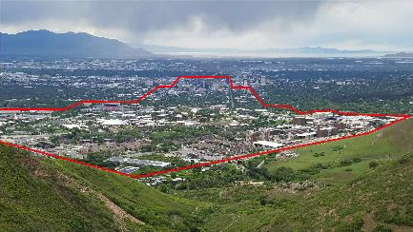
Truly City scale…
Base station locations
Campus Shuttle Routes

Slide 11
Status as of July‘19
http://powderwireless.net
Software Profiles:
  GNU Radio
  OAI TDD
  ONAP
  MATLAB
  O-RAN
  RENEW mMIMO software
Usage statistics:
  Number of projects: 25
  Number of users: 102
  Number of experiments: 1090

Slide 12



ACKNOWLEDGEMENTS
http://powderwireless.net
http://renew.rice.edu
POWDER-RENEW
http://cosmos-lab.org
COSMOS
http://advancedwireless.org
PAWR Project

