Slide 1
US-INDIA SSCP 5G Roadmap & Standards Activities
David K. Bain,TIA VP, Standards

Slide 2
Defining the 5g Ecosystem
5G > 5G Cellular
5G ECOSYSTEM = 5G cellular + the infrastructure (antenna supporting structures, datacenters, cabling), complementary standards & technologies enabling 5G services.
Notes:
5G is and the 5G ecosystem is…
80% of mobile traffic runs over Wi-Fi, and this will only increase with the advent of 5G. Much of this traffic will result from increased offloading from cellular networks onto Wi-Fi. By 2022, Cisco estimates that total data offload to Wi-Fi will increase from 74% to 79%. EPA:93% indoors (87% in buildings and 6% in cars).

Slide 3
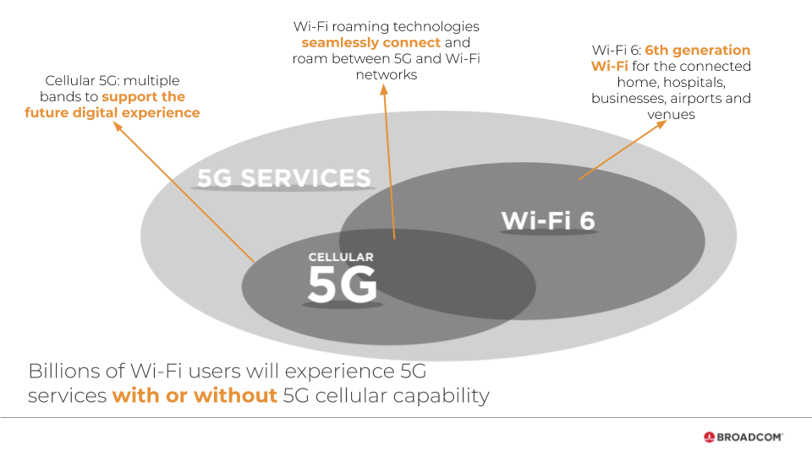
Defining the 5g Ecosystem
5G > 5G Cellular
IoT/M2M
LEO
WiFi-6 802.11ax
Datacenters / Cabling
Towers & Drones
Buildings / Facilities
Best practices
(efficiency; safety)
Notes:
5G is and the 5G ecosystem is…
80% of mobile traffic runs over Wi-Fi, and this will only increase with the advent of 5G. Much of this traffic will result from increased offloading from cellular networks onto Wi-Fi. By 2022, Cisco estimates that total data offload to Wi-Fi will increase from 74% to 79%. EPA:93% indoors (87% in buildings and 6% in cars).

Slide 4
IoT / m2m
CISCO: M2M connections will be more than half of the global connected devices and connections by 2022. The share of M2M connections will grow from 34 percent in 2017 to 51 percent by 2022. There will be 14.6 billion M2M connections by 2022.
OneM2M is a non-chartered, existing as a partnership of its founders, including TIA and TSDSI
Designed to leverage and complement 3GPP 5G architecture
Hypothetically vulnerable to Quantum attack due to reliance on TLS security protocols

Slide 5
The LEO Complement to 5G
LEO Constellations
Iridium Next
Boeing
SpaceX Starlink
OneWeb
BlueOrigin
LEOSat
Samsung

Slide 6
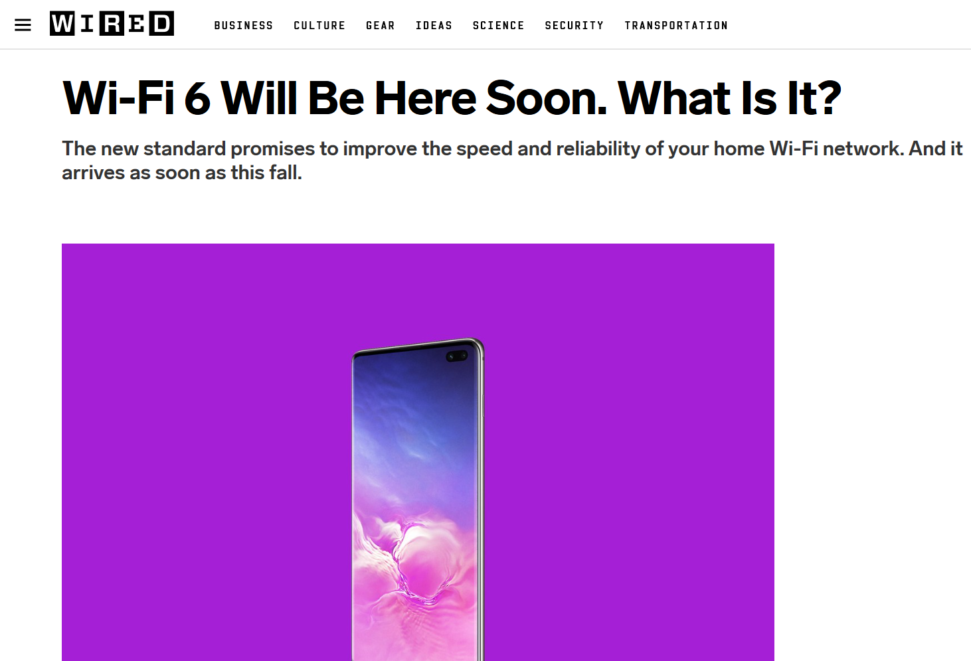
Wifi-6
Computational Intelligence
OFDMA + Mu MIMO
Spectrum Optimized: 2.4 & 5 GHz (6GHz? 5G Handoff?)
Notes:
EPA Estimates + Cisco Estimates on the Amount and Percentage share steadily climbing.

Slide 7
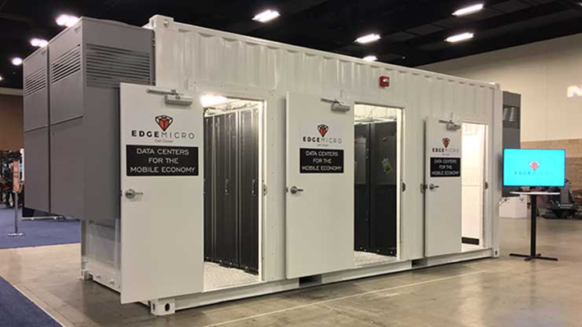
Datacenters ANSI / TIA 942
ULLUHB requires reducing distance between users and computing capacity
Global certification regime via partners
Edge Data Centers (EDCs) Working Group
EDCs: Four classes in current taxonomy:
Radio Site
Access Site
Aggregation Site
Core Site

Slide 8
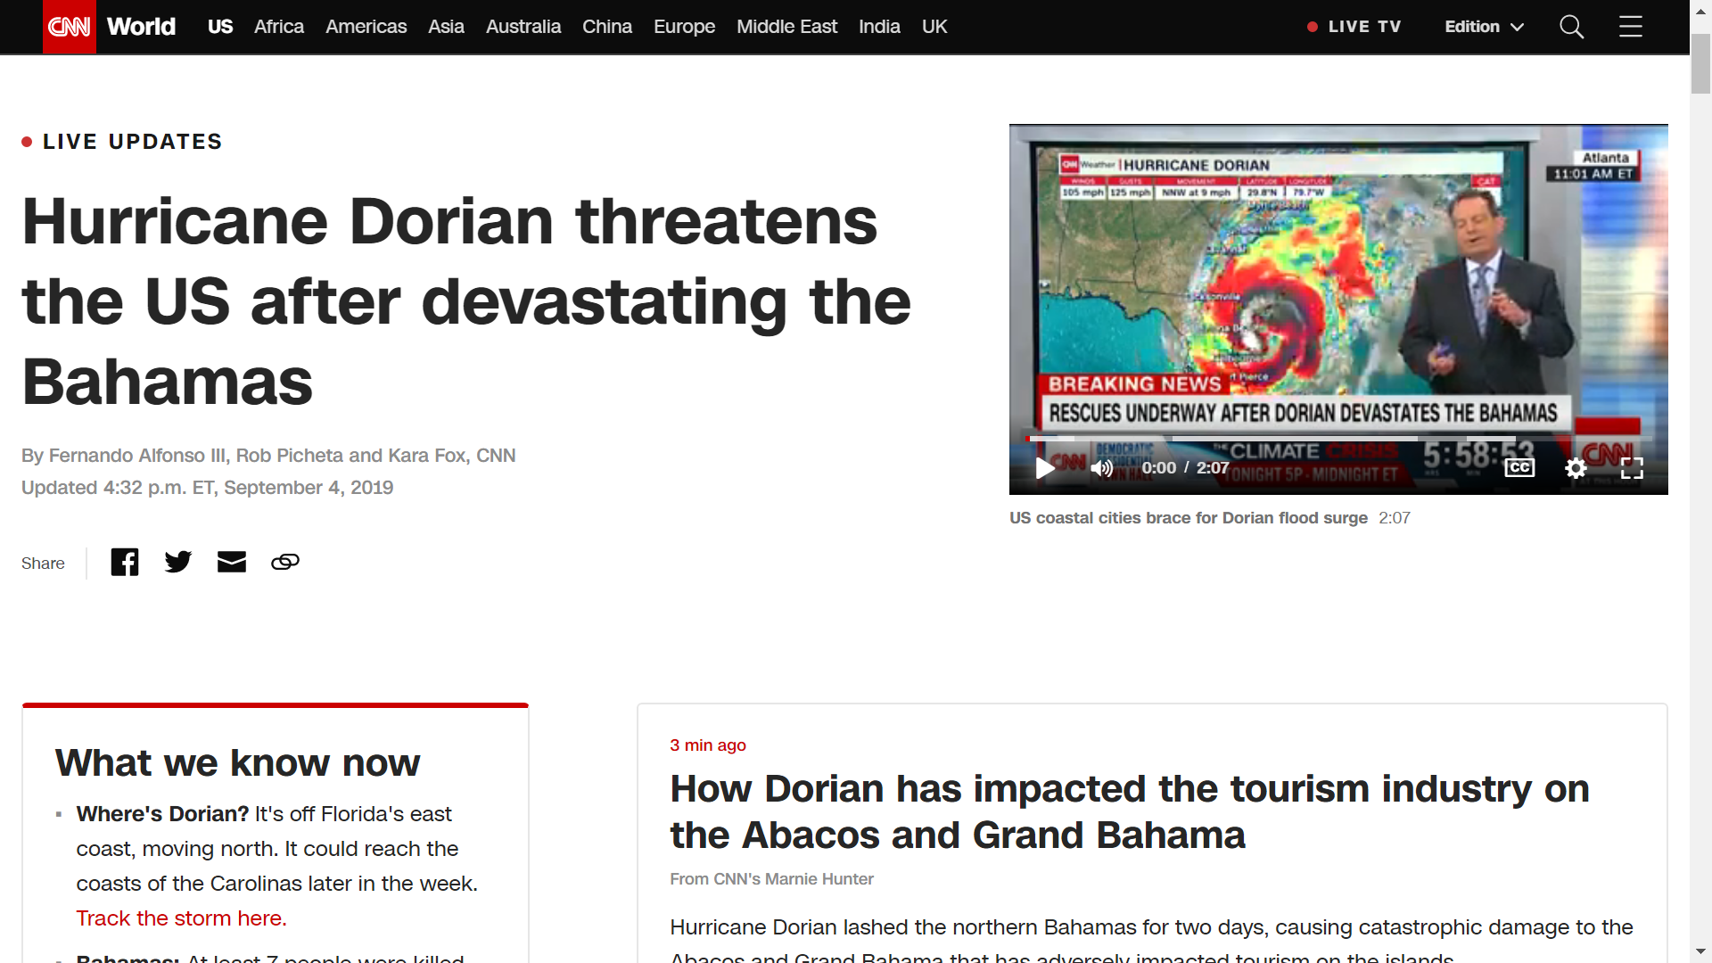
CRITICAL IMPORANCE OF Towers & ANSI / TIA 222H

Slide 9
Towers: ANSI / TIA 222H
Standard for antenna supporting structures (and wind turbines) in > 100 countries
Critical to 5G because of densification of network requiring more antennas on more towers (and structures)
Ad Hoc TG23 UAS (drone) technical group preparing addenda for consideration in 2020
QR code standardization project

Slide 10
Towers: ANSI / TIA 222H: Drones

Slide 11
Towers: ANSI / TIA 222H: DRONES!
Bring down the cost of 5G
Reduce time to market
Reduce cost of servicing and inspection (mount analysis, mount map, structural analysis, TIA Inspection)
Reduce insurance
M&A enabler
WITH ONE DRONE FLIGHT (~75%):
3 image types: Points in a mesh cloud; 3D CAD; 2D
Automated structural analysis
TIA 222 inspections
Field operations and maintenance
Financial modeling; insurance costs; change detection
Beget detailed object management

Slide 12
Buildings / facilities & Enterprises
Datacenters represent roughly 20% of ICT infrastructure (the remaining 80% is in facilities)
ICT Lifecycle Management problem
Catastrophic ICT failures
Missed SLAs
Deeper issues than DR/BC
Caused by
Myopic C-suite / IT project practices
Acute since 2008 financial crisis
TR-60 ICT Lifecycle Management
Provides longterm management framework
Overarching multiple standards and disciplines
Enabler of physical and cybersecurity
Led by IT thought leaders from vertical industries: banking, broadcasting, healthcare, hospitality

Slide 13
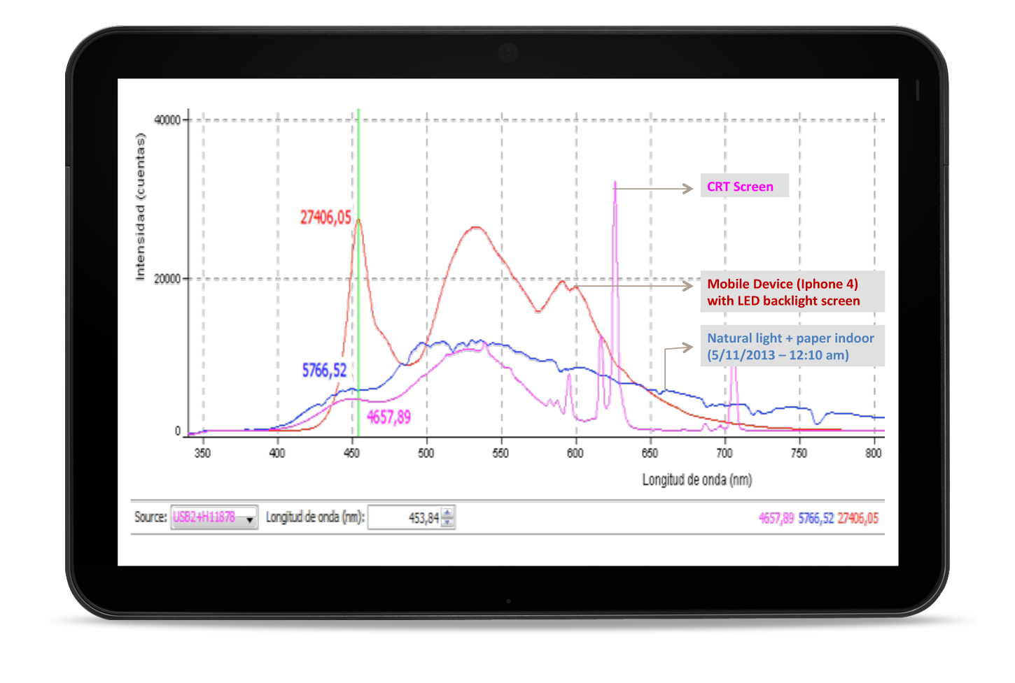
Essential for 5g: 4g best practices
Gradual process of a society coming to terms with new technology= Culture Lag
Expansive risk taxonomy of smartphones: Addiction, kinetic, privacy, security, health threats from multiple vectors: occipital protuberances, RF, and …
LED (ocular, cognitive / behavioral, immunological)
4G and smartphones: LED risk and standards of IEC TC76?

Slide 14
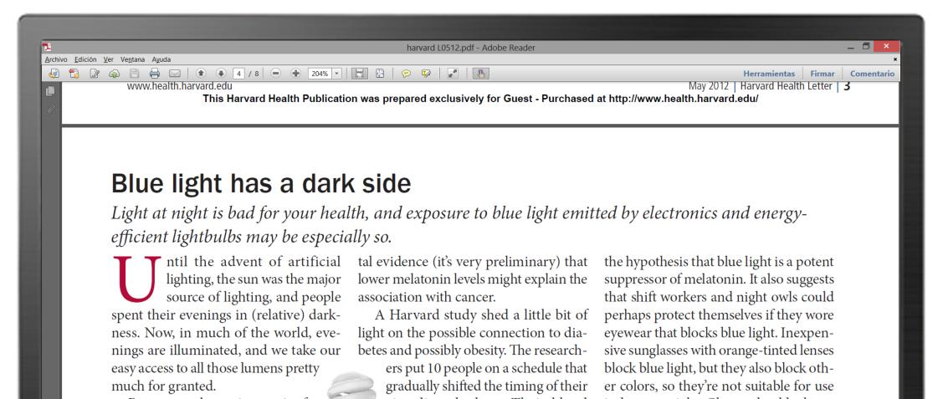
Depletion of Melatonin - N-acetyl-5-methoxytryptamine White light and any kind of light can suppress the secretion of melatonin, and Blue light does so more powerfully. Blue light suppresses melatonin for about twice as long as the green light; it also shifts the circadian rhythms by twice as much. Research shows that light at night may contribute to certain cancers, diabetes, heart disease, and obesity. (Harvard Medical
LED Best Practices:
Duration
Distance
Intensity
Time of Day
Ambient light
Use risk mitigating tech …and 5 G promises to be more immersive, engaging, essential, transformative

Slide 15
Essential for 5g: 4g best practices
Is indifference to tech ethics on the decline?
Culture lag catching up
GSC-22 ethical developments
GDPR
Gorbachev Foundation
IEEE efforts around AI

Slide 16
Implications for us-india partnership
Is India uniquely positioned to thrive in a climate in which integrity, ethical practices are ascendant? (Given it cultural roots valuing human rights, environment, health)
Are India and its partners in a position envision and invent the global knowledge economy of the future in which ICT are not used to manipulate, enslave, and subjugate but empower people, protect human dignity, freedom, personal and planetary health?

Slide 17
YES!
Helping to assure the safety and health of consumers and the protection of the environment are core to ANSI (and IEC).

Slide 18
Thank you for your partnership
@davidkbain
dbain@tiaonline.org

