Slide 1
5G India Strategy
Department of Telecommunications
Ministry of Electronics & IT
Department of Science & Technology
5th September 2019

Slide 2
Flow of the Presentation
NDCP, 5G HLF Committee
Priorities of 5G India
5G Taskforce (TF) Recommendations
5G Program Office and Committees to develop Action Plan
Status of Key areas for action on TF Recommendations
Way forward

Slide 3
National Digital Communications Policy 2018
Connect India
Propel India
Provisioning of Broadband for All
Creating 4 Million additional jobs in the Digital Communications sector
Enhancing the contribution of the Digital Communications sector to 8% of India’s GDP from ~ 6% in 2017
Propelling India to the Top 50 Nations in the ICT Development Index of ITU from 134 in 2017
Enhancing India’s contribution to Global Value Chains
Ensuring Digital Sovereignty
Provide Universal broadband connectivity at 50Mbps to every citizen
Provide 1 Gbps connectivity to all Gram Panchayats of India by 2020 and 10 Gbps by 2022
Enable100 Mbps broadband on demand to all key development institutions; including all educational institutions
Enable fixed line broadband access to 50% of households
Achieve ‘unique mobile subscriber density’ of 55 by 2020 and 65 by 2022
Enable deployment of public Wi-Fi Hotspots; to reach 5 million by 2020 and 10 million by 2022
Ensure connectivity to all uncovered areas
Attract investments of USD 100 Billion in the Digital Communications Sector
Increase India’s contribution to Global Value Chains
Creation of innovation led Start-ups in Digital Communications sector
Creation of Globally recognized IPRs in India
Development of Standard Essential Patents (SEPs) in the field of digital communication technologies
Train/ Re-skill 1 Million manpower for building New Age Skills
Expand IoT ecosystem to 5 Billion connected devices
Accelerate transition to Industry 4.0
NDCP
Impact on Indian economy could be $1 trillion by 2035
Secure India

Slide 4
Potential to Transform Lives of 125 crore+
Healthcare
Education
Agriculture
Safety
Track objects, students, staff
Instructional design
AR/VR based lessons
Remote monitoring
Telemedicine
Remote surgery
Monitoring crop yields, rainfall, pesticide, soil, etc.
Environmental control
Women and child safety
Alarms and surveillance
Connected cameras
Logistics
To reap socio-economic benefit
Financial Service
Power & Utilities
Automotive
Fleet management and optimization
Navigation and fuel management
Remote sales management
Mobile point of sales
Smart Meter, Smart Grid
Facilities Management
Equipment management
Infotainment and positioning services
In-car emergency systems
Remote diagnostics
5G to revolutionize broadband in India and accelerate Digital India vision

Slide 5
It is Time for India to Step Up
India’s turn to take the innovation lead in 5G
China did it in 3G, South Korea in 4G
5G opens up new vistas for innovation in areas such as IoT and Enhanced Rural Mobile Broadband where India can play a significant role
Thriving innovation and startup ecosystem in India
Unique confluence of entrepreneurship, access to capital, experienced mentors and a young, dynamic and talented workforce
Silicon design is moving to India; largest chip design base outside US
2,000 chips being designed every year for global MNCs
Early signs of IPR/R&D-driven Indian startups achieving global success
Tejas Networks products rebranded by global majors, deployed in 65+ countries
Forward-looking policies and proactive government
JAM Trinity: 1bn Bank Accounts (Jan Dhan) + 1bn Aadhaar + 1bn Mobile Broadband Users
High-speed broadband reaching every Indian via BharatNet project

Slide 6
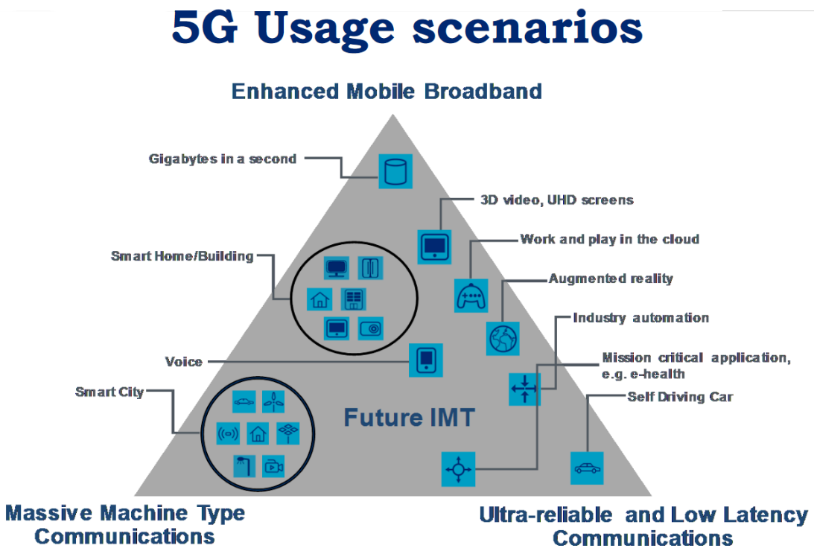
IMT 2020 (5G) Key Capabilities
Mapping to 5G Standardisation Landscape
User experienced
data rate
(Mbits/s)
Peak data rate
(Gbits/s)
100
IMT-2020
10
Spectrum
efficiency
20
3x
1
1x
Area traffic
capacity
(Mbits/s/m²)
0.1
350
400
500
Mobility
(Km/h)
10
1
1x
IMT-advanced
100x
10x
Network
energy efficiency
10⁵
1
Latency
(ms)
10⁶
Connection density
(devices/Km²)
3GPP PARTNERS

Slide 7
5G enabling Efforts & Technology Ecosystem in India
“Making India 5G Ready” Steering Committee Report submitted on Aug 23, 2018
Work in progress on
Spectrum Policy
Regulatory Policy
Education and Awareness Promotion Program
Application & Use Case Labs
Development of Application Layer Standards
Major Trials & Technology Demonstrations
Participation in International Standards for 5G
5G Testbeds
IIT Delhi (Ericsson)
IIT Madras (IITs, IISc Consortium testbed)
5G Technology Trials
OEMs & Technology Companies
Telecom Service Providers
Manufacturers (non-OEMs)
Startups / SMEs
5G Spectrum Studies

Slide 8
Expert Committees
Spectrum
Regulation
Education & Awareness
Technology Trials
Application and Usage Case labs
Budget
DEP
IPD &
Part FAT
IPD &
Part FAT
Participation in International Standards
Application
Layer Standards

Slide 9
5G Enabling Technologies
IoTs
MIMO / NR including Millimetric Band
Network Function Virtualization (NFV)
Network Slicing (NS)
Software Defined Networks (SDN)
Distributed or Edge Cloud Computing
Artificial Intelligence / Advanced Analytics
System on Chip
.. and many more
5G needs several enabling technologies for deploying networks efficiently and flexibly

Slide 10
Action Taken on 5G by the Government
Constituted Oversight Committee & 5G Program Office
Constituted Expert Committees for Action on HLF recommendations
Spectrum Policy
Major trials
Education and Awareness Promotion
Development of Application Layer Standards & international participation
Regulatory Policy Initiatives to Facilitate 5G Deployment
Setting up of Applications and Use Case Labs
Development of 5G Research Test Beds at IITs

Slide 11
Recommendations on Spectrum Policy
Three tiers of spectrum release based on availability /readiness, in some cases a two year R&D block before release
New 5G Spectrum
For wireless access – licensed spectrum with an aggregate of 405 MHz (tier 1) + 137 MHz (tier 2) in < 4 GHz and 5.25 GHz (tier 1) + 8.3 GHz (tier 2) in < 45 GHz.
For backhaul, 14 GHz of unlicensed and 10 GHz of lightly licensed spectrum in the 57 to 86 GHz band.
For Wi-Fi, opening additional bands of unlicensed spectrum in the 5 GHz band for outdoor use.
Set up a committee to advice on building Spectrum Technology Infrastructure in the country
Name & Designation (Shri/Smt.) | Status
Addl. Secretary (Telecom) | Chair
Advisor (T) | Member
Wireless Advisor, WPC | Member
Sr. DDG, TEC | Member
Prof. Bhaskar Ramamurthi, Director, IIT, Madras | Member
Prof Abhay Karandikar, Director, IIT, Kanpur | Member
Bharat Bhatia, ITU-APT Foundation | Member
T.V. Ramachandran, BIF | Member
Vikram Tiwathia, COAI | Member
Parag Kar, Qualcomm | Member
YGSC Kishore Babu, DDG (SRI) | Member Secretary

Slide 12
Recommendations on Regulatory Policy
Well over USD 250 Bn equipment investments in 5G in India over next 10 years
Much denser network supporting highly critical / essential services
Closely integrated with many economic verticals
Supportive Regulatory policy support is vital for success of 5G
Regulatory action needed for - Smarter Infrastructure, Cyber Security, Privacy, Net Neutrality, and Human Safety
Set up three expert Committees (Business, Security, Safety) that will draft clear guidelines across these areas and promulgated by DoT
Report under finalisation
Name & Designation (Shri/Smt.) | Status
Amit Yadav, Joint Secretary (Telecom) | Chair
R.S. Mathews, DG, COAI | Member
G Narendra Nath, DDG (SA) | Member
Nitin Jain DDG (DS) | Member
Atique Ahmed, Director (IC) | Member
Representative of MeitY | Member
Kunal Kumar, JS (Smart Cities) Representatives of MoUD | Member
Prof Rekha Jain, IIMA | Member
Prof Rajat Kathuria, ICRIER | Member
T. R. Dua, DG, TAIPA | Member
T. V. Ramachandran, President, BIF | Member
Swati Rangachari, Chair, CII Ease of Doing Business | Member
S.B. Singh, DDG (AS) | Member Secretary

Slide 13
Recommendations on Education and Awareness Promotion
5G will be used by many economic verticals, and is not just about smart phones
5G utilization needs significant knowledge base and skills development among economic verticals
Initiatives to improve knowledge base and skilling
Bring global 5G events to India
Create local 5G events
Create a nationwide skill-development program
Consumer Awareness Programs on 5G
Appoint full time Program Coordinator(s) to deliver on action areas
Report submitted
Name & Designation (Shri/Smt.) | Status
Amit Yadav, Joint Secretary (Telecom) | Chair
Mousumy Bedekar, DDG (Trg) | Special Project Coordinator
Sr. DDG, TEC/ Head NTIPRIT | Member
Ravi Kiran Annaswamy, IEEE | Member
Dr. Neena Pahuja, DG, ERNET | Member
Lt. Gen. Dr. SP Kochhar, CEO, TSSC | Member
DDG (Hq.), DGT | Member
Rajan S Mathews, DG, COAI | Member
T.V. Ramachandran, President, BIF | Member
Dinesh Chand Sharma, Director, SESEI | Member
Pamela Kumar, DG, TSDSI, | Member
Atique Ahmed, Director (IC) | Member Secretary

Slide 14
Education and Awareness Promotion Summary of Recommendations
Hosting of Global events (4 per annum) and India Centric events (12 per annum)
On line activities: Develop web portal, organize webinars, online tutorials, Certificate courses, etc.
Skill Development
Short-term and long-term training courses on 5G Technologies
Consumer Awareness Programs:
Empowered Committee in DoT comprising of members/ representative from COAI, BIF, TEPC, TSDSI, NTIPRIT etc.
Report submitted
10,000 youths to be skilled
Hosting Global events: Rs. 1.6 Cr per annum of which 50% as sponsorship
India Centered events: Rs. 2.2 Cr per annum of which 50% as sponsorship
Online Activities: Rs. 0.4 Crore per annum
Skill Development training to 10,000 youth every year: Rs. 2 Cr per annum
Short-term and Long-term training programs by NTIPRIT: 1,000 HR personnel to be trained every year: Rs. 1 Cr per annum
Consumer awareness program: Rs. 1 Cr per annum
Total budget requirement: Rs. 30.6 Cr for a period 3 years @ Rs. 10.2 Cr per annum

Slide 15
Recommendations on Applications and Use Case Labs
5G will spawn many rich applications in different economic verticals
Many applications will have India specific characteristics best addressed by local companies
Set up Use Case Labs
Labs to be set up within each economic vertical
Start with use cases on Education, Healthcare, Agriculture and Banking
Learn and adapt business cases for different classes of verticals
First Use Case Lab approved for setting up at IDRBT, Hyderabad for FinTech
Name & Designation (Shri/Smt.) | Status
Addl. Secretary (Telecom) | Chair
Sr. DDG, TEC | Member
Pamela Kumar, DG, TSDSI, | Member
Vipin Tyagi, ED, C-DoT | Member
R.K. Pathak, DDG (IC) | Member Secretary
YGSC Kishore Babu, DDG (Policy) | Special Project Coordinator

Slide 16
Recommendations on Participation in International Standards
There is a vast standards eco-system in ICT including 5G
Urgent need to scale up India’s participation in global standards setting
Short Term Measure
Set up Standards Project Teams (3-4 members) that focus on a single topic and with the help of local resources fully engage with relevant SDO
Begin with 2 teams in year one and grow to 10 teams by year three
Longer Term
Set up a Committee to recommend 10 year plan to bring India into full participation in SDO process
Appoint a full time Program Coordinator(s) for these Project Teams
Name & Designation (Shri/Smt.) | Status
Addl. Secretary (Telecom) | Chair
Prof. B Ramamurthy, Director, IITM | Member
Sr. DDG, TEC | Member
V. Raghunandan, DDG (IR) | Member
Chair, TSDSI, | Member
YGSC Kishore Babu, DDG (SRI) | Member Secretary
Atique Ahmed, Director (IC) | Special Project Coordinator

Slide 17
Recommendations on Major Trials and Technology Demonstration
5G Trials can help advance learning among TSPs, economic verticals, academia and local industry
Govt. has invited major OEMs to conduct 5G trials in different technology dimensions of 5G
Discussions with OEMs – key thinking
Each OEM may partner with major Indian TSP(s) who will pull in other local partners
One trial per zone, 4 zones nationwide
Avoid significant overlap of 5G use cases in these trials
Government will provide spectrum and other support measures
Name & Designation (Shri/Smt.) | Status
Addl. Secretary (Telecom) | Chair
DG (Telecom) | Member
Advisor (Finance) | Member
DDG (Policy) | Member
DDG (NT) | Member
Vipin Tyagi, ED, C-DoT | Member
All TSPs | Members
All OEMs | Members
T. V. Ramachandran, BIF | Member
C.S. Rao, QWS INC | Member
R. K. Pathak, DDG (IC) | Convener

Slide 18
Recommendations on Development of Application Layer Standards
5G Applications will deliver great value to the country
While there is vast global eco-system in the applications layer standards, new SDOs are being formed around 5G applications
Short term
Piggy back work in Standards Project Teams, Use Case labs and Awareness Promotion to support Applications Layer development
Longer Term
Set up a Committee to recommend 10 year plan to bring India into full participation in SDO process (same committee as Standards)
Report under finalisation
Name & Designation (Shri/Smt.) | Status
Ananth Krishnan, TCS | Chair
Pamela Kumar, DG, TSDSI | Member
Vipin Tyagi, ED, C-DoT | Member
Hemant Darbari, DG, CDAC | Member
V.B. Pravin Rao, COO, Infosys | Member
K. R. Sanjiv, CTO, WIPRO | Member
Atul Kunwar, President & CTO Tech Mahindra | Member
Reena Garg, Scientist-F & Head Elect. & IT, BIS | Member
R.K. Pathak, DDG (IC) | Member
YGSC Kishore Babu, DDG (Policy) | Member Secretary

Slide 19
ALS Committee Recommendations
Six 5G ALS Working Groups
Smart City
Finance & Banking
Technology Group
Standardization Participation Group
APIs and Open Source Group
Future Roadmap Group
Prioritized Application Use Cases
Smart Cities
Banking & Finance
Smart Health
Intelligent Transportation Systems
Public Protection and Disaster Relief / Public Safety
Smart Agriculture
Diverse Stakeholders
DoT
C-DAC
C-DOT
TSDSI
BIS
IISc, Bangalore
TCS
Wipro
Tech Mahindra
Reliance Jio
Vodafone
Airtel

Slide 20
Budget Projections by HLF
5G India programme requires a significant budgetary support from government complemented by investments from the industry. Hence, there is a need to have a high level Budget Committee for synergetic engagement with MeitY, DST and user ministries to ensure adequate availability of necessary funding to accomplish the 5G India objectives.
The committee recommends a broad planning estimate of INR 3000 million in Year 1, INR 4000 million in Year 2, INR 5000 million in Year 3 and INR 4000 million in year 4.
The 5G programs will require funding by the Govt. At present there are only notional figures available. The actual funding requirements can only be finalized once well-defined project proposals with budgetary justifications are submitted to DoT.
Name & Designation (Shri/Smt.) | Status
Member (Finance) | Chair
Addl. Secretary (Telecom) | Member
DDG (Policy) | Member
Vinod Kotwal, DDG | Member
R.K. Pathak, DDG (IC) | Member
DDG (E&F) | Member Secretary

Slide 21
Way forward to implement 5G HLF Recommendations
Approval of Experimental Spectrum Recommendations- Digital Communications Commission has already approved
Spectrum auction of mid-band 3.3-3.6 GHz in the process
CEWiT is working on coexistence studies
Budget allocation for the projects and programmes - Done in DoT
Expedite submission of Committee Reports-
Already submitted-Education Awareness
Regulatory Committee, Application layer & Standard Participation Committee reports under finalisation

Slide 22
Thank You

Slide 23
5G Ecosystem Homegrown capabilities
5G Operators (BSNL, Rel jio, Airtel, Idea-Vodafone)
(3)
Femto system
(Rjio, Airtel)
(6)
Small cell system (Sooktha, BEL, VNL)
(10)
Macrocell system (Tejas, CDOT)
(7)
L2 and above Software and Apps
(Radisys, Aricent, Sooktha, Lekha, Wipro)
(11)
L2 and above Software and Apps
(Radisys, Aricent, Sooktha, Lekha, Wipro)
(1)
Device software and Apps (Wipro)
(4)
L2 and above Software and Apps (TCS, Wipro)
(15)
Core software
(Aricent, Dynamic Digital Technology, Wipro)
(14)
5G cross-haul
(Tejas, CDoT)
(2)
BB+RF SoC
(Saankhya, WiSiG, Qualcomm)
(12)
Chipset/SoC
(Xilinx, Intel)
(5)
BB+RF SoC
(SignalChip,
Qualcomm)
(8)
Chipset/SoC (Xilinx, Qualcomm)
(14.a.)
E, V MW
(Astrome)
(16)
X86 server or customized hardware (Intel, NXP)
(13)
RF module (PA, Antenna)
(IITM, IISc)
(9)
RF module (PA, Antenna)
5G Devices
5G gNB- Femtocell
5G gNB- Small Cell
5G gNB- Macro
5G Cross-haul
5G Core
(17) Management Software (Sooktha, Wipro)
(Source: Author)

Slide 25
5G Use Cases

