Slide 1
INDIRECT EVAPORATIVE COOLING
A FRESH APPROACH TO ENERGY EFFICIENCY
PRESENTED BY:
SUNIL TIWARI
GENERAL MANAGER – A.T.E. Enterprises Private Limited

Slide 2
Contents
Why evaporative cooling?
What is evaporative cooling?
Types of evaporative cooling
Cooling solutions based on indirect evaporative cooling with case studies
References
The road ahead

Slide 3
Why evaporative cooling?
Energy
Environment
HVAC
There’s a definite connect between these three:
Energy
Percentage of energy consumed by HVAC in a building – approximately 60%
Load demand variation – surge in demand during peak summer
Environmental impact
Direct impact – in terms of CFC, ODP
Indirect impact – total energy, GWP of power generation, Carbon emissions etc.,
Space conditioning (heating, cooling, and ventilation) is the most significant energy use in buildings and hence represents the best opportunity for saving energy and reducing carbon emissions.
“It is the right time to re define comfort levels, that can open up newer alternative means of cooling”

Slide 4
Why evaporative cooling?
Fore-runner of modern concepts of comfort
Relative humidity
Air motion
% of fresh air
Temperature
Thermal Comfort: is 24⁰C the only choice?
ASHRAE 55 Standard defines comfort as “that condition of mind which expresses satisfaction with the thermal environment and is assessed by subjective evaluation.”
Allows temperature in range of 23.3⁰C - 26.7⁰C, with Rh ranging from 30 to 60%
“A few degree rise in conditioned space temperature will open up options for use of several energy efficient technologies, most significant being evaporative cooling”

Slide 5
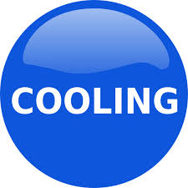
What is evaporative cooling?
One of the oldest & simplest comfort conditioning technology
Invented by mother nature and perfected by man
Uses world’s most clean natural refrigerant: “Water (R718)”
When the sun is hot……
Water + Moving air =

Slide 6
Types of Evaporative Cooling - Direct
DIRECT EVAPORATIVE COOLING (DEC)
40.0ºC DBT,
24.0ºC WBT
C
E
L
L
U
L
O
S
E
25.6ºC DBT
24.0ºC WBT
Primary air
(ambient)
Adiabatically cooled air
Water evaporates directly into the air stream, thus reducing the air temperature while humidifying the air.

Slide 7
Types of Evaporative Cooling
INDIRECT EVAPORATIVE COOLING (IEC)
Exhaust
air
40.0ºC DBT,
24.0ºC WBT
27.2ºC DBT
20.4ºC WBT
DAMA
Primary air
(ambient)
Sensibly cooled air
Secondary air (ambient)
Indirect evaporative cooling is about cooling air by water evaporation, but not allowing water and air to mix.
Pure sensible cooling: no humidity added, moisture level in air (grains) remains constant.
Lower both temperature and enthalpy (total heat) of air.

Slide 8
Types of Evaporative Cooling (Psychrometry)
 | Direct Evaporative cooling (DEC) | Indirect Evaporative cooling (IEC)
Air & water contact | Direct contact | No contact
Cooling Adiabatic process | Adiabatic process | Sensible cooling
Dry bulb temp | Reduces | Reduces
Wet bulb temp | No change | Reduces
Moisture (grains) | Increases | No change
Enthalpy | No change | Reduces
DEC
IEC

Slide 9
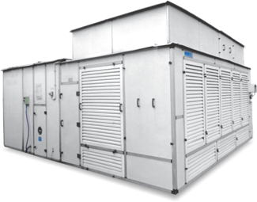
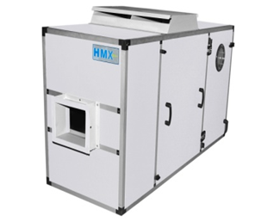
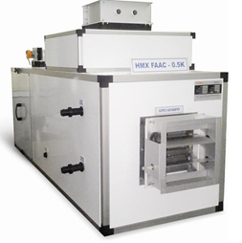
Cooling solutions based on Indirect Evaporative Cooling
Stand alone cooling
Indirect Evaporative Cooling
(IEC)
Indirect Direct Evaporative Cooling
(IDEC)
Pre cooling of fresh air
Pre-cooling of fresh air using fresh air
(TFAs)
Hybrid Air-Conditioning
Hybrid air-conditioning with recirculation of air
Hybrid air-conditioning for once through applications

Slide 10
INDIRECT DIRECT EVAPORATIVE COOLING
(IDEC)

Slide 11
IDEC: Working principle
Exhaust
air
40.0ºC DBT,
24.0ºC WBT
27.2ºC DBT
20.4ºC WBT
C
E
L
L
U
L
O
S
E
21.2ºC DBT
20.4ºC WBT
DAMA
Primary air
(ambient)
Sensibly cooled air
Cooler supply air
Secondary air (ambient)
Supply air is cooled in 2 – stages:
first with indirect evaporative cooling, and then
further with direct evaporative cooling
Thus lowering the air temp well below the ambient wet bulb

Slide 12
Psychrometric representation of IDEC
Outdoor (Ambient)
DBT 40⁰C WBT 24⁰C,
Specific Humidity 13.56 gm / kg
DEC Outlet
DBT 25.6⁰C WBT 24⁰C,
Specific Humidity 19.63 gm / kg
IDEC Outlet
DBT 21.2⁰C WBT 20.5⁰C,
Specific Humidity 16.1 gm / kg
Up to 60% less moisture added
DEC
IDEC
Up to 4.4°C more cooling
* Pune 0.4 conditions Source Energy Plus weather data

Slide 13
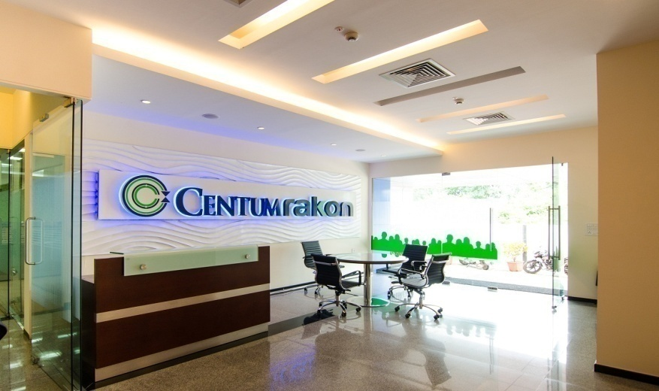
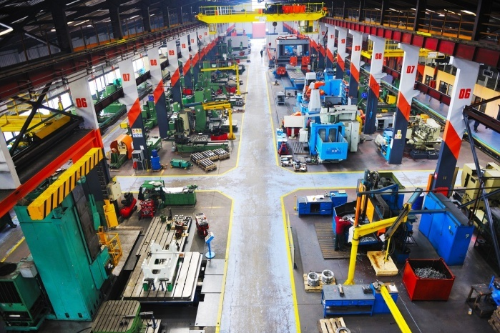
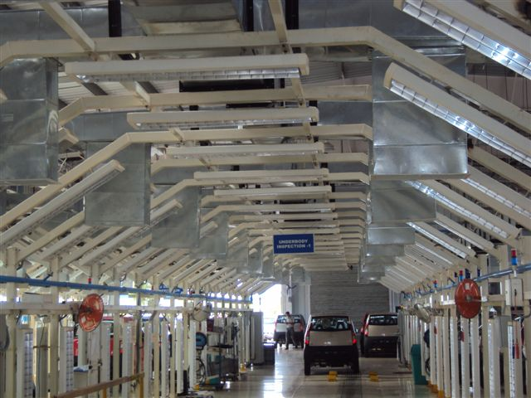
IDEC: Applications for stand alone cooling
Indirect evaporative cooling, either in pure ‘indirect form (IEC)’, or coupled with direct evaporative cooling (IDEC) can be used for variety of applications savings energy.
Commercial buildings – for non-regularly occupied zones:
entrance lobbies & atriums,
dining areas & pantry
roof top open sit outs & smoking areas
Gymnasium
Kitchens and laundries
Industrial sheds and large warehouses
Indoor stadiums & sports arena
Data Centres – cooling in stand alone mode, or as the air side economizer

Slide 14
Case study – 1: One of the world’s largest car manufacturer
Location | Pune, India
Project | Automobile manufacturing line including - body shop, assembly, paint shop, engine shop, solvent store and R&D center
Total area cooled | 500,000 ft²
Supply air | 2,300,000 cfm
Problem faced | Discomfort due to heat inside the factory sheds
Solution previously used | Ventilation units (air-conditioning was in consideration)
Solution provided | Indirect Evaporative Cooling (IEC)
Reason for selection | User wanted solution with no moisture addition to supply air, so DEC ruled out, IEC offered 60% Energy savings compared to air-conditioning

Slide 15
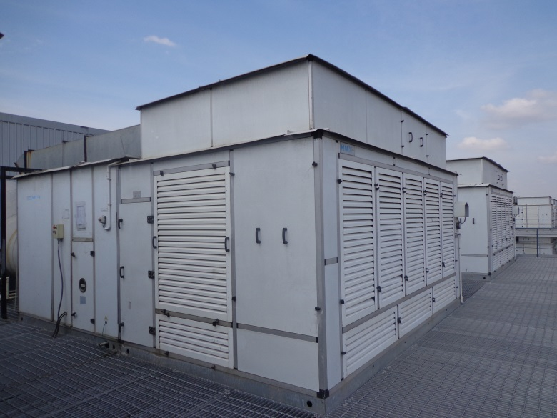
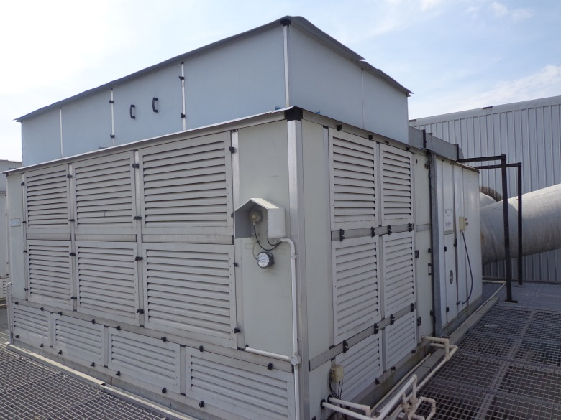
Case study – 1 continued….

Slide 16
Case study – 2: Middle East's Leader in Retail & Hospitality
Location | Riyadh, Saudi Arab
Project | Warehouse cooling
Total area cooled | 485,000 ft²
Supply air | 540,000 CFM
Problem faced | Greenfield project
Solution previously used | Air-conditioning was in consideration
Solution provided | Indirect Direct Evaporative Cooling
Reasons for selection | 100% fresh air Comfort at par with air-conditioning at a fraction of energy cost, saving 3,000,000 kWh annually

Slide 17
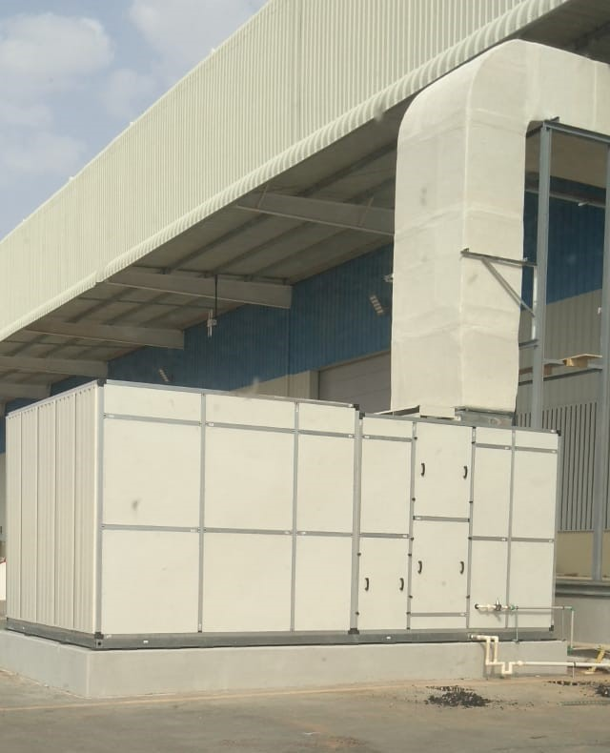
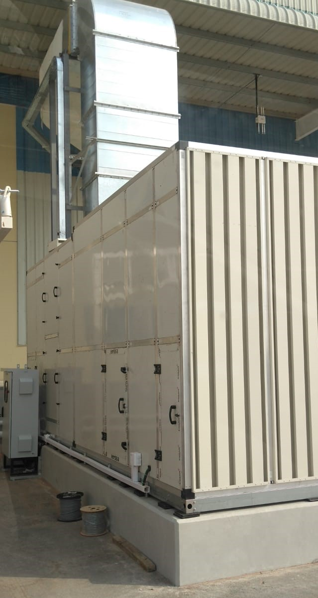
Case study – 2 continued….

Slide 18
FRESH AIR PRE COOLING
(TFA)

Slide 19
Pre-cooling of fresh air
AIR HANDLING UNIT (AHU)
Fresh air quantity: 15%
Recirculated air quantity: 85%
DBT 25ºC
DBT 14ºC
To conditioned space.
Room conditions
DBT 24⁰C, RH 60%
Return air from conditioned space
Supply air
Sensibly
pre-cooled air
DBT 27.2ºC
Pre cooling
(DAMA)
Ambient air
DBT 40ºC, WBT 24ºC
Fresh air can add up to 30% of the total cooling load in centrally air-conditioned spaces.
Pre cooling of outdoor fresh air before it mixes with return air reduces cooling load and thus, energy consumed
Notes:
According to ASHRAE Standard 62, an office space requires atleast 20 CFM of fresh air per person. With a centrally air conditioned office, the average fresh air quantity should ideally be 15% of the total air quantity. Lack of fresh air in the spaces leads to stale air and makes people less productive. The fresh air quantity, however, it is just 15%, consumes almost 40% tonnage load during peak summers.

Slide 20
Psychrometric representation of IEC pre cooling
TR Load without HMX-PCU
Ambient: 40⁰C
Coil Outlet:14⁰C
5.9 TR per 1,000 cfm
TR Load with HMX-PCU
Ambient: 40⁰C
IEC outlet: 27.2⁰C
Coil Outlet: 14⁰C
3.8 TR per 1,000 cfm
Savings with HMX-PCU:
2.1 TR per 1,000 cfm (36%)
Sensible cooling with HMX-PCU
27.2⁰C
40⁰C
14⁰C
Cooling and Dehumidification
of pre-cooled air
Cooling and Dehumidification of ambient air with cooling coil
* Pune 0.4 conditions Source Energy Plus weather data
Notes:
The total savings during peak summers in say, Pune conditions is 36%. There are much harsher conditions in India where the temperature reaches close to 48C which would result in even more energy savings through the HMX-PCU.

Slide 21
TRH savings in one year through IEC pre cooling
Note for cooling 1000 CFM of fresh air to 14/13 DBT/WBT (ºC)
No | City | Total TRH saving per 1000 CFM 24 x 7 operational hours / year | Total TRH saving per 1000 CFM 12 x 7 operational hours / year
1 | Ahmedabad | 5910 TRH | 4440 TRH
2 | Bangalore | 3800 TRH | 2970 TRH
3 | Chandigarh | 4200 TRH | 3220 TRH
4 | Chennai | 3350 TRH | 2010 TRH
6 | Hyderabad | 5650 TRH | 4040 TRH
7 | Indore | 4690 TRH | 3690 TRH
8 | Jaipur | 5550 TRH | 3910 TRH
9 | Kolkata | 2650 TRH | 2070 TRH
10 | Mumbai | 3560 TRH | 2540 TRH
11 | Nagpur | 6330 TRH | 4580 TRH
12 | New Delhi | 4700 TRH | 3400 TRH
13 | Pune | 4090 TRH | 3300 TRH
Such savings translate into attractive payback, e.g. less than 2 years
Legend: TRH – Tons of Refrigeration hours

Slide 22
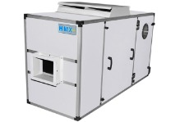
Advantages IEC over other pre cooling units
Zero
cross-contamination
Better
life-cycle cost
30% smaller
footprint
Minimal maintenance
50% lower capital investment
Eliminates
return-air ducting
50% lower energy consumption

Slide 23
Case study – 3: LEED Platinum rated IT office building in Jaipur
Location | Jaipur, India
Project | Fresh air pre-cooling for office building
Office area | 400,000 ft²
Fresh air intake | 40,000 cfm
Customer requirement | Pre-cooling of fresh air to reduce TR load on chiller
Other solution suggested | Energy recovery wheel
Solution provided | Indirect Evaporative Cooling
Reasons for selection | Better ROI than ERW Low maintenance Ease of operation

Slide 24
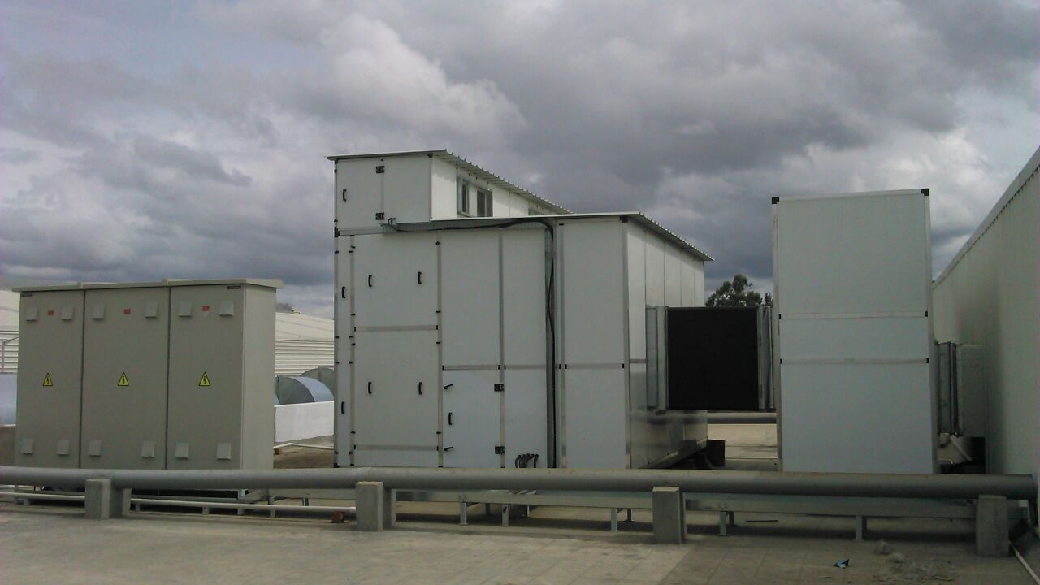
Case study – 3 continued…………

Slide 25
Case study – 4: High-rise residential tower in Sharjah
Location | Sharjah, UAE
Project | Fresh air pre-cooling for common areas such as lobbies, corridors, lift areas, etc.
Number of floors | 44
Fresh air intake | 60,000 CFM
Customer requirement | Pre-cooling of fresh air to reduce cooling load and avoid addition of new chiller
Other solution suggested | Addition of a chiller Recovery of air through ERW
Solution provided | Indirect Evaporative Cooling Retrofit to existing AHU
Reasons for selection | Ease of retrofit and low Capex and Opex
Savings with IEC based pre cooling in TRH | 132 TR/hour

Slide 26
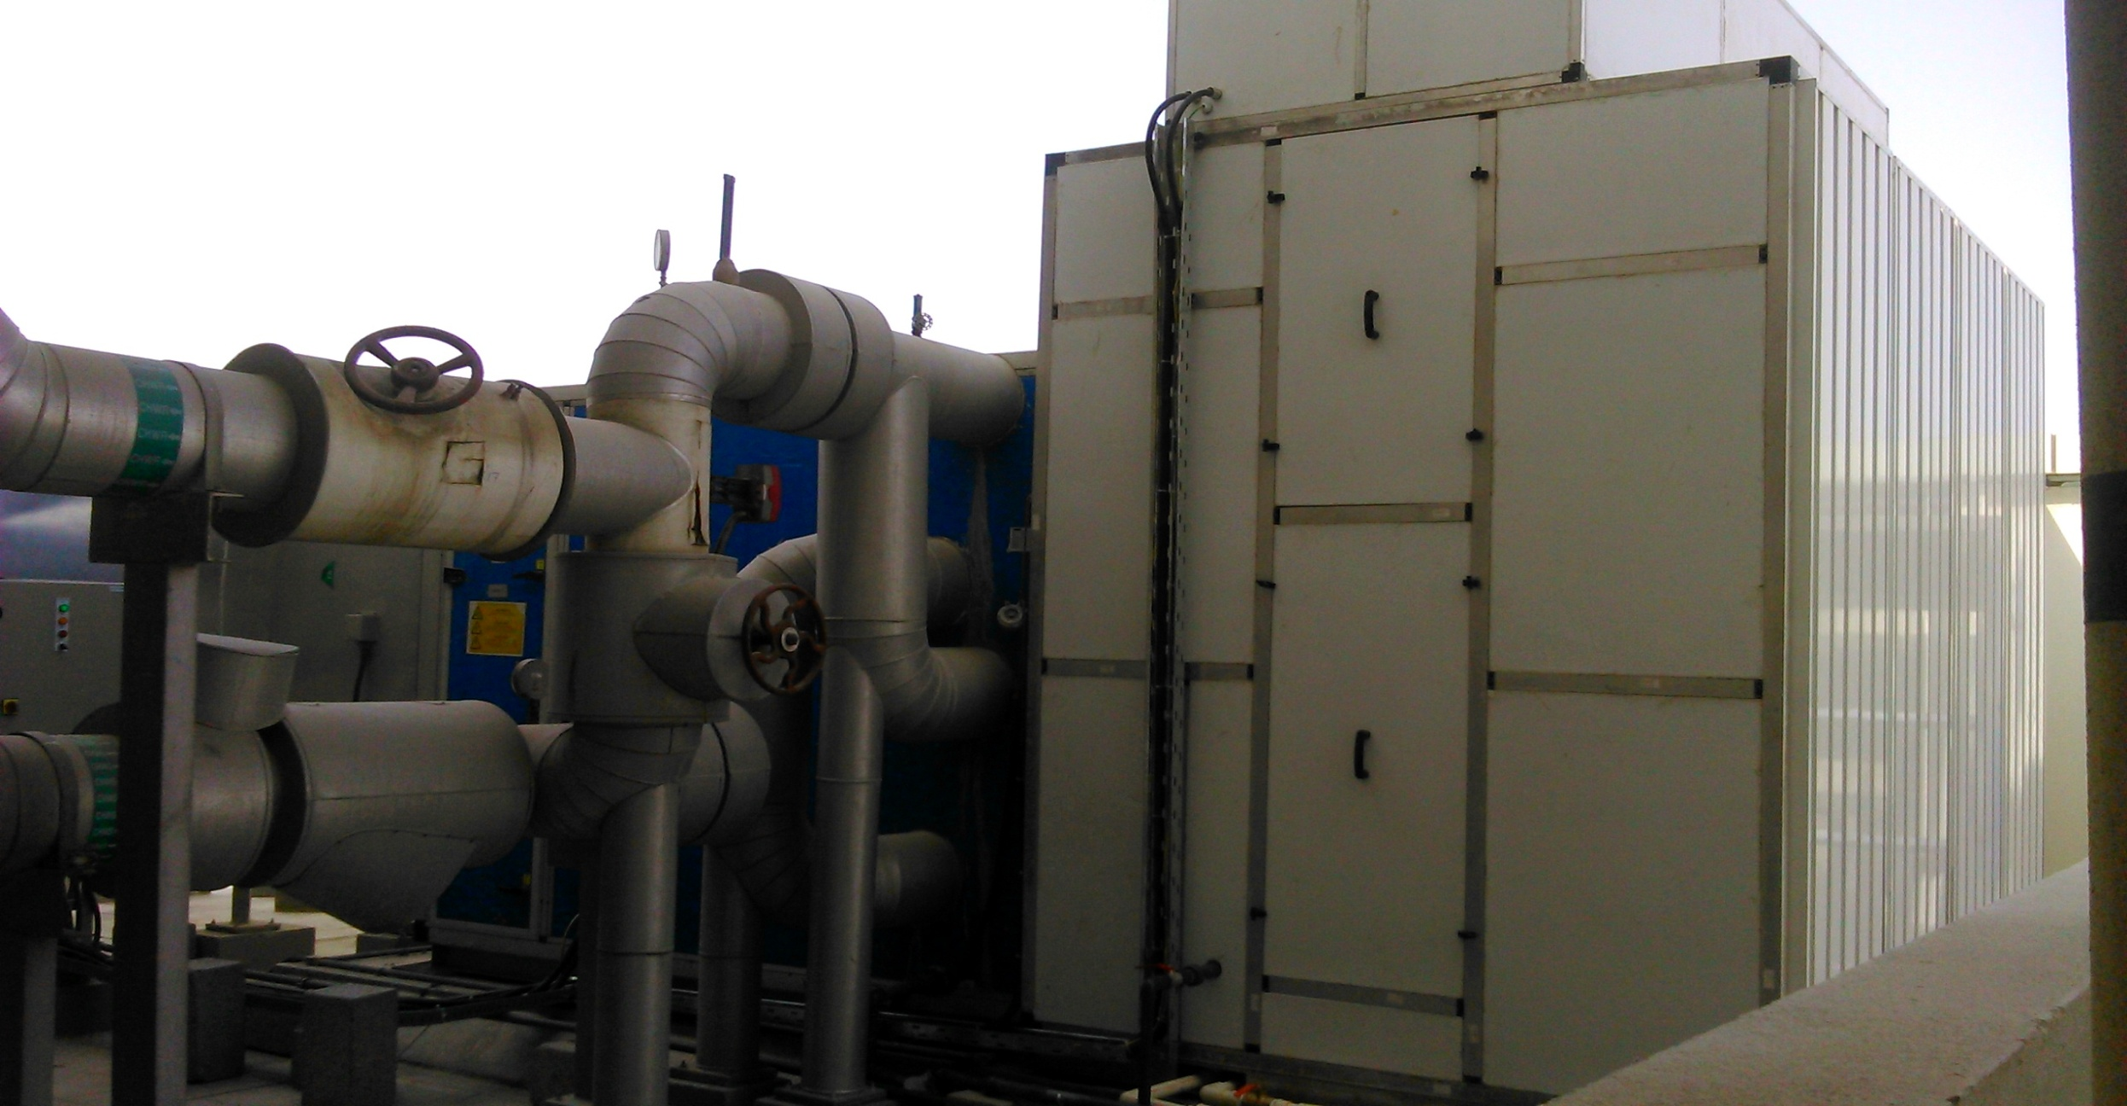
Case study – 4 continued…..

Slide 27
Case Study 5: LEED Platinum-rated IT office building in Bangalore
Location | Bangalore, India
Project | Fresh air pre-cooling for office building
Office area | 1,500,000 ft²
Fresh air intake | 150,000 cfm
Customer requirement | Pre-cooling of fresh air to reduce TR load on chiller
Solution provided | Indirect Evaporative Cooling
Reasons for selection | Better ROI than ERW Low maintenance Ease of operation

Slide 28
Hybrid air-conditioning unit

Slide 29
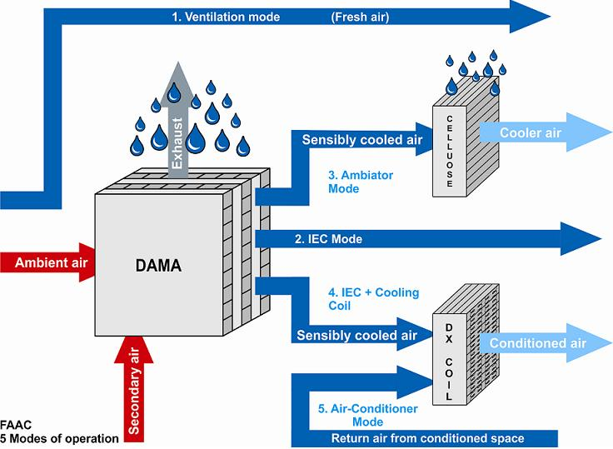
Hybrid air-conditioning
MODE OF OPERATION | WORKING DETAILS
Ventilation | Only fresh air
IDEC (Ambiator) | Indirect direct evaporative cooling
IEC | Only DAMA
IEC + Coil | DAMA + Cooling coil (once through application)
Air-conditioning | Cooling coil with re-circulated air
Notes:
With limitations in evaporative cooling in not maintaining constant temperatures, the Hybrid air-conditioning has been designed to maintain specific temperatures and gain significant energy savings. It combines the best of both worlds – the Indirect Direct Evaporative Cooling and Refrigerated Air-conditioning in a single machine. The HMX-FAAC has 5 modes of operation which change automatically with the temperatures desired in the room. The overall 8760 hours analysis result in significant energy savings with this system.

Slide 30
Case study – 5: LEED Gold rated office building
Location | Ahmedabad, India
Project | Office building
Total area cooled | 3,000 ft² with an occupancy of 20 people
System details | 20,000 cfm + 20 TR DX coil (IDEC + Cooling Coil)
Customer requirement | 26 ± 2°C inside throughout the year
Other solution suggested | Air-conditioning system of 20 TR
Solution provided | Hybrid air-conditioning (IDEC + Cooling Coil)
Reasons for selection | 25% lower annual power consumption
Annual power consumption | 60,000 kWh
Annual water consumption | 384,000 litres

Slide 31
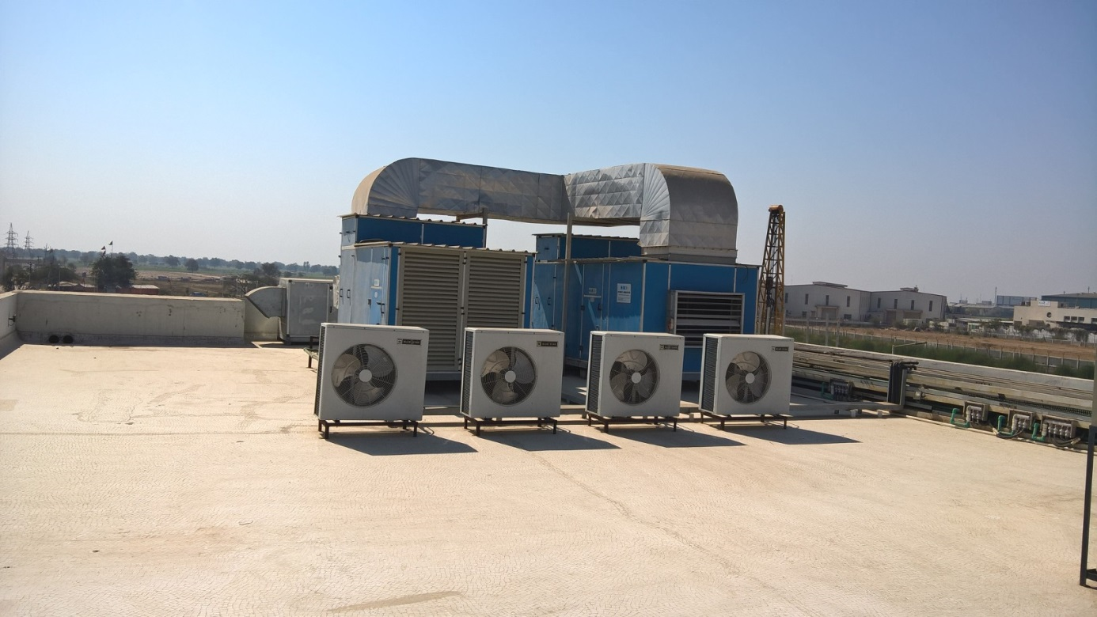
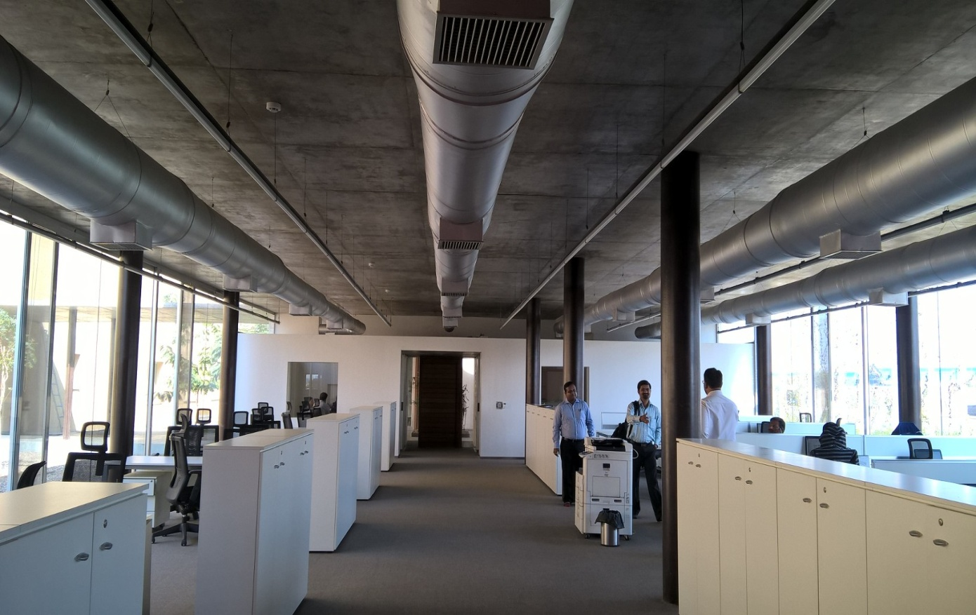
Case study – 5 continued…….
Notes:
Edit - crop

Slide 32
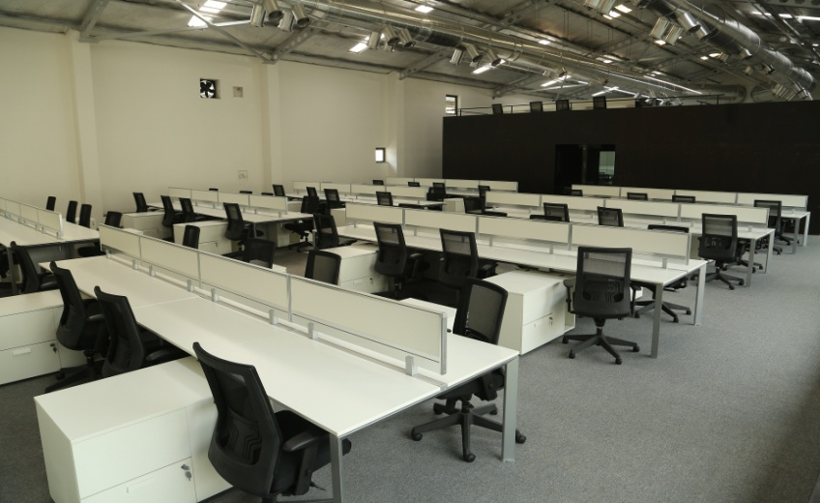
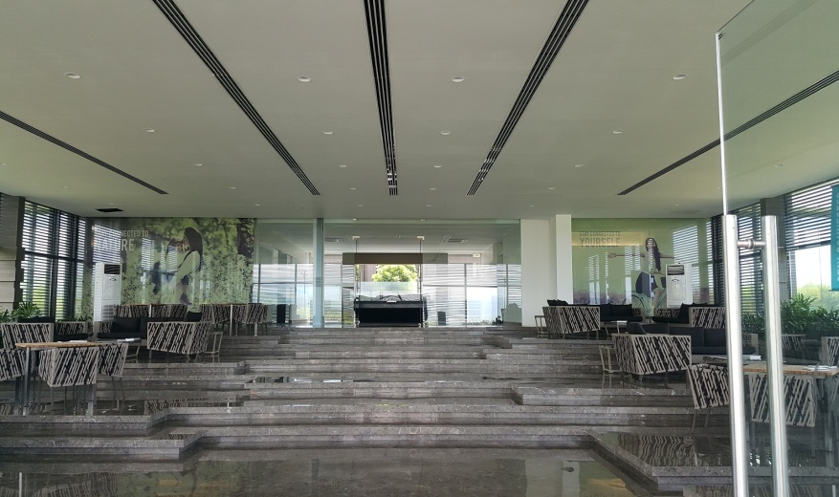
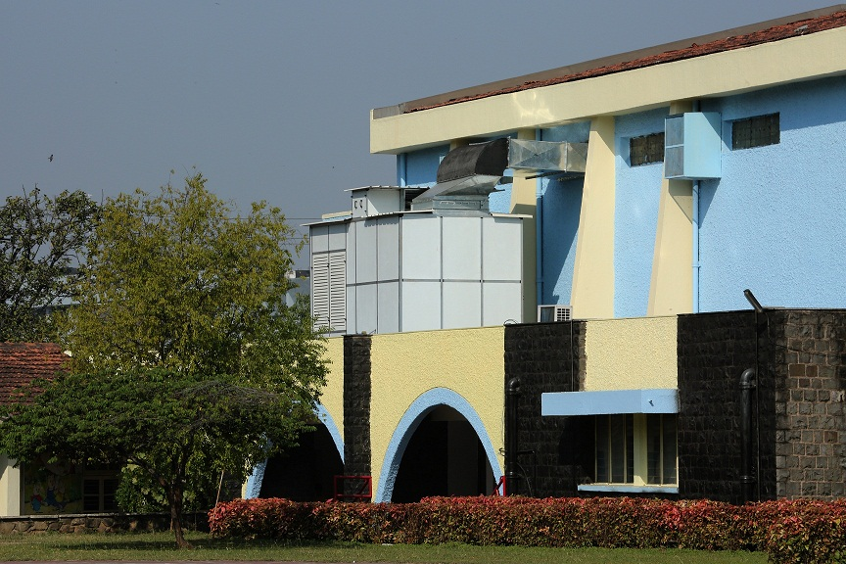
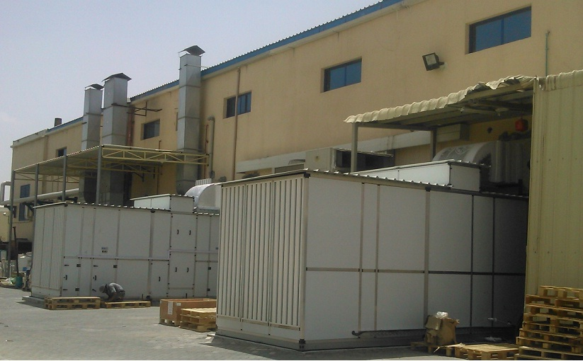
Application pictures
Office hall, Pune
Reception area, Bangalore
Entrance lobby, Pune
School Auditorium, Pune
Factory Shed, Ahmedabad
Factory Shed, UAE

Slide 33
THANK YOU

Slide 34
Contact
s_a_tiwari@hmx.co.in
+91 – 20 – 6717 0123
+91 – 93710 51636
www.ategroup.com/hmx

