Slide 1
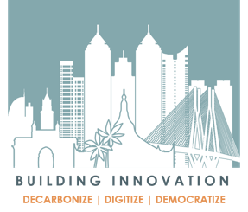
Building Innovation through Transformational Leadership
A movement to create green, smart, healthy buildings in India
Based on insights from the Building Innovation Guide (BIG)
Reshma Singh
B.Arch (New Delhi), MLArch (Harvard), LEED AP,
Program Director, Lawrence Berkeley National Laboratory (Berkeley Lab), USA
15th July 2019
Hyderabad
Notes:
Collaboration-
My personal story starts
Neutral R&D for synthesis
Market Forces and intelligence from a host of collaborators
India 5th largest economy @ $2.6T, aspirations to $5T by 2025
Huge growth in infra- Power and Real estate
Urban infra growth: Steel and cement causing 5X , 7.3 EJ to 36 EJ while China ($ 12T is tapering off, trajectory downwards reducing from 55.3 EJ to 52 EJ (2050).
(Steel sector is coal –intensive, not transitioning to lower C fuels (LBNL 2018))
Power needs to 3X from 150GW today to 450 GW by 2036 = 600 new (500MW sized power plants ~$25-30 B investment (Central Electricity Authority, 2019).
Buildings are a third of the country’s energy use
RE market size 8X from $120B (2017) to projected $1T (2030)
Explosive growth: 660 M sqmt (2018) to 1.9 B sqmt (2030), biggest growth sectors are IT, ITES, Consulting and retail. Also are the biggest, growing energy users due to typology of building- glass facades, air conditioning, computation load, multiple shift operations etc. (3x 3x 3x SLIDE)
30-50% waste in buildings in not uncommon. In correct building and operating practices have economic cost, environmental cost, social health cost (SLIDE)
But new buildings are promising opportunities for fast and deep sustainability.
Trends: Aspirational to buildings, millennial who are technophiles, Increasing co-working new trends, leading corporates environmental oriented

Slide 2
Could we be heading into a crisis?
India is the world’s 5th largest economy @ $2.6T, with aspirations to $5T by 2025
India’s rapid urbanization is a key driver of energy trends: an additional 315 million people—almost the entire population of the United States today—are expected to live in India’s cities by 2040
Huge urban infrastructural growth planned in India will cause a 3X increase in energy, and investment into 300GW of new power plants. One third of India’s energy use comes from buildings, the highest of all sectors.
How can India transition to strategic and sustainable growth?
Context?
Notes:
Why do it? Motivation and crises
India 5th largest economy @ $2.6T, aspirations to $5T by 2025
Huge growth in infra- Power and Real estate
Urban infra growth: As an example. Steel and cement causing 5X growth in energy use , 7.3 EJ (2015) to 36 EJ (2050) while China ($ 12T is tapering off, trajectory downwards reducing from 55.3 EJ to 52 EJ (2050).
Steel sector is coal –intensive, not transitioning to lower C fuels (LBNL 2018)
Power needs to 3X from 150GW today to 450 GW by 2036 = ~$25B investment (Central Electricity Authority, 2019).
Buildings are a third of the country’s energy use
RE market size 8X from $120B (2017) to projected $1T (2030)
Explosive growth: 660 M sqmt (2018) to 1.9 B sqmt (2030), biggest growth sectors are IT, ITES, Consulting and retail. Also are the biggest, growing energy users due to typology of building- glass facades, air conditioning, computation load, multiple shift operations etc. (3x 3x 3x SLIDE)
30-50% waste in buildings in not uncommon. In correct building and operating practices have economic cost, environmental cost, social health cost (SLIDE)
But new buildings are promising opportunities for fast and deep sustainability.
Trends: Aspirational to buildings, millennial who are technophiles, Increasing co-working new trends, leading corporates environmental oriented
Buildings have the highest share in electricity demand compared to other end-use sectors. Within buildings, demand will be driven by higher air conditioning and appliance ownership. (IEA, 2017). Commercial buildings are responsible for 8% of national electricity use and this is
growing at 8% annually. The total energy savings from space cooling efficiency improvement alone in using the best available technology has the potential reach over 118 TWh in 2030. The potential peak demand saving is found to be 60 GW by 2030, equivalent to avoiding 120 new coal fired power plants of 500 MW each (Phadke 2014)

Slide 3
India 5th largest economy @ $2.6T, aspirations to $5T by 2025
Huge growth in infra- Power and Real estate
Urban infra growth: Steel and cement causing 5X , 7.3 EJ to 36 EJ while China ($ 12T is tapering off, trajectory downwards reducing from 55.3 EJ to 52 EJ (2050).
Steel sector is coal –intensive, not transitioning to lower C fuels (LBNL 2018)
How can India transition to strategic and sustainable growth
Power needs to 3X from 150GW today to 450 GW by 2036 = ~$25B investment (Central Electricity Authority, 2019).
Buildings are a third of the country’s energy use
Real estate market size 8X: from $120B (2017) to projected $1T (2030)
Explosive growth: 660 M sqmt (2018) to 1.9 B sqmt (2030), biggest growth sectors are commercial offices in IT, ITES, Consulting, and retail. Also are the biggest, growing energy users due to typology of building- glass facades, air conditioning, computation load, multiple shift operations etc. (3x 3x 3x SLIDE)
30-50% waste in buildings in not uncommon. In correct building and operating practices have economic cost, environmental cost, social health cost (SLIDE)
Opportunity: New buildings are most promising for fast and deep sustainability.
Leverage Trends: Aspirational to buildings, millennial who are technophiles, Increasing co-working spaces, leading corporates environmentally-conscious, and keen to show leadership
Why? High -level
Notes:
Why do it? Motivation and crises
India 5th largest economy @ $2.6T, aspirations to $5T by 2025
Huge growth in infra- Power and Real estate
Urban infra growth: As an example. Steel and cement causing 5X growth in energy use , 7.3 EJ (2015) to 36 EJ (2050) while China ($ 12T is tapering off, trajectory downwards reducing from 55.3 EJ to 52 EJ (2050).
Steel sector is coal –intensive, not transitioning to lower C fuels (LBNL 2018)
Power needs to 3X from 150GW today to 450 GW by 2036 = ~$25B investment (Central Electricity Authority, 2019).
Buildings are a third of the country’s energy use
RE market size 8X from $120B (2017) to projected $1T (2030)
Explosive growth: 660 M sqmt (2018) to 1.9 B sqmt (2030), biggest growth sectors are IT, ITES, Consulting and retail. Also are the biggest, growing energy users due to typology of building- glass facades, air conditioning, computation load, multiple shift operations etc. (3x 3x 3x SLIDE)
30-50% waste in buildings in not uncommon. In correct building and operating practices have economic cost, environmental cost, social health cost (SLIDE)
But new buildings are promising opportunities for fast and deep sustainability.
Trends: Aspirational to buildings, millennial who are technophiles, Increasing co-working new trends, leading corporates environmental oriented

Slide 4
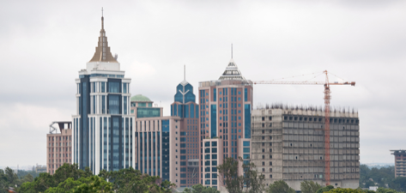
What is the situation?
U.S.
India
~8 quads
~38 quads
Buildings consume ~40% of total energy
Buildings consume ~30% of total energy
Total energy use= ~97 Quads (EIA 2018)
Total energy use= ~24 Quads
8% annual growth in building energy
(100 kBtu/sqft-yr)
(70 kBtu/sqft-yr)
Skyrocketing building energy use
SOURCES: EIA (2018), IEA (2015)
MOSPI (2017)
Notes:
India 5th largest economy @ $2.6T, aspirations to $5T by 2025
Huge growth in infra- Power and Real estate
Urban infra growth: As an example. Steel and cement causing 5X growth in energy use , 7.3 EJ (2015) to 36 EJ (2050) while China ($ 12T is tapering off, trajectory downwards reducing from 55.3 EJ to 52 EJ (2050).
Steel sector is coal –intensive, not transitioning to lower C fuels (LBNL 2018)
Power needs to 3X from 150GW today to 450 GW by 2036 = ~$25B investment (Central Electricity Authority, 2019).
Buildings are a third of the country’s energy use, and that is increasing rapudly
-----
US US buildings use 40% of all energy and 70% of all electricity — highest of all sectors, and increasing faster than others (Coffey, 2009; Majumdar, 2009)
U.S. commercial building average EUI
Year 2003: 298 kWh/m² (Source: CBECS)
(≈ 100 kBTUs/sqft)
India
India’s buildings account for 33% of the nation’s energy use, and this is growing by 8% annually (ClimateWorks, 2010).
Indian commercial building average EUI
Year 2010: 202 kWh/m² (Source: ECO-III)
(≈ 69 kBTUs/sqft)

Slide 5
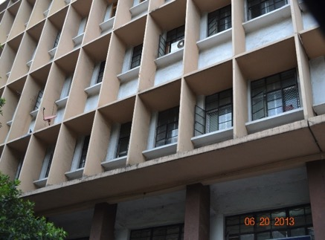
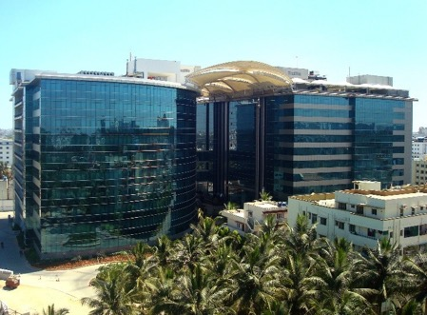
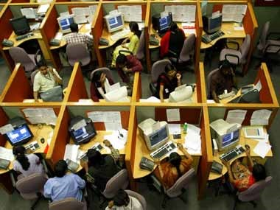
Why are we in this situation?
Why?
Not only is the commercial buildings sector energy use growing rapidly at 8% annually, unsustainably planned and constructed buildings are causing severe environmental impacts
0
Notes:
Why do it? Motivation and crises
Buildings are a third of the country’s energy use
RE market size 8X from $120B (2017) to projected $1T (2030)
Explosive growth: 660 M sqmt (2018) to 1.9 B sqmt (2030), biggest growth sectors are IT, ITES, Consulting and retail. Also are the biggest, growing energy users due to typology of building- glass facades, air conditioning, computation load, multiple shift operations etc. (3x 3x 3x SLIDE)
30-50% waste in buildings in not uncommon. In correct building and operating practices have economic cost, environmental cost, social health cost (SLIDE)
But new buildings are promising opportunities for fast and deep sustainability.
Trends: Aspirational to buildings, millennial who are technophiles, Increasing co-working new trends, leading corporates environmental oriented
Acc to UNEP, buildings account for 18% of total global CO2 emissions, and this will double by 2050. But while bldgs are a major contibutor to global emissions, the also hold the most potential to deliver significant cuts in emissions.
US US buildings use 40% of all energy and 70% of all electricity — highest of all sectors, and increasing faster than others (Coffey, 2009; Majumdar, 2009)
U.S. commercial building average EUI
Year 2003: 298 kWh/m² (Source: CBECS)
(≈ 100 kBTUs/sqft)
India
India’s buildings account for 33% of the nation’s energy use, and this is growing by 8% annually (ClimateWorks, 2010).
Indian commercial building average EUI
Year 2010: 202 kWh/m² (Source: ECO-III)
(≈ 69 kBTUs/sqft)

Slide 6
Why should we care?
PLANET: Environmental impact
Urban heat, natural resource depletion, extreme events, emissions, particulates
High
energy-use
design and operations
Pollution,
Poor health, Expensive operations
=
A high toll
Why?
PEOPLE: Societal impact
Health symptoms, thermal and visual discomfort, loss in productivity
PROFITS: Financial impact
High cost of facilities management, waste, churn, and vacancy
Notes:
Waste- lights left on, AC of areas or times that don’t need, bad design practices leading to high solar heat gain and glare. …

Slide 7
What changes do we need to make?
DECARBONIZE
Innovative combinations of wisdom and technology to reduce carbon footprint of buildings
DIGITIZE
Data-based approaches for design and operations of high-performance buildings
What?
DEMOCRATIZE
A shared mindset for stakeholders with triple-bottom-line values
Notes:
The BIG guide from Berkeley Lab
Berkeley Lab has deep roots in building science in the U.S and CA., Build on Art Rosenfeld’s work, that has kept the per capita energy use in CA constant for the past 40 years even though the GDP of CA has grown several fold. Infact CA is #5 economy in the world, at $3T.
Led a five-year program, Through a US-India bilateral energy cooperation program, to advance building energy efficiency.
Conducted years of on-the ground research, Modeling simulations, and experts benchmarking to develop the guide
Provides metgidological framework and best practices approach to deliver the theory of change: DDD

Slide 8
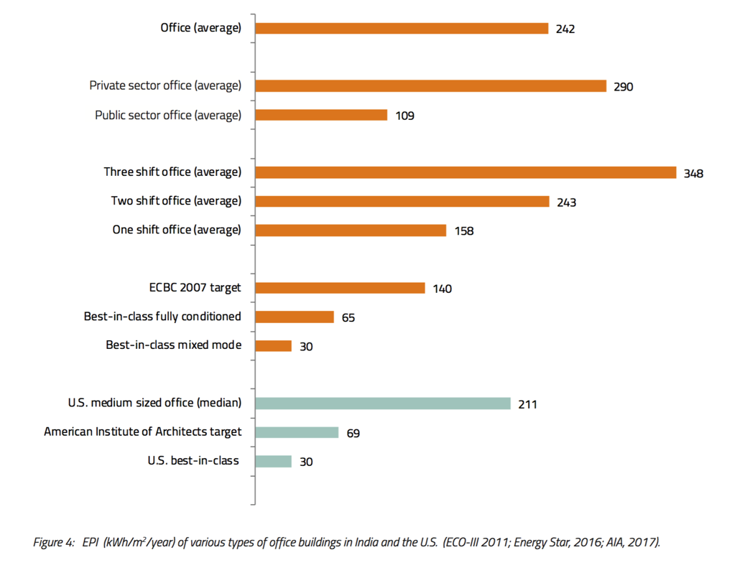
What are the benchmarks?
What?

Slide 9
What vision and targets are needed?
What?
Buildings that use a quarter of the energy while enhancing healthy and productive spaces to work and live in.
Notes:
Where are you trying to achieve: Vision and targets
BIG vision for green, smart, high-performance buildings:
Imagine buildings that uses a quarter of the energy per person while providing healthy and productive spaces to live and work in.
If standard buildings use 240 units of energy/sqmt/y to provide space, equipment and comfort, then target is air conditioned that use a quarter of that, 60, and eventual goal is partially AC’d, i.e. 30.
Codes get you to around Half.
These targets are from triangulating real data from 15 best in class buildings in the Indian climate zone, generating 40 EnergyPlus models for India, and benchmarking with expert opinion and other data.
That matches best practice around the world

Slide 10
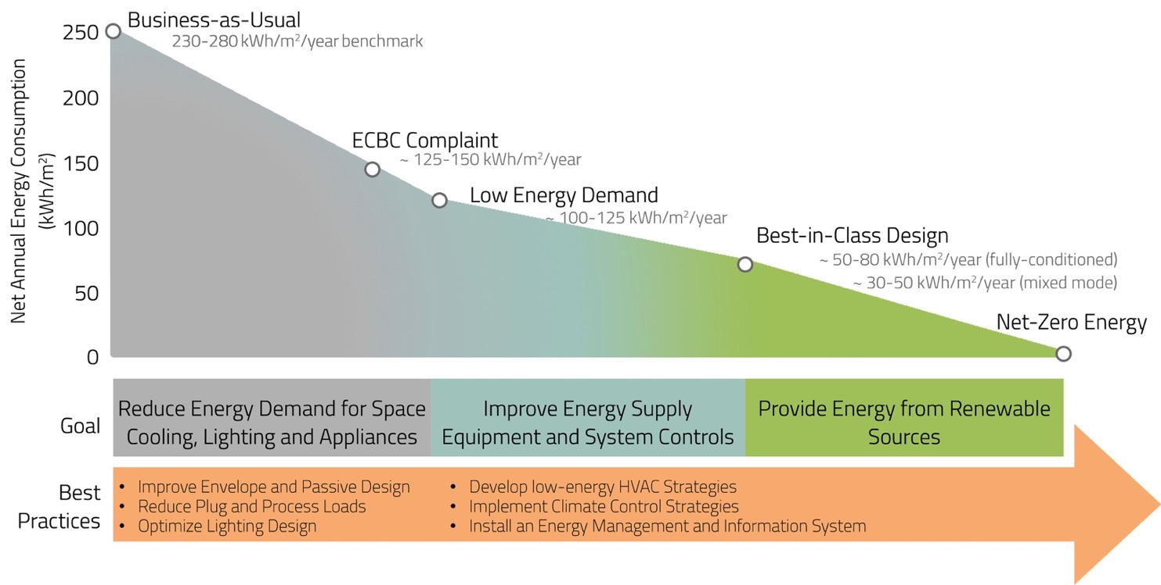
How do we achieve those targets?
How?
Develop a sequential approach with suites of energy conservation measures for building design and operations

Slide 11
Baselines
Common practice Envelope and Systems
Bldg. Dimension: 50 x 33m | Shell Composition: Brick | Wall: U = 2.18 W/m²K | Roof: U = 2.18 W/m²K | Solar Reflection: 30% | Thermal emittance: 90%
Windows: Simple Glazing, Aluminum Frame | WWR = 80% | U = 5.62 W/m²K | SHGC = 0.48 | VLT = 48%
HVAC System: PTAC VAV Multi-Zone with Water Cooling Coil | Chiller: COP = 5.1 | VAV Terminal with Electric Reheat
Occupancy: 10 m²/pers | LPD = 10 W/m² | Plug Loads Density = 10.8 W/m² | Ventilation = 8.5 m³/h/pers + 1 m³/h/m²
BAU
ECBC-compliant Envelope and Systems
Shell Composition: Brick, Glass Wool | Wall: U = 0.44 W/m²K | Cool Roof: U = 0.41 W/m²K | Solar Reflection: 70% | Thermal emittance: 90%
Windows: Double Glazing, Vinyl/Wood Frame | WWR = 50% | U = 3.30 W/m²K | SHGC = 0.22 | VLT = 50% | Overhangs depth: 0.6 m
LPD = 10 W/m²K | Plug Loads Density = 10 W/m²K
ECBC
Best Practices (BP) Cases
Optimized Envelope
Building Dimension: 80 x 20m
Window-to-Wall Ratio: North = 40% / South = 30% / East and West = 0%
Fins on North Façade and Overhangs on South (depth depending on location)
BP1
Reduced Internal Loads
LPD = 5 W/m² | Plug Loads = 7.5 W/m²
Daylighting Control: Two sensors (3m and 6m away from window) | Setpoint: 300 lux
BP2
Night Flush
Purge Flow Rate: 5 ACH
Trigger: Tout < Tins
Minimum Tins = 25°C
Radiant System
Loop: 12°C – 16°C
Heat Pump: COP = 5
VRF System
CAV Ventilation
Cooling System COP = 4
One Evaporator per Zone
BP3
BP5
BP7
Mixed Mode
Natural Ventilation: 5 ACH
Control: Maintaining 80% adaptive comfort
HVAC Suite
Radiant Ceiling + passive cooling strategies
Chiller COP = 7
BP4
BP6
Notes:
Assumptions squint tested by experts
ACH instead of vol/h?
Radiant + passive cooling strategies (night flush)

Slide 12
How?
Performance data analysis from 15 exemplary buildings and 176 models
across 4 climate zones

Slide 13
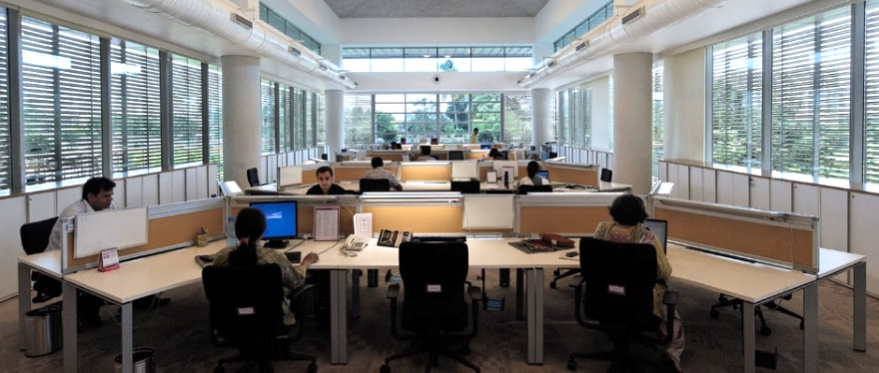
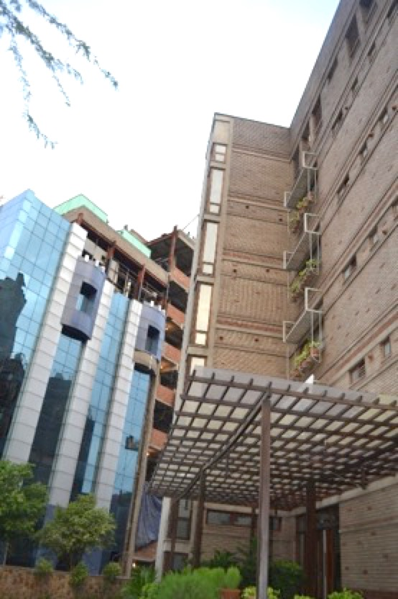
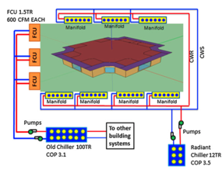
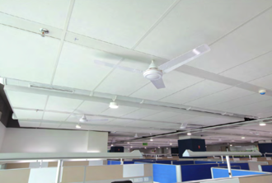
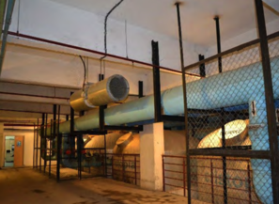
How?
1a. Window and shading design, Hyderabad ; 1b. Vegetated roof, Mumbai
2. Glare-free daylighting and narrow floorplates, with reduced artificial lighting, Pune
A study in contrasts, Delhi
3a. Radiant slab cooling, Hyderabad
3b. Chilled beans and ceiling fans for low energy cooling, Bengaluru
3c. Underfloor air distribution, Gurgaon
3d. Thermal storage and district energy system, Mumbai
Decarbonize: Envelope→ Plugs +Lighting → Air conditioning

Slide 14
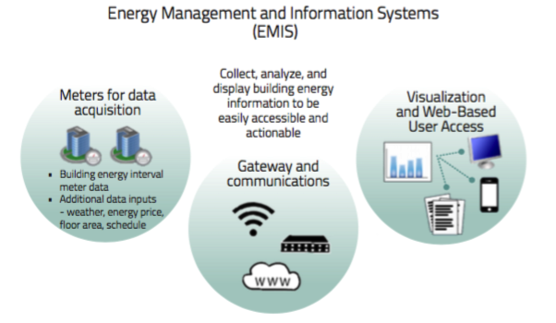
How?
Digitize: Data-driven insights through energy management and information systems

Slide 15
Schedule
PROFIT
Financial
Capital
PLANET
Natural
Capital
Quality
and
Performance
Scope
Cost
PEOPLE
Human
Capital
How?
Democratize: Establish a Triple Bottom Line Framework for Building Investment Decisions
Notes:
This is not a new standard or rating system
We recommend a framework, and suggest ways of meeting the goals of the holistic framework
Financial capital includes LCC Capex, Opex, O&M, PLUS Replacement

Slide 16
8 Key Metrics
Environmental Metrics
1. Whole-building and systems energy use [kWh/m2/ year]
2. Annual energy use per occupant [kWh/ year / person]
3. Whole-building and systems peak load [W/m2]
4. HVAC plant efficiency [kW/TR]
^{5.} Cooling load efficiency [m2/TR]
^{Financial Metrics}
^{6. Cost [INR/sqft]}
^{7. Payback period [years]}
^{Comfort Metrics}
8. Ratio of uncomfortable hours to total occupied hours
How?

Slide 17
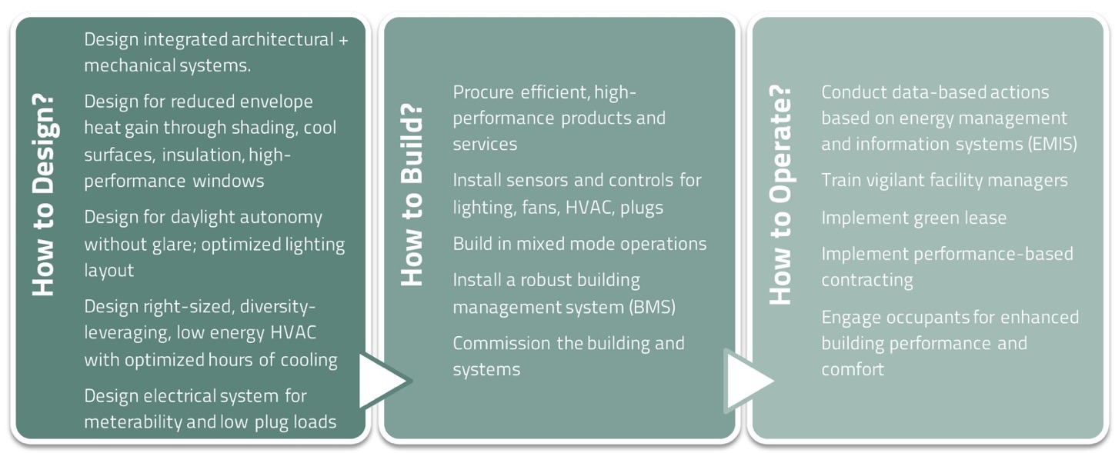
Value

Slide 18
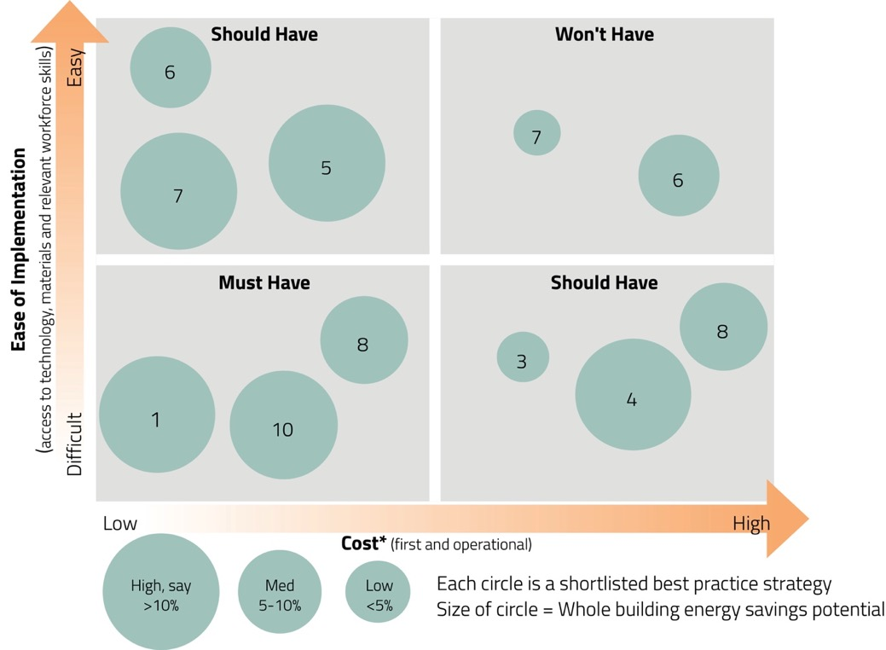
MoScoW matrix for buildings
Value

Slide 19
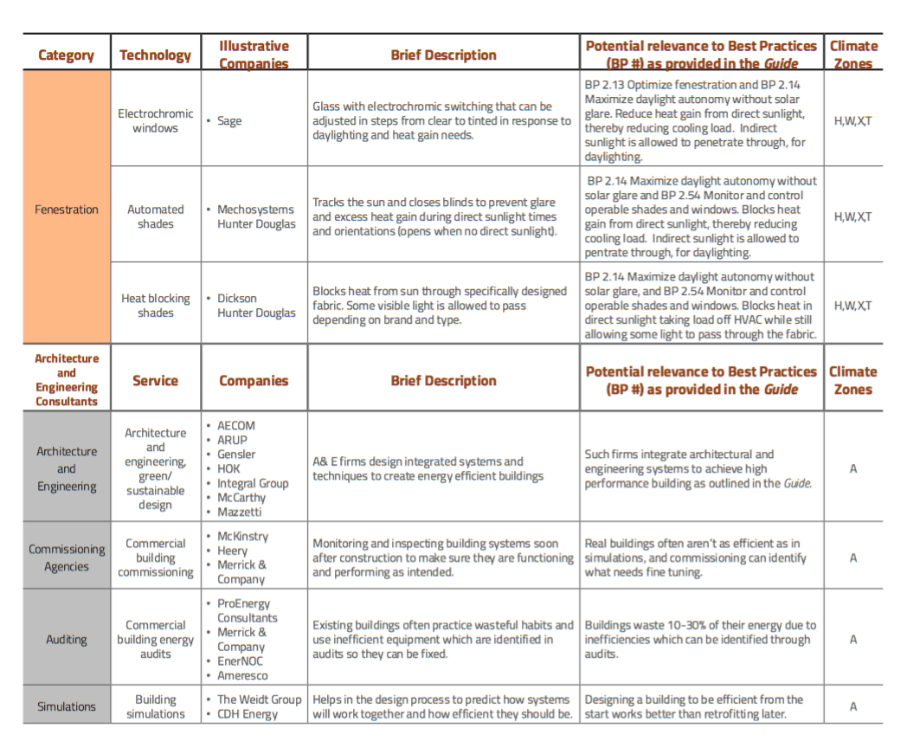
Value

Slide 21
This Building Innovation Guide authored by Lawrence Berkeley National Lab, USA provides technical recommendations for achieving high-performance Indian office buildings that are smart, green, and energy efficient. The best practices recommended in the Guide are particularly suited to the climatic, cultural, and construction context of India, thereby offering localized solutions.
Building Innovation achieved through the mantra- Decarbonize, Digitize, Democratize

