Slide 1
High Performance Buildings A Case Study
15th July, 2019
Damodhar Reddy Racherla

Slide 2
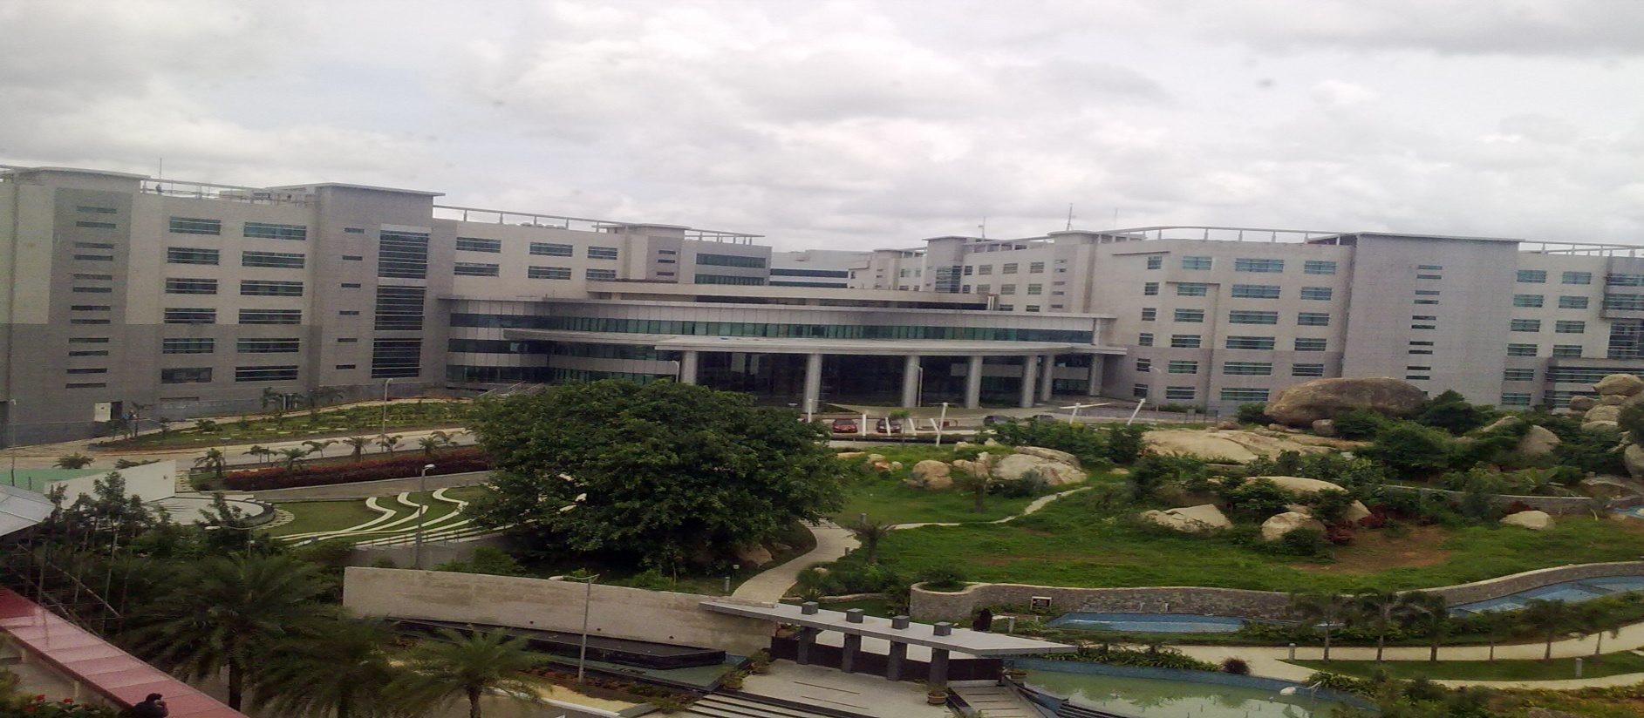
High performance of building is not a destination, it’s a journey…….”
Evolution of Building Performance @ Tech M

Slide 3
Index
Introduction
Evaluation of Building performance @ TechM
Case Study

Slide 4
The Consumption Spread

Slide 5
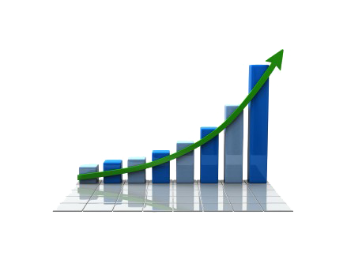
Building Performance Journey of TechM
Now, 175 units consumption PAPM
250 units consumption PAPM
2003-2004
2018-2019
Sustainability development
Focus on business benefits

Slide 6
Improvements Happened
LIGHTING
HVAC
IT LOAD

Slide 7
The Evolution: Air Conditioners
2003-2004
Reciprocating Chillers
R 22, R 12 Refrigerants
Scroll chillers
Primary & Secondary Chilled water pumps with VFDs
2018-2019
Screw Chillers
Centrifugal Chillers
Packaged AC
FCU
VRF
VAV
VFD
HRW
Magnetic Levitation Chillers
Radiant Cooling

Slide 8
The Evolution: IT Load
Green Data Centeres
TFT Monitors
Laptops
Non Standardised Server rooms
CRT Monitors
2005
2019
Server Load Optimisation
Server Rooms Consolidation
Servers Virtualisation
Star Rated Desktops
Cloud Based
LED Monitors
Handheld devices
Notes:
held

Slide 9
The Evolution: Lighting
Incandescent
CFL
LED
T5
FTL
IoT Based LED
Sensor Based

Slide 10
Case studies:
HT Ring main system for a large campus.
Radiant cooling system.

Slide 11
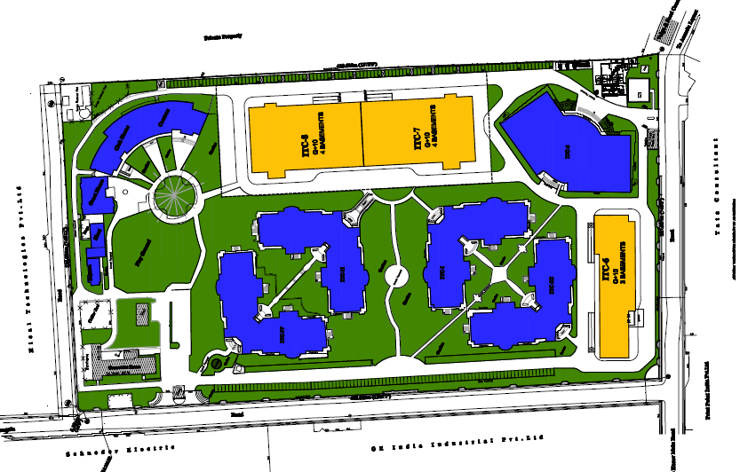
66/11 KV RING MAIN DISTRIBUTION SYSTEM
66/11KV Sub-station
Cafeteria
Tower-7
Tower-5
Tower-2
Tower-3
Chiller yard
Tower-6
Tower-1
Tower-4
DG Bank
BUSINESS BENEFITS: 1. Existing DG Sets 15Nos - 18500 KVA ( Range 380-1500 KVA) Replaced with 5Nos - 10,000 KVA (2000KVA each).
Huge reduction in operating cost and easy in operation
2. SCADA monitors and control. 3. Reduction in Maintenance cost. 4. Productivity and Efficiency has increased. 5. Real-time and historical data.

Slide 12
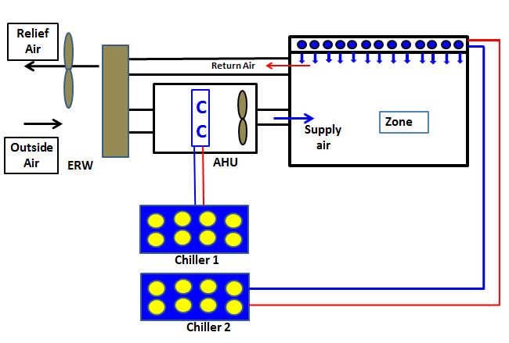
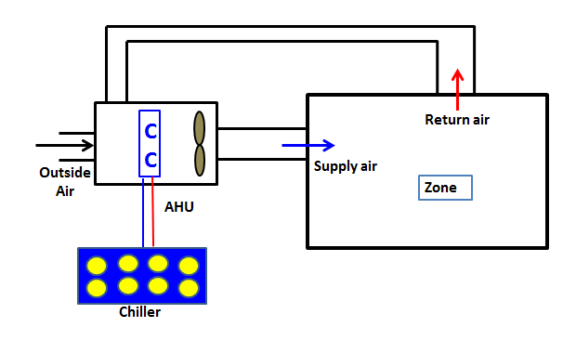
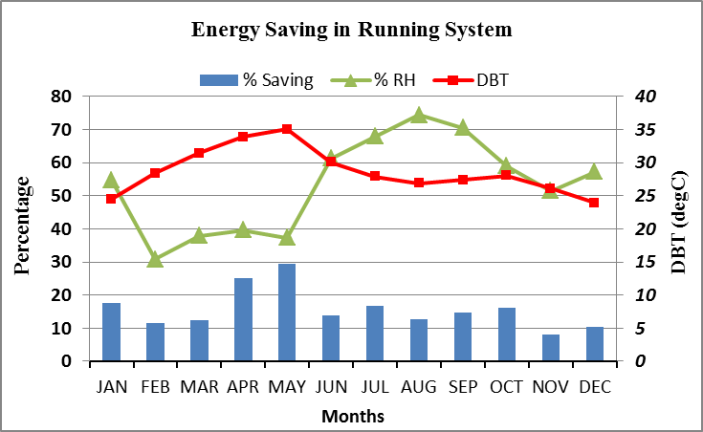
Radiant Cooling System Schematic & Energy Saving Pattern
Schematic of Radiant System with DOAS
Schematic of Conventional Case
Energy savings for Running Case over Conventional Case

Slide 13
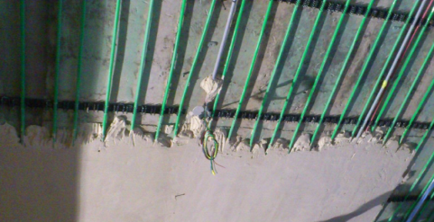
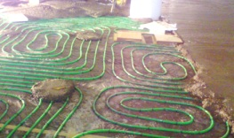
Radiation Cooling System - Versions
Ceiling Cooling System
Floor Cooling System
BUSINESS BENEFITS: 1. Better Indoor Air Quality
2. Energy Savings – 30%
3. More Uniform Temperature

