Slide 1
Free Cooling to Optimize Operational Expenditure
NetApp Bangalore Campus (NBC)
Mario Dias
WPR Program Manager

Slide 2
Contents
Introduction
NetApp
  Objective
  Campus details
Free Cooling
  Water Side Economizer
  Air Side Economizer
Results achieved
Conclusion

Slide 3
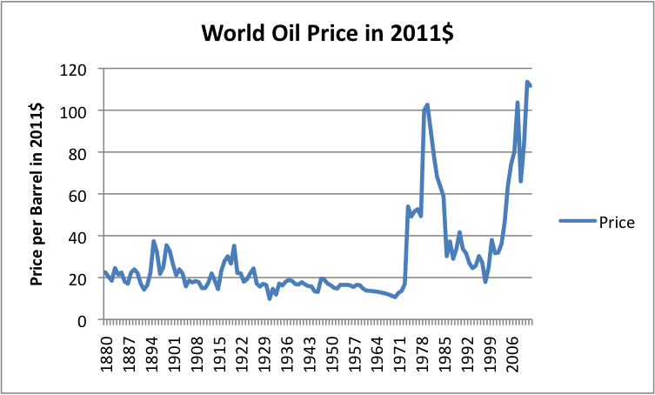

Introduction
Operational Cost
Energy Crisis
Global Warming
Global Scenario

Slide 4
NetApp Objectives
Design and Construction of New campus
“The NetApp India campus is built to embrace sustainability as a core value ”
- Mr. Deepak Visweswaraiah, Managing Director
Largest Consumer → Data centers
      Data Centers will keep on multiplying globally as dependence on Data will increase multifold
Goal
PUE of <1.3
Least impact to environment (Global warming)

Slide 5
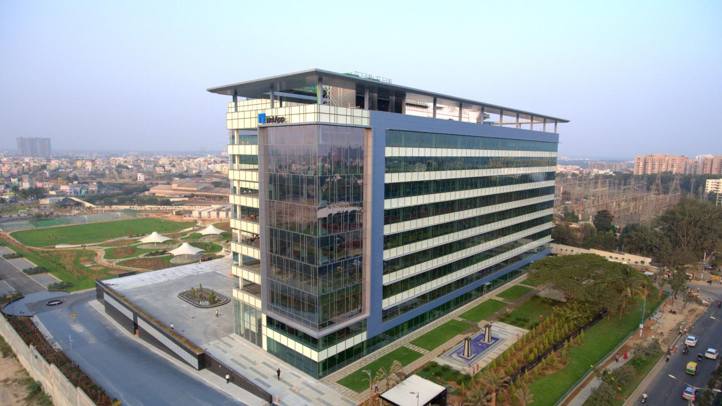
NetApp Bangalore Campus
Hoodi, Bangalore
IGBC Platinum
15 acre Campus
1 million sq.ft floor space
Data center with 546 racks
Roof Top Solar
Rain Water harvesting
3300 Work stations

Slide 6
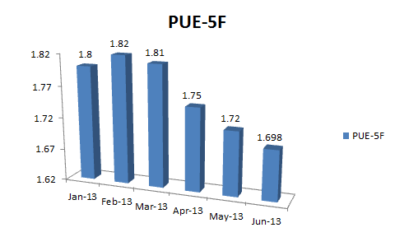
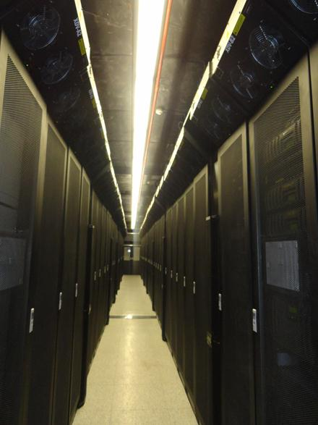
Existing Datacenter-NetApp EGL
Build Year 2013
Extreme Density In Row Cooling system
Modular, Scalable UPS system
“Hot
Aisle”
Cold
Aisle
“Hot
Aisle”
Side View

Slide 7
Approaches
To Achieve the Objectives
Design
Selection of Equipment
Cooling
Free Cooling
Air Side
Water Side
Conventional Cooling
Condenser
Air cooled
Water Cooled
After a lot of deliberations, decided on Water Cooled condenser with Air Side Economizer

Slide 8
Normal Cooling
Filter Box
Free Cooling Air
Duct
During normal Cooling, cooling is fed by
chillers,
The louvers and Free cooler dampers
Are closed as shown.
The PAC/AHU bypass valve will be closed
100%
Mixer Box
Fan
Hot Aisle
Cold Aisle
Hot Aisle
Cold Aisle
Open
Rack
Rack
Closed

Slide 9
Free Cooling
Filter Box
Free Cooling Air
Duct
During Free cooling, fresh air from roof
fop will enter cold aisle directly after
Filtration.
The louvers will be opened to pump out air
from Hot Aisle.
The PAC/AHU bypass valve will be opened
100% to Shutoff the chillers
Mixer Box
Fan
Hot Aisle
Cold Aisle
Hot Aisle
Open
Rack
Rack
Closed

Slide 10
Results
PUE Comparison
2013 | PUE
Jan | 1.80
Feb | 1.82
mar | 1.81
Apr | 1.75
May | 1.72
Jun | 1.70
2019 | PUE
Jan | 1.24
Feb | 1.26
mar | 1.28
Apr | 1.29
May | 1.29
Jun | 1.24

Slide 11
Way Forward
FY 2020
Goal to achieve a PUE of <1.2
Standardize the ASE design for future builds

Slide 12
Thank You

