Slide 1




In partnership with
Internet Of Things (IOT) in Buildings
USE IN DECISION MAKING
SCCP II – Green Buildings & Innovation, Hyderabad

Slide 2











Ecolibrium through the years
June 2010-May 2011
2011
2012
Regions covered:
04
Clients: 90
Regions covered: 09
Clients: 128 Award
Global Entrepreneurship Award,
Barcelona (2012)
Seed funding from CIIE,
IIM - Ahmedabad
2015
2014
2013
Installations: 255
Installations: 210
Installations: 170
Team size: 11
India Power Award (2013)
Presence in Saudi and Malaysia
Climate Solver (2013)
Most Innovative Energy Efficiency Product (2014)
UNFCCC Lighthouse Activity (2014)
2016
2017
2018
Installations: 370
Installations:
545
Installations: 700+
Team size: 75
Global Recognitions
Presence in India, Middle East and South East Asia
Marico Innovation Foundation Award for best start up in India
Notes:
Ecolibrium Intro - 8 year old IOT based predictive analytics company
Active at 700+ factories across 300+ customers
Funded by World bank, JLL, Infuse VC
Awarded by UNFCCC, Ashden, Marico & Schneider
Recognized by ET Markets & Markets as only Indian IOT company among 6 others

Slide 3












































700+ Installations across 250+ global organizations
FMCG
Automobile
Pharma & Chemical
COMMERCIAL BUILDINGS
UTILITIES
OTHER MANUFACTURING
OEM
PARTNERS
GLOBAL RECOGNITION
Most Innovative Energy Efficiency Product
Energy Management
Best Practices Award– 2016
Global Climate
Solver Award
International Ashden Award
Lighthouse Activity
Notes:
IOT footprint in buildings is on the rise
Customers are more energy conscious, want more insights from daily data to take CAPEX & OPEX decisions
Most of use-cases centered around Overall facility Energy & HVAC

Slide 4

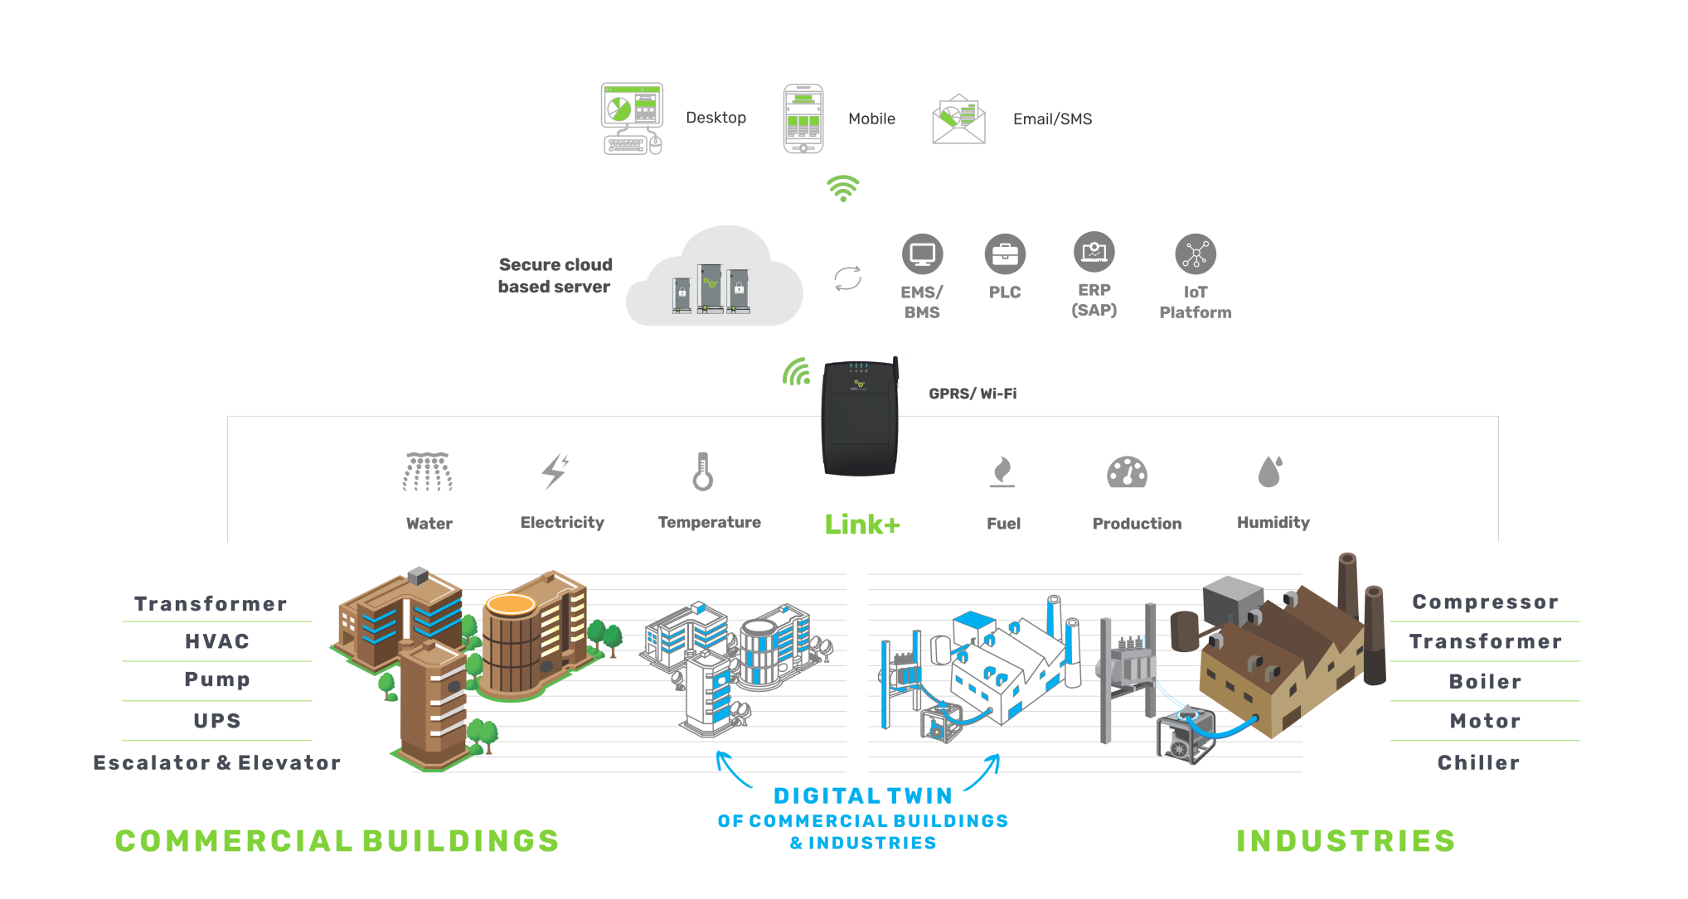
SmartSense: An end-to-end solution in your Enterprise 4.0 journey
Reduce Asset Downtime
Identify asset degradation |
Root cause & Recommendation
#PredictiveMaintenance
#ReduceMaintenanceCosts
Reduce Energy spent
Energy analyses & network leakage identification| Root cause & Recommendations
#EnergyEfficiency
Real-time monitoring
#Digitization
Notes:
Full Stack Platform : Strong Acquisition Layer – Different types of Sensors & Protocols
200+ million data points from 20K+ sensors sent to SmartSense application everyday (AWS-hosted)
4000+ equipment on board
AI & ML models use 4TB Data + Domain – Brand Agnostic & proven

Slide 5


Creating Impact with IOT – Electrical data monitoring
The business problem
Make buildings ‘Smart’ by moving to a Predictive maintenance regime
Result
Downtime period of 1 working day was avoided due to timely intervention
Breakdown and Energy costs amounting to US$ 50,000 were avoided since the fault was detected at an early stage & rectified
We are helping our clients
optimize their maintenance costs by 30% using the powerful insights provided
by SmartSense.”
Rajat Malhotra
COO – Integrated Facility Management
(West Asia), JLL
Notes:
Min. Sensor approach – Only EM data used for building models & identify anomalies
Decreases time for making decisions - Data converted to actionable insights which can be immediately acted upon
Immediate ROI – can be achieved easily (within a couple of faults identified)

Slide 6

Creating Impact with IOT – Temperature Data Monitoring
The business problem
Make buildings ‘Energy efficient’ by reducing energy wastages
Result
Energy savings amounting to US$ 1,000 per month were realized after identification of low temperature & correcting these issues
We are helping our clients
optimize their maintenance costs by 30% using the powerful insights provided
by SmartSense.”
Rajat Malhotra
COO – Integrated Facility Management
(West Asia), JLL
Notes:
Simple Data can create Huge Impact – Temp. monitoring can help identify AC failures & energy wastages

Slide 7
Helping Enterprises improve their asset efficiency
Using IOT powered predictive analytics
Full-stack solution
Integration with PLC, sensors, SCADA
Store cleaned data-stream in AWS/ private cloud
Energy, Power KPI
Other analytics
Visualization
Visualization
Integrated dashboard of Network & Assets; providing –
Condition based Monitoring
Detailed alerts & alarms
Asset/network Health report
Anomalies/early faults
Recommendation
Benchmark (internal)
Robust data acquisition in weeks
Repair / Replace
Alternate Technology
Savings, ROI
Data-driven asset performance; moving from preventive to predictive maintenance
Decisions to improve Overall Energy Efficiency
Notes:
How IOT converts Data to Decisions
Data Acquisition – From existing available sensors & if reqd. new sensors
Data Processing – Cloud storage, AI, ML
Data Analytics – CBM, PdM, Alerts, Reports, Insights, Recommendations

Slide 8
The digital transformation journey
01
Enterprise Dashboard
UNDERSTAND REQUIREMENTS FROM FACILITY MANAGERS
UNDERSTANDING OF EXISTING INFRASTRUCTURE
DIGITIZATION
PLAN
Reduction in unscheduled downtime
02
Condition Monitoring
Reduction of maintenance cost
03
Enterprise Insights
Reduction of energy cost
04
Predictive Maintenance
LAYOUT OPERATIONAL KPI’S
BUILD AN IOT ROADMAP
USER PERSONA IDENTIFICATION
Consulting
Implementation
Impact
Notes:
Planned Approach - Digitizing everything might not be a solution
Consulting – Clearly defined stages to reap benefits at every stage
Implementation – Execute with clear deliverables (Dashboard, Widgets, KPI, etc.)
Impact - Measurable in terms of energy spent & maintenance cost

Slide 9

START YOUR IOT JOURNEY WITH SMARTSENSE TODAY.
Ecolibrium Energy Pvt. Ltd.
India |Singapore | UAE
www.ecolibriumenergy.com | info@ecolibriumenergy.com

