Slide 1
ECBC to Induce Energy Efficiency In Buildings
Rajkiran V Bilolikar,
Associate Professor
Energy Area, ASCI

Slide 2
Context
Building energy codes represent a significant savings opportunity for U.S. home and business owners. Model energy codes¹ for residential and commercial buildings are projected to save (cumulative 2010-2040):
$126 billion energy cost savings
841 MMT of avoided CO₂ emissions
12.82 quads of primary energy
These savings equate to the annual emissions of:
177 million passenger vehicles
245 coal power plants
89 million homes²
Indian Context -
From 400 towns – to 2000 cities by 2050 in India¹
India will add 1 billion m² of new commercial building space by 2030 - BEE
With Energy Codes (ECBC)
90014 Gwh savings potential in new buildings by 2030
8700 Gwh savings potential in existing buildings
By adopting ECBC 2017, BEE predicts
300 BU Energy Savings
15 GW Peak Demand Reduction
250 mtCO2e GHG Abatement
Rs. 35000 Crores Savings
1 PURA – P.S RAO

Slide 3
ECBC – Energy Efficiency in Building Sector
Energy Conservation Building Codes (ECBC)
  Minimum energy efficiency standards
  Applicable to large commercial buildings
  (connected load of 100 kW/contract demand of 120 kVA and
  above)
ECBC prescribes standards for:
  Building Envelope (Walls, Roofs, Windows)
  Lighting (Indoor and Outdoor)
  Heating Ventilation and Air Conditioning (HVAC) System
  Solar Water Heating
  Electrical Systems

Slide 4
Key Features of ECBC
Applicable for all commercial buildings with connected load of 100kW or greater/ contract demand of 120kVA or greater.
ECBC focuses and set standards on Building Envelope, Lighting, Heating, ventilation and Air conditioning (HVAC) System, Service Water heating and electrical, renewable energy systems
Introduction of three levels of compliance: ECBC (mandatory), ECBC Plus and Super ECBC (voluntary).
Daylighting requirements are mandatory to follow.
Targeted for net zero energy buildings in future

Slide 5
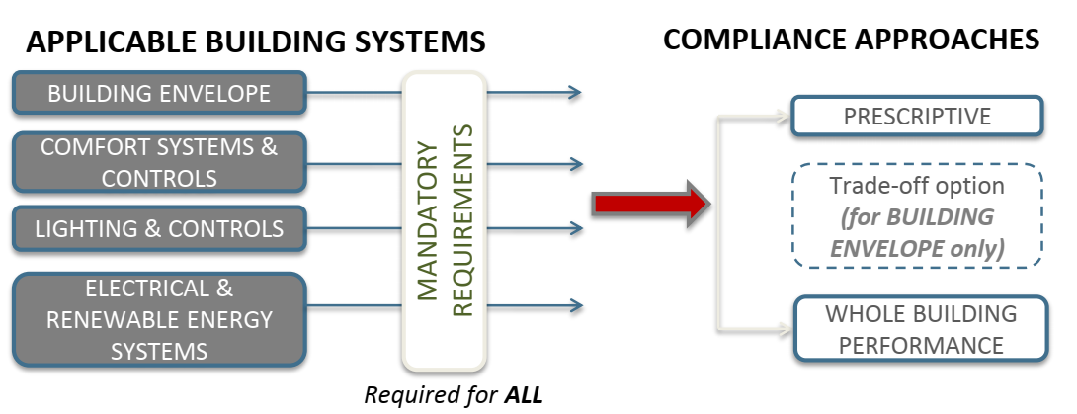
ECBC – Applicability and Approaches

Slide 6
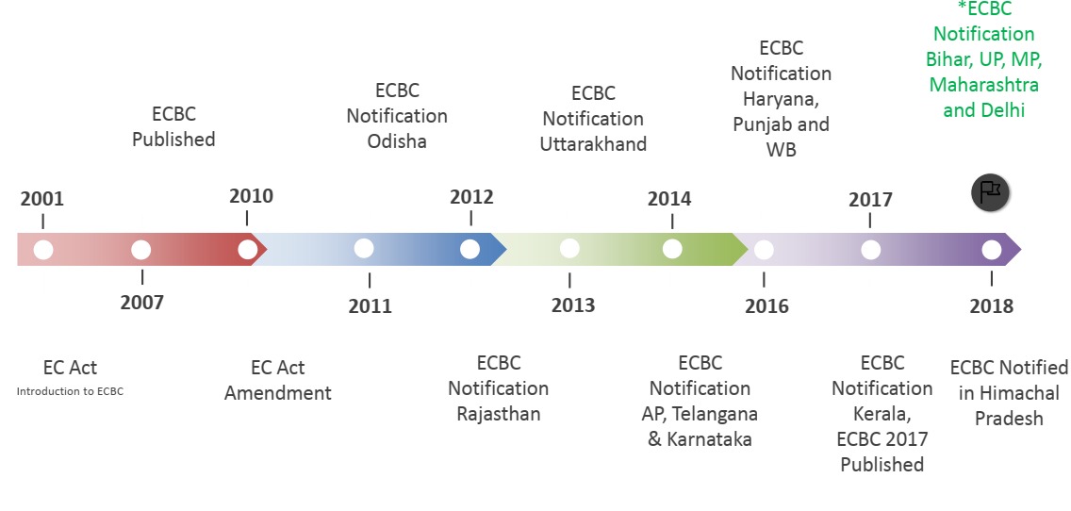
ECBC Implementation – National Time Line

Slide 7
ECBC Implementation in the State of Telangana
Bifurcation into Andhra Pradesh and Telangana
Needs Assessment Workshops on Energy Efficiency
ECBC Technical Steering Committee formed
Coalition Building and Outreach
Notification of Code Adoption G.O. 30
Hyderabad Pilot Compliance Framework
Capacity Building and Training
2010-11
2011-12
2012-13
2013-14
2014-15
2016-17
Extensive stakeholder consultations and awareness building about ECBC
Formation of a steering committee and a technical committee to inform process and adapt ECBC to local bylaws
Notification of ECBC through amendment to G.O.M.S.168 i.e., G.O.M.S. 30 dt. 28.01.2014.
Implementation of ECBC in the state of Telangana
42 empanelled consultants in Phase 1 and 31 in Phase 2
Empanelment of architects (Third Party Assessors) – First in India
Training completed – more than 280 government officials, real estate developers
Trained more than 130 architects, MEP consultants
Telangana already incorporated ECBC in online Building Construction approval System and created new system of energy efficiency compliance in Building construction Approval (First time in India)

Slide 8
HYDERBAD – ECBC APPROVAL PROCESS
TPA 1- DESIGN STAGE CERTIFICATE
TPA 2-OCCUPANCY STAGE CERTIFICATE

Slide 9
Key Features of TSECBC
Applicable for all commercial buildings with connected load of 100kW or greater/ contract demand of 120kVA or greater/ plot area of 1000 m2 or greater/ built up area of 2000 m2 of greater
Simplified requirements only for composite climatic zone as Telangana has only composite climate.
Incorporation of Cool Roofs as mandatory clause in TSECBC 2019. Telangana goal of 300 sq.km of roof conversion to cool roof by year 2030.
Incorporation of Electric vehicles infrastructure as mandatory clause in TSECBC 2019.

Slide 10
TS ECBC – Electrical Vehicle Provision
TS* - building shall be EV capable.
TS** and TS*** - building shall be EV ready
Pre-installed charging spaces be at a Level 2 minimum (208V-240V/40A)
Require the main electrical panel be installed with sufficient capacity to support at least 20% of the parking spots
Consider having each parking spot “EV capable” by having conduit and sub-panels pre-installed
Certified electrical contractors to install AC and DC surge protection devices required for the chargers

Slide 11
Cool Roof Targets
Hyderabad Year 1 Goal: 100,000 sq.m of cool roofs citywide (equivalent to 1,000 roofs)
Hyderabad Year 5 Goal: 30,00,000 sq.m of cool roofs citywide (equivalent to 11,000 homes) and 100 government buildings in the state retrofitted including cool roofs
Hyderabad Year 10 Goal: 100,30,000,000 sq.m of cool roofs citywide (equivalent to 11,000 homes), 20,000 low cost housing units across the city have cool roofs and 1000 commercial buildings
Year | Hyderabad Cool roof area (sq.kms) targets | Telangana Cool roof area (sq.kms) targets
2019-20 | 0.1 | 0.1
2020-21 | 0.2 | 0.2
2021-22 | 0.3 | 1
2022-23 | 0.7 | 2
2023-24 | 1.7 | 5
2024-25 | 3.3 | 10
2025-26 | 6.7 | 20
2026-27 | 12.3 | 37
2027-28 | 25 | 75
2028-29 | 50 | 150
2029-30 | 100.3 | 300.3
Telangana Year 1 Goal: 100,000 sq.m of cool roofs in state (assuming its only Hyderabad)
Telangana Year 5 Goal: 83,00,000 sq.m of cool roofs citywide approx. equivalent
Telangana Year 10 goal: 300,30,000,000 sq.m (300.3 sq.kms) of cool roofs state wide

Slide 12
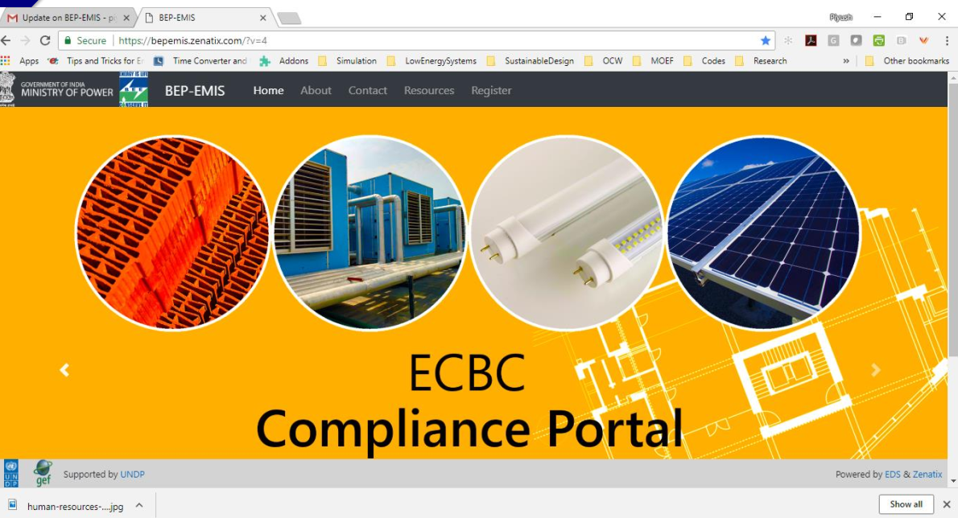
Ensuring Compliance – Support from BEE

Slide 13
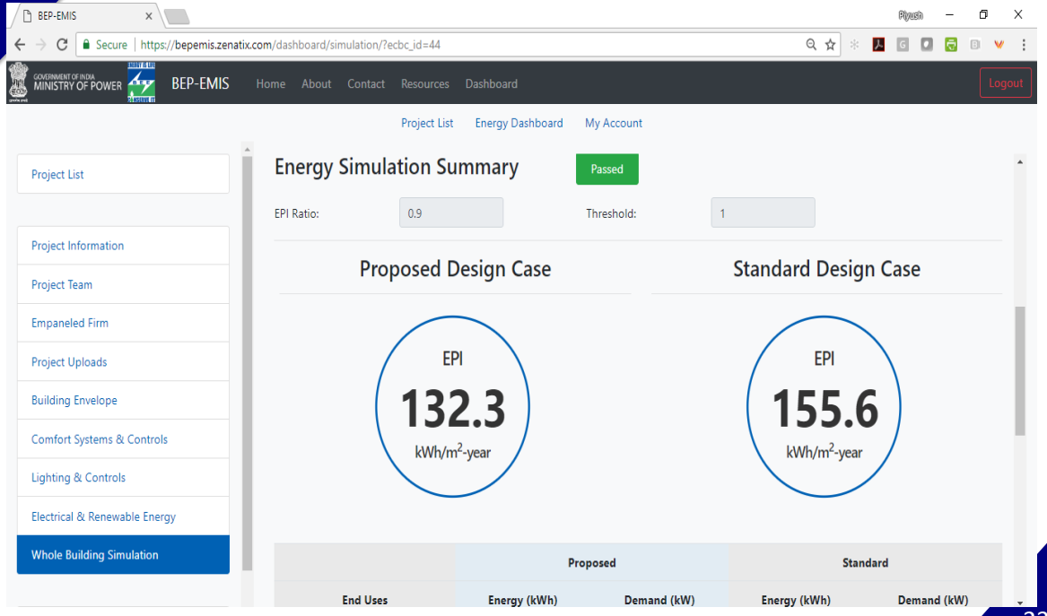
Energy Simulation Output

Slide 14

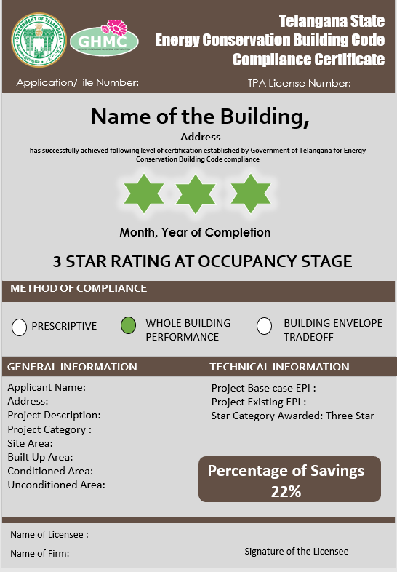
ECBC Certificate Format
TPA 1 - Issues certificate in Design Stage
TPA 2 - Issues certificate in Occupancy Stage

Slide 15
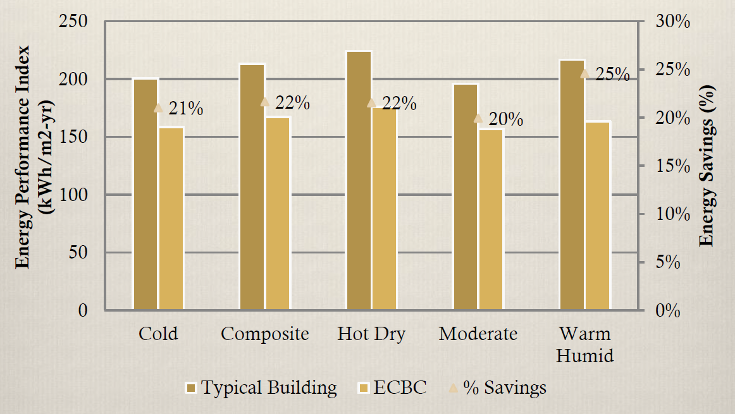
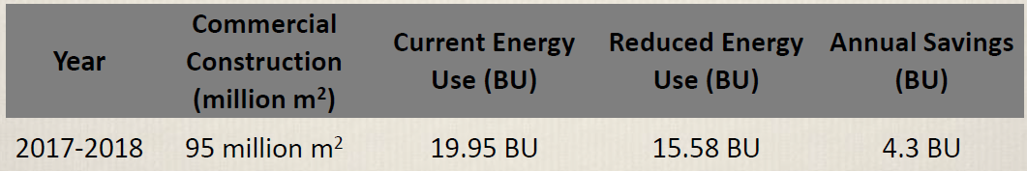
Potential Impact of ECBC
As per a study conducted by Bureau of Energy Efficiency (BEE), mandatory enforcement of ECBC has potential of yielding a savings of 4.3 billion kWh and 3 Million metric ton of CO2

Slide 16
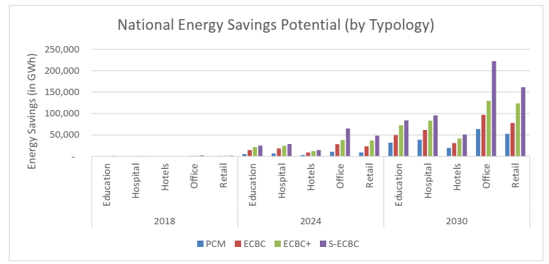
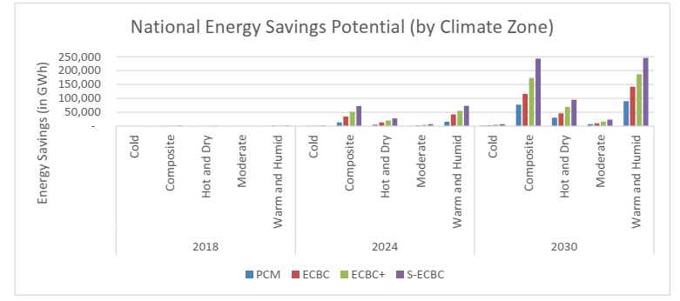
National Energy Savings Potential
EDS with BEE projected National Energy Savings by typology and Climate Zone
In office buildings and Retail, the savings will cross 200,000 Gwh by 2030
By Climate Zone, in Composite and Warm and Humid Climate, the savings will reach 250,000 Gwh

Slide 17
THANK YOU
Rajkiran V Bilolikar
Associate Professor
Energy Area
Administrative Staff College of India,
Bella Vista, Raj Bhavan Road,
Hyderabad - 500082

