Slide 1
Passion.
Enthusiasm.
Tenacity.
Variable Frequency Drives – Building Application & Benefits

Slide 2
Why is VFDs in a Building?
Energy savings
Automation
System/Simple/Sound-Control
Easy maintenance & retrofit
Bypass capability

Slide 3
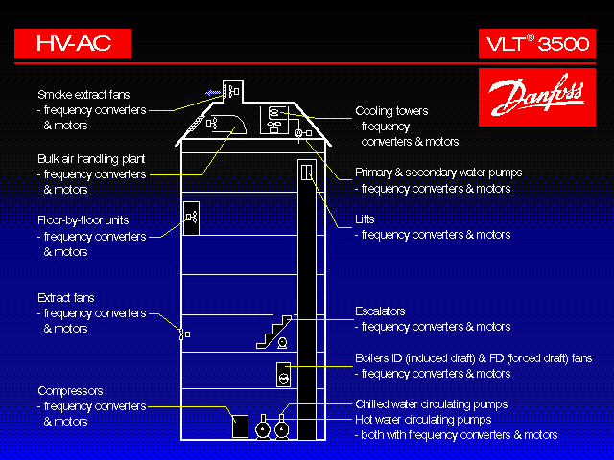
Building Loads

Slide 4
Building Energy Analysis
Kitchens *
Lifts *
HVAC Load is typically 60% on commercial Installations.
50% of motors installed on fans and pumps
Majority of motors on fans / pumps are oversized.
80% speed = 50% energy.
VFDs integrated into the IOT & BMS can do so often at the lowest initial cost for the system
Variable Speed Drives (VSDs) can help reduce these costs and improve comfort levels for occupants.
Lighting *
Others *
Hot Water *
Air Conditioning * = 60%

Slide 5
Flow Control
Why?
HVAC systems are designed for “best performance at the peak load/worst case” situations. Most of the time they have excess capacity.
Controlling flow
Saves energy
Improves occupant comfort
Methods
Air flow
Inlet guide vanes
Outlet dampers
Variable pitch fan
Variable speed
Fluid flow
Bypass valve (three way)
Throttling valve (two way)
Variable speed

Slide 6
Drive Applications
Fans
Pumps
Compressors

Slide 7
Flow vs Speed
If the speed of the impeller is increased from N₁ to N₂ rpm, the flow rate will increase from Q₁ to Q₂ as per the given formula:

Slide 8
The affinity law, the speed changed:
Flow:
Q1 / Q2 = N1 / N2
Example: 100 / Q2 = 1750/3500
Q2 = 200 GPM

Slide 9
Head Vs speed
The head developed(H) will be proportional to the square of the quantity discharged, so that
Head:
H1/H2 = (N1²) / (N2²)
Example: 100 /H2 = 1750 ² / 3500 ²
H2 = 400 Ft

Slide 10
Power Vs Speed
The power consumed(W) will be the product of H and Q, and, therefore
Power(kW):
kW₁ / kW₂ = (N1³) / (N2³)
Example: 5/kW₂ = 1750³ / 3500³
kW₂ = 40

Slide 11
Fans
ROOM 1
Exhaust
air
Extraction Fan
Room Temperature
T
Recirculation
Filter
Outside
air
T
Discharge Temperature
Supply Fan
Cooling
Heating
Air Temperature Control Panel

Slide 12
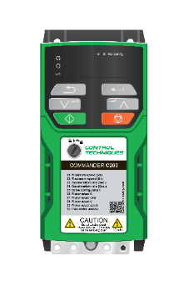
Fans

Slide 13
Energy Balance-Pumps
100%
ELECTRICITY
MOTOR
12% LOSS
COUPLING
2% LOSS
PUMPS
24% LOSS
VALVES
9% LOSS
PIPES
11% LOSS
WORK DONE ON WATER

Slide 14
Pumps

Slide 15
Pumps

Slide 16
Compressors
UNI
Power Control
4-20 mA
4-20 mA
Vane
Control
A
4-20 mA
Control
Panel
4-20 mA
4-20 mA
P
4-20 mA
ON/OFF
4-20 mA
4-20 mA
P
T
Condenser
Cooling Tower
Water
dP
T
T
Evaporator
Chilled H₂0 Supply
Chilled H₂0 Return
Notes:
5

Slide 18
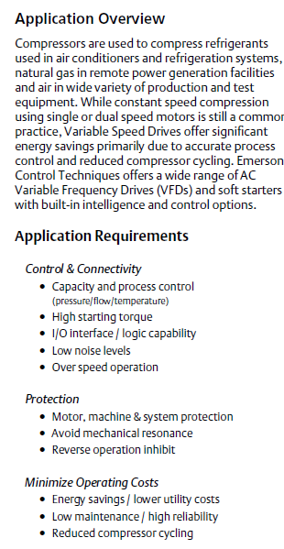
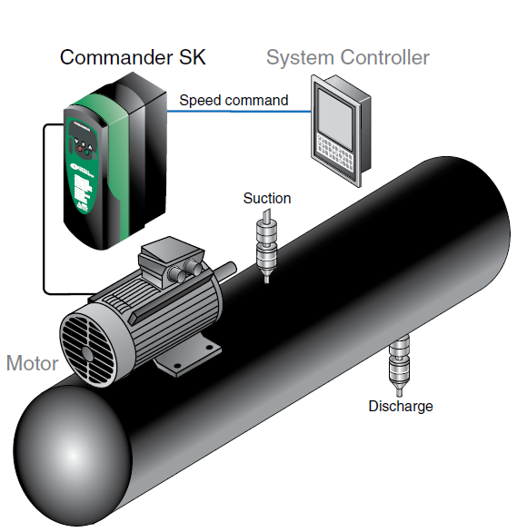
Compressors

Slide 19
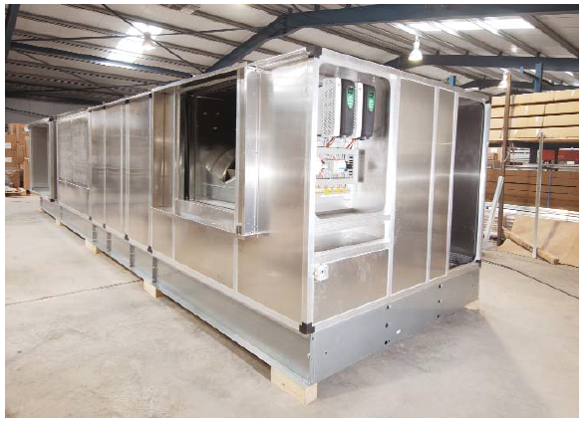
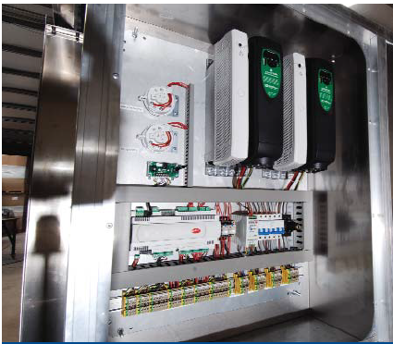
AHU Case Study

Slide 20
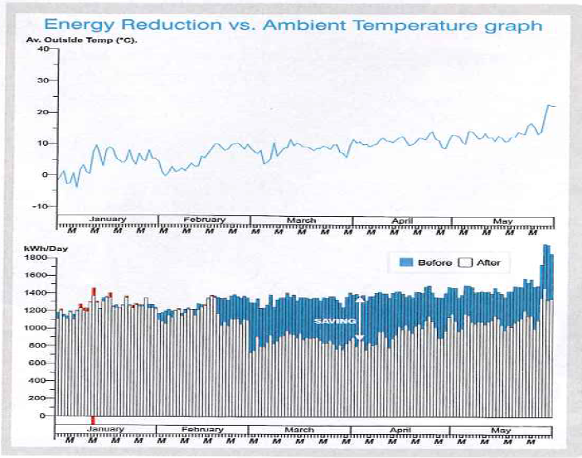
Refrigeration Compressor with PM Motors
Notes:
23

Slide 21
Energy saving Proposal for PUMP’s and AHU’s.

Slide 22
Advantages of VFD’s
• VFDs provide the most energy efficient means of capacity control.
• VFDs have the lowest starting current of any starter type.
• VFDs reduce thermal and mechanical stresses on motors and belts.
• VFD installation is as simple as connecting the power supply to the VFD.
• VFDs provide high power factor, eliminating the need for external power factor correction capacitors.
• VFDs provide lower KVA, helping alleviate voltage sags and power outages.

Slide 23
Total Power Consumption
Rated Motor Rating in kW | 187 | In Kw
Motor/Pump Rating in KW | 160 | in KW
Usages ( hrs/day ) | 20 | Hrs
Power Consumption ( Units/Month ) | 96000 | Units
Unit Rate | 4.5 | Rs
Power Bill / Month | 432000/- | Rs
Power Bill P. A. | 5184000/- | Rs

Slide 24
Power Saving by putting VFD
Total Rated Motor rating in Kw | 187 | in KW
Motor/Pump Rating in KW (Eff.=85%) | 160 | in KW
Usages ( hrs/day ) | 20 | hrs
Power Consumption ( Units/Month ) | 96000 | Units
Unit Rate | 4.5 | Rs
Power Bill / Month | 432000/- | Rs
Power Bill P. A. | 5184000/- | Rs
Speed reduction | 10 | %
Power Saving | 27 | %
Power Saving P.A. | 1399680/- | Rs
VFD Price Offered | 1375000/- | Rs
Tentative pay back period | 11 | Months

Slide 25
Tentative Payback Period
Savings/Annum by putting VFD’s= Rs 13,99,680/-
Investment for putting VFD’s = Rs 13,75,000/-
Pay Back Period for VFD’s = 11 Months.

Slide 26
Total Savings 14 Lakh/Annum

