Slide 1
Performance Optimisation For Code Compliance and Operational Benefits
Tony Gaunt
Senior Director, Vertiv Asia & India
16th July 2019

Slide 2





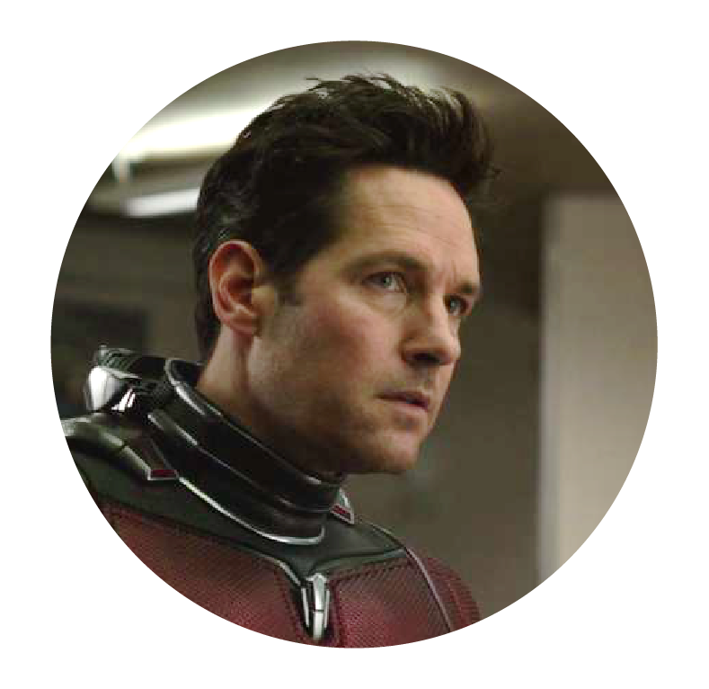

INDI SPOTLIGHT 2020
SIA PACIFIC SPOTLIGHT 2020
Colo ~ 2M sq. ft.
Big, HUGE Data
HYPER Scale
Big, HUGE Data
160 Hyperscale Sites
2,220 MW of Power
and 34M SqM of Data Center Floor Space Needed
Top 7 operators 90% sellable space
Expected to reach $2B in revenue
Upto 14.1 ZB (1.2ZB/Month)
by the end of 2020
From 5.9ZB
To 33.8ZB of Data Generated
CONNECTED
IOT Devices
CONNECTED
Devices
2 Billion by 2020
$8.6 Billion
Living on the EDGE
Living on the EDGE
UP in the Clouds
UP in the Clouds
Expected 18% CAGR by 2020, reaching
$1.3B in revenue
21% of Data to be
Created in the Edge
90% of Orgs will increase
the use of Edge Computing
Cloud data center traffic from 908 to 3,469 exabytes/year
20% of Data to be
Created in the Edge
91% of Orgs will increase
the use of Edge Computing
Sources : C&W, 451 Research, IDC, GARTNER
Images Source : IMDB.com No Copyright Infringement intended
Sources : CBRE, IDC, GARTNER
Images Source : IMDB.com No Copyright Infringement intended

Slide 3


Data Center
2025 Revisited
Renewing our original Industry Survey from 2014
#DataCenter2025
www.Vertiv.com/DC2025
Notes:
Five years ago, we led a global, industry-wide examination of the data center of the future and produced a report called Data Center 2025: Exploring the Possibilities, that stretched the imaginations of industry professionals and introduced a collaborate vision for the next-generation data center.
Our new report, Data Center 2025: Closer to the Edge, builds on the earlier research and serves as a mid-point check-in on the original report. More than 800 data center professionals from around the world, as well as Vertiv experts, took part in the survey. The results reveal progress that has been made in key areas while also providing new perspectives on emerging trends.
Two major developments are driving the future of the data center industry: more distinct segmentation in data center types and growth of edge computing.
This deck reveals the findings from our 2019 data center 2025 survey.
Note to presenter – if asked 5 years ago we were Emerson Network Power when we did the 2014 report – however this is a historical piece of data of which we retained access and usage of

Slide 4
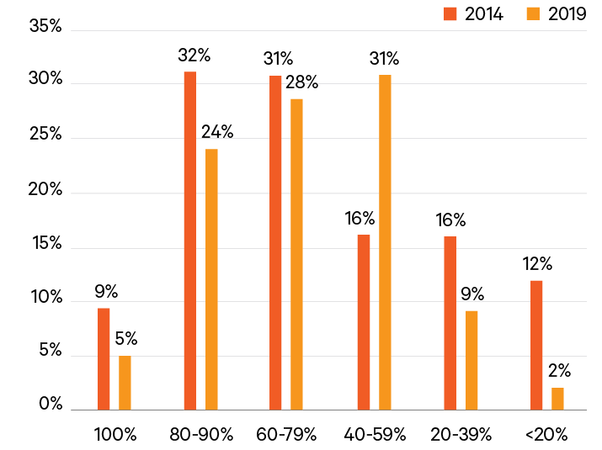
IT Utilization Rates (Core): Realism Mixed with Opportunity
Comparison of 2014 and 2019 survey results for the question, “In 2025, what do you expect the average IT resource utilization rate to be at the network core?”
We often focus on the Infrastructure, but the IT guys have to play too…
#DataCenter2025
www.Vertiv.com/DC2025
Notes:
KEY TAKEAWAY: IT UTILIZATION
Overall, 57% expect IT utilization rates to reach at least 60% by 2025. In 2014, 72 percent of participants expected to hit that threshold.
64% of participants who identified their data center type as high-performance computing and 60% of those who identified as enterprise/private cloud expect it to reach that level.
The hyperscale/private cloud/colocation segments were more cautious. Slightly more than half of those participants expect IT utilization rates to reach 60% by 2025.
China and Asia Pacific were more optimistic than other parts of the world with 58% and 61% respectively expecting utilization rates to reach at least 60%. The U.S./Canada were the most cautious at 50%.
Participants in the hyperscale/private cloud and colocation segments were more conservative than those in the HPC or enterprise/private cloud segments, perhaps indicating greater awareness of current utilization rates.
If current projections are to be realized it will almost certainly come via continued growth in hyperscale and cloud operators, which typically achieve significantly higher utilization rates based on the varying needs of multiple users.

Slide 5
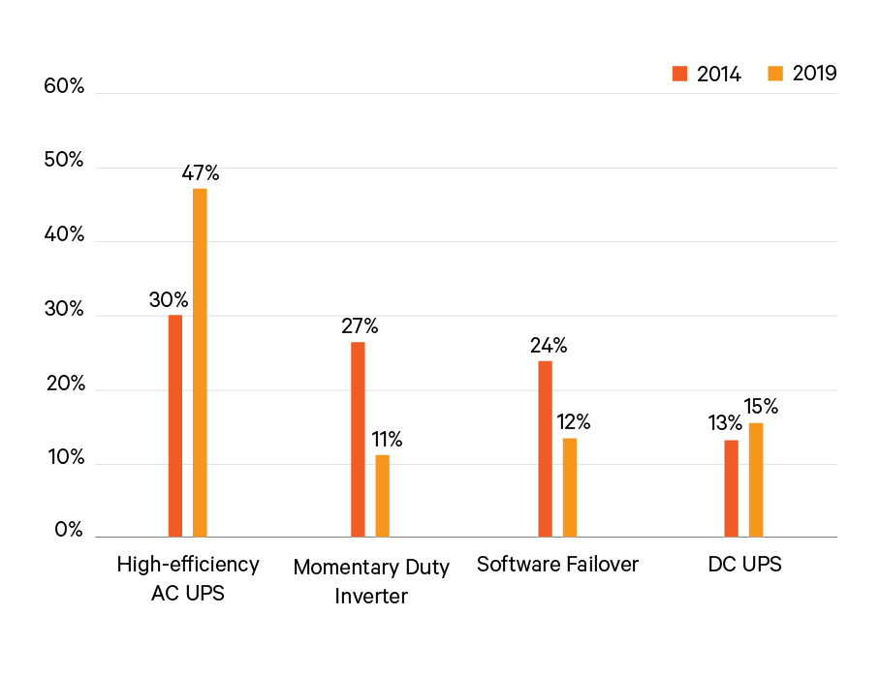
Backup Power Strategies
Comparison of 2014 and 2019 Data Center 2025 responses to the question, “What will be the primary means of delivering backup to data center equipment in 2025?”
Alternate technology hasn’t met expectations/become acceptable…
And the same is true for Cooling…
Although there is at least some innovation
#DataCenter2025
www.Vertiv.com/DC2025
Notes:
KEY TAKEAWAY: BACKUP POWER
AC UPS systems continue to be the anticipated strategy of choice, with 47% of participants identifying those systems as the likely source of backup power in 2025. That’s up from 30% in 2014.
Somewhat surprisingly, considering the virtualization capabilities of cloud computing and the interconnection capabilities now offered by colocation providers, software failover saw a significant drop in confidence between the two surveys, as did momentary duty inverters.
The reduced confidence in software failover could reflect challenges some early adopters have faced in implementing this strategy or the growing realization of the transmission bandwidth and cloud resources required to support software failover.

Slide 6
Asia – what do we see happening in real life?

Slide 7
Asian experiences of Data Centre codification
Regulations and standards
We have no choice; must comply as these are legal requirements
Codes & Guidelines
“Must have” or advice/suggestions?
How to regulate?
Best Practices
What are people choosing to do proactively to optimize energy efficiency?
How can I learn from others?
Paid Standards
Business decision/choice to undertake these.
Apart from Regulations/Standards – there needs to be a motivation or incentive to undertake all the rest “what’s in it for me?”.

Slide 8
Asian experiences of Data Centre codification
Government Certification/Incentives
Singapore Building and Construction Authority Green Mark (www.bca.gov.sg)
  Defines guidelines, technology, design for Energy Efficiency – but very prescriptive on technology (e.g. only considers water based cooling)
  Scoring system for award – weighting may not be ideal (Design PUE, not operational)
  New AND Old sites – recognizes complexity/difficulty of existing facilities
Australia NABERS & New South Wales State E.S.S.
  National Australian Building Environment Rating System (www.nabers.gov.au)
    Originally for office/high-rise use,
    Typically for new build facilities,
    Regulated annually,
    Requires 1 year of full documented power consumption data before first award
  Energy Saving Schemes (www.ess.nsw.gov.au)
    Perfect for existing site improvements/retro-fits
    Provides financial incentives to improve Energy Efficiency – similar to carbon credits

Slide 9
Indian Data Centres Codifications
New Version Of ECBC Was Launched In 2017
Data Centres Are No Longer Excluded From ECBC But Only Few Standards Are Specifically Relevant To Data Centres
Higher Level Of Standards Were Not Developed For Indian Data Centre
The ECBC Allow 3 Levels Of Performance
  ECBC Code Compliance
  ECBC+
  SuperECBC
Measure Categories
  Chiller Plant
  Data Centre Cooling
  Electricals Systems
  IT Hardware And Software

Slide 10

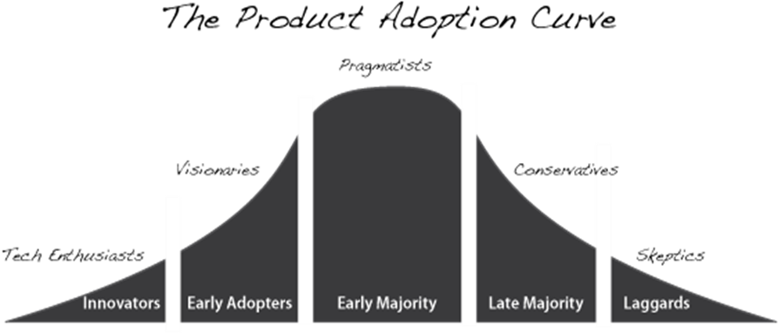
Move To Innovative Conversations on Data Center Builds
Architecture and design discussion : Am I designing for what we need now and in the future
From 2N design to Reserve Bus Architectures
50% to >75% Utilization
Capacity Normalization: Larger Capacity Building Blocks (minimum 1.2 MW) Standardized , Repeatable, Proven → Quick to Deploy
Skid Design, Modular/Pre-fab (IMS) for Faster Deployment
Technology Evolution : Am I being efficient? What is my differentiator?
Technology adoption – Availability, Agility, Cost ($/MW Delivered)
Thermal Technology changes eg. Indirect Evaporative Cooling in Tropical Countries : Quick to deploy, water usage and size
Lithium Ion Batteries, ESS
…While maintaining my client SLAs?
….And being Competitive…
“Whatever size you want to scale to, it’s too small”
– Christian Belady, Microsoft
“Whatever you think today is wrong”
– Joe Kava, Google

Slide 11
Asian experiences of Data Centre codification
How to justify and regulate?
Business decisions
Often taken as Marketing/Publicity exercise to establish credentials – e.g. Uptime Tier rating.
  Very few people go beyond Design Certification to Build and Operate.
    Beware the “Tier 3 Design” Certificate.
  Motivation & Incentive to undertake?
    Why should I do it?
    Corporate Social Responsibility,
    Competitive differentiation,
    Customer expectation,
    New market entrant.
  How to police it over the life of the facility?
    Is it a “one-off” like Uptime; or “renew or lose” like NABERS?
    PUE is real easy to doctor…

Slide 12
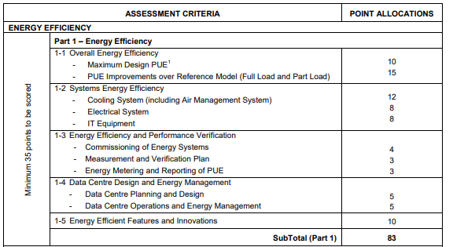
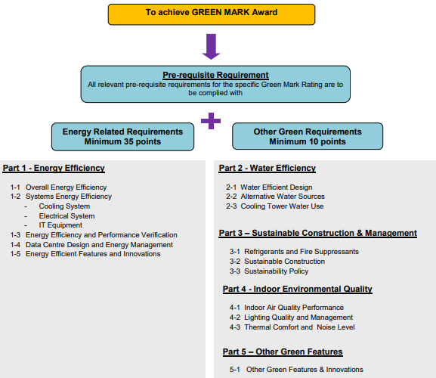
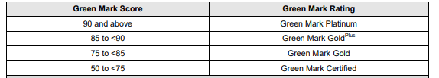
Singapore BCA/IDA Green Mark process
Score up to 100; Awarded according to final score – no recourse once awarded

Slide 13
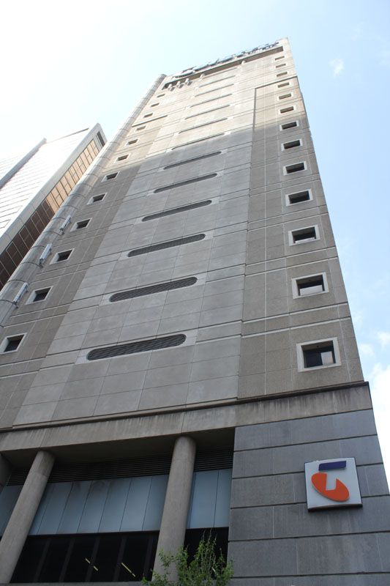
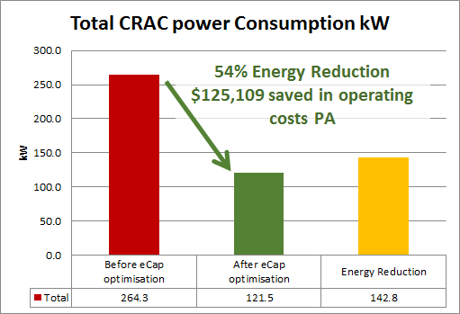
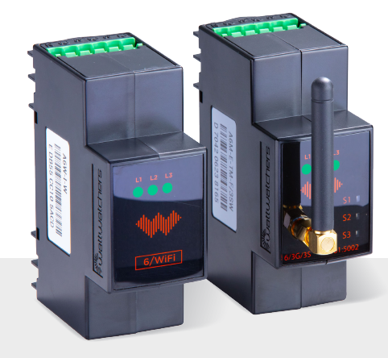
Use Case: Optimization at A Leading Australian Telco - ESS
Vertiv Australia developed a program to Optimise our customer’s white-space
Meter the Environment using Class-1 (Billing –grade) IoT Power Meters
Tune the environment, reducing CRAC Energy Consumption whilst still maintaining conditions , Utilising all available tools: Containment Solutions, Airflow Enhancement (Floor Grilles), Teamwork Mode, etc.
Project funded by Energy tariff savings and State Government sponsored Energy Savings Certificates
Results:
143kW or 54% energy reduction in CRAC floor power consumed (CHW CRAC’s Only – No Chiller Power)
Ongoing $125k savings annually (@ $0.10/kWhr)
Ongoing power reduction of 1,253 MWhr/Annum
Energy Saving Certificates claim submitted to State Gov’t, yielding $273k in Rebates
Project ROI: < 22 Months
Class-1 IoT Power Meters
Notes:
https://www.gartner.com/smarterwithgartner/gartner-top-10-strategic-technology-trends-for-2018/

Slide 14
Finally, why is this becoming even more important?
Where are we going next..?

Slide 15
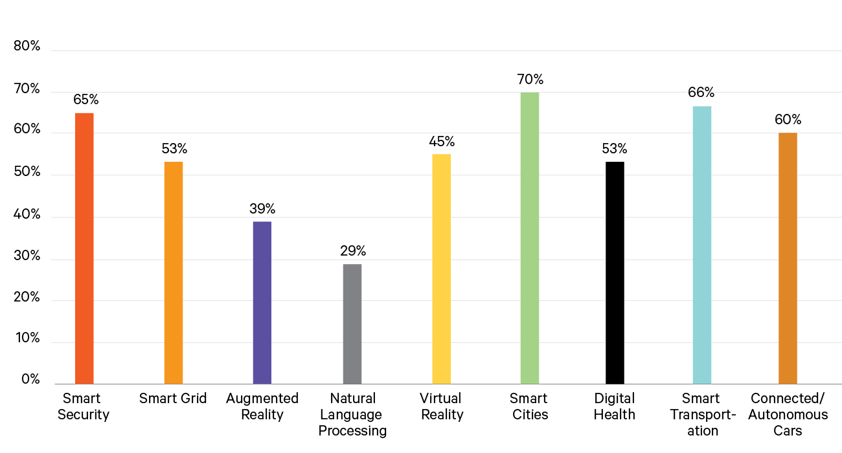
Applications Enabled by 5G
2019 Data Center 2025 responses to the question, “Thinking broadly of the world in 2025, which applications do you believe will require 5G technology to be fully functional? Your responses can include, but are not limited to, the specific requirements of your job or the business you work for.”
#DataCenter2025
www.Vertiv.com/DC2025
Notes:
When survey participants were asked what applications in the future would require 5G technology to be fully functional, you can see smart cities ranked highest with smart transportation and smart security closely following.
Note: Another reference point is our Archetypes Study or the details of the differences within the larger Data Center 2025: Closer to the Edge Report. www.Vertiv.Com/DC2025 . https://www.vertiv.com/en-emea/about/news-and-insights/news-releases/vertiv-defines-four-primary-edge-archetypes--and-their-technology-requirements/

