Slide 1
IT Standards, Sustainability and Efficacy
July 2019
Henry M. Wong
Chief Technologist
E³HS IT Consulting, LLC
sfhenm@gmail.com
V1.3

Slide 2
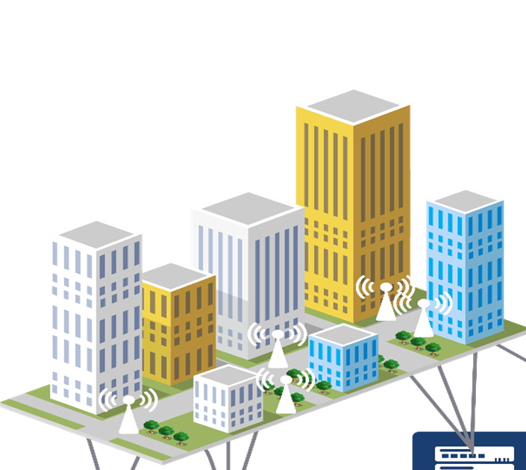
The Edge and Hybrid Clouds
Local context
Low Latency
Security
Resilience
Privacy
Costs
Private Cloud
Private Cloud
Private Cloud
Private Cloud
Hybrid local Cloud
Hybrid local Cloud
Regional Cloud
Regional Data Centres

Slide 3
Leading IT Considerations
IT Facilities Efficiency & Efficacy
Most productivity for resource consumed
Edge Computing; Hybrid Cloud
Resilience and Availability
5G- Ubiquitous Connectivity
Low Latency, Network Heterogenality, Speed
Expansion, technology rollout
Security & Privacy
Intrusion rates continues to climb, costs and efficiency impacts
BlockChain popularity; not secure and inefficient
Hardware and Software gaps
Access Control, Accountability, GDPR
Artificial Intelligence, Machine Learning
Emulation of Neural Networks- High Energy Costs
Training and model transfer-key challenge
Training, Inferences – optimize location and relevance
IoT, IIoT – Transforming BigData ➔ Useful Information
Need for common meta-data and data hierarchy
Custom platforms – lowers efficiency and increases security risks
Latency, Privacy, and Security
Need: standards & methods with a holistic data centric view

Slide 4
ISO/IEC JTC1 SC39
Title: Sustainability, IT & Data Centres
Scope: Standardization related to the intersection of resource efficiency and IT which supports environmentally and economically viable development, application, operation and management aspects.
As internet and computing trends drive growth in demand for data centers, the energy and resources consumed by data centers is attracting more and more attention, especially from industry and governments around the world. A number of efforts have sought to quantify the energy consumed by data centers, promote energy efficient methods and to develop ways to maximize productivity while conserving resources such as energy.
The ISO/IEC Joint Committee SC39 intends to establish and converge efficiency standards for Data Centres and ICT equipment.
Working Group 1 (WG1) : Resource Efficient Data Centres; Development of
  Data centre resource efficiency taxonomy and vocabulary;
  Holistic suite of metrics and Key Performance Indicators;
  Guidance for resource efficient data centres; and
  Energy management system standard specifically tailored for data centres.
Working Group 3 (WG3) : Resource Efficiency Practices for ICT Facilities
  Internationalize best known practices described by data center code of conduct

Slide 5

ISO/IEC JTC1 SC39
Completed Standards (IS) and Technical Reports (TR)
IS 30134-1, Requirements for data centre resource efficiency key performance indicators
IS 30134-2, Data Centre KPI, Power Usage Effectiveness (PUE)
IS 30134-3, Data Centre KPI, Renewable Energy Factor (REF)
TR 20913, Holistic Approach to Data Centre Operations
IS 30134-4, Data Centre KPI, IT Energy Efficiency-Servers (ITEEsv)
IS 30134-5, Data Centre KPI, IT Energy Utilization- Servers (ITEUsv)
Updates to 30134-1, -2, -3 to clarify & specify logical & physical boundary
TR 30133, Guidelines for Resource Efficient Data Centres
IS 30134-6, Data Centre KPI, Energy Reuse Factor (ERF)
TR 21897, Primary Energy
In Process (dates are estimates)
TR 23050, Excess Energy 2H2019
IS 21836, Server Energy Efficiency Metric (SEEM) 2H2019
IS 23544, Application Energy Effectiveness 2H2020
30134-8, Carbon Usage Effectiveness (CUE) 1H2021
30134-9, Water Usage Effectiveness (WUE) 1H2021

Slide 6
ISO/IEC JTC1 SC39
Roadmap Plans
30134-7, Cooling Effectiveness Ratio (CER)
IS Electronic Product Environmental Assessment Tool (EPEAT)
IS/TR Security and Privacy – data center/IT resource impact vs. security level
TR Application of 30134-x series
IS Water Reuse Factor (WRF)
IS Resiliency Class or Type of Data Centre
IS Data Centre Cost eXpense (DCCX)
IS Data Centre Cost Effectiveness (DCCE)
IS Data Centre Utilization (DCU)
IS IT Equipment Effectiveness Networking (ITEEnetw)
IS IT Equipment Utilization Networking (ITEUnetw)
IS IT Equipment Effectiveness Storage (ITEEstor)
IS IT Equipment Utilization Storage (ITEUstor)
IS Seasonally adjusted Energy Efficiency Ratio (SEER)
IS Coefficient of Performance (COP)
TR Economic Output
TR Resiliency Risk Impact
TR Data Centre Life Cycle Impact
TR Boundaries of Software Defined Data Centre
TR Boundaries of Software Defined Subsystems
TR DC Integration for Smart Cities
TR DC and IoT integration
TR Waste Impact to Local Area
Always Welcoming
Technical contributors
Editors
Examples

Slide 7
Panelists
Mr. Sandeep Dandekar, Executive Vice President, Netmagic Solutions, NTT
Mr. Shashi Bhushan, Director, Projects, STT Data Centre
Mr. Sandeep Kumar, Services Leader, SIH East (AP, MEA, Japan, GCG, Global COC*
Mr. Siddharth Jain, Managing Director, epi-India
Mr. Mahesh Trivedi, Head Solutions Engineering, Bridge Data Centers

Slide 8
Panelist Questions
Global Efficiency standards seem to focus on PUE or servers. Are regional standards in conflict or are there gaps that need to be addressed for India?
Are there resource efficiency considerations beyond electricity?
What standards or best practices do you consider critical to improving IT sustainability in India
What do you see India’s role in global or regional IT standards?

Slide 9
Backup

Slide 10
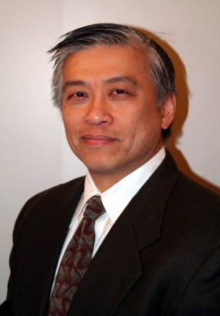






IT Infrastructure Consultant
Henry M Wong the Chief Technologist at E³HS IT Consulting, enabling and evangelizing a holistic approach to resource efficiency of and by data centres and data centre equipment. Mr. Wong has over 35 years of IT industry experience in computer system development, manufacturing, and deployment, including technical standards, best practices, and policies. Mr. Wong’s experience ranges from leading edge product development, e.g. low power server processors, to enabling data centre level technologies, e.g. modular data centres and 380VDC, For the past 12+ years, Mr. Wong has led and supported many of the enterprise industry energy-efficiency initiatives, technologies, and policies with organizations such as the US EPA, US DOE, Lawrence Berkley National Labs, and The Green Grid. Mr. Wong has represented IT industry’s technical positions to policy organizations such as the US DOE, Japan METI, California’s Energy Commission, Korea’s KEMCO, and China’s standardization bodies. Mr. Wong has also coordinated technical assessment and policy positions between industry organizations such as IT Industry Council, the Green Grid, Storage and Networking Industry Association (SNIA), and SPEC. Mr. Wong is a 1984 graduate of Yale University with a degree in semiconductor physics.
Working with the industry on Data Centre, IT infrastructure, and IT equipment efficiency, security, and effectiveness….

Slide 11
IS 30134-2, PUE
Power Usage Effectiveness (aka PUE)
Specification describes the proper designation, measurement methods, and reporting requirements for PUE_{x}. The specification provides normative methods of converting energy sources to electrical equivalents, evaluating PUE, and categorizing measurement methods.
In addition to yearly measured values, the specification also describes the methodology, designation and reporting requirements for the following derivatives:
Partial PUE (pPUE_{sub})- used when describing a subset of facilities to focus on specific areas or equipment type.
Design PUE (dPUE)- used to describe the anticipated PUE justified by design parameters, equipment information, and/or modelling information (e.g. CFD)
Interim PUE (iPUE [date1 : date2])- used to describe a temporal period less than a year.
Examples are provided for all versions of PUE, mixes of energy sources, and designations of combining PUE derivatives (e.g. idPUE [2018-04-01 : 2018-09-30])

Slide 12
IS30134-2 Amendment
IS 30134-2 was amended to clarify the ability to describe the boundaries of the PUE assessment to be either physical and/or logical to better represent the facilities under review. Logical boundaries allow for the inclusion of equipment critical in describing the environment under evaluation but, may not be within a contiguous space to the IT facility, e.g. a cooling or power distribution unit that may not be immediately adjacent to or contained the facility space.
Addition changes included naming and designation consistencies in the examples (editorial in nature).

