Slide 1
Accelerating Energy Efficiency in Indian Data Centers through continuous improvement in HVAC system.

Slide 2
Accelerating Energy Efficiency in Indian Data Centers
AGENDA
Analysis of water and air-cooled chillers
Recommendation on water and air cooled chillers for ECBC-2017
Recommendation on cooling tower for ECBC-2017
Recommendation on pumps for ECBC-2017
Recommendation on economiser for ECBC-2017
Recommendation on system efficiency for ECBC-2017

Slide 3
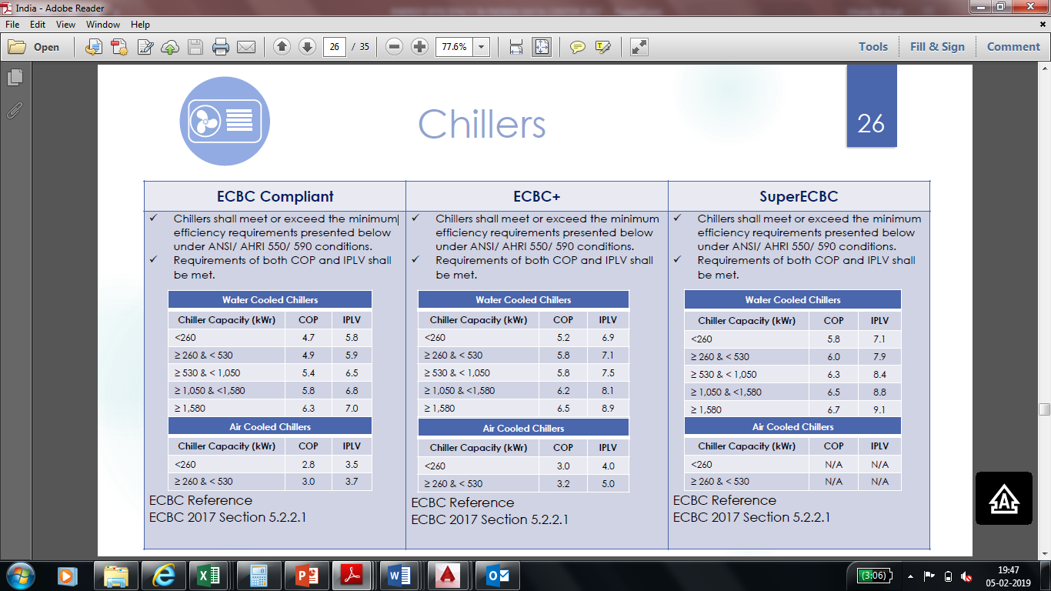
Accelerating Energy Efficiency in Indian Data Centers

Slide 4
Accelerating Energy Efficiency in Indian Data Centers
Data received from Vendors for water cooled chillers.

Slide 5
Accelerating Energy Efficiency in Indian Data Centers
Recommendation for water cooled Chiller
.
All venders complying with COP and IPLV values for ECBC compliance, and hence can be accepted.
For ECBC + and ECBC super recommendation is for compliance of either COP or IPLV.
Chillers designed at different temperature shall be de-rated at AHRI-550-590 to comply ECBC norm.

Slide 6
Accelerating Energy Efficiency in Indian Data Centers
Data received from Vendor for Air cooled chillers.

Slide 7
Accelerating Energy Efficiency in Indian Data Centers
Recommendation for Air cooled Chiller
All venders are complying with COP and IPLV values for ECBC compliance, and hence can be accepted.
Recommendation is to Add one slab of chiller capacity above 530 KW. The chiller performance above 530 KW shall have COP of 3.0 and IPLV of 3.7 for ECBC compliance.
For ECBC+ recommendation is to comply either COP or IPLV. For ECBC + chiller performance above 530KW shall have COP of 3.2 or IPLV of 5.

Slide 8
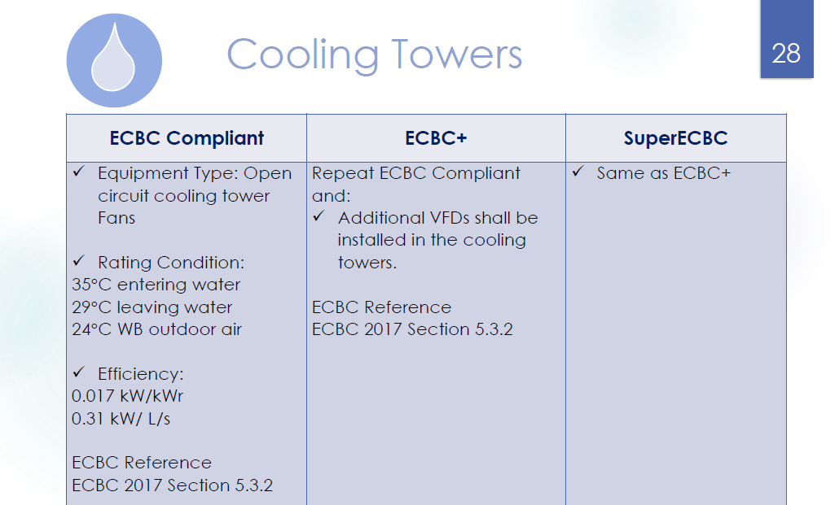
Accelerating Energy Efficiency in Indian Data Centers

Slide 9
Accelerating Energy Efficiency in Indian Data Centers

Slide 10
Accelerating Energy Efficiency in Indian Data Centers
Recommendation for Cooling tower.
Cooling tower should be designed at actual site condition and shall be rated at ECBC compliant condition (35/29/24).
Cooling tower performance shall be rated on either power consumption/Cooling capacity or power consumption/ water circulation rate (Cooling capacity shall be chiller rated capacity as per AHRI 550-590).
ECBC recommendation of efficiency 0.017kw/Kwr. or flow 0.31kw/l/s is acceptable. However there is a huge scope of improvement in efficiency of CT requirement for ECBC compliance.

Slide 11
Accelerating Energy Efficiency in Indian Data Centers
Recommendation for Cooling tower.
Performance improvement in cooling tower fan can be done with VFD installation on Cooling tower fan for ECBC + and ECBC super.
Cooling tower performance specified in ECBC compliance is liberal. CT performance can be specified as 0.012 Kw/Kwr. or 0.17 Kw/lit./sec. In future same can be taken in to consideration.

Slide 12
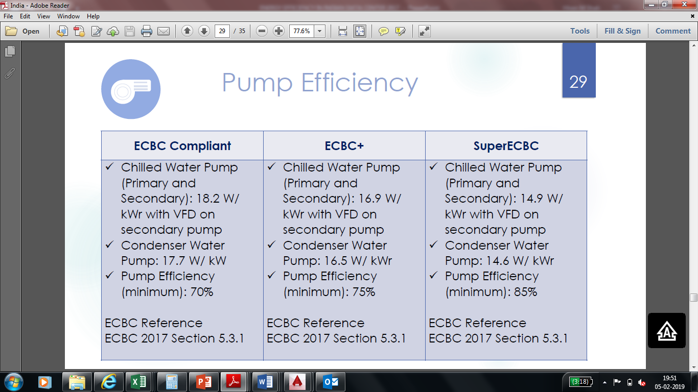
Accelerating Energy Efficiency in Indian Data Centers

Slide 13
Accelerating Energy Efficiency in Indian Data Centers

Slide 14
Accelerating Energy Efficiency in Indian Data Centers
Recommendation for Chilled water pumps.
Pump to be designed at site condition water flow rate and shall be rated at pump power / chiller tonnage as per AHRI condition.
For any instance total pump head of chilled water system should not be more than 30 Meter for compliance of ECBC , ECBC + and ECBC super at given pump efficiency.
Pump power efficiency mentioned ECBC 2017 for all levels are acceptable. However there is a scope of improvement in chilled water pump head requirement in ECBC+ and ECBC super.

Slide 15
Accelerating Energy Efficiency in Indian Data Centers

Slide 16
Accelerating Energy Efficiency in Indian Data Centers
Recommendation for Condenser water pumps.
Pump to be designed at site condition water flow rate and shall be rated at pump power / chiller tonnage as per AHRI condition.
For any instance total pump head of condenser water system should not be more than 24 Meter for compliance of ECBC , ECBC + and ECBC super at given pump efficiency.
Pump power efficiency mentioned ECBC 2017 for all levels are acceptable. However there is a scope of improvement in condenser pump head requirement in ECBC+ and ECBC super.

Slide 17
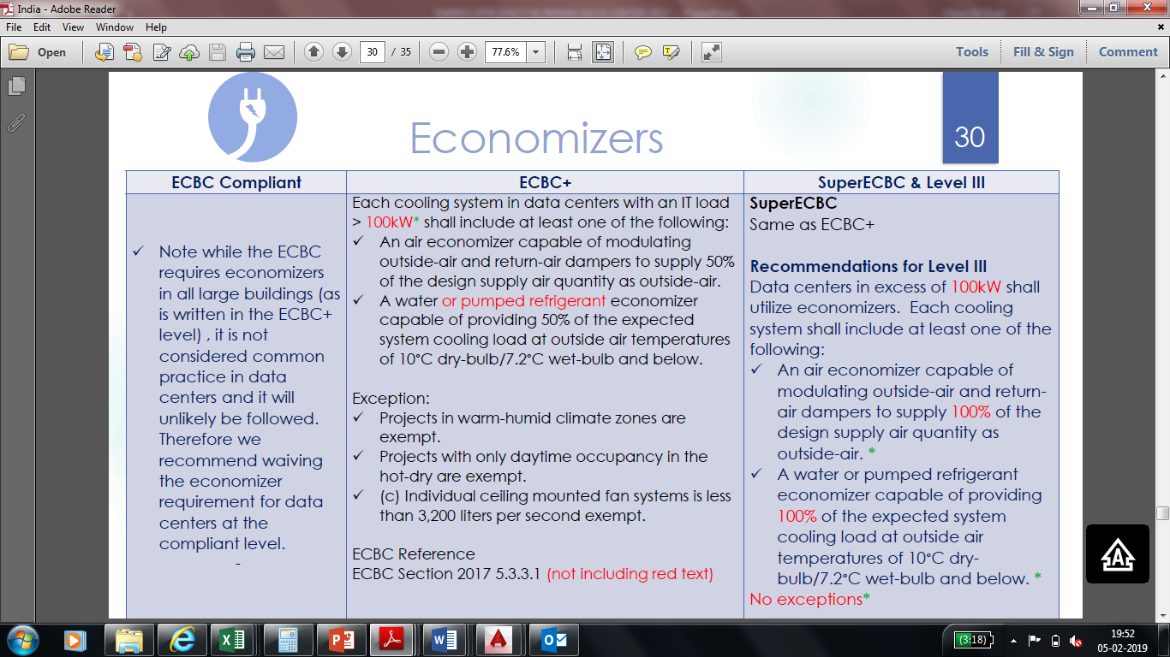
Accelerating Energy Efficiency in Indian Data Centers

Slide 18
Accelerating Energy Efficiency in Indian Data Centers
Recommendation for economizer
Use of economizer for ECBC compliance is waived off and it can be accepted.
Recommendation of use of economizer for ECBC + & ECBC super is same and it can be accepted.

Slide 19
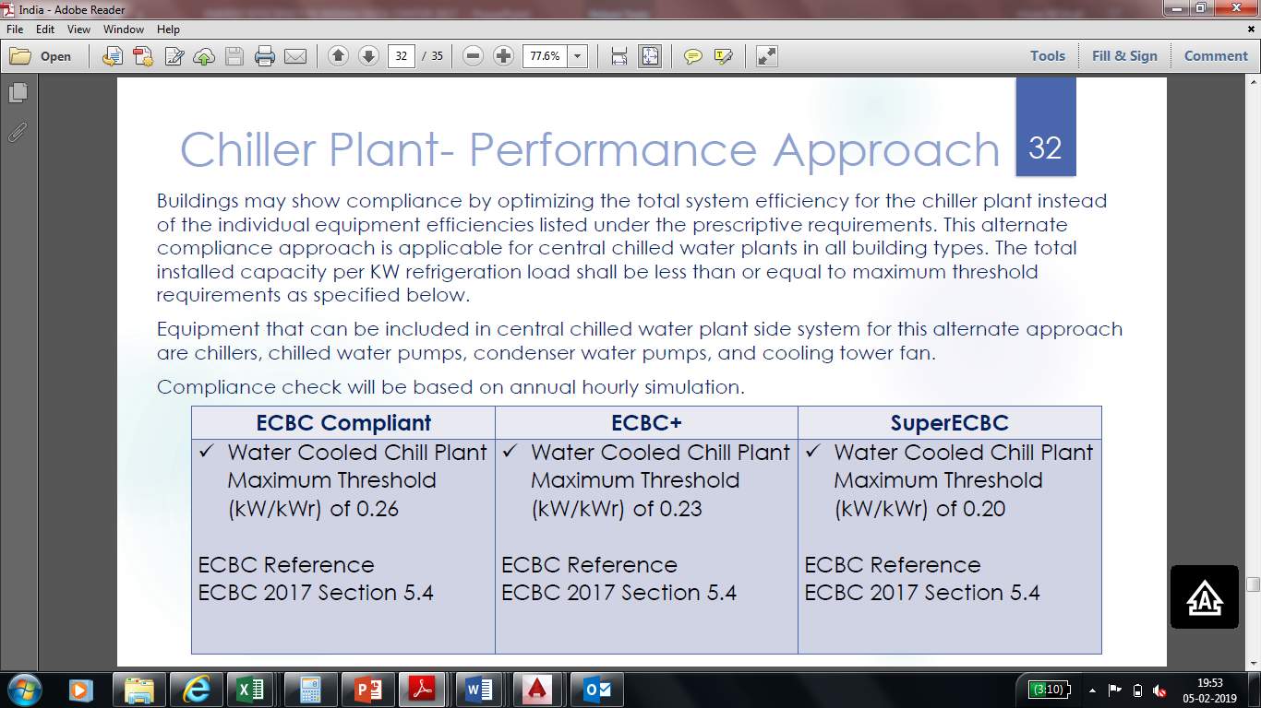
Accelerating Energy Efficiency in Indian Data Centers

Slide 20
Accelerating Energy Efficiency in Indian Data Centers

Slide 21
Accelerating Energy Efficiency in Indian Data Centers
Recommendation for Overall Chiller plant performance.
Recommendation is to specify range wise overall chiller plant performance. Overall chiller plant performance should not be more than summation of individual component performance.
“compliance check will be based on annual hourly simulation” is site/project specific condition and will not be rated on common platform hence chiller pant performance should not be rated at this condition.

Slide 22
Thank You

