Slide 2
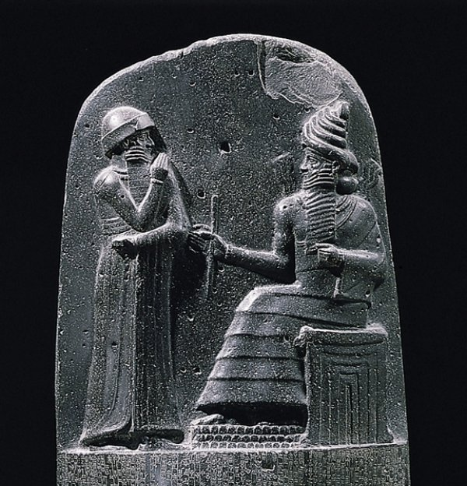
History of Building Codes
Codes of Hammurabi
“In the case of collapse of a defective building, the builder is to be put to death if the owner is killed by accident; and the builder’s son if the son of the owner loses his life…”
Socrates – 341 BC
“He shall set the joists against each other, fitting, and before inserting the dowels he shall show the architect all the stones to be fitting, and shall set them true and sound and dowel them with iron dowels, two dowels to each stone…”

Slide 3
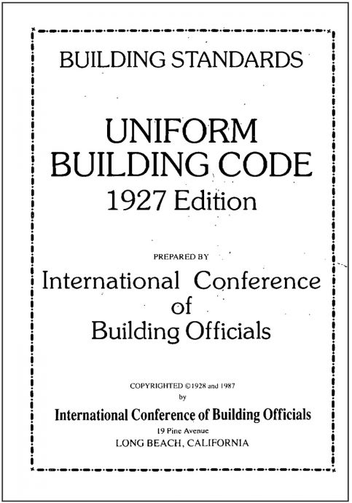
Origin of Modern Codes
Disasters: Fire, natural disasters – Mitigate loss of life and property
Insurance industry: Establish standards to minimize accidents/claims
Local governments: Develop regulations to deliver health and safety to public
Some of the Key Codes over the years:
First American Fire Ordinance 1631
Years of incidents and tragedies have helped evolve methods how people handle, control, prevent, contain and provide case conditions with fire
1905 - Recommended Building Code, helped create the three original model codes
1927 - Uniform building code published by the International Conference of Building Officials (now ICC)

Slide 4
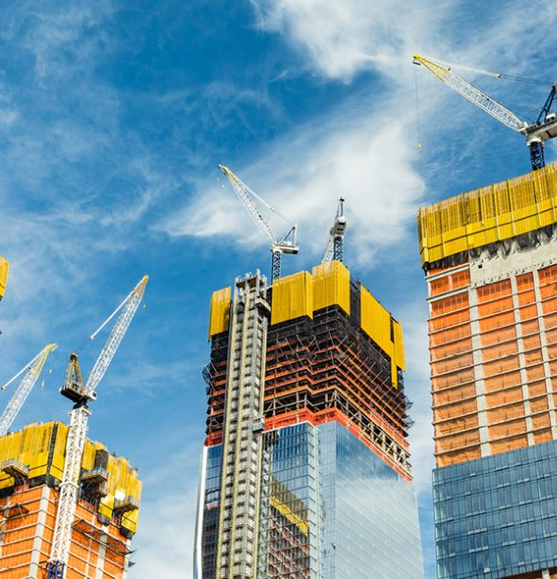
Why are Building Codes Necessary?
Codes specify the minimum requirements to safeguard the health, safety, and general welfare of building occupants
Codes create a uniform regulatory environment in which design professionals and contractors are held to a set of standards adopted by and applicable to the jurisdiction they work
Codes provide you, your family, and your community protection in the event of a natural disaster

Slide 5




Holistic Approach to Building Codes
Code Development
Code Implementation
Code Adoption
Code Enforcement

Slide 6
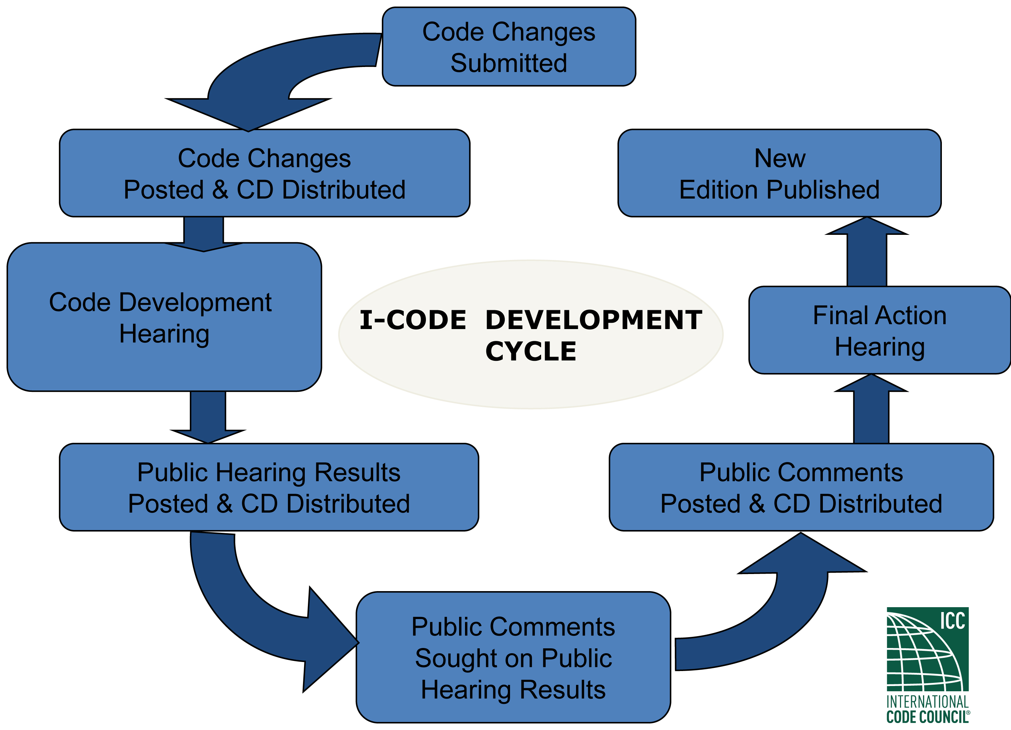
Code Development
Open Transparent Process with meetings held in public forums
Representation from various industry stakeholders (code officials, architects, engineers, consultants, builders, contractors, manufacturers, traders, Govt. agencies etc.) No domination by single entity or agency
All discussions, actions and reasons for actions are all documented and published
Well-established and well-documented consensus based process

Slide 7


Code Implementation
Training and education for all stakeholders involved with the code design, execution and enforcement activities
Sufficient and high quality materials are made available for effective code implementation
Robust processes in place to aid in implementation of the code

Slide 8

Code Adoption
Nationally created codes are adopted regionally/ locally by various building departments
Until and unless a local jurisdiction adopts via its legislative process, these codes are just part of the "model" code system
The process of adoption gives local communities a chance to further debate the applicability and relevance of the code requirements to their specific terrain and construction practices
Local building departments may then publish additional requirements specific to their region which gets adopted & eventually enforced

Slide 9


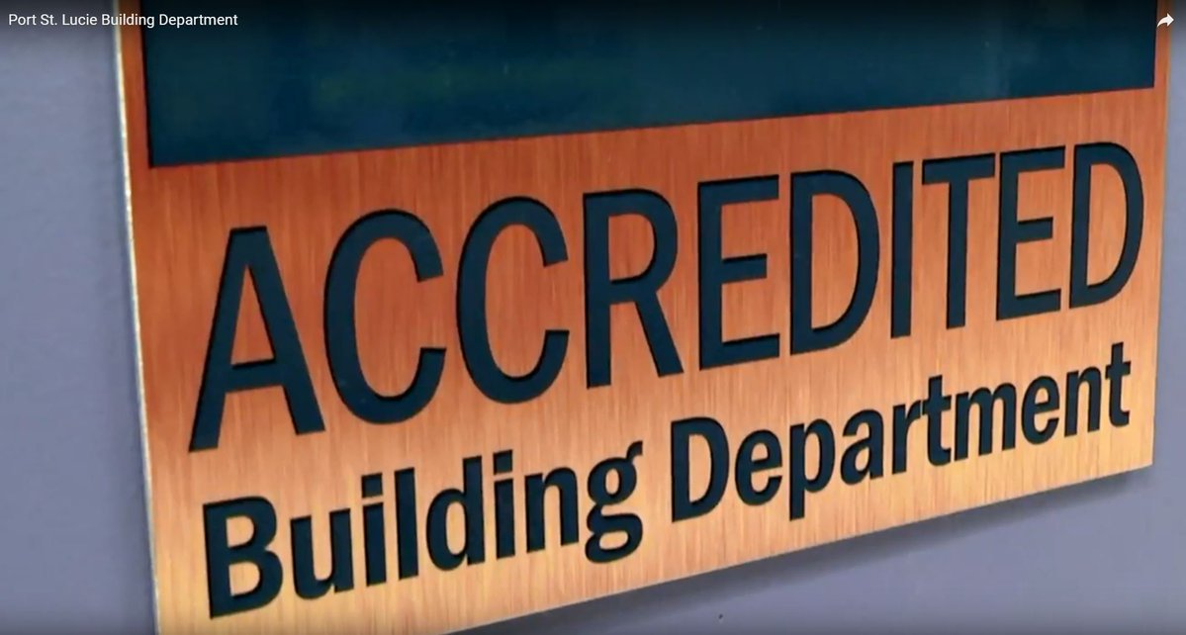
Code Enforcement
Certification of Personnel involved in the various building activities
Accreditation of various agencies involved in buildings including special inspection agencies, fabricators, metal building assemblers, field evaluation bodies etc.
Product evaluations, listing and certification programs for various building materials
Building department accreditation to ensure that building departments are competent for providing public safety services for the community

Slide 10
A Building Code & Enforcement System in Balance
Courtesy: International Code Council

Slide 11
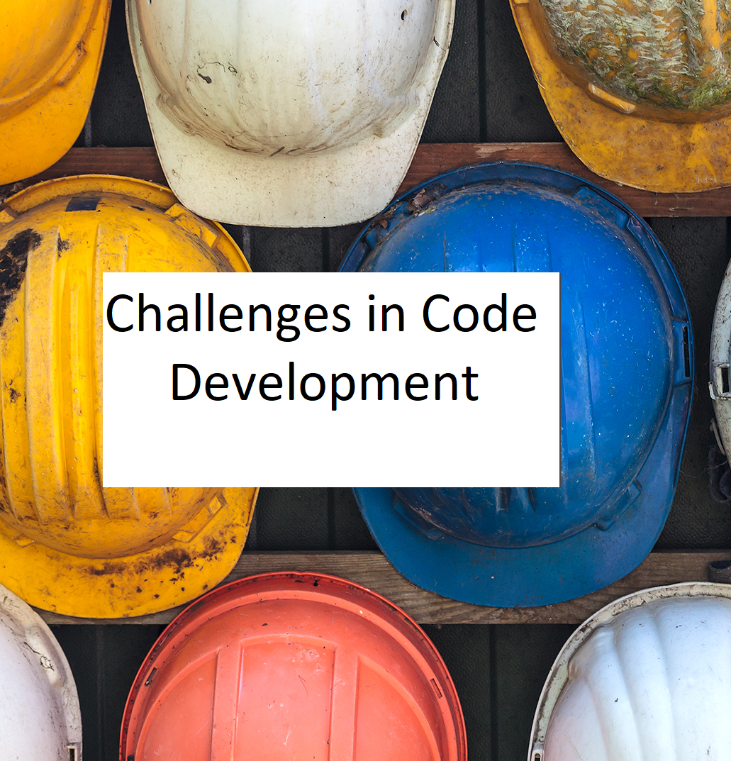
Challenges in India in Code Development
Similar to the U.S., its also an open-consensus based approach inviting all stakeholders & developing the code in a structured manner
However not all stakeholders participate in these meetings nor provide detailed structured inputs, thereby creating enforcement issues at a later date at the field level
Minimal representation of the local building officials in these meetings hence very little ownership or responsibility is taken by them in enforcing the written code

Slide 12

Challenges in India in Code Implementation
Training and education needs to be imparted to all professionals including building officials
Need to create teaching infrastructure both at the institutional level – architectural & engineering colleges and local officials
Necessary to create opportunities for young professionals and exposure them to hands-on design and construction activities under experienced peers
Preparation of robust materials that will aid entire industry through the code implementation process

Slide 13

Challenges in India in Code Adoption
No adoption through a legislative process and hence the national code remains as a “model code” in most jurisdictions
Local building departments have their own code with respect to key developmental requirements - zoning, set-backs, heights, FSI/FAR areas, parking, fire etc.
Local jurisdictions refer to certain sections of the national code but not in entirety
Critical for local building authorities to take a holistic approach to develop local changes to national codes as needed and adopt legally

Slide 14

Challenges in India in Code Enforcement
Creation of a formal “Personnel Certification” program to ensure competency levels and for monitoring level of knowledge of professionals in different technical areas of the code
Imperative to set up “Product evaluation, listing and/or certification” programs for the furtherance of innovative technologies
Setting up of an “Accreditation Program” for Building departments, inspection agencies, fabricators and assemblers, training providers etc. to ensure competency, monitor ongoing performance and initiate corrective actions so as to prevent any life safety or health issues for the community

Slide 15
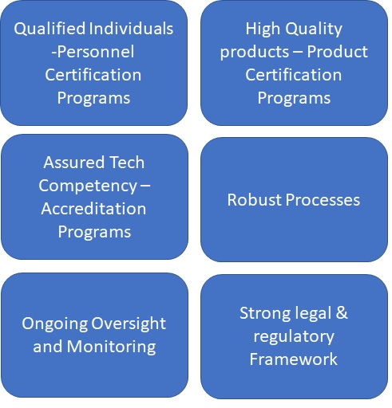
In Conclusion
Code development & implementation, Product Listing/Certifications, Accreditation and Personnel Certification are all critical for successful code enforcement
In India unlike the U.S. where there are “No” strong “Tort remedies” to provide further assurance to the public, it is critical that code enforcement mechanisms be robust and well-established to ensure accountability
Having a state-of-the-art code alone is not sufficient to protect the public. For effective enforcement of the code, qualified individuals, robust processes and high-quality materials are essential

Slide 16
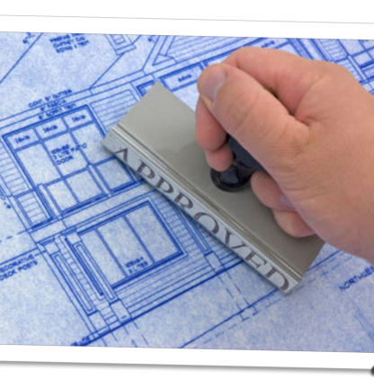
In Conclusion
Create formal process for “National level” certification for building plan reviewers, building inspectors to ensure competency
Set up a National level Certification Program for plumbing, mechanical, electrical and structural inspectors as India moves to high-rise buildings to manage risk and ensure safety & health of occupants
Development of elaborate “Accessibility code” as India’s ageing population grows for better access to all spaces
Better coordination between other requirements including sustainability, health and wellness along with building codes for a more holistic approach for buildings

