Slide 1

Module II-B:
USNC/IEC Organizational and
Governance Structure

Slide 2

Module II-B: Learning Objectives
This module provides an overview of the U.S. National Committee of the International Electrotechnical Commission (USNC/IEC)
  Membership
  Organization structure
  Governance and policy-setting bodies
  USNC Technical Advisory Groups (TAGs)

Slide 3
Module II-B: Disclaimer
The information contained in this self-taught
learning module is intended as a summary of documents and procedures frequently used within the IEC and the USNC/IEC.
For additional information about content addressed in this module, please contact the USNC/IEC Staff (usnc@ansi.org).
Additional information is also available via ANSI Education and Training Services.

Slide 4
Reference Materials &
Source Documents
ISO/IEC Directives, Part 1: 2017
Procedures for the technical work
ISO/IEC Directives, Part 2: 2016
Rules for the structure and drafting of International Standards
ISO/IEC Directives, Part 1:2017 + IEC Supplement:2017
Procedures specific to IEC
IEC Statutes and Rules of Procedures
IEC membership and participation procedures
USNC Statutes and Rules of Procedure: 2005
Model Operating Procedures for USNC/IEC TAGS: 2014
Guide for U.S. Delegates to meetings of ISO and the IEC

Slide 5
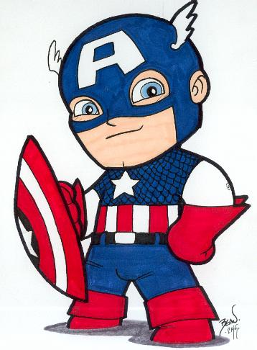
U.S. National Committee of the IEC
The U.S. National Committee of the
International Electrotechnical Commission (USNC/IEC) is a committee of the American
National Standards Institute (ANSI).
The USNC serves as the official U.S. member of the IEC and represents and coordinates the U.S. involvement in electrotechnical bodies associated with the IEC on behalf of ANSI.

Slide 6

U.S. National Committee of the IEC:
Guiding Principles
governance
administration
management
guidance
authority
diplomacy
influence

Slide 7

U.S. National Committee of the IEC:
Our Mission
The USNC/IEC mission is to provide strategy to effectively participate in the development of IEC standards to facilitate international trade for the benefit of the U.S. industry in the fields of all electro-technologies, and to provide a framework to the U.S. industry which serves as the focal point, conduit and advocate for U.S. interests in international and regional electrotechnical standards, conformity assessment, and other related matters.

Slide 8
U.S. National Committee of the IEC:
Strategic Objectives
Seek Leadership Positions at all levels of IEC and related activities
and work to guide and influence the structural and market positioning of the IEC in Global Markets consistent with U. S. electrotechnical positions
Grow USNC Membership through improvements in service, outreach, participation and diversity of the organization
Increase regional effectiveness of the USNC and the IEC
Develop comprehensive standards strategy
Develop comprehensive conformity assessment strategy
Build strong Consumer Involvement and Active Participation in the Management and Technical Levels of the IEC and USNC

Slide 9

USNC/IEC Membership
The broad-based USNC/IEC constituency represents the stakeholders in the U.S. electrotechnical community
The USNC/IEC includes representatives of academia, consumers, government agencies, manufacturers, professional societies, testing organizations, trade associations and more

Slide 10
USNC/IEC Membership (cont)
ANSI members may become voting members of the USNC upon determination of material interest, provided they are also:
  organizations serving as TAG Administrators and/or TC/SC Administrative Secretariats and having paid the requisite fees
    or
  entities which have expressed interest in participating in the USNC and have paid the USNC Organizational Fee
For more information about membership, please contact the USNC/IEC staff (usnc@ansi.org).

Slide 11
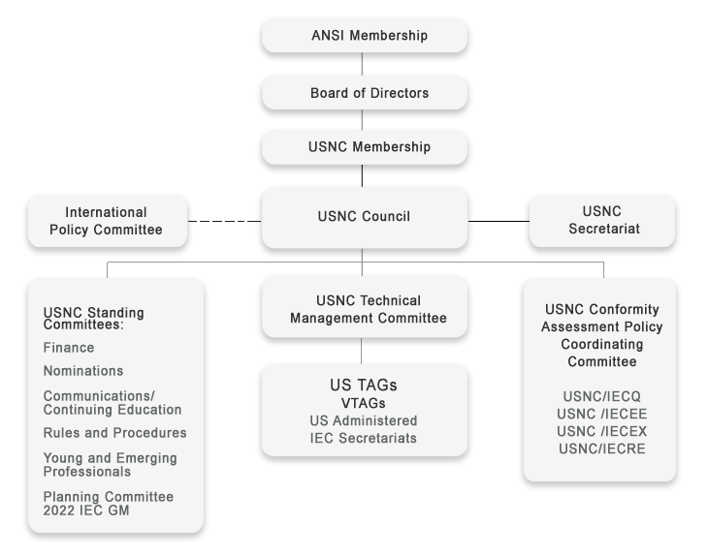
USNC/IEC Organizational Structure

Slide 12
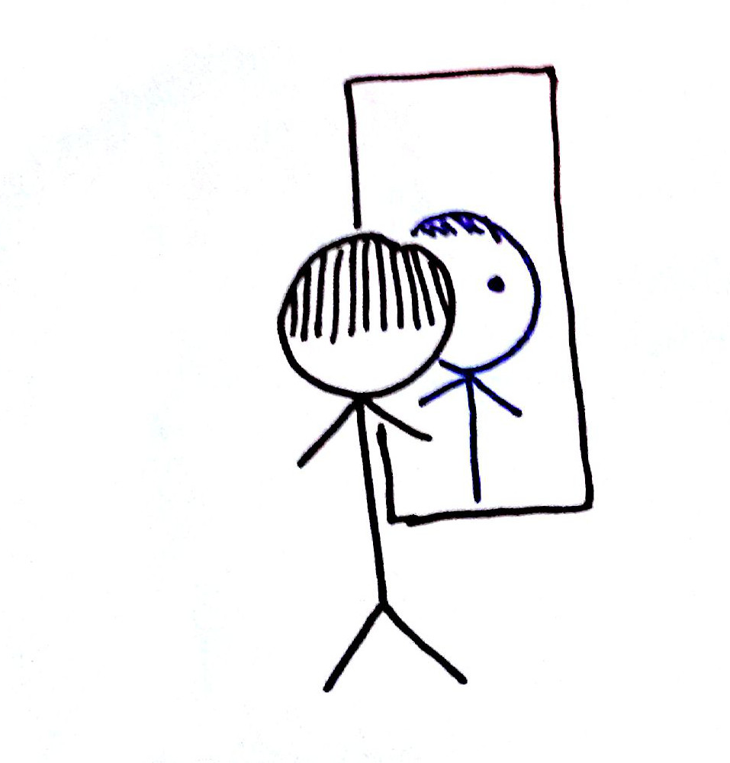
Look familiar?
That’s because the USNC “mirrors” the IEC structure
in order to best coordinate US positions for each of the respective IEC Council, Committees, and Groups

Slide 13
IEC/USC Organization Structure:
Mirror Image Relationships
IEC Council
USNC
USNC Technical Management Committee (TMC)
IEC
USNC Council
IEC Council Board
USNC Council
IEC Standardization Management Board (SMB)
IEC Technical Committees (TCs)
USNC Technical Advisory Groups (TAGs)
IEC Conformity Assessment Board (CAB)
USNC Conformity Assessment Policy Coordination Committee (CAPCC)

Slide 14
USNC Participation in IEC
Policy and Management Activities
U.S. is one of six permanent Council Board members
  15 members total
U.S is one of seven permanent Standardization Management Board (SMB) members
  15 members total
The USNC and its members participate in approximately 90% of Technical Committees and administers 14% of TC Secretariats

Slide 15
USNC Council

Slide 16

USNC Council
Represents and coordinates U.S. involvement in IEC on behalf of the U.S. electrotechnical community
Coordinates USNC activities with standards developers to promote consistency in IEC international and national activities

Slide 17
USNC Technical Management
Committee (TMC)

Slide 18
USNC Technical Management
Committee (TMC)
Manages the technical work of the USNC and represents the interests of the U.S. at the Standardization Management Board (SMB)
  Develops U.S. positions in preparation for IEC/SMB meetings
  Appoints and oversees the designation of Technical Advisors, Deputy Technical Advisors, and TAG Administrators
  Approves the designation of U.S. Secretariats to IEC Committees
  Authorizes invitations to host IEC Technical Committee (TC) and Subcommittee (SC) meetings in the U.S.
  Interfaces with regional/international bodies on technical issues

Slide 19
USNC Technical Advisory Groups
(TAGs)

Slide 20

USNC TAGs
USNC-approved Technical Advisory
Groups (TAGs) develop the U.S. positions on technical – and certain policy – issues under consideration within the IEC technical committee structure
U.S. TAGs are mirror committees of IEC TCs and SCs
TAGs provide the delegates who will represent the United States in technical committee discussions at IEC meetings and also the experts who will serve on WGs, PTs and MTs

Slide 21
USNC Technical Advisory Groups
(USTAGs)
U.S. Technical Advisory Groups (USTAGs) are
committees appointed by the USNC for participation
in all IEC technical and certain IEC policy activities
  Any U. S. national interested parties directly and materially affected by the work of the TC/SC may participate as members of a USNC-approved TAG.
  The process for developing USNC positions provide an opportunity for fair and equitable participation without dominance by any single interest
  An annual TAG participation fee of $310 is required

Slide 22
USNC TAG Responsibilities
Development and maintenance of international standards in a specific technical area
  “Mirrors” relevant IEC committee
  Formed when new area of technical work is identified
Compliance with ISO/IEC Directives
Providing the U.S. delegations to technical committee meetings
Including all relevant stakeholder interests

Slide 23

USNC TAG Responsibilities (cont)
Determining U.S. positions on
matters arising before international technical committees
  All U.S. positions developed by a TAG must be submitted to the relevant IEC committee by the USNC office
  U.S. Technical Advisors (TAs) for IEC committees are appointed by the USNC Technical Management Committee and operate in compliance with the USNC Operating Manual (see Module
  III-B for more information on TAs).

Slide 24
USNC Criteria for Establishment of a US TAG
There shall be NO undue financial barriers to participation.
Participation shall not be conditional upon membership in any organization nor unreasonably restricted on the basis of technical qualifications or other such requirements.
Guidelines for determining a U.S. voting position shall be provided and followed
Criteria for approval of U.S. positions on International Standards shall be met
At least three (3) voting members are required for viability

Slide 25

USNC TAG Procedures
All USNC/IEC TAGs may choose to adopt:
  the Model Operating Procedures for USNC/IEC Technical Advisory Groups
  or
  their own procedures, which must be equivalent to or more stringent than the TMC-approved model procedures and conform to the essential requirements of the Model Operating Procedures for USNC/IEC Technical Advisory Groups

Slide 26
Example IEC/TC and
USTAG Relationship
IEC Technical Committee (TC)
USNC Technical Advisory Group (TAG)
TC 37
Surge Arresters
SC 37A
Low-voltage surge protective devices
SC 37B
Components for low-voltage surge protection
TAG for TC 37
Surge Arresters
TAG for SC 37A
Low-voltage surge protective devices
TAG to SC 37B
Components for low-voltage surge protection

Slide 27

USNC Funding
In 1998, the ANSI Board of Directors challenged the USNC/IEC to become a self-supporting entity
With the exception of membership fees, the USNC receives no subsidies from other organizations or financial support from the U.S. government
Numerous funding options were considered and a “Pay to Play” philosophy was ultimately adopted by the USNC/IEC Council
  * Determined to be the fairest, most equitable and least onerous payment mechanism

Slide 28
USNC Funding
“Pay-to-Play”
  Modest, across-the-board fee for all individual TAG Participants (currently $310 annual fee; $620 for TAGs serving two or more TC/SCs)
    ANSI membership is not required
    Exemptions, waivers, etc. are considered on a case-by-case basis
  ANSI members (companies, organizations and government agencies) can become voting USNC Members for an annual fee of $6,600
    Individual TAG participation fees are waived for any employee of that company, organization or agency

Slide 29
USNC Conformity Assessment Policy Coordination Committee (CAPCC)

Slide 30
USNC Conformity Assessment Policy Coordinating Committee (CAPCC)
Manages the conformity assessment work of the USNC and represents the interests of the U.S. at the Conformity Assessment Board (CAB)
  Develops U.S. positions in preparation for IEC/CAB meetings
  Appoints and approves Secretariats of the four US conformity assessment mirror committees;
    IECEE
    IECEx
    IECQ
    IECRE
  Interfaces with regional/international bodies on conformity assessment issues

Slide 31
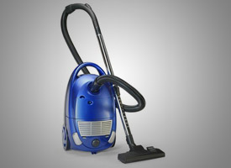

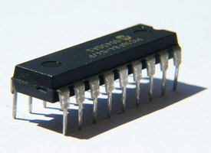

USNC Four Conformity
Assessment Systems
IECEE
  Electrical equipment: safety and performance
IECEx
  Hazardous environments
IECEQ
  Electronic components
IECRE
  Renewable energies

Slide 32
USNC Standing Committees

Slide 33

USNC Standing Committees
Finance Committee (FinCom)
Nominations Committee (NomCom)
Communications and Continuing Education Committee (C&CEC)
Young and Emerging Professionals (YEP)
Rules and Procedures (R&P)
Planning Committee 2022 IEC GM (PlanCo)

Slide 34
USNC Constituent Training Program
Module II-B
Complete

