Slide 1

Module II-A
IEC Organizational and Governance Structure

Slide 2

Module II-A: Learning Objectives
This module provides an overview of the International Electrotechnical Commission:
  Membership
  Policy and management groups
  Technical committee structure
  Overview of Shared Committees
  Overview of Systems Approach

Slide 3
Module II-A: Disclaimer
The information contained in this self-taught
learning module is intended as a summary of documents and procedures frequently used within the IEC and the USNC/IEC.
For additional information about content addressed in this module, please contact the USNC/IEC Staff (usnc@ansi.org).
Additional information is also available via USNC/IEC Education & Training.

Slide 4
Reference Materials &
Source Documents
ISO/IEC Directives, Part 1: 2021
Procedures for the technical work
ISO/IEC Directives, Part 2: 2021
Rules for the structure and drafting of International Standards
ISO/IEC Directives, Part 1:2021 + IEC Supplement:2021
Procedures specific to IEC
IEC Statutes and Rules of Procedures
IEC membership and participation procedures
USNC Statutes: 2018
USNC Rules of Procedure: 2005
Model Operating Procedures for USNC/IEC TAGS: 2019
Guide for U.S. Delegates to meetings of ISO and the IEC
IEC Code of Conduct (Patent Policy included)
IEC Diversity Statement

Slide 5

Objectives of the IEC
Meet the requirements of the global market efficiently
Ensure primacy and maximum world-wide use of its standards and conformity assessment schemes
Assess and improve the quality of products and services covered by its standards
Establish the conditions for the interoperability of complex systems
Increase the efficiency of industrial processes
Contribute to the improvement of human health and safety
Contribute to the protection of the environment

Slide 6
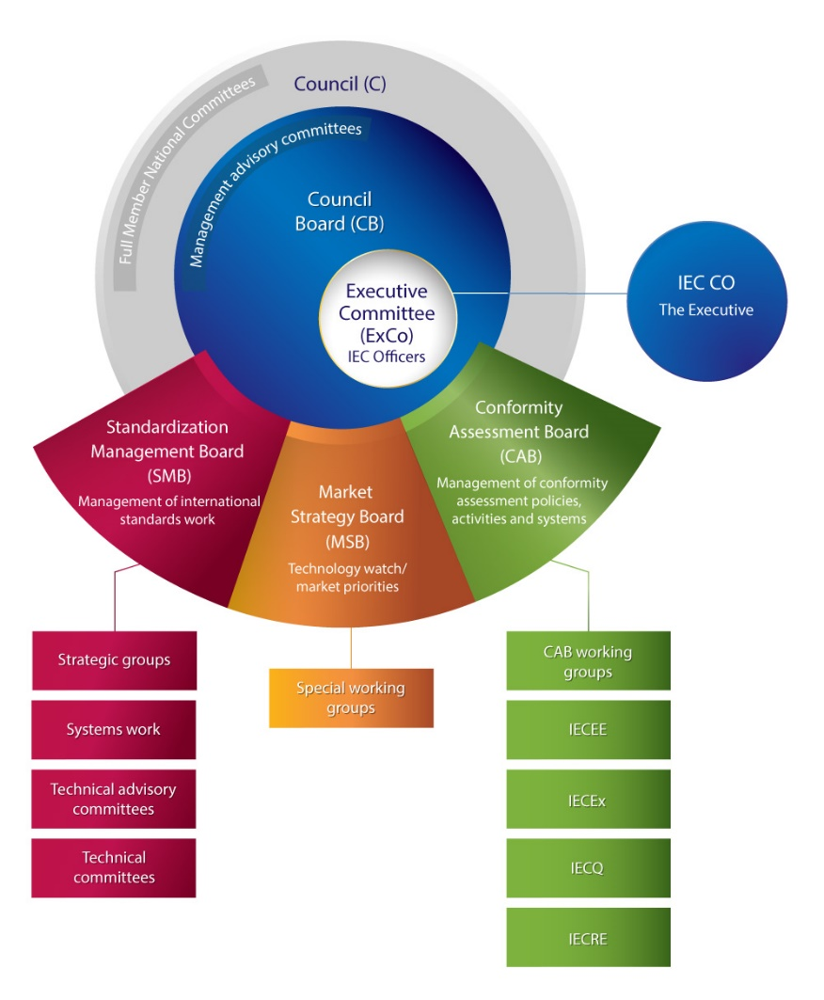
IEC Organizational Structure

Slide 7

Dues and Budget
IEC derives its income from the following:
  annual dues paid by its members
  the sale of publications
  other sources (as approved by the Council)

Slide 8

Dues and Budget (cont)
The Council determines the annual budget, including the annual dues of its members, which are divided as:
  Group A: Those NCs that pays the highest fixed percentage of the total dues
  The remainder from all other Full Member National Committees

Slide 9

IEC Membership and Participants
National Committees (NC)
  A National Committee (NC) is an IEC member body
  Each NC represents a nation's electrotechnical interests in IEC management and standardization work
  NC’s are comprised of private and public sector organizations
  Membership structure:
    Full Member NC – full participation rights
    Associate Member NC – limited participation
    Affiliates – nonmembers with limited access to
    resources

Slide 10

Rights of IEC National Committees
Full Member | Associate Member | Affiliate
Vote on all TC/SC and Council documents via electronic voting system | Authorized to submit votes on documents of 4 selected TC/SCs via electronic voting system | No voting rights
Comment on all TC/SC and Council documents | Authorized to submit comments only on TC/SC documents, but not on Council documents | Authorized to submit comments on the documents of 10 selected TC/SCs via email
FULL Participation Rights | LIMITED Participation Rights | NOT A MEMBERSHIP and access to information only

Slide 11
National Committee Participation:
TCs, SCs, and SyCs
National committees have the right to participate in the work of every IEC TC, SC and SyC*. They may register as either a Participating (P) or an Observer (O) Member. All Members should:
  Organize efficient and timely votes and comments on all matters coming before the committee(s) in which they participate
  Take into account all relevant interests at their national level
  Provide input at the earliest possible time so as to mitigate duplication, overlap and redundancy
*Associate members may participate, under certain conditions, in a limited number of committees

Slide 12
National Committee Participation:
TCs, SCs, and SyCs (cont)
Participating “P” Members
  Responsible for submitting votes and/or comments on all technical matters coming before the committee
    Votes are submitted within the given timeframe. Failing to vote on questions before the committee will be reported by the Secretariat to the IEC Office.
  Send delegation or accredited experts to meetings
    Failing to make a contribution to two (2) consecutive meetings, either by direct participation or by correspondence, will be reported by the Secretariat to the IEC Office
  Nominates members on Project Team (PTs), Working Groups (WGs), Maintenance Teams (MTs)
  May host meetings of the committee

Slide 13
National Committee Participation:
TCs, SCs, and SyCs (cont)
Observer “O” Members
  Monitor the technical work, but do not actively participate
    Have options to attend meetings and to receive and comment on documents
    Have no power of vote within the committee*
    May not nominate members in PTs, WGs, MTs
*All national bodies, regardless of their status within a particular technical committee or subcommittee, have the right to vote on enquiry drafts and on final draft International Standards (see Module 4 for additional information)

Slide 14
IEC Council

Slide 15

IEC Council (cont)
Sets IEC policy, long-term strategic and financial objectives
Members are the Presidents of all National Committees of the IEC, past presidents, IEC officers, CB members
Approves financial matters, IEC membership, revisions to Statutes and Rules of Procedures
Elects IEC officers and members of Council Board (CB), Standards Management Board (SMB), Conformity Assessment Board (CAB), and Market Strategy Board (MSB)

Slide 16

IEC Council Board
Works for the good of the whole Commission and its constituency
  Implements the IEC Council policy and makes policy recommendations
  Comprised of IEC Officers and 15 voting members elected by Council
  CB reports all of its decisions to Council

Slide 17

IEC Council Board (cont)
Members are elected on their professional qualifications
  Some permanent elected members are appointed from those National Committees in financial Group A
  The other individual members are from the Full Member National Committees

Slide 18
Standardization Management
Board (SMB)

Slide 19
Standardization Management
Board (cont)
The Standardization Management Board (SMB) is responsible for management of the activities of the
IEC technical committees
Oversees operation of Advisory Committees
  Environmental Aspects (ACEA)
  Electromagnetic Compatibility (ACEC)
  Energy Efficiency (ACEE)
  Safety (ACOS)
  Information security and data privacy (ACSEC)
  Electricity Transmission and Distribution (ACTAD)

Slide 20
Standardization Management
Board (cont)
Manages the technical work through TC/SC/SyC Reports/Strategic Policy Statement (SPS) and data prepared by IEC Central Office (CO)
Reviews the functioning of TC/SC/SyCs and proposed changes
Approves nominations for Chairpersons and Secretariats of TCs, SCs, and SyCs
Creates/disbands new TCs, ratifies creation/disbanding of new SCs, SyCs.
Develops rules for standards development process
  ISO/IEC Directives and the IEC Supplement
Reports to the Council Board

Slide 21
Standardization Management
Board (cont)
Comprised of 15 members
  Chair Elected by Council
  Secretariat held by the IEC Central Office (CO)
  USNC is one of the permanent members of the SMB
Meets 3 times a year
Documents, comments and votes normally handled electronically
  Decisions require a two-thirds majority of those members voting; if fewer than eight members vote, the decision must be deferred to the next meeting of the SMB

Slide 22
Technical Committees (TCs)

Slide 23
Technical Committees (cont)
Responsible for conducting technical work of IEC
  Formed when new area of technical work is identified and if
    at least two thirds majority of the IEC National Committees submitting votes in favor
    at least five IEC National Committees express their intention to actively participate
  Established (including title and scope) by the Standardization Management Board
  Title and Scope determined by SMB

Slide 24

Technical Committees (cont)
Recently established IEC TCs:
  Binary power generation systems (PC 126)
  Communication Technologies and Architectures (SyC COMM)
  Low-voltage auxiliary power systems for electric power plants and substations (PC 127)
  Network Management in Interconnected Electric Power Systems (SC 8C)
  Operation of electrical installations (PC 128)
  Personal e-Transporters (PeTs) (TC 125)
  Robotics for electricity generation, transmission and distribution systems (TC 129)

Slide 25

Subcommittees (SC)
Established and dissolved by the parent TC, subject to ratification by the IEC SMB
  Responsible for progressing the technical activities of a more narrowly defined aspect of the TC’s program of work
  Title and scope defined by the TC (within the scope of the TC)
  At least five members of the TC are willing to participate actively

Slide 26
Relationship between TCs and SCs
A Subcommittee (SC) is created by, dissolved by, and reports directly to its parent Technical Committee (TC)
Not all TCs have SCs
For individual standards that fall outside the scope of a TC/SC, a Project Committee may be formed, which is dissolved once the standard is published
  A Project Committee is independent of a TC or SC

Slide 27
Systems Committees (SyCs)

Slide 28
What is a System?
  A group of interacting, interrelated, or interdependent elements forming a purposeful whole of a complexity that requires specific structures and work methods in order to support applications and services relevant to IEC stakeholders.
  System standards are increasingly necessary in sectors such as the environment, safety, and health.

Slide 29
Systems Committees (SyC)
Systems Committees operate within the defined scope of a system. They develop high-level interfaces and functional requirements that span the work areas of several TC/SC. Through collaboration and consensus, the SyC develops a work plan that involves, and is followed by all relevant TC/SCs. However, the SyC does not have the authority to dictate to TCs what work they must carry out.
IEC Member countries (National Committees) who are willing to send experts (P-members), form the membership of each SyC. The secretariat of all SyCs is provided by IEC central office in Geneva.

Slide 30
Project Teams (PT), Working Groups
(WG), and Maintenance Teams (MT)
Created if necessary by TC or SC for further defined focus
  WGs are responsible for a grouping of related projects
  PTs are responsible for a single project
  MTs work on a revision project
    New edition
    Amendment
Conveners (i.e. the chair of the PT, WG or MT) are appointed by the parent TC or SC

Slide 31
IEC Standards Development
IEC standards development work is conducted
within this technical committee structure
  To facilitate the broadest participation possible, most development work is undertaken “virtually” (e.g., via e-mail correspondence, online development, video- and teleconferences, etc.)
  Meetings of IEC technical committees are held only when work cannot be conducted by other means
  Agenda and documents must be circulated at least
  four months before a meeting to allow adequate time for review by the National Committee delegates

Slide 32
Overview of Shared Committees
Shared Committees are committees that coordinate the activities of multiple standards development organizations to minimize work duplication
  Information technology (ISO/IEC JTC 1)
  Joint Directives Maintenance Team (JDMT)
  IEC/ISO/ITU World Standards Cooperation (WSC)
  IEC-ISO-ITU Joint Smart Cities Task Force (J-SCTF)

Slide 33
ISO vs. IEC Terminology
Terminology between ISO and IEC differs slightly
These terms may be altered occasionally – check the IEC/ISO Directives for any updates (https://www.iec.ch/members_experts/refdocs/)

Slide 34
Overview of Systems Approach
Abundance of technologies converging in new and emerging markets, has necessitated a different approach to standardization
Systems work
  Systems work takes a top-down approach
  Start with the architecture of a system instead of working from the product level
  Intended to ensure complex market sectors (e.g., environment, safety, health) are adequately addressed/supported.
IEC Systems Work includes:
  Standardization Evaluation Groups (SEGs)
  Systems Committees (SyCs)
Learn more at:
  https://www.iec.ch/standards-development/systems-approach
  Specific SEGs, and SyCs can be found under the Systems Work Tab here: https://www.iec.ch/dyn/www/f?p=103:48:0::::FSP_ORG_ID,FSP_LANG_ID:3228,25#3

Slide 35
Conformity Assessment Board (CAB)

Slide 36

Conformity Assessment Board (cont)
The Conformity Assessment Board (CAB) is responsible for the overall management of the IEC’s conformity assessment activities
  Comprised of a Chair, 12 voting members (and alternates) who are elected by Council, one representative from each IEC conformity assessment scheme, the IEC Treasurer and General Secretary
  Reports all its decisions to the Council Board

Slide 37
Conformity Assessment Systems
Responsible for evaluating and maintaining, as necessary, the IEC conformity assessment systems:
IECEE
IECEx
IECQ
IEC System of Conformity Assessment Schemes for Electrotechnical Equipment and Components
International Electrotechnical Commission System for Certification to Standards Relating to Equipment for Use in Explosive Atmospheres
IEC Quality Assessment System For Electronic Components
IECRE
IEC System for Certification to Standards Relating to Equipment for Use in Renewable Energy Applications

Slide 38
Market Strategy Board (MSB)

Slide 39

Market Strategy Board (cont)
The Market Strategy Board (MSB) is
Comprised of 15 members
Reports to the IEC Council Board
Identifies the main technological trends and market needs in the IEC's fields of activity
Sets strategies to maximize input from primary markets and establishes priorities for the technical and conformity assessment work of the IEC

Slide 40

Market Strategy Board (cont)
The MSB meets at least
once a year
It is composed of:
  A chairperson
  15 high level technology expert members appointed from industry
  IEC Officers

Slide 41
IEC Central Office (CO)

Slide 42
IEC Central Office (CO)
The IEC CO is responsible for:
  Providing support to IEC Members/Affiliates
  Supervising the proper application of rules and procedures
  Ensuring the smooth progress of work by TC/SC/SyCs and the IEC Conformity Assessment Systems
  Publishing standards and other publications
  Contributing to the organization of the annual General Meeting
  Hosting meetings, seminars and workshops

Slide 43
USNC Constituent Training Program
Module II-A
Complete

Slide 44
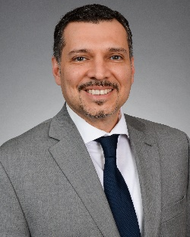
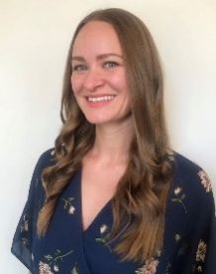



The USNC Team
Tony Zertuche
USNC General Secretary
Director, International Policy (ANSI)
Megan Pahl
USNC Program Administrator
Adelana Gladstein
USNC Program Manager
Debbie Negron-Badillo
USNC Meetings Coordinator
Chynna Anuszewski
USNC Program Administrator

Slide 45
USNC Staff Contact Information
Joe Tretler
Vice President, International Policy
jtretler@ansi.org
(202) 331-3618
Tony Zertuche
Director, International Policy
& USNC General Secretary
tzertuche@ansi.org
(212) 642-4892
Adelana Gladstein
Program Manager
agladstein@ansi.org
(212) 642-4965
Chynna Anuszewski
Program Administrator
canuszewski@ansi.org
(212) 642-8927
Megan Pahl
Program Administrator
mpahl@ansi.org
(212) 642-8907
Debra Negron-Badillo
USNC Meetings Coordinator
dnegron@ansi.org
(212) 642-4936

Slide 46
USNC of the IEC
American National Standards Institute
25 West 43rd Street
Fourth Floor
New York, NY 10036
usnc@ansi.org
www.ansi.org/unc |www.ansi.org | webstore.ansi.org

