Slide 1
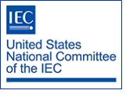
Module I
International Standardization
Introduction and Overview

Slide 2
Module I: Learning Objectives
This module provides a general overview of international standardization, including:
  Definition of basic terms and concepts
  An overview of the benefits of participation in international standardization
  An introduction to the:
    Role of the U.S. National Committee of the International Electrotechnical Commission (USNC/IEC)
    Key international standards organizations
    Key regional standards organizations

Slide 3
Module I: Disclaimer
The information contained in this self-taught
learning module is intended as a summary of documents and procedures frequently used within the IEC and the USNC/IEC.
For additional information about content addressed in this module, please contact the USNC staff (usnc@ansi.org).
Additional information is also available via USNC/IEC Education & Training.

Slide 4
Reference Materials &
Source Documents
ISO/IEC Directives, Part 1: 2021
Procedures for the technical work
ISO/IEC Directives, Part 2: 2021
Rules for the structure and drafting of International Standards
ISO/IEC Directives, Part 1:2021 + IEC Supplement:2021
Procedures specific to IEC
IEC Statutes and Rules of Procedures
IEC membership and participation procedures
USNC Statutes: 2018
USNC Rules of Procedure: 2005
Model Operating Procedures for USNC/IEC TAGS: 2019
Guide for U.S. Delegates to meetings of ISO and the IEC
IEC Code of Conduct (Patent Policy included)
IEC Diversity Statement

Slide 5
Standardization is a global activity encompassing a myriad of interests
Standards Developers and Conformity Assessment Bodies
Commercial Interests
Government Interests
Consumers, Educational Institutions, and General Interests

Slide 6
One Standard, One Test,
Accepted Everywhere
Accepted Everywhere
One Test
One Standard
In a global marketplace, the objective of the standardization process must be a single, technically valid and globally relevant standard with a single test of conformance to that standard. This will allow products to be distributed for worldwide commerce without change or modification.

Slide 7
Definitions
Standards
  Formal technical documents for generally accepted products, procedures, and policies
Standardization
  Use of common products, processes, procedures, and policies to facilitate attainment of business objectives
Conformity Assessment
  A process whereby a product, process, service, or system is evaluated against a standard

Slide 8
Definitions (cont.)
Consensus
  General agreement, characterized by the absence of sustained opposition to substantial issues by any important part of the concerned interests and by a process that involves seeking to take into account the views of all parties concerned and to reconcile any conflicting arguments.
  Source: ISO/IEC Guide 2
  IMPORTANT NOTE: Consensus does not imply unanimity

Slide 9

“Standards and technical regulations affect over 80 percent of global commodity trade”
Source: Benjamin H. Wu, Asst. Secretary for Technology Policy, U.S. Department of Commerce Testimony before the U.S. House of Representatives, Committee on Government Reform, May 13, 2005

Slide 10

Did you know…
In accordance with the World Trade Organization’s Technical Barriers
to Trade Agreement, International Standards are:
  developed within procedures intended to ensure global consensus
  developed and applied on a voluntary basis, but are increasingly adopted or referenced by governmental bodies
These standards shall be globally relevant and not “give preference to characteristics or requirements of specific countries or regions when different needs or interests exist in other countries or regions.”
The World Trade Organization (WTO) fosters international trade based on, among others, conformity assessment practices that balance regulated public protection and heightened industrial competition.

Slide 11

Q: Why should one participate in the development of international standards?
To facilitate the adoption of globally-accepted standards that will promote interoperability and commercial acceptance across the electrotechnical industry
To gain access to international markets; promote the protection of consumers by improving safety and health standards in the electrotechnical industry; safeguard the environment
To anticipate emerging standards and their impact on technology and global markets

Slide 12

Q: Why should one participate in the development of international standards? (cont)
Standards are strategic business tools
which help develop new global markets for electrical and electro-technology-related products and services.
U.S. participation helps ensure international market access to U.S. technology and helps to eliminate non-tariff trade barriers.
International standards are frequently adopted as, or used as the basis for, national and regional electrotechnical standards.
Participation keeps one on the cutting edge of current technology and market trends.

Slide 13
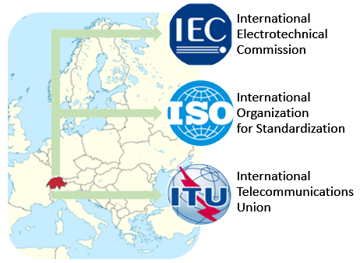
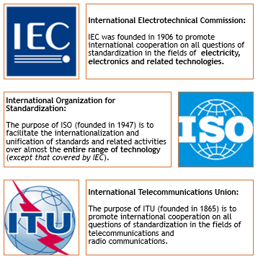
The Big Three

Slide 14
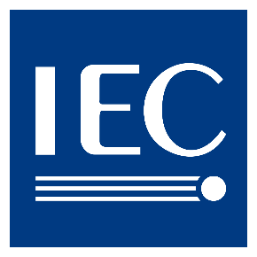
International Electrotechnical
Commission
The International Electrotechnical Commission (IEC),
based in Geneva, Switzerland, is a global non-
governmental organization that prepares and publishes international standards for all electrical, electronic and related technologies.
Through its members, which are known as “National Committees”, the IEC promotes international cooperation on all questions of electrotechnical standardization and related matters, including the assessment of conformity to standards.
Notes:
Based in Geneva with offices all over the world.

Slide 15

International Organization for
Standardization
The IEC’s sister organization, ISO, is a non-
governmental organization and network of the national standards bodies of countries, one member per country, with a Central Secretariat in Geneva, Switzerland, that coordinates the system.
ISO acts as a bridging organization in which a consensus can be reached on standards and conformity assessment solutions that meet both the requirements of business and the broader needs of society, such as the needs of stakeholder groups like consumers and users.

Slide 16

International
Telecommunications Union
ITU is a world-wide organization which brings
governments and industry together to coordinate the establishment and operation of global telecommunication networks and services.
ITU is responsible for standardization, coordination and development of international telecommunications including radio communications, as well as the harmonization of national policies.
The ITU differs from ISO and IEC in that it was founded on the principle of cooperation between governments and the private sector.

Slide 17
Guiding Principles of
International Standards
International standards should meet societal and market needs and should not be developed to act as barriers to trade
ISO and IEC follow globally accepted principles of standards development:
  Transparency
  Openness
  Impartiality
  Effectiveness and relevance
  Consensus
  Performance-Based
  Coherence
  Due Process
  Technical Assistance

Slide 18
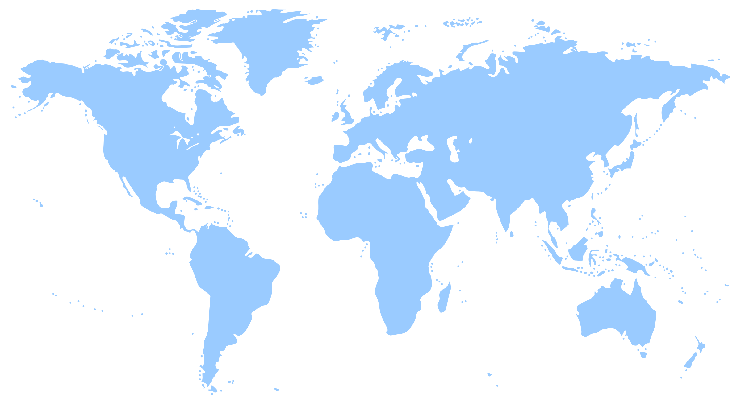
National Committees
Participating in the IEC
Canada
(SCC)
UK
(BSI)
Germany
(DIN/VDE)
U.S. National Committee
(USNC)
France
(AFNOR /UTE)
Japan
(JISC)
China
(SAC)
Brazil
(COBEI)
Australia
(SAA)

Slide 19
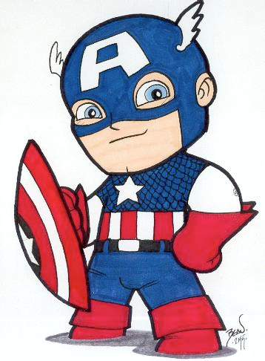
U.S. National Committee of the IEC
The U.S. National Committee of the
International Electrotechnical Commission (USNC/IEC) is a committee of the American
National Standards Institute (ANSI).
The USNC serves as the official U.S. member of the IEC and represents and coordinates the U.S. involvement in electrotechnical bodies associated with the IEC on behalf of ANSI.

Slide 20
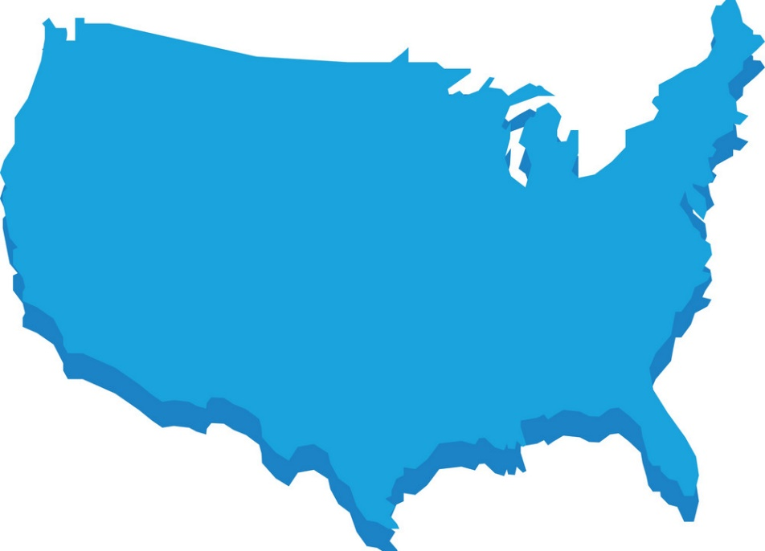
U.S. National Committee of the IEC:
Guiding Principles
governance
administration
management
guidance
authority
diplomacy
influence

Slide 21


USNC/IEC’s Mission
The USNC/IEC mission is to coordinate the effective participation in the development of IEC standards and conformity assessment systems to facilitate trade and to promote global safety, efficiency, reliability, and interoperability in the fields of all electrotechnologies. Provides a framework for USNC stakeholders to advocate for U.S. interests in international and regional electrotechnical-related matters.

Slide 22
U.S. National Committee of the IEC
Represents the U.S. in the development, promulgation and use of globally-relevant standards for the electro-technical industry
Engages in the assessment of conformance to standards such as testing, certification and accreditation
Serves as a conduit to the global standards-setting community
Is a totally integrated committee of the American National Standards Institute (ANSI)
  ANSI provides administrative support to the USNC

Slide 23
USNC/IEC’s Scope of Work
Electrotechnologies
  Electronics
  Magnetics and electromagnetics
  Electroacoustics
  Multimedia
  Telecommunication
  Energy production and distribution
Associated general disciplines
  Safety, security, and the environment
  Dependability, design and development
  Measurement and performance
  Terminology and symbols
  Electromagnetic compatibility

Slide 24
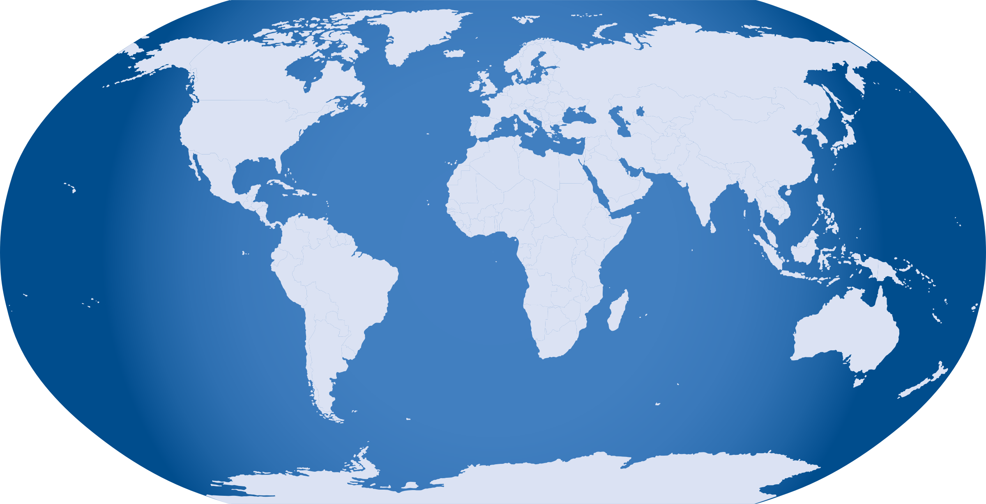
Regional Standards Organizations
European Standards
Organizations
(CEN)
(CENELEC)
(ETSI)
The Americas
(CANENA)
(FINCA)
Pacific
Rim
(COPANT)
(APCF)
(PASC)

Slide 25

Importance of global cooperation and collaboration
Active participation in both international and regional standards-setting activities provides U.S. electrotechnical industry experts with. . .
  The ability to influence domestic and international policy
  A chance to benefit from unique networking opportunities and exchange experiences with international colleagues
  A forum for the presentation of the U.S. industry positions
  Opportunity to comment upon proposals submitted by others
  Ability to work actively and multilaterally towards the abolishment of technical barriers to trade and expand U.S. access to international markets

Slide 26
Join Us!
The USNC operates over 170 IEC Technical Advisory Groups (TAGs)
Over 2,000 experts are currently involved in TAG activities in the U.S.
Every year hundreds of U.S. experts participate in international IEC Technical Committee meetings, directly affecting the development of international standards
Get involved!!! Contact the USNC staff to learn how to join a TAG and make a difference (usnc@ansi.org).

Slide 27
Internet Resources
International
IEC – International Electrotechnical Commission
ISO – International Organization for Standardization
United States
USNC – United States National Committee
of the IEC
ANSI – American National Standards Institute

Slide 28
Internet Resources (cont)
Regional
CANENA - Council for Harmonization of Electrotechnical Standards of the Nations of the Americas
COPANT - Pan American Standards Commission
FINCA - Forum of IEC National Committees of the Americas
CENELEC - European Committee for Electrotechnical Standardization
ETSI - European Telecommunications Standards Institute
PASC - Pacific Area Standards Congress
APCF - Asia-Pacific Cooperation Forum

Slide 29

Further Training Activities
The USNC holds Instructor-Led Training Courses throughout the year. Contact the USNC staff (usnc@ansi.org) to find out when and where the next one is taking place.

Slide 30
USNC Constituent Training Program
Module I
Complete

Slide 31
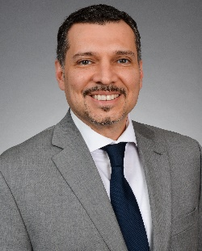
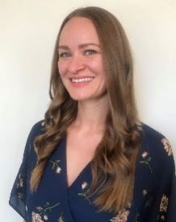



The USNC Team
Tony Zertuche
USNC General Secretary
Director, International Policy (ANSI)
Megan Pahl
USNC Program Administrator
Adelana Gladstein
USNC Program Manager
Debbie Negron-Badillo
USNC Meetings Coordinator
Chynna Anuszewski
USNC Program Administrator

Slide 32
USNC Staff Contact Information
Joe Tretler
Vice President, International Policy
jtretler@ansi.org
(202) 331-3618
Tony Zertuche
Director, International Policy
& USNC General Secretary
tzertuche@ansi.org
(212) 642-4892
Adelana Gladstein
Program Manager
agladstein@ansi.org
(212) 642-4965
Chynna Anuszewski
Program Administrator
canuszewski@ansi.org
(212) 642-8927
Megan Pahl
Program Administrator
mpahl@ansi.org
(212) 642-8907
Debra Negron-Badillo
USNC Meetings Coordinator
dnegron@ansi.org
(212) 642-4936

Slide 33
USNC of the IEC
American National Standards Institute
25 West 43rd Street
Fourth Floor
New York, NY 10036
usnc@ansi.org
www.ansi.org/unc |www.ansi.org | webstore.ansi.org

