Slide 1
SG 12 Meeting
Online meeting: 2021-01-25
12:00pm to 2:30pm CET

Slide 2
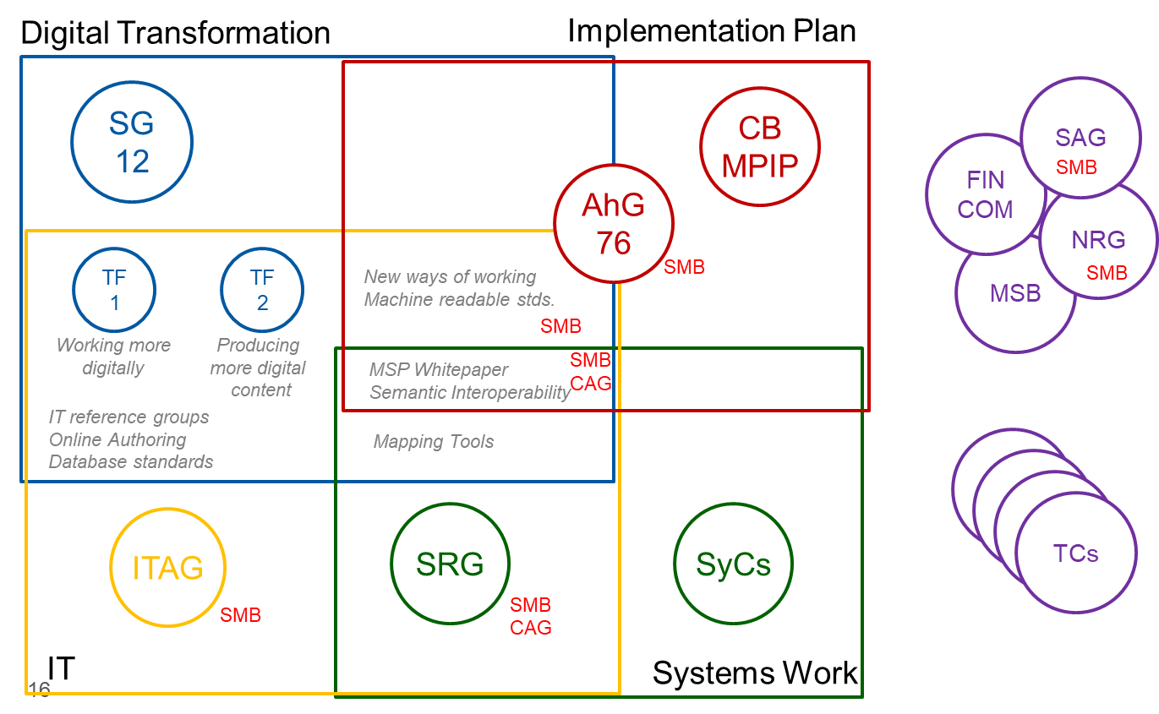
A little bit of history
SG 12
Implementation Goals
New ways of working; Machine readable Standards
System Related Activities (incl. Tool support)
MSB WP “Semantic Interoperability” – Information Models
Relation to IT
Pilots Online Authoring
Reference Group on Database standards (incl. CDD), XML
Mapping Tool, UCMR
Outreach
TCs, Digitalization Officer

Slide 3
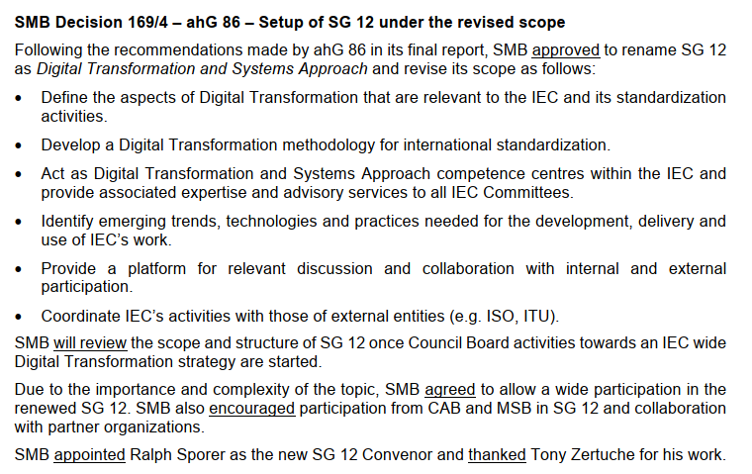
SMB decisions – ahG 86

Slide 4
Structure
Digital
Transformation & Systems Approach
Task Force 1
Working more digitally
Methodology Group
Committee Forum
TCs, SyCs
others
Task Force 2
Producing more digital content
Task Force 3
Semantic Interoperability & Information models

Slide 5
Digital Transformation Group*
Ralph Sporer
Oliver Hateley
Miroslav Siket
Scope
Define the aspects of the Digital Transformation that are relevant to the IEC and standardization activities
Develop DT methodology for international standardization
Act as DT competence centre within the IEC and provide DT expertise and advisory services to all IEC TCs
Identify emerging trends, technologies and practices needed for the development, delivery and use of IEC’s work
Provide a platform for relevant discussion and collaboration with internal and external participation.
Provide a link between IEC's activities and those of external entities (e.g. ISO, ITU, etc.) and the technical work under supervision of IEC
* Actually Digital Transformation & Systems Aspects SG

Slide 6
Taskforce 1 Working more digitally
Ivano Visintainer
(Alan Sellers)
Scope
Develop a Framework for working more digitally
Develop a capability model (potentially incl. benchmarking)
Collect Use Cases
Prepare and recommend pilot projects
Develop guidance on working more digitally
Investigate and prioritize necessary IT developments
Status
Hasn’t started yet
Next Steps (proposal)
Participate/follow-up on online authoring pilot (nomination of members to reference group)
Check ToR against Vision&Mission statement
Collect use cases
From „new ways of working“
From future TC meetings
From external sources
Members: Jos Remy, Pablo Corona Fraga, Bettina Funk, Tony Zertuche, Lange Holger, Miguel Aranda, Shuji Hirakawa, Daehyun Kwon, Ronald Tse, Laurent Guise, Vimal Mahendru, Clare Hobern, Andrea Nafi, (Anja/Alisdair – member from IEC CO/Online auth ref group)

Slide 7
Taskforce 2 Producing more digital content
Ivan Salcedo
(Laurent Guise)
Scope
Develop a Framework for machine interpretable standards (on the base of 5-level capability model)
Collect Use Cases
Disseminate and further develop 5-level capability model
Match existing activities to capability model
Develop guidelines and best practice sharing around moving towards machine interpretable standards
Prepare and recommend pilot projects
Status
Framework and questionnaire done
Use cases collected
Next Steps (proposal)
Build on the survey results, match existing activities to the existing use cases and capability model
Provide input to TC meetings organized by committee forum
Members: Ralph Sporer, Maria Iafano, Tony Capel, Damian Czarny, Juan Rubio, Shuo Wang, Sundeep Oberoi, Hisanori Mishima, Andrea Nafi,

Slide 8
Taskforce 3 Semantic Interoperability / Information models
Candidates:
Christian Diedrich
Sundeep Oberoi
Stephen Dutnall
Scope
Provide overview on existing information models and inventory about existing interoperability standards, database standards and ontologies (e.g. IEC 61360, CDD, ISO 13584-42, ISO/IEC 21823-3)
Investigate existing or future model integration strategies
Investigate, promote, design and publish integration mechanisms for information models in the form of best practice
Develop a best practice guideline for semantic interoperability and information models
Status
Hasn’t started yet
Input DBRG (database reference group); WP “Semantic interoperability”
Next Steps (proposal)
Connect, learn from and potentially participate in the European pilots
Provide inventory of existing work based on the DBRG activities
Members: Jaeho Lee, Ronald Tse, Maria Iafano, Shuo Wang, Narang Kishor (guest), EuiSuk Jung, Damian Czarny, Lan Yamashita, Ning Sun, Juan Rubio, Laurent Guise, Ivan Salcedo,

Slide 9
Methodology group
Candidates
Alexander Samarin
Francois Coallier
Laurent Guise
Gennaro Ruggiero
Scope
Develop Systems Approach, Digital Transformation, and synergies thereof, and apply them to standardization.
Foster the uptake of Systems Approach and Digital Transformation in all IEC Committees.
Act as IEC Competence Centre for Systems Approach and Digital Transformation methodology, architecture, and practice, and provide expertise and advisory services to all IEC Committees.
Develop best practice guidelines.
Investigate and prioritize necessary IT developments by:
championing and coordinating IT tools for broad use in the IEC community; and
establishing and participating and/or leading reference groups on specific items.
Status
Hasn’t started yet
Input SRG, TF 2, SyC SE WG5, JTC 1 SC 7
Next Steps (proposal)
Re-start IEC competence center for Systems Approach based on SRG material
Enlarge community from SyCs to all TC/SCs
Develop approaches to connect SA & DT (e.g. TC 57 approach on SE)
Review Use Case management repository & investigate new mapping tool
Members: Kishor Narang (guest), Jaeho Lee, Vimal Mahendru, Damian Czarny, Hirokazu Tanaka (guest from JP NC), Ronald Tse, Ning Sun, Christian Gabriel,

Slide 10
Committee Forum
Oliver Hateley
Miroslav Siket
Scope
Provide a platform for IEC Committees for information and best practice sharing
Receive and distribute input from TFs and MGs
Establish point of contact in TCs
Discuss on and propose pilot projects
Establish a link to reference groups
Status
Hasn’t started yet
Input TF 2
Next Steps (proposal)
Analyse questionnaire of TF 2
Start with individual TCs (as of TF 2 activities)
Build up concept for committee engagement
Platform
Members from SG 12: Bettina Funk, Ronald Tse, Maria Iafano, Shuo Wang, Ivano Visintainer,

