Slide 1
USNC: A Year in Review Goodbye 2022, Hello 2023!
USNC Council Meeting 26 January 2023
Tony Zertuche, USNC General Secretary

Slide 2
Snapshot of the USNC’s Activities and Accomplishments in 2022
In 2022, the USNC Office continued to fulfill the mission and serve our members, while launching new platforms, continuing to support programs, and planning for the 2022 IEC General Meeting in San Francisco.

Slide 3
Primary Accomplishments
Successfully hosted the 86th IEC General Meeting in San Francisco
Achieved 98% payment of Individual TAG fees and 97% overall USNC dues payment for 2022
Held first in-person USNC Management Meetings since January 2020, featuring two training opportunities: USNC TAG Leadership Workshop and IEC Processes and Procedures Course
On-boarded a new USNC team member

Slide 4
Primary Accomplishments (cont.)
Added two new USNC Premier Members: Phoenix Contact & National Renewable Energy Laboratory
Fully participated in the IEC’s new governance structure. The US participates in all three new advisory committees (BAC, DAC, & GRAC), and holds the chair position for the DAC and GRAC.
Launched the USNC’s online voting system for all policy committee ballots

Slide 5
Looking forward to a great 2023!

Slide 6
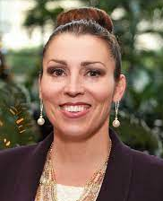
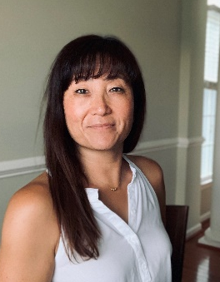
Welcome New USNC Officers!
USNC President
Ms. Veronica Lancaster (CTA) was elected for a three-year term as President of the USNC, which began on 1 January 2023.
USNC VP – Technical
Ms. Hae Choe (AAMI) was elected for a three-year term as USNC VP – Technical, which began on 1 January 2023.

Slide 7
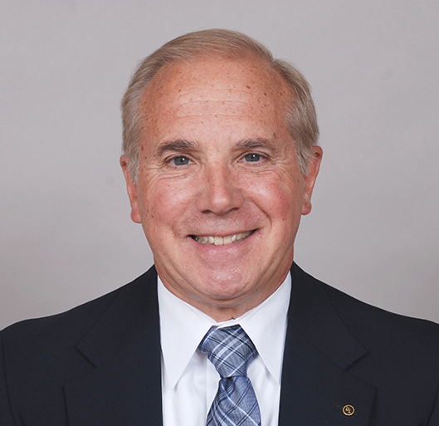
USNC ANSI Board Members
ANSI Board Chair
Mr. Phil Piqueira (UL Standards & Engagement) was re-appointed for third, one-year term as Chair of the ANSI Board, which began on 1 January 2023.
USNC ANSI Board Members
Monica Barone (Qualcomm); Amanda Benedict (AAMI); Scott Colburn (FDA); Elisabeth George (Elisabeth George Consulting LLC); Gordon Gillerman (NIST); Jeff Grove (ASTM International); Patrick Hughes (NEMA); Ajit Jillavenkatesa (Apple); Veronica Lancaster (CTA); Alan Manche (Schneider Electric); Amy Marasco (Microsoft); Joe McGuire (AHAM); Ed Mikoski (ECIA); Earl Nied (Intel); David Stehlin (TIA)

Slide 8
Contact Information
Joe Tretler
Vice President, International Policy
jtretler@ansi.org
(202) 331-3618
Tony Zertuche
Director, International Policy
& USNC General Secretary
tzertuche@ansi.org
(212) 642-4892
Adelana Gladstein
USNC Program Manager
agladstein@ansi.org
(212) 642-4965
Megan Pahl
USNC Program Administrator
mpahl@ansi.org
(212) 642-8907
Betty Barro
USNC Program Administrator
bbarro@ansi.org
(212) 642-4963
Mackenzie Connors
USNC Program Administrator
maconnors@ansi.org
(212) 642-8927
Debra Negron-Badillo
USNC Meetings Coordinator
dnegron@ansi.org
(212) 642-4936

